Slide 1
Expanding SURF Research Cloud as a Digital Research Environment for SUNET and Beyond
Community Hub Demo
Richard Freitag et al.

Slide 2
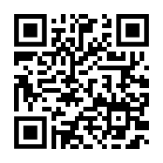
Research Cloud – Proof of Concept
Research Cloud
Portal developed by SURF to provision cloud-agnostic above-the-net services
Extended to support cloud infrastructure hosted by other NRENs
Proof of Concept with virtual machines, more to come
Live demo
Pre-recorded video: https://sunet.drive.sunet.se/s/zikY5Yd2ijrj5jj

Slide 3
Thank you
Please contact us if you want to use Research Cloud!
freitag@sunet.se
ivar.janmaat@surf.nl

