Slide 1
Beyond the Net: Enabling Research Collaboration: EOSC NREN Community meet up
Sara Garavelli, CSC (Finland) & EOSC-A Board
Helen Clare, JISC (UK)
11 June 2025, TNC2025

Slide 2
EOSC as a flagship policy initiative
Contributing to the EU’s strategic ambitions
Address grand societal challenges by facilitating large-scale, data-driven research efforts that enhance Europe’s global scientific competitiveness
Strengthen European digital and data sovereignty by creating a European Knowledge Commons
Enhance security and trust in research data management through a federation model aligned with GDPR, cybersecurity directives, and the Data and AI Acts
Strengthen research infrastructure and interoperability by standardising data-sharing protocols
Boost European productivity and innovation by promoting FAIR data principles, reducing duplication, and streamlining research efforts
will…
Support European leadership in artificial intelligence by providing high-quality, FAIR data essential for AI model training
Advance social equity and inclusivity by democratising access to research data

Slide 3
Principles for Building the EOSC Federation
The vision for EOSC is to establish a system that enables researchers in Europe to store, share, process, analyse, and reuse FAIR research outputs—such as research data, publications, and software—across disciplines and borders.
System of systems approach: Build on existing and planned infrastructures to create an interconnected ecosystem.
Inclusivity and accessibility: Ensure low barriers to entry, ease of use, and broad participation.
Community-driven and participatory: Engage the research community in co-creating and shaping the Federation.
Trust, security, and governance: Establish clear rules, monitoring, and enforcement mechanisms to ensure a safe and reliable environment.
Flexibility and adaptability: Allow for an evolutionary approach, adapting based on findings and lessons learned.
Autonomy and control: Respect institutional autonomy while ensuring that data and service owners retain full control over shared resources and openness levels.
Broad engagement and transparency: Keep all interested stakeholders informed and involved in key developments.

Slide 4
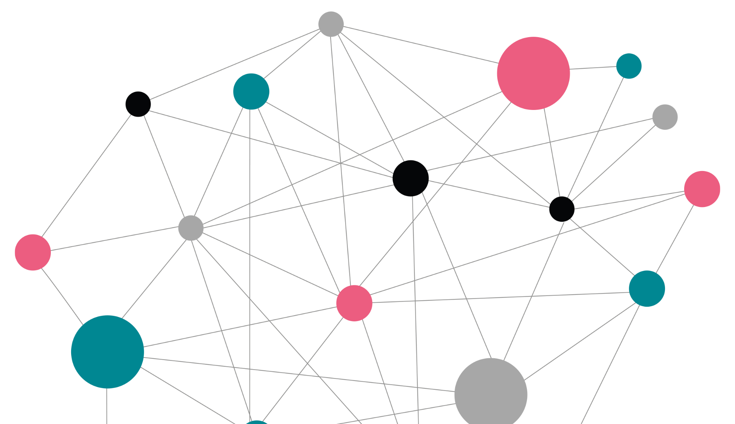
EOSC Nodes
The EOSC Nodes will be the entry points for end users to the entire EOSC Federation.
An organisation may therefore enrol its activities as an EOSC Node in the EOSC Federation or onboard its services on an existing EOSC Node as a provider.
A Node is composed of FAIR datasets and/or services. A legal entity (organisation / institute) responsible for the Node commits to comply with a set of common rules and regulations defined by the Federation
The input provided and experience gained from a first wave of EOSC Nodes will be used to define the first version of the rules and regulations Nodes must comply with as members of the Federation
A set of minimum requirements agreed by the Tripartite group. See: https://eosc.eu/building-the-eosc-federation

Slide 5
What to expect from the EOSC Federation
By Q4 2025 the EOSC Federation will …
consist of several enrolled EOSC Nodes
have established a first operational governance and organisational structure, including clear description of the roles and responsibilities of its constituent bodies
have detailed the application process to become an EOSC Node, including assessment of organisational, legal and technical requirements
have established a first edition of Federation-wide policies, such as Rules of Participation, Access and Acceptable Use policies, cybersecurity, privacy and data protection
have established a first edition of the EOSC Interoperability Framework
have demonstrated cross-Node utilisation of some of the federating capabilities such as monitoring, accounting or helpdesk
Courtesy of the European Commission

Slide 6
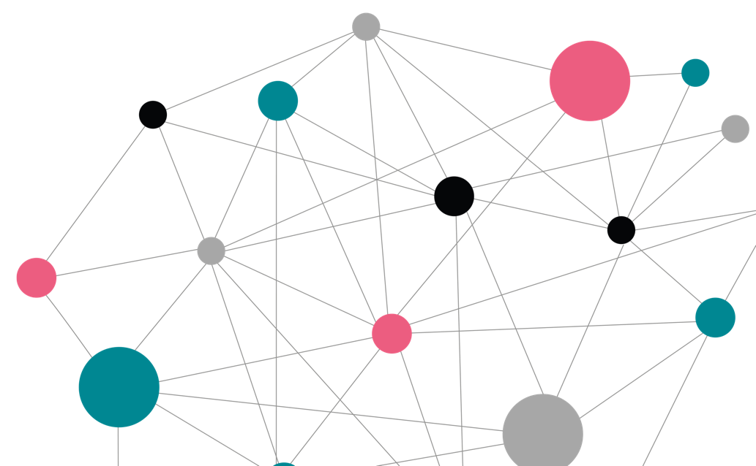
Overview of questionnaire submissions and assessment
Open: 12 Jun 2024 - 18 Aug 2024 (late submissions accepted until 31 Aug 2024)
121
Submissions
25
Countries plus many internationalorganisations
Organisations identified to be invited to a dialogue with the Tripartite and EU node.
5
Node types: thematic, national, institutional, regional, and other (such as the EU Node)
29
Goal of dialog process was to get from 29 to ~13 nodes for first wave of deployment
~13
To join the first wave starting March 2025
+
Subsequent waves of enrolment from Q4 2025 onwards
Notes:
Submissions were received from a total of 25 countries (20 EU member states)
IO – international organisations includes ERICs and EIROforum members with IO status (such as CERN) as well as the EC but not e-infrastructures such as EGI, GEANT
These node categorisations were derived from the answers obtained and NOT indicated by the submitters - Other includes e-infrastructures (EGI, OpenAIRE) and European Commission (EC node)

Slide 7
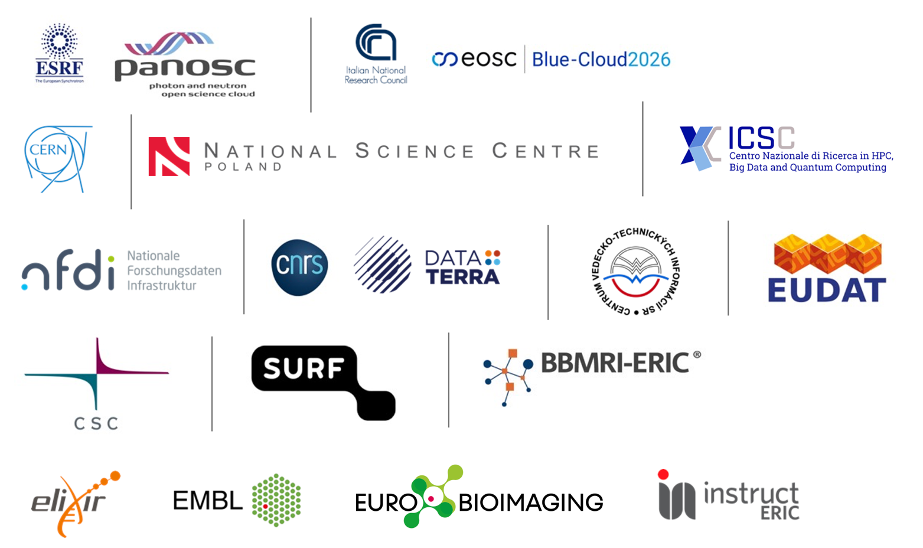
13 Candidate Nodes + EOSC EU Node
Aneta for NCN

Slide 8
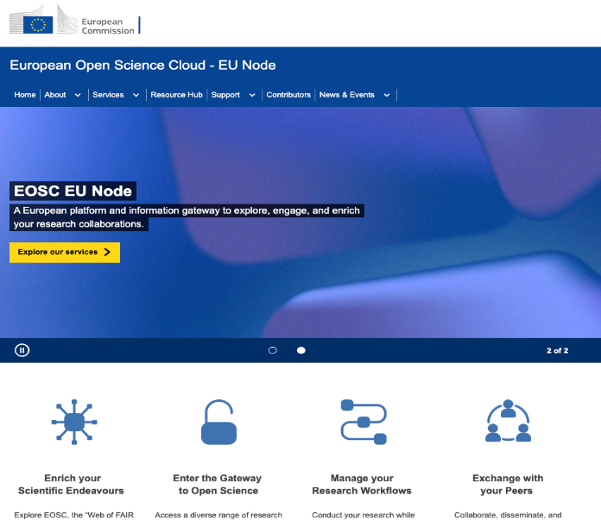
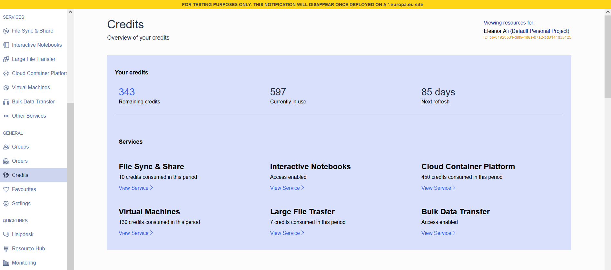
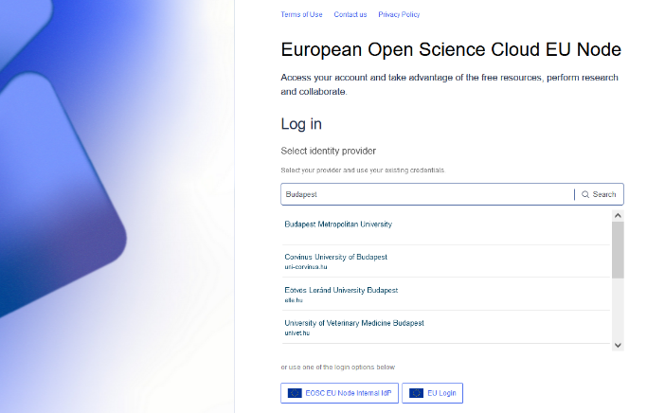
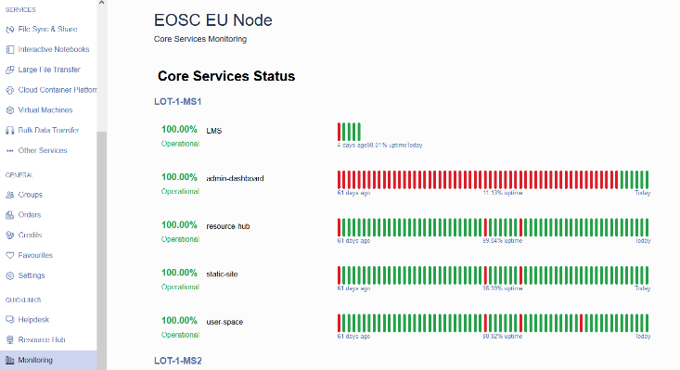
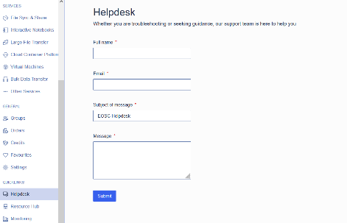
The EOSC EU Node
open-science-cloud.ec.europa.eu
The first node of the EOSC Federation
Owned and procured by DG CNECT (2023, 32M€, 3 years)
Launched in production on 22 October 2024
Serves as a blueprint for other EOSC Nodes; architecture and open-source software
Provides:
Federating capabilities (e.g. AAI) and SaaS (e.g., Helpdesk) offerings to other Nodes (optional; lower the entry barrier/costs)
Discovery and sharing of research outputs (publications, data, software, services) and tools
Guaranteed and high-quality integrated compute and storage services to support researchers (Notebooks, Virtual Machines, data/file transfer etc.) via quota/time-based access

Slide 9
Indicative Timeline for 2025
March
April
May
June
July
August
Sep
Oct
Nov
17/18 June F2F workshop, Krakow
17/18 March: Kick-off workshop, Brussels;
03-05 Nov:
EOSC Symposium
2 days
29 Sept-3 Oct F2F Review workshop: location?
27/28 June:
Present status at Meeting INFRAEOSC projects
Draft Letter of Intent / call with Legal teams
Direct communication between nodes
Temporary subgroups on operational aspects
Monthly “Build-up Group” call
Launch 2nd wave of enrolment
28 March: Webinar for all questionnaire respondents
Monthly “Build-up Group” call
31 March: deadline for revised project charters
Monthly “Build-up Group” call
Monthly “Build-up Group” call
Monthly “Build-up Group” call
Slide by EOSC A

Slide 10
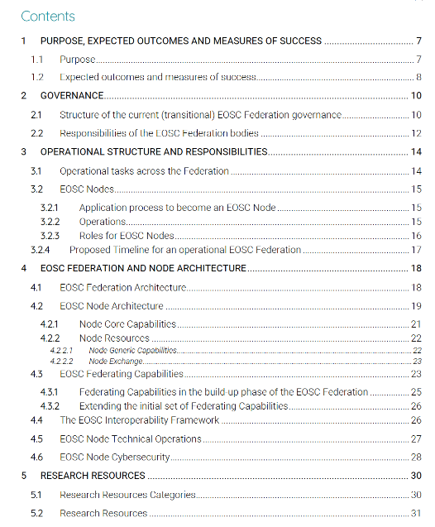
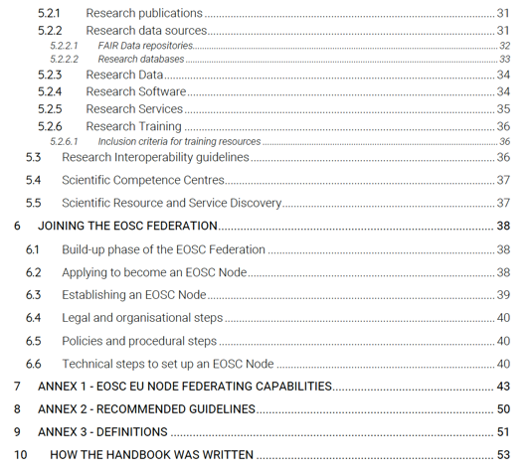
The EOSC Federation Handbook has been written by a group of volunteers, who have been working together since March 2024 with the support of the EOSC Focus project.
The Handbook provides an overview of the organisational and operational structure, and technical characteristics, of the EOSC Federation
DOI 10.5281/zenodo.14999577
CC-BY-4.0 licence

Slide 11
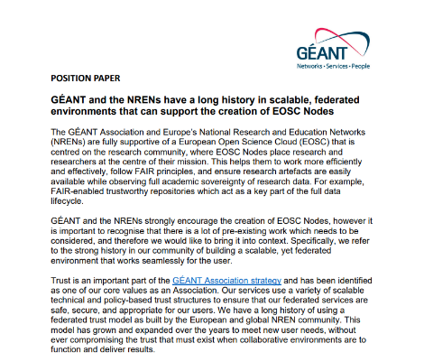
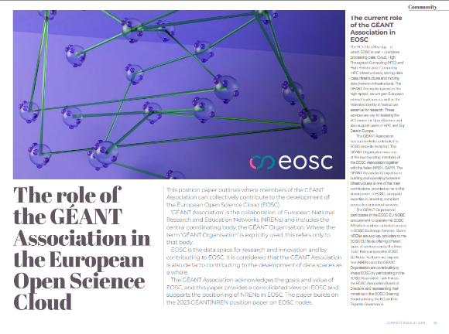
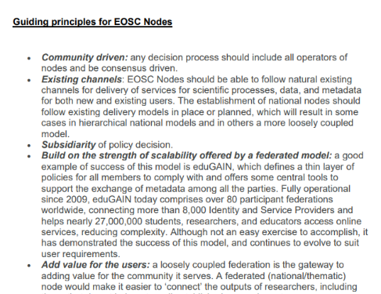
Shaping the role of NRENs in EOSC
November 2024 GÉANT position paper on the community’s position on the establishment of EOSC Nodes
October 2024 Position Paper on the role of the GÉANT Association of NRENs in EOSC
“GÉANT and the NRENs strongly encourage the creation of EOSC Nodes, however it is important to recognise that there is a lot of pre-existing work which needs to be considered, and therefore we would like to bring it into context. Specifically, we refer to the strong history in our community of building a scalable, yet federated environment that works seamlessly for the user.”
from the 2023 GÉANT position paper

Slide 12
Q&A
To get involved in GÉANT coordination activities around EOSC, email partner-relations@geant.org
Photo by Leeloo The First on Pexels

