Slide 1


Quantum Technologies Initiatives and Current Landscape in Europe – Synergies and Alignment with NREN Community Activities
Domenico Vicinanza
Géant Senior Research Engagement Manager
Piotr Rydlichowski
Resercher at PSNC
GEANT Quantum Session
WP6 Meeting

Slide 2
Quantum Flagship
Large-scale research and innovation initiative funded by the EC
Complemented by National Programs and Initiatives
Started in October 2018 and will run for 10 years.
Active in the areas of quantum computing and quantum communication – applications, integration, use cases

Slide 3
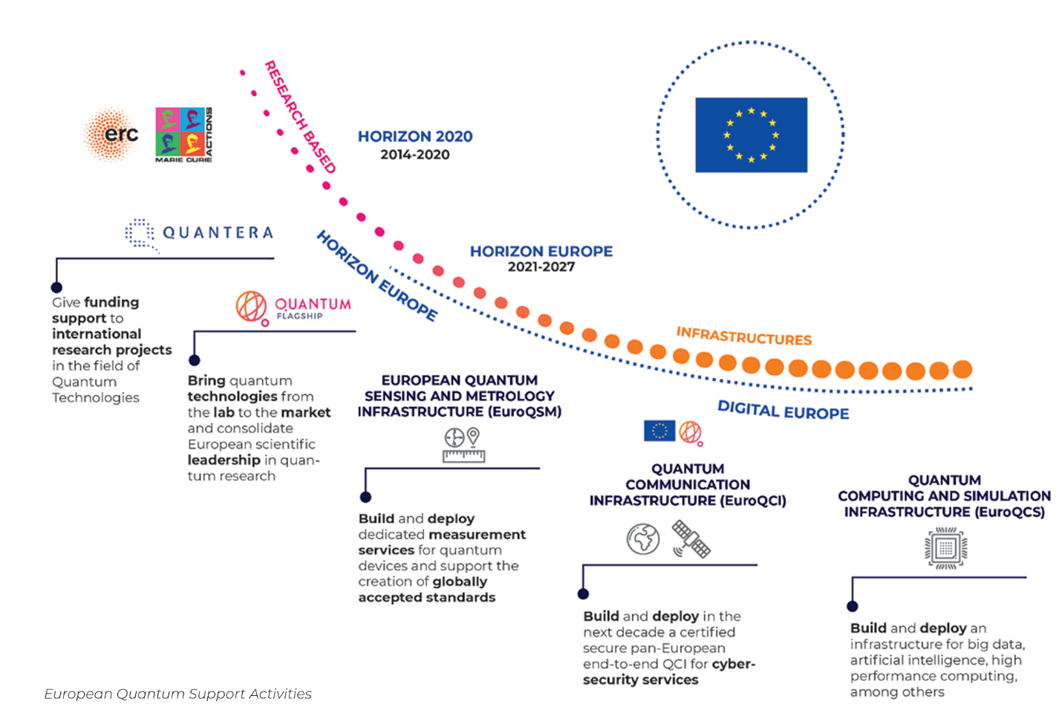
Quantum Flagship

Slide 4
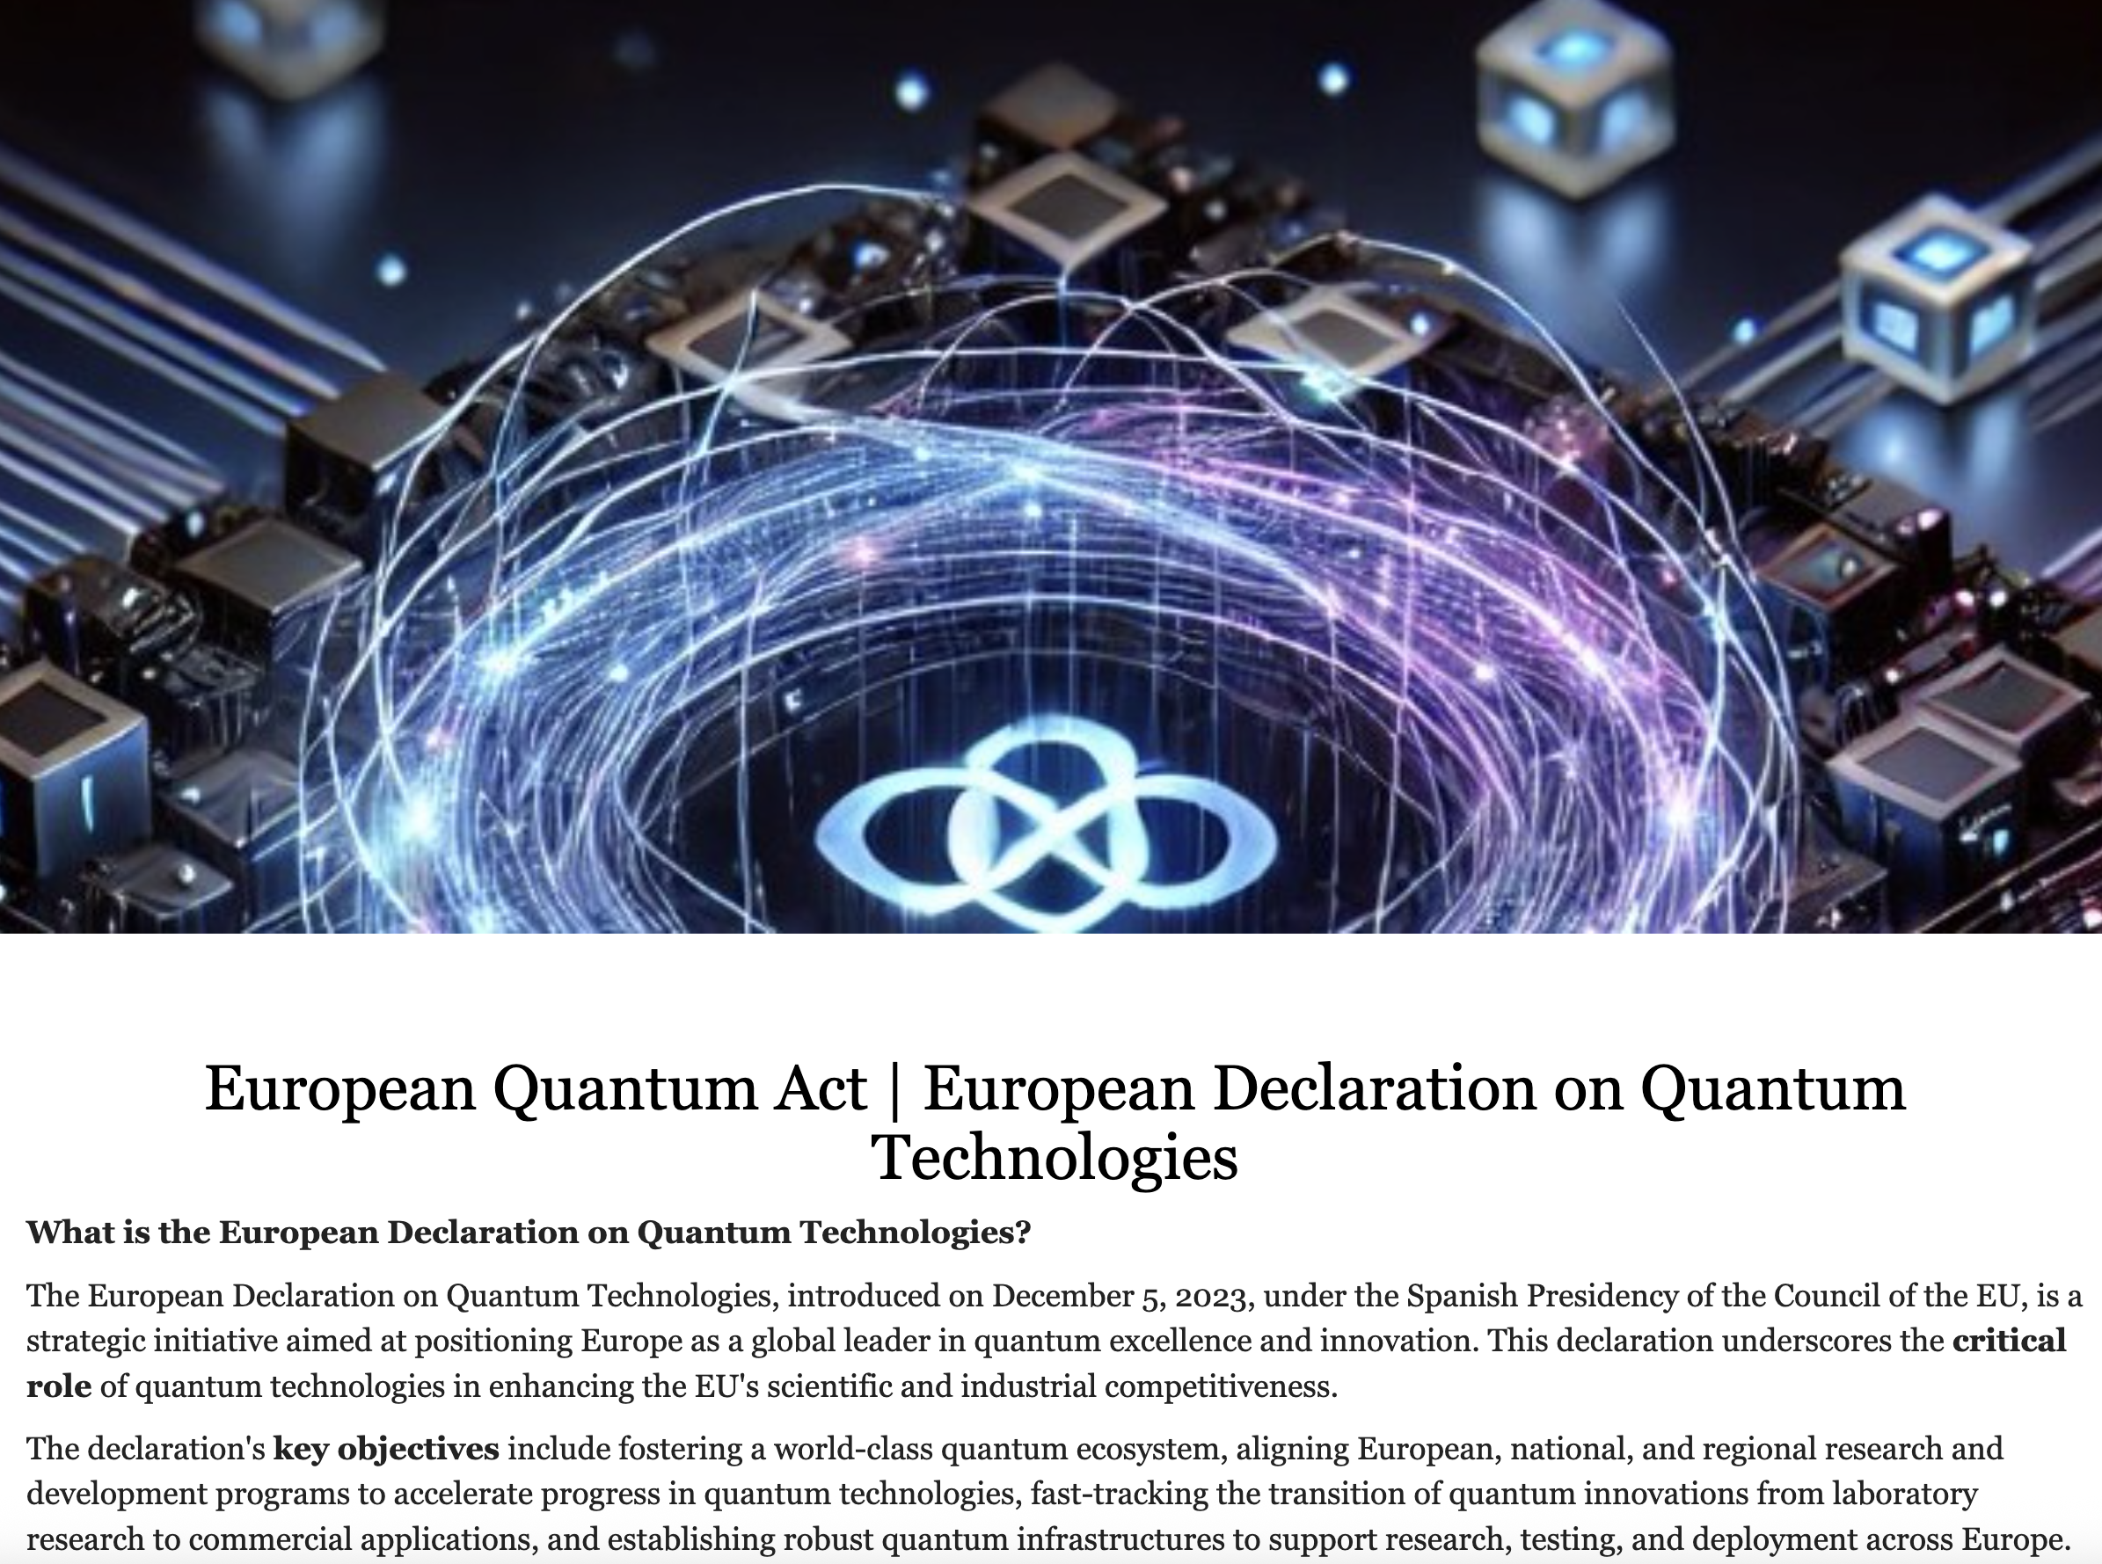
European Quantum Act

Slide 5
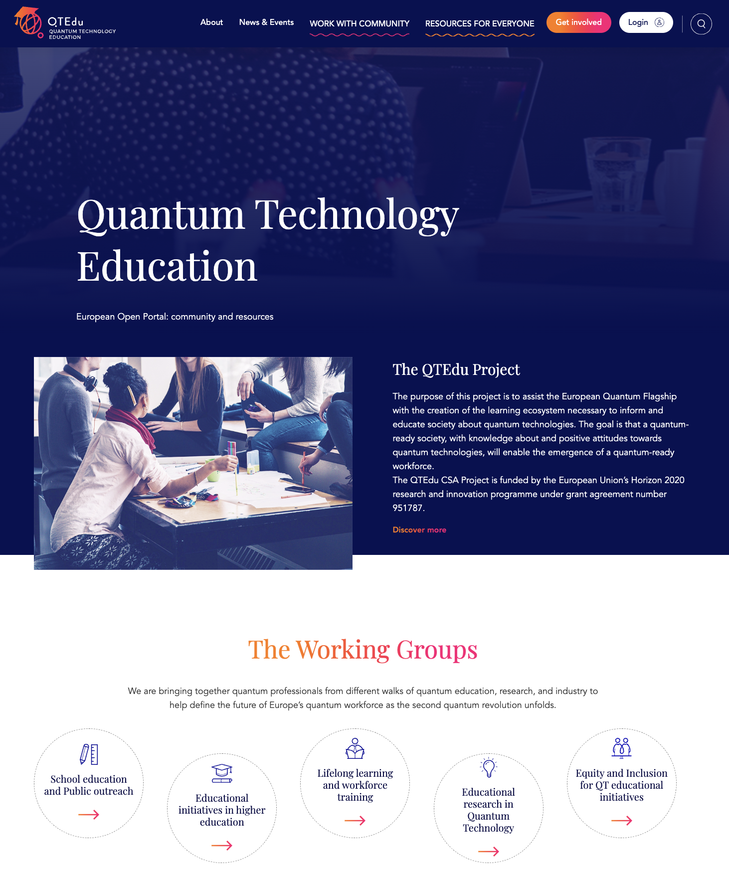
QT.Edu

Slide 6

2025: International Year of Quantum Science and Technology (IYQ)
Declared the UNESCO International Year of Quantum Science and Technology.
Marks 100 years since the birth of quantum mechanics
  a milestone that transformed our understanding of the universe.
Quantum mechanics is the foundation for most of the computing and networking technology we use

Slide 7
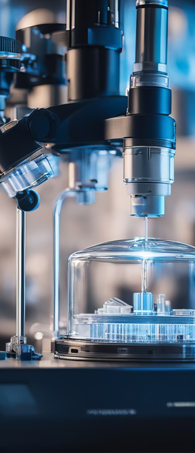
Introducing SIG-Quantum
What: Open forum for the diverse community engaged in quantum technologies, across Research and Education Networks (RENs).
A hub for the exchange of:
  Experiences
  Ideas
  Knowledge on the
    Development
    Deployment
    Testing
    Standardisation of quantum solutions.
Notes:
In alignment with this global celebration, GÉANT announces the establishment of the Special Interest Group on Quantum Technology (SIG-Quantum). A collaborative forum to advance quantum technologies and shape the future of Research and Education Networks.

Slide 8
Focus area
Focus Areas:
  Quantum networking
  Quantum computing
  Quantum sensing
  Cryptography and communication across Research and Education Networks (RENs).
Aiming at grouping:
  National Research and Education Networks (NRENs)
  Research institutes
  Vendors
  GÉANT interested in quantum technologies

Slide 9
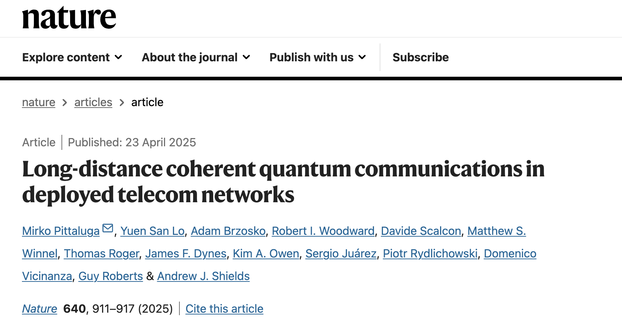
More quantum activities: Time/Frequency Distribution
SIG-Time/Frequency Network (SIG-TFN) → Design a Core-TFN within GEANT
Collaboration with industry (Toshiba) about QKD

Slide 10
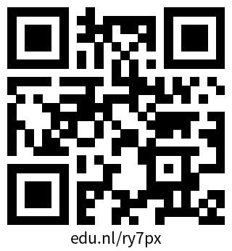
More info
For more information about SIG-Quantum and how to get involved, visit: https://wiki.geant.org/display/SIGQ/SIG-Quantum+Homepage
Join SIG-Quantum

Slide 11

Thank You!
Let’s stay in touch!
dom.vicinanza@geant.org
www.geant.org

