Slide 1
EU plans on dual-use
Future Ready Networks - Future of Fibre Optic Sensing
Edit Herczog
Brighton, Community Hub
11 June 2025

Slide 2
Context
Weaponization of everything
  Re-use of semiconductors from household appliances
  Attack on civilian infrastructure (submarine infrastructure)
Securitization of everything
  Sensors on submarine cables: research whales (civilian); observe movements around the cables for protection (defense); monitor traffic around cables (military).
Legislation was made before weaponization of everything
→Need to adapt
  Short term: Preference in-built into future calls (e.g.: 5G Toolbox); CEF and DEP includes Security clause; but civilian programmes (Horizon Europe; Copernicus) need to be revisited; Sanctions
  Medium term: revisit sectoral and horizontal legislation including Financial Framework rules; mainstream dual-use throughout?
  Organisations need to change to

Slide 3
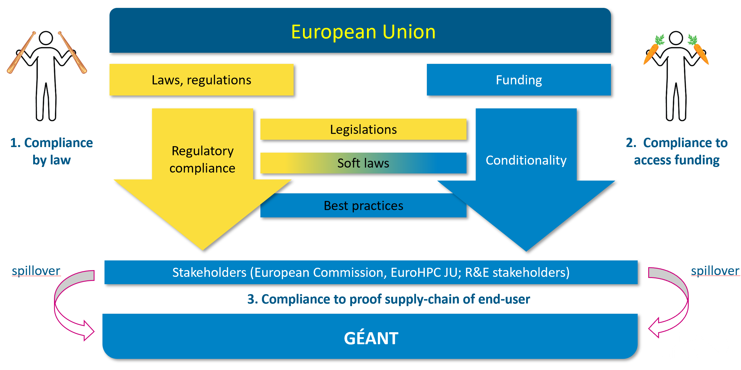

Slide 4
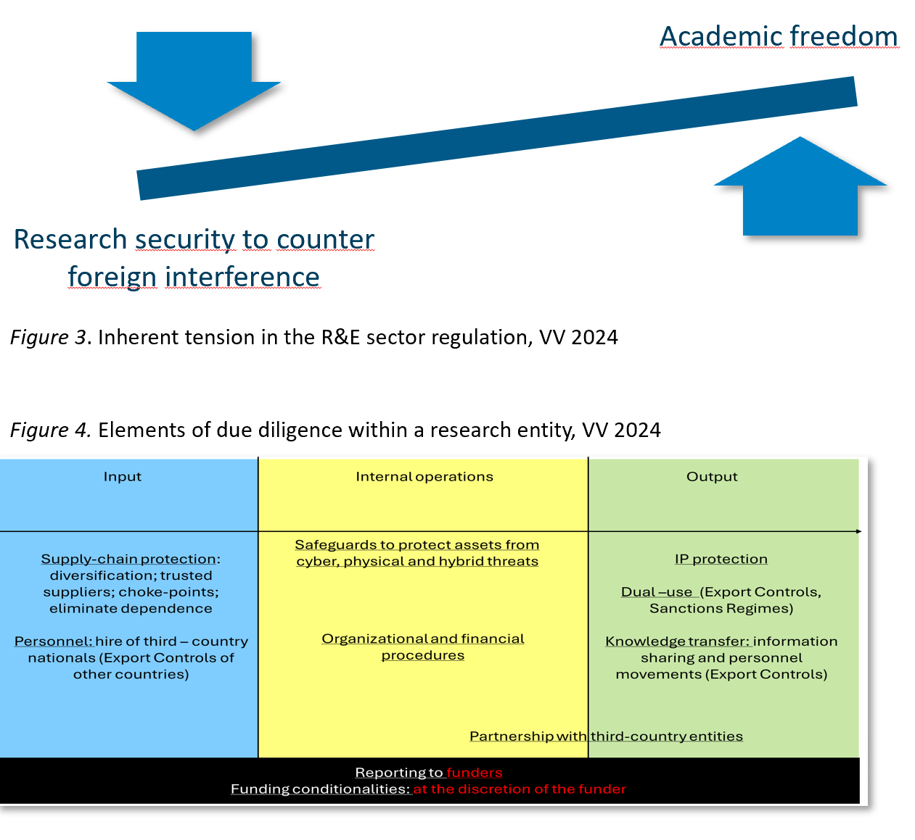
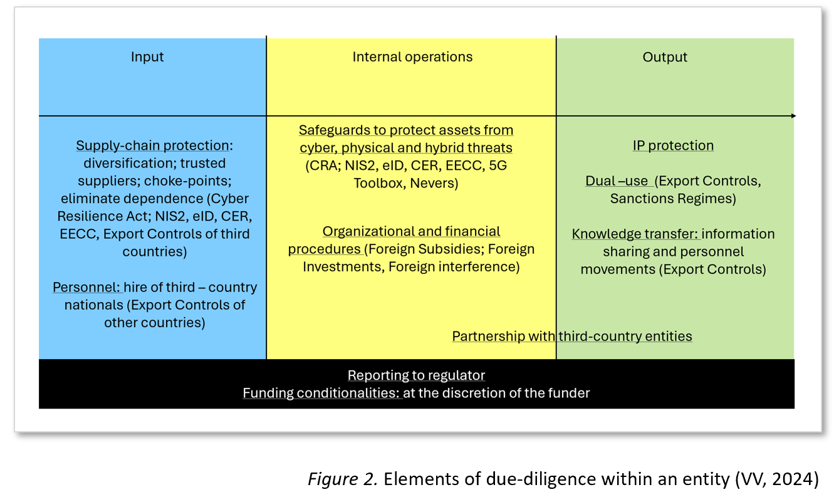

Slide 5
Thank you
Any questions?
Presenter email

