Slide 1
Time, Frequency and White Rabbits
Supporting Science and Society with Precision Timing
Raimena Veisllari
TNC25
Wednesday, 11th June 2025

Slide 2
Content
Importance of Time Services and Opportunities for NRENs
Low-Cost High-Accuracy Time Service with White Rabbit
Activities in GEANT and NRENs

Slide 3

Importance of Time Services and Opportunities for NRENs

Slide 4
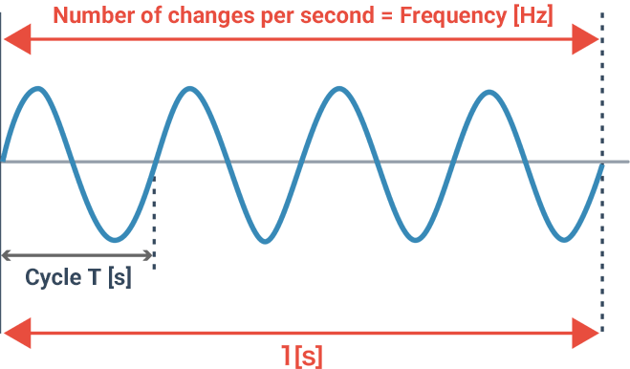
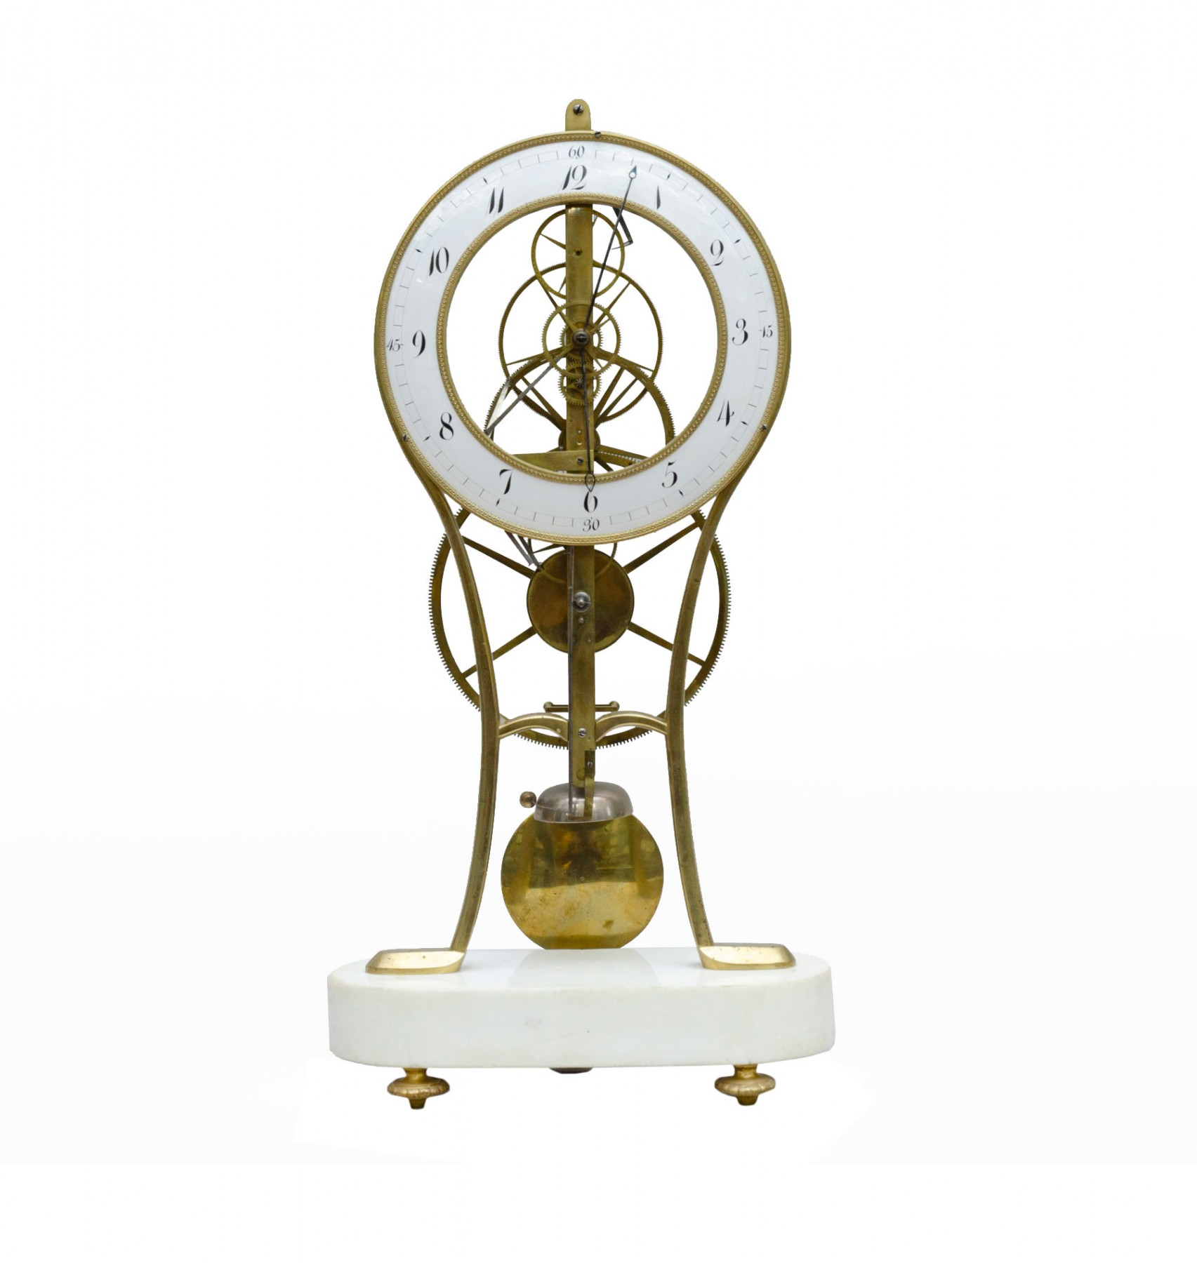
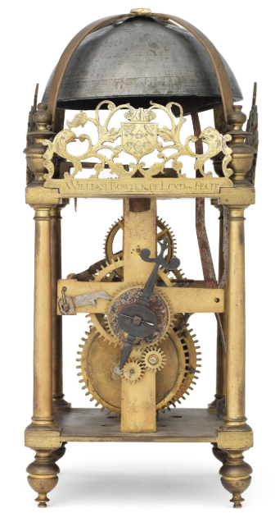
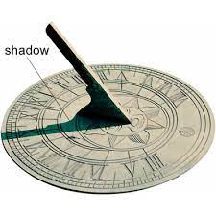
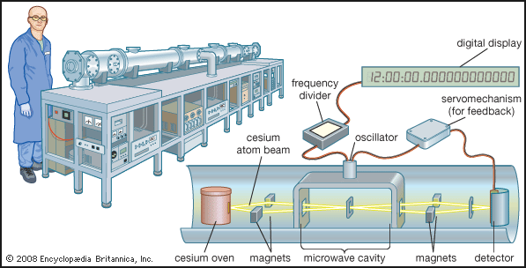
Time and Frequency in a Nutshell
Time is how long something takes, and Frequency is how often it repeats.
Source: Encyclopedia Britannica
1500 B.C.
17th Century
Pendulum f=50Hz
Louis Essen's 1955 invention of the first practical atomic clock
1968 definition of second f= 9,192,631,770Hz

Slide 5
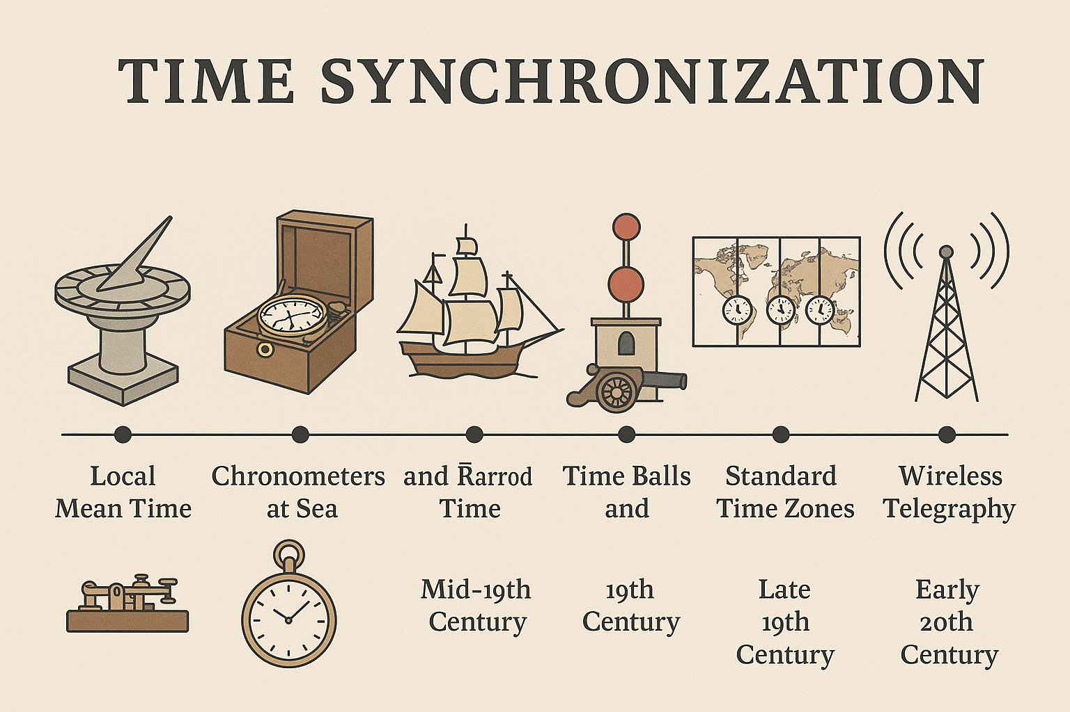
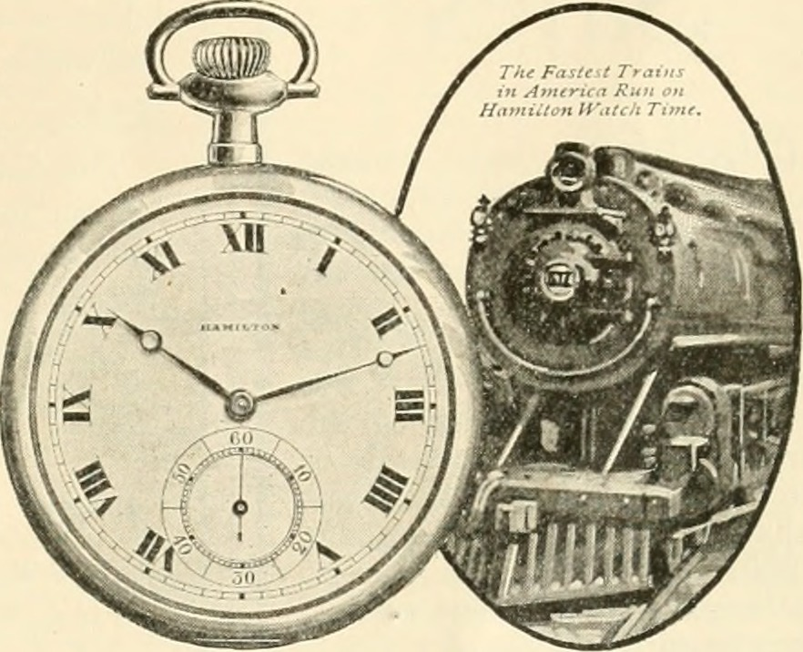
Time and Frequency in a Nutshell
How did we “know” the time when moving in different geographical locations?
Src: Zmodal, How Railroads Created Standardized Time Zones

Slide 6

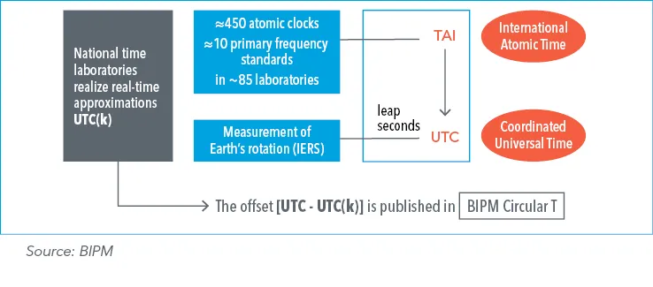
How Do We Measure and Maintain Time Now?
Coordinated Universal Time (UTC) is the worldwide reference time scale computed, maintained and improved by the Bureau international des poids et mesures (BIPM) − the international organization focused on measurement science and standards.
  National Metrology Institutes (NMIs) maintain and distribute the national timescale.
  Their clocks provide regular measurement data to BIPM, as well as the local real-time approximations of UTC, known as UTC(k), for national use. BIPM compares and gives the NMIs the offset.
Precision timing underpins many features of our daily lives: mobile phones, financial transactions, electric power grids and global navigation satellite systems all rely on time and frequency standards.

Slide 7
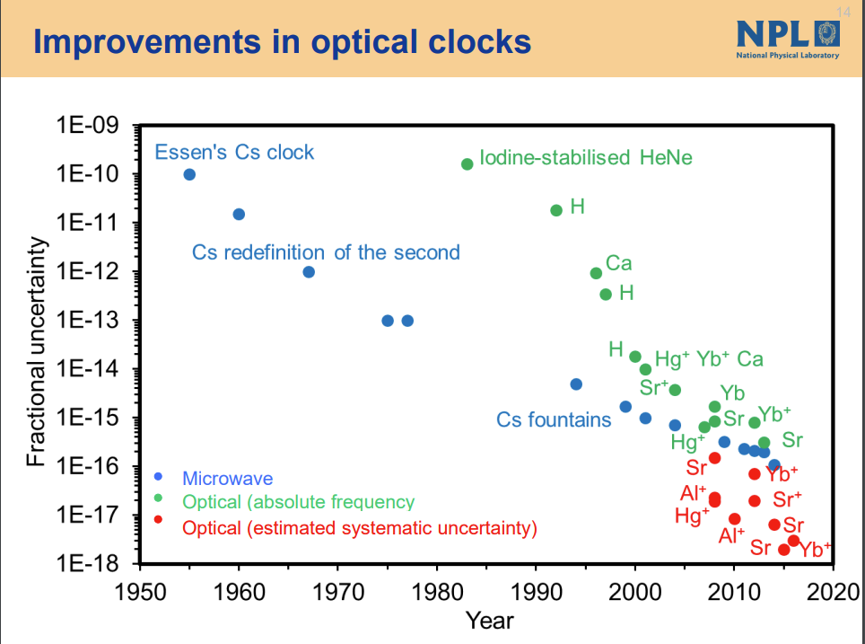
Optical Atomic Clocks
The Future of Time
How accurate are atomic clocks?
Since 1968 the second has been defined by measurement using Cesium ‘RF’ atomic clocks.
  E.g. an atomic clock with a fractional uncertainty of 1E-16 will drift by one second in 300 million years.
Optical atomic clocks are now a better technology for measuring time at 1E-18.
  ~ 31.7 billion years, less than 1 second drift since the Big Bang.
Courtesy: Guy Roberts, TNC 2024

Slide 8
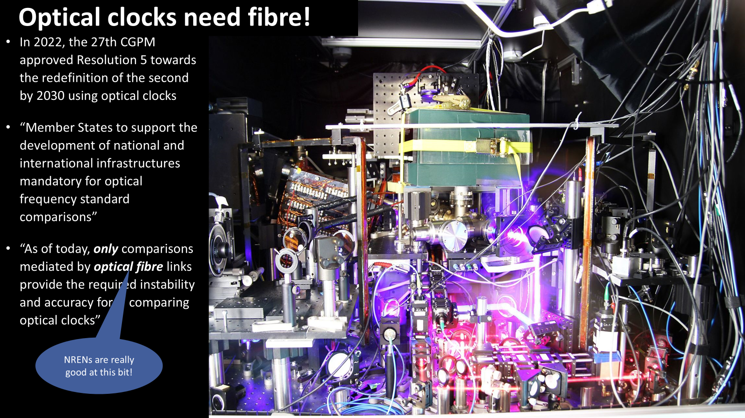
Redefinition of the SI Second and the Role of NRENs
Support the redefinition of the SI second being carried out between now and 2030+ by NPL, PTB, Syrte and INRIM and other NMIs.
GEANT GN5-2 C-TFN project ongoing for fibre-based time and frequency distribution in Europe.
Courtesy: Guy Roberts, SIG-TFN Workshop, Ispra, 2025

Slide 9
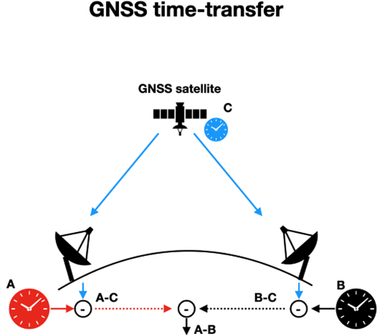
Maintaining the Coordinated Universal Time (UTC)
BIPM organizes the international network of time links to compare national/local realizations of UTC(k) from contributing laboratories.
The network of time links used is non-redundant and relies on observation of Global Navigation Satellite System (GNSS) and two-way satellite time and frequency transfer.
  Need to compensate for the delay due to e.g. the ionosphere, the gravitational field, movement of satellites, etc.
Future: complement with reliable and high-precision distribution through optical fibres.
Common View GNSS Time Transfer
Source: NIST
Comparing remote clocks, A and B with a common GPS clock (C). The time differences are computed using measurements logged by GNSS receivers that are referenced to local clocks A and B.

Slide 10
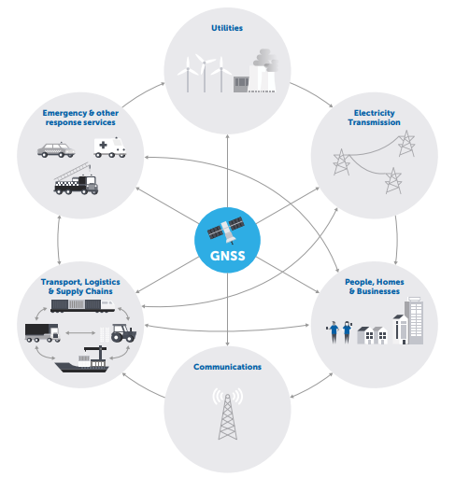
GNSS for Positioning Navigation and Timing (PNT)
Ubiquitous in today’s society :
  Your mobile phones (mobile networks)
  Financial services
  Electric power networks (smart grids)
  Automotive
  Aviation
  Emergency services and public safety
  ….
Source: UK Government Office for Science Report
Satellite-derived Time and Position: A Study of Critical Dependencies

Slide 11
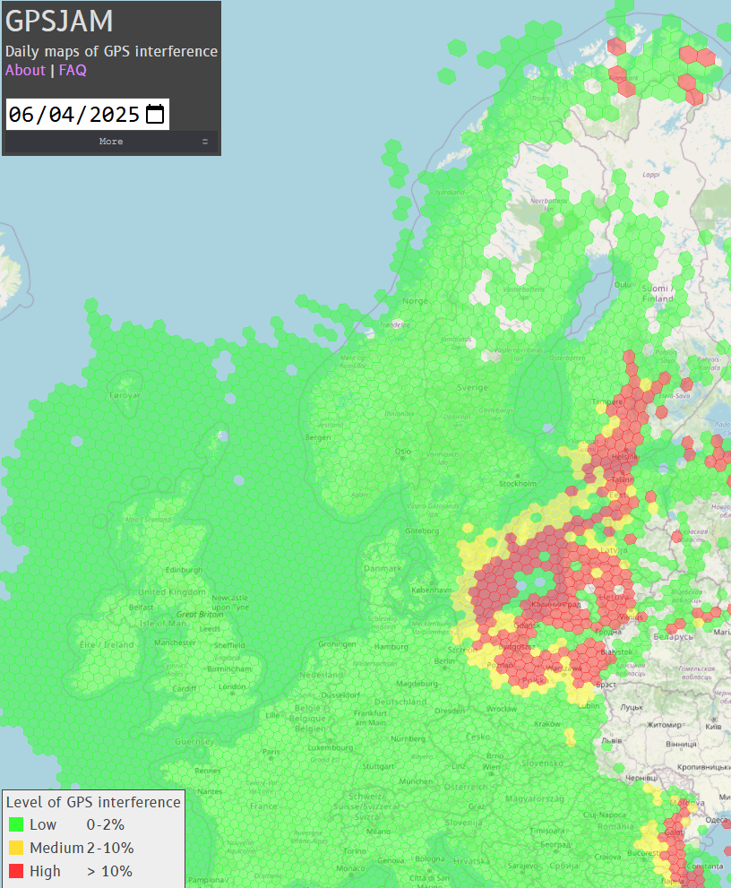
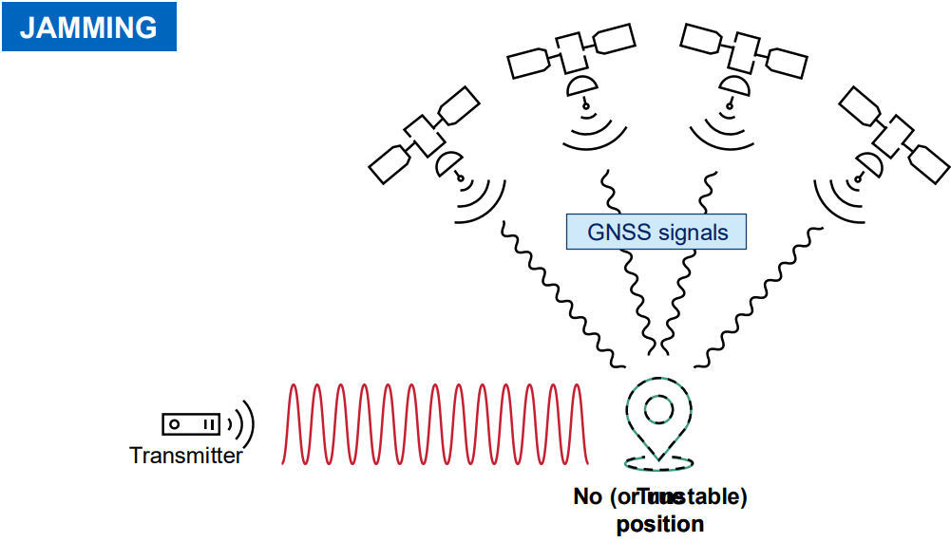
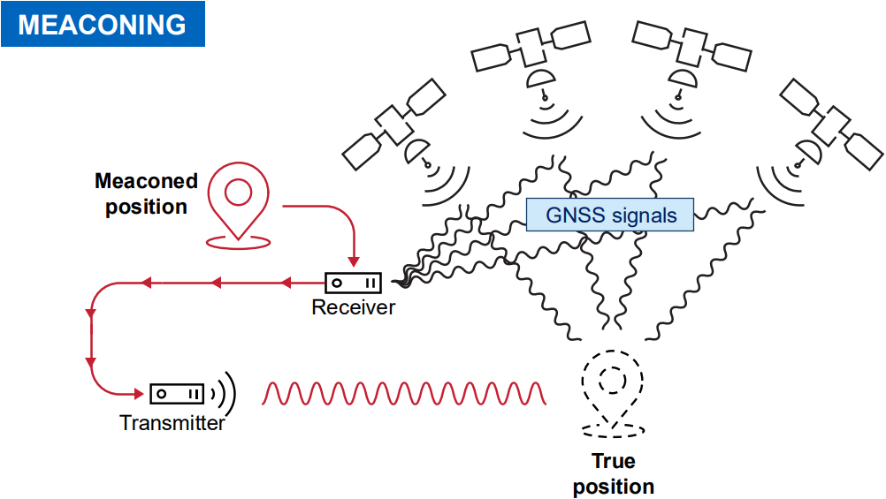
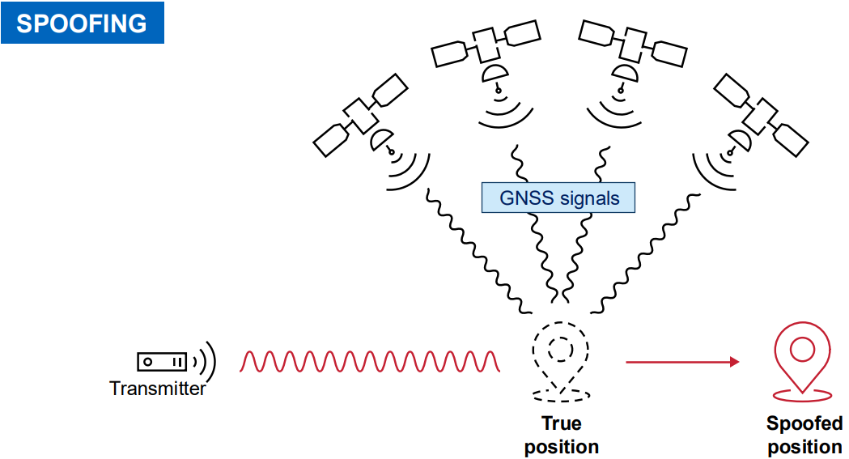
GNSS Vulnerability
The benefits of GNSS to the UK economy were estimated to be £13.62 billion per annum.
The impact of a loss of GNSS for 7-days was estimated to be £7.64 billion and impact of a loss for 24 hours was estimated to be £1.42 billion.
Report: The economic impact on the UK of a disruption to GNSS
Achilles’ heel: low power system at Rx
Multiple type of attacks possible with cheap and accessible devices one can buy easily.
Source: Jammertest 2025 Information Meeting.
Source: https://gpsjam.org/

Slide 12
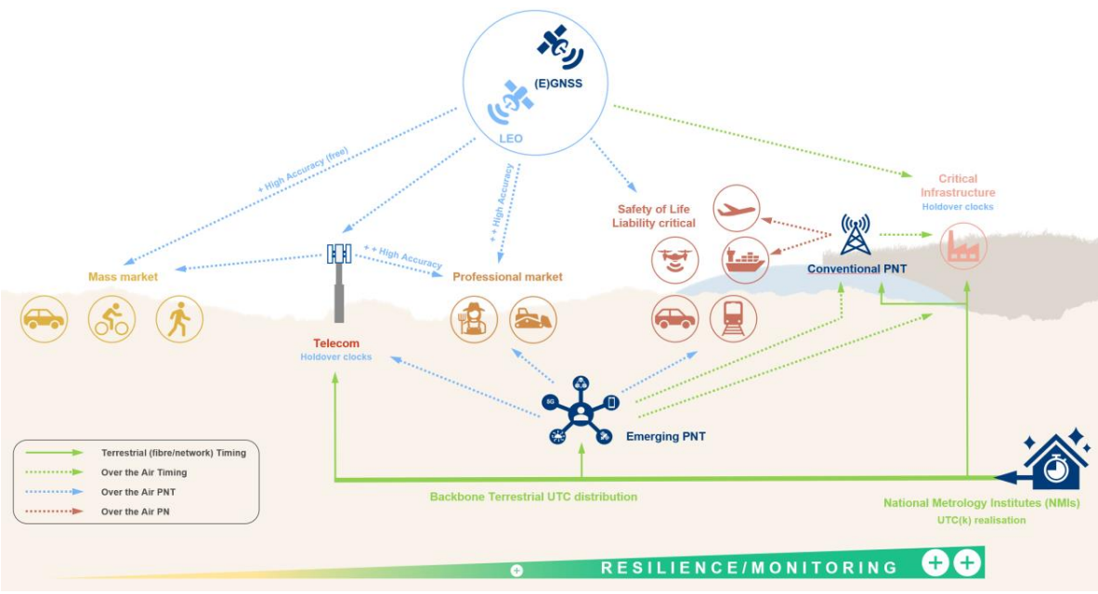

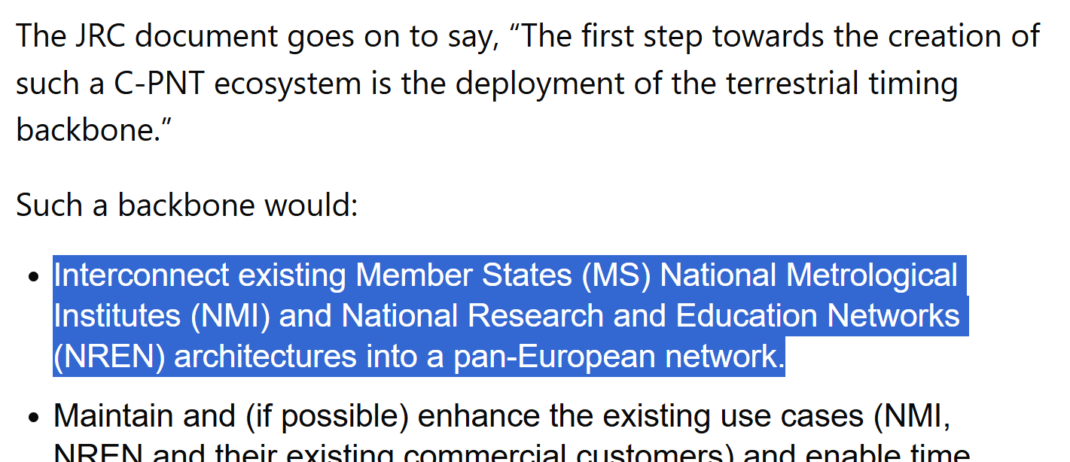
Positioning Navigation and Timing (PNT)
Terrestrial High-Accuracy Time Service
Source: https://www.gpsworld.com/europe-moving-toward-a-timing-backbone-and-looking-for-input/
Source:European Commission, European Radio Navigation Plan 2023 and JRC136355

Slide 13
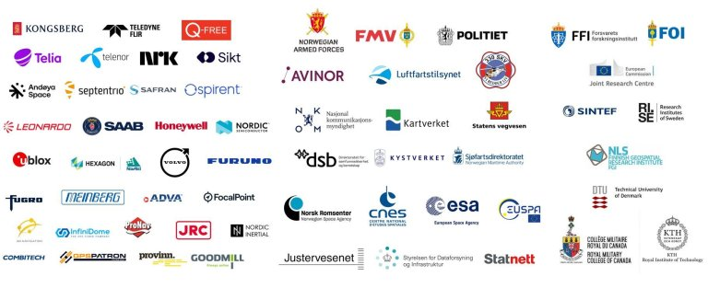
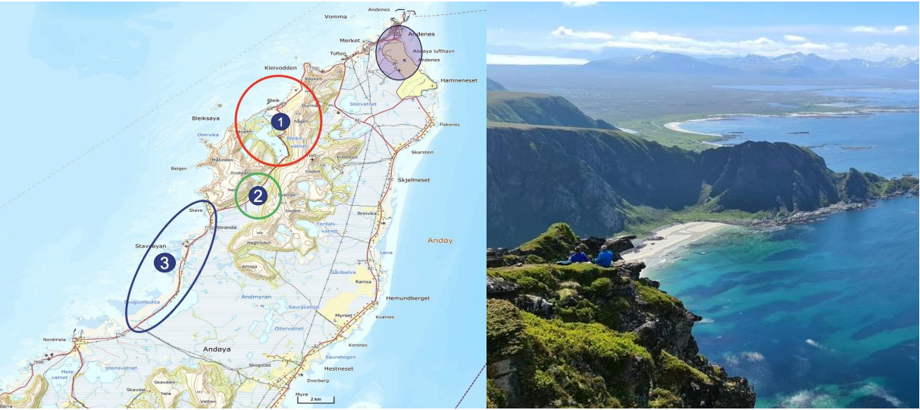
GNSS Attack Tests in Andøya, Norway
Test and Develop Resilient Systems
Jammertest is the largest open satellite signal resilience test in the world.
Facilitate industry and authorities to test their systems and products for potential weaknesses against realistic and extreme signal disturbance attacks.
  Organized yearly in September by the Norwegian Communication Authority NKOM and Norwegian NMI Justervesenet.
  Record applications in 2025 from 150 organizations and 24 countries.
SIKT providing terrestrial time and frequency service with White Rabbit

Slide 14
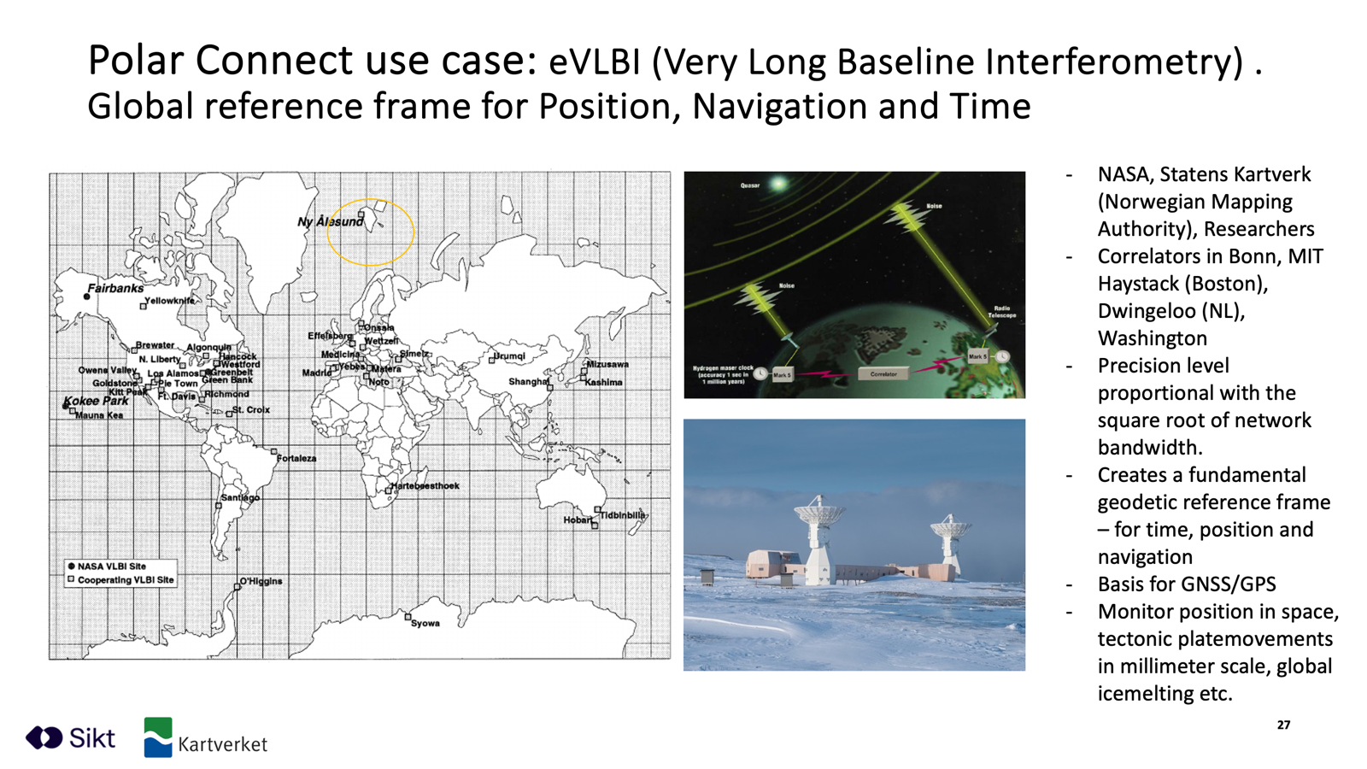
Opportunities for GEANT and NRENs
High-Accuracy Core Time and Frequency Network (C-TFN)
Use cases for T&F services are very wide-reaching and can be broadly broken down into the following categories:
Redundancy to GNSS and terrestrial T&F
Support the redefinition of the SI second being carried out between now and 2030.
Support fundamental physics research.
Opportunities for new services and applications.
Contributing to European scientific leadership.
Courtesy: Olaf Schjederup, Bright Cables Session Thursdat 11:00am, TNC 2025

Slide 15
Low-Cost High-Accuracy
Time Service with White Rabbit

Slide 16
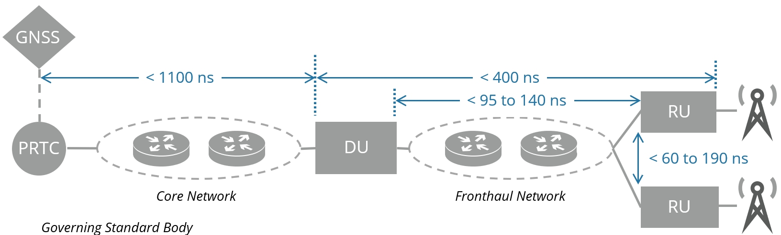
Time Distribution in Data Networks
Protocols for packet-based time transfer
1985: Network Time Protocol NTP (your PC time) on Layer 7 (UDP)
  Time accuracy in the tens of milliseconds on average
  Heavily affected by delay variation as you are contending for capacity with other IP data packets
2002: Precision Time Protocol PTP (IEEE1588-2008, ITU-T profiles) on Layer 2 (Ethernet)
  Time accuracy in the range of 1millisecond down to hundreds of nanoseconds
  Heavily affected by transmission path asymmetry, devices have free-running oscillators, etc.
  Most “legacy” networks partially support it and not good enough for most use cases
    E.g. Most mobile network operators had big issues during 5G roll out of Time Division Duplex Frequencies(e.g.3.5GHz) requiring end-to-end time accuracy < 1.5µs.

Slide 17

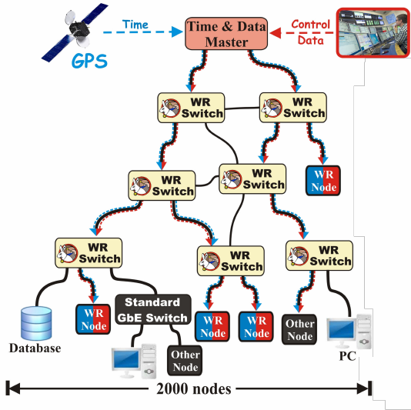
White Rabbit Protocol for Sub-Nanosecond Accuracy
IEEE1588-2019 High Accuracy Profile
First developed at CERN in 2008, meant for Big Physics facilities, e.g. CERN, GSI, NIKHEF
Combination of IEEE1588-2008 with further extensions:
    Clock syntonization over the physical layer L1Sync (similar to SyncE).
    Enhancement of timestamps precision through phase measurement.
    Automatic precise evaluation and compensation of transmission link asymmetry.
    Backward compatible with PTP IEEE1588-2008.
        No ITU-T profile.
Open Source and commercially available
Initial specs for links < 10km and scalable to 2000 nodes, but for maintaining sub-ns accuracy up to ~20 WR nodes in a chain.
Refer to White Rabbit Collaboration Source: Javier Serrano, GEANT Time and Frequency Workshop

Slide 18
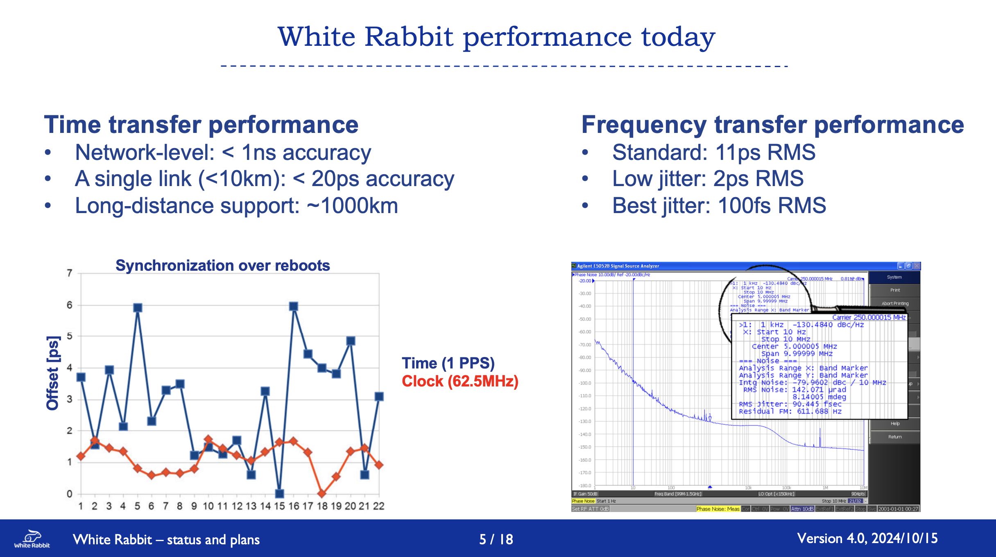
Why is White Rabbit Important?
WR offers a solution that is unmatched by other technologies
Gaining rapid acceptance among network operators
Several system vendors are providing carrier-grade WR switches
Continuous development with research and industry partners (WR Collaboration).
  Further possibilities for development, e.g. an ITU-T telecom profile in the future?
Courtesy: Guy Roberts, SIG-TFN Workshop, Ispra, 2025

Slide 19
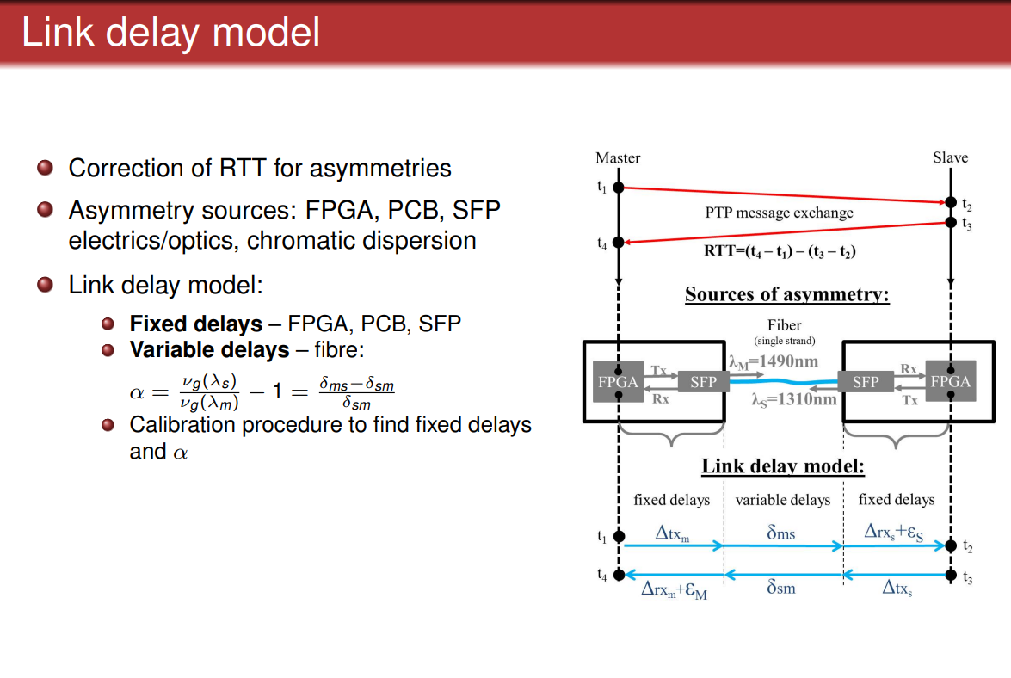
White Rabbit Asymmetry Compensation
Rule of thumb: speed of light in optical fibre ~4.9 ns/1 meter -> 1ns ~20cm
“Traditional” optical fibre communication uses fibre pairs, one fibre per direction (Tx Rx) using the same wavelength:
  In practice fibres have different lengths even in the same cable from few to tens of meters. Different transmission time introduces delay variation/time error
  Pre-calibration is difficult for in-situ as every “fix” of a fibre break will introduce unknown ∆ fibre length.
Single fibre with different wavelengths per direction:
  Asymmetry is introduced because of chromatic dispersion: different wavelengths travel at different speeds in the fibre medium (e.g. higher wavelengths travel faster).
  Compensated with calibration.
Source: M. Lipinski, GEANT 2022 SIG-TFN WS,

Slide 20
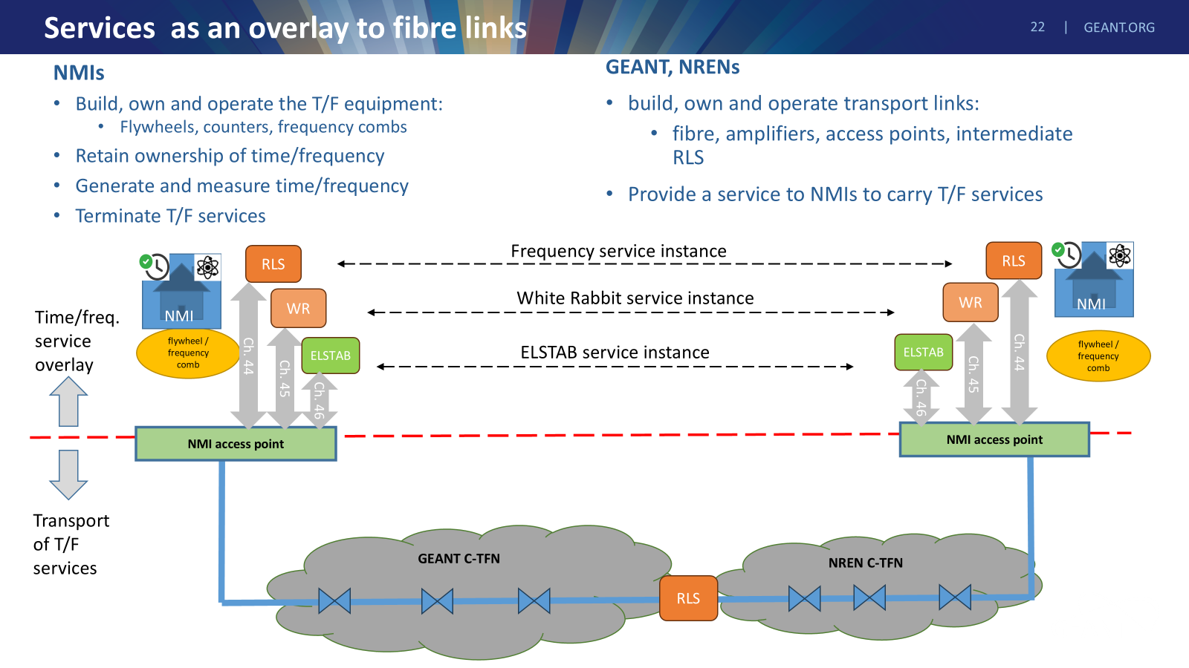
White Rabbit over Dedicated Single Fibre
See outcomes from CLONETS project
2024: Build Pathfinder link and prepare C-TFN.
GN5-2: 2025-27: Build C-TFN northern route .
GN5-3: 2027-29: continue C-TFN southern route.
Courtesy: Guy Roberts, SIG-TFN Workshop, Ispra, 2025

Slide 21
White Rabbit over Fibre Shared with Telecom Data
Optical Dense Wavelength Division Multiplexing (DWDM)
Using existing fibre-optic infrastructure in parallel with telecom data
Low cost of deployment of telecom equipment
No dedicated fibre required facilitates acceptance by network operators
In long-haul transmission, at amplification sites solutions are required for the WR bidirectional optical path,
Optical channels for data
(>100 Gb/s each)
MUX
DeMUX
Optical fibre A
WR Grandmaster
(GM)
WR Slave
(BC)
WR channels
(2 wavelengths)
Fibre pair
WR Slave
(BC)
Optical fibre B
DeMUX
MUX
WR time error can be measure if deploying a loop
(i.e. from Grandmaster to slave on fibre a and
from slave to grandmaster on fibre b)

Slide 22
Activities in GEANT and NRENs

Slide 23





GEANT GN5-2 Project 2025-H1.2027
Included:
10-year IRU for fibre on red routes
Bidirectional amplifiers as needed to light the fibre on the red routes
Excluded:
Green lines – fibre built by NRENs
Blue lines – fibre bult by NMIs
Dashed grey – proposed future links
flywheels, counters frequency combs needed are to be funded by the national time/frequency providers
Time/Frequency overlay services
Copenhagen
Lithuania
UMK
Torun
PSNC
Poznan
PTB
Braunschweig
Slubice
SURF
VSL
Delft
TU Eindhoven
GUM
Warsaw
NPL
London
Lille
Wroclav
OB
Brussels
IRE
Prague
ILNAS
Luxembourg
CESNET
Cieszyn
OP
Paris
Karlsruhe
Ostrava
ISI
Brno
Strasbourg
Munich MPI
South-East
Europe
New established link
Basel
BEV
Vienna
METAS
Bern
Innsbruck
NMI Frequency reference
CERN
Geneva
Ljubljana
Research institute
Grenoble
Trieste
Zagreb
Hut for housing RLS
Bordeaux
Modane
INRIM
Turin
Milan
Source, GN5-1, T&F incubator initiative, Guy Roberts (GÉANT)
Madrid

Slide 24
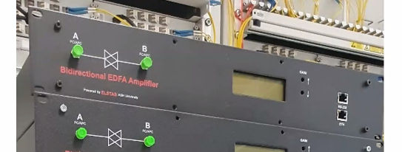
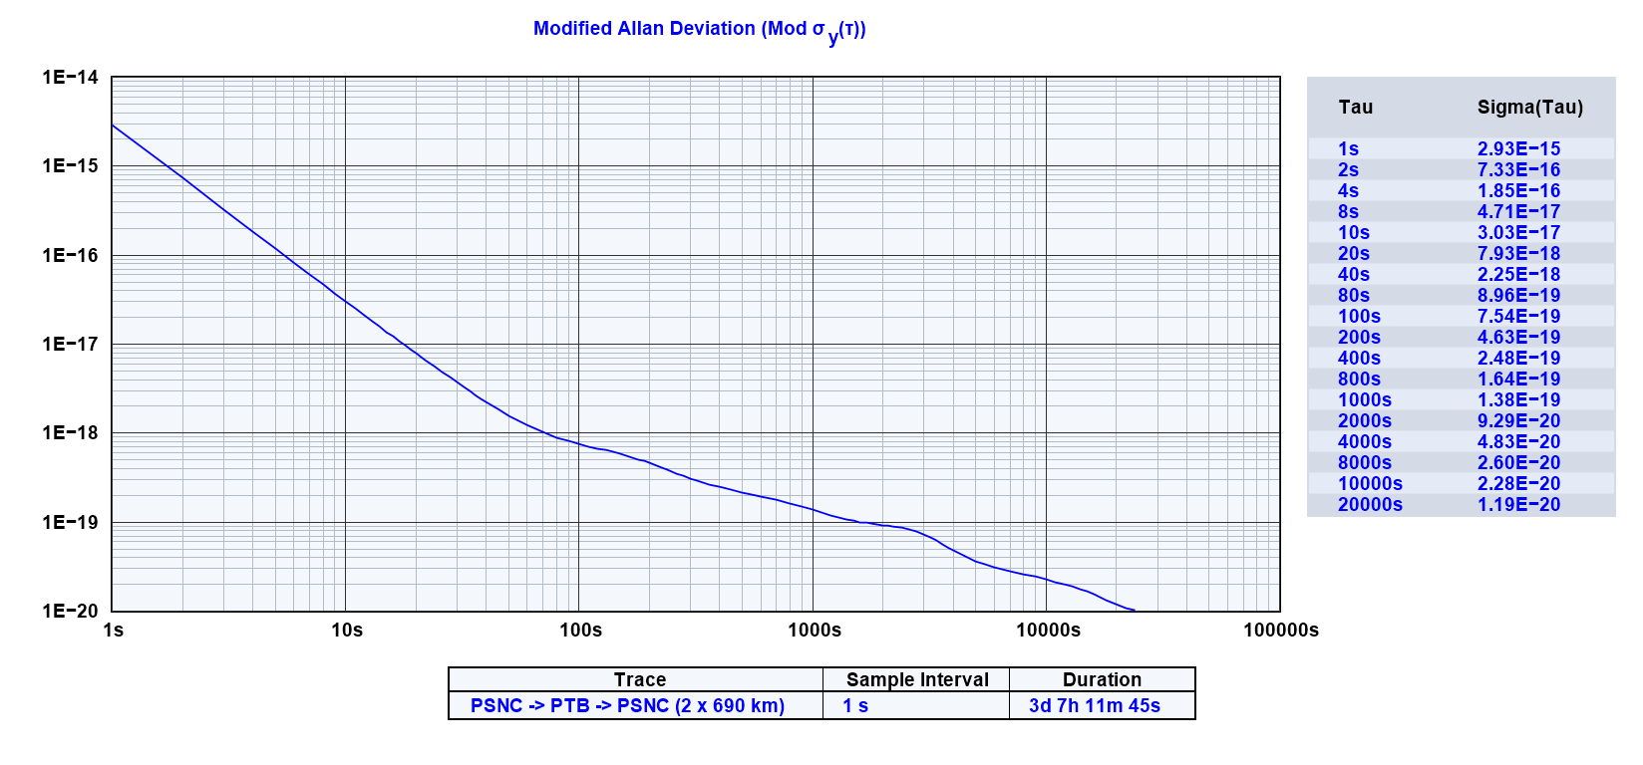
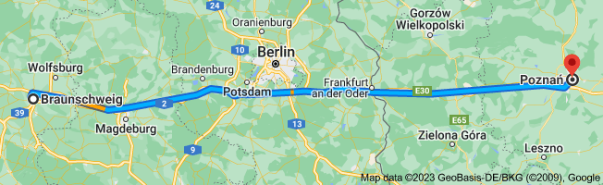
Pathfinder: Blaizing a Trail
First proof-of-concept link for the CLONETS core-TFN.
  GÉANT fibre from PTB to the polish border.
  PSNC provides access to their existing fibre from the border to Poznan
Purpose is to prove the technical concept
Both frequency and time tested.
Bi-directional amp
PSNC
PTB

Slide 25
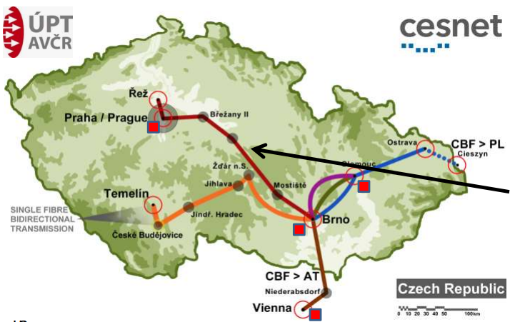
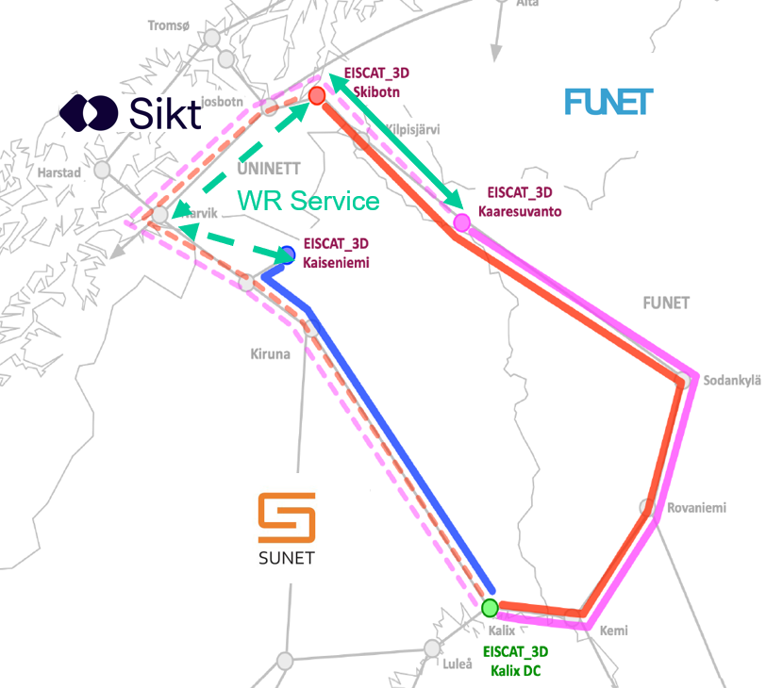
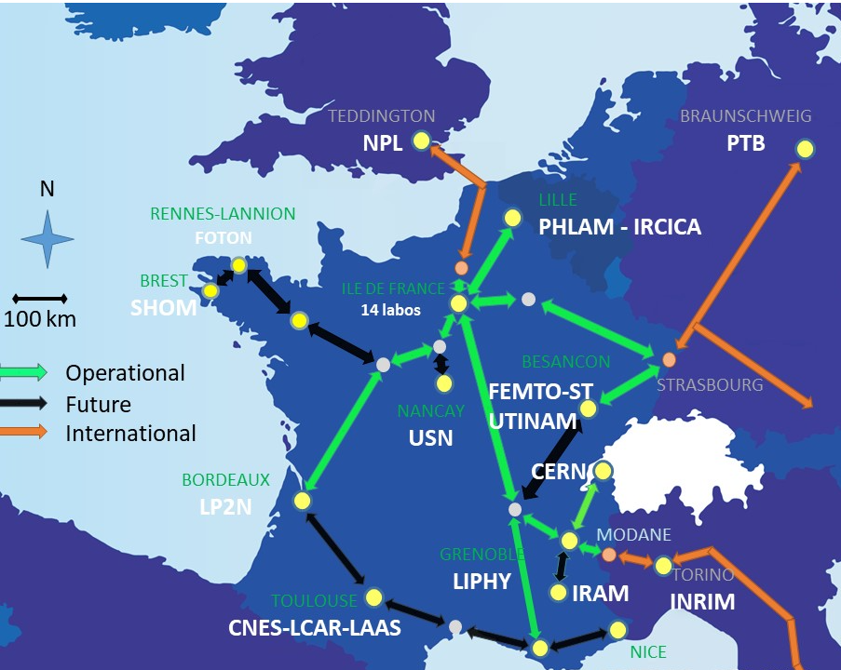
Multiple NRENs Already Deploy National WR Networks
A few examples
EISCAT 3D
REFIMEVE

Slide 26
Long-haul White Rabbit Time Distribution
GEANT has initiated a WR incubator led by SIKT (Norwegian NREN) on long-haul WR time service over DWDM networks.
Aims to evaluate the available solutions, compare the performance/cost ratio, and make recommendations to NRENs on how best to deploy WR in their long-haul DWDM networks.
Key challenges for long-haul is the regeneration at In-line Amplification Sites (ILA). Competing solutions to be evaluated:
  Bidirectional amplifiers, WR switches for regeneration, and Optical-Electrical-Optical media converters.
Partners: GEANT, SIKT, CESNET, SUNET, FUNET, GARR
If you would like to participate, please reach out raimena.vesillari@sikt.no
Field-trial on GEANT Prague – Vienna link
~450km optical link with loop
Field-trial on GEANT Prague – Vienna link
~450km optical link with loop

Slide 27
Thank you
Any questions?
raimena.veisllari@sikt.no

