Slide 1
Evolutionary Transition to Advanced Automation of Network and Service Management
A Blueprint Implementation in the PIONIER Network
TNC26, Helsinki, 8-12 June 2026
Tomasz Szewczyk (PCSS), Roman Łapacz (PCSS)

Slide 2
Agenda
1
PIONIER
4
Implementation
2
The goal
5
Production in PIONIER
3
The plan
6
Key takeaways
7
Future

Slide 3
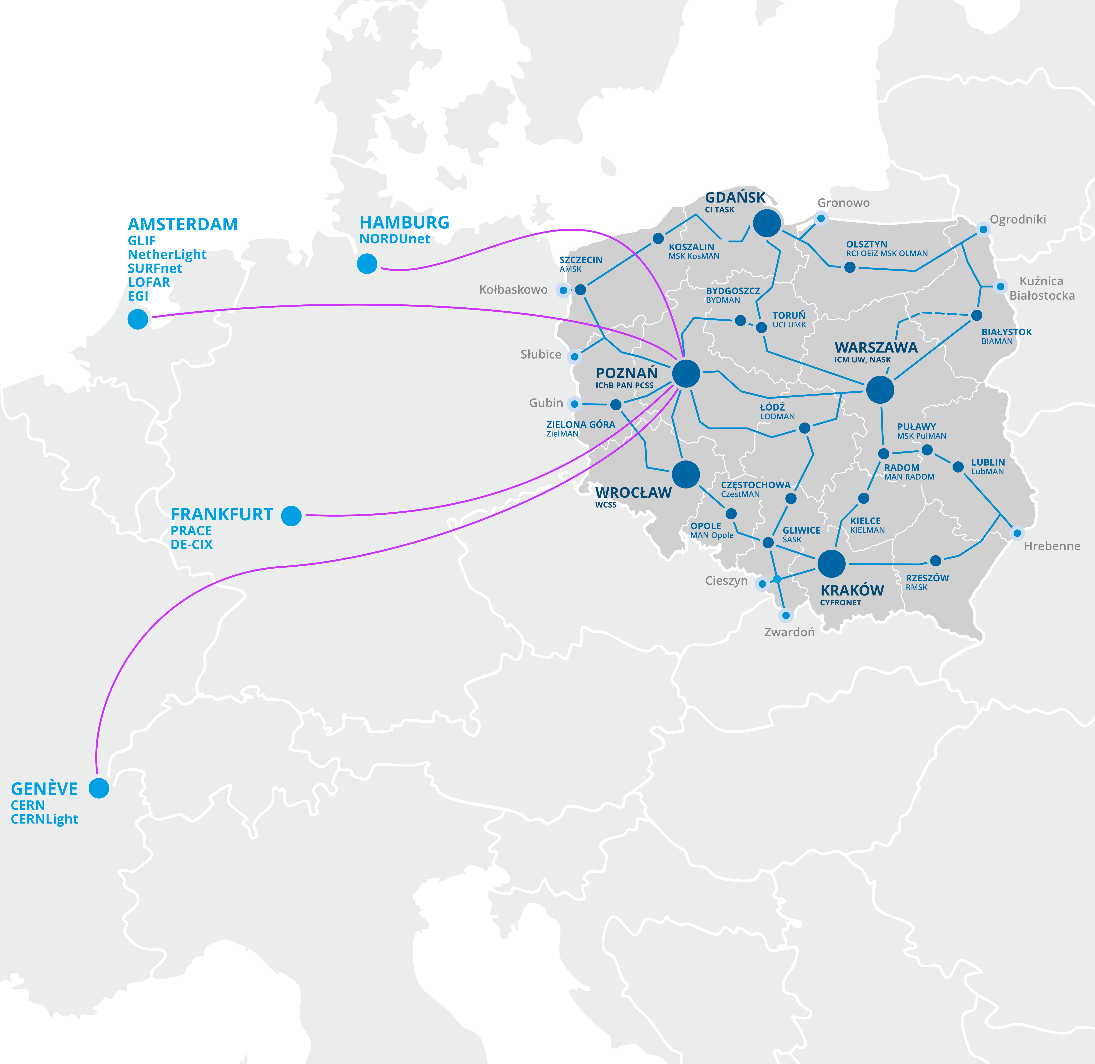

PIONIER – Polish National Research and Education Network
Consortium of 22 academic MANs
8,504 km of fibre-optic infrastructure connecting major scientific centres across Poland and beyond
International connectivity via GÉANT, linking Polish science to European NRENs and the global Internet
A platform for many national and international projects

Slide 4
PIONIER – Polish National Research and Education Network
Optical transmission system: CDC nodes, ROADM architecture, alien wavelengths and spectrum as a service
Wide set of interfaces and transponders: 1200G/800G/400G/200G/100G
Packet network for IP and MPLS based services: Internet access, virtual L2 and L3 networks

Slide 5
The goal
Implement a system for automated network service lifecycle management in PIONIER, gradually replacing manual operations while integrating with existing tools — ensuring zero negative impact on live services throughout the transition.

Slide 6
Key objectives
Integrate proven components
Reduce operational time
Eliminate human error
build upon existing, battle-tested management elements rather than replacing everything from scratch
significantly shorten the time required to provision, modify, and decommission network services
replace repetitive manual tasks with reliable, consistent automated workflows
Ensure extensibility
Maintain full control
Embrace open solutions
Enable self-services
design for future growth, enabling new functionalities and adapting to evolving service market demands
preserve operator oversight and trust despite increasing automation and autonomy of system components
built on open standards and open-source technologies, supporting a heterogeneous, multi-vendor environment
empower users and teams to independently manage selected operations without requiring manual operator intervention

Slide 7
The plan
1
The 1st phase
Data Model & Source of Truth
2
The 2nd phase
Workflows for network services and operations
3
The 3th phase
Scale up, extensions, autonomy

Slide 8

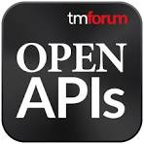

Data model & Source of Truth
of system development — consistent management of network information based on a flexible data model and a Source of Truth component
The 1st phase
We need a way to quickly and easily define all possible resources and services (even those we don’t know about yet) and the relationships between them
TMF639 ResourceInventory
TMF638 ServiceInventory
We want to avoid data duplication and synchronization issues
Source of Truth must integrate seamlessly with other components
of the network management system
Maat – Source of Truth in PIONIER

Slide 9
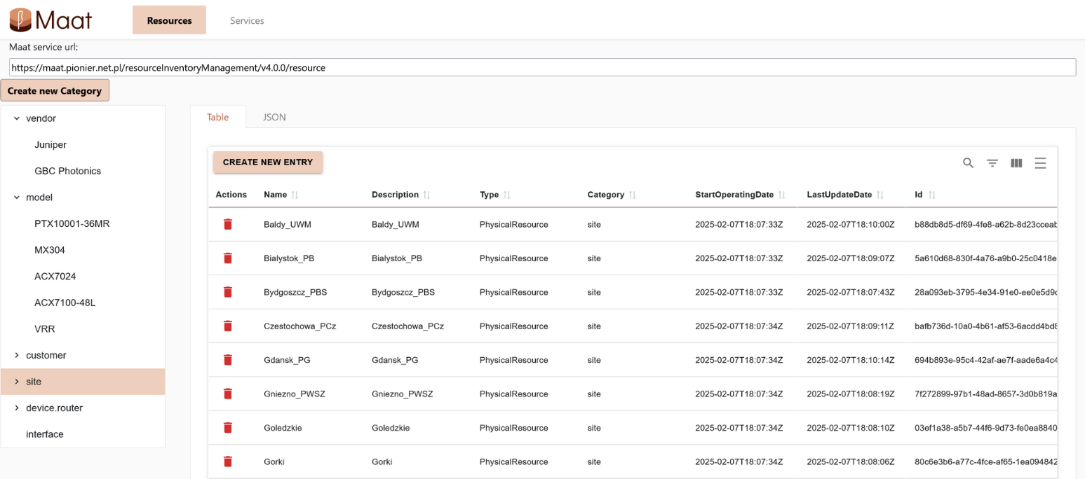
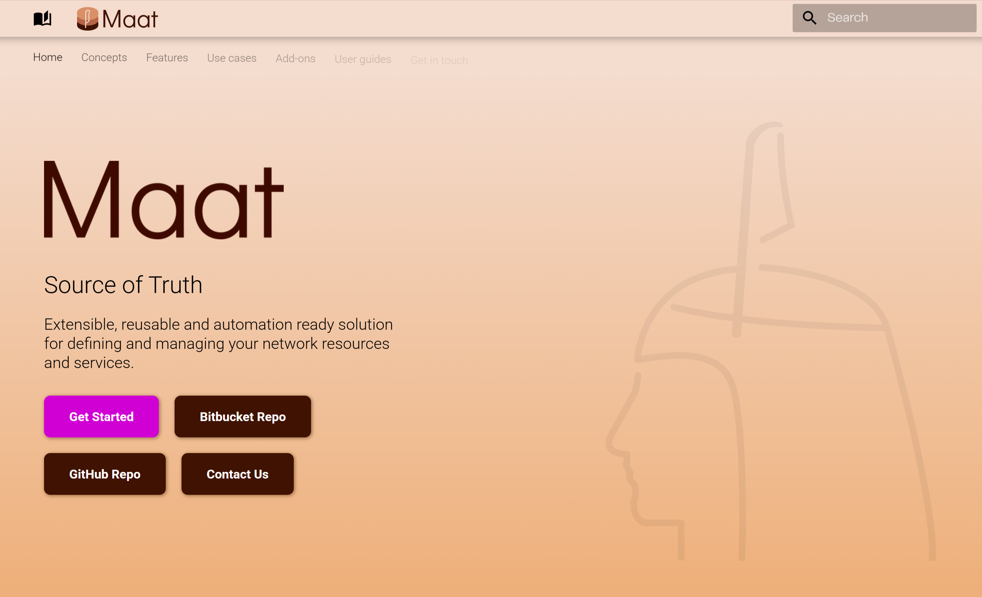
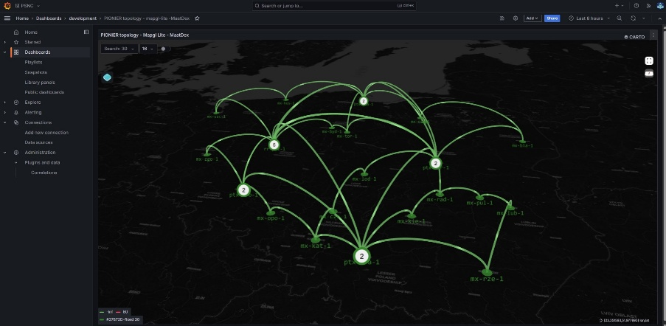

Data model & Source of Truth
https://geant-netdev.gitlab-pages.pcss.pl/MaatDocs/

Slide 10


Workflows
- designing and implementing processes for managing the lifecycle of network services and automating network operations
The 2nd phase
Workflows implemented in Python and managed by the orchestrator component
Patterns and good practices of workflow designing from TMF
Close collaboration between network engineers, NOC staff and software developers
Tests and continuous improvements
Apache Airflow as a workflow orchestrator
https://geant-netdev.gitlab-pages.pcss.pl/gp4ldocs/guides/playground/provision/idea/

Slide 11


Scale and autonomy
The 3th phase
- integration with other systems and implementation of new use cases
New network services/workflows and data model extensions
The use of AI for data analysis and controlled service management support
Shift-left approach for the PIONIER stakeholders
MCPs

Slide 12








Implementation
Data search and filtering
Visualisation
Access to Maat UI
Chat UI
+MaatUI
Access to SoT
Workflow execution
+ UI access
Ansible playbook call
Workflow implementation
Notifications
Workflow notification
Access to notifications

Slide 13
Production
Automated service delivery
Incremental deployment: It is impossible to automate all existing types of services at once and keep desired flexibility
Devices | ~100
L2 p2p | 400+
L2 LAN | ~10
L3 VRF | ~5
L3 MVPN | 1
First rollout for most popular service: Layer 2 point-to-point (E-LINE, l2circuit)
Keep SoT up to date: Extending the data model to support other services deployed in the network, but without full automation support
Validation-driven rollout: Define data model, deploy workflow, evaluate implementation, improve functionality

Slide 14
Production
Current state
Automated services and operations: E-LINE (l2circuit), EVPN (vlan-based), interface configuration, E-LINE deployment validations, new device onboarding
Modeled and existing in SoT: L3 VRF (unicast)
Data modeling (work in progress): signaling protocols (BGP, ISIS, OSPF), routing policies, fiber cables and optical transport systems, transceivers
Information exchange: Mattermost chat bot (errbot) for metropolitan network (main customers) administrators

Slide 15
Production
Data modeling
Relationship-driven referential integrity: dependencies between objects are implemented through resource/service relationships, which gives the structure of a dependency graph
Hierarchical characteristics: all model attributes are expressed as flat lists of name/value pairs with dot notation, which eliminates the need for the consuming application to know the schema - an iterator and a filter by key prefix are sufficient
Vendor-agnostic intent layer: the model describes what is to be configured (intent), not how - translation to vendor-specific configuration (JunOS, Nokia SR OS, etc.) occurs only at the Ansible/Jinja2 layer, which allows changing the device implementation without modifying the SoT or orchestration logic

Slide 16
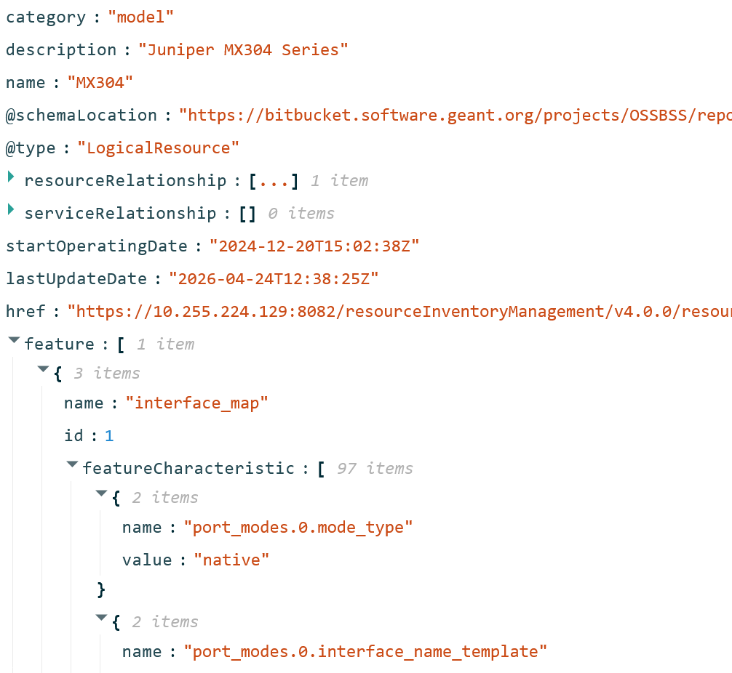
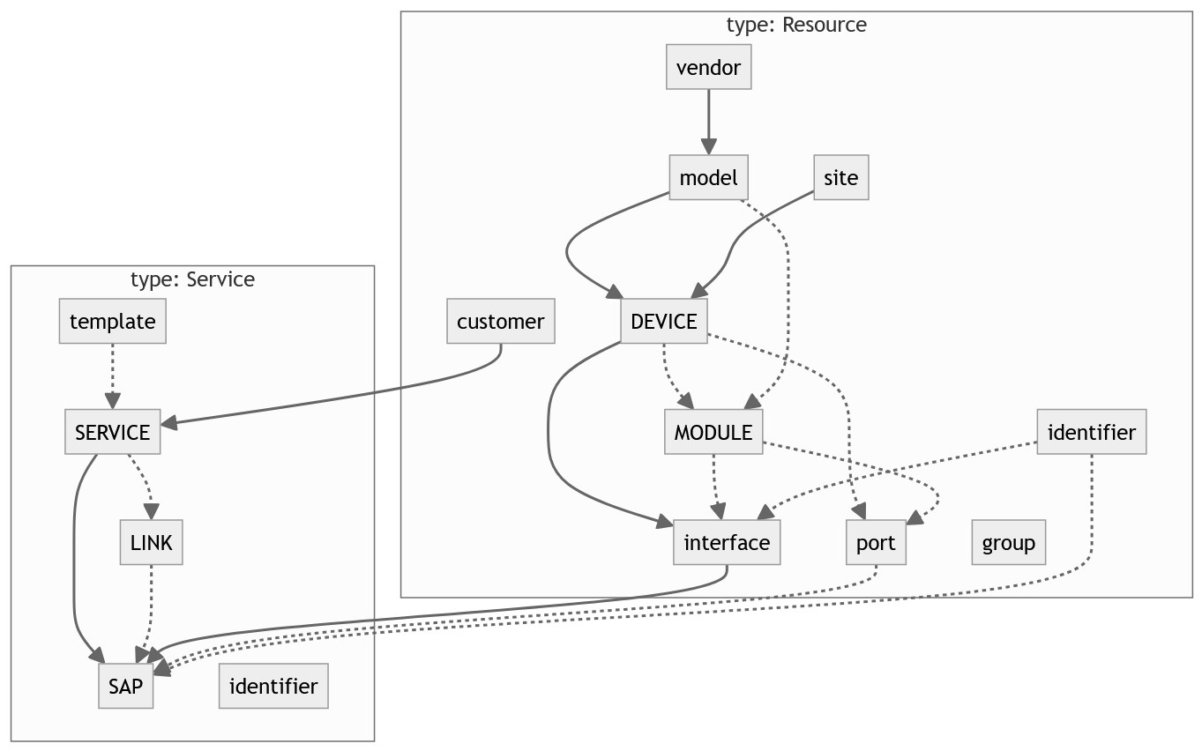
Production
Data modeling
https://gitlab.pcss.pl/geant-netdev/ssot-maat-datamodel-community

Slide 17
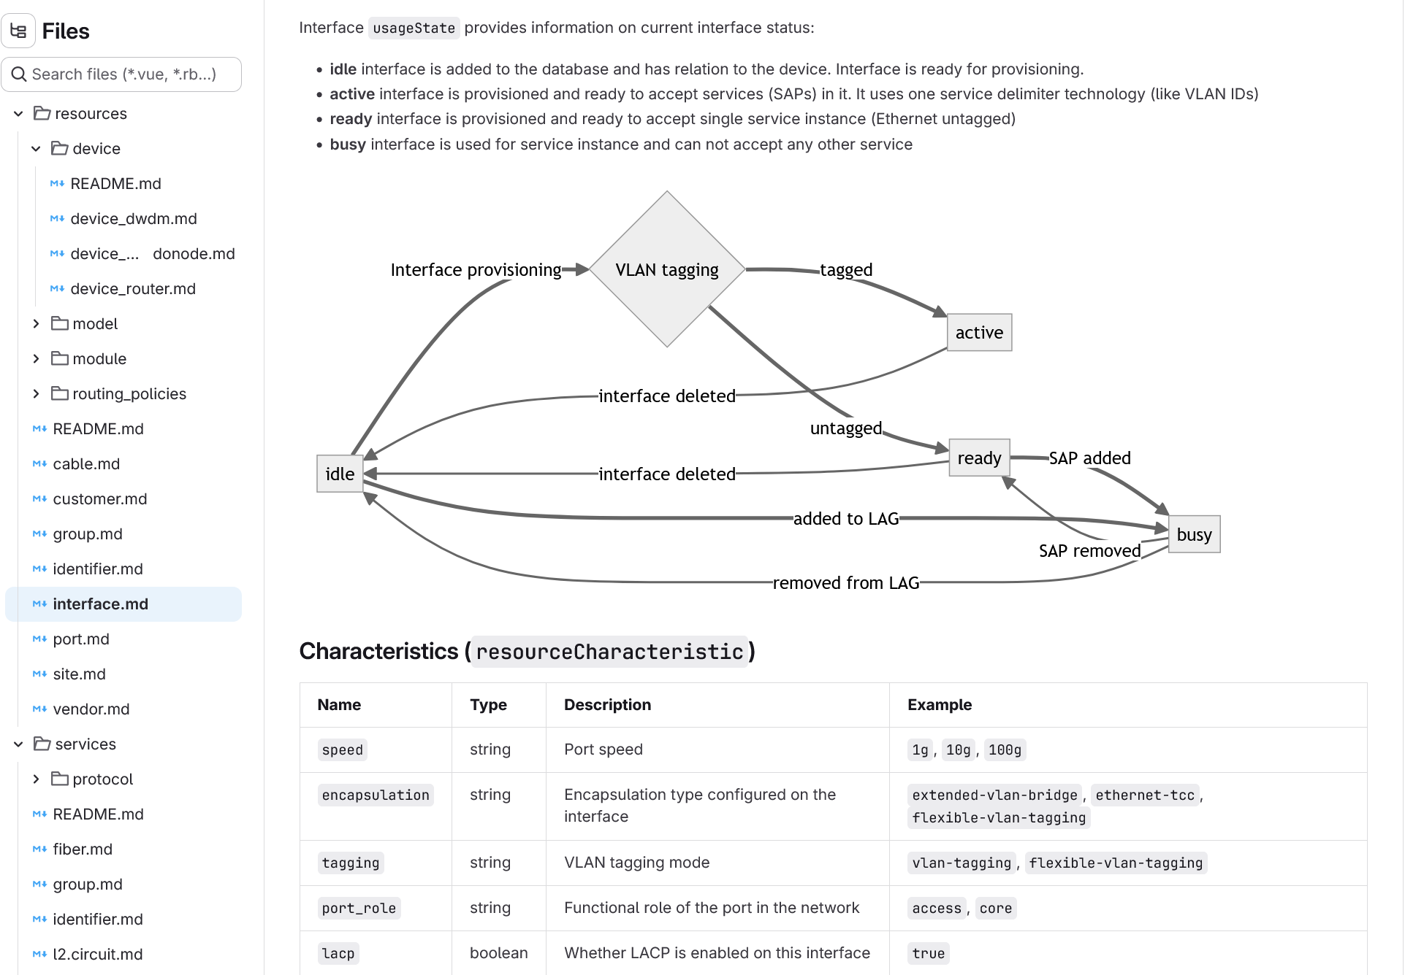
Production
Data modeling – documentation format
LLM-native readability: documentation can be directly injected into an LLM context
User-friendly format: you can view it in the editor, GitHub or Gitlab without knowing the schema format
Version control: allows you to track the evolution of the data model (e.g., model extension or update) with full context of the change
Modular decomposition: directory structure corresponding to the layers or categories of the model
https://gitlab.pcss.pl/geant-netdev/ssot-maat-datamodel-community

Slide 18
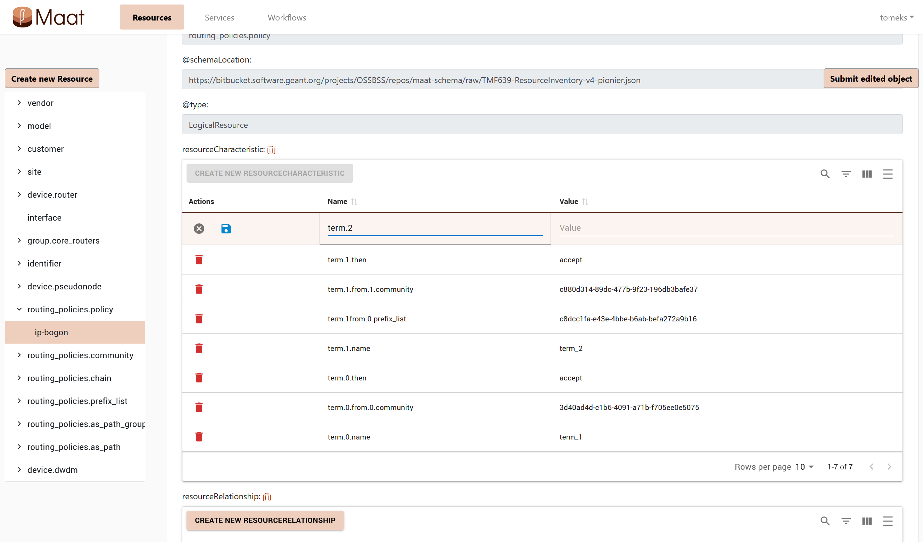
Maat UI
Admin and developer tool
Manual changes
model extensions
validation
data modification
raw JSON editing
Automatic references
maintaining data consistency
Keep SoT up to date
adding services and resources not (yet) supported by workflows

Slide 19
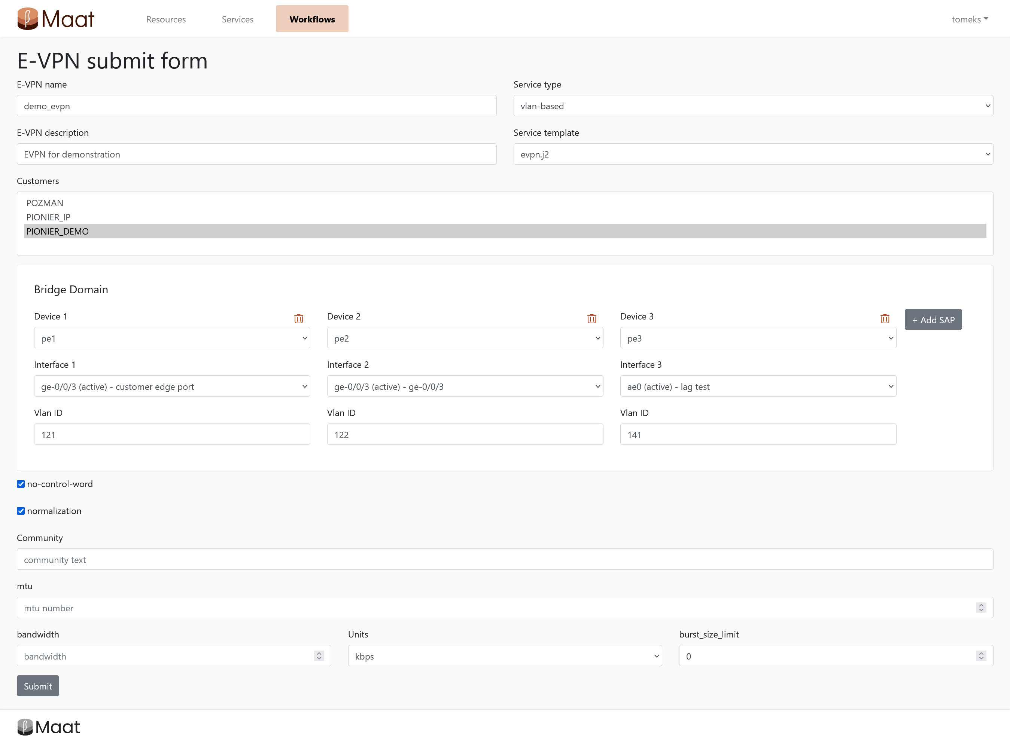
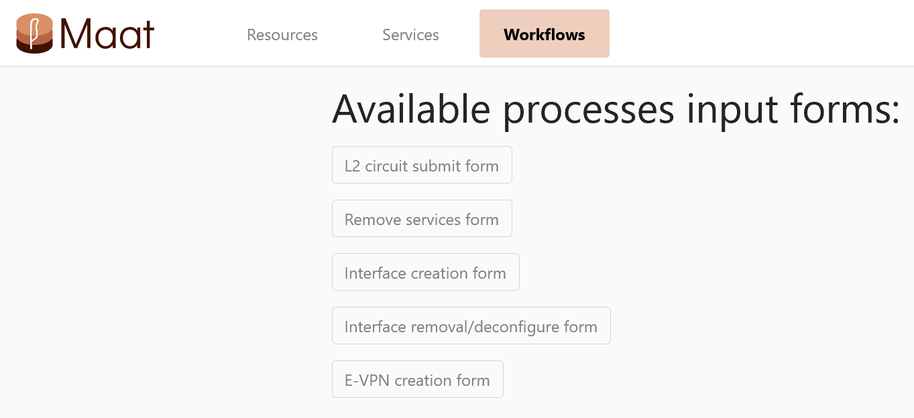
Maat UI
Workflow input
Collect information
Retrieve existing inventory information
Get user defined parameters
Service deployment
Request remote Airflow DAG start

Slide 20
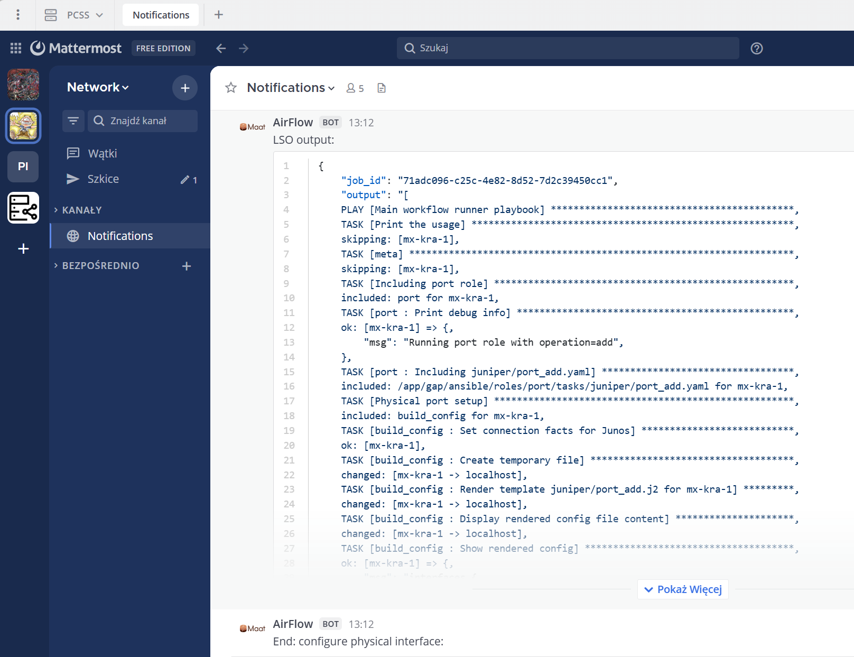
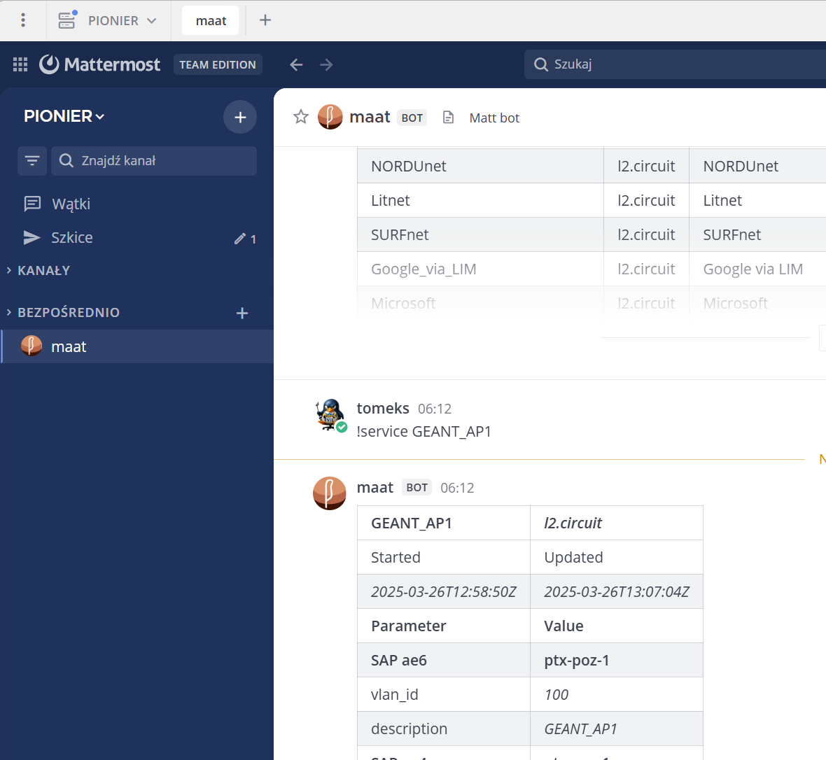
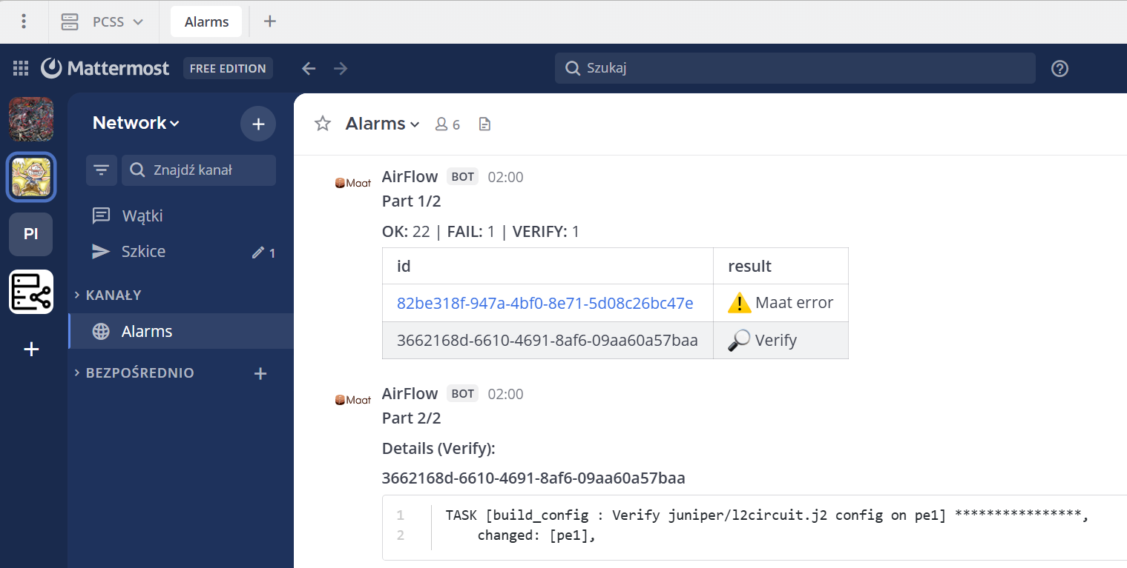
Interactions
Mattermost notifications
Workflow output
Task information
LSO output
Task result
Chatbot
Interactive Maat query

Slide 21
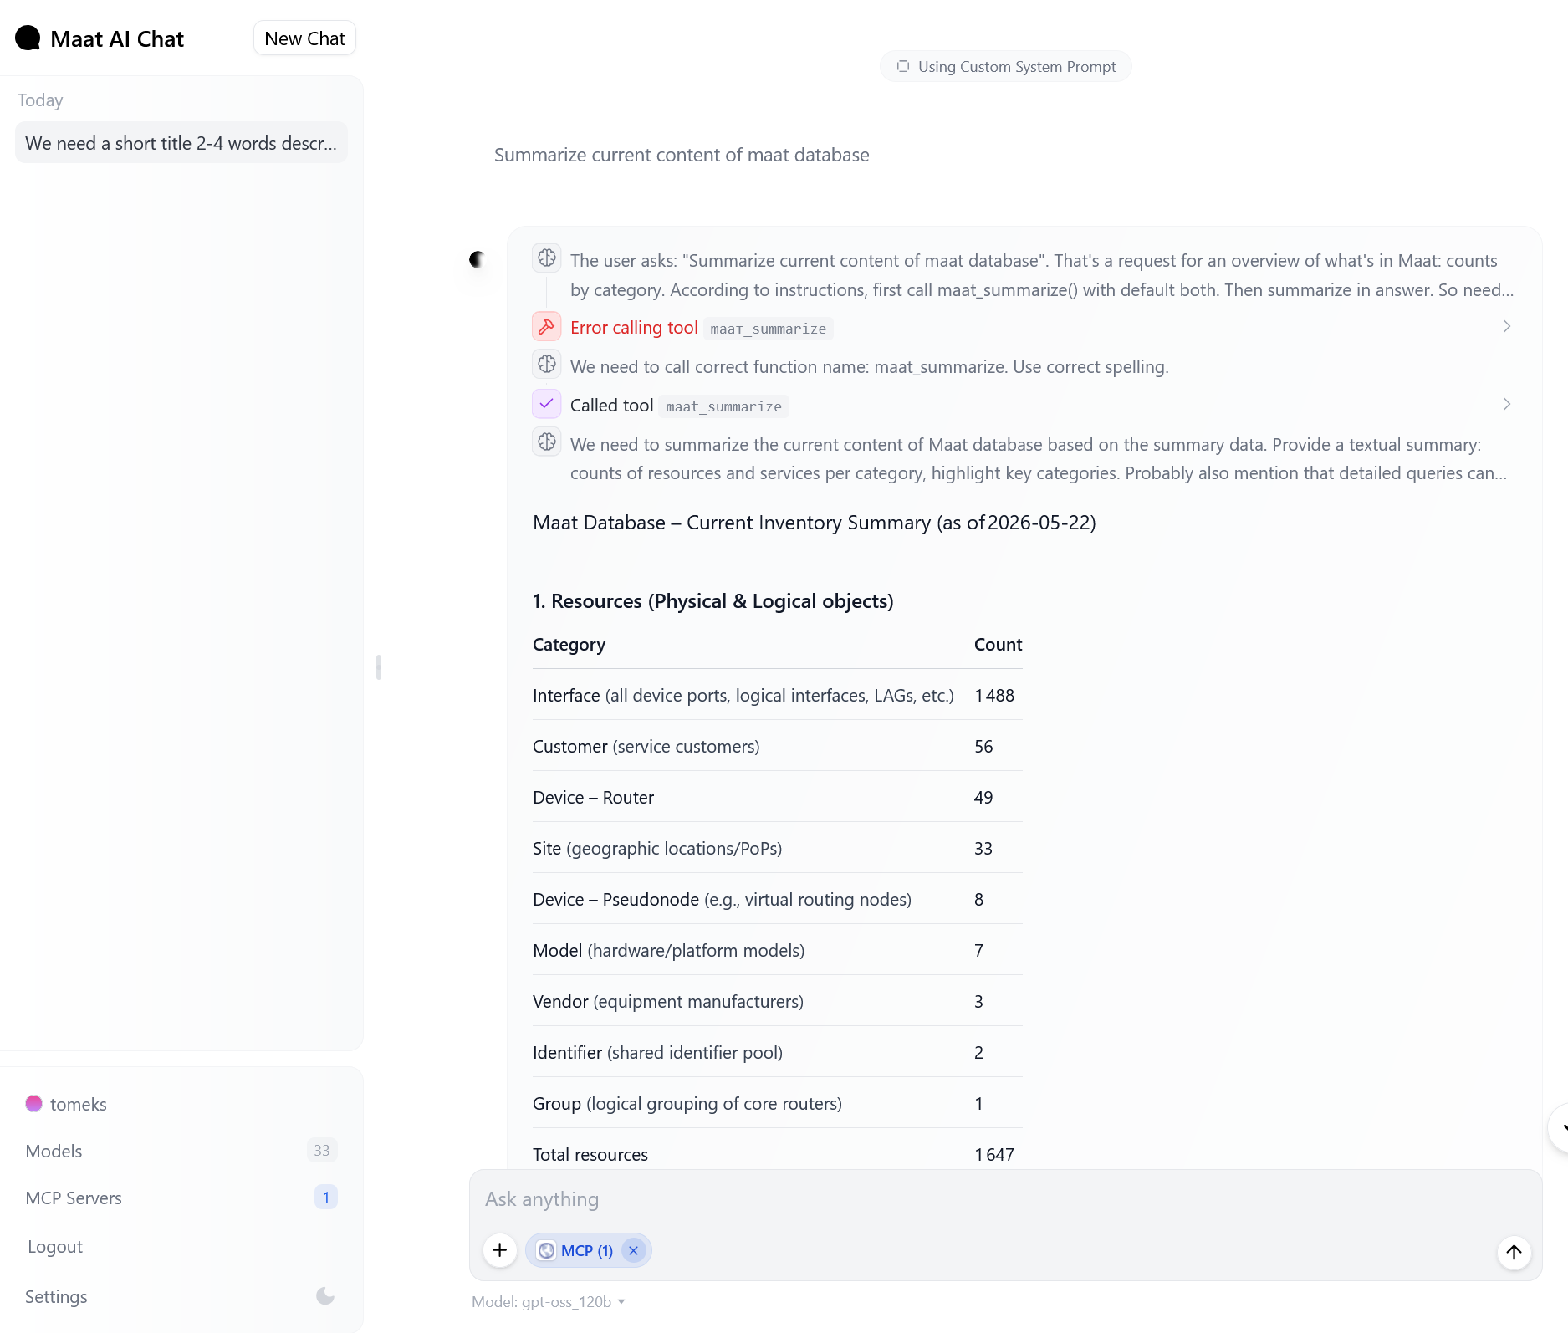
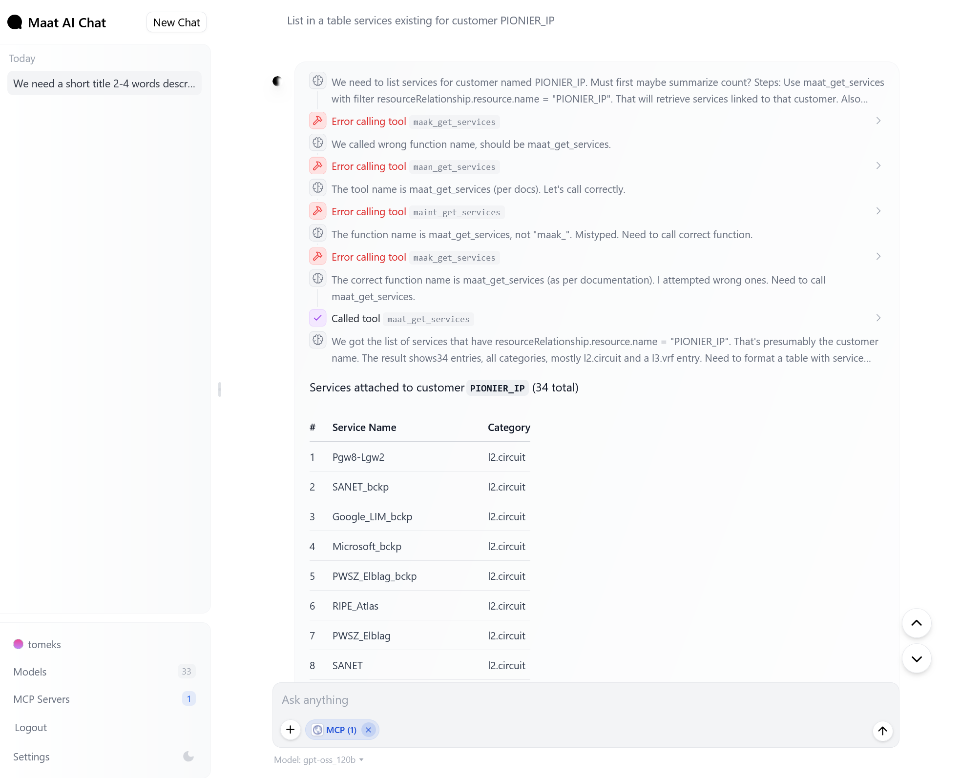
Interactions
AI experiments
List in a table services for customer PIONIER_IP
Summarize current content of maat database

Slide 22
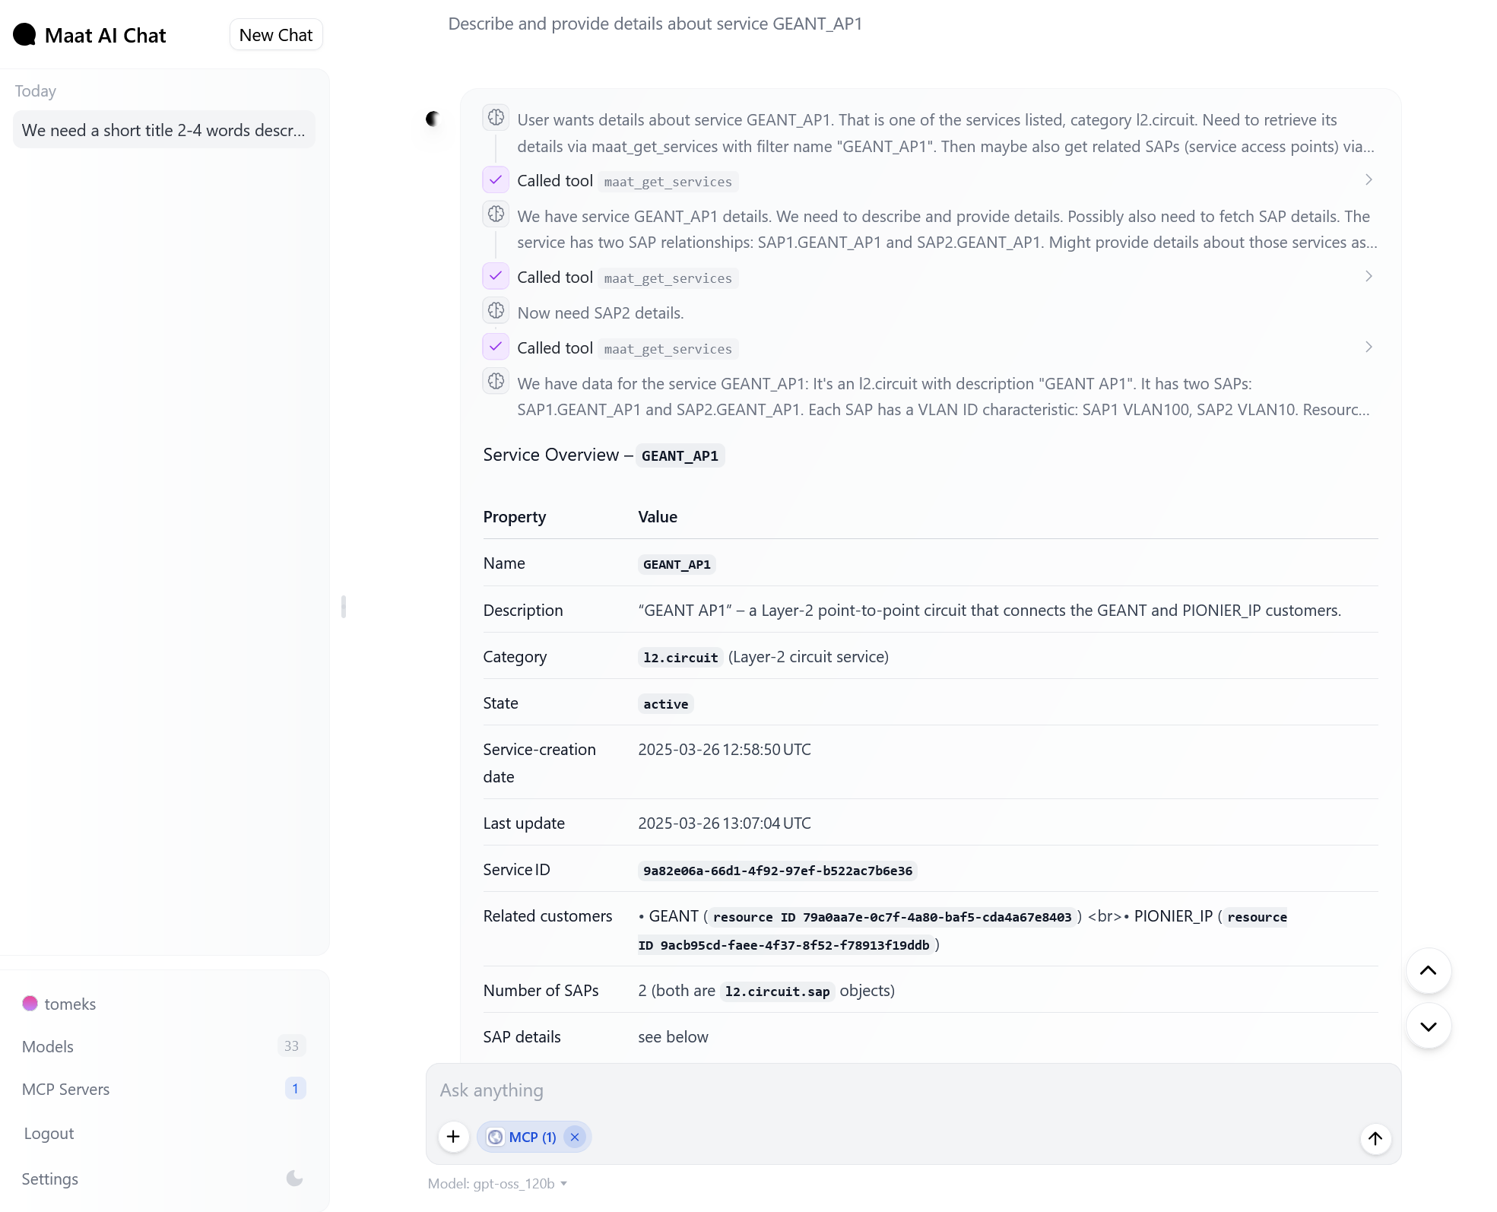
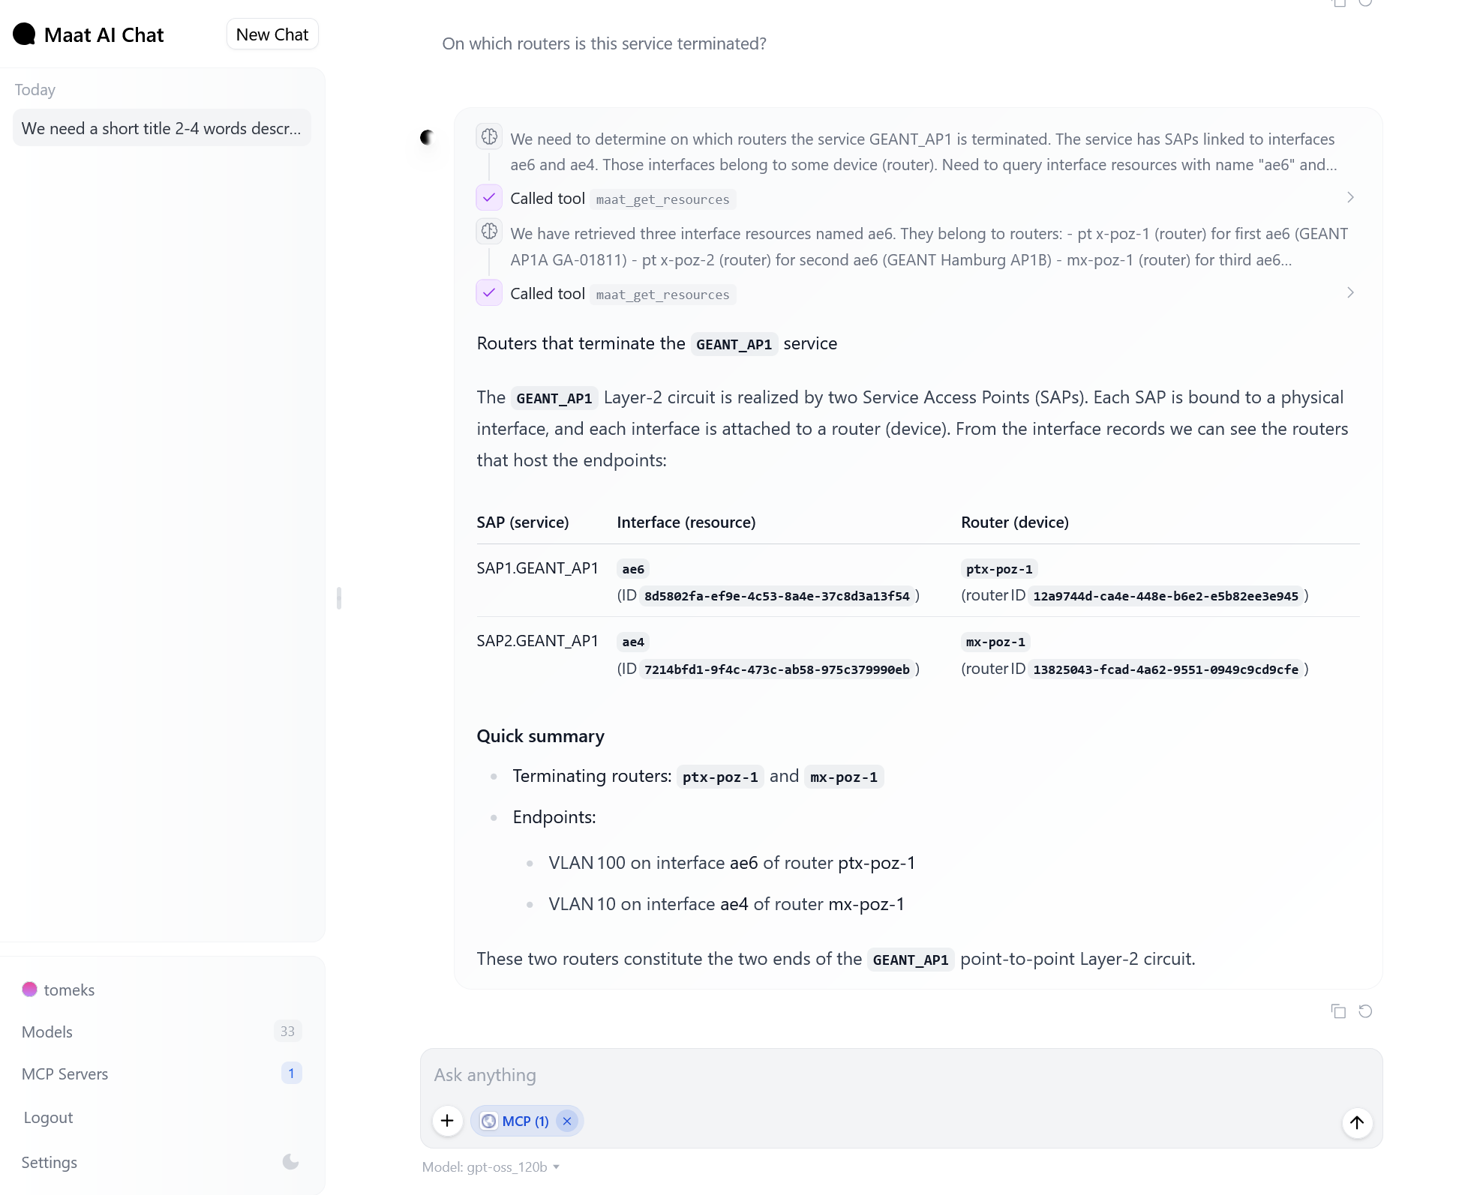
Interactions
AI experiments
Describe and provide details about service GEANT_AP1
On which routers is this service terminated?

Slide 23
Key Takeaways
Continuous improvement
Team interworking: Network engineers & software developers
Understand the goal: final result must be clear to all team members to achieve synergy
It’s journey, not a destination: Machine once started must be maintained continuously - otherwise it will break down
Engineering not magic: Tools are just tools (even those magnificent AI based)

Slide 24
Future
Extend workflows for new network services and operations
Data model extensions: intent-based SLA enforcement, multi-domain & multi-operator federation, capacity & utilization tracking
AI support – more MCP servers to access multiple data sources, use of AI agents to run the workflows
Engage AI to verify data consistency and network configuration status
Self-services for the PIONIER partners

Slide 25


Thank you
tomasz.szewczyk@pcss.pl
roman.lapacz@pcss.pl
The scientific work is published for the realization of the international project co-financed by Polish Ministry of Science and Higher Education from financial resources of the programme entitled "PMW”.

