Slide 1
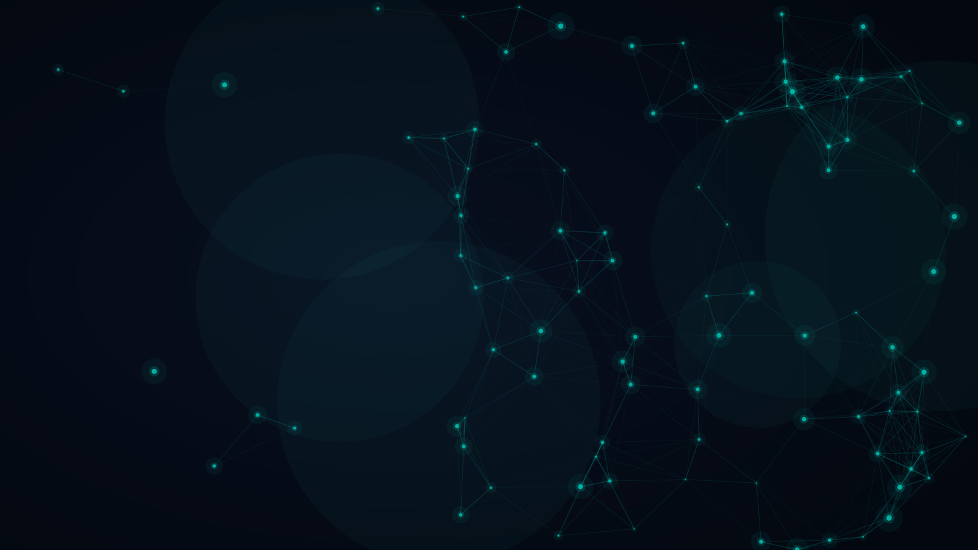
TNC26 · HELSINKI · JUNE 2026
Beyond Configuration
Rethinking
Network
Orchestration
With Generative AI
Sonja Filiposka · UKIM
Roman Łapacz · PCSS
Notes:
Emphasise three tensions throughout the deck:
AI is powerful, but networks punish ambiguity.
Configuration generation is useful, but orchestration is the real bottleneck.
Autonomy is exciting, but guarded autonomy is the only responsible path.

Slide 2




Networks are complex.
Teams are small.
AI changes this.
AUTONOMOUS
3
AUTOMATED
2
ASSISTED
1
Agentic
Orchestration
Workflow
Orchestration
Config
Management
AI helps engineers generate
and validate configurations
AI generates full workflow
pipelines from intent alone
AI reasons, decides and acts
on the live network

Slide 3


WHY NOW
Three Forces Converging
LLM CAPABILITY
NREN PRESSURE
OPEN STANDARDS
Models that
actually work
More network,
fewer engineers
The API surface
is finally ready
Production-grade models now widely available
On-demand services expected as standard
YANG + NETCONF + RESTCONF widely deployed
High accuracy on non-complex network config
Multi-vendor, multi-domain complexity growing
TM Forum ODA providing service model layer
RAG + function calling close the domain gap
Smaller NRENs can't staff deep automation teams
A2A, MCP — agent interoperability emerging
Cost dropping — inference now viable at scale
Manual config is the bottleneck, not the network
CMDB providing AI a grounded source of truth
Notes:
Demand for on-demand services is growing.
Network complexity is growing.
Automation expertise is not growing at the same speed.

Slide 4


CONFIGURATION MANAGEMENT
What GenAI
Can Do Today
Intent → Config
AI Co-pilots
Natural language to vendor-specific device configurations (NETCONF, CLI, YANG)
Interactive assistants that guide engineers step by step, reducing cognitive load
Validation & Fix
Multi-vendor Bridge
AI flags inconsistencies, suggests alternatives, and validates against policy
Unified intent layer across heterogeneous infrastructure — Cisco, Juniper, Nokia…

Slide 5
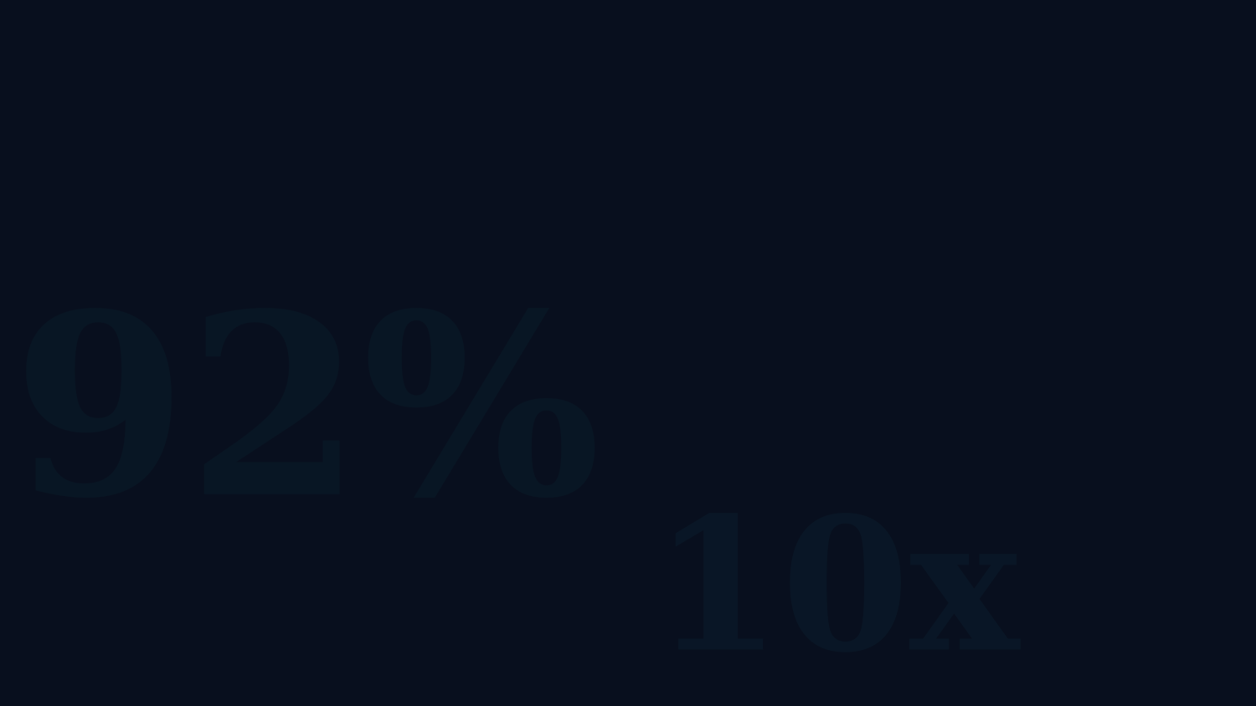
WHAT RECENT RESEARCH SHOWS · 2023–2025
92%
100%
10× / 6×
Static NAT success (narrow task)
LLM + RAG + Function Calling
Config translation / policy impl.
(verified prompt programming)
zero-touch config accuracy
(LLM-NetCFG, small network, non-complex tasks)
5-7
min
⚠
Strong results when tasks are structured, scoped and verified.
Non-complex config intents
handled (LLM-NetCFG)
Complex tasks still need
decomposition, verification
and human approval
Complexity still breaks naive autonomy.
Notes:
AI can generate configurations with impressive results for simple and structured tasks.
But the literature is clear: complex, multi-domain, safety-critical tasks still require decomposition, verification and human oversight.
This matters most for smaller NRENs and campus teams that cannot dedicate large engineering teams to orchestration.

Slide 6
Configuration generation is impressive.
But networks do not
need more snippets.
They need safe, auditable,
end-to-end change workflows.

Slide 7
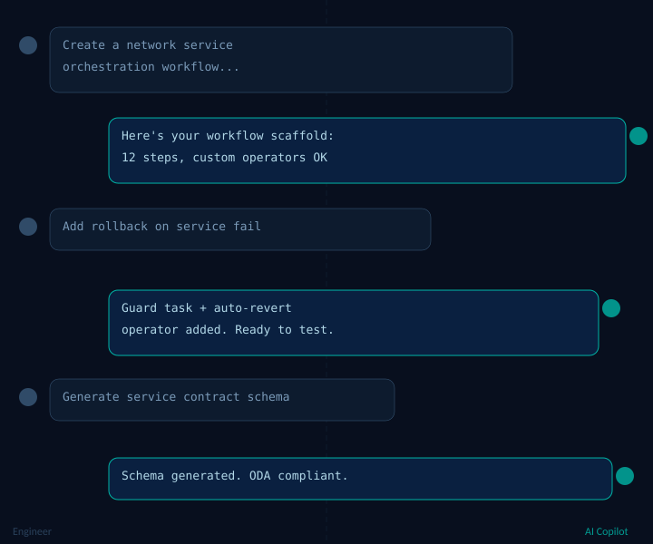
WORKFLOW GENERATION
"Vibe-Coding"
Orchestration
Express intent. AI drafts the workflow.
You review, validate, deploy.
Phase 1
Holistic Prompting
Full-context prompt → standards-aligned workflow blueprint
Phase 2
Granular Refinement
One function at a time → auditable incremental patches, engineer approves each step
Human oversight at every step: AI suggests, engineers decide and validate
Notes:
We used AI not to configure a router, but to help build the machinery that provisions services.
Generated artefacts included TMF-style service schema, Airflow DAG structure, custom operator skeletons and API interaction logic.

Slide 8

RESULTS FROM OUR EXPERIMENTS
What AI Actually Built
TM Forum Data Models
TMF-compliant service schemas
Dynamic attribute mapping
Reusable across environments
ODA-aligned blueprints
Orchestrated Workflows
Complete workflow generation
Custom operators & tasks
API interaction code
Error handling & rollback
DAYS → HOURS
Development time slashed
Standards-aligned output
Consistent structure
Lower barrier to entry
Notes:
AI generates configs.
AI generates workflows.
AI can assist controlled network actions.
But only inside guarded loops.

Slide 9
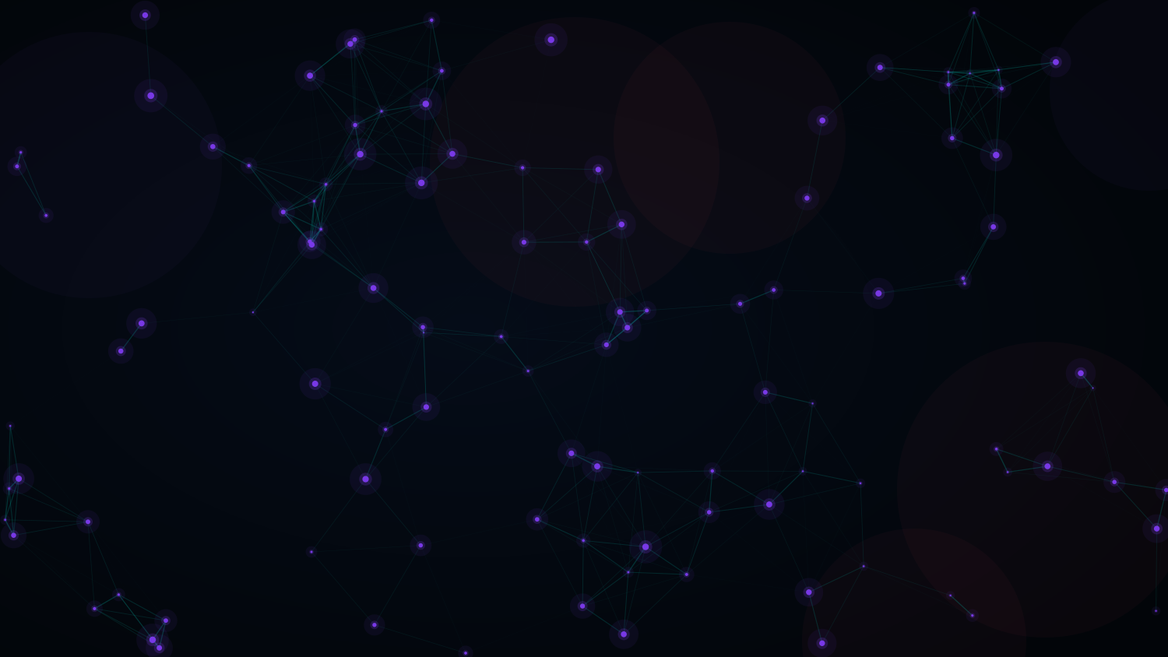
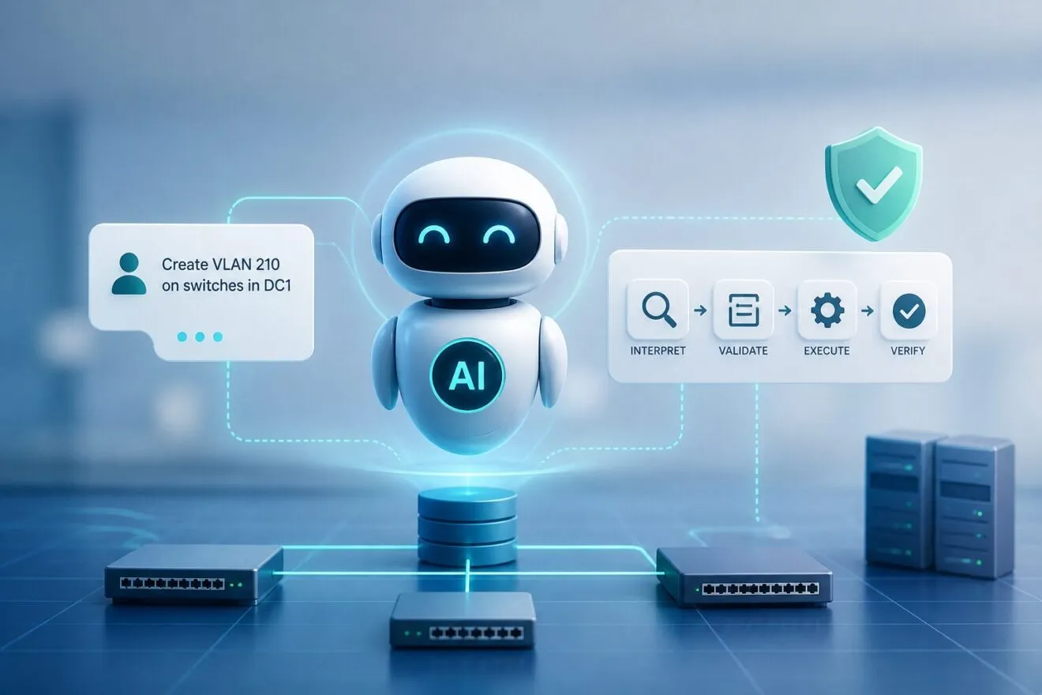
THE NEXT LEVEL
AI generates configs
AI generates workflows
AI acts on
the network.
Observes · Plans · Decides · Acts
The question is not:
"Can an AI agent change the network?"
The real question is:
"Can we design the workflow so that when the AI is wrong, the network is still safe?"
Notes:
The guardrail is not a policy statement.
It is executable architecture.

Slide 10
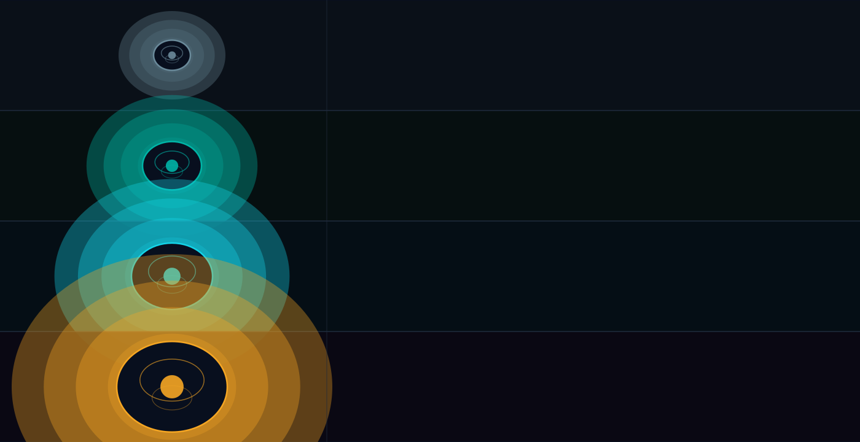
AGENTIC AI · THE SOPHISTICATION SPECTRUM
Why Guarding Matters
approach to agentic network ops
1
Just let the LLM call the network API directly
2
Add a try/catch and retry on failure
3
Validate every output — guard before every write
4
Normalise · Validate · Guard · Approve · Verify
at every agentic step — automatically

Slide 11

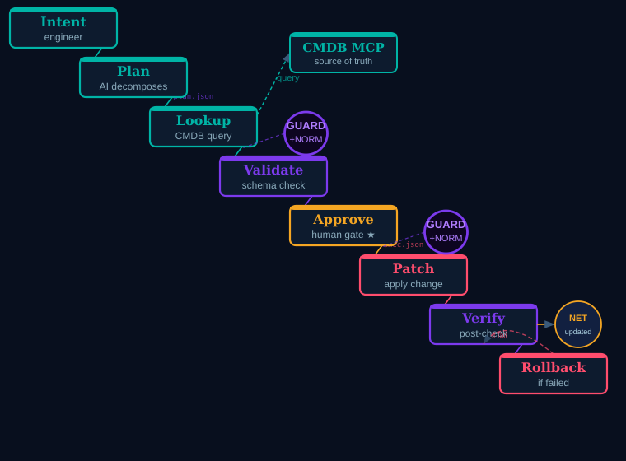
AGENTIC ARCHITECTURE
Multi-Agent Guarded
Apply a service change on a router — how agents collaborate to get it done safely
Agent Contracts
Agents speak structured JSON —
not freeform text
plan.json
{
"action": "add_vlan",
"device": "core-rtr-dc1",
"vlan_vid": 40,
"source": "cmdb://dc1",
"ok": true,
"approval": true
}

Slide 12
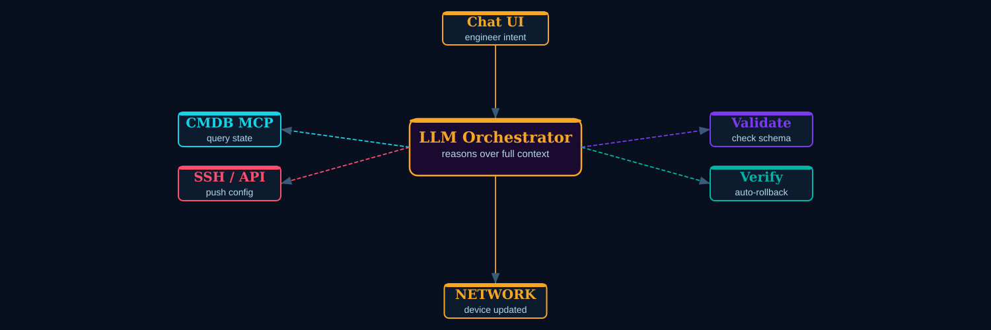
ALTERNATIVE PATTERN
Single Orchestrator
One LLM reasons over the full context and decides the next tool call each step
The Good
The Bad
The Ugly
Fast, simple, impressive demo value. Great for rapid prototyping.
Harder to audit — more hidden reasoning, more dependence on prompt discipline.
The model may skip a step, call tools in the wrong order, or produce a convincing but unsafe answer.

Slide 13
PLATFORM COMPARISON · SAME TASK · DIFFERENT PHILOSOPHY
The Engine Matters
n8n
VS
Langflow
Graph-based routing
LangChain agent loop
Wait nodes & deterministic flow
LLM decides next tool call
~40 nodes for guarded pipeline
~8 nodes for orchestrator
Explicit routing between agents
Emergent agent behaviour
Production rigour
Rapid prototyping
Notes:
n8n: deterministic flow control, better for guarded pipelines.
Langflow: excellent for rapid agentic experimentation, best with Python tools enforcing safety-critical logic.

Slide 14
LESSONS LEARNED FROM HANDS-ON EXPERIMENTS
Six Things We Learned
1
Works for blueprinting
2
Guarding is essential
Design & scaffolding phases — not yet for fully autonomous production deployment.
LLMs are probabilistic — architecture must catch failures visibly, never silently.
3
Human stays in loop
4
Preprocessing is key
Every PATCH to the network requires explicit approval.
A deliberate design choice.
Structured inputs + RAG + vendor context dramatically improve AI output quality.
5
Build skills, not just workflows
6
Barrier lowered
Agentic workflow knowledge can be packaged as a skill and shared across the community.
Days → Hours for workflow generation. Any NREN can now participate in orchestration.
Notes:
1 AI is strongest before production execution.
Structure beats clever prompting.
Deterministic guards are non-negotiable.
Human approval must be part of the architecture.
Platform execution models matter.
The barrier is lower, but responsibility is not.

Slide 15
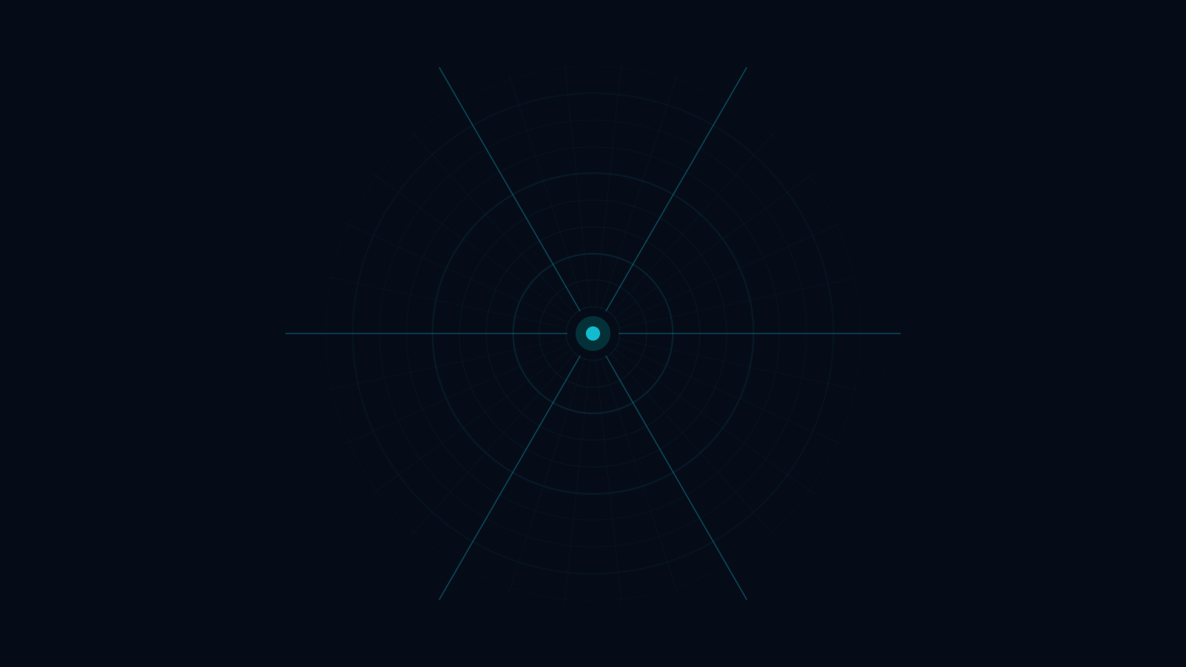
FOR THE R&E COMMUNITY
Adopt · Experiment · Lead
Today
Near Future
Horizon
AI config generation
Guarded agentic network ops
Internet of Agents for NRENs
Workflow scaffolding in hours
AI-driven fault remediation
Cross-domain orchestration
Standards-aligned blueprints
Dynamic service adaptation
Autonomous service lifecycle
AI co-pilot for engineers
Multi-platform agent chains
Open agent marketplaces
Notes:
The future is not an AI that magically runs the network.
The future is a network operations stack where intent, source of truth, workflow engines, validation logic and human approval are connected by AI — carefully, visibly and safely.

Slide 16
YOUR ADOPTION PATH
How to Start
Do not start with autonomous networks. Start with reusable, guarded, standards-aligned workflow patterns.
1
ASSISTED
2
AUTOMATED
3
AUTONOMOUS
Start with copilots.
Move to workflow scaffolding.
Test agents only with contracts, guards, approval and rollback.
AI suggests. Engineer decides. Every output reviewed before anything touches the network. Zero operational risk.
Express intent. AI generates the workflow scaffold. Review and validate every output before deployment.
Guard before every write. Human approval for every change. Auto-rollback on failure. If you cannot explain what the agent did — do not deploy it.
Risk: none · Reversibility: immediate
Risk: low · Reversibility: review before apply
Risk: contained · Reversibility: by design
Notes:
Beyond configuration means beyond snippets: toward guarded, reusable orchestration patterns for the R&E community.

Slide 17
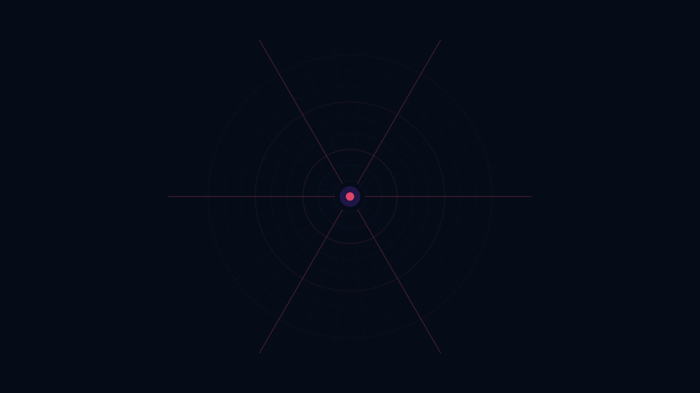
Thank You
Questions & Discussion
Documentation:
https://geant-netdev.gitlab-pages.pcss.pl/gp4ldocs/guides/playground/
Agentic AI tests conducted using open-source LLMs provided by
The presentation was prepared with the assistance of Generative AI
— in the spirit of the topic —

