Slide 1
Context-Aware Network Orchestration
Modelling Commercial Peers in GÉANT
Aleks Kurbatov, Karel van Klink
Helsinki, Finland
June 2026

Slide 2
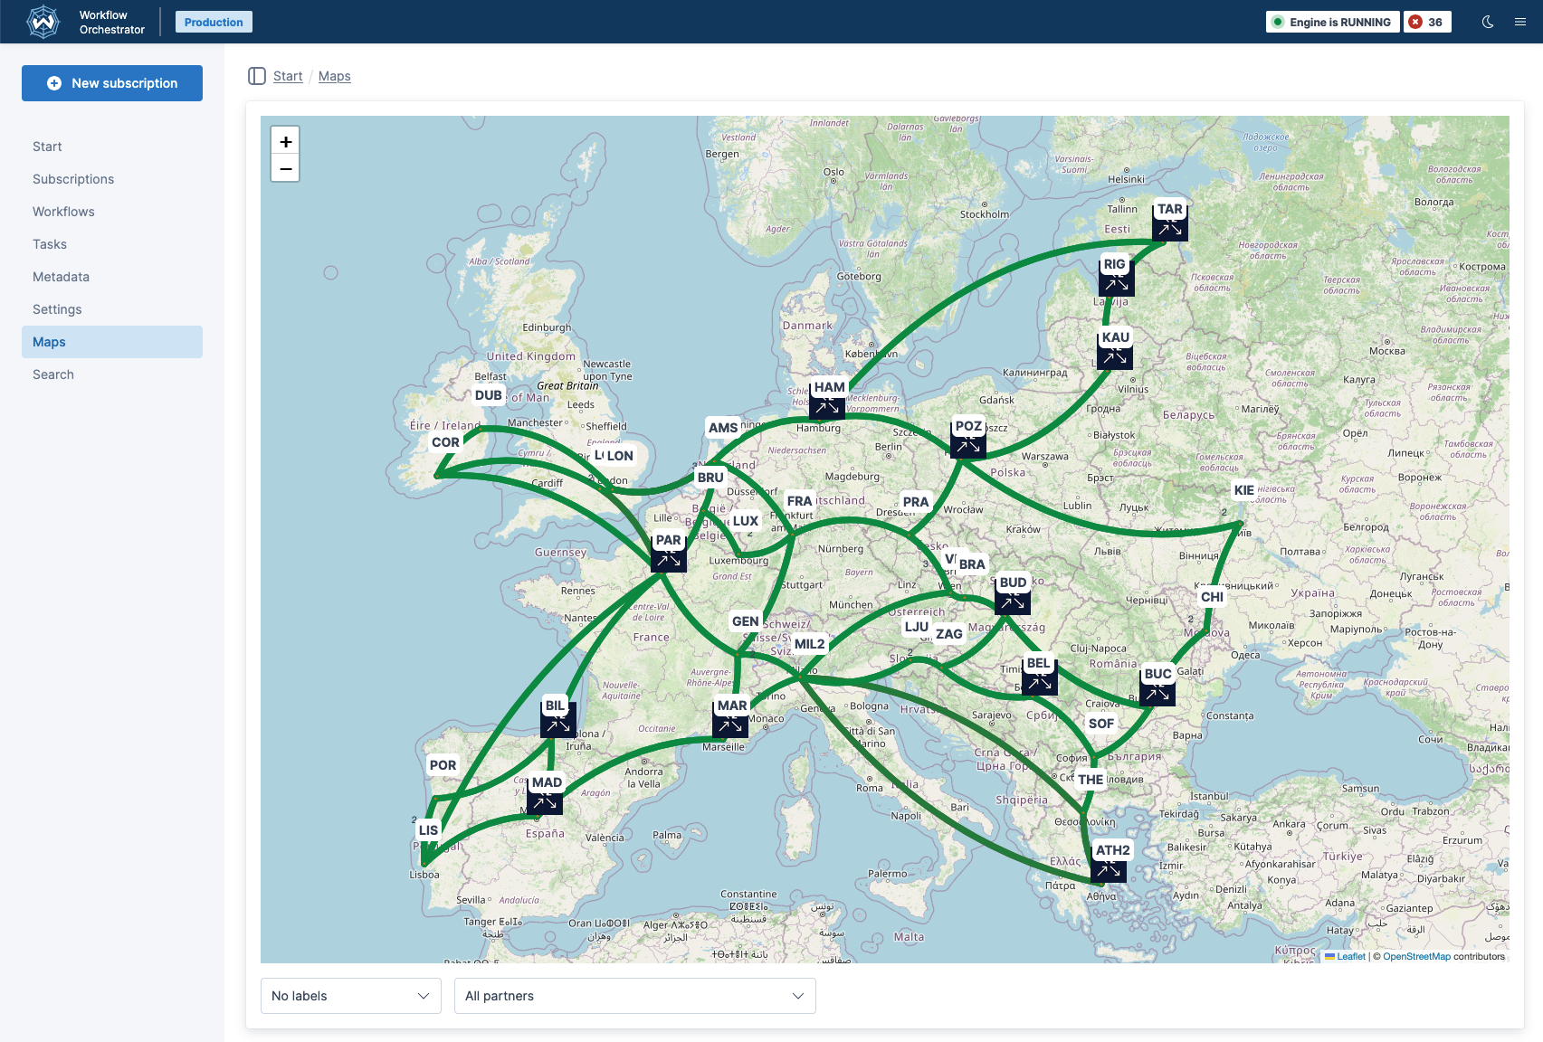
Network Orchestration In GÉANT

Slide 3
Finishing The Migration One Site At A Time

Slide 4
Finishing The Migration One Site At A Time
LON
FRA
AMS

Slide 5
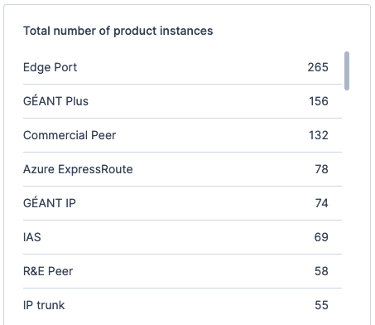


Network Orchestration In GÉANT

Slide 6
Modelling Peering Locations

Slide 7
Modelling Per Peering Point

Slide 8
Modelling Per Peering Point?

Slide 9
Multiple Peering Locations…

Slide 10
…Means Meeting In Different Places

Slide 11
Which Makes Updates Painful

Slide 12
Updates Take Place In Every Peering Location

Slide 13
We Model Per Organization, Not Per Port

Slide 14
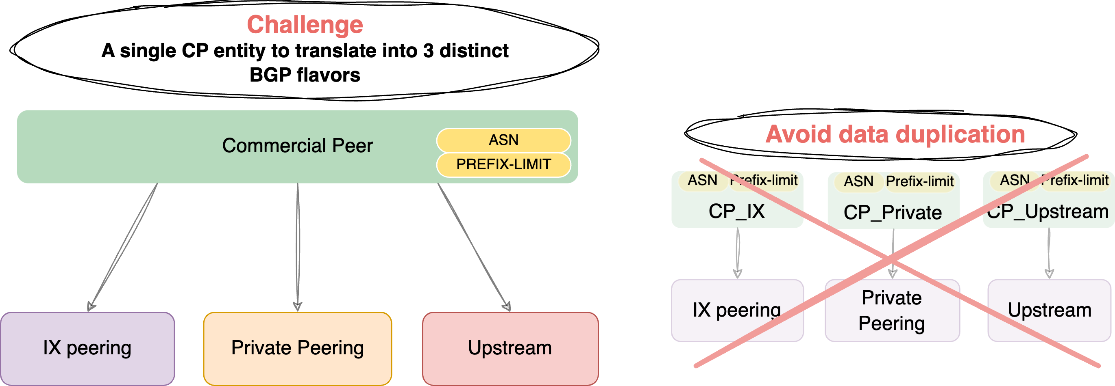
The Problem & Model
Notes:
As my colleague mentioned, we want to model the **Commercial Peer (CP)** as a single entity. It holds core attributes like the ASN and Prefix Limit, but it can have **multiple connections** to different placement ports: an IX Port, a Private Peer Port, or a Transit Provider Port.
This diagram shows our chosen model on the left, and the **'anti-pattern'** we specifically wanted to avoid on the right: data duplication.

Slide 15
Peering Connection Product Models

Slide 16
Peering Connection Product Models

Slide 17
One Update, One Workflow

Slide 18
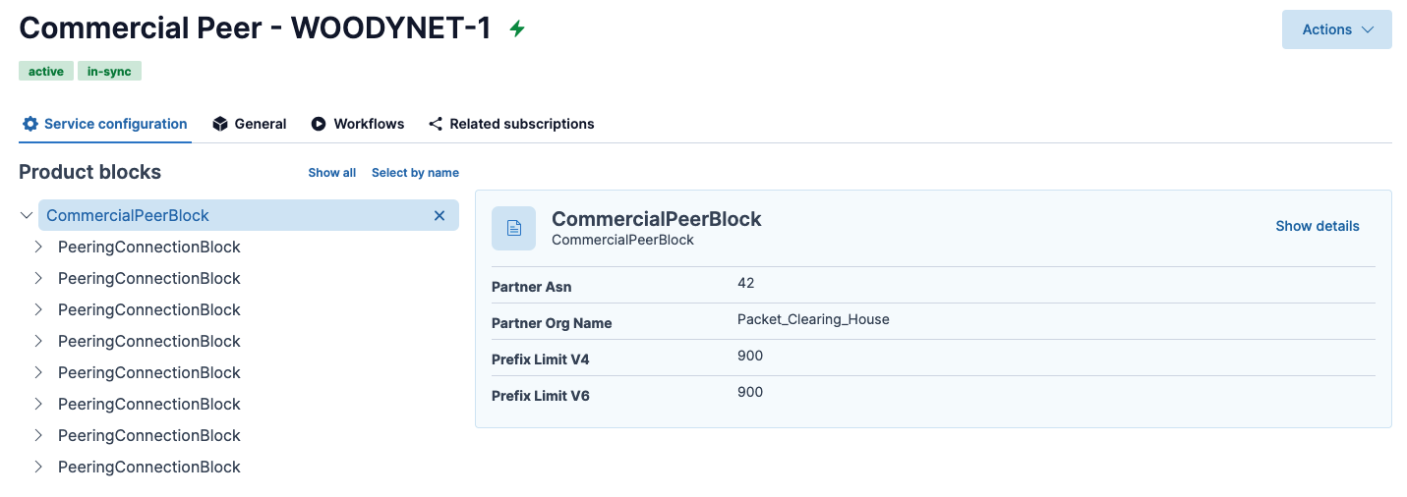
Example

Slide 19
Example

Slide 20
Example

Slide 21
Where Do We Peer With Partner X?

Slide 22
Best UX Ever

Slide 23
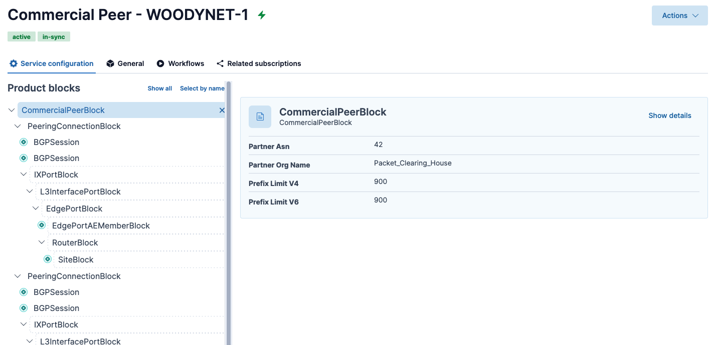
It’s Somewhere In Here, I Promise

Slide 24
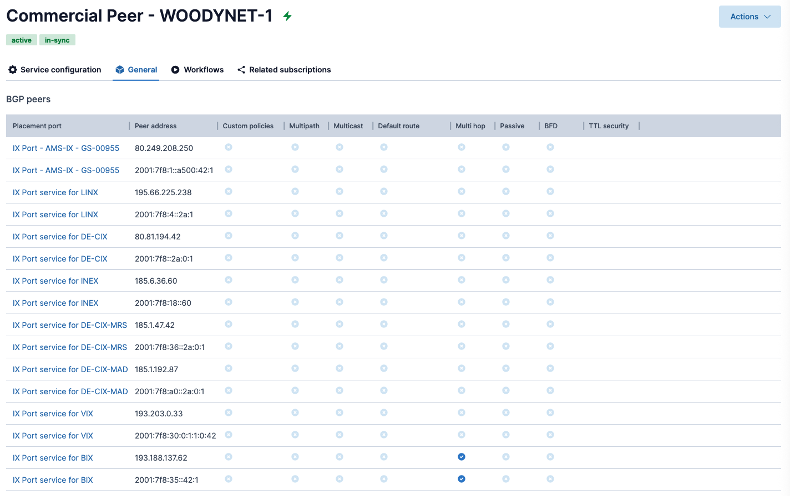
Custom Overview Of All Peers

Slide 25
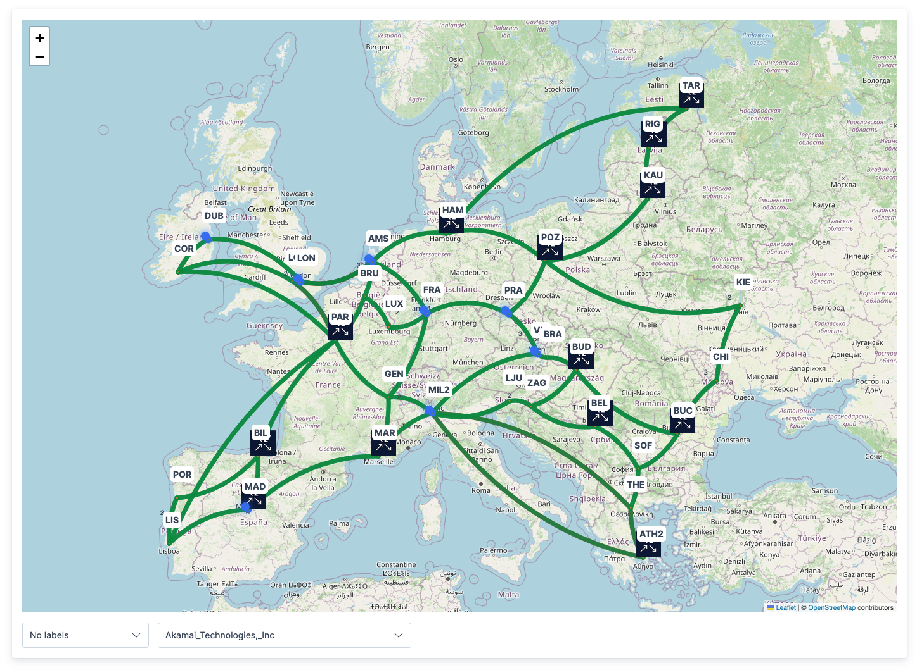
All Peers Are On The Map

Slide 26
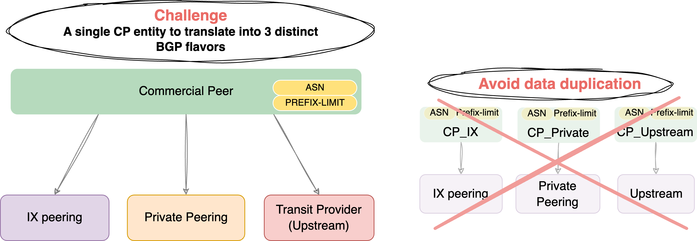
The Problem & Model
Notes:
As my colleague mentioned, we want to model the **Commercial Peer (CP)** as a single entity.
It holds core attributes like the ASN and Prefix Limit, but it can have **multiple connections** to different placement ports: an IX Port, a Private Peer Port, or a Transit Provider Port.
This diagram shows our chosen model on the left, and the **'anti-pattern'** we specifically wanted to avoid on the right: data duplication.

Slide 27
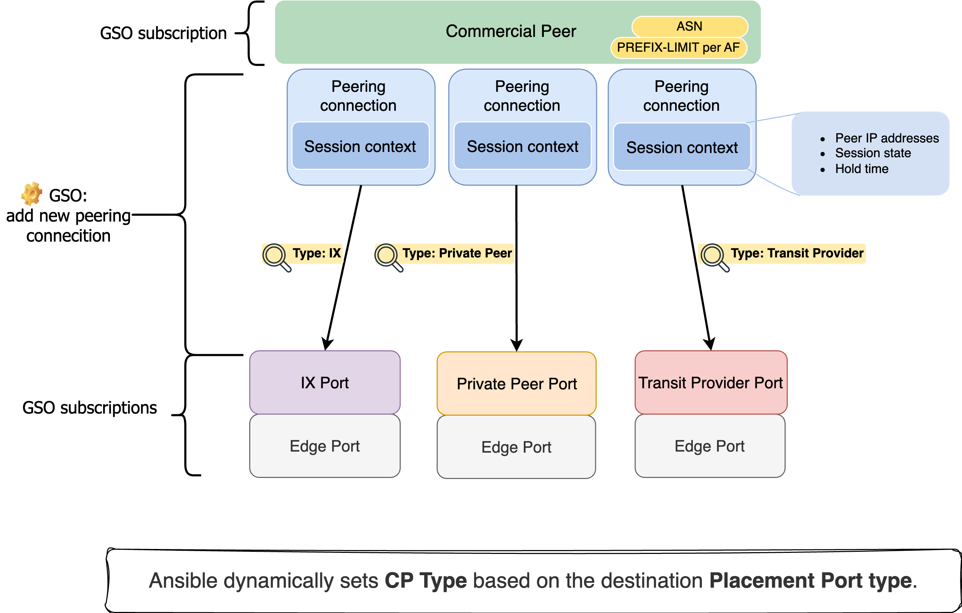
The Architecture (Layered Model)
Notes:
So, how does the CP relate to these ports?
As you see here, a single CP can have **multiple peering connections**—shown in blue—to different port types.
Crucially, each connection has its own **Session Context**, specifying parameters like BGP peer addresses and session state. Meanwhile, the **Type** of that connection is automatically derived from the target placement port.

Slide 28
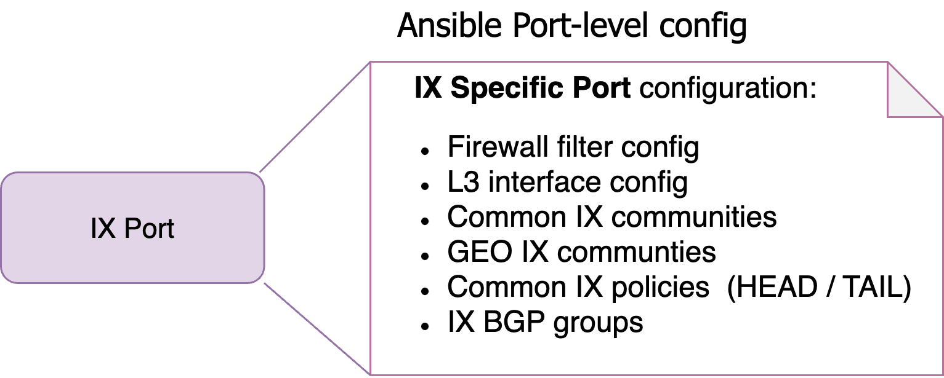
Port Creation (Infrastructure)
Notes:
To create a peering connection, we first need to prepare the infrastructure. Let's take an **IX Port** as an example.
What is an IX Port? It's essentially a Layer 3 interface, but it requires specific additional configuration—like firewall filters and common communities.
The beauty here is that **Ansible configures all of this** through a single playbook run.

Slide 29
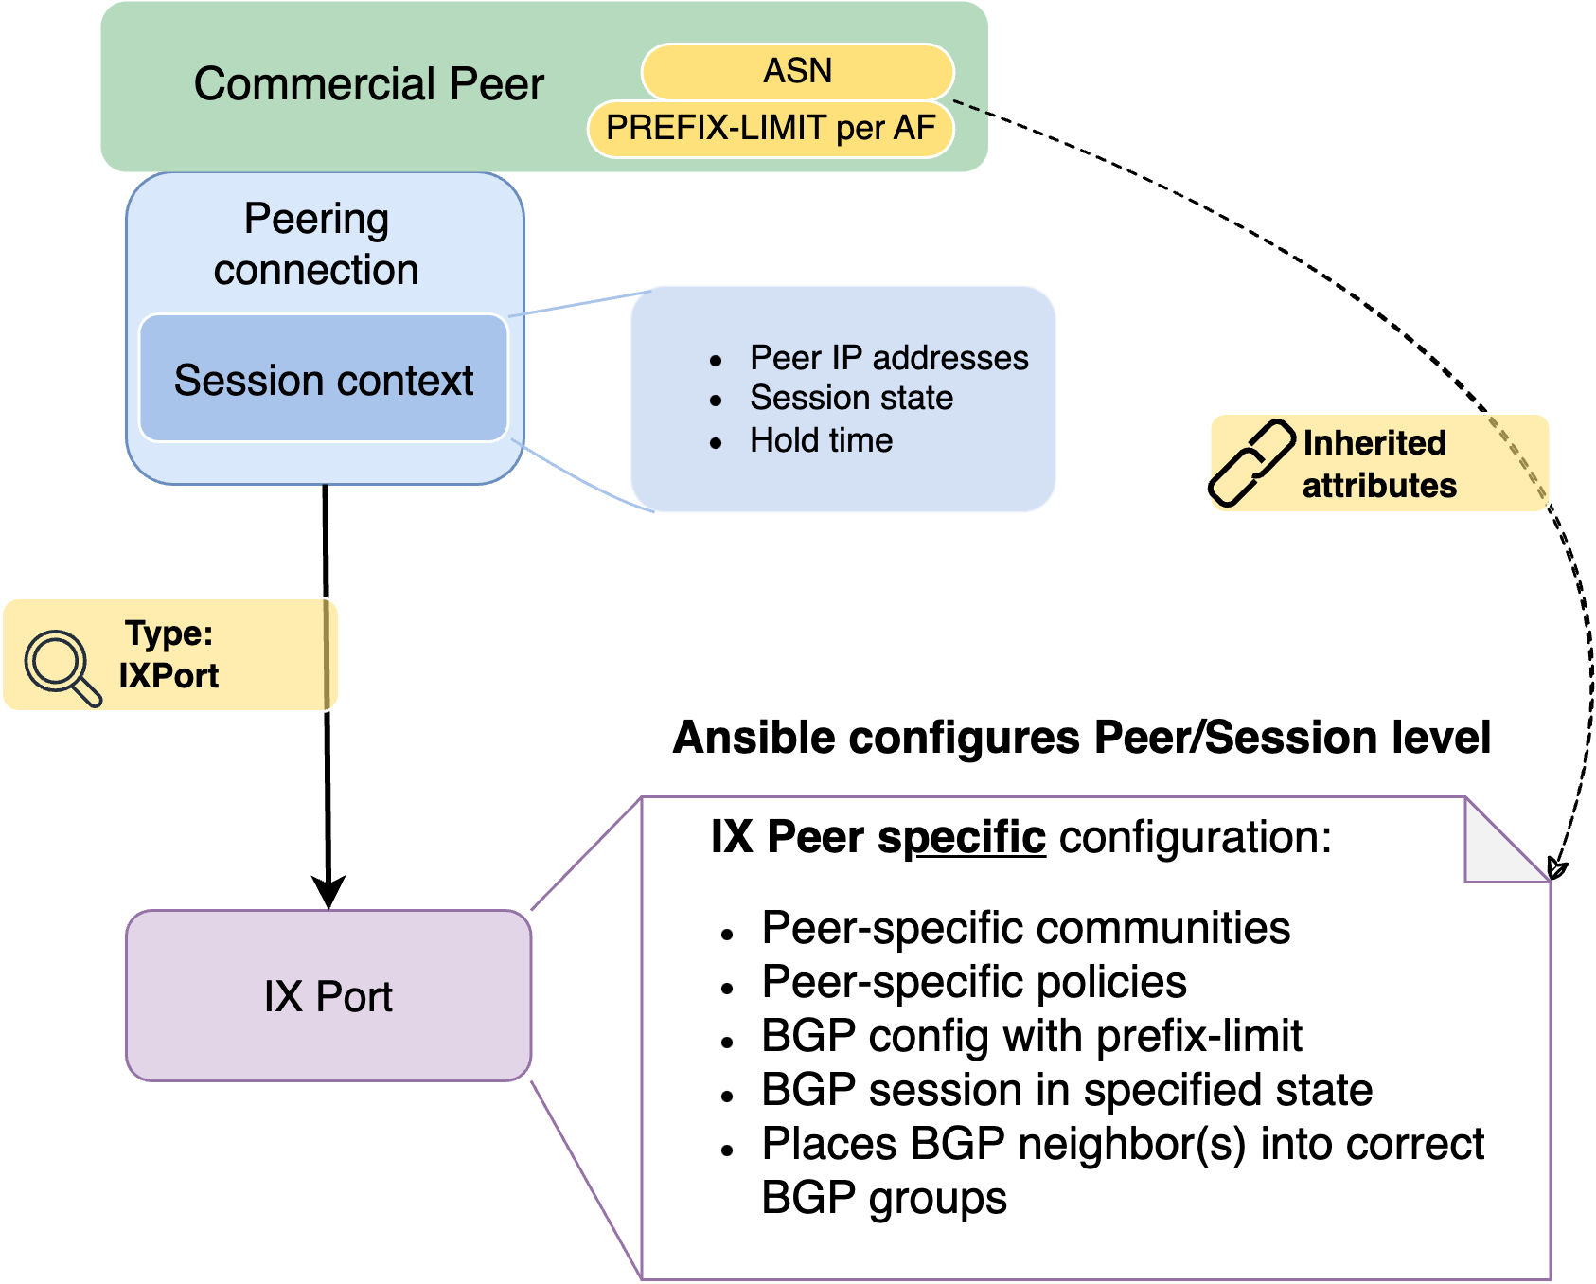
Peer Placement (The "Magic")
Notes:
Once the placement port is ready, we can add a new peering connection.
But the BGP configuration differs significantly depending on the context. So, knowing **exactly which peering type** to configure is vital.
This is managed dynamically: Ansible extracts the **Type** of the target port and pulls the correct variables. In this example, it configures an **IX Peer** because the port is an IX.
Notice that the core attributes—the ASN and Prefix Limit—are simply inherited from the CP instance in the orchestrator.

Slide 30
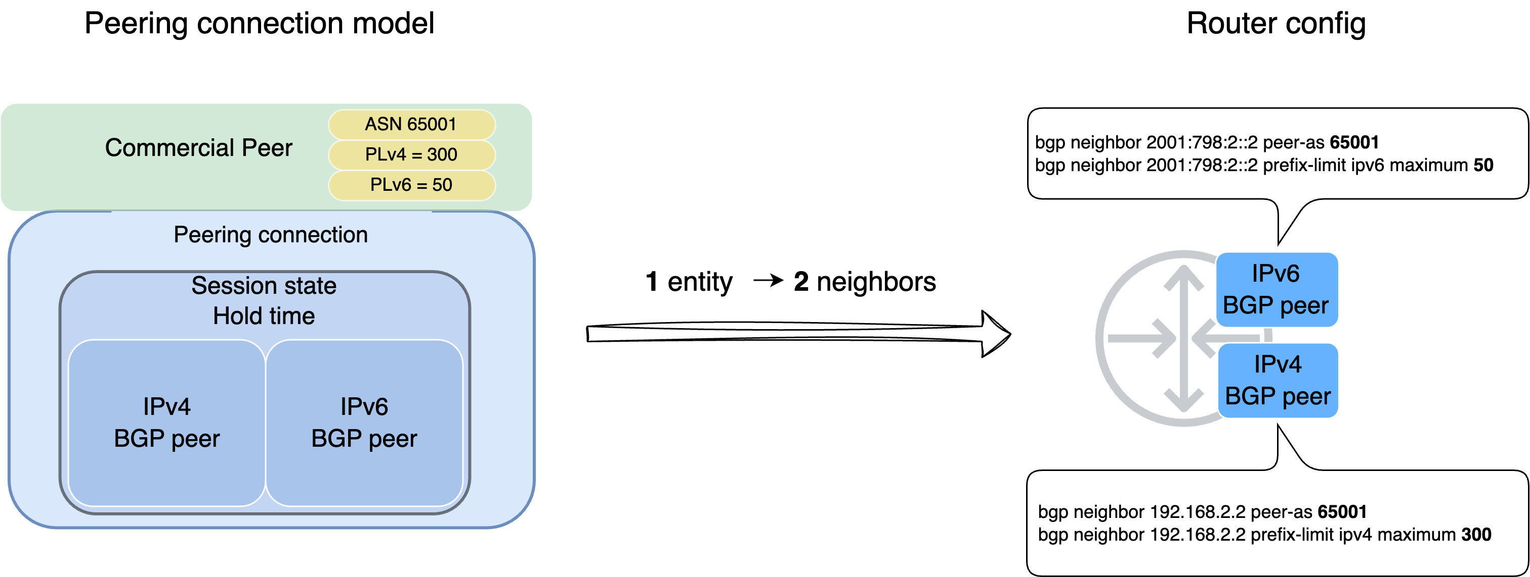
Zoom in to Peering Connection block
Notes:
Let's zoom into the Peering Connection block.
In the orchestrator, IPv4 and IPv6 peers are logically grouped inside a single Peering Connection entity — one object to manage. We can think of this block as our representation of the remote end.
But the actual config for our router is different – there are 2 independent BGP neighbor statements in case of dual-stack peer. However they need to be managed together in the workflows.
Ansible does this translation for us between the Orchestrator asbstraction and the router config.

Slide 31
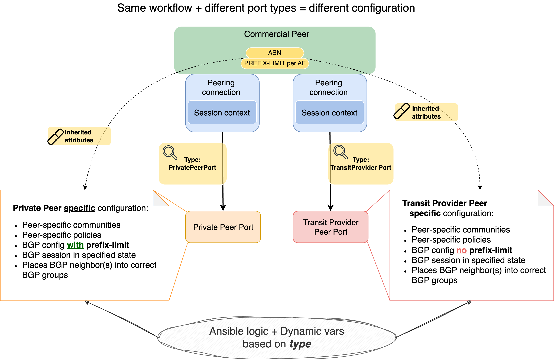
The Contrast (Private vs. Transit)
Notes:
Now, let's see what happens when we use the **same CP** but connect to **different placement ports.**
Here is the key takeaway: An operator runs the **exact same workflow**, but because the target port is different, Ansible produces **distinctly different configurations.**
We get different communities, different policies, and neighbors placed into different BGP groups. And crucially, the **Prefix Limit** is intelligently applied—or skipped—depending entirely on the context.

Slide 32
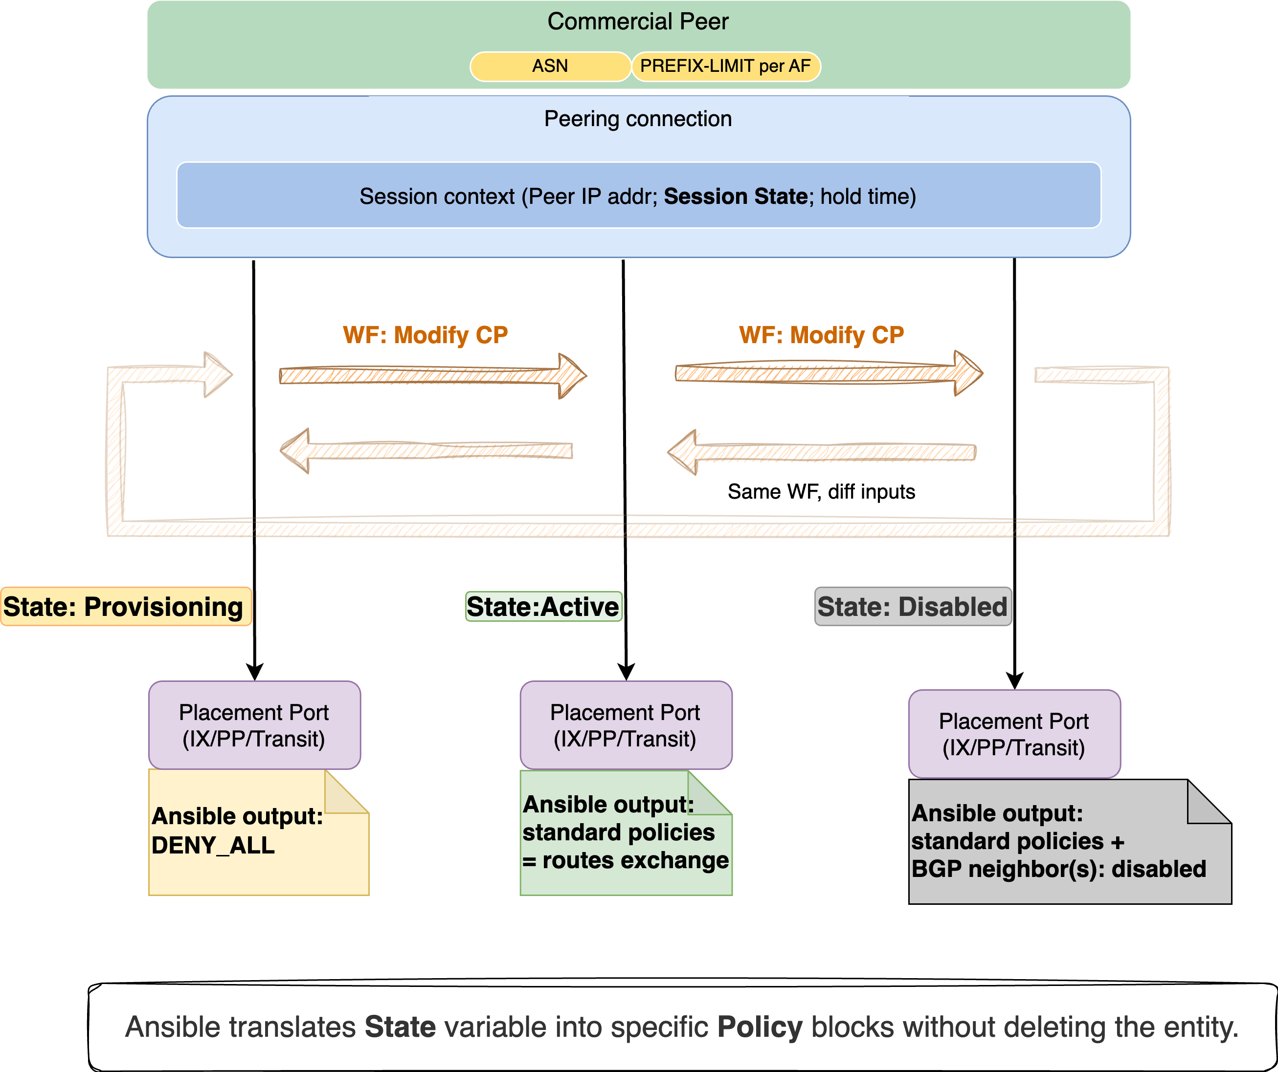
Session State Control
Notes:
Next, let's look at how we control the configuration using the **Session State** parameter.
In Orchestrator we can choose different Session States per Peering connection.
Imagine we need to provision a new Peering Connection for a Commercial peer. Typically, we first put a session in the Provisioning state – this is a preparation.
All BGP are established, but there is no route exchange yet.
Next, we agree with our Commercial partner for an activation date, and during this maintenance window we run an update workflow on the peering connection and choose now Active state.
Now we exchange the routes with the CP.
If something happens with our peering connection, we want to disable it quickly and investigate in the background. This is where Disabled state comes in handy – all config is still in place, but the BGP neighbors belonging to this Peering connection are disabled.

Slide 33
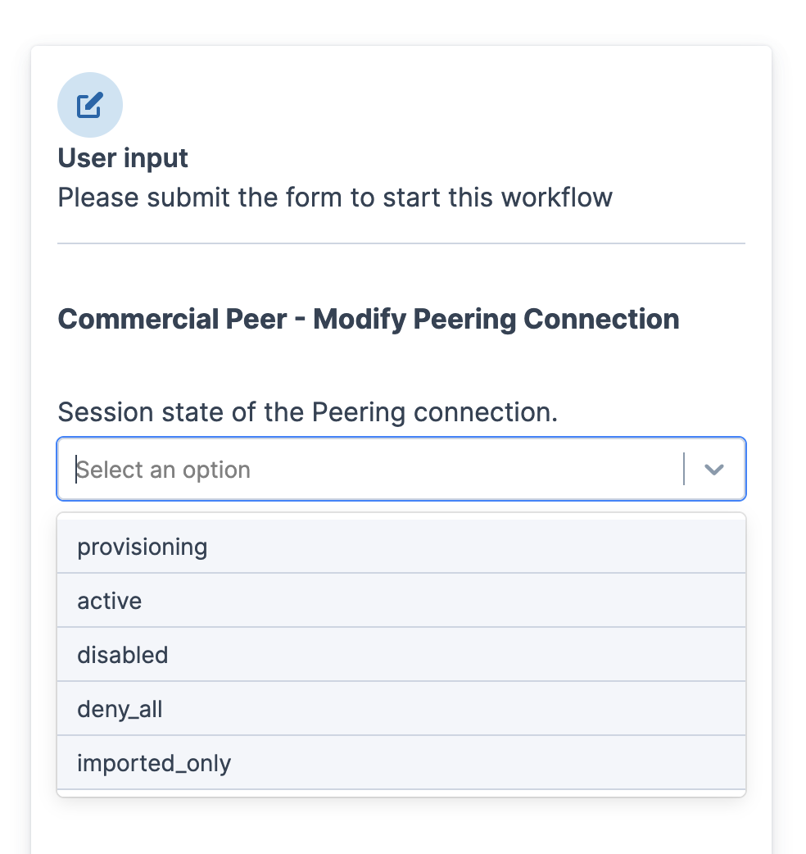
Session State Control
Notes:
I see the session states as very useful shortcuts to the predefined configurations.
There is no need for an operator to figure out every time what configuration needs to be changed – just run an update workflow on the peering connection, and choose the most relevant state from a drop down menu.
Importantly, the state of each session is managed independently from the others, it is per Peering Connection.

Slide 34
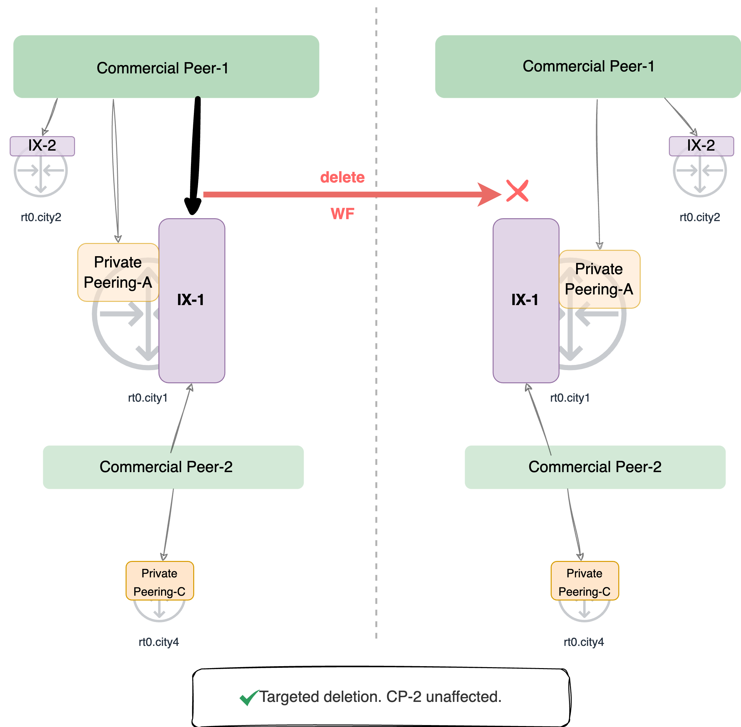
Granular Control. Safe deletion.
Notes:
Now, let's look at safety in a multi-tenant environment.
We have CP-1 with its list of current connections, and CP-2 that also has peering connection to IX-1.
If an operator runs a 'Delete' workflow on CP-1's connection to IX-1:
That specific session is removed.
CP-1's other sessions remain.
Crucially, CP-2 is completely unaffected.

Slide 35
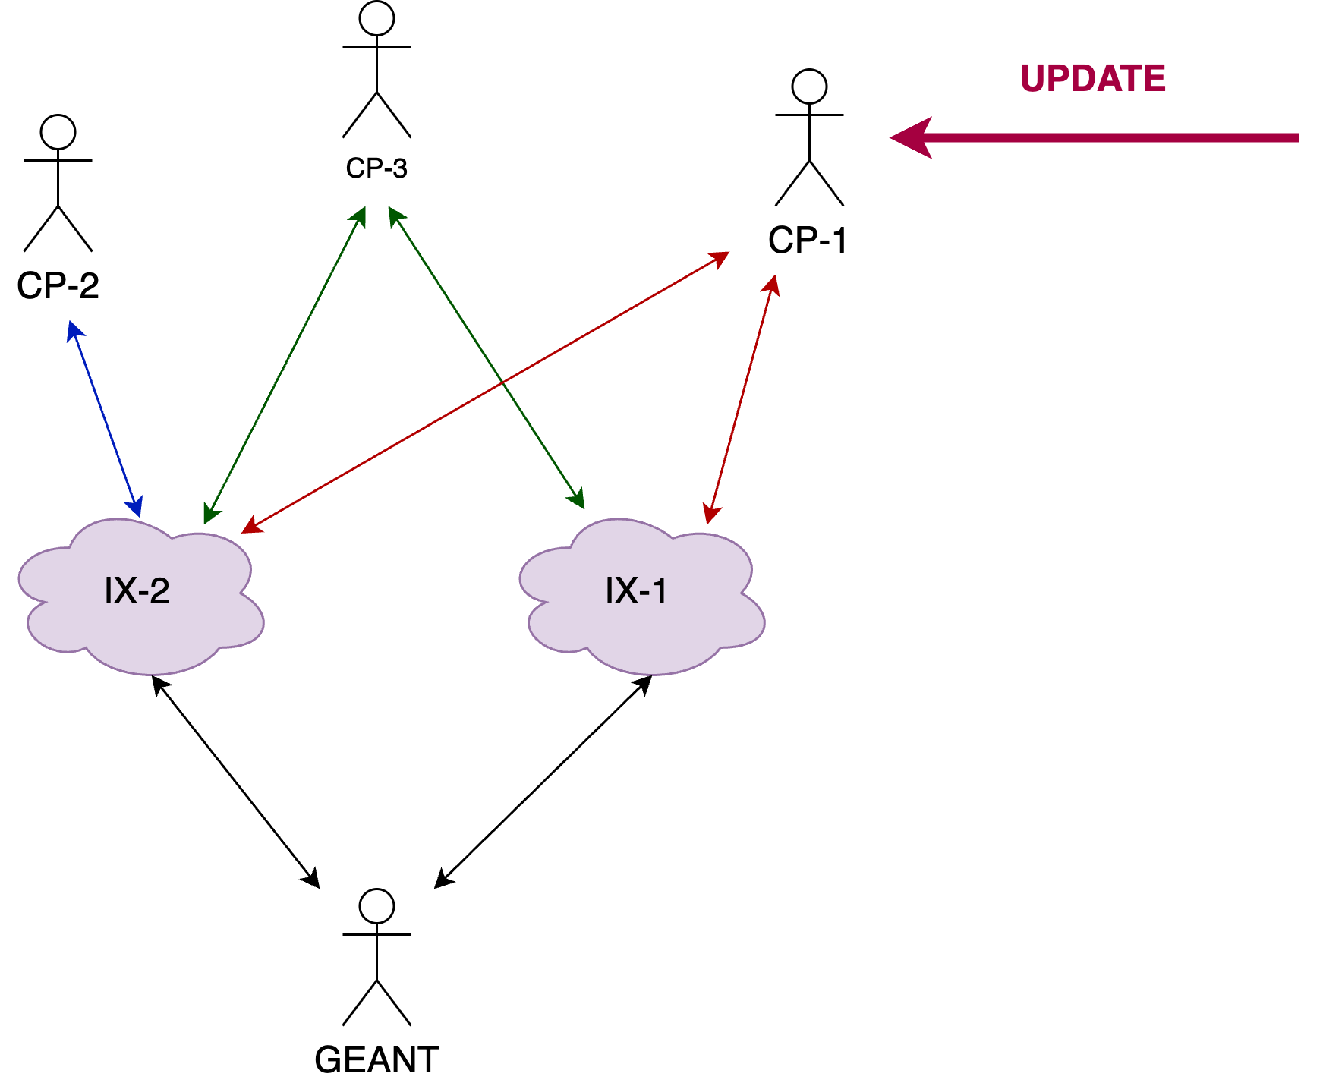
One Update, One Workflow
Notes:
Remember one of the previous slides when the benefit of modelling per organization was mentioned?
One great advantage of this is that we update once per CP, and the updates are applied to all current connections as shown in the next slide.

Slide 36
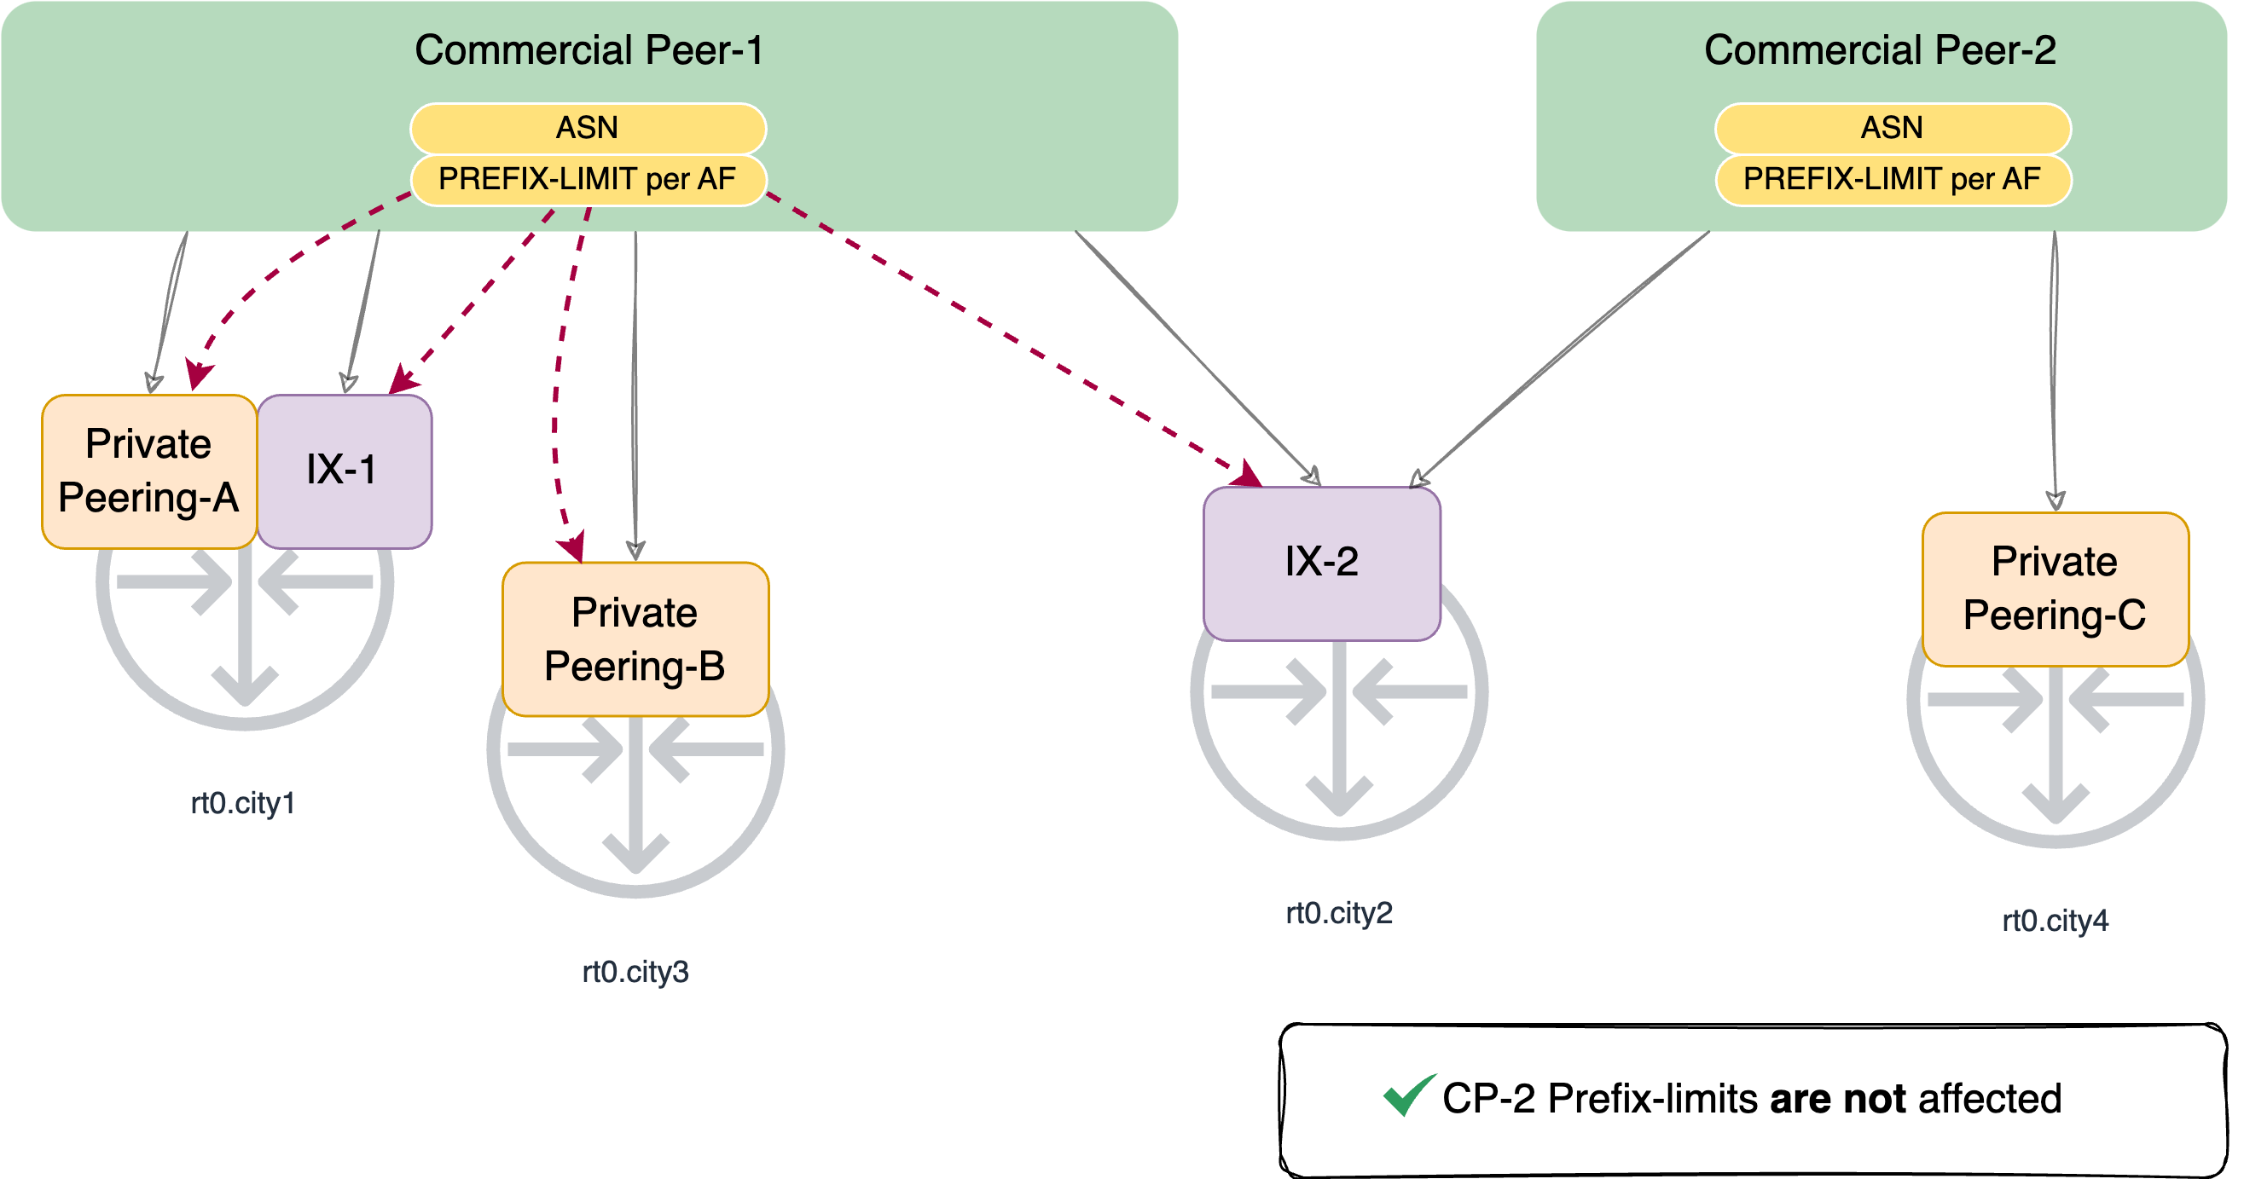
Granular Control. Targeted Updates.
Notes:
Here we see CP-1 and CP-2 coexisting.
They both share IX-2.
They each have their own private links.
Notice the red arrows: When we update the Prefix Limit for CP-1, the change propagates to both its IX and Private connections. Crucially, CP-2 is completely unaffected. Its ASN and limits remain independent.

Slide 37




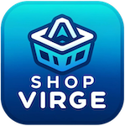




The Workflow Orchestrator Programme
We are not doing this alone, and you are welcome to join!
WFO Programme - workfloworchestrator.org
3 level of engagement: (Partner / Graduate / Sandbox)
Join us on discord!
Notes:
None of the work we showcased in our presentation today would've been possible without the Workflow Orchestrator.
The Workflow Orchestrator framework is developed and adopted by different members of our community.
If you are interested in learning more about the WFO, or adopting it in your organization, you can find more information at the website shown in the slide.
If you want to meet with like-minded people on the WFO, you can find us on Discord by scanning the QR code.

Slide 38
Thank you
Any questions?
goat@geant.org

