Slide 1
Lost in transmission
A field guide to clear communications
Meagan Hampel, VP Strategic Communications | Cybera

Slide 2
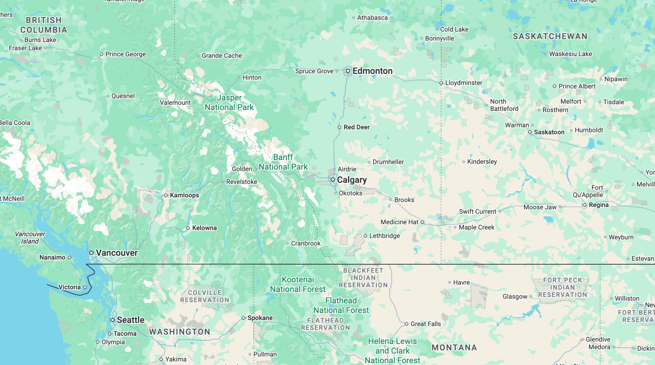

Notes:
Drive from Calgary to cottage is about 260km or 3 hours, equivalent of Amsterdam to Cologne

Slide 3

Thu, May 7 at 11:22
What time were you thinking of heading out tomorrow?
After work, so maybe hitting the road for around 5pm
What time do you think you’ll drive back on Sunday? I’m wondering if I should just hitch a ride with you

Slide 4
I was thinking about returning early-to-mid afternoon. You are welcome to join.
I’d love a ride actually, if that’s ok?
No problem.

Slide 5

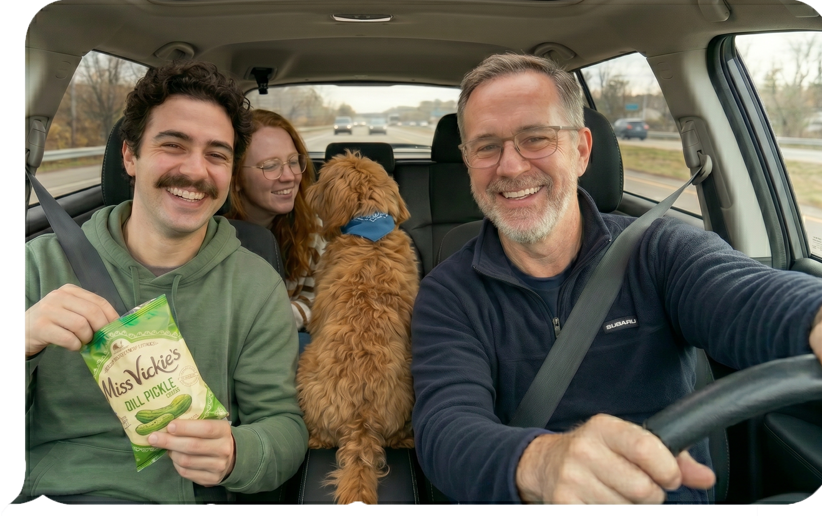
Fri, May 8 at 17:11
Status?
ETA?
8

Slide 6
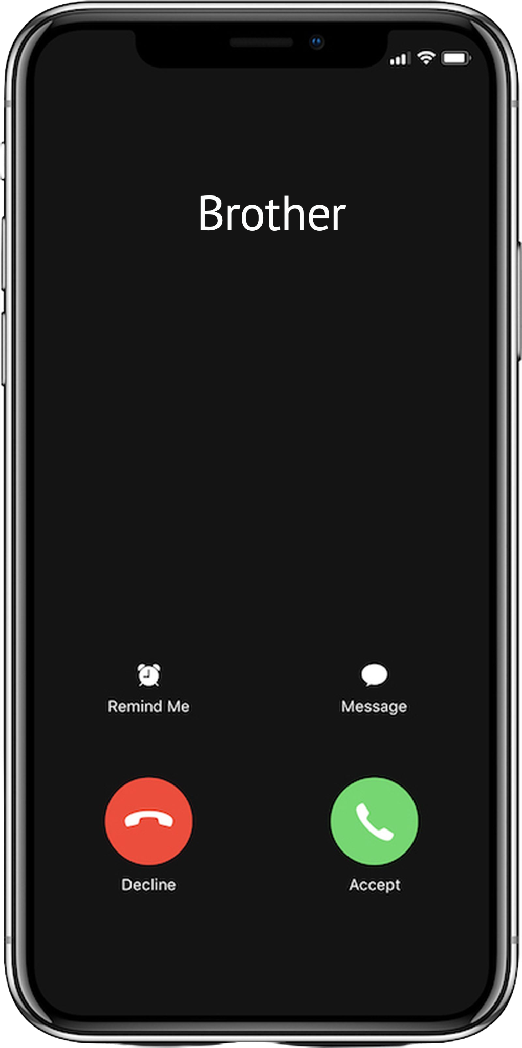
Fri, May 8 at 17:57
So when you said 8, did you mean 8pm? lol
Yes.
What???
Notes:
Why am I bringing this up as an example: If my own flesh and blood could not be on the same wave length as me, how could I possibly assume that a co-worker would be able to understand what I’m thinking?

Slide 7
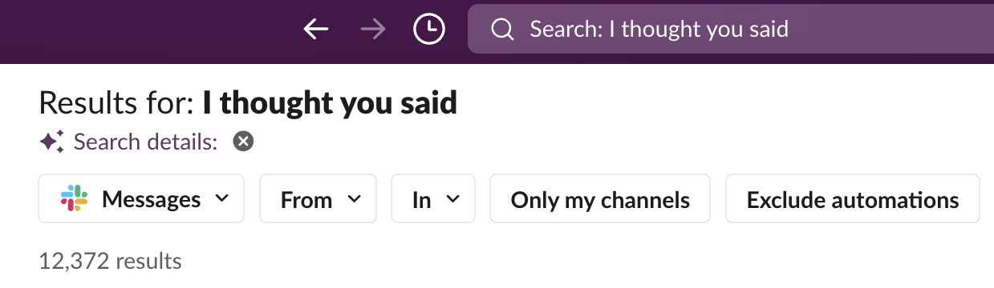
Miscommunications happen every day
Notes:
In the last two years alone, we found over 9,000 examples of potential miscommunication on the *public* channels on Slack

Slide 8
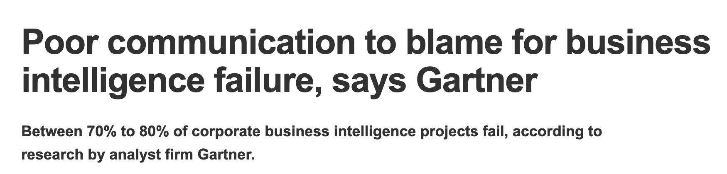
The hidden costs of miscommunication
The cost of poor communication in the workplace has been estimated to be anywhere between US$9,284 to well over US$30,000 per employee per year.
source: 2025 State of Internal Communication Report, Axios HQ
Notes:
And in fact, the data shows the co-workers are really not able to communicate effectively.

Slide 9

What modern “communication” looks like

Slide 10






The problems with text-only conversations
Unexpressed emotions and rushed, unfinished thoughts…
… not to mention the jargon, acronyms, and hard-to-decipher emojis
We need to schedule a L&L on OCM
DTN
I’m building the DMZ DNS
FWIW
TL;DR
Notes:
Communic

Slide 11
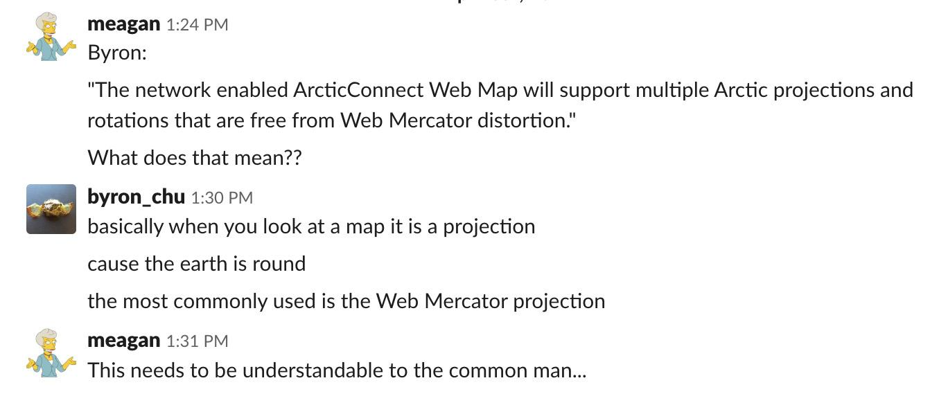

Rushing also leads to assumptions
“To someone who isn’t clued in, jargon can be seen as technical snobbery.”
Kacee Erhard, Marketer

Slide 12
How to address miscommunications

Slide 13
Treat miscommunications like a cyber incident
Run a post-mortem to uncover the points of confusion
What time do you think you’ll drive back on Sunday? I’m wondering if I should just hitch a ride with you
ETA?
8

Slide 14

Get other’s feedback
Your message was confusing.

Slide 15
Lesson one: more words please
What time do you think you’ll drive back on Sunday? I’m wondering if I should just hitch a ride with you there and back
ETA?
8 pm

Slide 16
… but still aim to be clear and direct
i.e. don’t write a word salad
I’ve been thinking about this weekend and wondering what makes the most sense for getting out to the mountains. On the one hand, I wouldn’t mind heading back late on Sunday so I can get some more work done around the cabin, but on the other hand, it seems like a waste of gas if we drive separate cars. What do you think would work best? I can always drive you guys, though I don’t want the dog in my car. Maybe you could drive, if you think there is enough room, and if you are heading back not too early on Sunday…?

Slide 17
Lesson two: write your opener like a news article
Most important details up front: who, what, when, why, how.
Instead of us both driving out separately this weekend, could I hitch a ride with you there and back?

Slide 18
Lesson three: repeat and reiterate
Should be part of comms processes
I’d love a ride actually, if that’s ok?
No problem.
Great! So you’re okay
driving me there and back?
Notes:
Processes: this can be a whole other presentation, but you should absolutely have set processes and templates for writing meeting notes, action plans, documenting next steps and who is doing them, and general staff communications. I have seen what happens when teams come together to agree on next steps, and they take their own notes and go off and do their own projects, and invariably it is a disaster

Slide 19
Lesson four: never assume
Pause and ask yourself these questions before reaching a conclusion:
Do you know the full context of the conversation? Does the other person?
Do you know exactly what they are working on, and why?
Do you have a good understanding of how they process information?
What is their level of technical understanding?
Know your audience!

Slide 20
Key points for written communications
When a comms failure happens, do a post-mortem
Emphasize more words over less…
… but get the key points across in your first two sentences
Reiterate the main action / thought process, so both sides are clear
Never assume

Slide 21
Misunderstandings due to “tone”

Slide 22
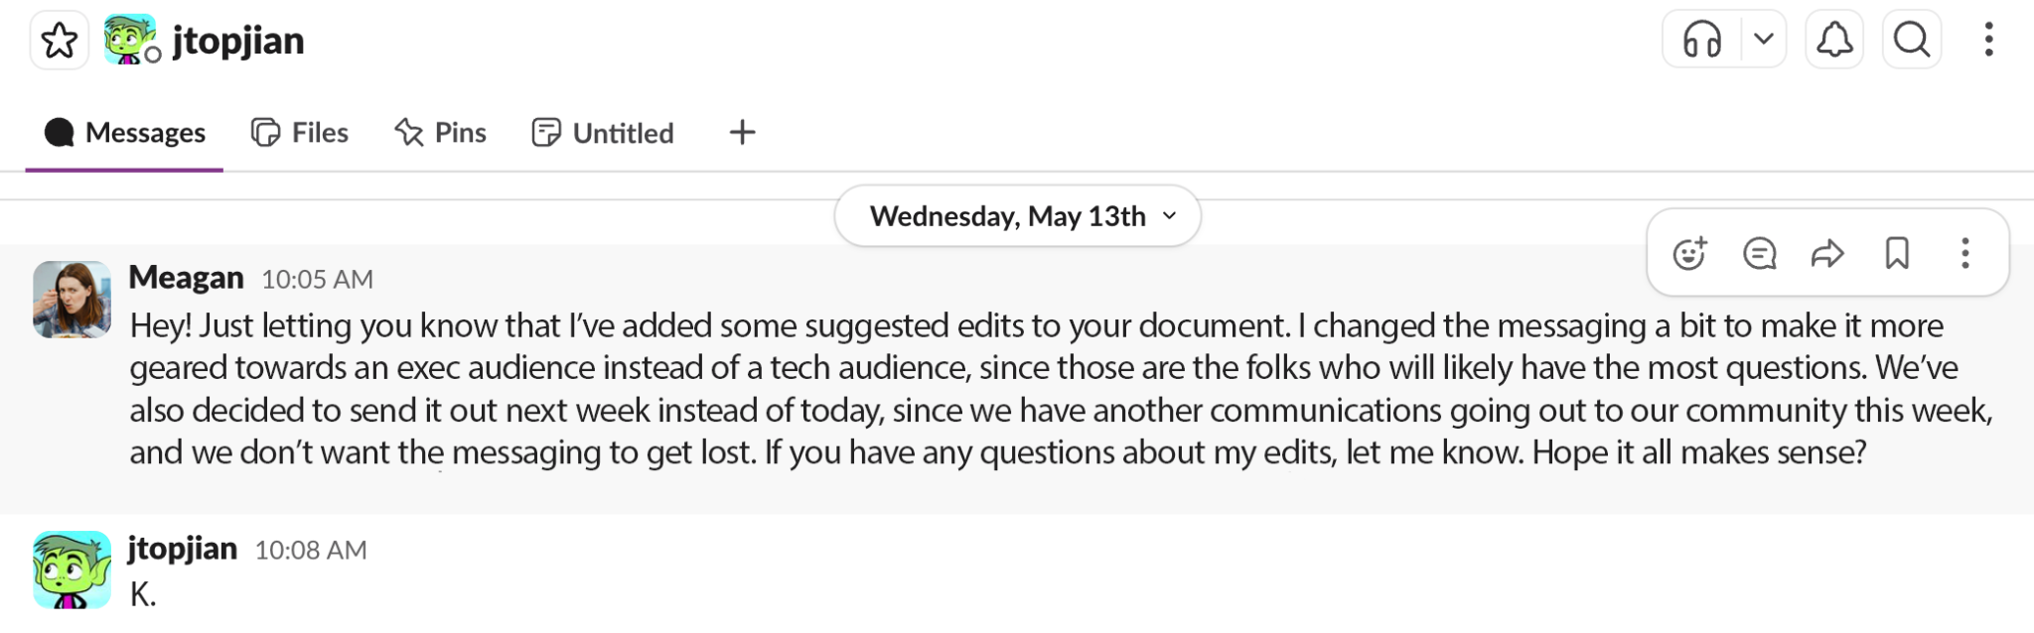
Notes:
Show of hands: who thinks he’s fine? Who thinks he’s angry? Who says it depends?

Slide 23

You need to talk to, and get to know, your coworkers
Notes:
Talk to the other person. In person or over videoconference. At this point, you can’t continue using the chat tool.

Slide 24

Ask others (even AI) to read your message for tone
“The tone of this email is direct and technically firm, but it borders on being dismissive.”

Slide 25

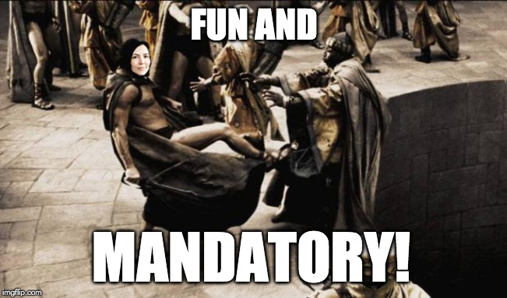
Introduce new staff to your culture
Conversation formality
Feedback culture (direct/indirect)
Acceptable / unacceptable behaviour
Memes, jokes, other references

Slide 26

Learn about the culture new staff come from
Includes work, school, and
geographic region
Culture norms around:
  asking questions
  career growth
  sharing ideas
  giving/receiving feedback
Notes:
Good to have someone to go to for any questions, including how to interpret messages from others / approach them in conversations

Slide 27

Incorporate work “buddies”
Can explain nuances
Safe space for any questions
Notes:
Good to have someone to go to for any questions, including how to interpret messages from others / approach them in conversations

Slide 28

Key points for reducing misunderstandings
Talk to people if you think they may be confused or upset
Have others, or AI, review your message for tone
Introduce new staff to your work culture
Understand the culture new staff are coming from
Create safe spaces for people to ask questions

Slide 29
Thank you!
meagan.hampel@cybera.ca

