Slide 1
Creating Network Effects
How Internet2 Amplifies Cloud Capabilities
Through Community
Bob Flynn and Sean O’Brien
Helsinki, Finland
9 June 2026

Slide 2
Agenda
01
About Internet2 & NET+
02
Introducing the Cloud Infrastructure Community Program (CICP)
03
Data Benchmarking
04
Barn Raisings & Tech Jams
05
CLASS: Cloud Learning & Skills Sessions
06
Answers by Experts Chatbot
07
CICP Success Stories & Looking Ahead

Slide 3
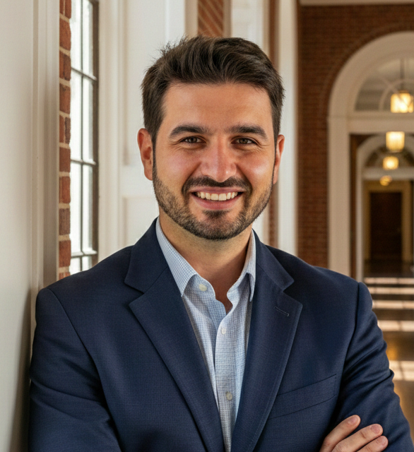
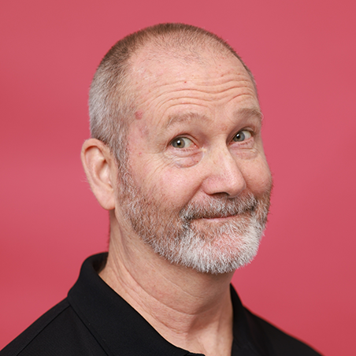
Meet Your Speakers
Photo
Sean O'Brien
Bob Flynn
Associate Vice President, NET+
Sr. Manager, Cloud Infrastructure
& Platform Services
Internet2
Internet2
Leads Internet2's NET+ program portfolio
Focused on cloud services strategy and community programs
Senior program lead for CICP since its founding
20+ years building R&E community programs
Architect of CICP's community engagement model

Slide 4
About Internet2
Internet2 is a non-profit, member-driven advanced technology community founded in 1996 by the nation's leading higher education institutions. We deliver a diverse portfolio of technology solutions that leverage, integrate, and amplify our members and stakeholders' strengths to advance their educational, research, and community service missions.
Network
Cloud
Security
Community
Accelerate science and research with exclusive access to the national high-performance network infrastructure.
Implement leading cloud services customized for colleges, universities, and R&E organizations.
Maintain a secure infrastructure and enable frictionless, cross-institutional collaboration among students, faculty, staff, and researchers worldwide.
Enhance an institution's influence, efficiency, and technical capabilities.
INTERNET2 SERVES:
345+
600+
23
46
1,000+
U.S. Universities
Universities via 1,300+ Active NET+ Contracts
Non-Profit Institutions
Regional & State Education Networks
InCommon Participants
1,000+
61
70
34
80,000+
eduroam Subscribers at more than 40K Hotspots Worldwide
Industry Members
National R&E Network Operators representing more than 100 Countries
Federal Agencies
Community Anchor Institutions

Slide 5
Four Pillars of the Internet2 NET+ Program
Engaging with the community across four interconnected areas
Research and
Education Cloud Community
Service
Brokerage
Training and Workforce Development
Intelligent Cloud
Usage
Vendor Management
at Scale
INTERNET2 NET+ TEAM

Slide 6
What Is CICP?
From contract add-on to open community program
2015
2019
2022
Oct 2024
NET+ AWS & Azure
participation fee
NET+ GCP added
to portfolio
Program activities
expanded
CICP launched —
open to ALL
CICP separates the community program from the contract — open to all U.S. higher ed institutions, Internet2 affiliates, and federal affiliates regardless of how or whether they procure cloud.
✓
A dedicated space for cloud conversations — across AWS, Azure, and GCP
✓
A place to learn and grow as a team and as a community
✓
A cloudforce multiplier: your institution backed by 250 peers
✓
Open to all — no cloud contract required

Slide 7
How CICP Engages Institutions
Engagement opportunities for across institutions
Peer Discussions
Expert Presentations
Monthly calls with cloud practitioners across R&E
Deep dives from hyperscaler architects, product, and peer teams
Barn Raisings
Tech Jams
Hands-on build events deploying shared solutions together
Collaborative sessions exploring emerging cloud tools
Advisory Groups
Training Cohorts
Working groups that shape CICP's direction and priorities
Structured, cohort-based learning via CLASS
Data Benchmarking
Cloud Consulting
Community spend and efficiency analytics
Direct access to solution architects for your challenges

Slide 8
CICP by the Numbers
Since official launch in October 2024
250
86
91
CICP Individual Members
Subscribing Institutions
Community Calls
189
1,891
58
Institutions Attended
Community Participants
Community Presenters

Slide 9
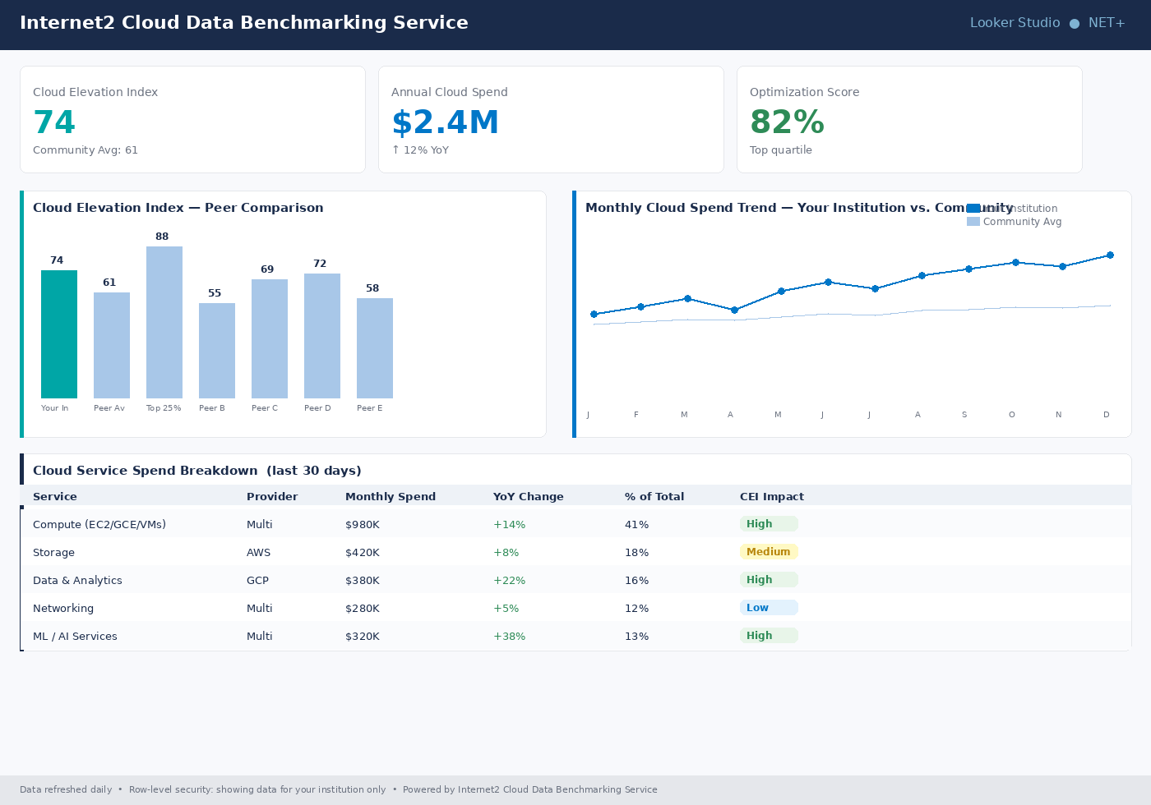
Data Benchmarking
Cloud Data Benchmarking Service — turning institutional data into community intelligence
Secure Dashboards
Looker Studio dashboards with row-level security — each institution sees only its own data
Cloud Elevation Index (CEI)
A standardized score measuring cloud efficiency and maturity, benchmarked against peer averages
Spend Trend Analytics
Interactive views of monthly cloud spend by service, provider, and workload type
Community Scorecards
The Internet2 Cloud Scorecard Finder helps institutions discover and compare vetted cloud solutions

Slide 10
Barn Raisings & Tech Jams
A Barn Raising is a hands-on build event where one institution shares a proven solution and the community deploys it together. Tech Jams explore emerging tools in rapid collaborative sessions.
#1
Amplify GenAI
Open-source enterprise GenAI platform — cost-effective LLM access for any institution
Vanderbilt + AWS
#2
Automated Transcription Service
Research-grade transcription using Amazon Transcribe + Google Speech-to-Text
Indiana University + AWS
#3
Campus Engagement Coach
AI-powered campus event aggregator and personalized connector
Wash. Univ. in St. Louis + Google
#4
PDF Accessibility Remediation
Automated WCAG 2.1 AA remediation — reduces remediation effort from weeks to hours
Arizona State CIC + AWS

Slide 11
CLASS: Cloud Learning & Skills Sessions
Cloud training designed specifically for the research & education community
Annual Registration Vouchers
Sample Course Topics
CICP subscribers receive annual vouchers to cover and streamline CLASS registration
• Multi-Cloud Networking
Institutional Discounts
• Security on the Cloud
Any participant from a subscribing institution receives discounted access
• Container Orchestration for Research
• GitHub Copilot for Research
Cohort-Based Learning
Structured cohorts drive accountability, peer connection, and completion rates
• GCP Administrator Basic Training
• Research Data Security & Compliance
R&E-Specific Curriculum
• Secure Research Environments
Courses address the unique compliance, research, and infrastructure needs of higher ed
• Advanced AI & ML Workloads

Slide 12
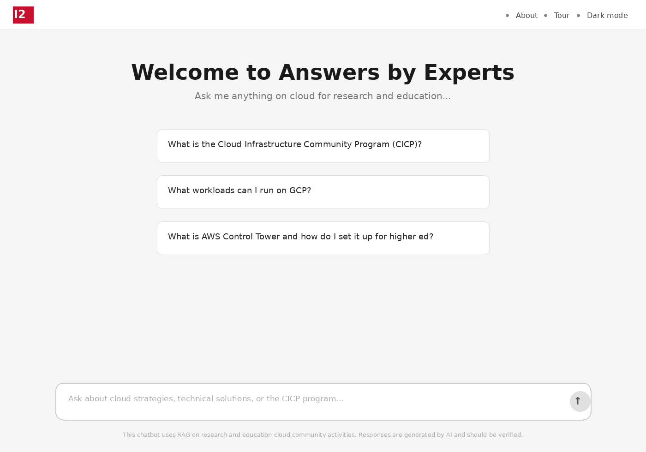
Answers by Experts Chatbot
Unlocking community knowledge at the speed of a question — abe.internet2.edu
What Is It?
An AI-powered chatbot that surfaces peer-generated insights from CICP community sessions, NET+ town halls, and webinars — pointing you directly to the source
Built With the Community
Co-developed with the California Polytechnic State University's (Cal Poly) Cloud Innovation Center (AWS CIC program); launched at the 2026 Higher Ed Cloud Forum; codebase open source at github.com/Internet2/i2ccc
Accessible to All
Log in with your InCommon credentials or an Internet2 guest account. Subscriber-only materials are gated; everything else is open to the broader community

Slide 13
CICP in Action: Success Stories
Network effects in practice — where community investment pays institutional dividends
Community-Built Solutions Adopted Broadly
• Amplify GenAI deployed at multiple institutions after a single barn raising event
• PDF accessibility tooling cut remediation time from weeks to hours at adopting schools
Peer Knowledge Accelerating Cloud Journeys
• Institutions new to cloud reach production faster by leveraging community architectures
• 87 subscribing institutions benefit from shared expertise spanning AWS, Azure, and GCP
Data Driving Smarter Decisions
• CEI scores help identify efficiency opportunities — community averages surface best practices
• Benchmarking data builds the internal business case for strategic cloud investments and helps matchmake with peer experts

Slide 14
Looking Ahead
What's next for CICP and the community
Cloud Incubator Program
A structured pathway to help institutions design, build, and operationalize a secure cloud environment based on peer experience and recommendations
CLASS Curriculum Expansion
Deeper tracks in AI/ML, FinOps, secure research environments, and platform engineering
Adding More Cloud Platforms
Expanding CICP to address the full multi-cloud landscape used by R&E institutions
Community-Driven Roadmap
Advisory groups and community feedback directly shape what CICP builds next — the community owns the direction

Slide 15
DIY Cloud Community
What does it take to get your own community going?
Dedicated and Engaging Staff
Volunteers have day jobs. They need someone whose job it is to organize, recruit, persist, and lead. It should be someone who loves to make connections and help others tell their stories.
We Stand on the Shoulders of Giants
We grow by learning from each other. Few feel their own contribution amounts to much, nor do the realize how much their work can inspire others to new ideas. People like to be asked. Shine a light on every story.
(The Right) Partner with the Cloud Providers
The most valuable partners at the CSPs are Customer Success and Product Managers. The goals are education and removing barriers to adoption.
The Mutual Value Proposition
Everyone loves a good press release. The stories you uncover make great case studies. The Service Advisory Groups can focus the community voice with position papers that can lead to product improvements. Educating them about your industry will pay off for them.

Slide 16
Thank you
Any questions?
netplus@internet2.edu
Internet2.edu

