Slide 1

Securing the Heart of the University
Partnering with Libraries to Strengthen the Research Trust Fabric
TNC 2026 | Helsinki, FI
Sari Frances
Director of Content Protection Services
Elsevier
Amanda Ferrante
Principal Product Manager, IAM
EBSCO

Slide 2




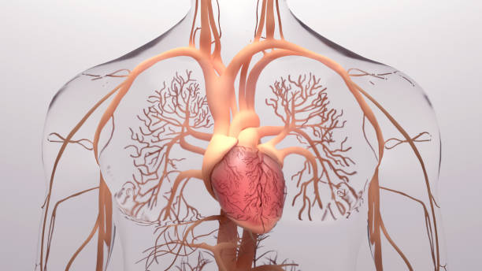
The library is the institution’s heart
Access to trusted scholarly content is the lifeblood of the academic mission
Knowledge flows through every vein of the institution — research, teaching, discovery
Not love
Access is the circulatory system
Identity is the pulse

Slide 3










We protect what makes research possible
Scholarly Network Security Initiative (SNSI) brings together stakeholders from across the scholarly ecosystem to address shared cybersecurity challenges.
Trust in research trust depends on secure, interoperable access
Increasingly, cybersecurity challenges lead
back to Identity & Access Management

Slide 4
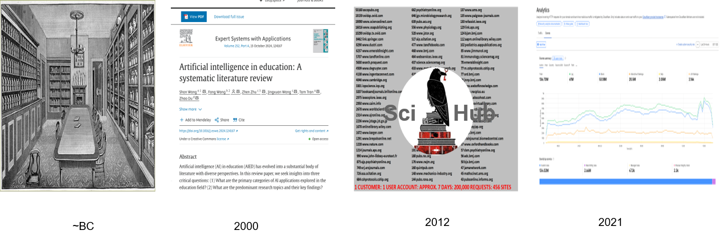
From print to digital: redefining risks and threats

Slide 5
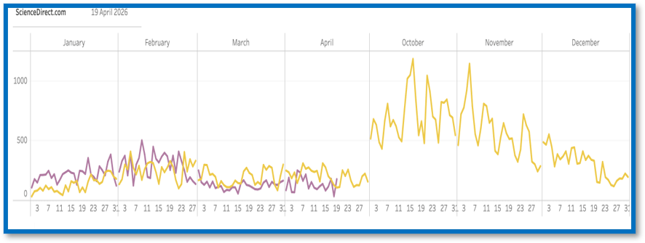
Libraries operate inside your security perimeter
Juicy target
Library vulnerabilities
increases exposure to
the university network.
Vulnerable target
Heavy reliance on IP-
based and shared authentication models.
Decentralized target
Licensed scholarly platforms are a major institutional access surface.
Libraries are part of the institutional risk surface, whether they’re governed that way or not.

Slide 6
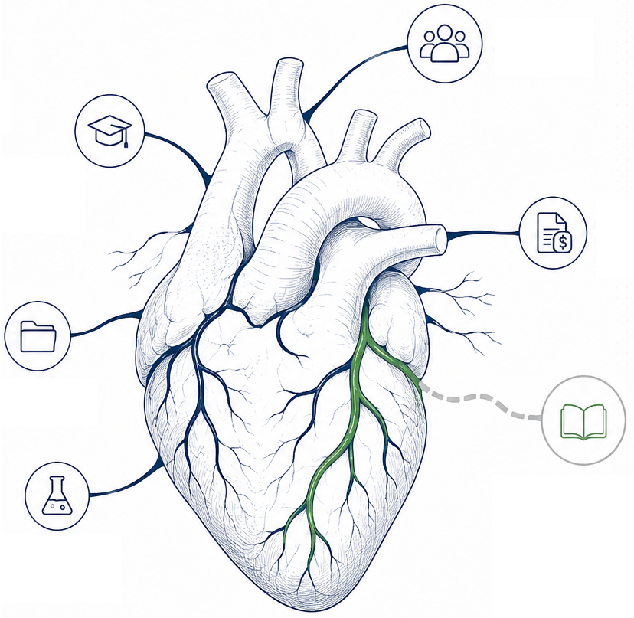
Federation already secures core research workflows
Licensed scholarly access – one of the most highly trafficked academic workflows – has not normalized into that model.
Security incidents and instability in library systems affect research continuity and trust.

Slide 7
The solution exists, but adoption has not followed.
95%
of licensed scholarly access still relies on IP ranges.
70%
of federation-enabled libraries rarely use it for e-resource workflows.
23%
median increase in researcher access after moving to SSO.

Slide 8

The adoption gap is structural, not technical
No shared operational baseline emerged for library e-resource access.
Variation is today’s normal, and adoption cannot scale.

Slide 9
What could bridging the gap unlock?
Libraries & Researchers
Reliable access that doesn’t fail silently.
NRENs & Federations
Coherent value across the entire research lifecycle.
IAM & Security
Governance over massive academic access surface.
Publishers
Achievable participation and deployment.

Slide 10
Building a shared federation baseline for library e-resource access
We need agreement on what “normal” looks like for e-resource access.
Define a proportional, achievable baseline deployment profile
Validate it through federation-led pilots

Slide 11





A cross-sector initiative is forming through SeamlessAccess to define a new common operational baseline for e-resource access.
Libraries, NRENs, federations, publishers, and IAM leaders must shape this together.

Slide 12
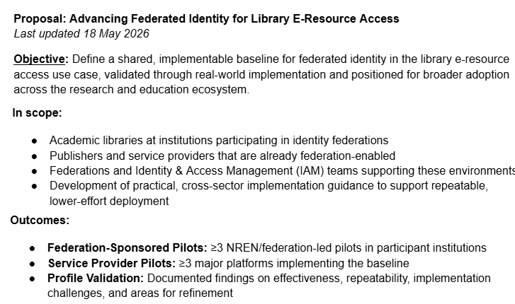




Slide 13
We're looking for NRENs and federations to help shape this work — and to pilot it.
Interested?
Find us after this session or reach out directly.
aferrante@ebsco.com | s.frances@elsevier.com

