Slide 1


Building AI That Works: ESnet's Pragmatic Approach to AI-Driven Operations
Jon-Paul Herron
Network Services
Department Head
Edward Balas
Measurement & Analysis
Group Lead

Slide 2
Agenda
What is ORBIT?
Our approach
How it went
How it works
Lessons learned
What comes next

Slide 3
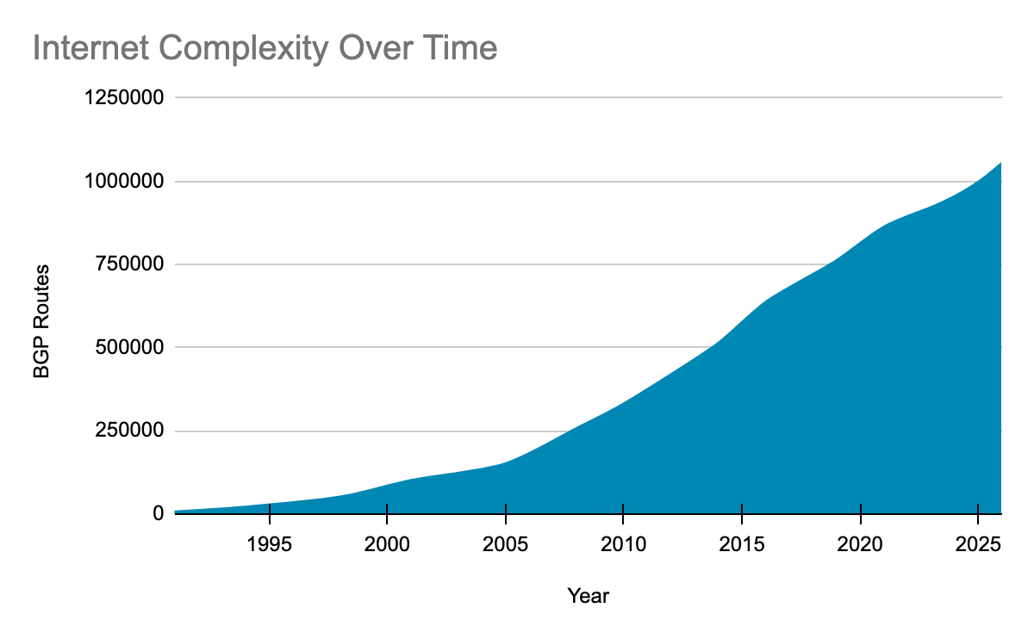
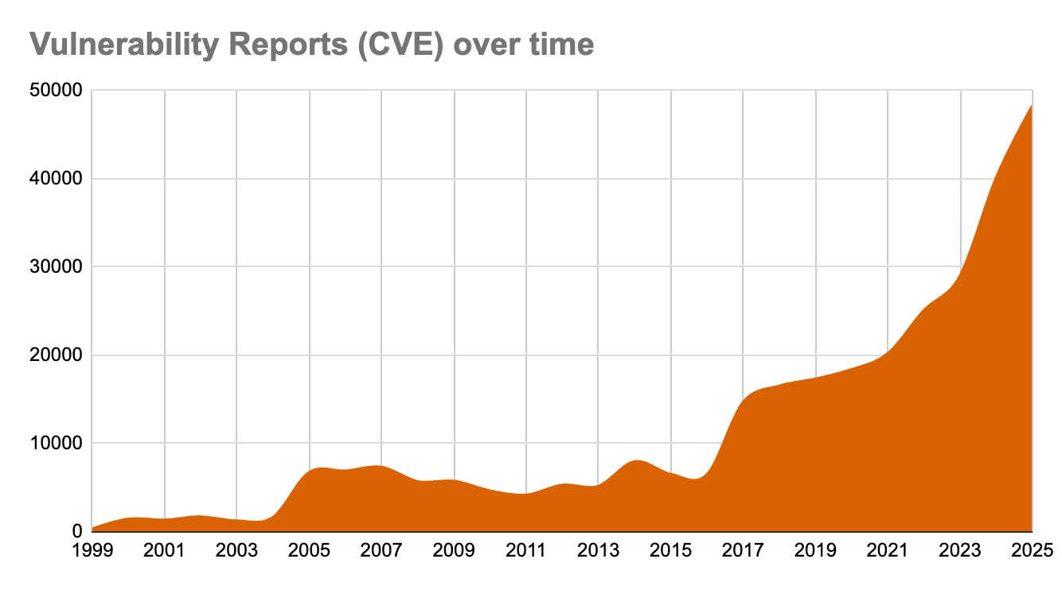
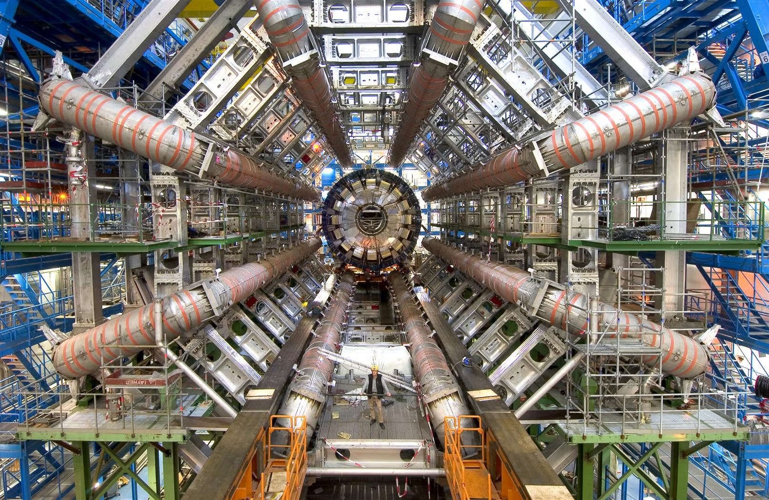
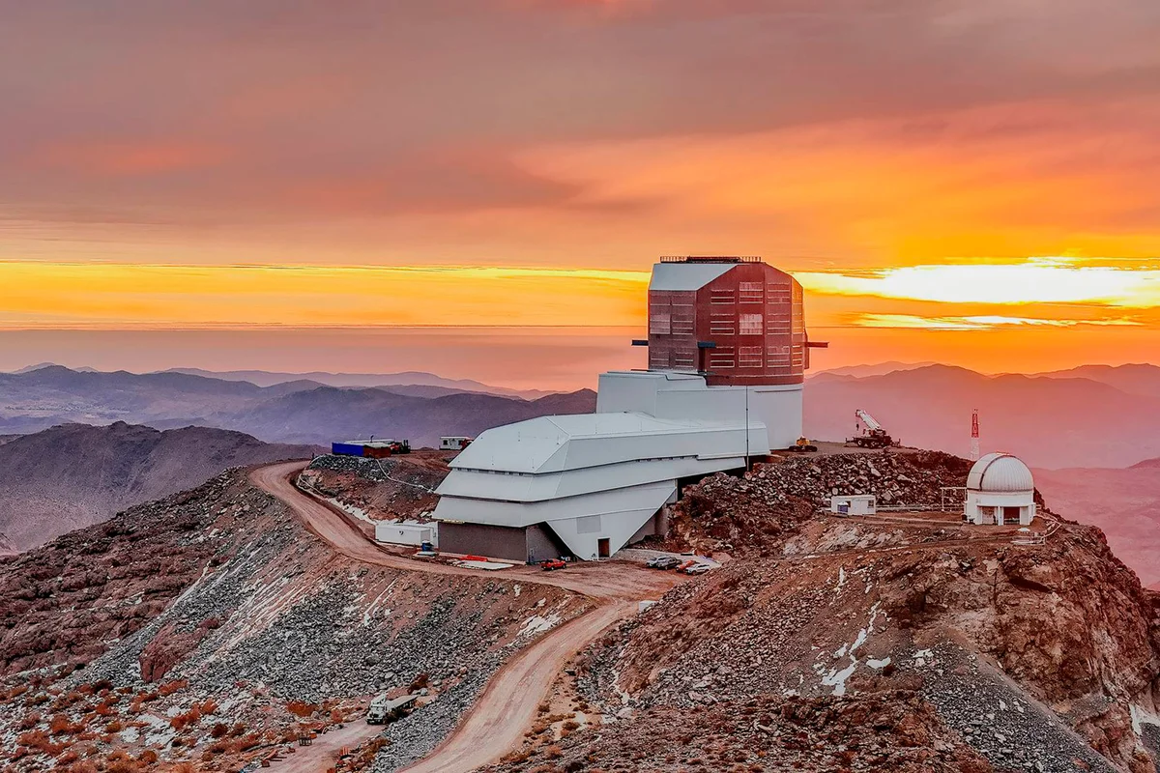
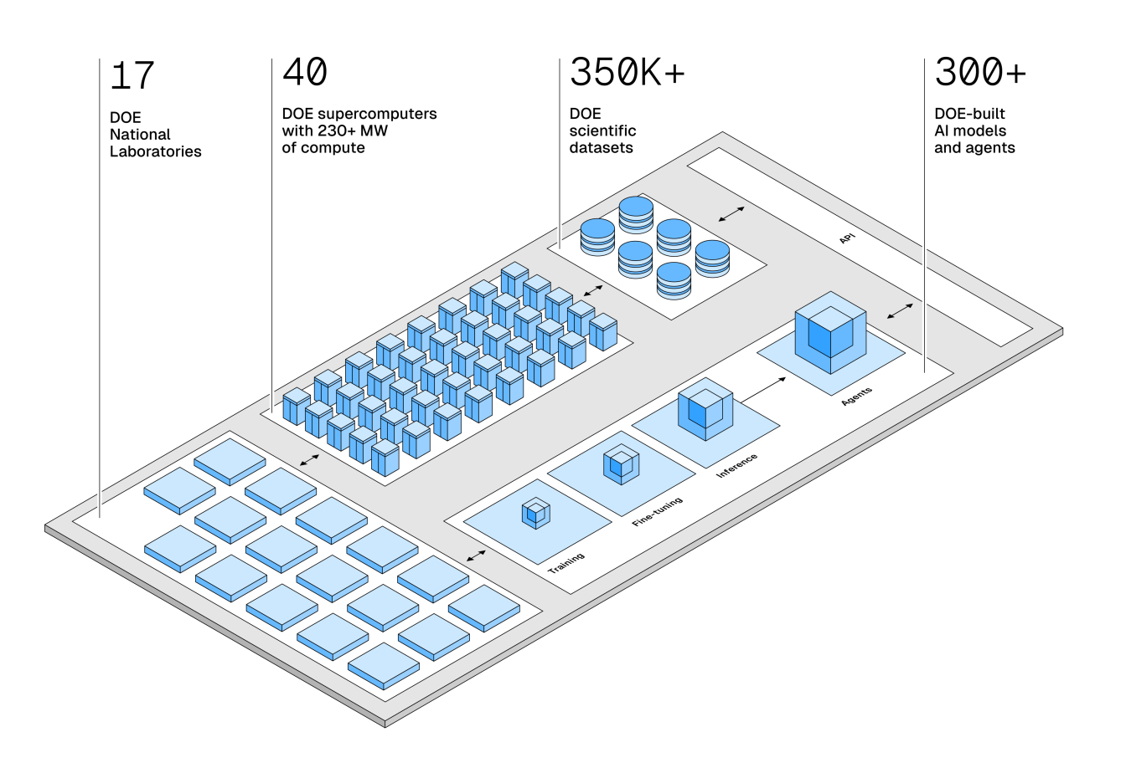
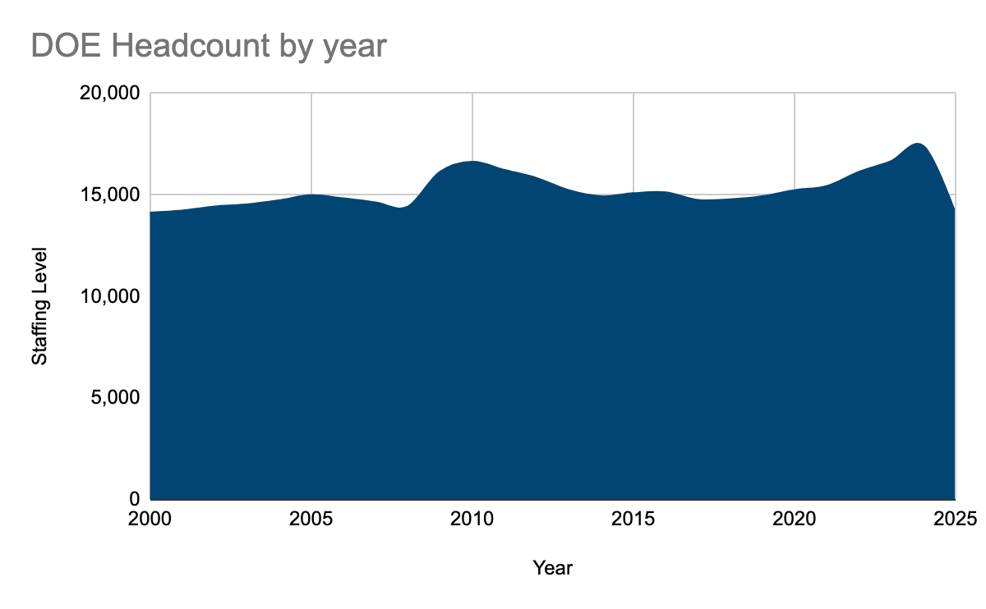

Our Operations Challenge
Growing Scale
But Fixed Staffing Levels
Accelerating Demands

Slide 4
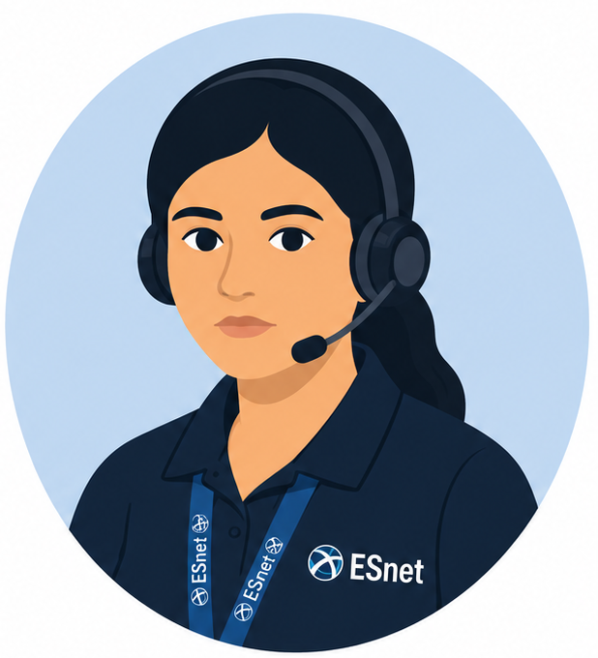

ORBIT
Data Source Examples
Use Case Examples
Operations
Response &
Business
Intelligence
Toolkit
Network Database (ESDB)
AAR Timelines
Ops Chat (Slack)
Shift Reports
Ticketing (ServiceNow)
RFO Suggestions
Procedures / Documentation (Wiki)
ORBIT
Procedure Suggestions
Happy NOC Engineers

Slide 5
Our Principles
Start With Real Workflows
Every capability maps to a pain point identified by operators — not by us in a conference room
Humans in the Driver’s Seat
ORBIT suggests. The operator decides.
Meet People Where They Are
AI shows up in ServiceNow — not a shiny new app nobody asked for
Exploration > Tunnel Vision
This is ESnet's first AIops effort — learning what works is the real deliverable

Slide 6




What AI Brings to the Table
Understands Intent
Cross-Source Synthesis
Semantic search gets context, not just keywords — "VPN broken" matches "can't access network from home"
Combines tickets + docs + Slack into coherent answers. No more five browser tabs.
Pattern Matching
Speed of Insight
Connects new alarms to relevant past incidents and resolution procedures
Information surfaces when needed, not after 20 minutes of searching

Slide 7
Six NOC Use Cases
We evaluated 20 candidate workflows with ENOC and picked the six with the best feasibility-to-impact ratio:
1
Alarm Procedure
Suggestion
2
Process & Procedure
Chat Bot
3
Recommend Incident
Priority
Alarm -> Procedure
Natural language Q&A across all data sources
Suggest priority based on alarm profile + docs
4
Suggest Likely
RFO
5
Generate Incident
Timeline
6
Incident Handoff
Report
Draft RFO code and close-out summary
Summarize ticket activity for after-action reports
Auto-summary for escalation

Slide 8
How It Went

Slide 9

“As you start to walk on the way, the way appears.”
- Rumi

Slide 10
Six NOC Use Cases
Useful
We evaluated 20 candidate workflows with ENOC and picked the six with the best feasibility-to-impact ratio:
1
Alarm Procedure
Suggestion
2
Process & Procedure
Chat Bot
3
Recommend Incident
Priority
Alarm -> Procedure
Natural language Q&A across all data sources
Suggest priority based on alarm profile + docs
4
Suggest Likely
RFO
5
Generate Incident
Timeline
6
Incident Handoff
Report
Draft RFO code and close-out summary
Summarize ticket activity for after-action reports
Auto-summary for escalation
Didn’t really save time
Works, but infrequently used

Slide 11
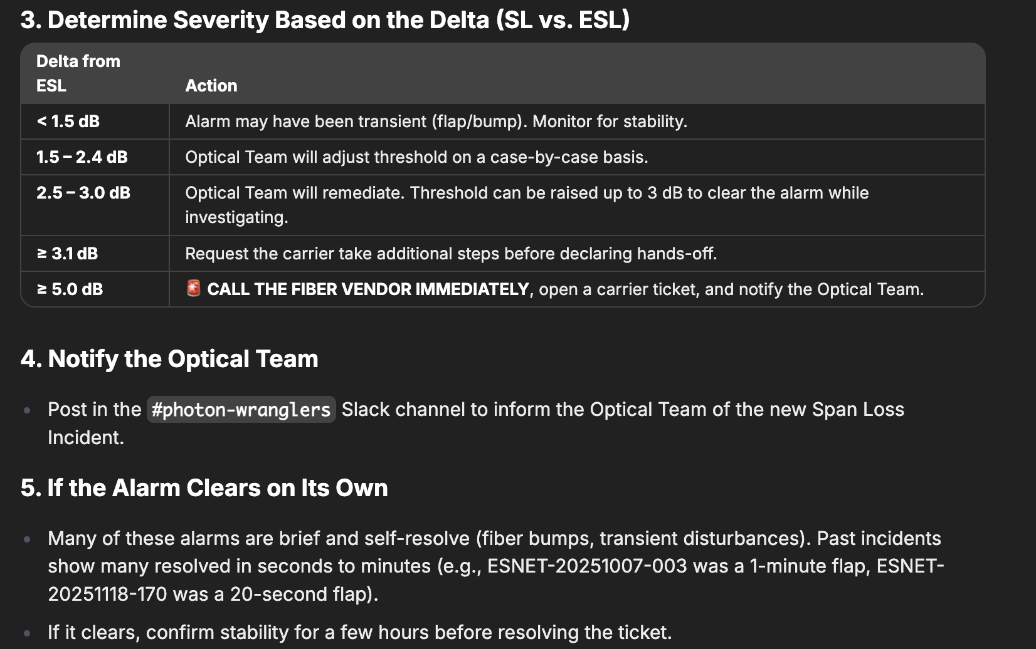
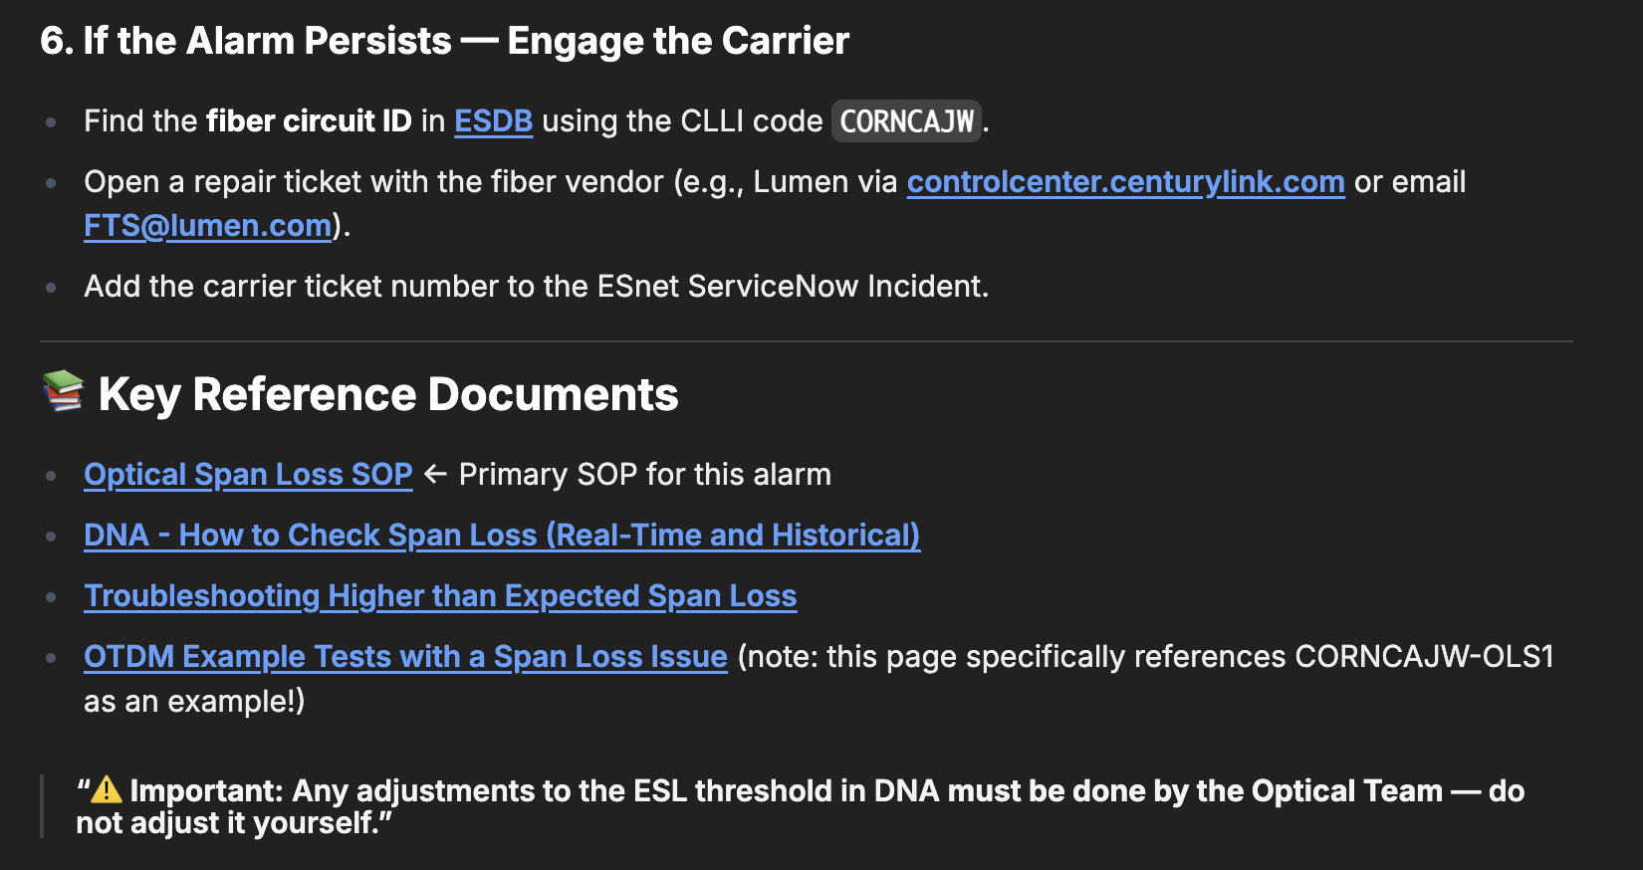
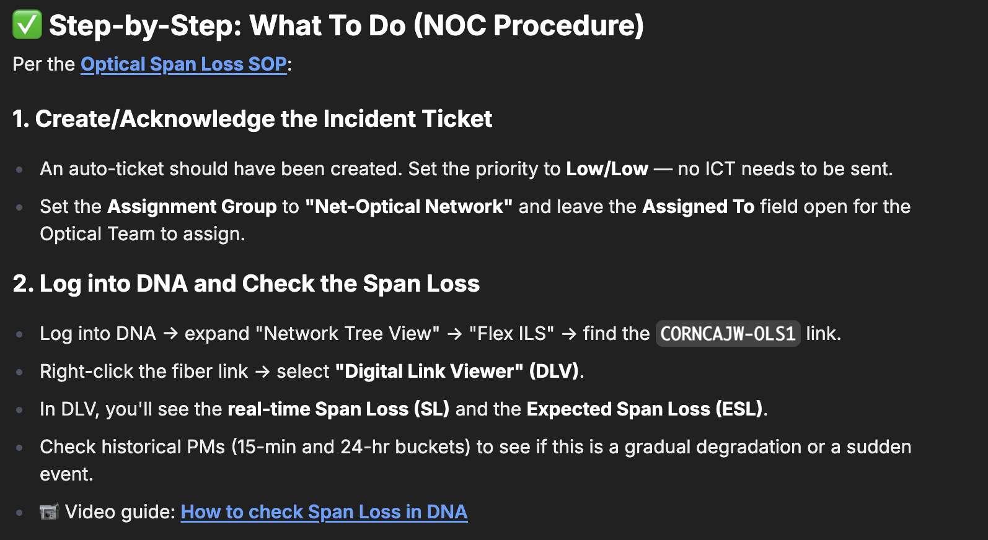
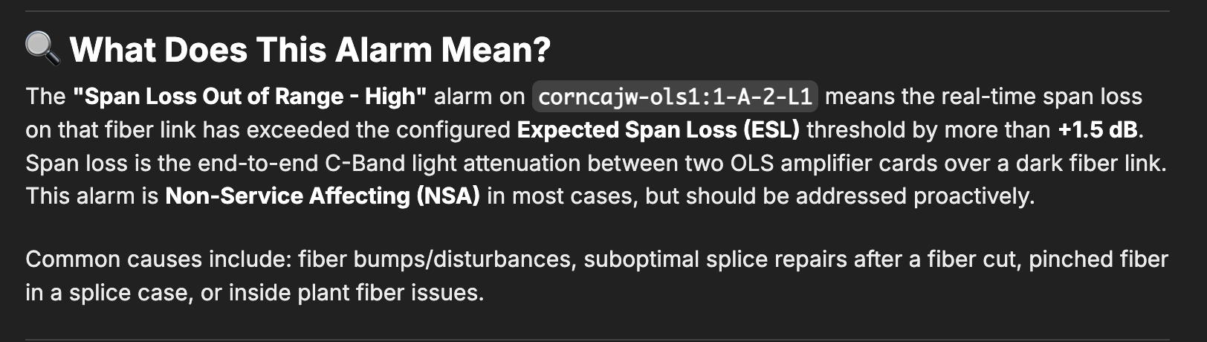
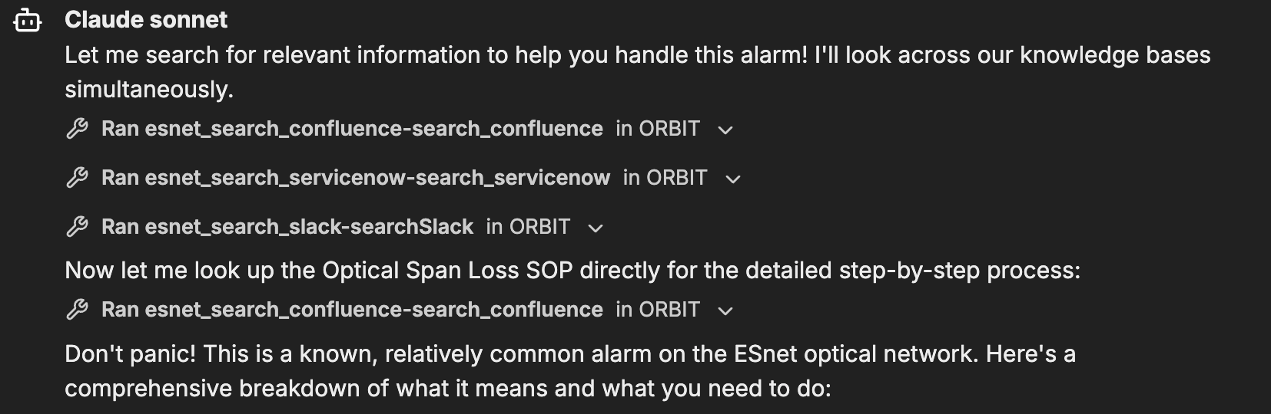
“I just received the following alarm: "corncajw-ols1:1-A-2-L1: Span Loss Out of Range - High". What do I do?!?”

Slide 12
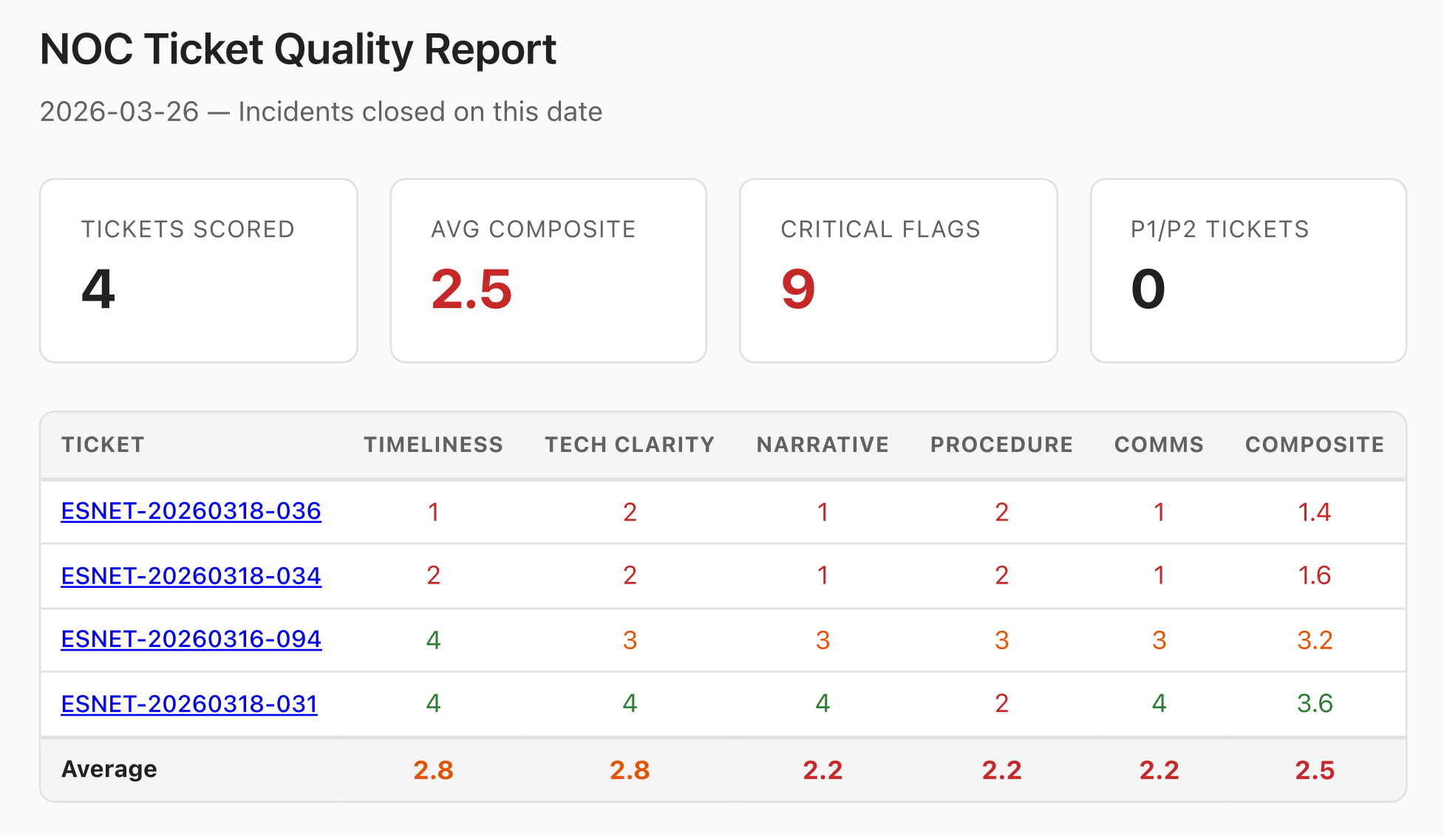
Example Future Use Cases
Daily Incident Ticket Quality Report
  Identify tickets that need more attention
Daily NOC “Ledger”
  daily summary for handoff
  Aggregate summaries for trends

Slide 13
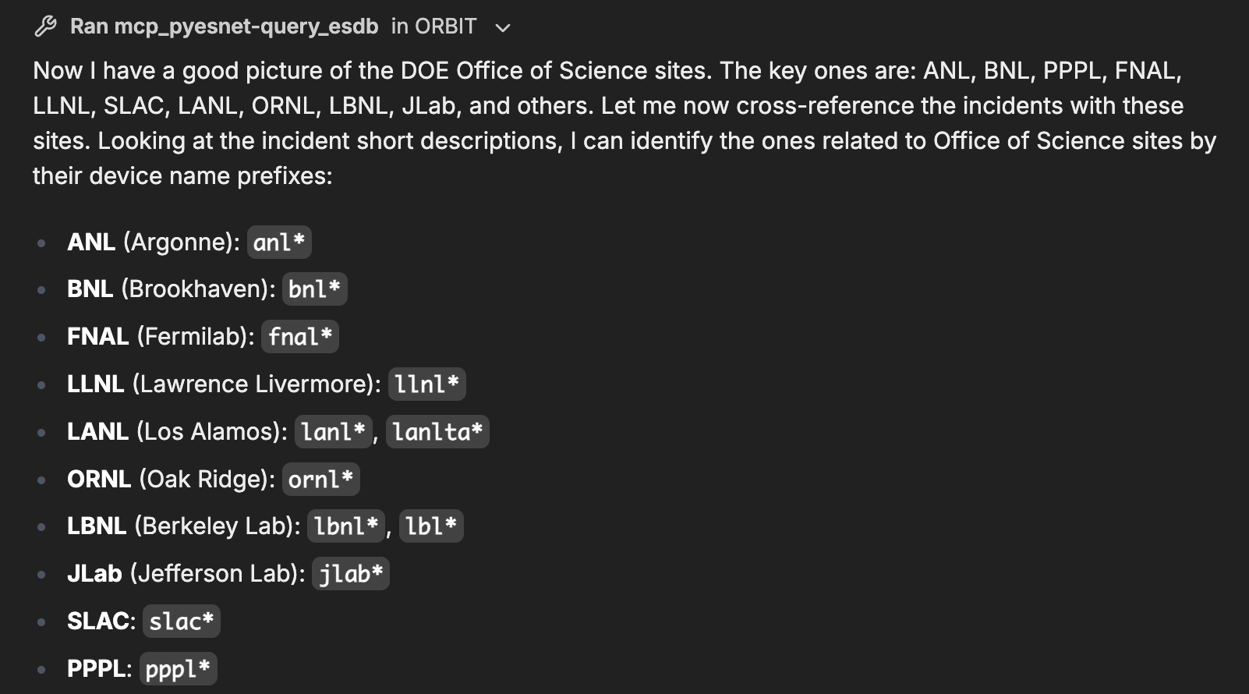
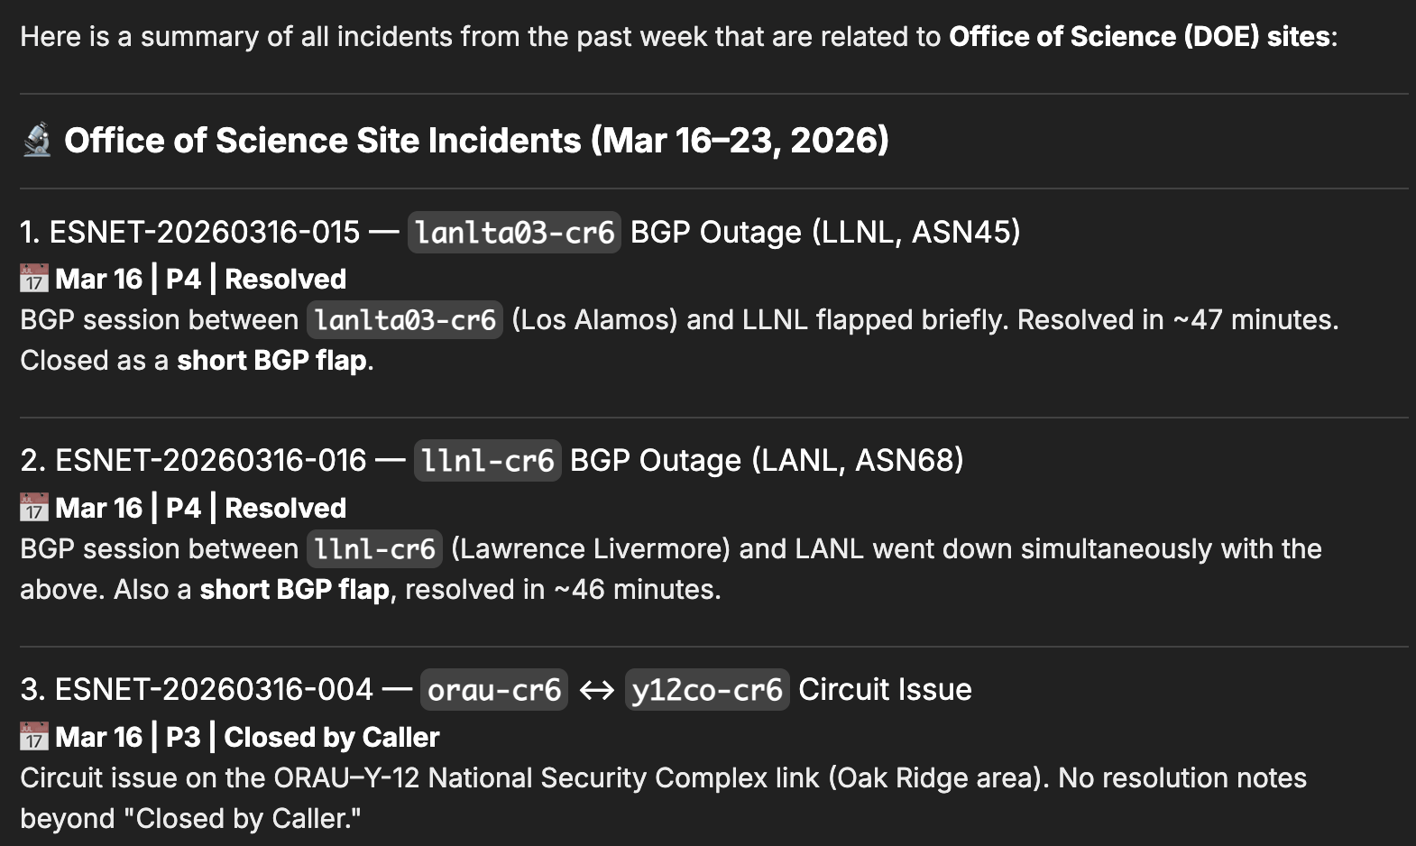
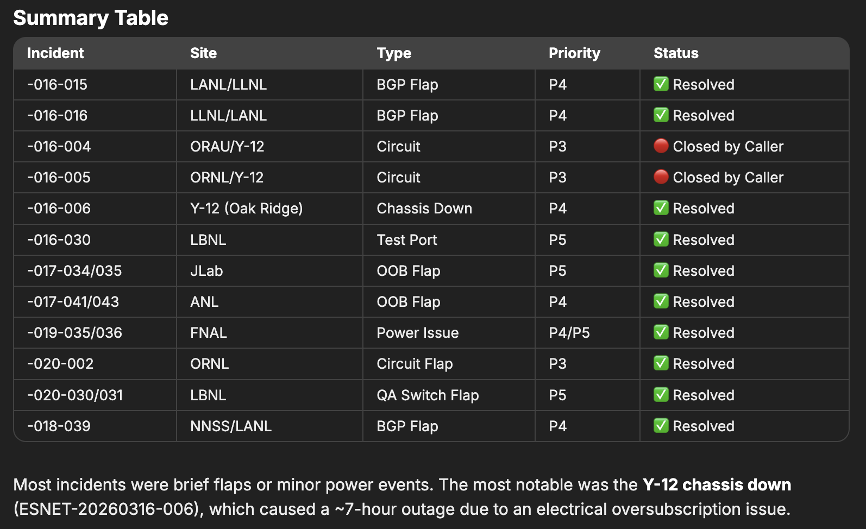
“Show me all incidents from the past week that were related to an Office of Science sites. Summarize each incident and keep the conversation compact”

Slide 14
How we make work

Slide 15
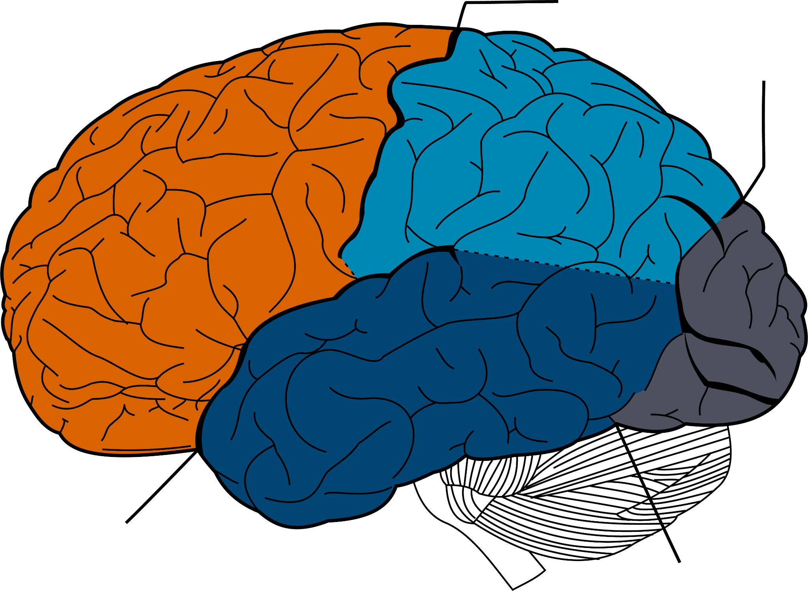

Observe → Orient → Decide → Act
Network Management Stack as a crude brain approximation
Combine AI with human intellect to manage risk
deliver reliable and performant capabilities
Integrate where we can, Innovate as needed.
Network Automation
Artificial Intelligence + Wetware
Network Observability
Ed
Notes:
Without nerding out, basically the brain has a hierarchy with areas of specialization
We see network management as mimicking that type of conceptual network
But we see Human Intellect in control

Slide 16
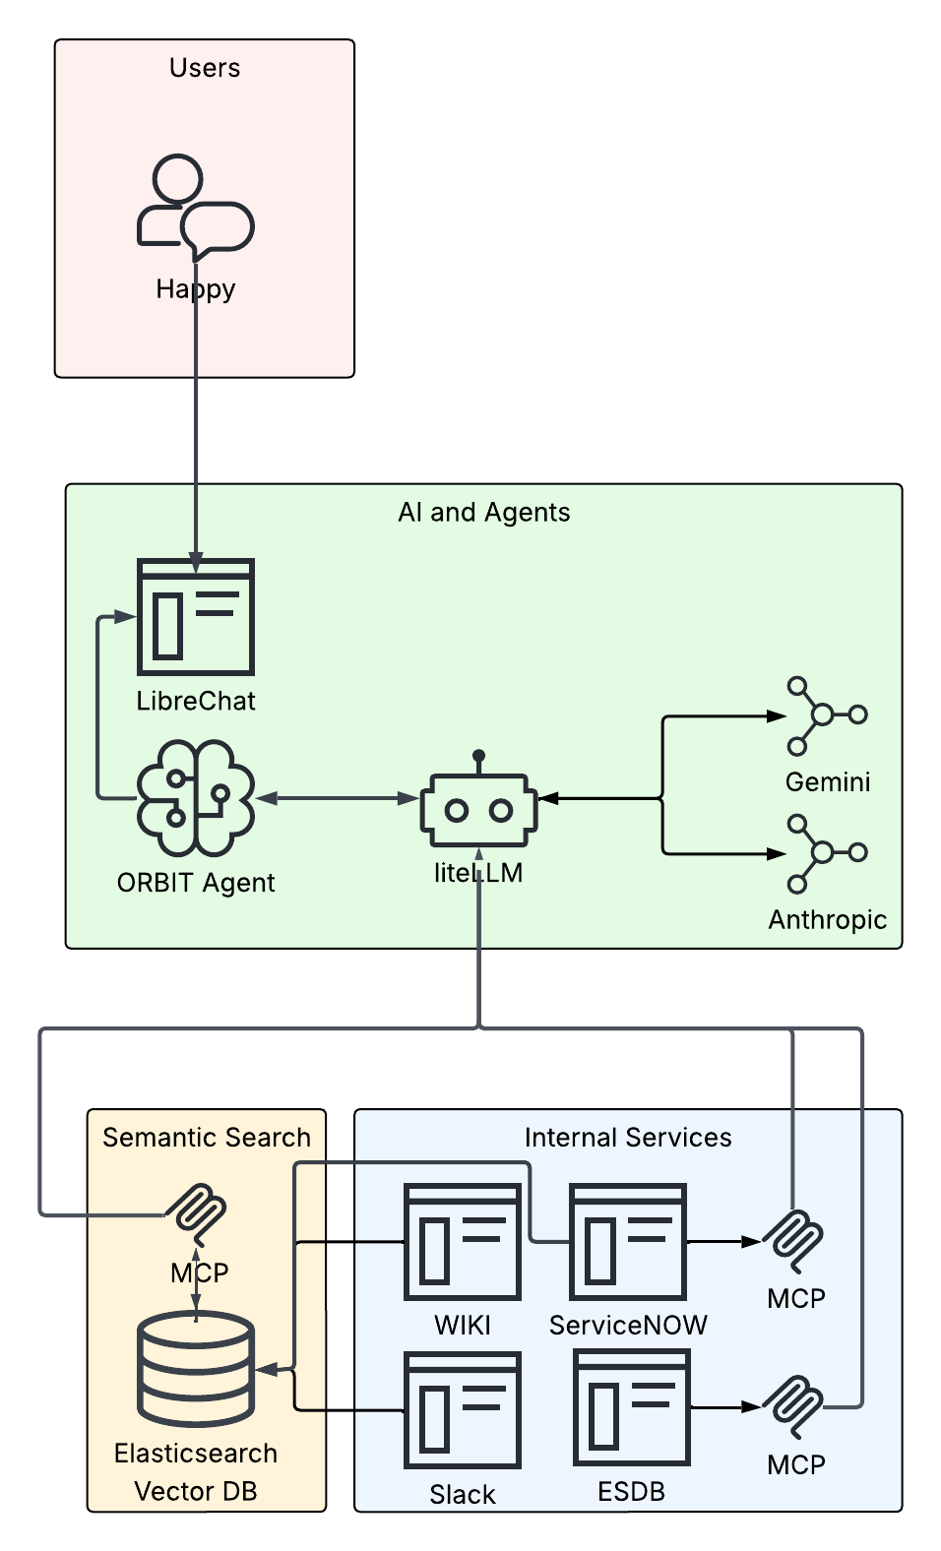
High Level Architecture
Unified data access gives us a more complete view of the situation.
  Slack data fills in missing context that never made it to the ticket
  integrated policies and procedures allow agents to recommend actions inline with established practice
Developers focused on refining context / prompts to agents to improve effectiveness of system.
Notes:
We respond with a blended approach
Continue with the prudent best practices
Combine with AI augmentation
Leave the Human in the loop
Example of multidata source would be:
“Customers connected through Chicago are reporting unstable service, please summarize whats going on that might be responsible”
Then the agent looks at our customer database to figure out who is in chicago, what backbone routers are there, then queries the ticketing system to look for known outages and maintenaces, then looks at live metrics and logs, and finally checks to see if there were any Operations chats in slack that were relevant. It then synthesises a response.

Slide 17

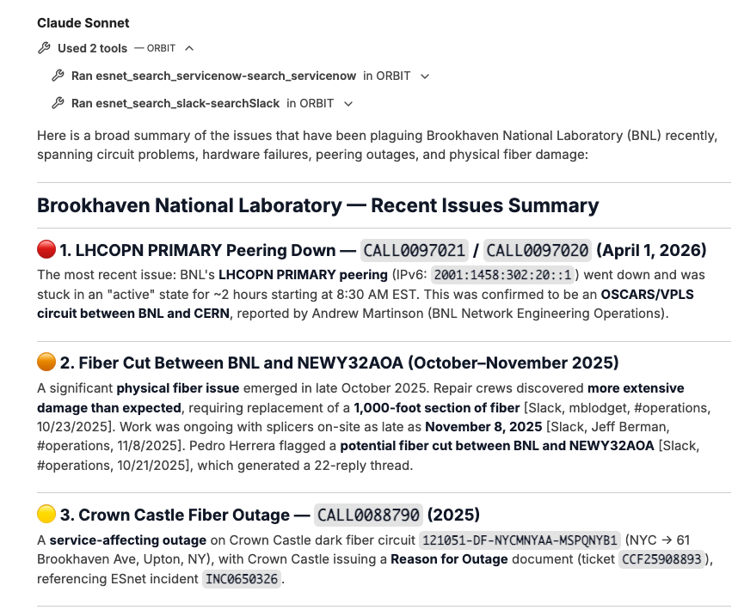
Agentic Access to Semi-Structured Data
Integrate LLMs and Semantic Search with local skill building
Move beyond keyword search into meaning and context comprehension
Create AI-ready knowledge with semantic search and MCP
Notes:
Orbit shows the power of combining human chat, ticketing and documentation into a Generative AI Agent environment
It helps address the gap between ideal and real ticketing etiquette

Slide 18
ServiceNow Integration
Triggered Automatically
Where appropriate, business rules can fire on new incident tasks — no operator action needed
Results in Work Notes
AI content appears directly in tickets, visible to the whole team
Model Selection
Claude Opus via LiteLLM — configurable per action type
Operator Always in Control
Accept or reject any suggestion. It's an assistant, not a boss.
Feedback Built In
Quality tracking so we can measure and improve over time

Slide 19
Lessons Learned

Slide 20
Technical Lessons
Treat prompts as code
  If you are precise in your guidance, your results improve
  How you express things directly impacts token efficiency
  We have seen 25% speed up with modest refinements
  Version them and do QA
Plan for inconsistent responses
  These are probabilistic, outputs can be a bit stochastic
  Precise guidance helps but does not eliminate

Slide 21
Non-Technical Lessons
AI is so new, most people have difficulty envisioning use cases
  Most people still view AI as glorified chatbots and aren’t keeping up with the field
  It is difficult to reason about what is possible vs what is pipe dream
  Once you give people a taste of what’s possible, the ideas begin to flow rapidly
Don’t expect your initial use cases to be your strongest
  The more infrastructure you build out and the more data sources you add, the more options become available
  Initial uses cases help you discover your REAL use cases
Pace and power of AI presents risks
  Just because you can do something does not mean you should
  Develop organizational policies for AI usage and data access
  Focus on security, but don’t overcorrect and stifle innovation

Slide 22
If you walk away with one slide in mind….
Listen to Your Operators
Identify real pain points directly from the front lines to ensure tool relevance.
Data Integration is Key
The challenge isn't the AI — it's unifying data access across siloed, legacy systems.
Custom Synthesis
Off-the-shelf bots can't see across platforms; bespoke work is required for synthesis.
Avoid Vendor Lock-in
Leverage open-source tools like LangChain and LiteLLM for long-term flexibility.
Prompt Engineering
Budget for iterative prompt design—it's more art than science right now.
Platform and Use Cases
Build the foundation, let users innovate, but maintain focus on important use cases.

Slide 23
Future

Slide 24
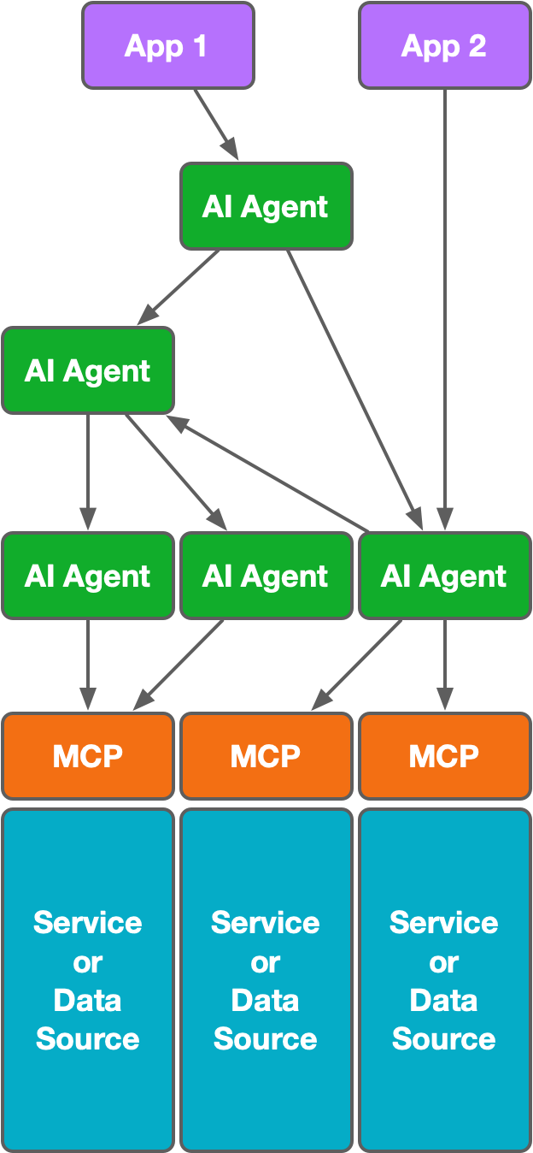
Desired Future State (for Network Operations)
Human-mediated and AI-Assisted Automation resolves issues faster with less labor
A network of agents will give us powerful capabilities not available possible with one agent
All services and relevant data will be accessible to agents on behalf of authed users (Zero Trust arch.)
Notes:
This is overly simplistic but gives you a mile high sense of what we are attempting to provide

Slide 25
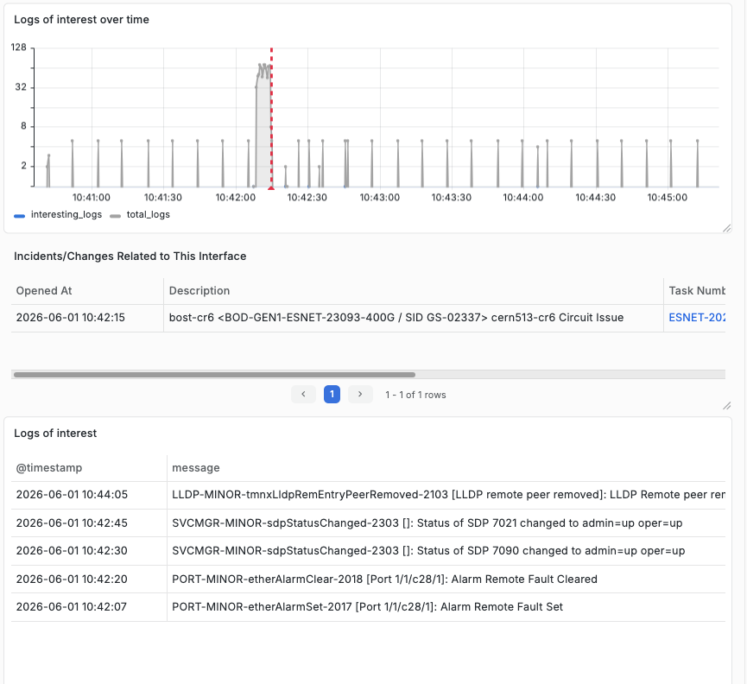
Drishti Automated Log Analysis
Identify interesting events
Cluster events
Generalize into behavioral sequences
Provide text summary
Do this without supervision.
Early Alpha Stage
Open Telemetry and Router Logs
Notes:
Find the Needle in the Needle Stack

Slide 26
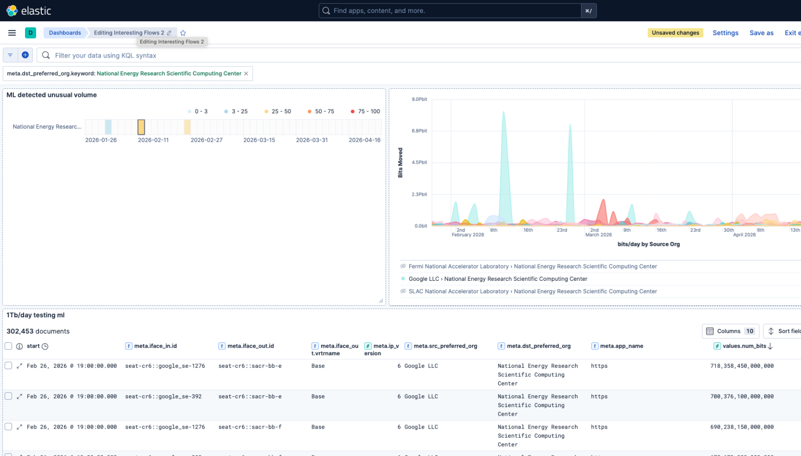
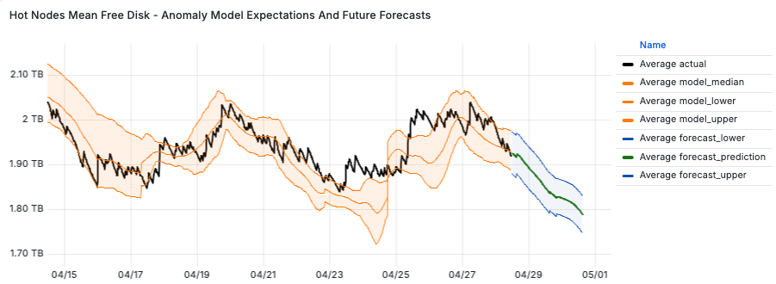
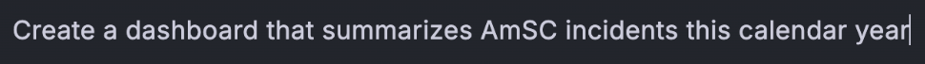
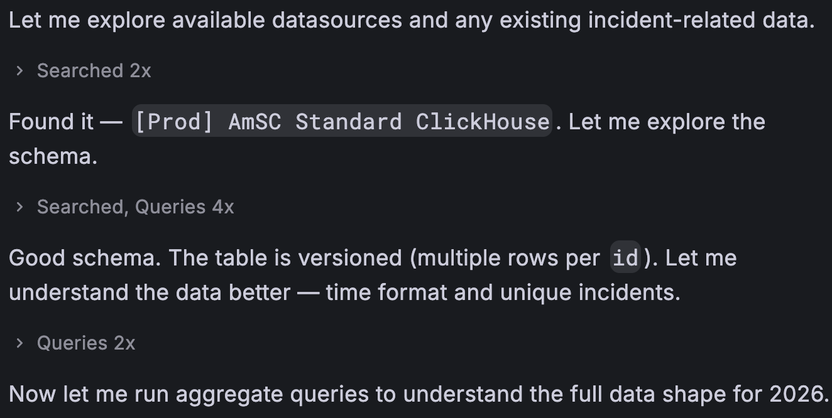
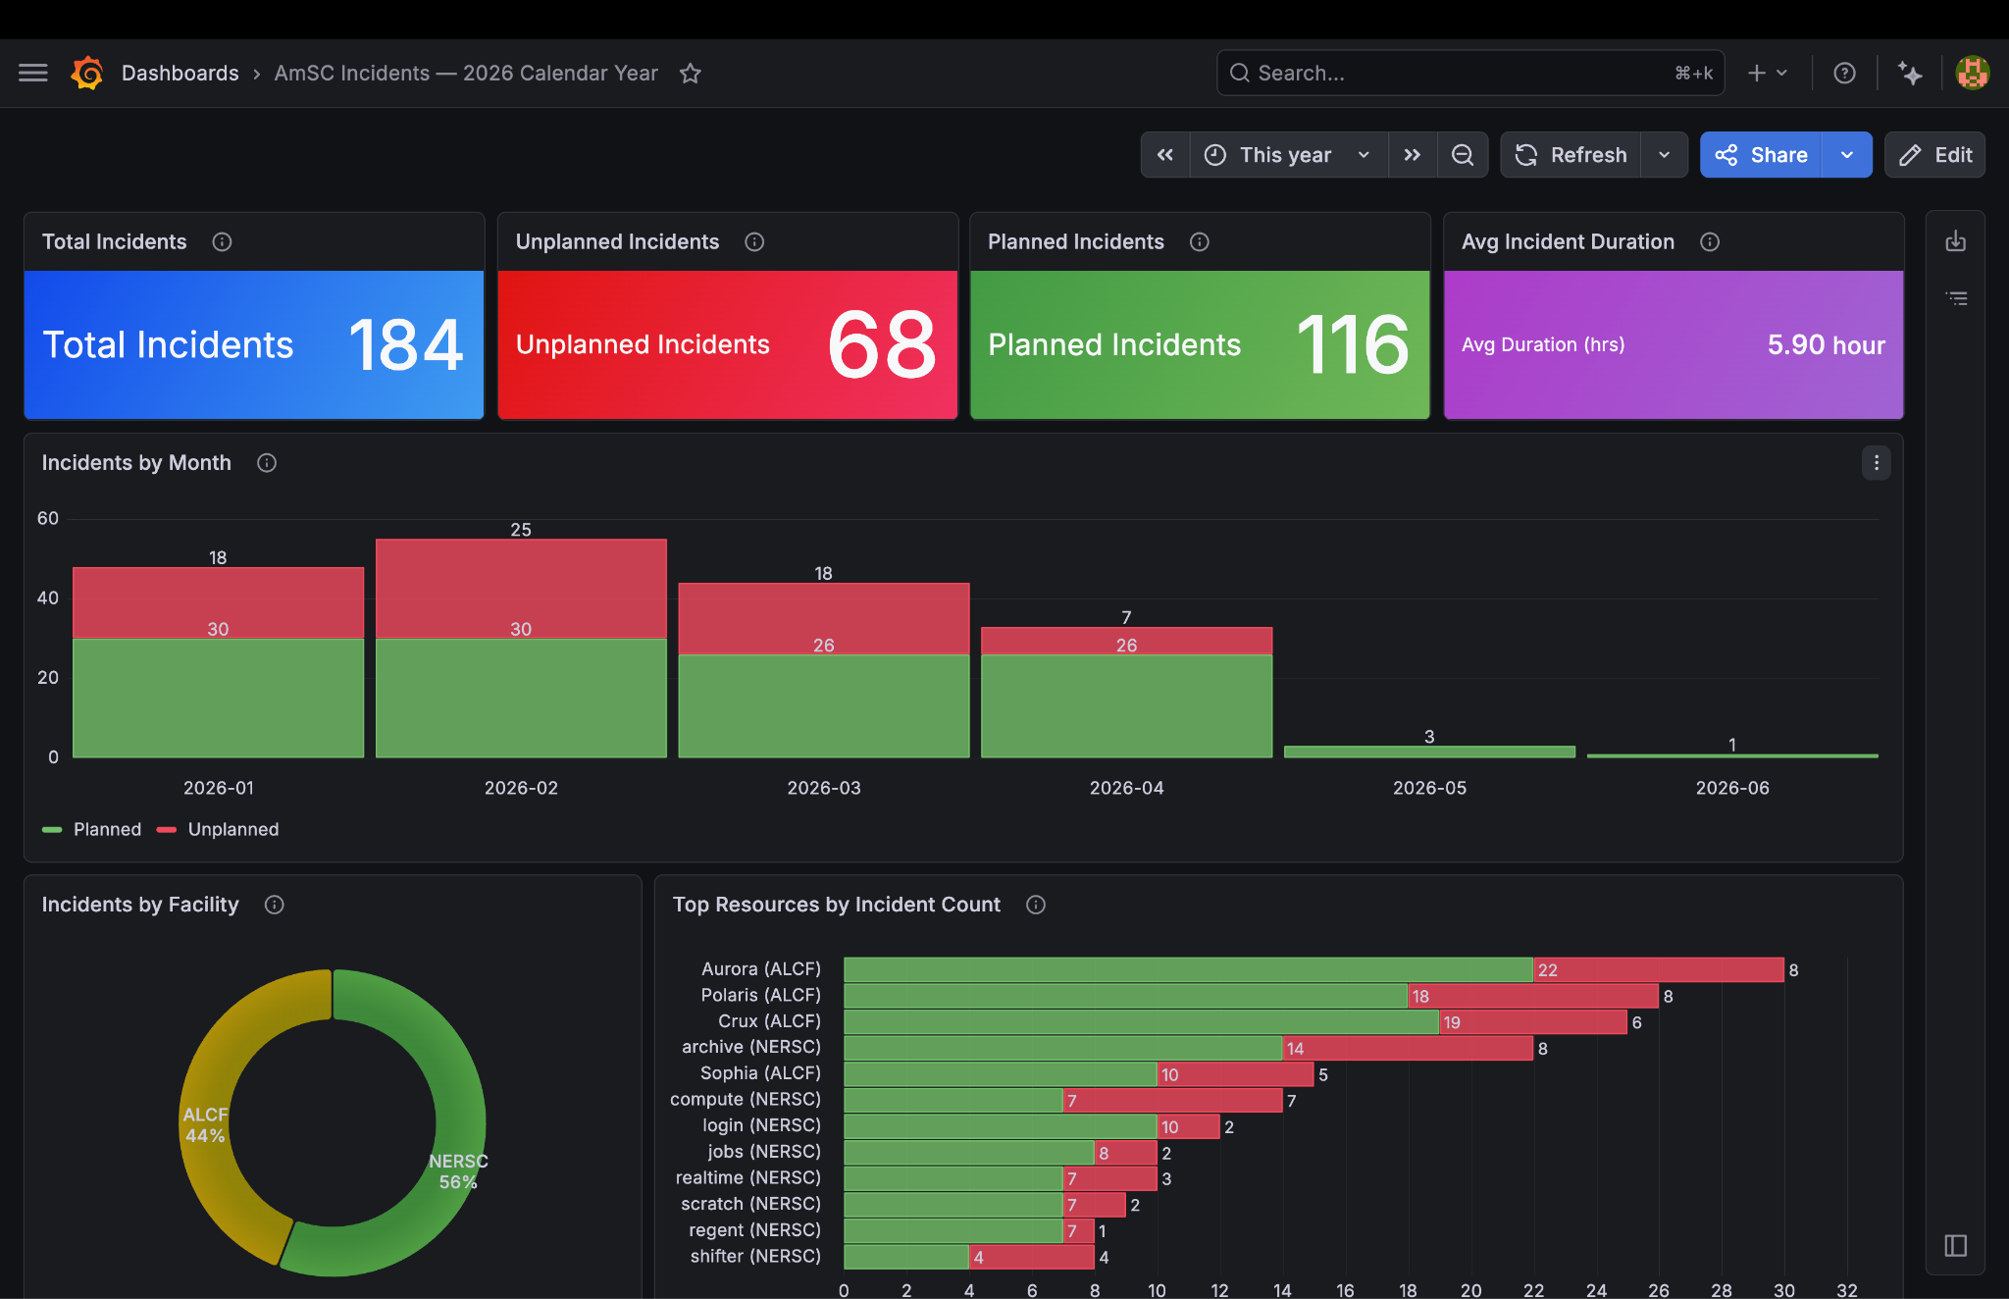
Leverage Vendor Features
Integrate commercial capabilities where we can
Elasticsearch
  Find interesting data movements
  Predict resource exhaustion
Grafana
  Create a dashboard for me
Notes:
This shows two common use cases that are both reasonably achievable with off the shelf tech
Find interesting data movement
Elasticsearch based, multivariate
Limits on dimensionality
Lacks explainability (proprietary)
Warn before resource exhausted
Elasticsearch based, univariate
Preserves our engineers’ weekends
Works well for this use case

Slide 27
Thank You
Contributors:
David Mitchell, Sukhada Gholba, Bin Dong, Garrett Stewart,
Brendan White, Brooklin Gore, Shawn Kwang, Luke Baker,
Chin Guok, Jon-Paul Herron, John Macauley, Scott Richmond,
Chris Robb, Chris Tracy, John Wu, Ed Balas

