Slide 1
TNC26
Machine Learning for Anomaly Detection in RNP Network Operations

Slide 2
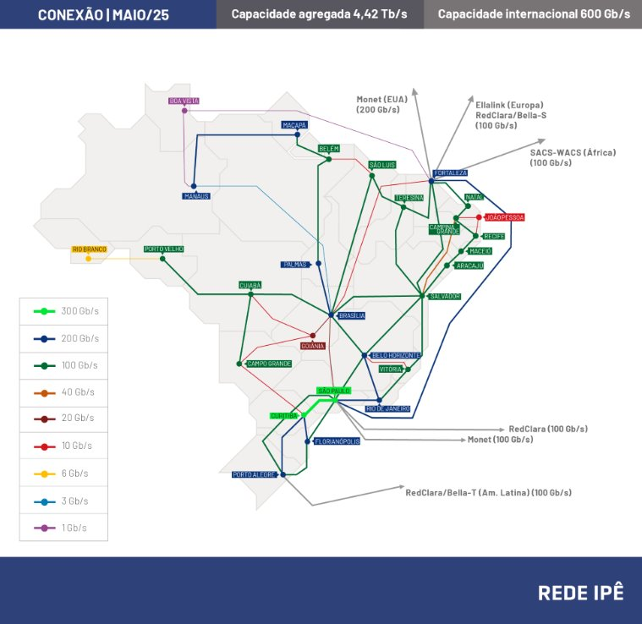
RNP – Rede Nacional de Ensino e Pesquisa
Brazilian NREN
Presence in all 27 states in Brazil
~1800 sites connected
International connections
  US: Monet
  Europe: Bella-S
  Africa: SACS
  South America: RedClara

Slide 3
Our reality
Complex network running many networking protocols
MPLS-TE provisioning dynamic tunnels (full mesh between PoPs)
A lot of data being collected
A small team takes care of the backbone

Slide 4
Pathway on observability
Started in 2018 with a considerable change
  Telemetry
    High resolution and push model
Many improvements on tools and new ways to detect problems
2024 – Elastic cluster was implemented
2025 – Started working with Machine Learning

Slide 5
Why to look at ML
Network engineers have to handle a high volume of network data and
increasing fast.
  Customer requirements are pushing the network SLAs (low latency, high throughput and no congestion)
  Binary logic (up/down) is not enough
Difficult to set threasholds on alarm tools for different types of data and
behavior over time
Unstructured data needs to be handled differently
Relieve network engineers having this algorithm doing the 1st step of
analysis. (grouping and detecting trends/anomalies)

Slide 6
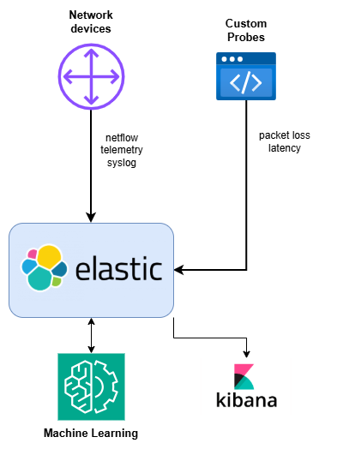
Architecture

Slide 7
ML Model
Elastic Learned Sparse EncodeR - ELSER v2
  is an out-of-domain model that does not require fine-tuning on your own data, making it adaptable for various use cases out of the box.
  Choosing an out of the box model was important to have it running with the same observability tool, avoiding to reivent the wheel.
  We don't have data scientists in the team, so we needed a ready to go solution

Slide 8
Use cases
Time series data
  Interface metrics
  Ping (packet loss and latency)
  netflow
Categorization data
  syslog

Slide 9
Anomaly examples

Slide 10
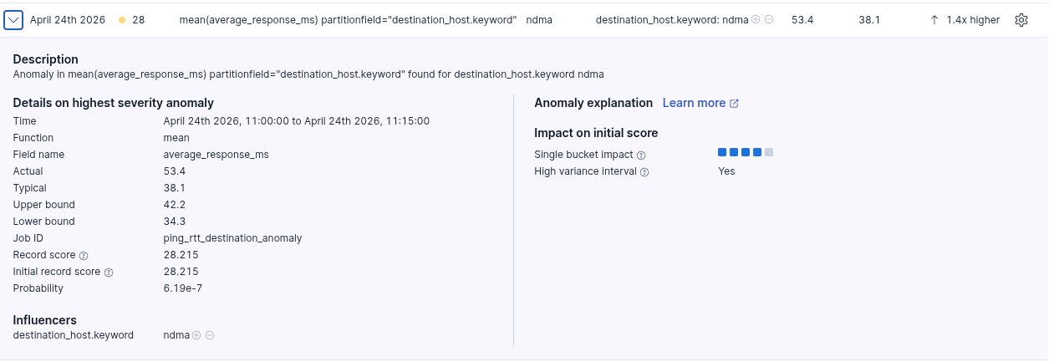
Latency anomaly
Different sources to a single destination

Slide 11
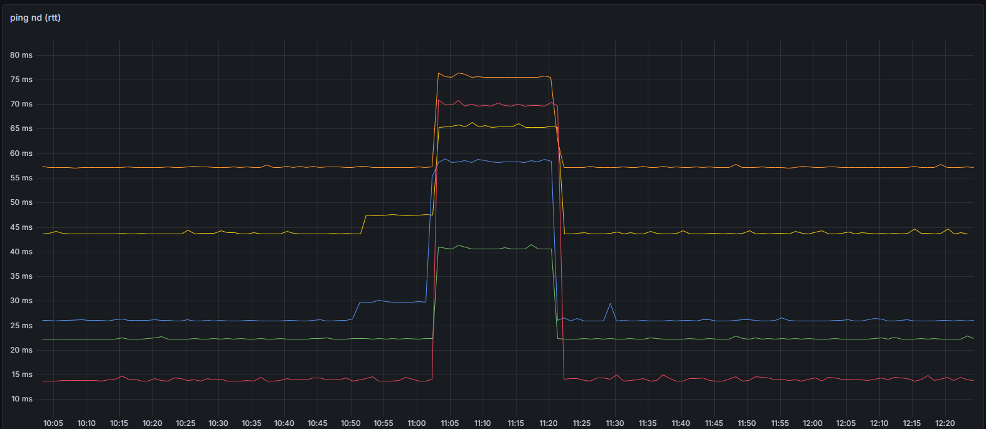

Slide 12
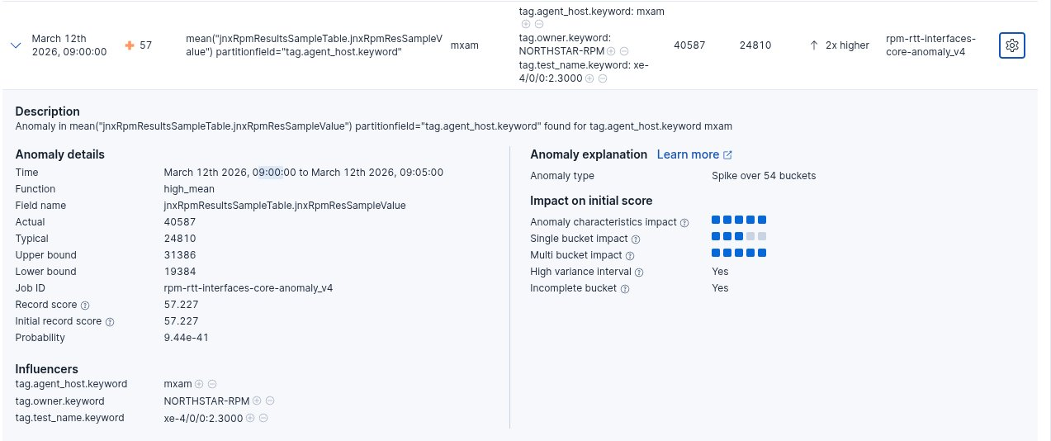
Interface delay anomaly – Case #1

Slide 13
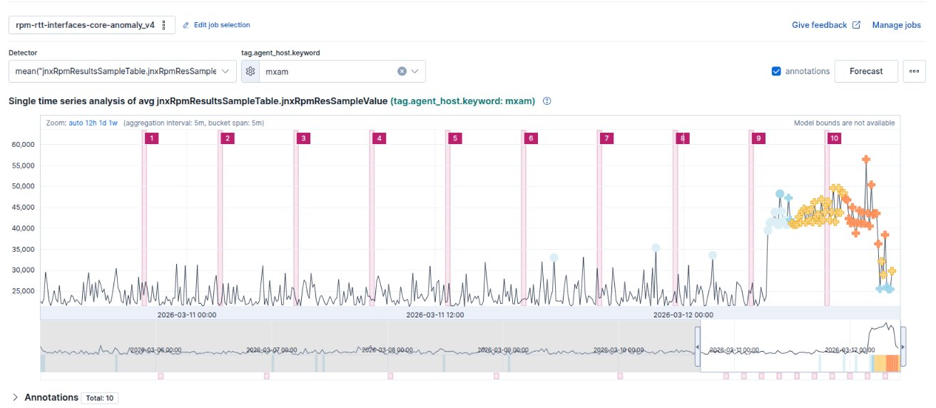
Case #1

Slide 14
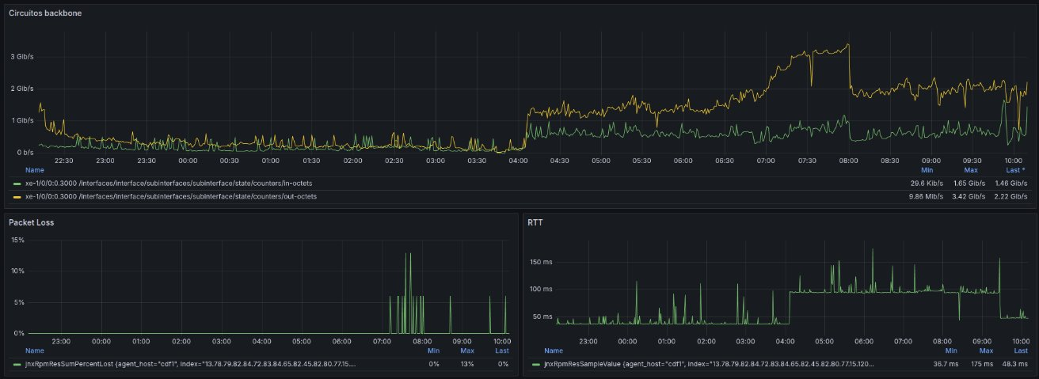
Case #1
Packet loss associated and probably a physical route change

Slide 15
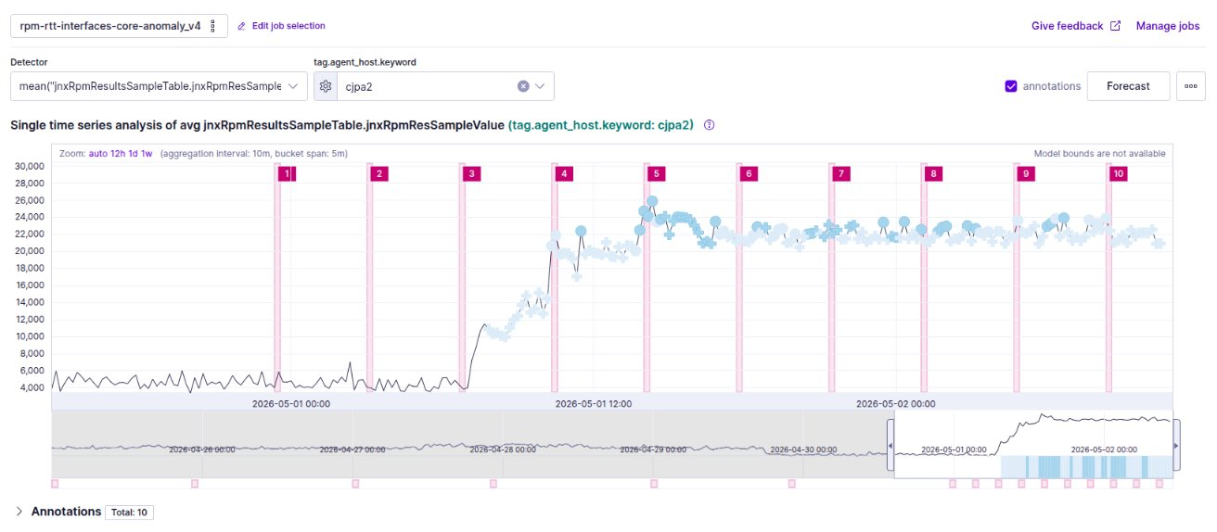
Interface delay anomaly – Case #2

Slide 16
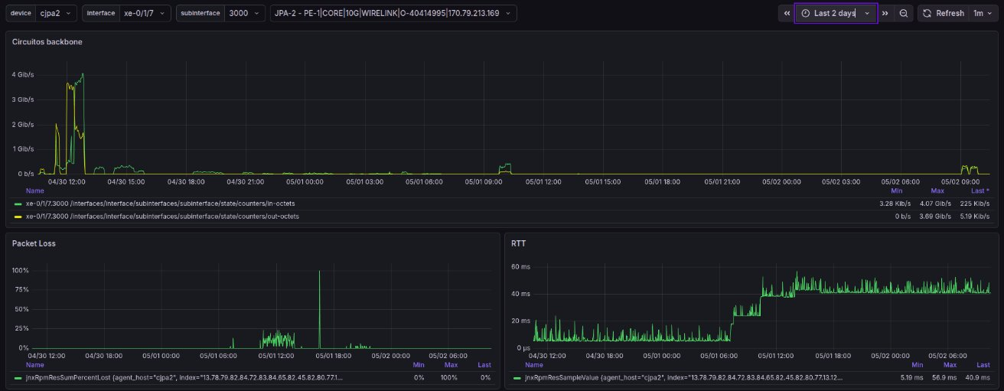
Case #2

Slide 17
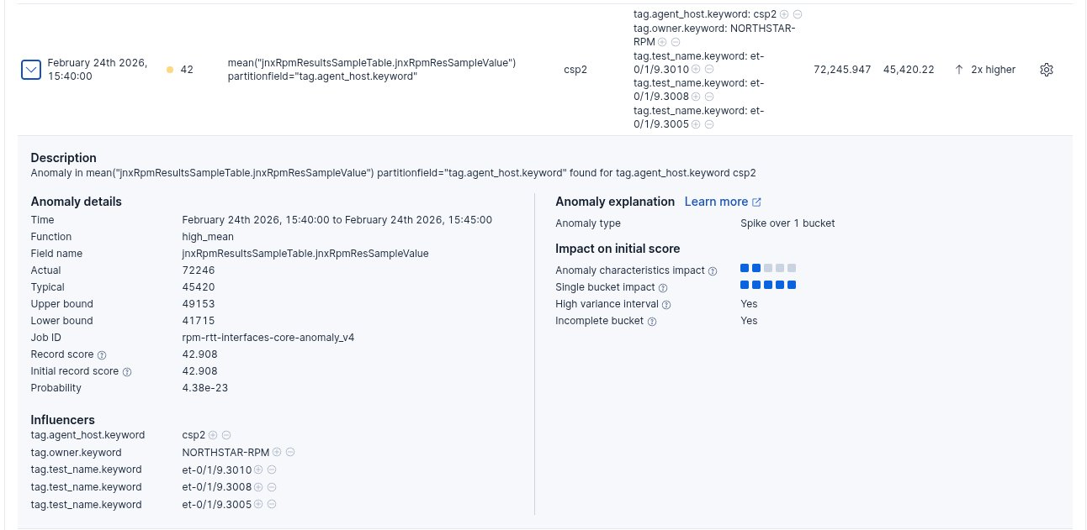
Interface delay anomaly – Case #3

Slide 18
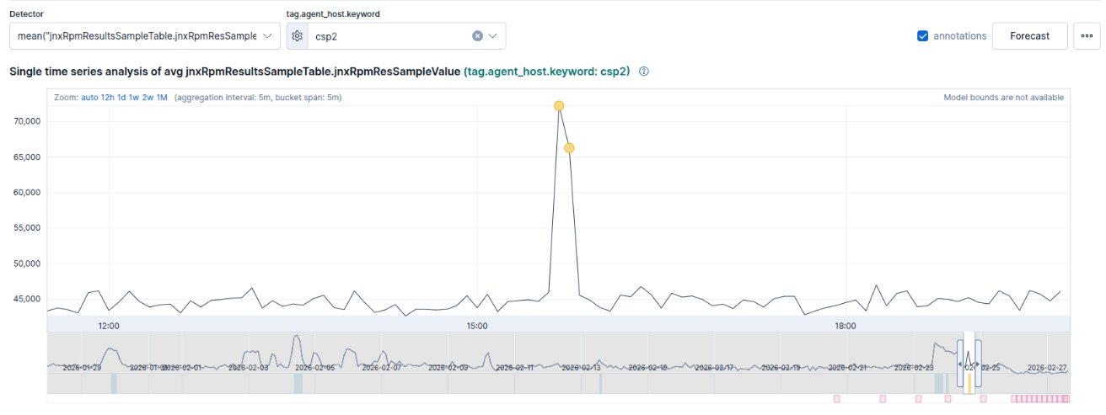
Case #3

Slide 19
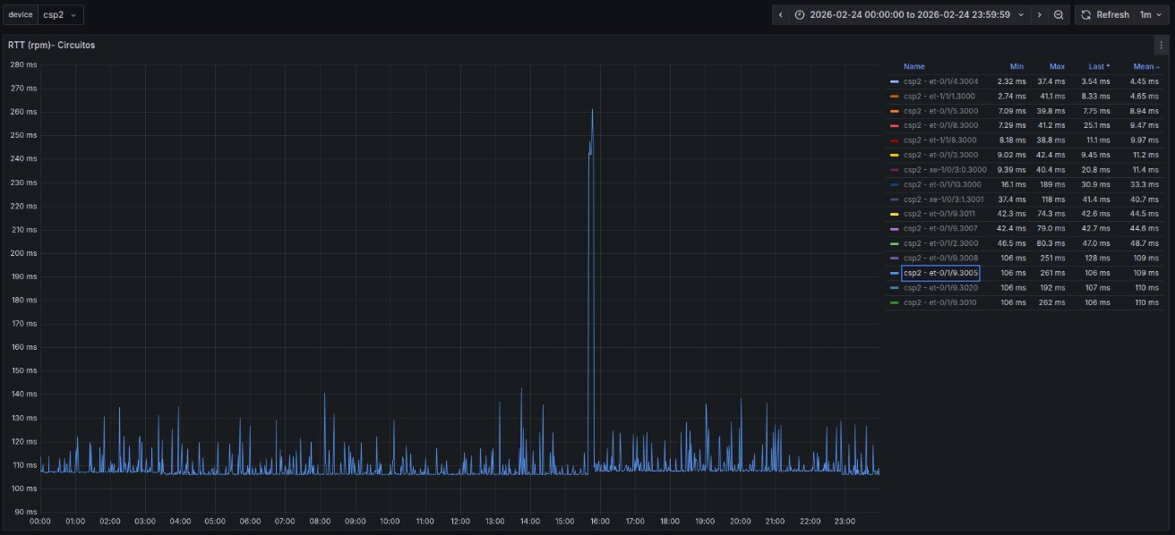
Case #3

Slide 20
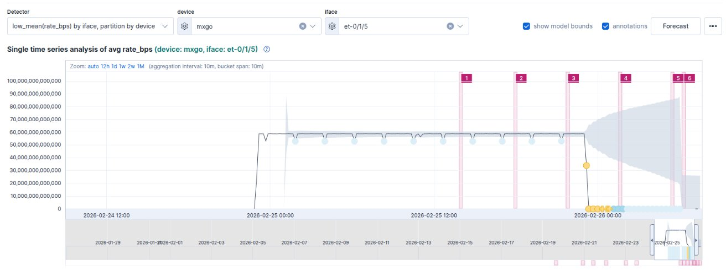
Interface utilization anomaly - Case #1

Slide 21
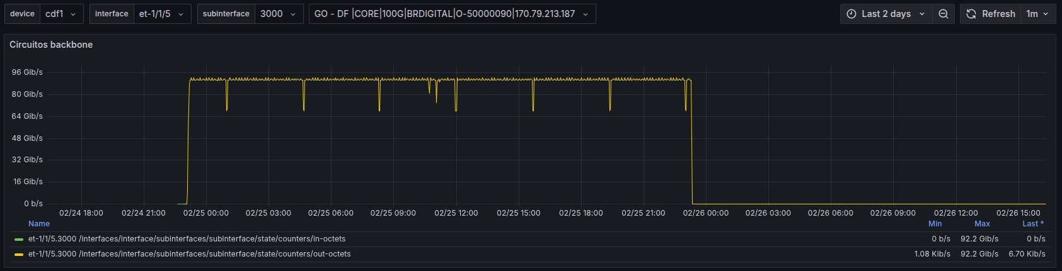
Case #1

Slide 22
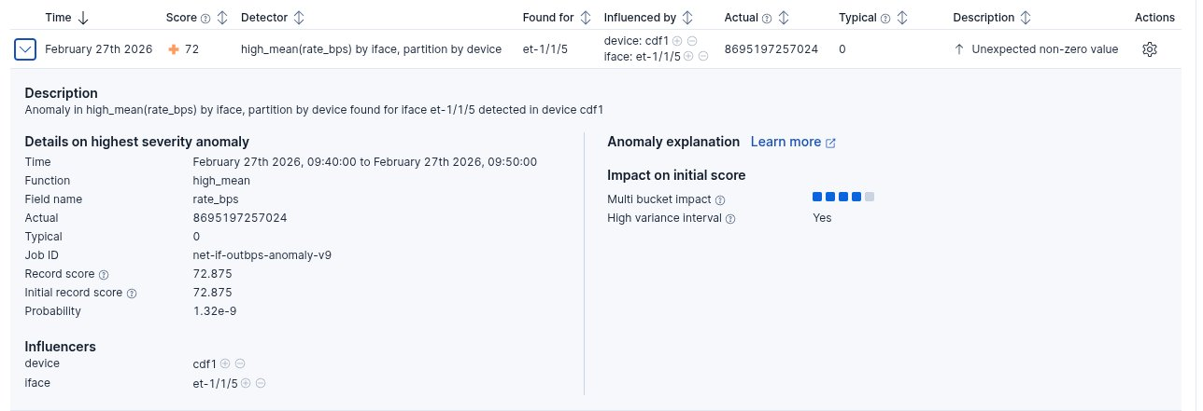
Case #2

Slide 23
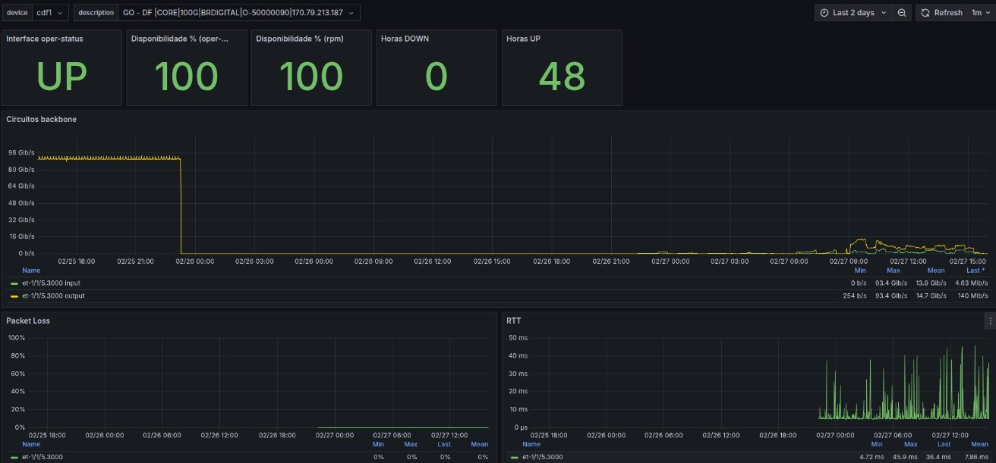
Case #2

Slide 24
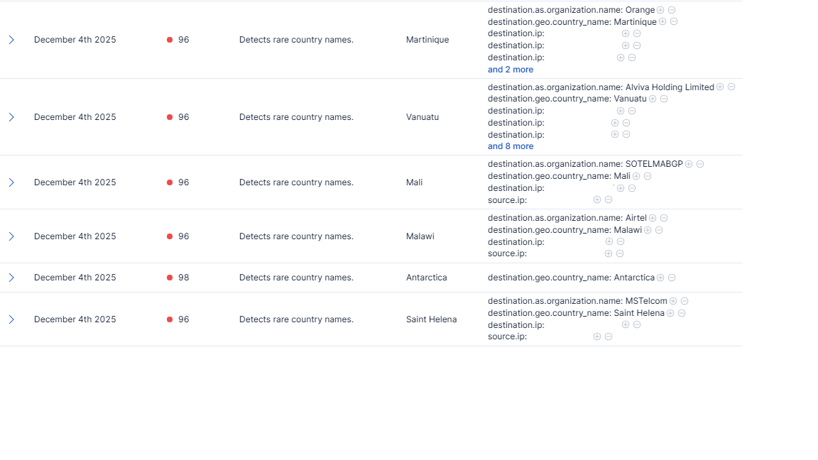
Netflow anomalies

Slide 25
Syslog categorization
Standard Categorization – group common messages
Rare categorization

Slide 26
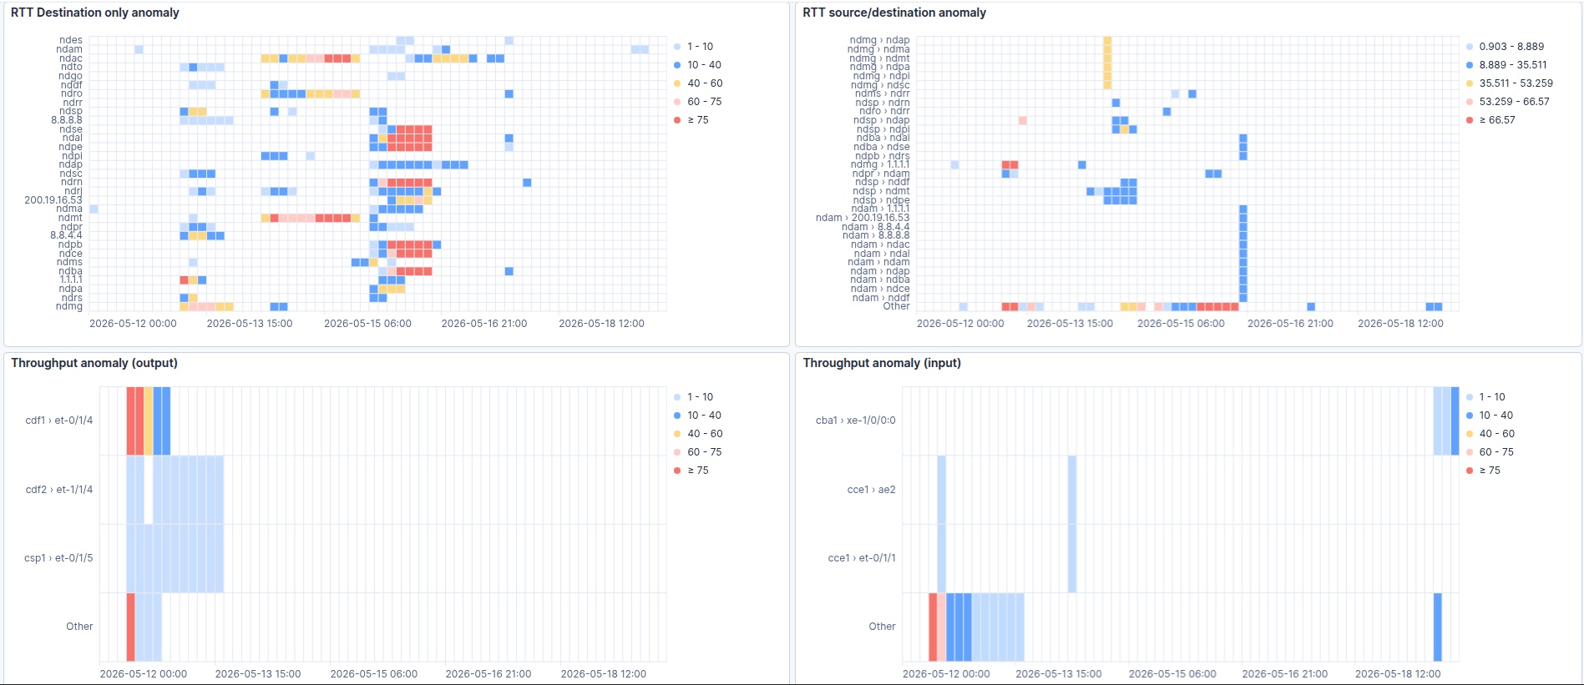
Dashboard

Slide 27
Limitations
As you saw before, the ML algo does not make reason of value
Cross reference with network data
RCA is not done by a single AD job
The analysis of the anomalies still need to be interpreted by a network engineer

Slide 28
Conclusions
ML is just one more tool in the toolset but it has a promising value.
An incremental provisioning of ML is a good way to start using and experiencing its benefits.
The network ecosystem still needs more tools focusing on non-experts adoptions.

Slide 29
Ideas for Future work
Represent our network in a format that an AI could understand it and help on the analysis of the anomalies
Consolidate more data sources so that the AI can have data of the big picture and bring insights.

Slide 30
Thank you! guilherme.ladvocat@rnp.br

