Slide 1
Building Digital Resilience through Cloud Sovereignty
A view of the Global South
Brenda Namuli
Systems Engineer
Research and Education Network for Uganda (RENU)

Slide 2
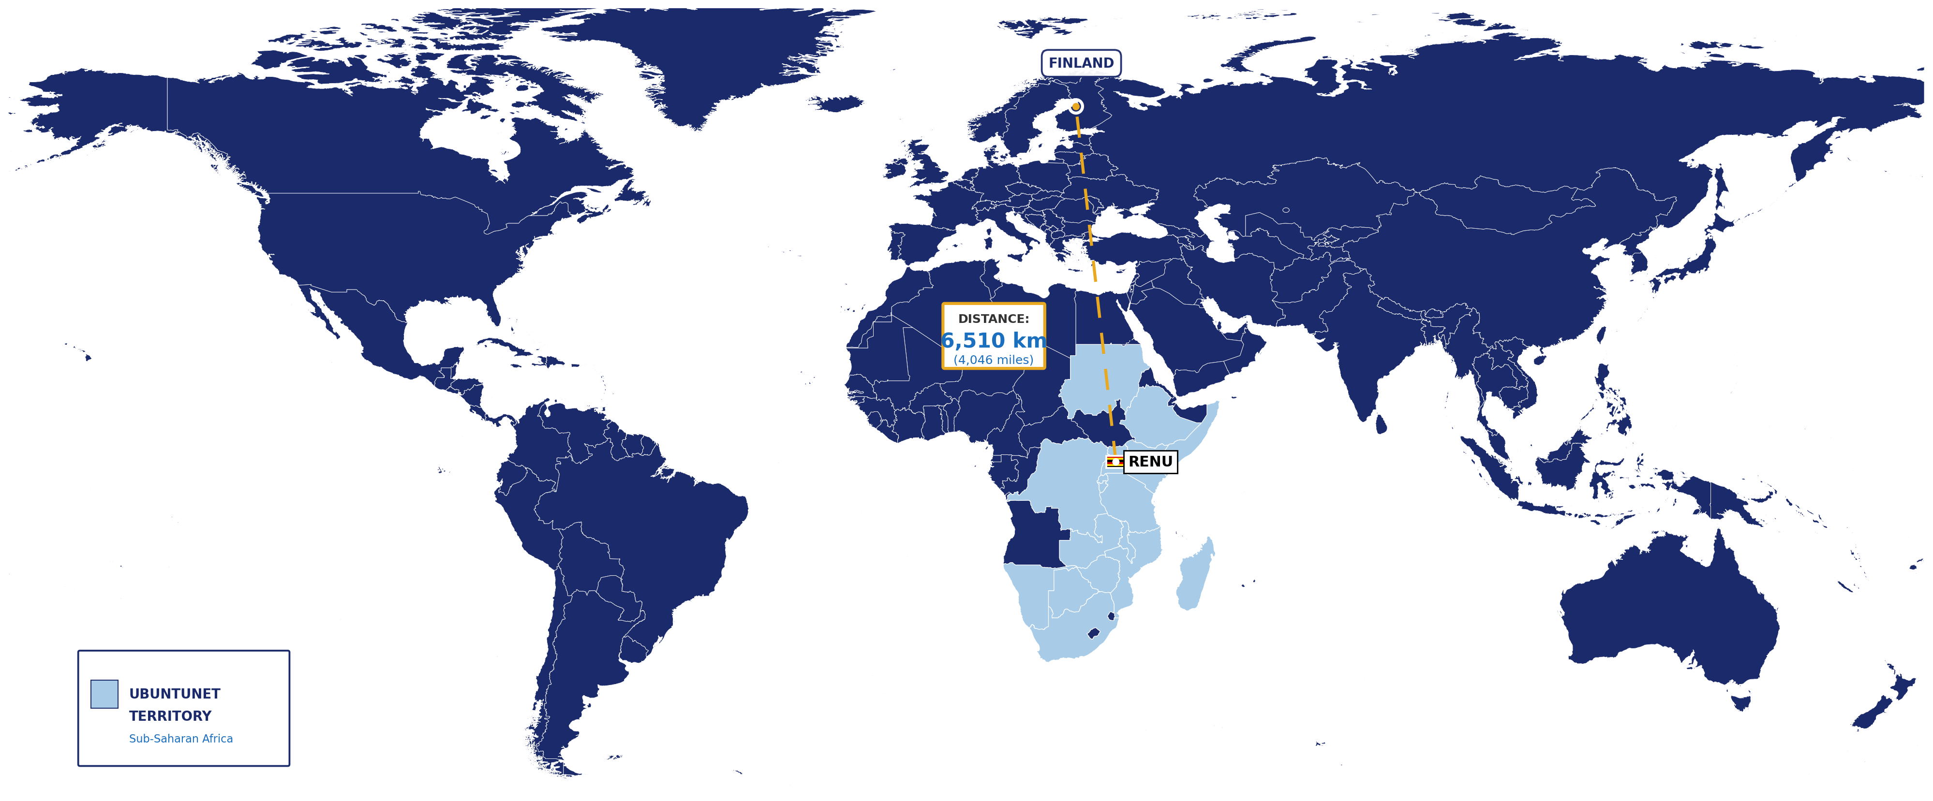
2

Slide 3
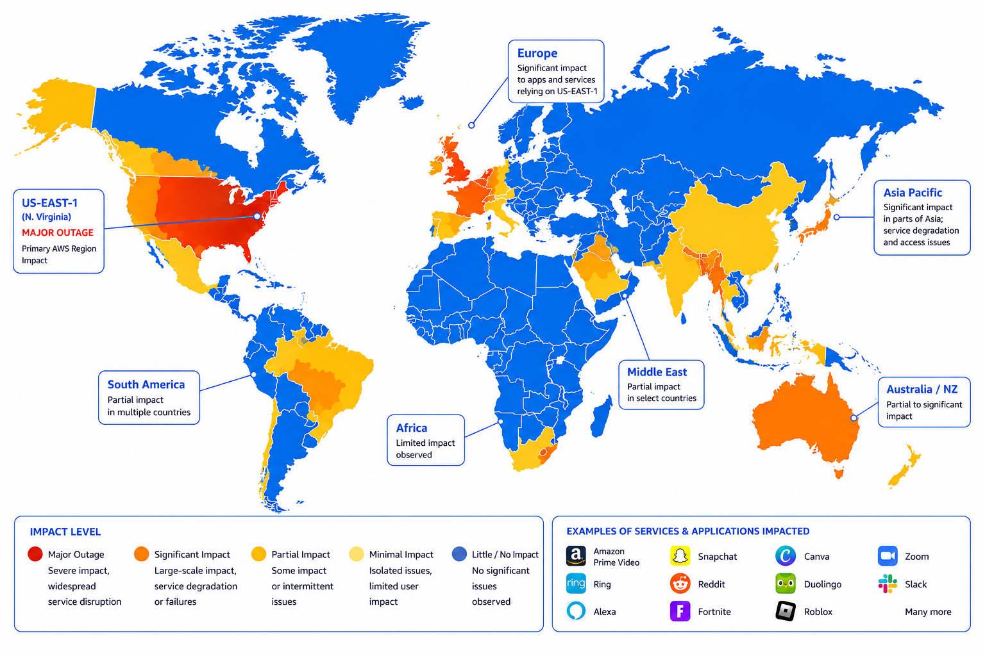
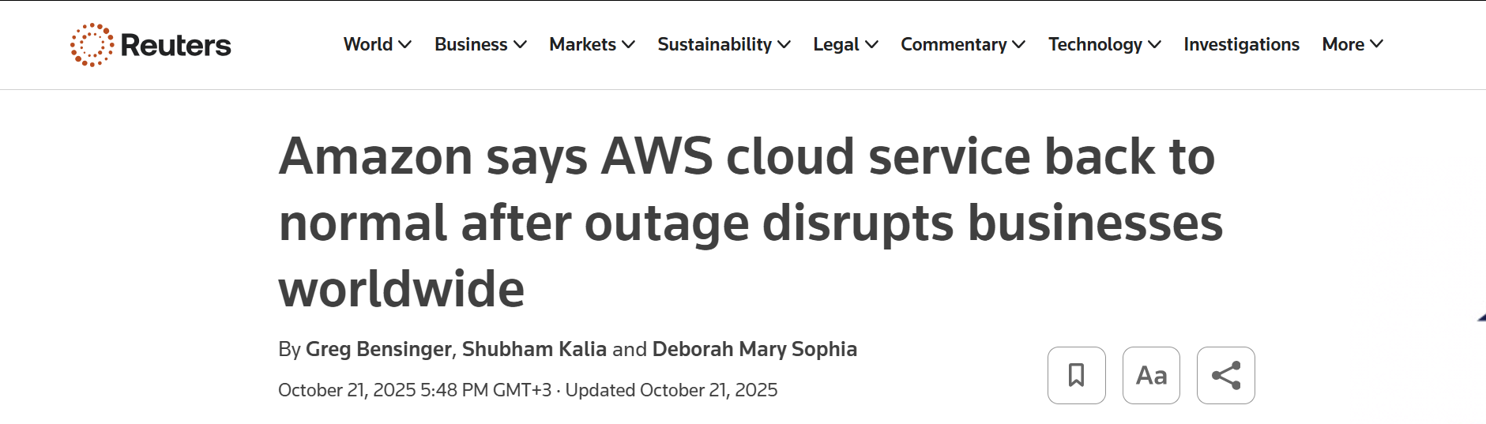
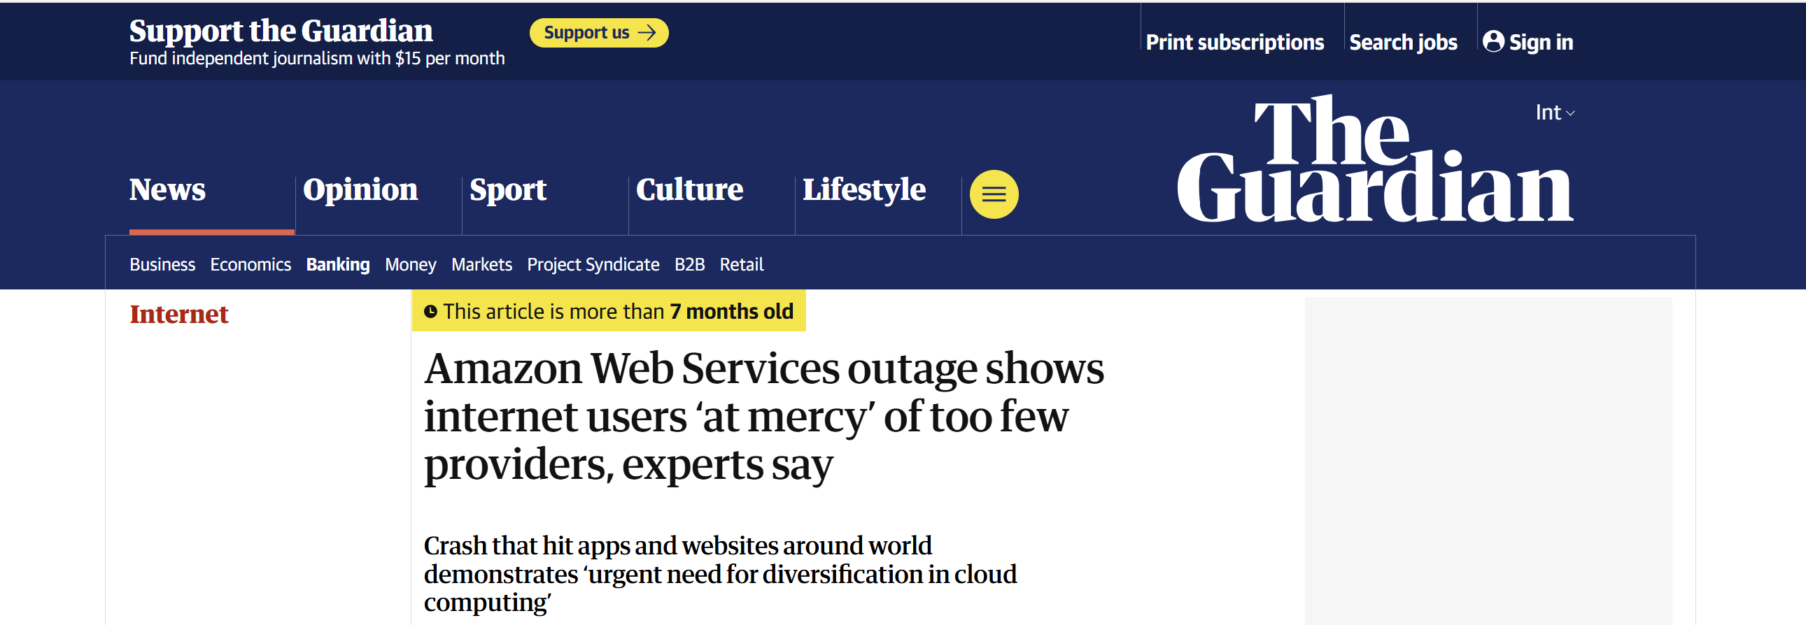
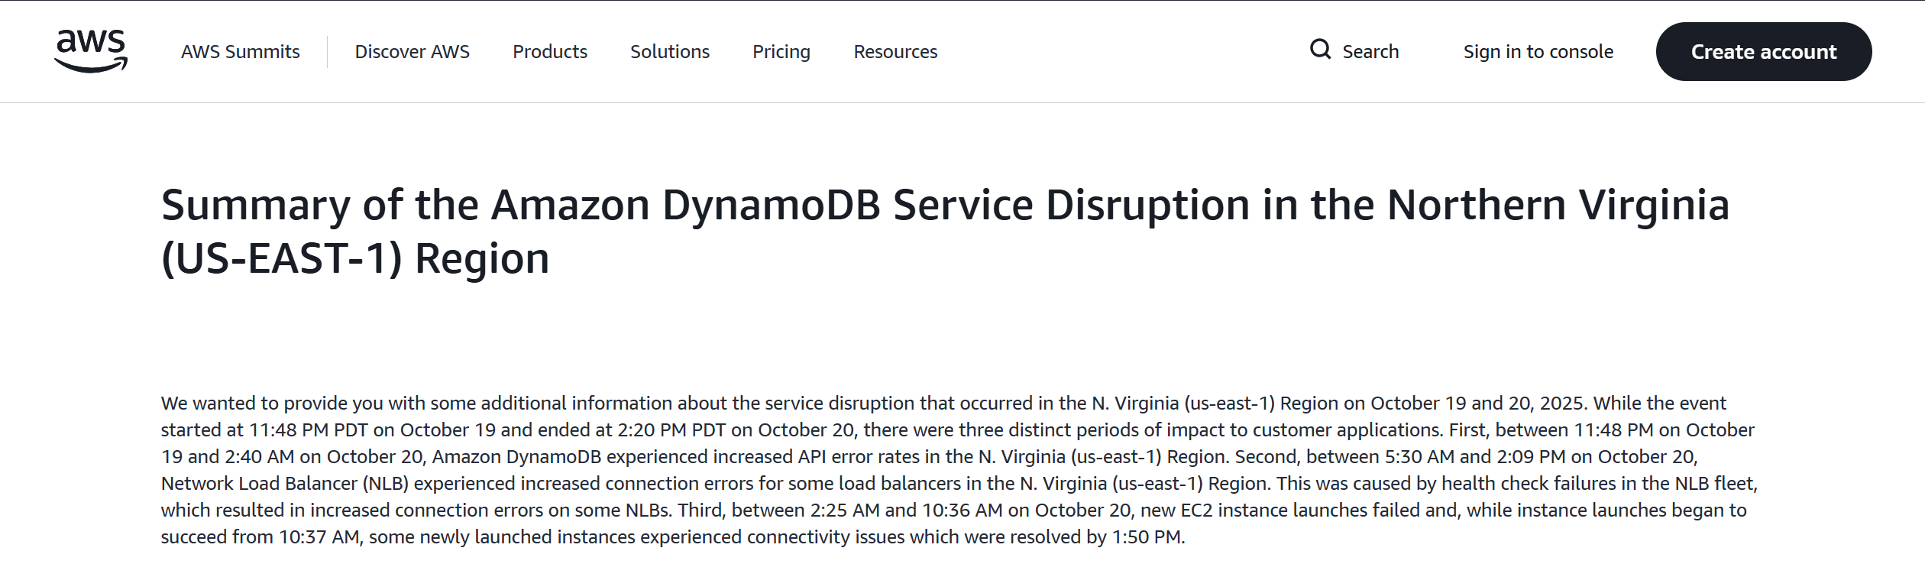
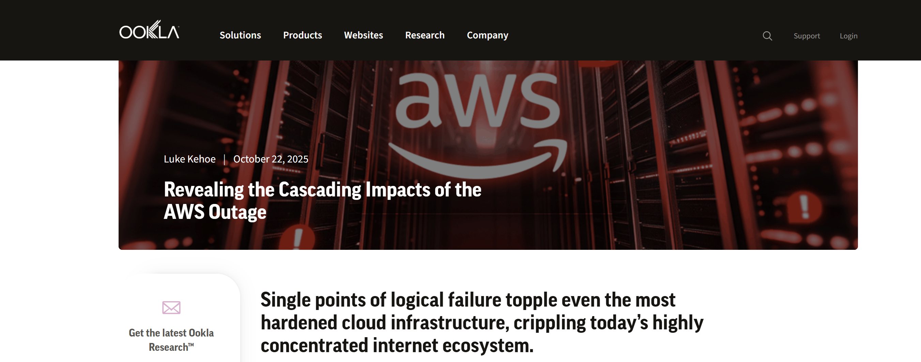
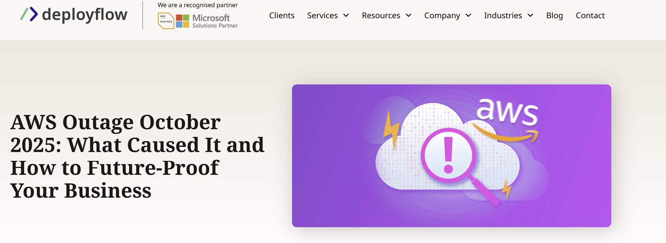

Slide 4
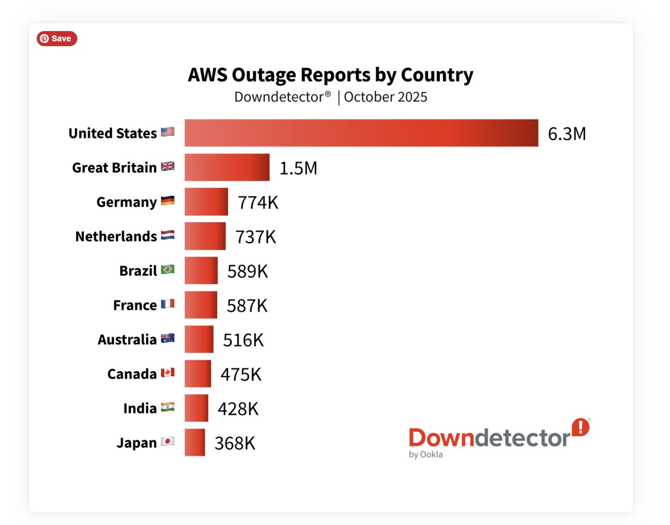
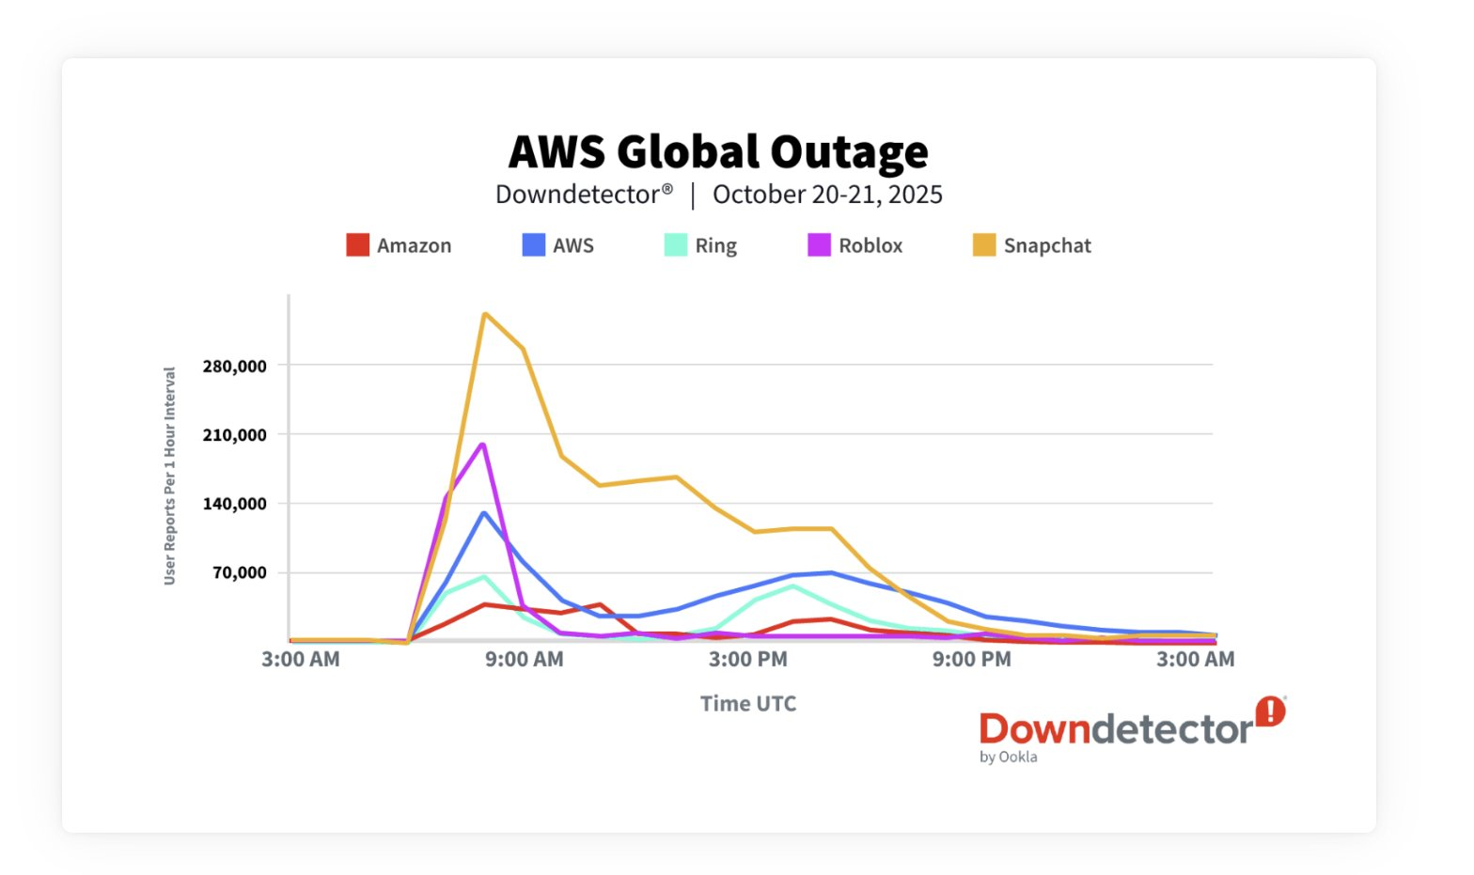
The Outage by the Numbers
Downdetector® by Ookla · October 20–21, 2025
Source: Ookla® / Downdetector®.
4

Slide 5
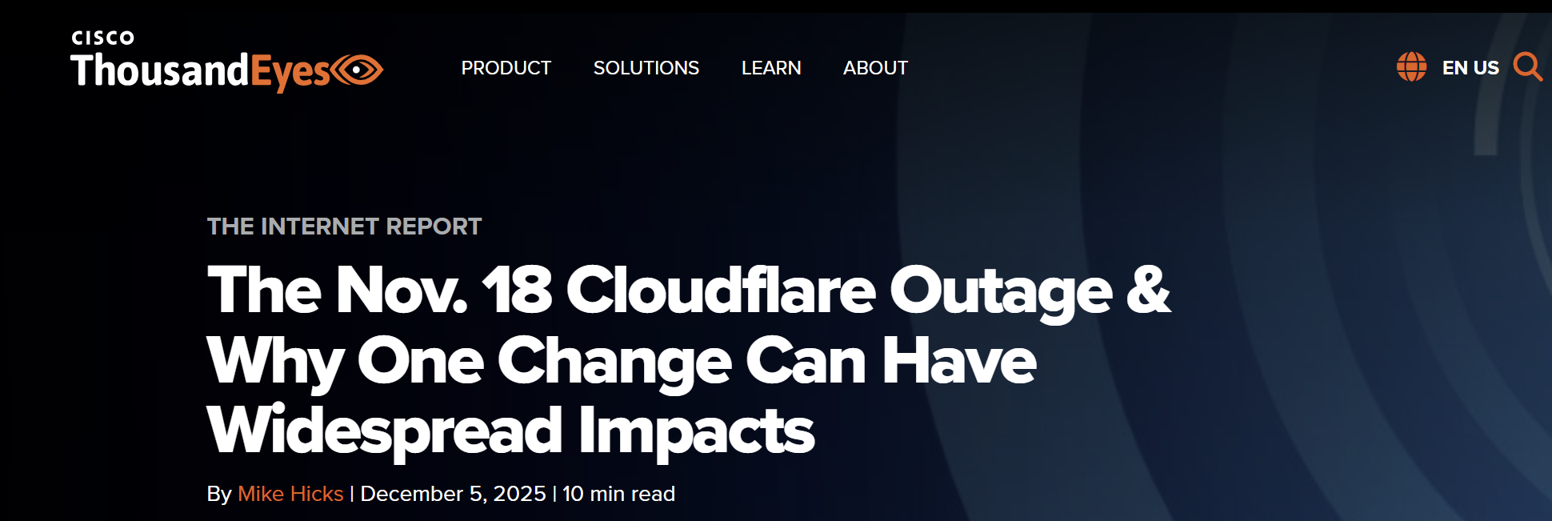
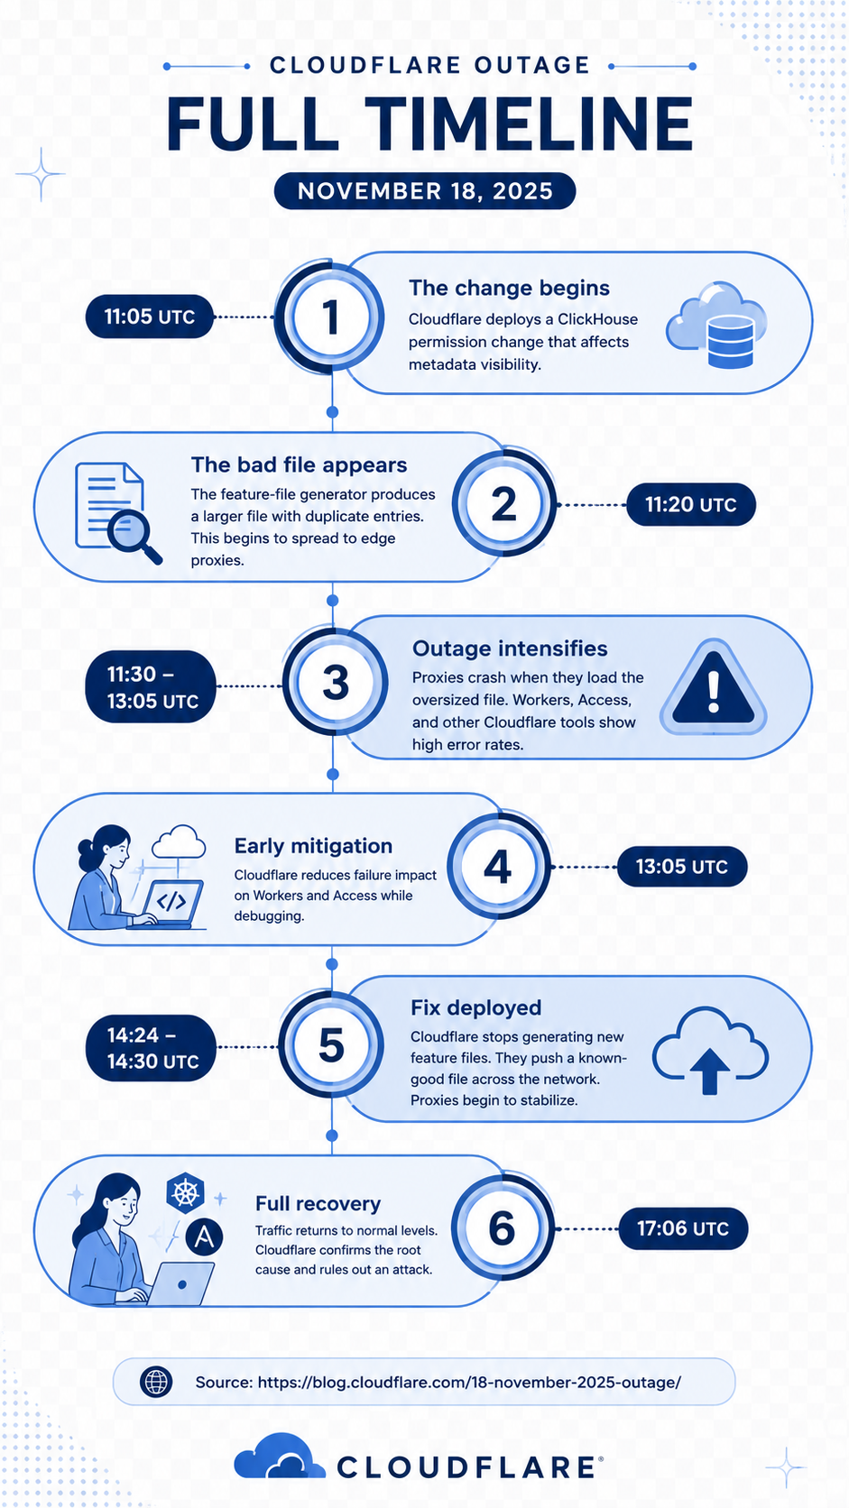
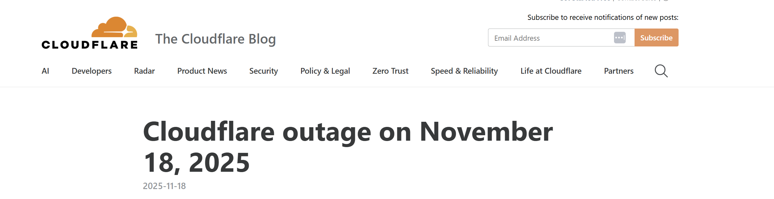
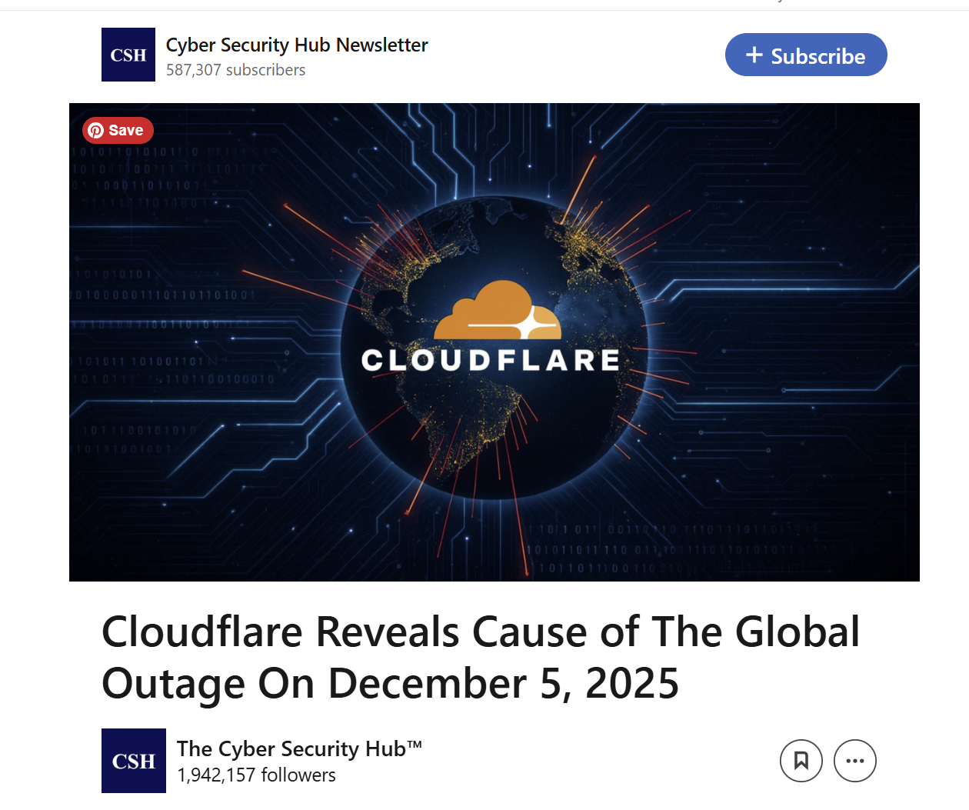
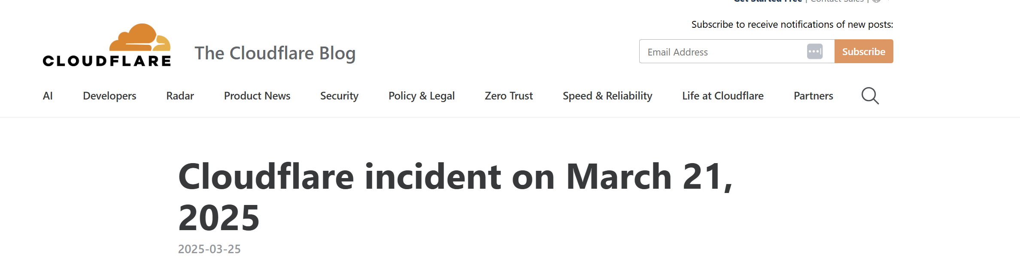
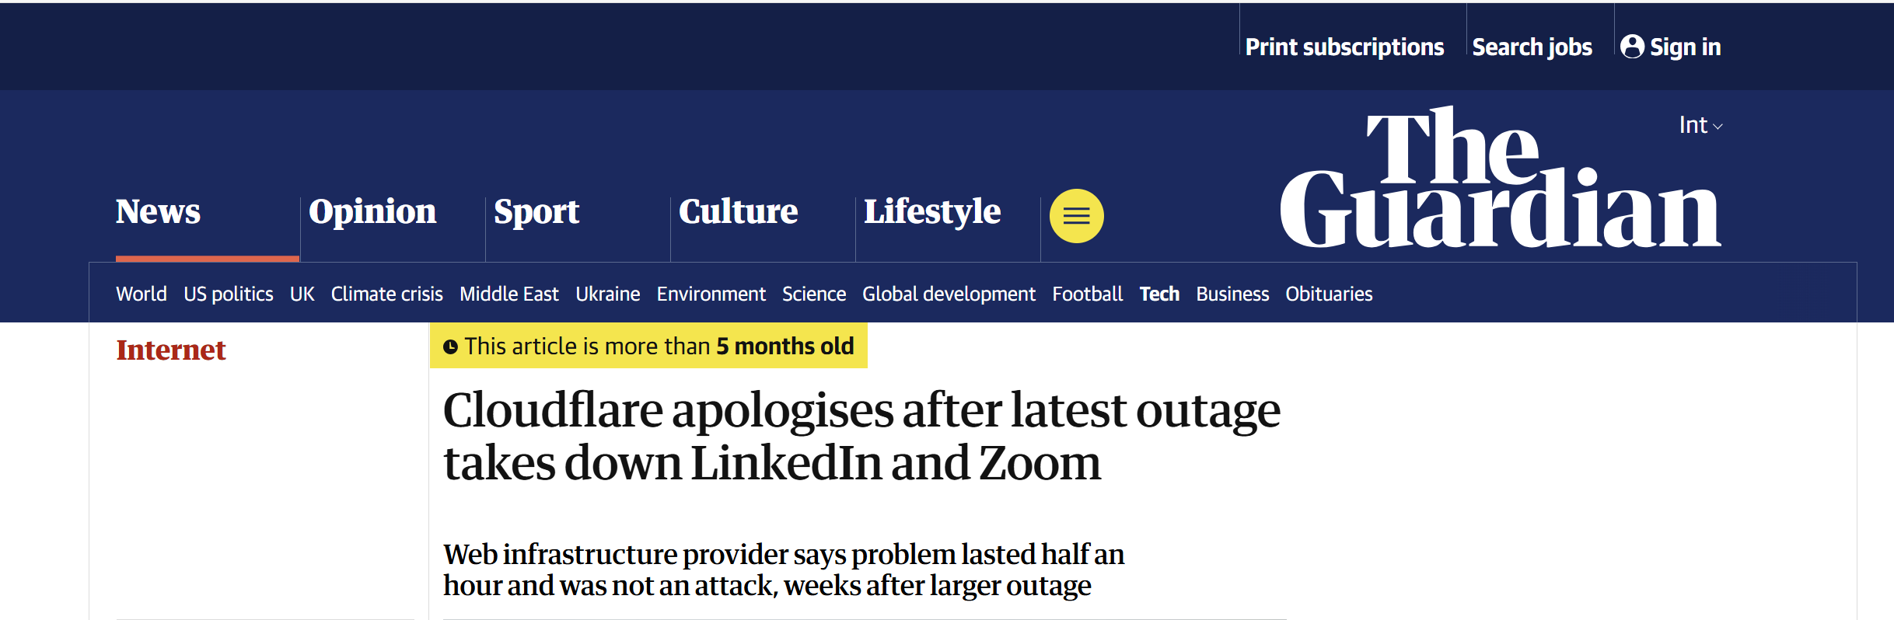
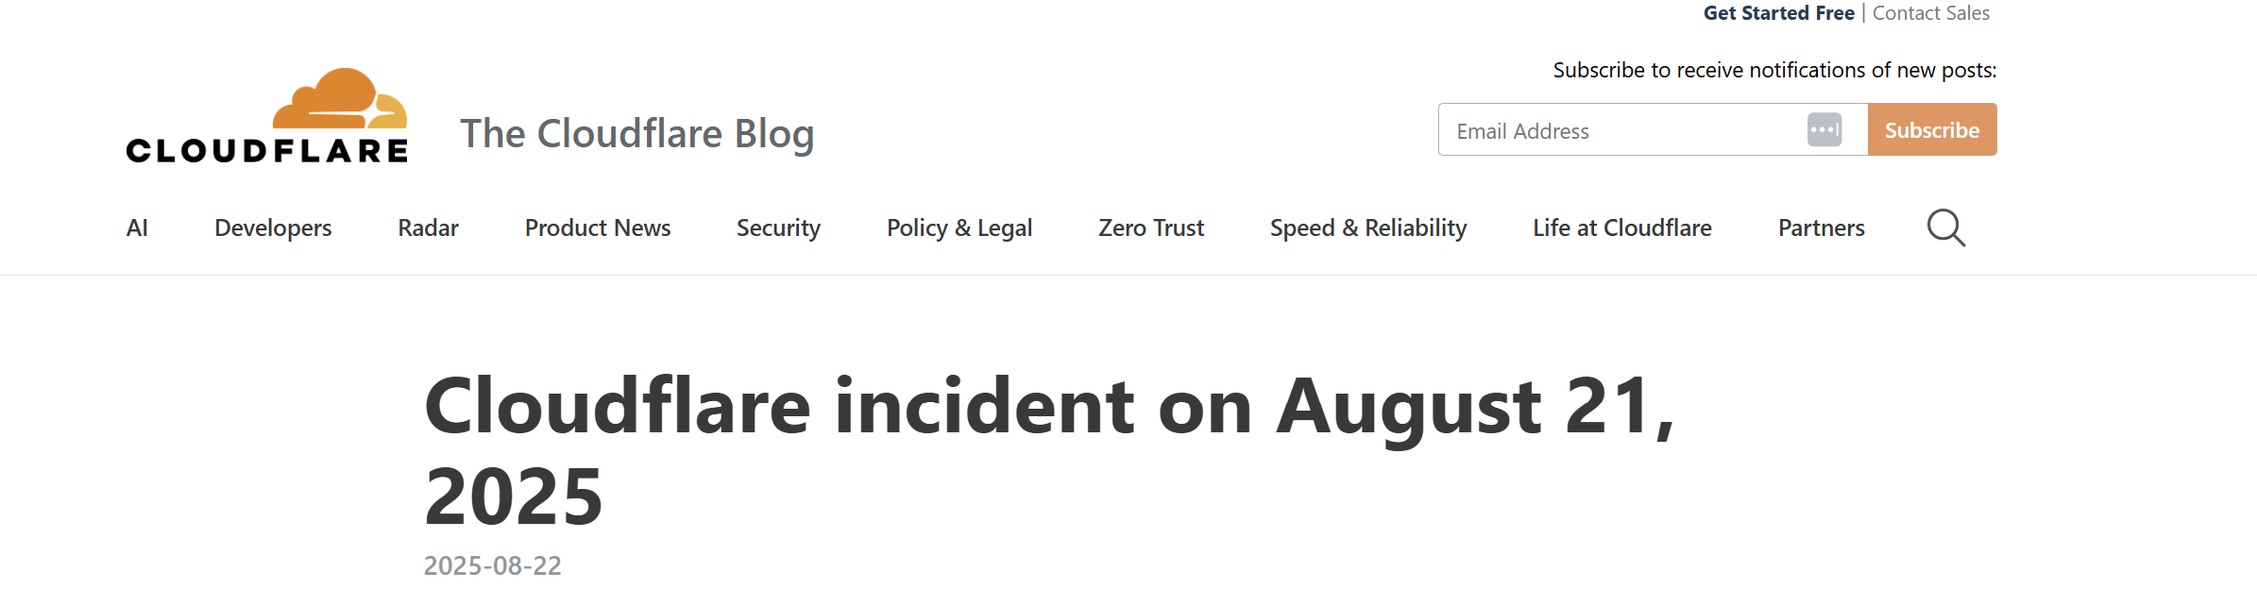

Slide 6
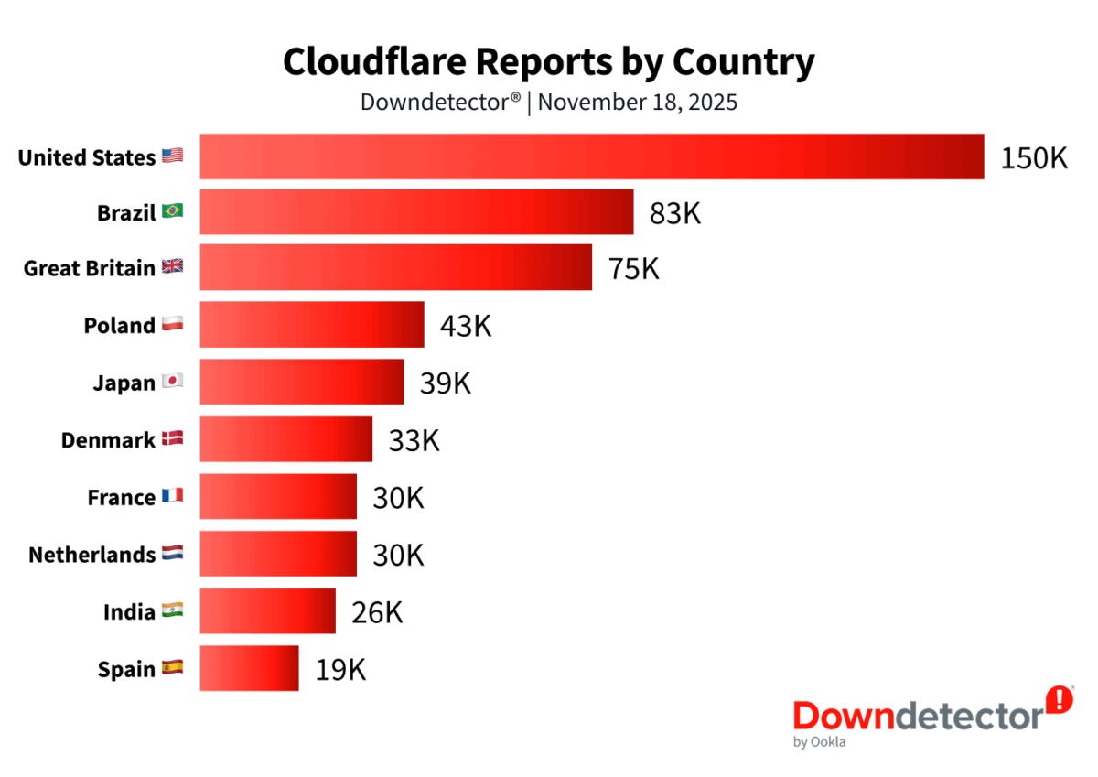
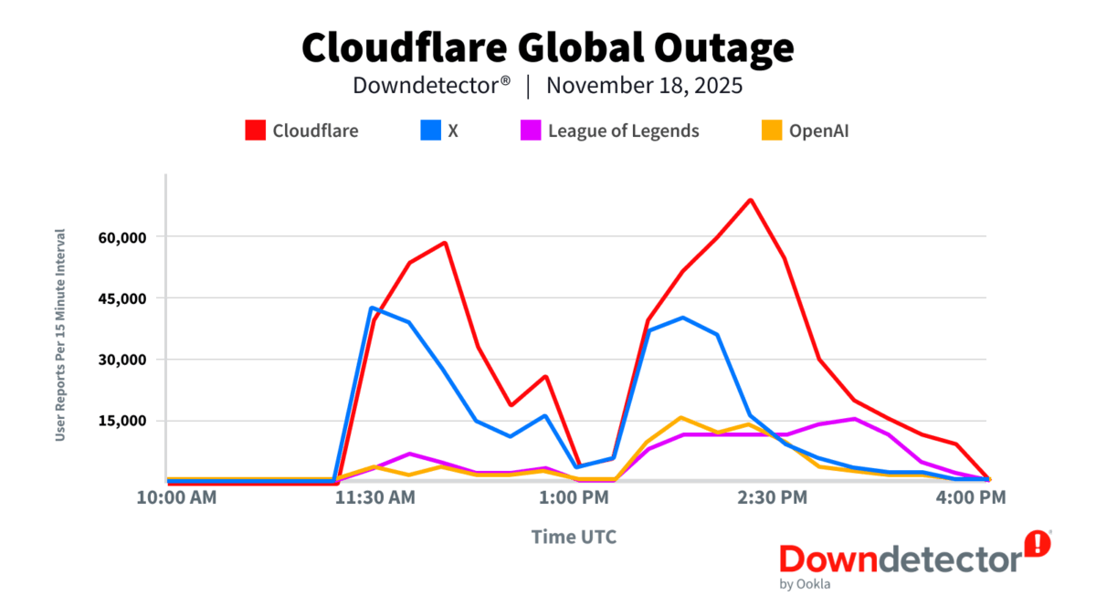
The Outage by the Numbers
Downdetector® by Ookla · November 18, 2025
Source: Ookla® / Downdetector®.
6

Slide 7


RENU stayed operational through global outages
THE WORLD — OCTOBER 20, 2025
RENU CLOUD USERS - SAME DAY
All RENU-hosted services kept running
17M+ users reporting outages
3,500+ companies disrupted globally
Member institutions unaffected - lectures, research, operations normal
Banks, hospitals, universities offline
99.4% service continuity maintained
14 hours to full restoration
Institutions using external hyperscale services did feel some impact, exposing the dependency
7

Slide 8
Is this an operations problem
or a sovereignty problem?
The answer changes everything: the architecture, the investment, the policy.
If it's an operations problem…
If it's a sovereignty problem…
Buy more bandwidth. File a support ticket.
Wait for AWS to recover.
Build local infrastructure. Own the stack.
Control your data. Lead the continent.
6

Slide 9
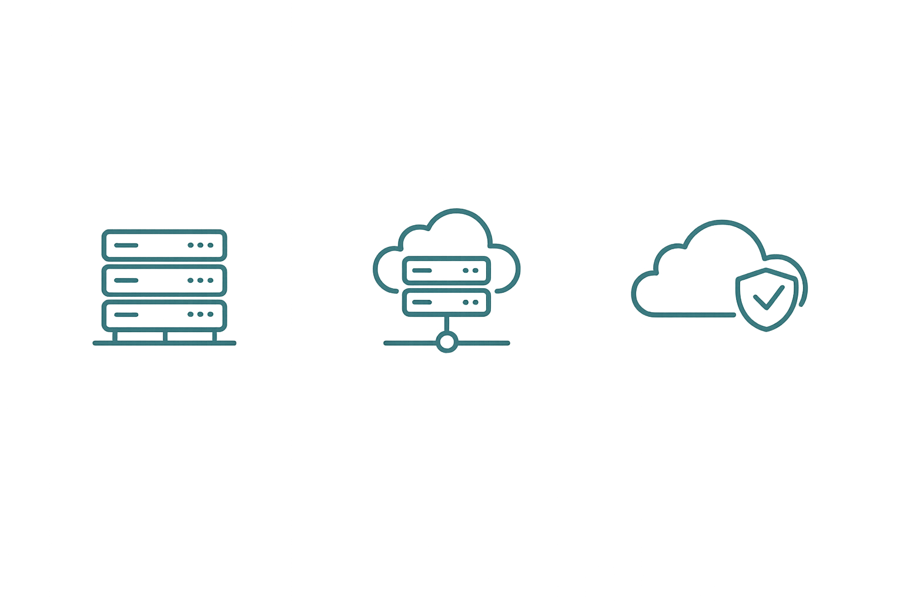
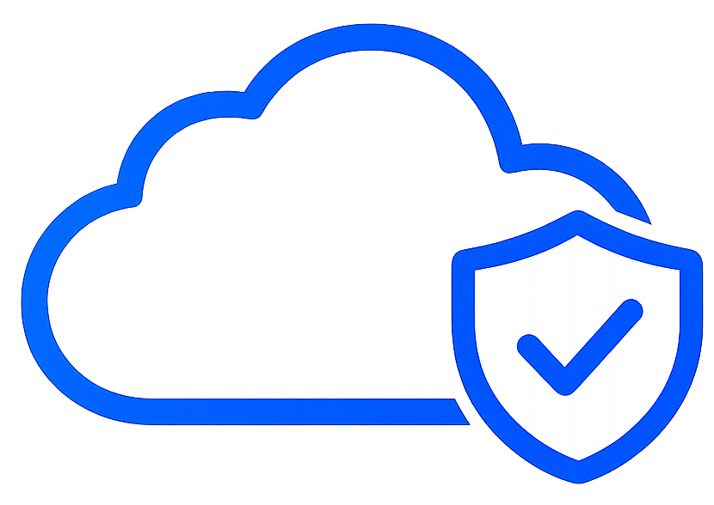
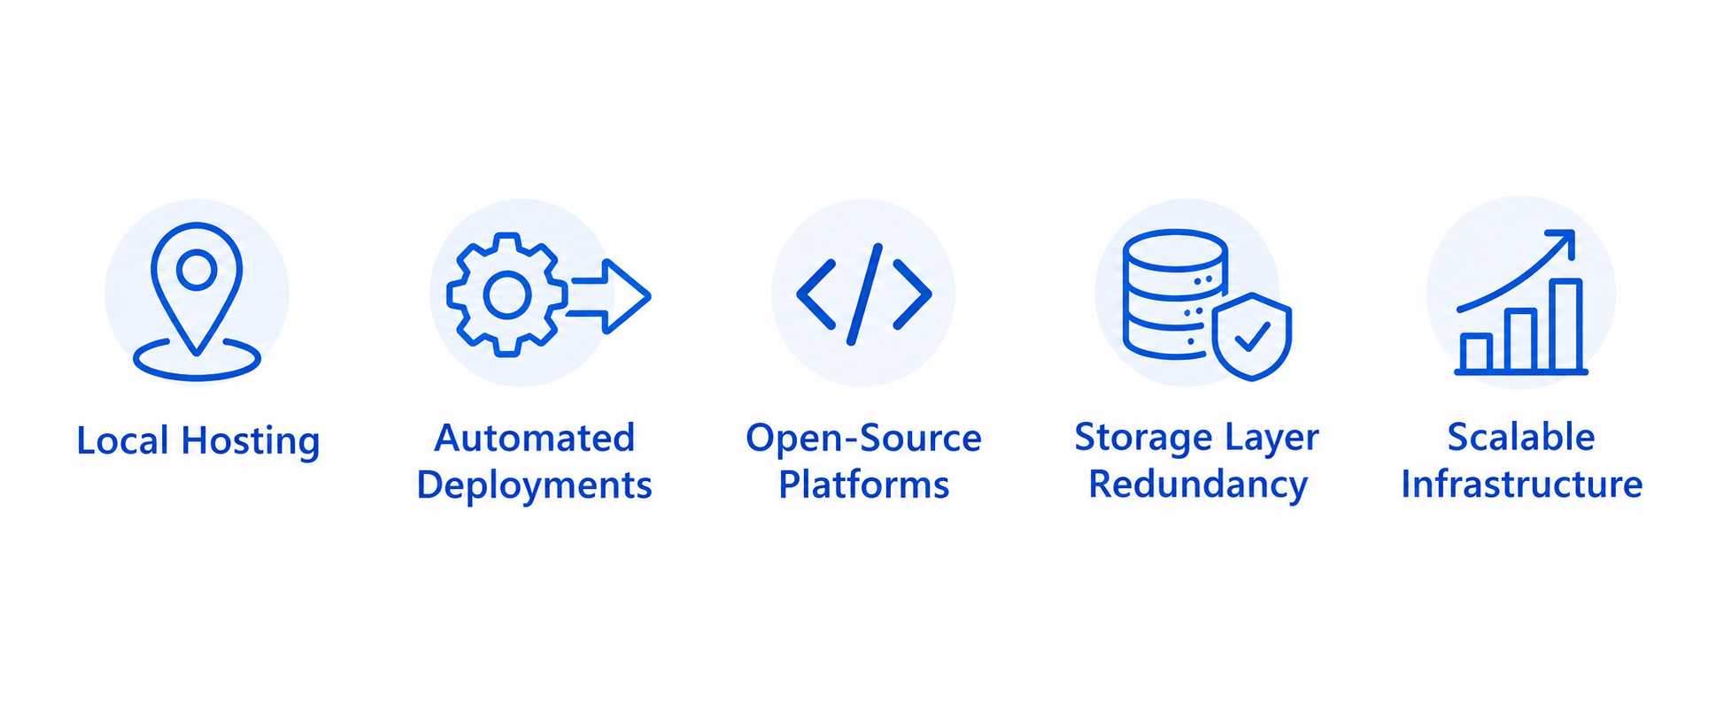
Our Journey: What RENU Built…
Phase 1
Phase 2
NOW
Ganeti
OpenStack with Fuel
OpenStack Ansible + ProxmoxVE
Initial virtualization environment
Internal RENU workloads
Member institution hosting
Automated deployments
Distributed storage and backup
Multi-tenancy
Local Hosting
Storage Layer Redundancy
Scalable Infrastructure
Automated Deployments
Open-Source Platforms
Lower latency and local operational control
Reduced vendor dependency
Improved continuity during failures
Growth aligned with institutional growth
Faster provisioning and recovery
9

Slide 10
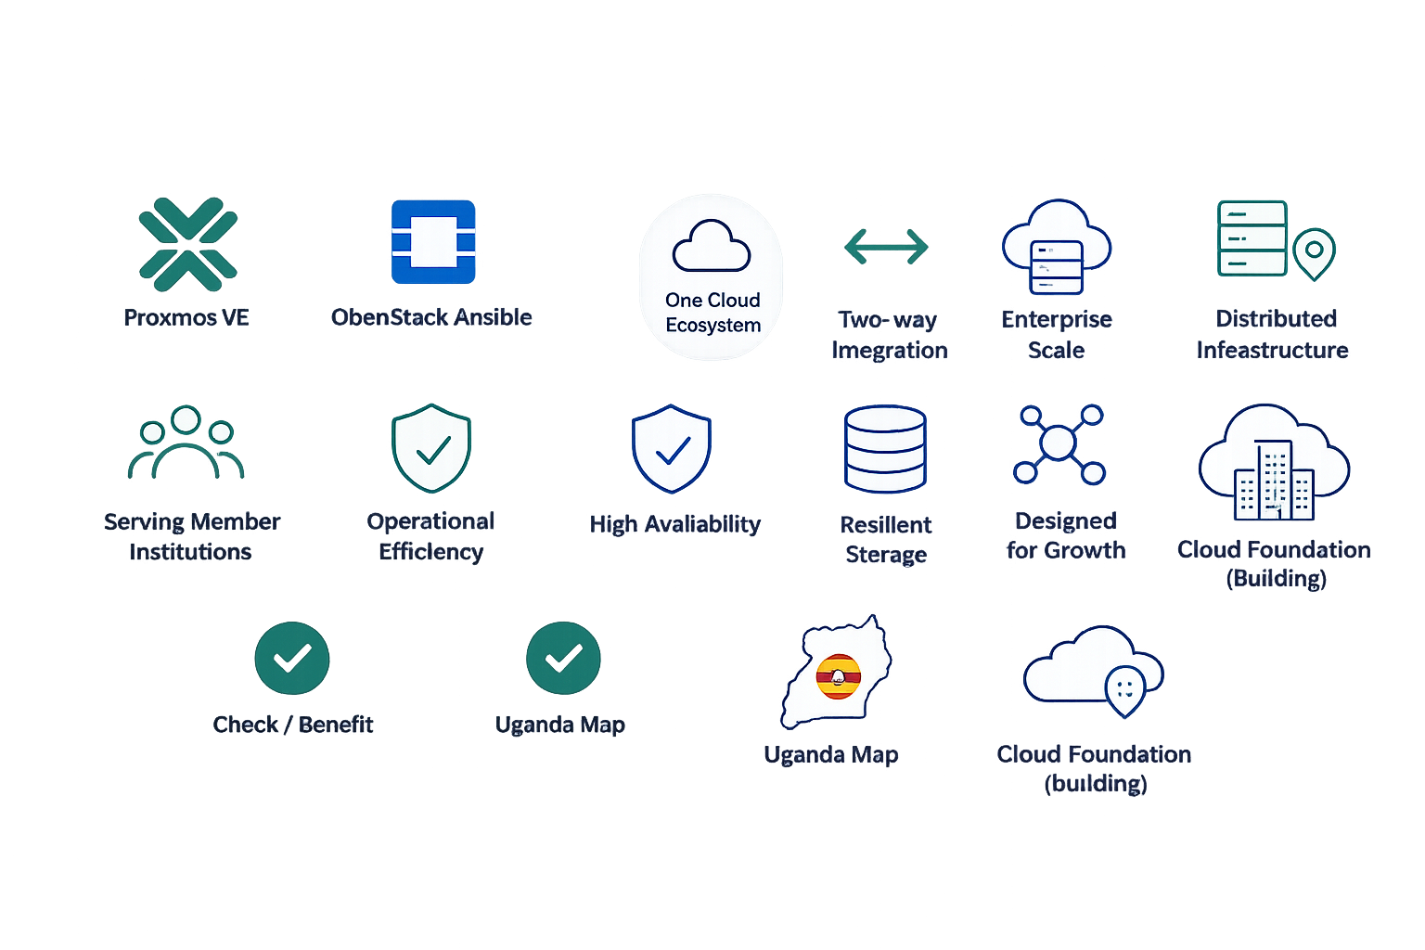
Two Platforms, Complementary Roles
ProxmoxVE
OpenStack Ansible
Distributed Infrastructure
Member Institutions
Operational Efficiency
Enterprise Scale
High Availability
Resilient Storage
Designed for Growth
Centralized management and monitoring
Scalable compute capacity
Optimized for smaller distributed workloads
High Availability across zones
High Availability storage and live migration
Resilient, distributed storage
Cost-effective and open-source
Multi-tenant infrastructure
10

Slide 11
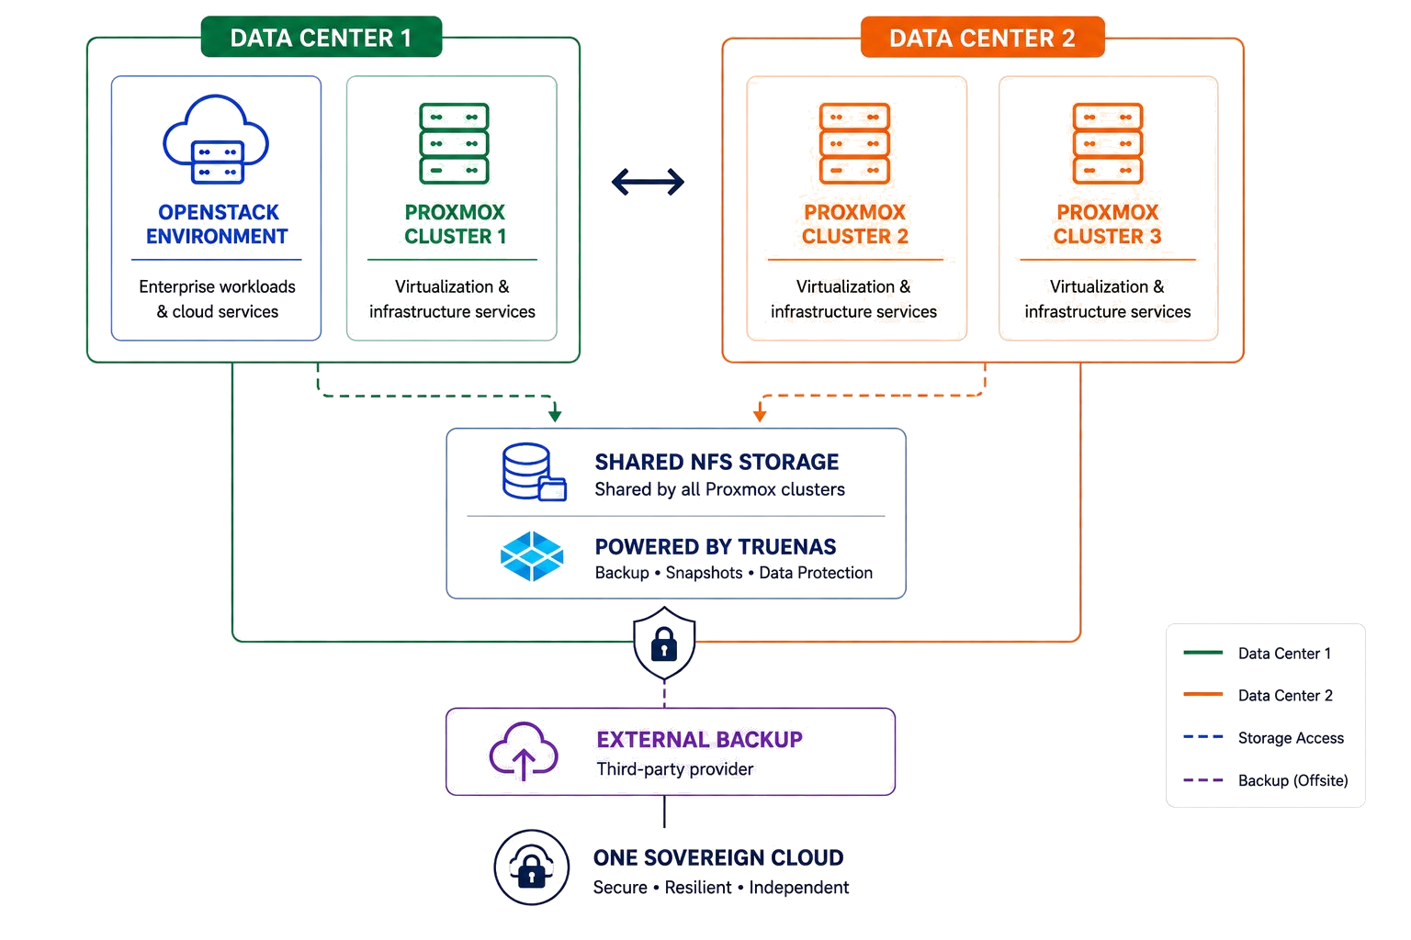
RENU Cloud Infrastructure

Slide 12
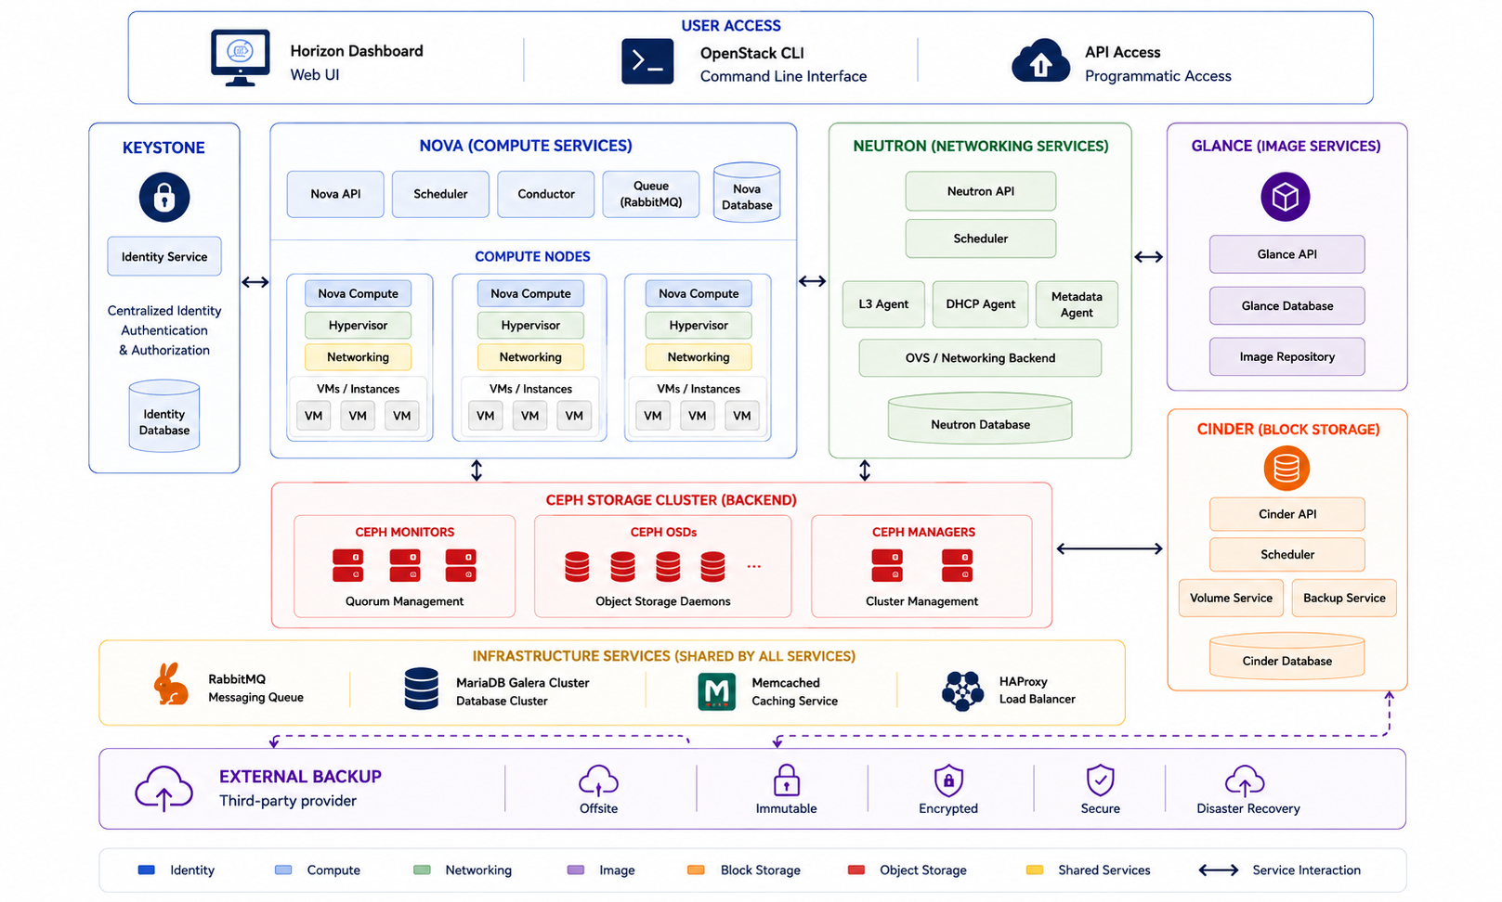
OpenStack Architecture

Slide 13
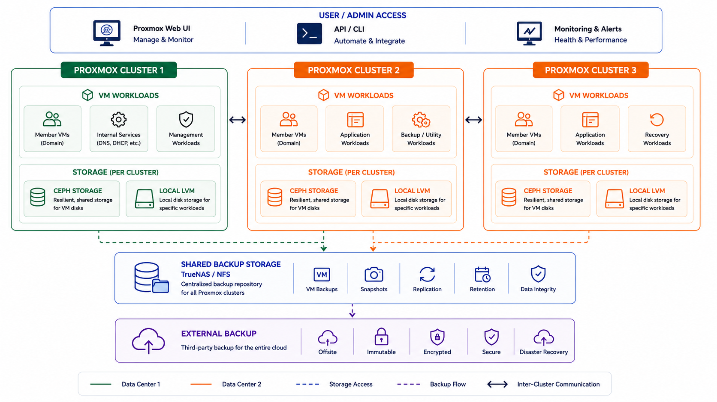
Proxmox Architecture

Slide 14
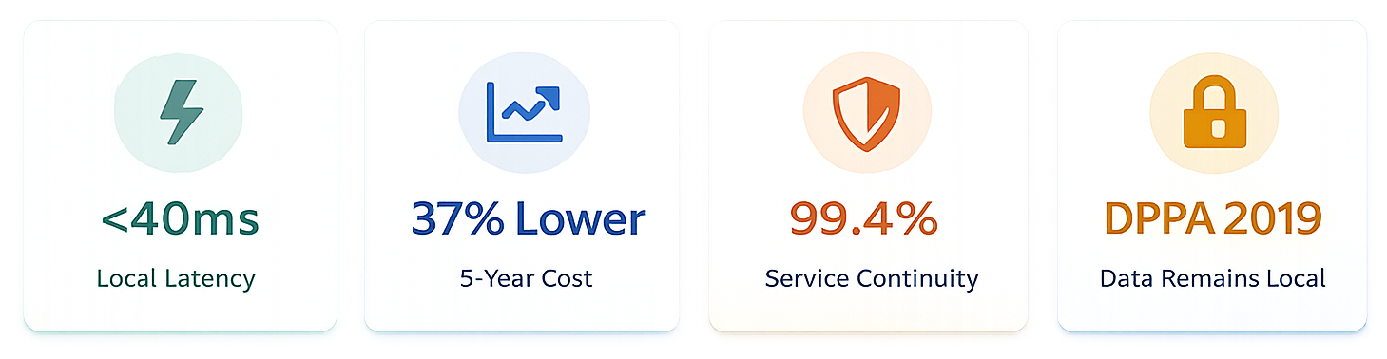
Why Sovereign Cloud Wins
Faster . Lower Cost . More Resilient . Sovereign

Slide 15
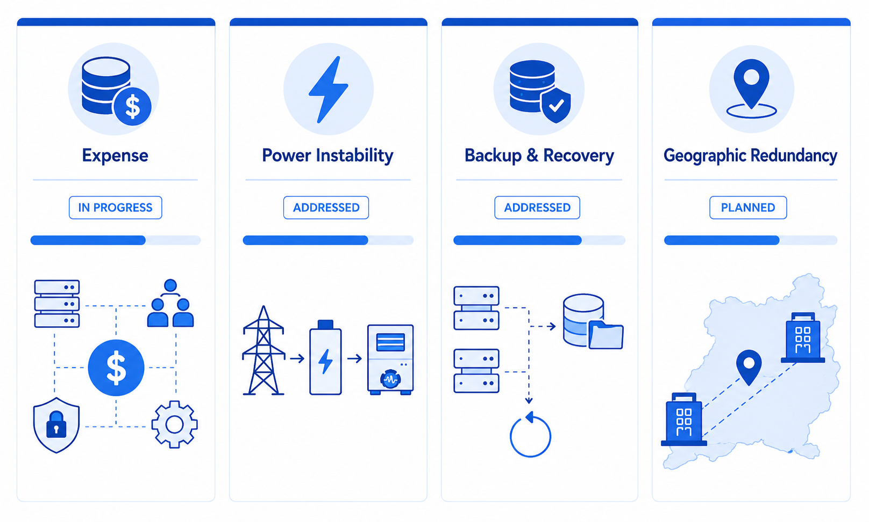
Challenges

Slide 16
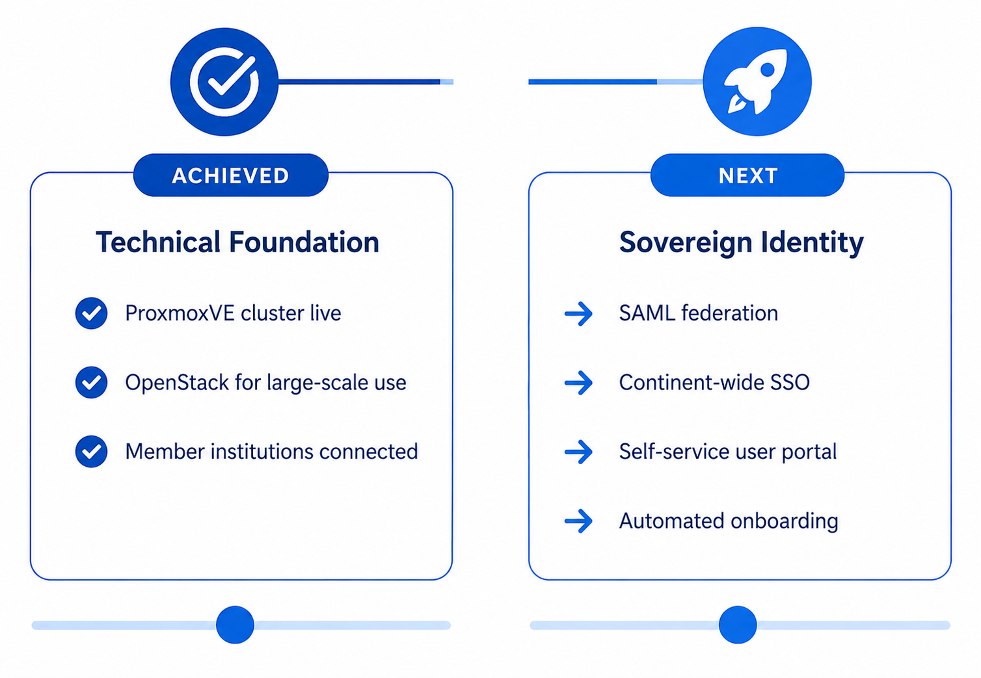
Where RENU Stands - and Where We're Going

Slide 17
This is not a Ugandan problem.
This is a Global NREN opportunity.
And it starts here.
17

