Slide 1
Passkeys for Research and Education
Results and Lessons Learned from One Year in Production
Erwin Kupris & Florian Ritterhoff
09.06.2026

Slide 2
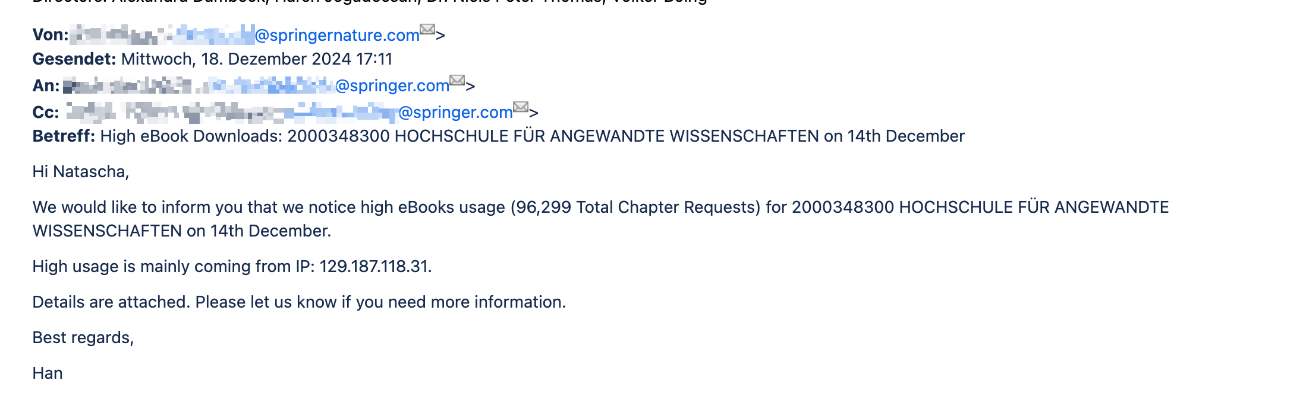
Why MFA?
And why for everyone and everything?
Part of our
eduVPN Full-Tunnel Pool
( … without MFA … )
… Just a usual day in IT Support … 🤨

Slide 3
The Passkey Promise Meets University Reality
The Promise
Passwordless login
No username typing
Synced across devices
Phishing-resistant by design
The university reality
Students, faculty, staff
Managed vs. personal devices
Shared lab machines
Large variety of technical expertise
Question: Does the promise survive institutional deployment reality?

Slide 4
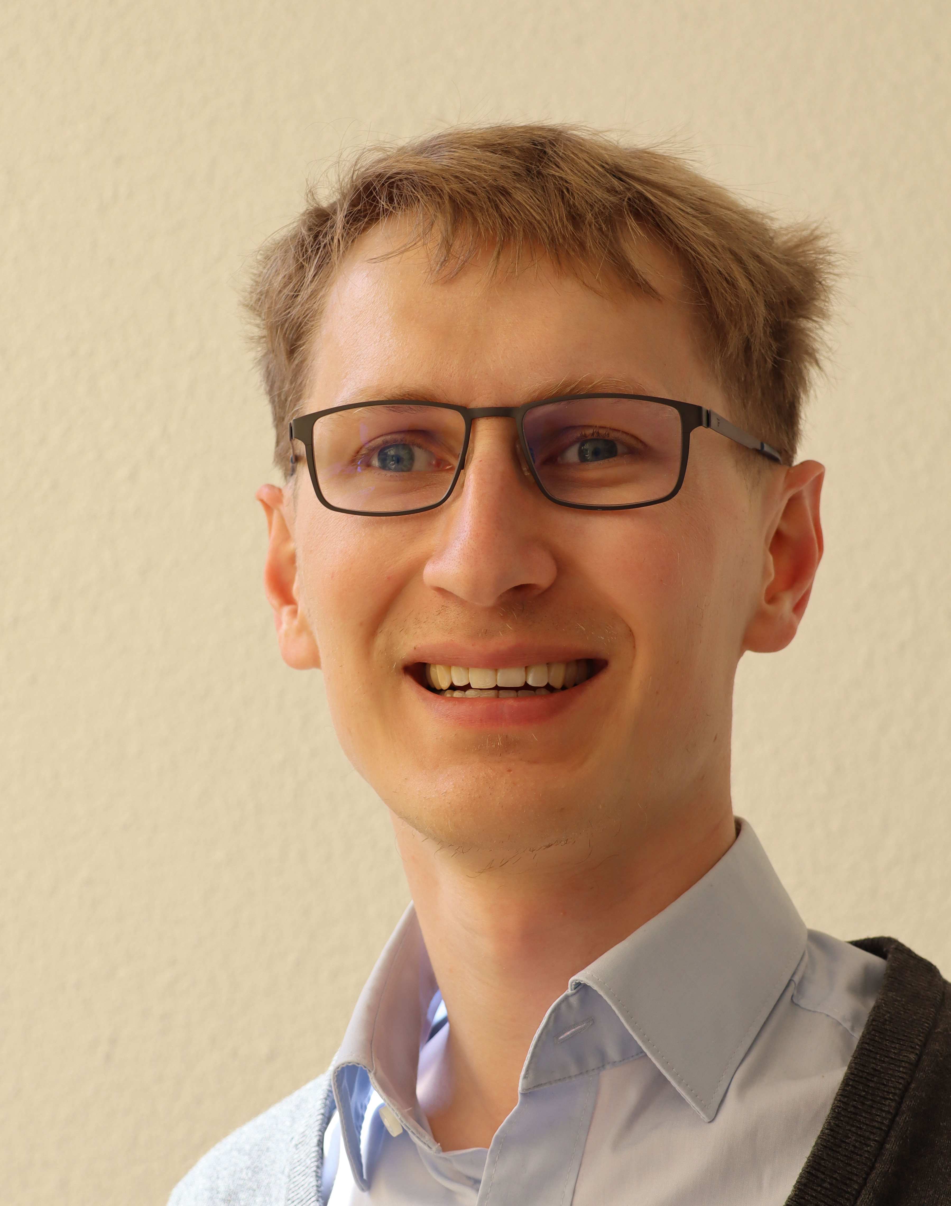
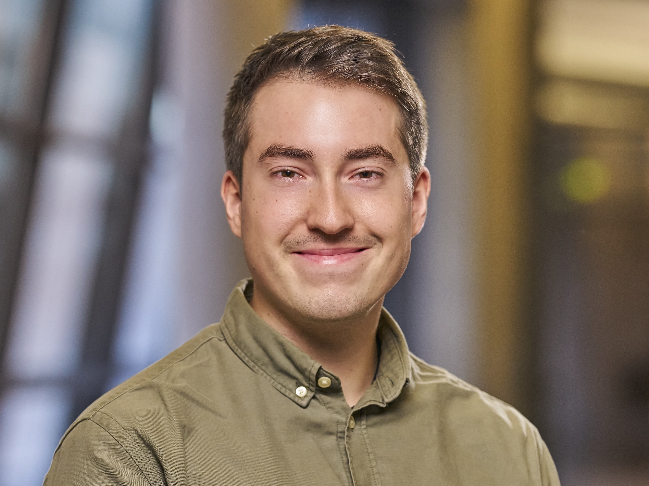
Who we are
Erwin Kupris
PhD Candidate
Focus on digital identities
→ Research perspective
Florian Ritterhoff
Member of the IT department
Responsible for SSO/IAM/..
→ Operational perspective

Slide 5
Keyfacts
Munich University of Applied Sciences (HM)
Approx. 19,000 Students
Approx. 2,000 Employees
14 faculties covering everything from
civil engineering and computer science
to health care
Hundreds of systems connected to SSO
(SAML and OIDC)
Until 04/2025: no MFA and passwords without complexity rules

Slide 6

Setup

Slide 7
MFA @ HM
Time-Based One Time Passwords (TOTP)
FIDO2/WebAuthn
  Classic “Second Factor” using security key (ND-FIDO2)
  Passkeys (all types, even with no attestation signature)
  User verification enforced
Enforced for everyone and every SSO-protected service

Slide 8
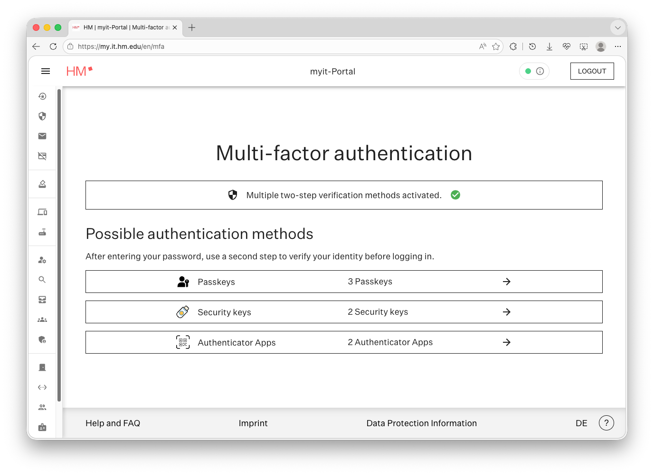
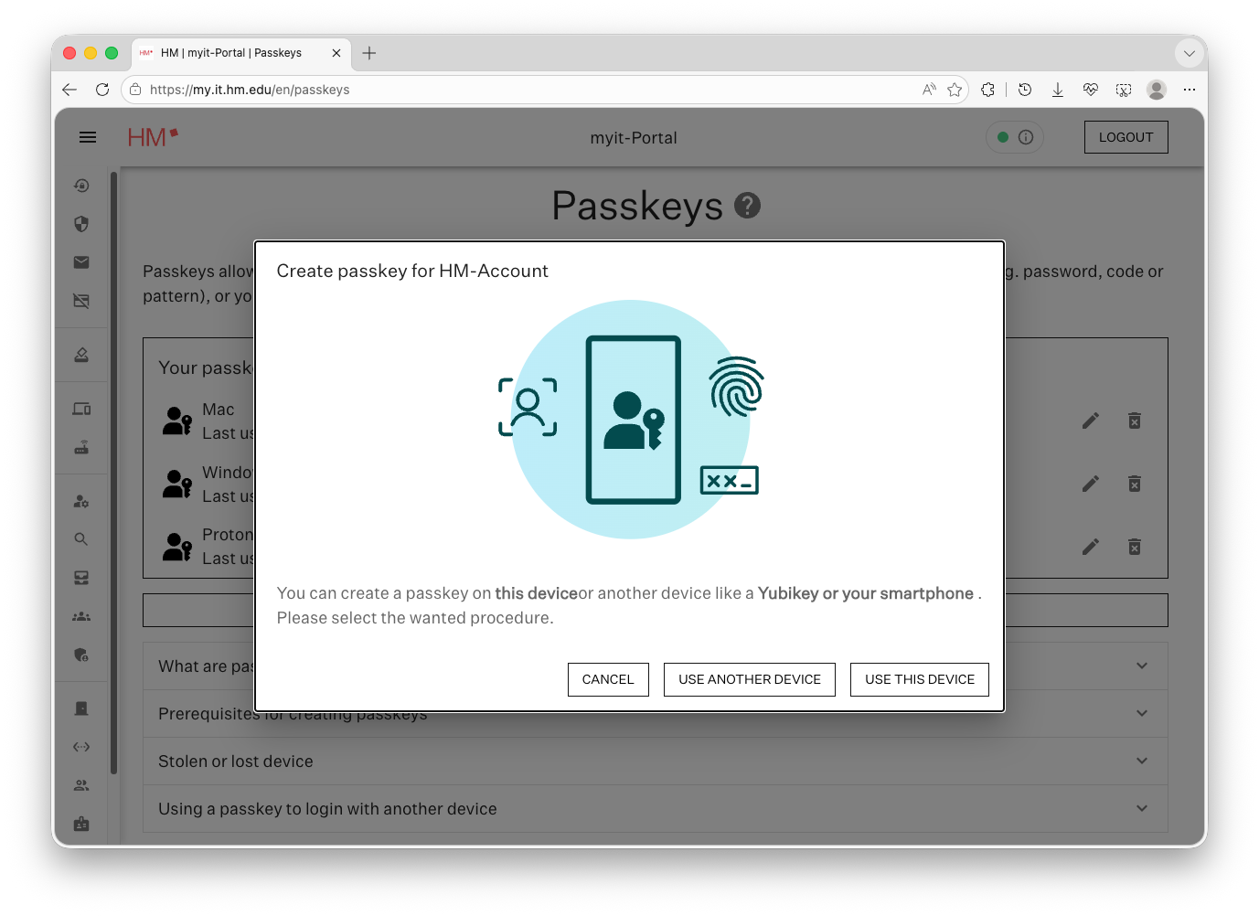
Enrollment Process
Implemented Custom Portal
  Based on FIDO UX guidelines
  Informed by prior usability study
No additional factor for initial setup
→ Rollout authorized with first factor (Password)

Slide 9
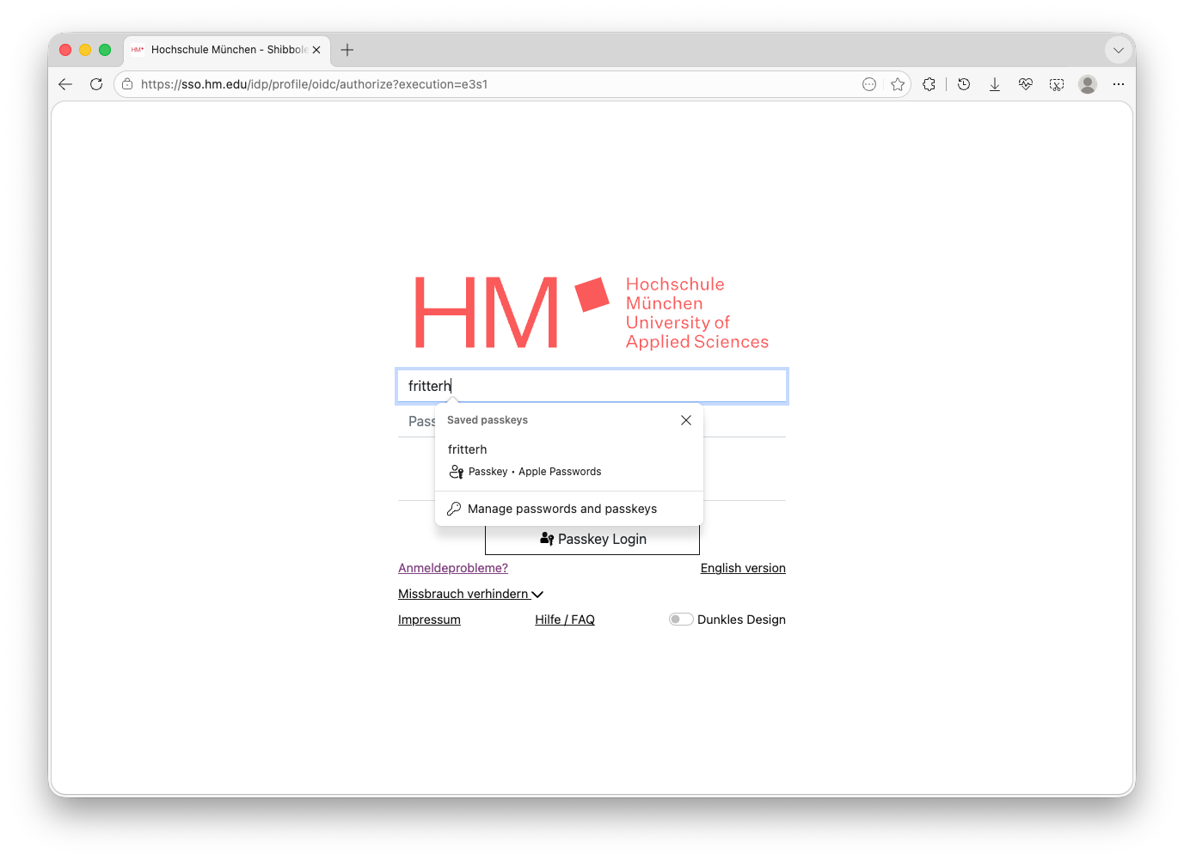
Authentication Process
Focus on Shibboleth Authentication Flows
  “Seamless” Integration into existing OIDC & SAML Flows
Using eduMFA & fudiscr Plugin
Attached services:
  eduVPN
  eduroam via easyroam
  VoIP
  Campus Management System
  Learning Management System
  And plenty more …

Slide 10
Usability and Acceptance
Paper accepted at IEEE S&P 2026

Slide 11
Usability Study at a Glance
Between-groups lab study
N = 92 university participants
Three MFA methods compared
Tasks
  Enrollment
  Login on MacBook, iPhone, Windows Laptop

Slide 12
Lab Study: Passkeys Win on Usability
Usability (SUS):
Passkeys: 87.10
OTPs: 75.81
Security keys: 71.58
Acceptance:
Passkeys: 4.51
OTPs: 3.83
Security keys: 4.01
Speed (all tasks):
Passkeys: 559s
OTPs: 676s
Security keys: 801s

Slide 13

Qualitative Results: Why passkeys won
Less to remember
Less to type
No extra device
Familiar biometric unlock
Fastest overall
“Very good. It has a touch of magic.”

Slide 14

… and where the promise cracked
Biometric Privacy
Personal-device use
“You always wonder if it makes sense to send your fingerprint out to the world.”
“[Using personal phone]. That’s an overlap of private and work life, which I don’t like.”
Security Concerns
Exam scenarios
“[…] in the area of online banking [...], I would like to have one more factor.”
“Suddenly, smartphones play a very important role in the exam […]”
Mistrust in clouds and vendors
Lab Device Compatibility
“Is it really safe on this iCloud?”
“How would I authenticate in our practical lab sessions?”
09.06.2026
TNC26 - Passkeys for Research and Education
14

Slide 15
From Lab Results to Production Evidence
Collecting Telemetry Data over 1y

Slide 16
How and What We Measured
Telemetry Logs
  Shibboleth IdP
  Enrollment Portal
  MFA Backend
Measures:
  Time to enroll
  Time to authenticate
  Success vs. failure
  Method adoption and use
>150 GB logs across 1y
16.6M distinct sessions
9.8M human login attempts
98k enrollment attempts
27k+ unique users across students, faculty, staff, and others
4.58M successful logins
48k successfully enrolled tokens

Slide 17
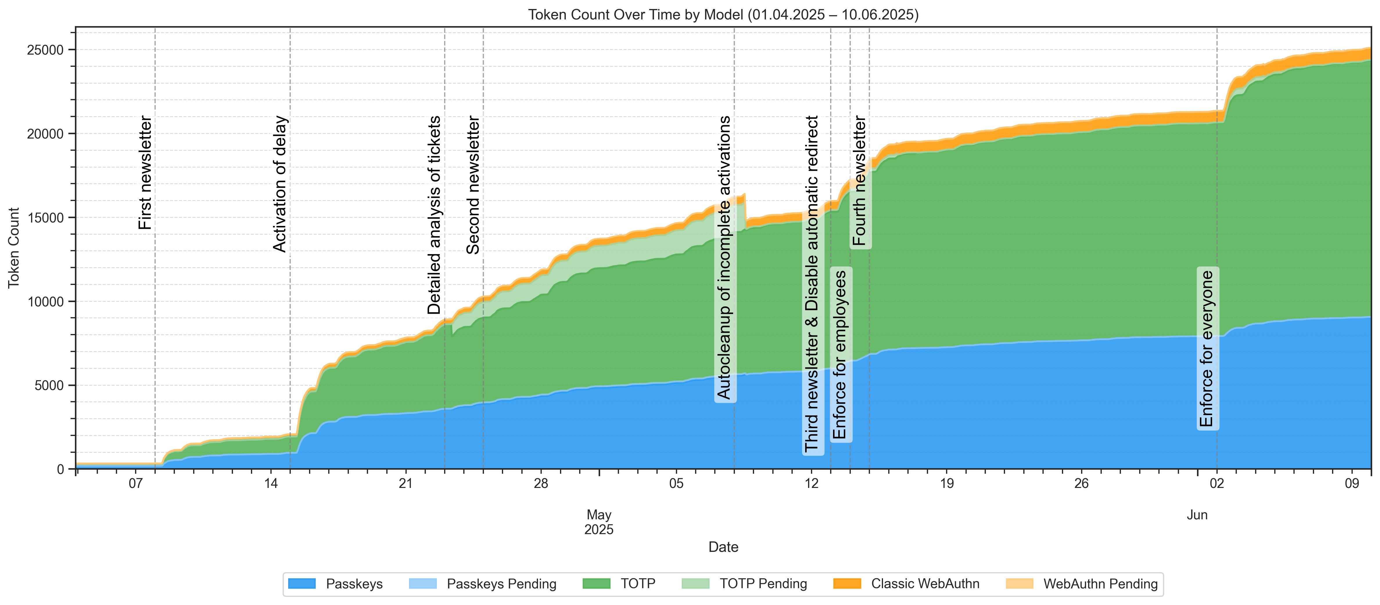
Rollout Statistics

Slide 18
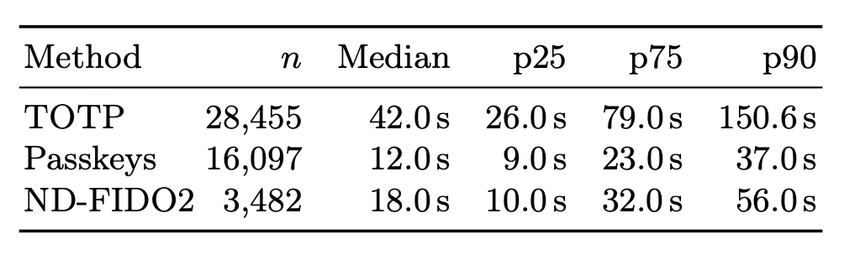
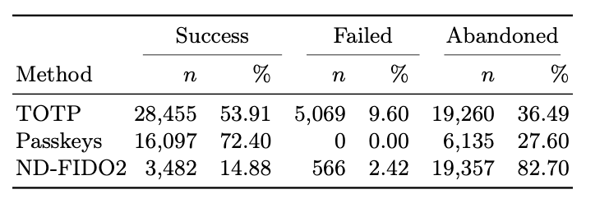
Enrollment: Passkeys Were Fastest and Most Completed
Median successful enrollment:
  Passkeys: 12s
  ND-FIDO2: 18s
  TOTP: 42s
Completion:
  Passkeys: 72.40%
  TOTP: 53.91%
  ND-FIDO2: 14.88%
ND-FIDO2 required more retries

Slide 19
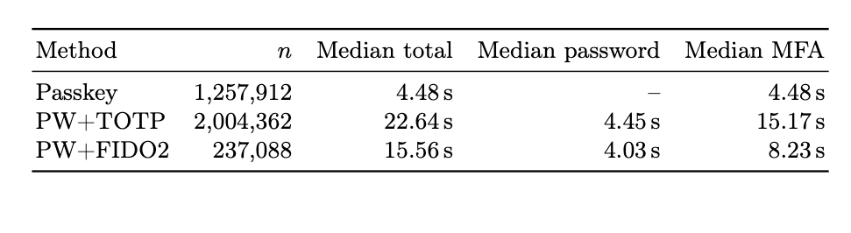
Authentication: Passkeys Reduced Login Time
Median authentication time:
  Passkey: 4.48s
  PW+FIDO2: 15.56s
  PW+TOTP: 22.64s
Password step was similar across password-based modes
Main difference came from MFA interaction

Slide 20
Adoption Grew - But TOTP Stayed Dominant
Passkey share of successful logins grew:
  29.22% in June 2025
  41.55% in March 2026
PW+TOTP remained the dominant method

Slide 21
The Context Matters
Passkey use was stronger in Safari/macOS/iOS contexts
Lower passkey use in Edge, Firefox, Windows
Embedded/webview contexts were overwhelmingly TOTP
Passkeys are fast!
…where the ecosystem supports them

Slide 22

Lessons Learned

Slide 23
Lessons Learned – Rollout
Newsletters & Warnings were not enough, esp. for students
Use repeated, unavoidable nudges before enforcement
  Login-flow warnings
  Intentional delays of logins
Users often ignored backup token recommendations

Slide 24
Lessons Learned – Support & Helpdesk
Approx. 6% (1775) of users contacted the helpdesk at least once due to login issues
  27% (486) Mixture of support requests for setting-up MFA
  20% (360) Due to lost/new/… smartphones & TOTP issues
Mitigations
  Official support “office hours”
  Offering self-service reset for students

Slide 25
Lessons Learned – Technical
Handle canceled, abandoned, and incomplete enrollments
  → Always verify new FIDO2/TOTP tokens before activation
Exam environments
Passkeys work in general … but think about:
  Systems in Labs
  Browser engines embedded in applications
  (often hard to detect or influence)
  Expect every vendor, OS, browser, and device age (Bring your own Device)

Slide 26
Summary
MFA with Passkeys works in R&E!
Plan support and reset options from day one
BYOD introduces more challenges
Keep institutional constraints (exams) in mind
Mix of methods is the way to go
Passkeys reduce login friction.
Institutions must handle the remaining friction.

Slide 27
Thanks for your attention!
Any questions left?
Erwin Kupris
erwin.kupris@hm.edu
Florian Ritterhoff
florian.ritterhoff@hm.edu

Slide 28
Further Resources
eduMFA → https://edumfa.io/
fudiscr → https://doku.tid.dfn.de/de:shibidp:plugin-fudiscr

Slide 29
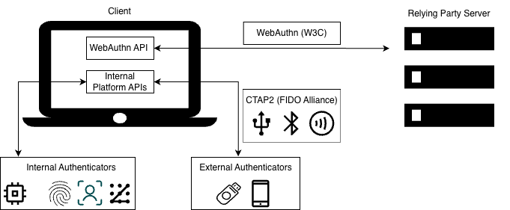
Backup: What are Passkeys?
Passkeys are discoverable FIDO2 credentials
Can be device-bound or synced across devices
Enable passwordless and usernameless login flows
Cross-device authentication allows using a phone to sign in on another device
More features:
  phishing-resistant through origin binding
  no shared secret, asymmetrical cryptography instead
  user verification for MFA

Slide 30
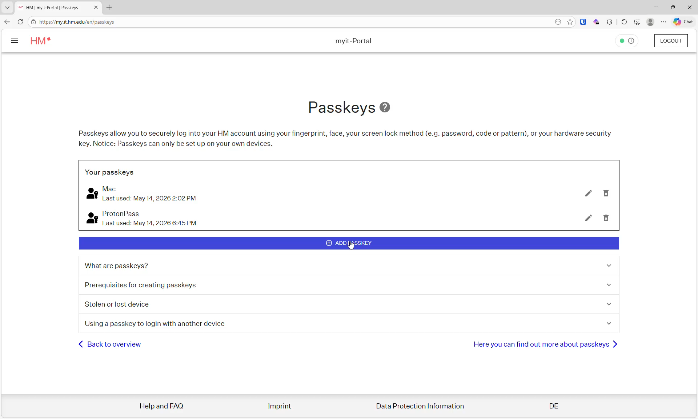

Slide 31
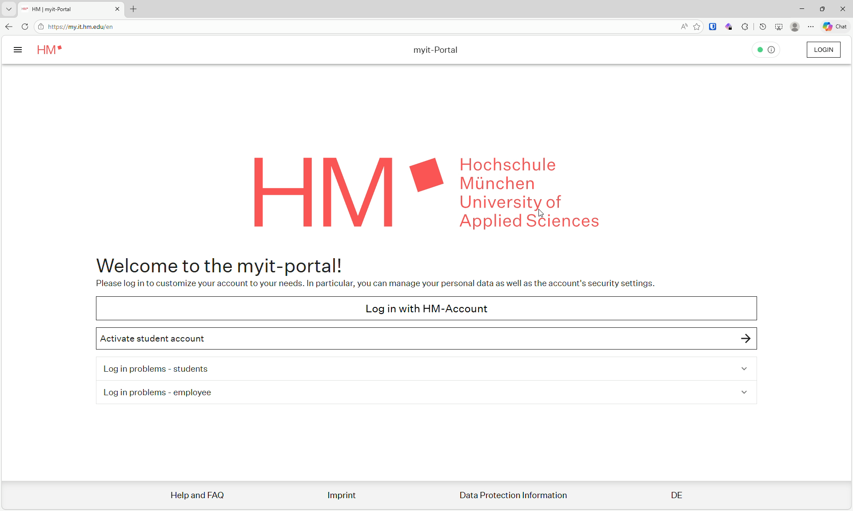

Slide 32
Roles Changed the Shape of Adoption
Passkeys fastest across students, faculty, and staff
Staff/faculty had slower login medians than students
Faculty/staff showed more mixed portfolios and backups
Role-specific support remains important
 | Students | Faculty | Staff
Passkeys | 4.3s | 6.99s | 8.21s
PW+TOTPs | 22.15s | 28.82s | 30.65s
PW+FIDO2 | 13.25s | 19.69s | 23.81s

Slide 33
What’s Next
EntraID + External Authentication Method
→ One MFA Method across both environments
→ PoC running since 01st March 2026
    Few tickets so far
    Mostly related to FIDO2 support
“LDAP-only” – Services
→ OIDC-to-LDAP bridge built
→ PoC running in Computer Science faculty

