Slide 1
Testing Our Way to Trust
Earning Confidence in the Face of Uncertainty
Notes:
ADrian

Slide 2

We Used to Ship Features Nobody Asked For
We had roadmaps. We had stakeholders. We had opinions.
What we didn't have — was evidence.
This is the story of how we started treating our ideas as bets instead of facts.
Notes:
Adrian

Slide 3

Who We Are
👤 Ingrid Amelia Bruholt – Product Manager
👤 Adrian Fellman – Product Manager
Notes:
Begge

Slide 4

Our World: Sikt and the Two Products
🏛 Sikt — national digital infrastructure for Norwegian education and research
🔐 Feide — federated identity for 1.5M users across hundreds of services
📚 Læremiddelkatalogen — national overview of digital learning resources used in Norwegians schools
Public sector. High trust. High stakes.
Notes:
Adrian
Alternativ: National catalogue connecting schools, teachers and edtech vendors

Slide 5
The Challenge
Notes:
ADrian

Slide 6

We Can't Move Fast and Break Things
Many stakeholders — conflicting needs, no single customer
Complex, interconnected, long-lived services
End users are indirect and hard to observe
Strong security, privacy and regulatory constraints
Notes:
Adrian

Slide 7

And the World Keeps Changing Anyway
Very high reliability expectations — tiny error tolerance
Limited capacity vs. endless lists of demands
Fast-changing tech vs. slow institutional change
Cross-organisation decision and adoption complexity
Growing pressure to show real value — not just ship deliverables
Notes:
Adrian

Slide 8
The Approach
Notes:
Ingrid
Given this challenge, we needed a way to reduce risk and learn faster. Our approach is hypothesis‑driven development.

Slide 9
The hypothesis loop
1. ASSUME
Name your riskiest assumption
2. TEST
Run a small, focused experiment
3. LEARN
Measure outcomes, not opinions
↑ then loop again
with a new assumption
4. DECIDE
Keep, kill or adapt
Inspired by Teresa Torres’ Continuous Discovery Habits — treat every idea as a bet, not a fact
Notes:
Ingrid

Slide 10
How it works in practice
01
Surface assumptions
Use story mapping or opportunity mapping to name every assumption behind your idea
02
Find the riskiest one
Plot on an importance vs. evidence matrix. The top-right quadrant is where you start
03
Make it testable
Write a hypothesis with a clear outcome and a measurable stop condition
Notes:
Ingrid

Slide 11
In Practice
Case: Untangling a complex subject structure
Notes:
Ingrid

Slide 12
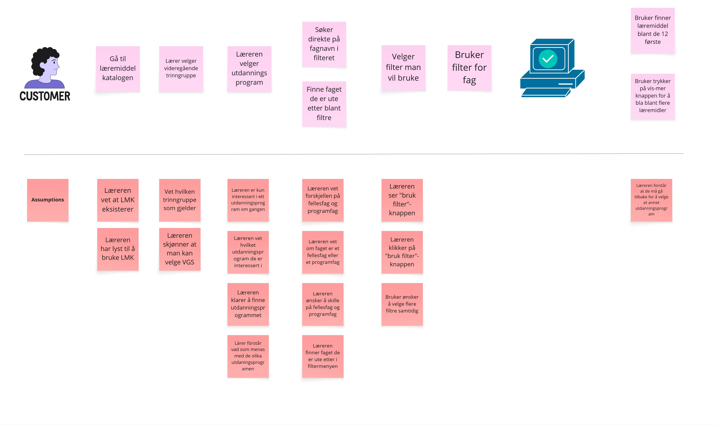
Step 1 of 3
Using story maps to surface assumptions
Notes:
INgrid
Example from Upper secondary school
Userstory mapping

Slide 13
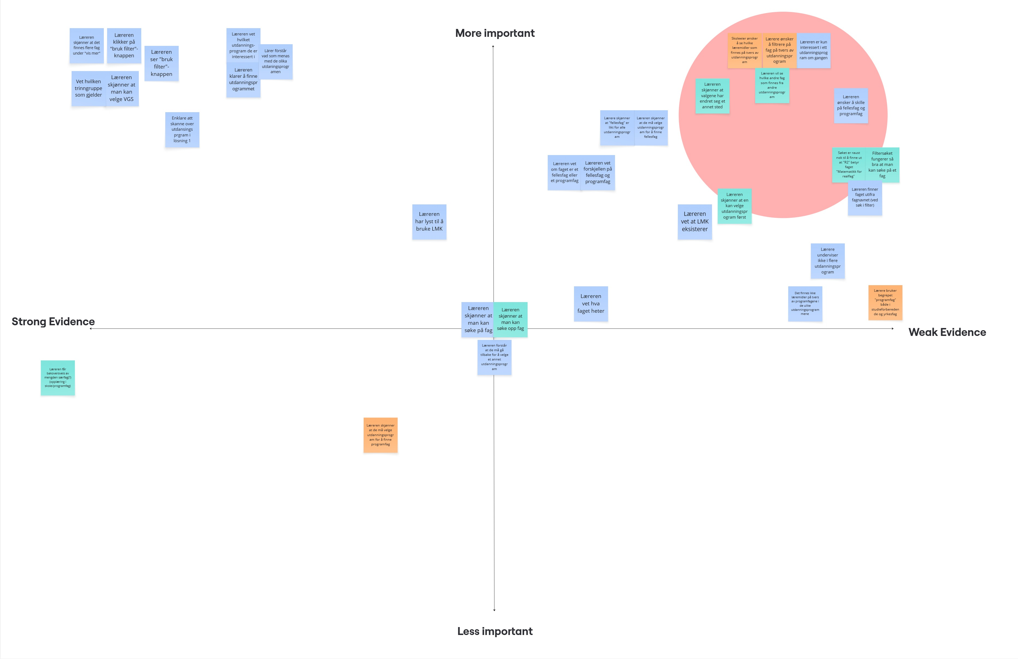
Step 2 of 3
Mapping assumptions – finding what matters most
Notes:
Ingrid
Example from Upper secondary school

Slide 14
Step 3 of 3
Turning assumptions into testable hypotheses
Assumption
Teachers want to seperate common subjects from programme subjects
Hypotheses
We believe that separating common subjects from programme subjects will result in less confusion and faster subject selection for teachers.
We will know this is true when teachers can identify the correct subject without assistance in at least 4 out of 5 usability tests

Slide 15

What We've Learned
Keep experiments small – the goal is to learn fast, not build a prototype
“What would make us stop?” – is the most important question you can ask
A failed hypothesis is a win — it saved you from building the wrong thing
Hypothesis work is a team sport – bring in design, tech and product from the start
Public sector and experimentation are not opposites — they need each other
Notes:
Adrian

Slide 16

Questions?
We'd love to hear how you navigate uncertainty in your products
Find us here at TNC or at sikt.no
Notes:
Adrian

