Slide 1

From eduGAIN to eduEU: Why NRENs Matter for Building Europe’s Interoperable Higher Education Ecosystem
Goran Škvarč, CARNET
James Clay, JISC
Tuesday 9 June 2026, TNC 2026
Helsinki
Notes:
Good afternoon everyone. My name is Goran Škvarč from CARNET. Together with James Clay from Jisc, I would like to share why we believe NRENs have a unique role in building the interoperable digital infrastructure needed for the European Education Area.

Slide 2
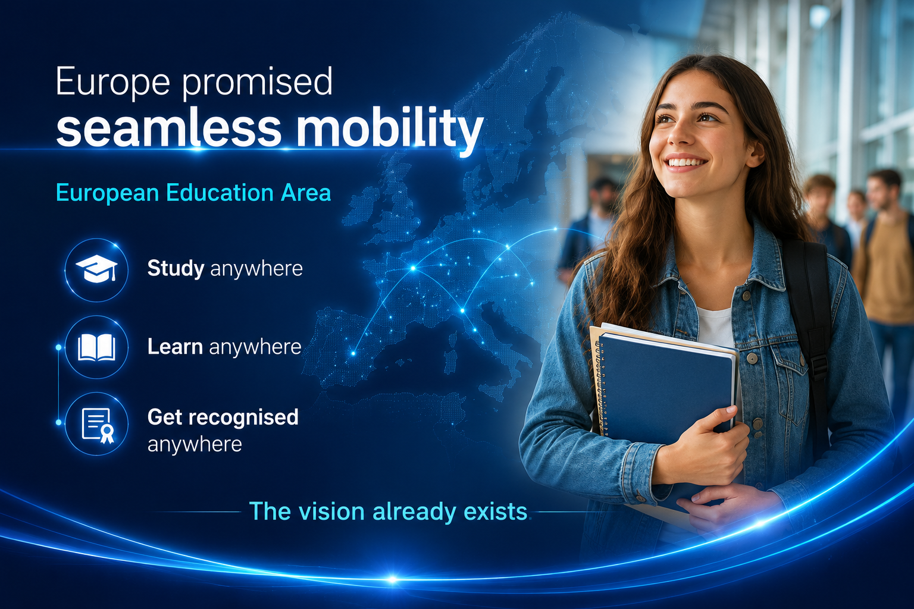
Notes:
Europe has ambitious goals for mobility, lifelong learning and cross-border education.

Slide 3
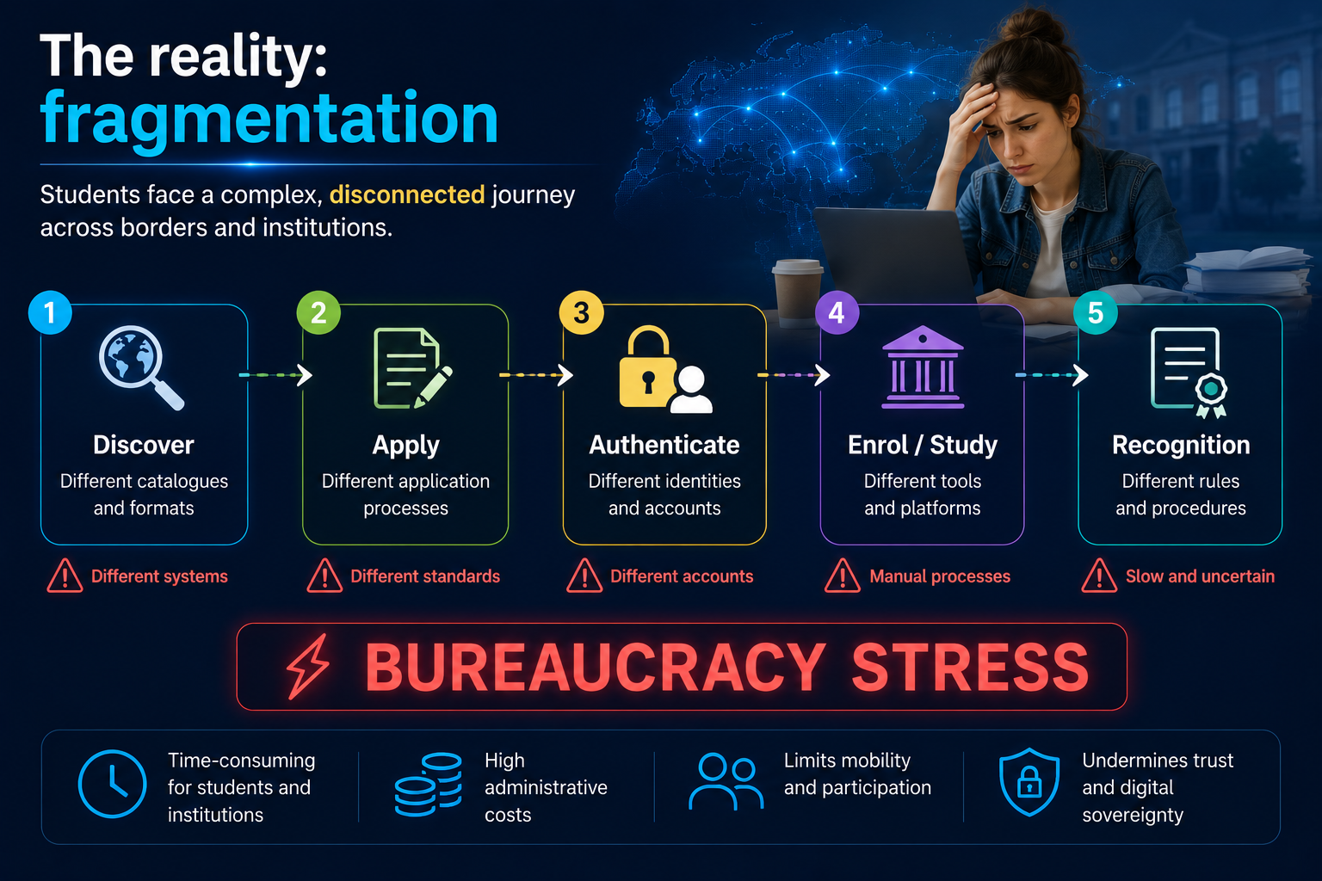
Notes:
But while policy is moving quickly, implementation remains fragmented.
Students still face significant barriers when trying to discover opportunities, apply across institutions and receive recognition for their achievements.
Today I will explain why NRENs are uniquely positioned to help close this gap.

Slide 4
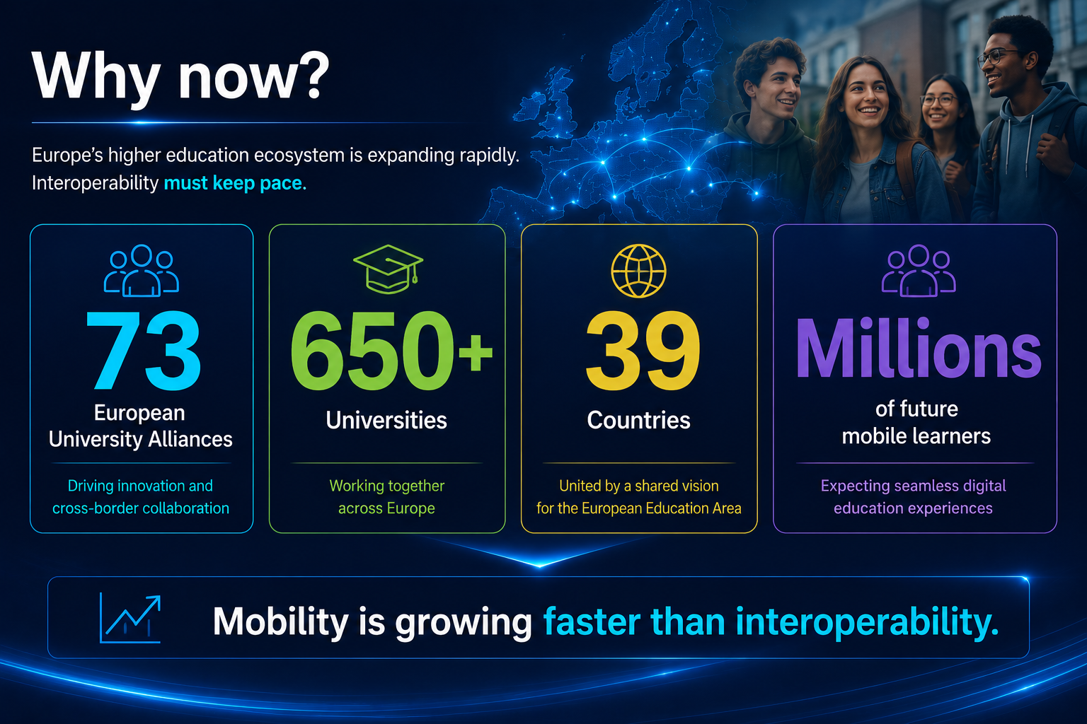
Notes:
The urgency is increasing.
We now have 73 European University Alliances involving more than 650 universities across 39 countries.
Student mobility is growing rapidly and the demand for flexible, cross-border learning continues to expand.
The problem is simple: mobility is growing faster than interoperability.

Slide 5
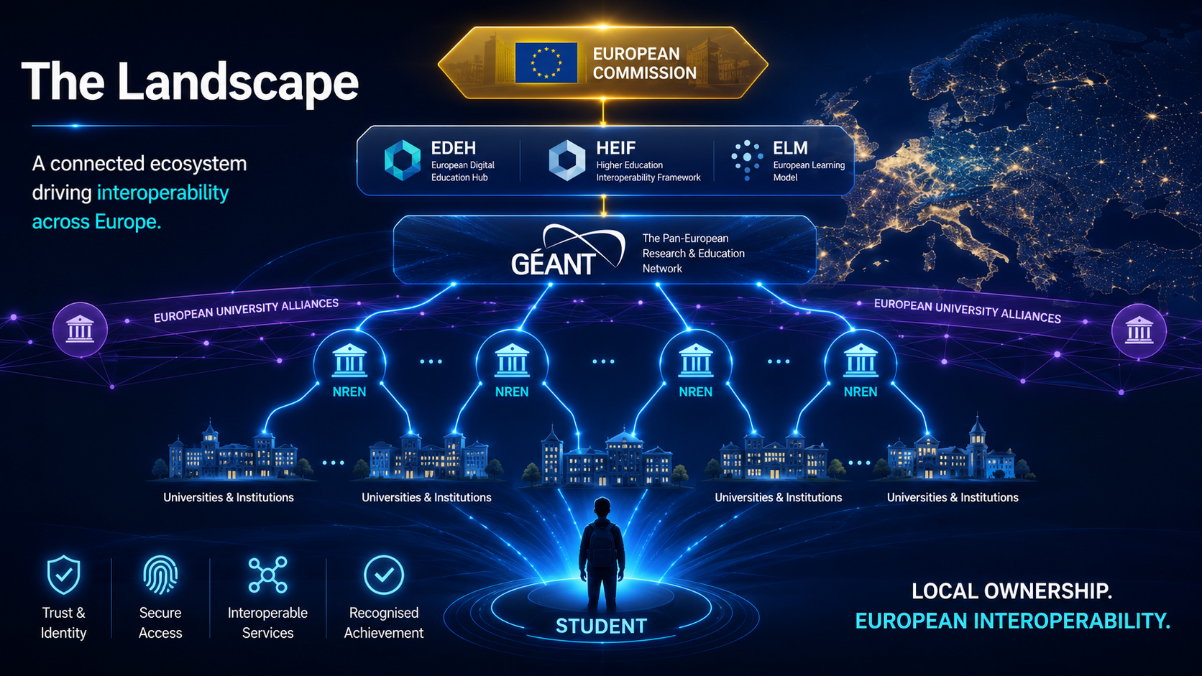
Notes:
The European landscape is rich but fragmented.
We have the European Commission, EDEH, HEIF, European University Alliances, Erasmus initiatives, national ministries, universities and many projects.
Everybody is working on parts of the puzzle.
The challenge is connecting these initiatives into a coherent ecosystem.

Slide 6
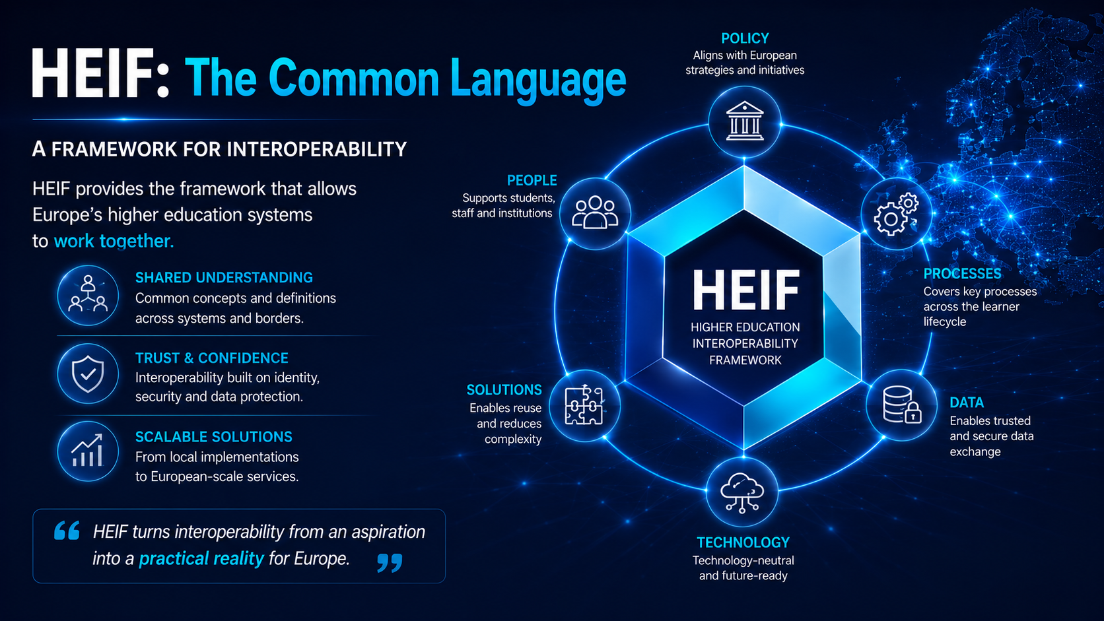
Notes:
The European Higher Education Interoperability Framework provides a common vision.
HEIF defines the key building blocks needed to support the learner journey.
It gives us a shared language and a shared direction.
What is needed now is implementation.

Slide 7
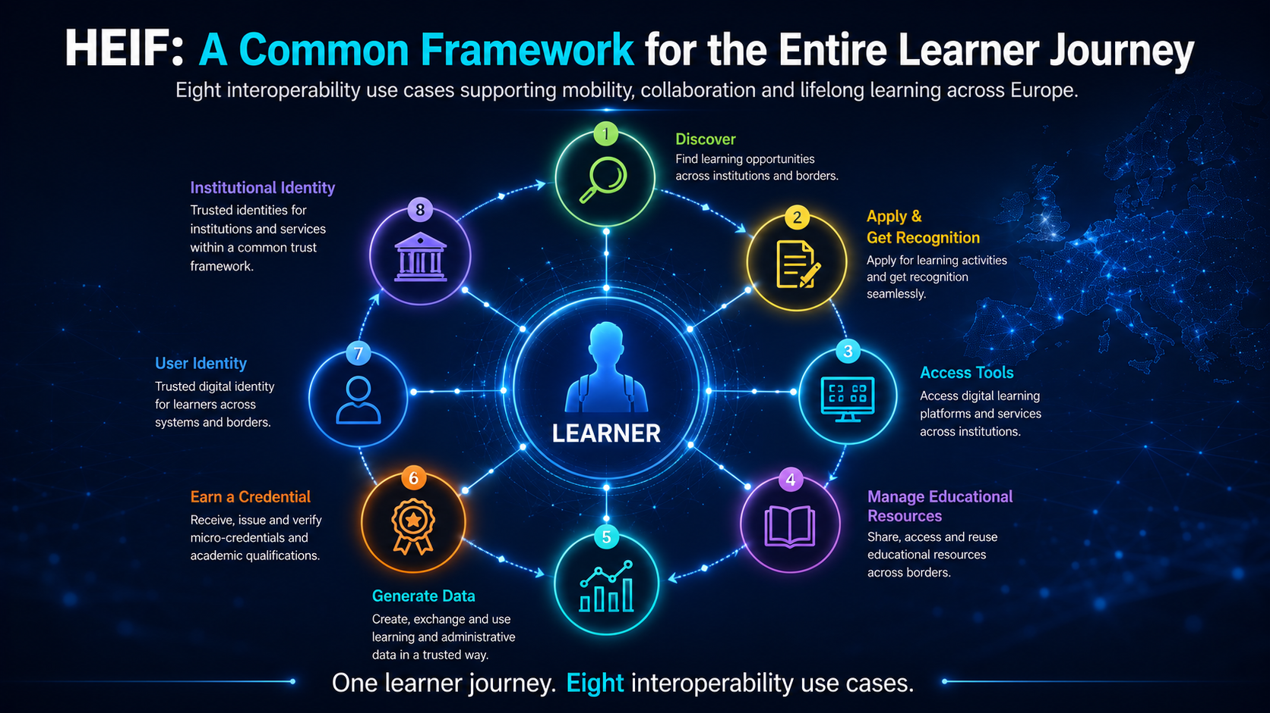
Notes:
HEIF identifies eight use cases that together support the learner journey.
These range from discovering learning opportunities and applying for courses to earning credentials and managing identity.
The important point is that these use cases are interconnected.
Solving only one of them is not enough.
Europe needs an interoperable ecosystem.

Slide 8
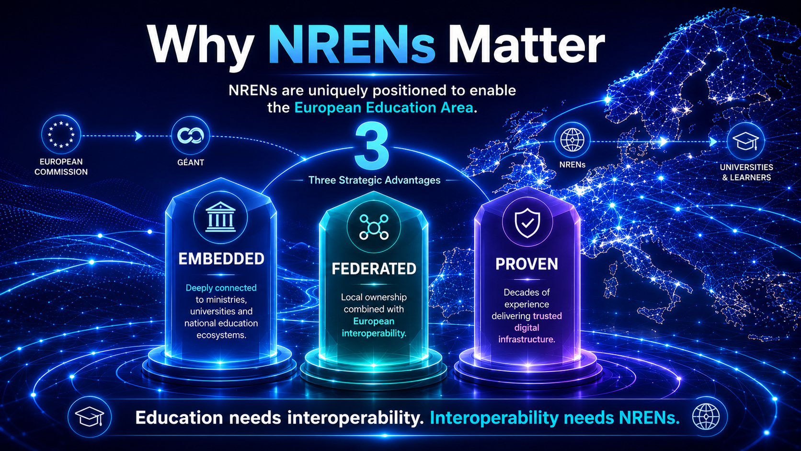
Notes:
So who can help turn this vision into reality?
We believe NRENs are uniquely positioned because they combine technical expertise, trusted relationships and a long history of European collaboration.
There are three reasons why.

Slide 9
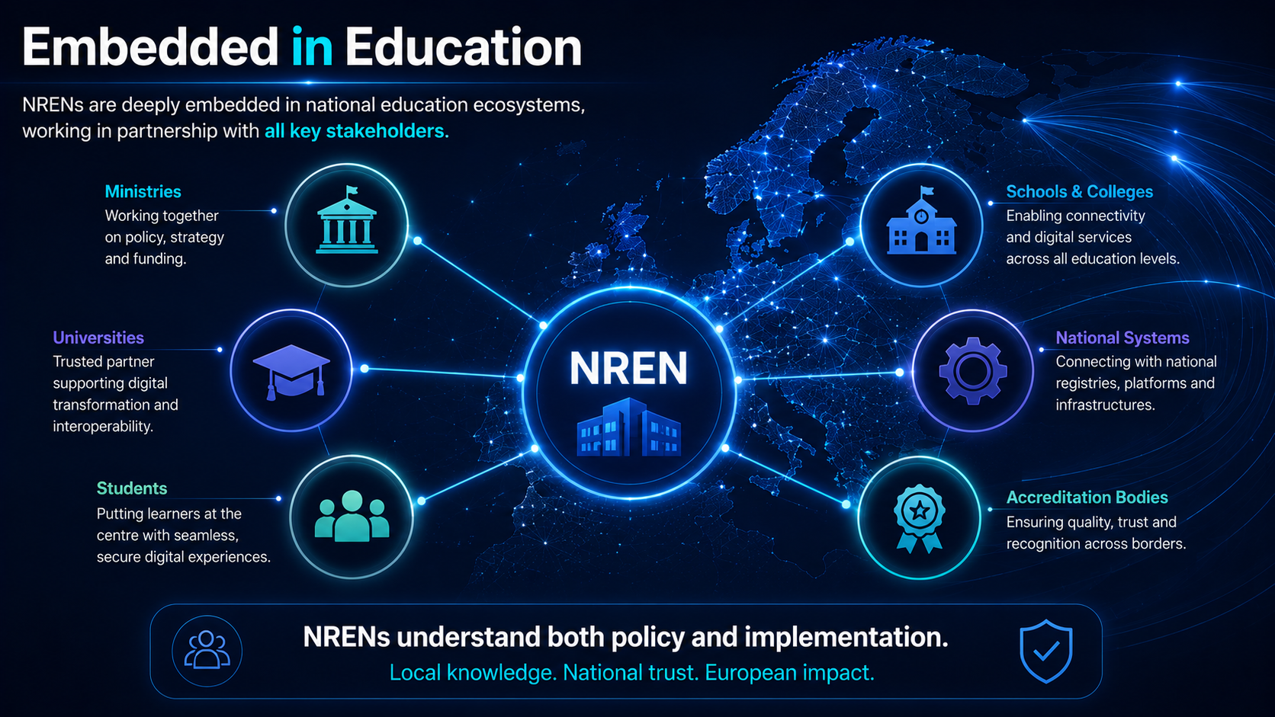
Notes:
First, NRENs are deeply embedded in national education ecosystems.
We work closely with ministries, universities, schools and national service providers.
We understand both policy requirements and operational realities.
This allows us to translate European ambitions into practical implementation.

Slide 10
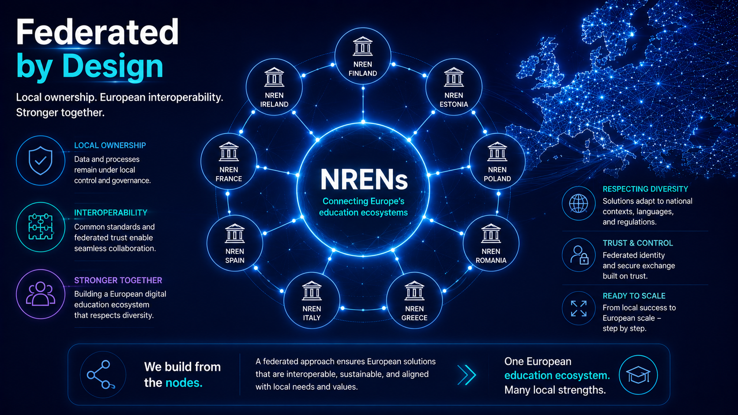
Notes:
Second, NRENs believe in a federated approach.
Local ownership remains local.
National diversity remains national.
But interoperability is achieved through shared standards and trusted connections.
This is exactly the approach that already powers services such as eduroam and eduGAIN.

Slide 11
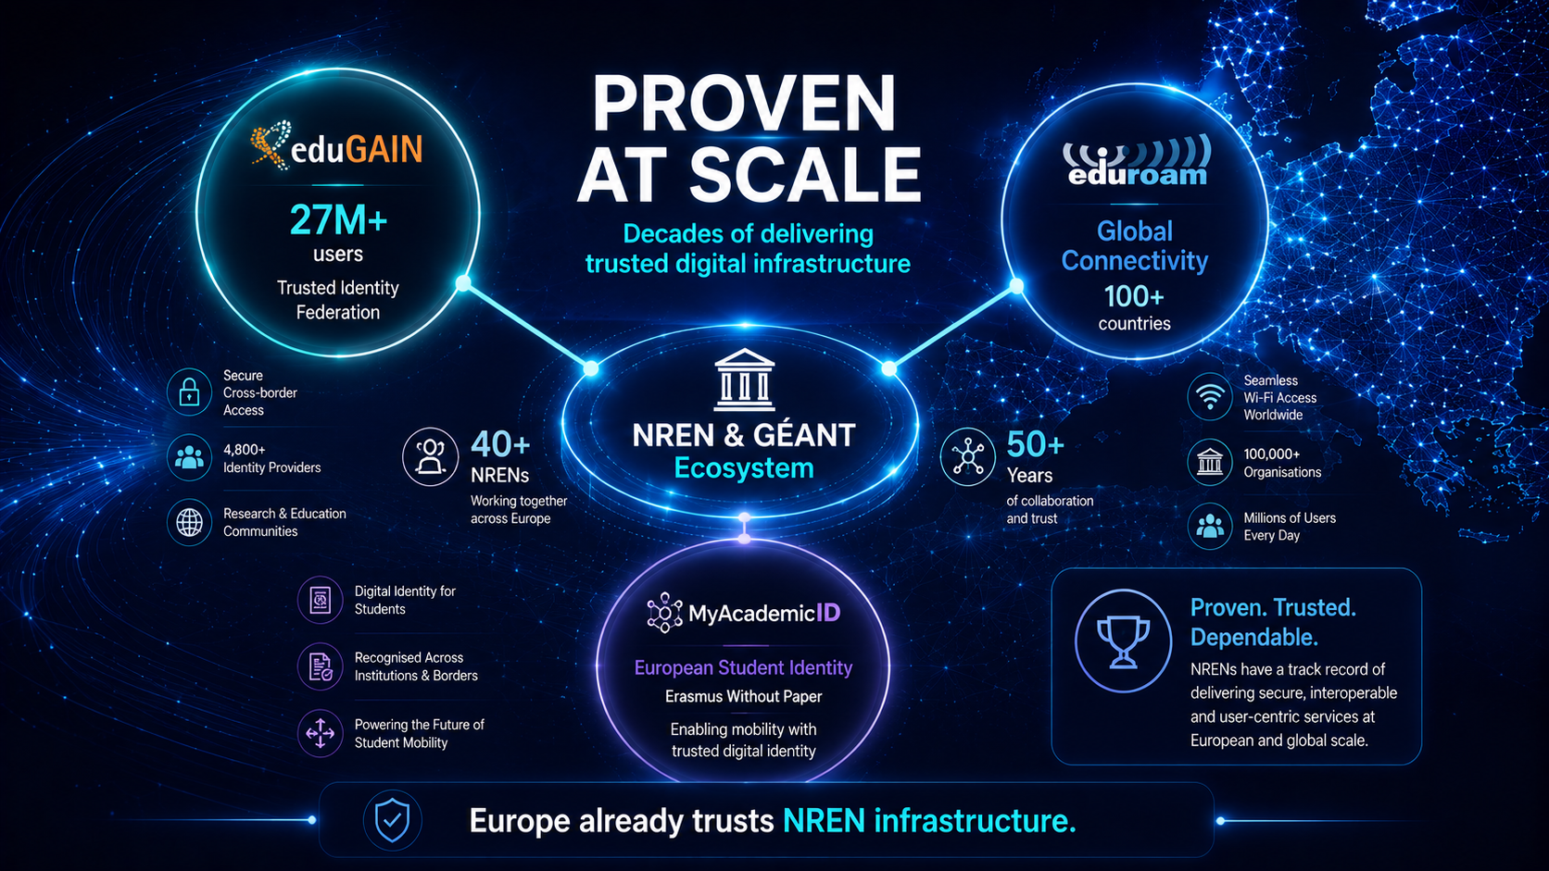
Notes:
Third, NRENs have already demonstrated that this model works.
eduGAIN, eduroam, MyAcademicID and many national services started as local initiatives and scaled internationally.
We are not proposing a new theory.
We are building on decades of proven experience.

Slide 12
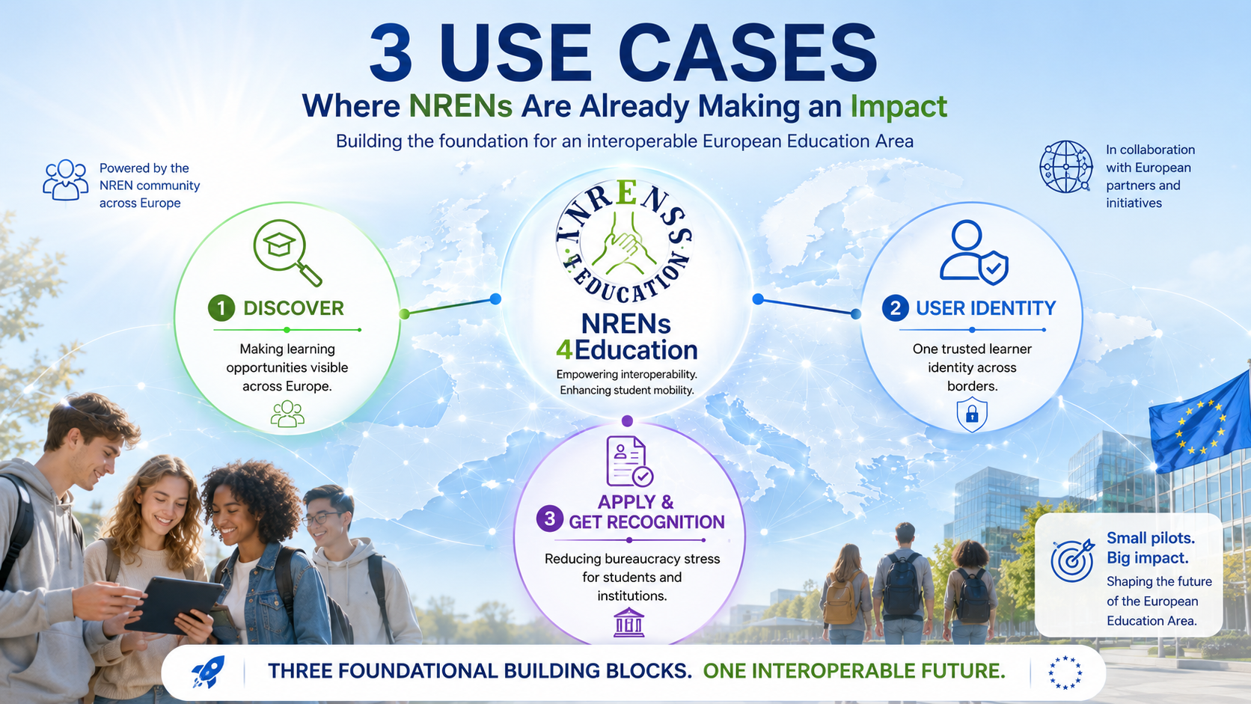
Notes:
Through the NRENs4Education initiative we are focusing on three priority use cases.
Discover - helping students find learning opportunities across Europe.
User Identity - enabling trusted, seamless access across institutions and borders.
Apply and Get Recognition - reducing bureaucracy and simplifying mobility processes.
These are areas where mature national solutions already exist and can be scaled.

Slide 13
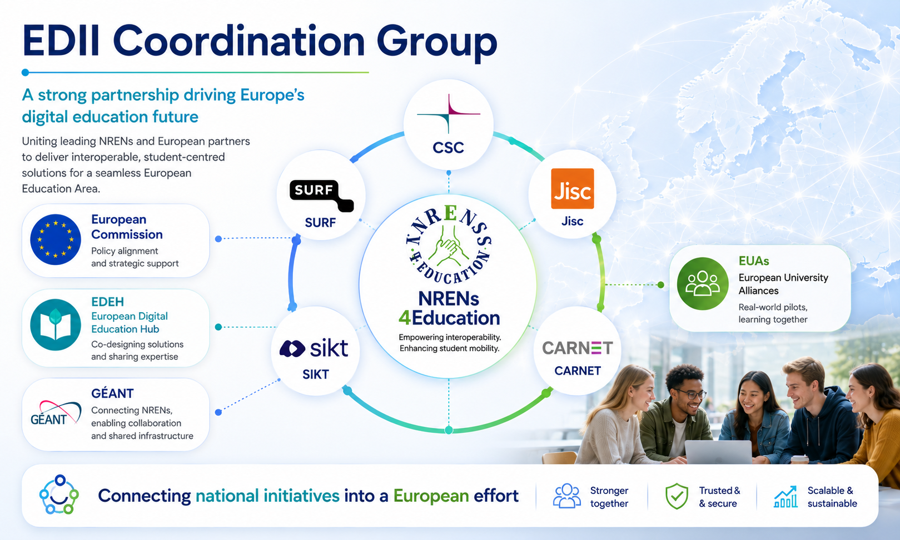
Notes:
To make this happen, collaboration is essential.
The EDII Coordination Group brings together NRENs that are already active in this area.
We work closely with the various stakeholders - EDEH, European University Alliances, GÉANT and the broader GÉANT community.
The objective is simple - connect national initiatives into a European effort.

Slide 14
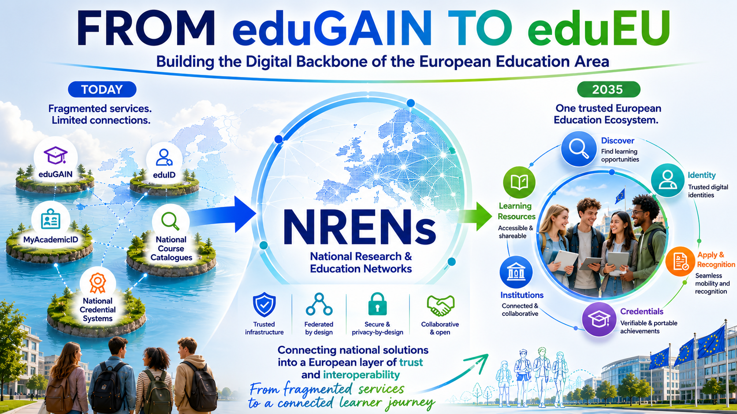
Notes:
Our vision is not to create another platform.
Our vision is to connect what already exists.
By linking national solutions through a trusted and federated architecture we can create what we call eduEU - a digital backbone for the European Education Area.
A system where students can move seamlessly while institutions retain autonomy.

Slide 15
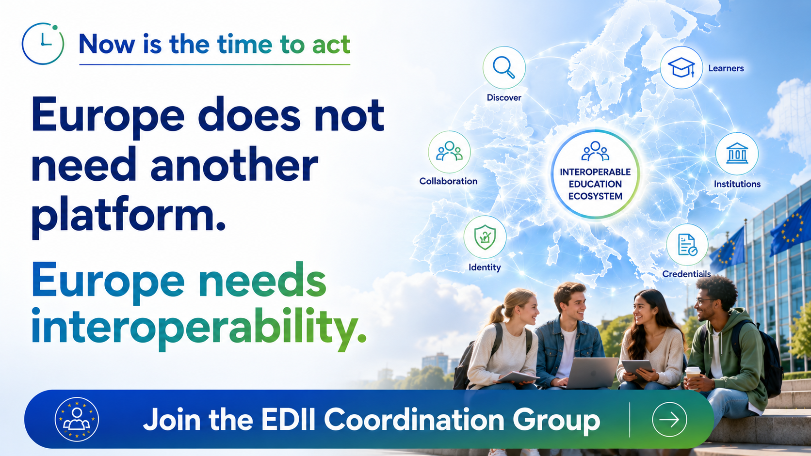
Notes:
Europe does not need another platform.
Europe needs interoperability.
The frameworks exist.
The technology exists.
The community exists.
What is needed now is coordinated implementation.
We invite NRENs, universities, alliances and partners to join us in shaping this future together.

Slide 16
Thank you
Any questions?
goran.skvarc@carnet.hr
Notes:
Thank you very much.
I look forward to your questions and discussion.

