Slide 1
European Higher Education Interoperability Framework: Use Cases Driving Cross-Institutional Collaboration
Jukka Kohtanen (CSC)
Sami Hautakangas (Tampere University)

Slide 2
Current Drivers for Development
ECTS User’s Guide 2027 will bring new requirements/aims for digital support of cooperation
  Move to digitally
    verifiable credentials (European Digital Credentials recommended) and
    open course catalogue data for all studies
  Mobility: Individual Learning Agreement, Embedded Pathways (no LA), Open Mobility
    -> formalise automatic recognition of credits

Slide 3
Current Drivers for Development
Interoperability challenges are not limited to European university alliances, but the 73 alliances comprising more than 600 higher education institutions (including 28 from Finland) have placed interoperability challenges at the centre of attention.
If the interoperable digital solutions and common practices cannot be applied in cross-institutional processes, this means a large amount of manual work in HEIs -> blocks achieving the goals of cooperation

Slide 4
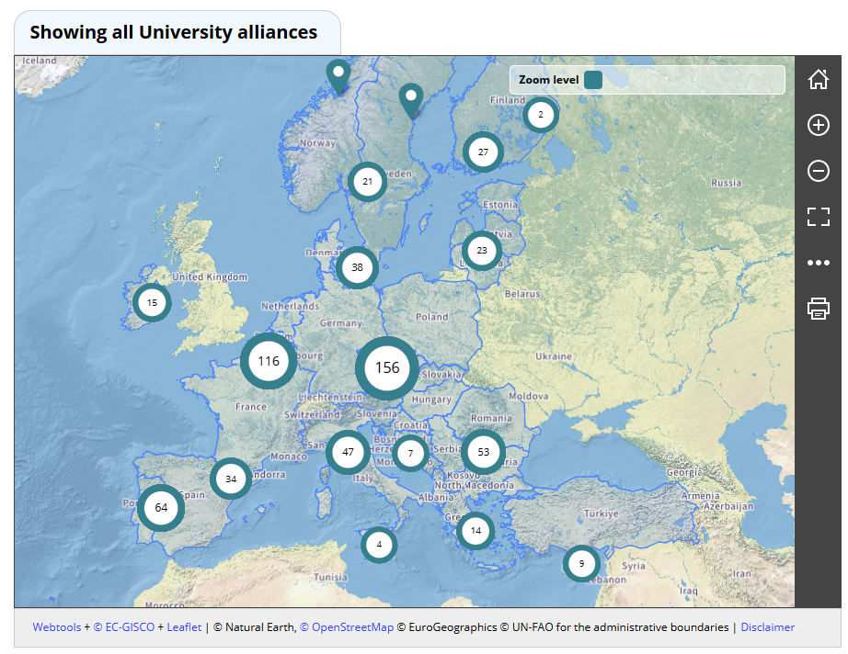
https://education.ec.europa.eu/education-levels/higher-education/european-universities-initiative/map

Slide 5
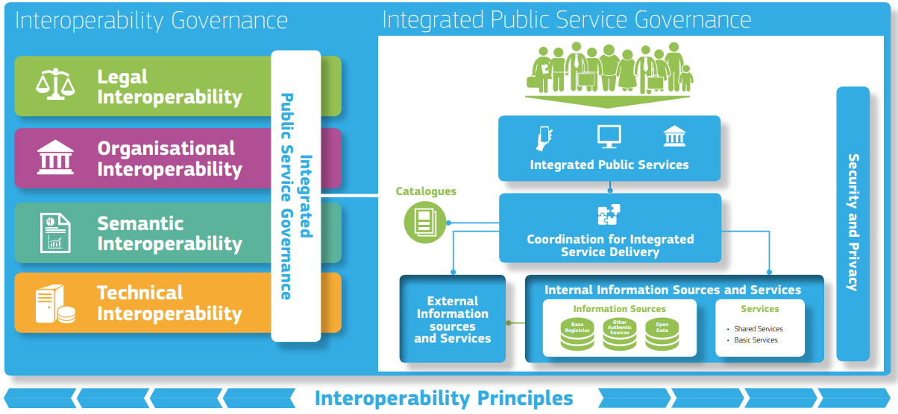
Interoperability - European Interoperability Framework (EIF)
EIF joinup.ec.europa.eu

Slide 6
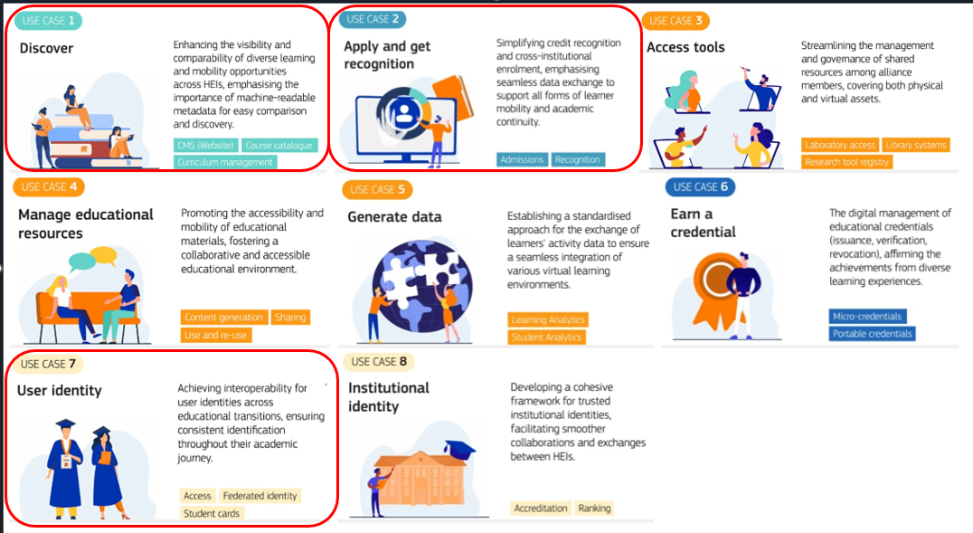
European Higher Education Interoperability Framework
Based on the use cases of student life-cycle that are developed in the cooperation with HEIs and Alliances.
NRENs4Education cooperation initiative has recognised 3 use cases as most urgent/feasible to start with, and these coincide with the views of early adopter alliances
  Discover
  Apply and get recognition
  User identity
Solving the use cases means utilising current standards and solutions, but also developing new ones.
European Higher Education Interoperability Framework use cases

Slide 7
Status from the point of view of Finnish alliance member
Use case | Europe maturity | Finland maturity | Key bottleneck
1 Discover | 2 | 2-3 | Semantics, standards alignment
2 Apply & recognition | 1–2 | 2 | Identity + integration
3 Access tools & 4 Manage educational resources | 3 | 3–4 | Identity fragmentation
5 Generate data | 1–2, 3 (statistics) | 2, 5 (statistics) | GDPR + governance
6 Earn credential | 2–3 (EDC), 4–5 (traditional unsigned) | 2–3 (EDC), 5 Degree Certificates, 4–5 (traditional) | Transition to EDC
7 User identity | 2–3 | 3–4 | Assurance level
8 Institutional identity | 3-4 | 3-4 (5 national HEI ids) | Agreements on the use of certain id:s (schacHomeOrganization, DEQARINST ID, DID)
Level | Meaning
1. Emerging / POC | No production-ready solutions, pilots ongoing
2. Production-ready (limited adoption) | Technical solutions exist, used in some contexts
3. Somewhat adopted | Used in multiple HEIs / alliances, but not standard practice
4. Large-scale adoption | Widely used across HEIs / countries / ecosystems
5. Mainstreamed | Common practice across HEIs

Slide 8
What we in alliances need next?
Shared minimum data models
  “lowest common denominator” for cross-border processes – however this means i.e. the most demanding data requirement/union of requirements of HEIs as host institutions (e.g. registering students)
Stronger identity layer
  Assurance level up in eduGAIN, EUDI wallet + higher assurance authentication for initial registration
Operational interoperability between HEIs systems (not just pilots)
  POCs → production services (e.g. course data exchange)
  Bridging the gaps in integrations for each use case
Joint governance
  agreements on semantics, technical standards, responsibilities, lifecycle of data
  HEI’s need support from national and international coordination
    e.g. for course catalogue data European Learning Model (ELM), OEAPI (NL), Edu-API and OCCAPI standards are analysed as most fitting with ECTS requirements in interoperability Task force 2
  Common shared data of used solutions and standards in different use cases
    Compare | eduXS
    4 Alliances have described their situation – ECIU as coordinator of FOREU4ALL next to complement the platform to share experiences FOREU4ALL - FOREU4ALL?

