Slide 1
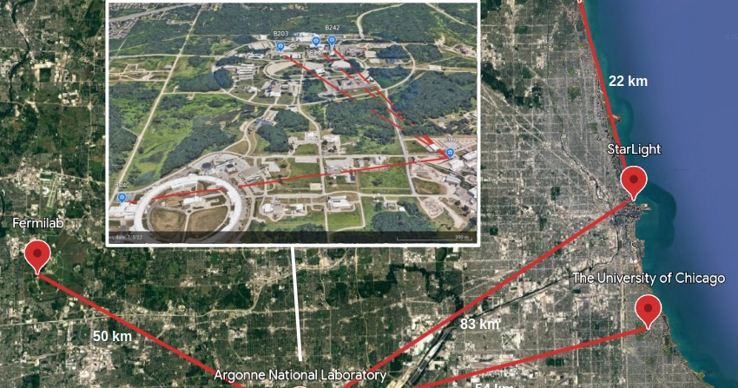
Toward Scalable Quantum Networks: Lessons from InterQnet
TNC26 – June 2026
Rajkumar Kettimuthu
Senior Scientist and Group Leader
Data Science and Learning Division
Argonne National Laboratory
Notes:
Good afternoon, everyone. Two years ago at TNC24, I introduced InterQnet as a vision for scalable quantum networks.
Today I want to give a progress report: what we have built, what we have measured, and what we have learned since then.
Quantum networks will depend on deployed fiber, automation, synchronization, optical-channel engineering, and operational expertise that NRENs already have. And I can see from this morning's quantum technologies for NRENs BoF that many NRENs are already engaged in quantum networking efforts.

Slide 2
Talk Outline
Progress and Lessons Learned (TNC24 → TNC26)
Section | Highlights | ~Time
Background & InterQnet Overview | Scalability challenge, project goals, ArQNet testbed, NREN relevance | 7 min
Hardware Progress (Thrusts 1 & 2) | Yb atoms, Er³⁺ ions, M-O transducers, QFC; error mitigation & purification | 6 min
Architecture & Protocols (Thrust 3) | Orchestrator, heterogeneous simulation, GHZ routing, encoded repeaters | 7 min
Synthesis & Outlook | Lessons learned, Collaboration opportunities | 5 min
Notes:
Here is the structure for the 25-minute talk.
I will begin with the scalability challenge and the InterQnet setup, including why this is directly relevant to NRENs. Then I will summarize hardware and error-handling progress, followed by architecture and protocol results from orchestration and simulation. I will close with lessons learned and specific collaboration opportunities.

Slide 3
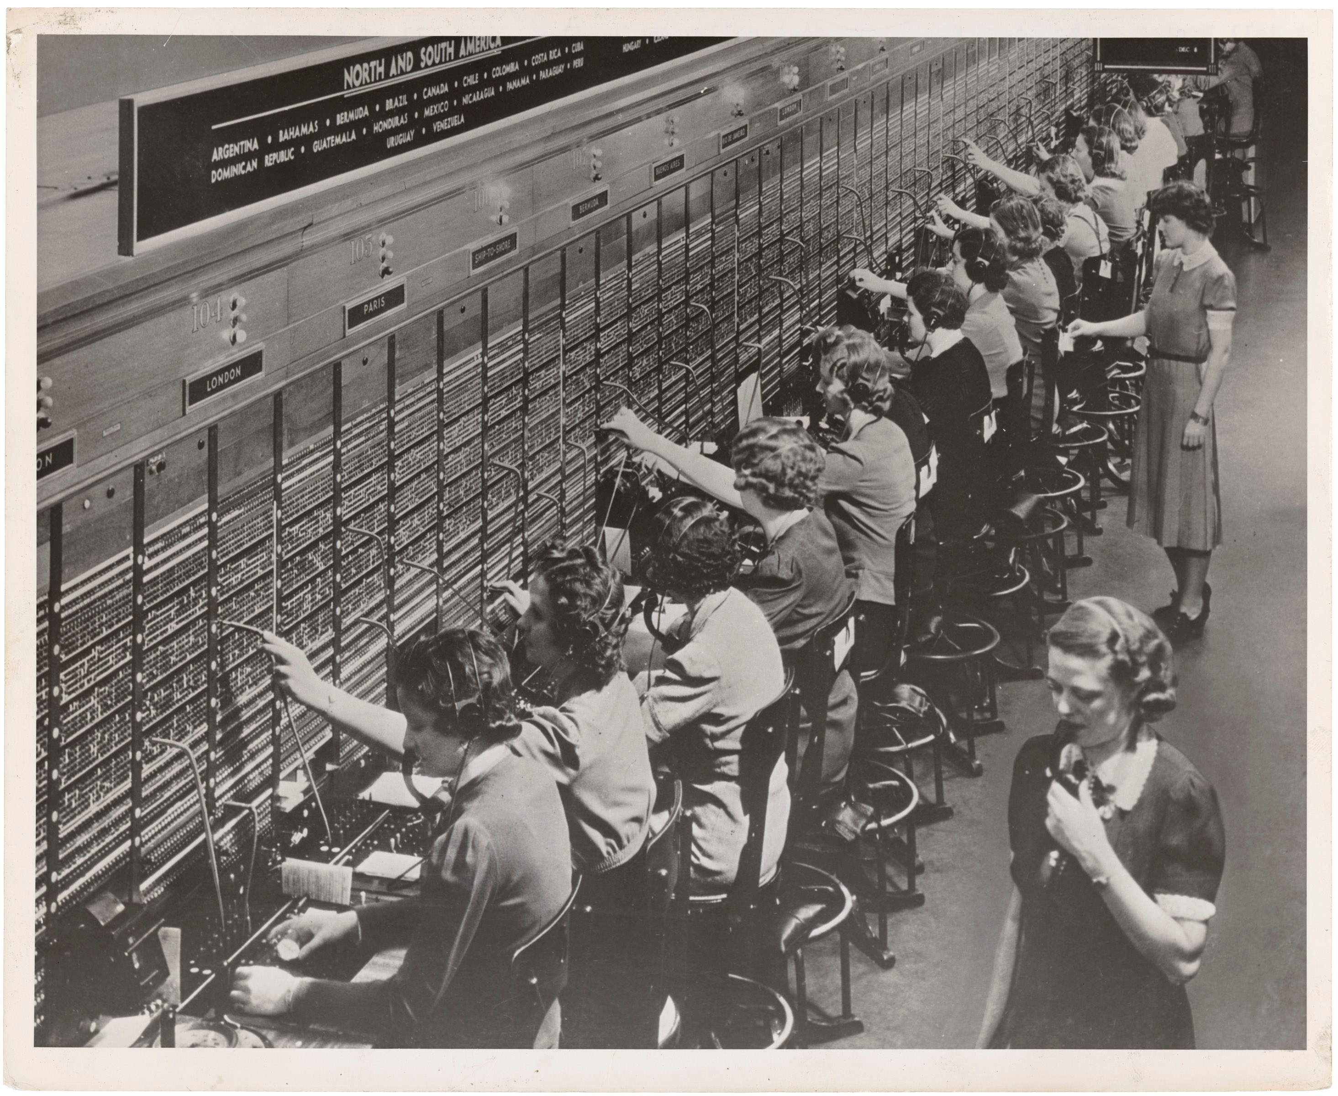
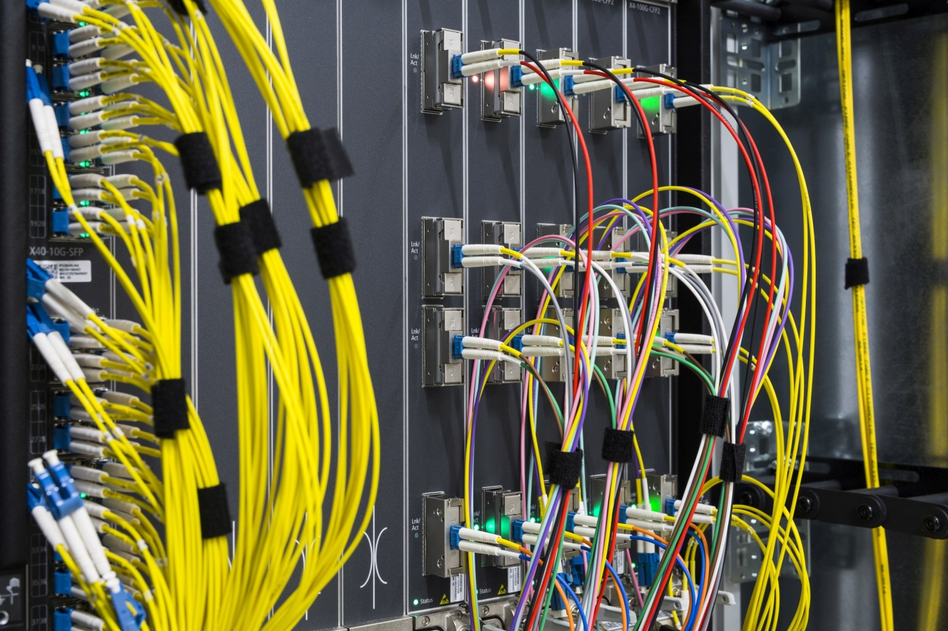
The Challenge
How to Scale Quantum Communication Networks?
Early quantum networks rely on manual orchestration and static configurations.
Hardware heterogeneity & manual fiber switching mirror classical telecom's early limitations.
Scaling requires automated coordination, dynamic control, and system-level abstractions.
Notes:
The core challenge is scaling quantum communication networks beyond isolated demonstrations.
We can distribute entanglement in controlled settings, and many research groups including mine have demonstrated that on deployed-fiber links, including campus and metropolitan scale links. But supporting multiple users, heterogeneous hardware, and real operational constraints is a different problem.
In some ways, quantum networking today resembles early classical networking: manual setup, static configurations, platform-specific interfaces, and limited automation. The lesson from classical networks is clear: scale requires architecture, abstraction, automation, and operations—not just better devices.

Slide 4
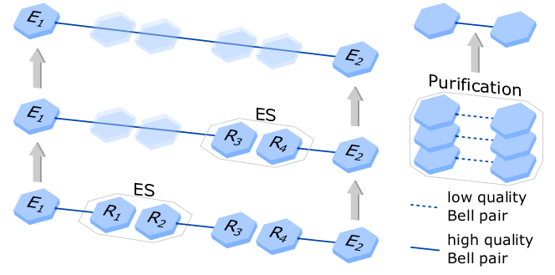
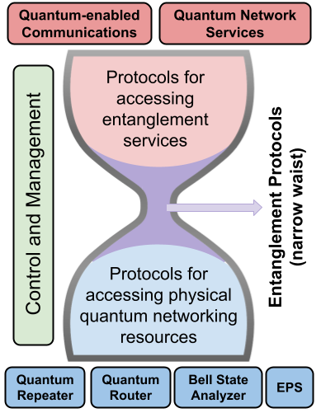
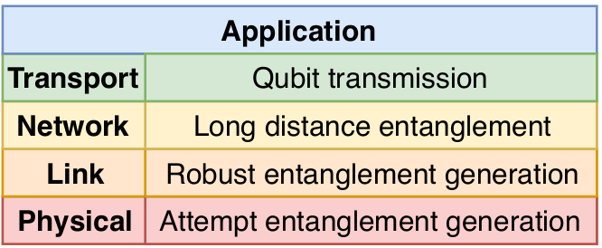
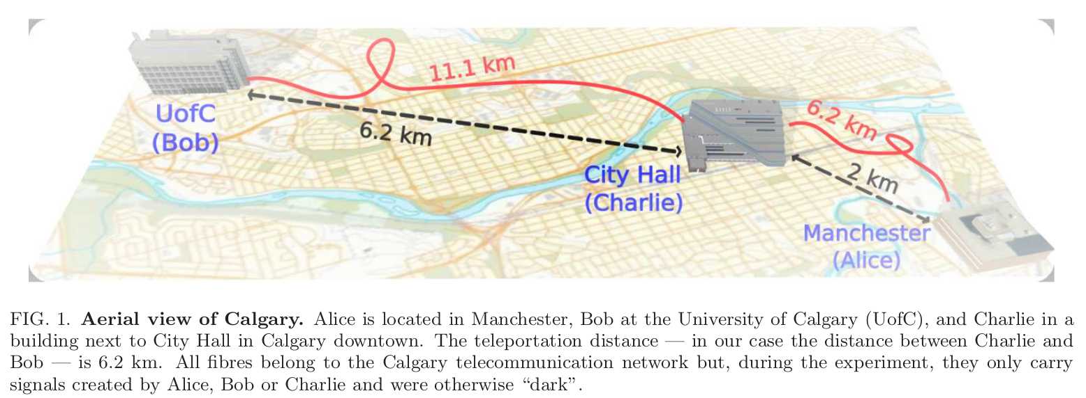
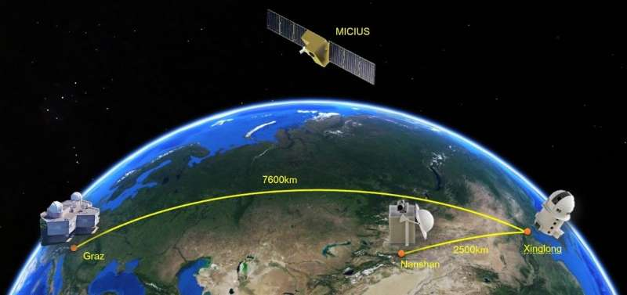

The Gap Between Experiments & Scalable Architecture
Rapid Experimental Progress
  Metro- and continental-scale demonstrations
  Telecom fiber, satellite links, campus testbeds
Emerging Architectural Models
  Layered abstractions
  Control-plane concepts
  Early protocol stacks
But critical gaps remain
  No interoperable framework for heterogeneous hardware
  No standard abstraction for “entanglement as a service”
  No performance-grounded architecture loop
  No shared scalability metrics
Van Meter et al., 2021
Dahlberg et al.,
Notes:
The field has made rapid experimental progress: metro-scale links, campus testbeds, telecom-fiber experiments, and satellite demonstrations. At the same time, there are emerging architectural models and early protocol-stack proposals.
The gap is that these two threads are not yet tightly connected. We still lack interoperable abstractions for heterogeneous hardware, a standard way to request entanglement, a feedback loop from measured performance into architecture, and common scalability metrics.
InterQnet is designed to close that gap: using real hardware, realistic simulation, and protocol development in one co-design loop.

Slide 5
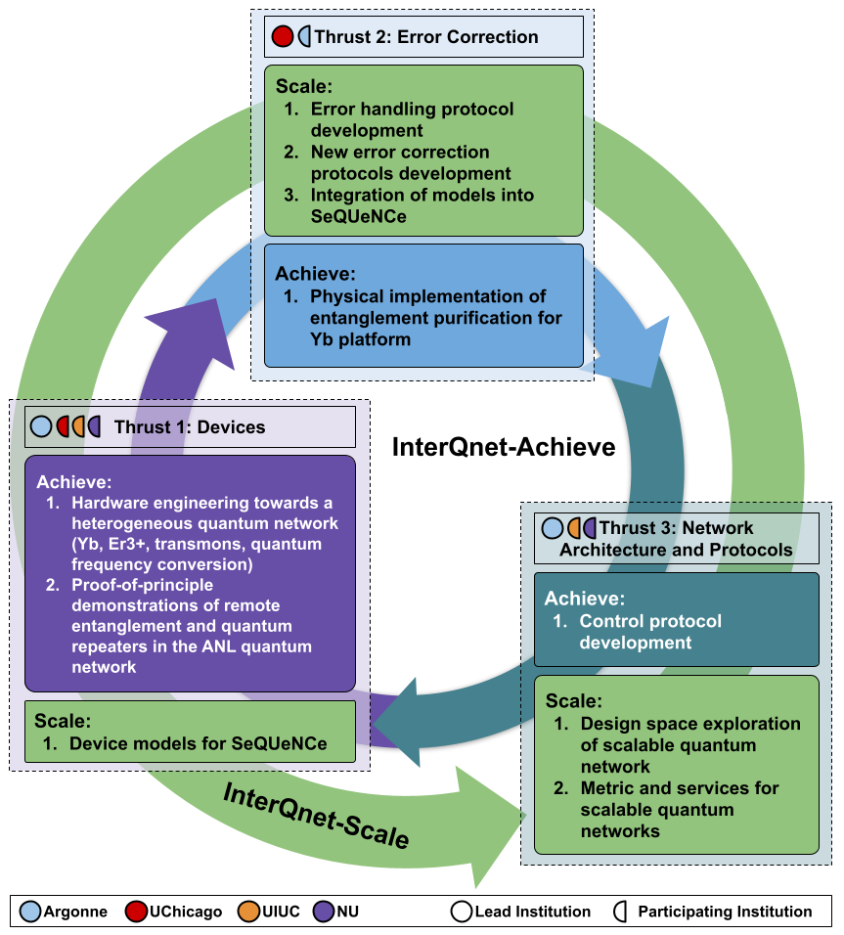
InterQnet: A Heterogeneous Full-Stack Approach to Co-designing Scalable Quantum Networks
Advance the state of the art in scalable quantum communications
Organize the proposed work into three Thrusts:
Devices
Error Correction
Network Architecture and Protocols
Notes:
InterQnet is organized around three thrusts: devices, error correction, and network architecture and protocols.
The important point is that these are not independent work packages. Devices inform simulation. Simulation guides architecture. Architecture feeds back to hardware requirements.
That closed loop is the defining feature of the project.

Slide 6
InterQnet: Two Interrelated Goals
InterQnet-Achieve: Build a 3-node heterogeneous quantum network on ArQNet
  Yb atom array (repeater) – Er³⁺ ions (end node) – Superconducting qubits (end node)
  Linked via deployed fiber, quantum frequency converters, and microwave-optical transducers
  Centralized SDN-style orchestration with automated calibration and continuous operation
  Near-term milestone: remote M-O conversion across ArQNet demonstrated (Bldg 242 → 440)
InterQnet-Scale: Simulation-driven architecture studies for scalable quantum networks
  SeQUeNCe simulator extended with device-faithful models (Yb, SC, QFC, transducers)
  Explore centralized vs. distributed control, routing protocols, error correction strategies
  Studies cover topologies from 2 to 200+ nodes; results validated on ArQNet
Notes:
InterQnet has two tightly connected goals.
InterQnet-Achieve is the experimental goal: build a three-node heterogeneous quantum network connecting Yb atom arrays, Er ions, and superconducting qubits using deployed fiber, frequency conversion, and microwave-to-optical transduction. The near-term control model is centralized, SDN-style orchestration with automated calibration.
InterQnet-Scale is the architecture goal: use simulations to study what happens as we move from a few nodes to regional or national-scale networks. We perform these simulations using SeQUeNCe, a quantum network simulator we have been building at Argonne for about 7 years now. The key is that the simulations are device-faithful and are checked against real measurements.

Slide 7
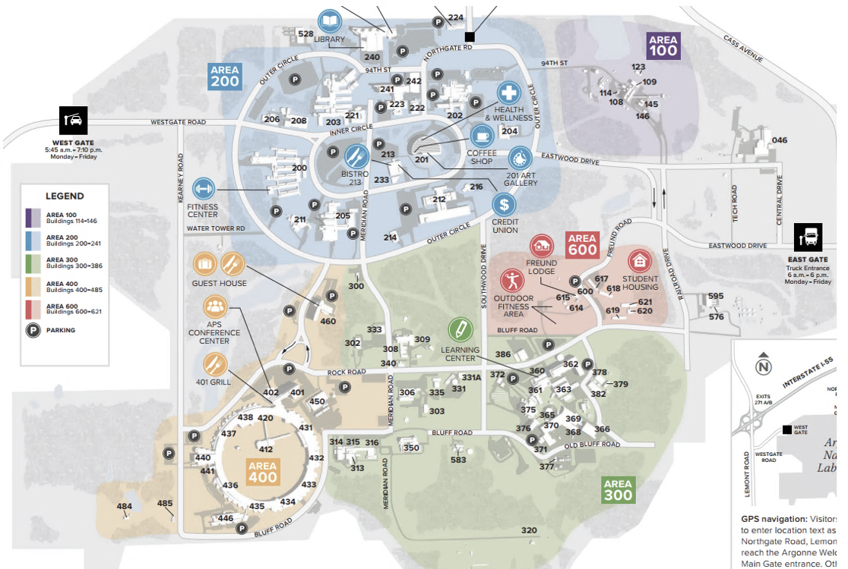
Argonne Quantum Network (ARQNET)
To Fermilab
242/F225
1.10 km
To StarLight
241/A041
Er³⁺
203/H138
Yb
2.87 km
3.09 km
2.72 km
360/C216
SPDC
440/D116
Notes:
Fiber lines are only for illustration purpose, NOT real physical topology.
Each line represents at least one pair of fibers.
µWave
2.19 km
Notes:
This is the Argonne Quantum Network (or ArQNet for short)
It connects several buildings on the Argonne campus using deployed optical fiber. The Yb platform is in Building 203, Er system is in Buildings 241, the superconducting microwave platform is in Building 440, and the entangled photon source is in Building 360.
The campus links are roughly one to three kilometers, and we also have dark-fiber paths toward Fermilab, the University of Chicago, and StarLight. This is not a table-top testbed. It is a multi-building testbed over deployed fiber with the kinds of constraints that network operators recognize.

Slide 8
NRENs and InterQnet
NRENs are already leading quantum network work
  SURF (QuTech collaboration), GÉANT Quantum Task Force, GRNET, PCSS, and others
  EuroQCI, OpenQKD, and national testbeds:
Open problems
  Heterogeneous hardware integration: no standard interfaces across platforms yet
  Control plane scalability: how does SDN-style orchestration hold up at 50+ nodes?
  No consensus benchmarks: fidelity, rate, latency metrics differ across testbeds
What InterQnet brings to this conversation
  Full-stack co-design results: simulation ↔ hardware ↔ protocol in a closed loop
  SeQUeNCe: open-source simulator, actively extended, complementary to EU QIA / EuroQCI work
Notes:
This slide makes the NREN connection explicit.
NRENs in Europe are already active in quantum networking through several different efforts. So, the question is how we learn from each other.
The open problems are similar: heterogeneous hardware integration, control-plane scalability, and the lack of common benchmarks for fidelity, rate, latency, and operational availability.
What InterQnet brings is a full-stack co-design loop and an open-source simulator, SeQUeNCe, that can be used to explore NREN-relevant topologies and compare architecture choices before hardware is fully available.

Slide 9
Thrust I: Devices
Interface Engineering Toward Heterogeneous Networking
Platform | Interface Progress | Key Integration Barrier
Yb | 0.95 spin–photon fidelity; fiber emission | Photon collection & rate scaling
Er | 1000× linewidth narrowing; telecom emission | Cavity Q & spectral matching
SC / Transducer | Tunable qubits; improved resonator yield | Efficient, low-noise M-O conversion
Freq. Conv. | Cavity-filtered architecture designed | Quantum-level noise suppression
Notes:
Let me now summarize progress in the device thrust.
The common theme is interface engineering: each platform has strengths, but each also needs the right optical or microwave interface before it can become part of a heterogeneous network.
On the Yb side, we now have high-fidelity spin-photon entanglement and a clear route toward repeater nodes. On the Er side, we have made major progress in linewidth narrowing and telecom-compatible emission, which are essential for quantum memory interfaces. On the superconducting side, we have improved the device fabrication and resonator yield needed for microwave-to-optical transduction. And on frequency conversion, we now have the cavity-filtered architecture designed and classically characterized, moving us toward quantum-compatible conversion.
We have made good progress but challenges remain: photon collection rate for Yb, cavity quality and spectral matching for Er, efficient low-noise microwave-to-optical conversion for superconducting qubits, and quantum-level noise suppression in frequency conversion.

Slide 10
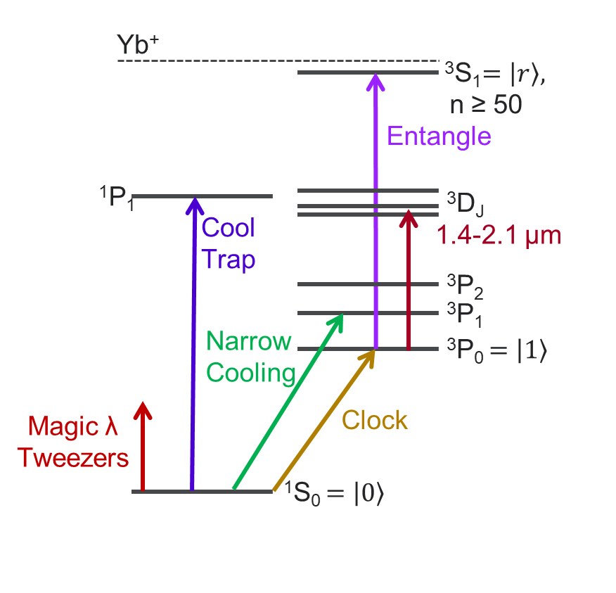

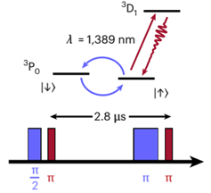
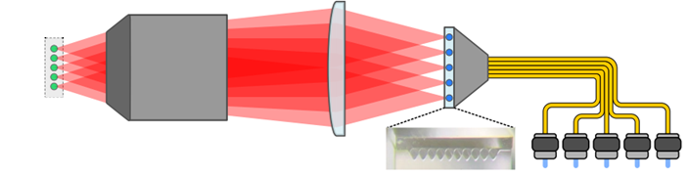
Ytterbium Atoms in Optical Tweezer Arrays
Goal: Utilize demonstrated high-fidelity atom-photon entanglement for heterogenous networking applications
Platform Strengths: Versatile level structure for multi-function nodes; bottom-up control in optical tweezer arrays; long coherence in nuclear spin states; deterministic entangling via Rydberg interactions.
Photon Interface: 1389 nm atom-photon entanglement for direct telecom; 556 nm for local or QFC converted links.
Deployment: Systems under development at Argonne and UIUC, with plans for a campus-scale Yb network.
Recent Results:
Parallelized spin-photon
entanglement demonstrated
at 1389 nm with a 5-atom
array
L. Li, et al., Nature Physics 21, 1826-1833 (2025)
Notes:
Ytterbium atoms in optical tweezer arrays are central to our repeater-node strategy.
The advantage is the combination of long-lived memory, controllable atom arrays, telecom-relevant transitions, and deterministic gates through Rydberg interactions. That is a powerful combination for a network node.
The recent result highlighted here is parallelized spin-photon entanglement from a five-atom array at 1389 nanometers, directly in the telecom band, with about 0.95 fidelity. For InterQnet, this is important because it points toward scalable repeater nodes that can interface naturally with fiber networks.

Slide 11
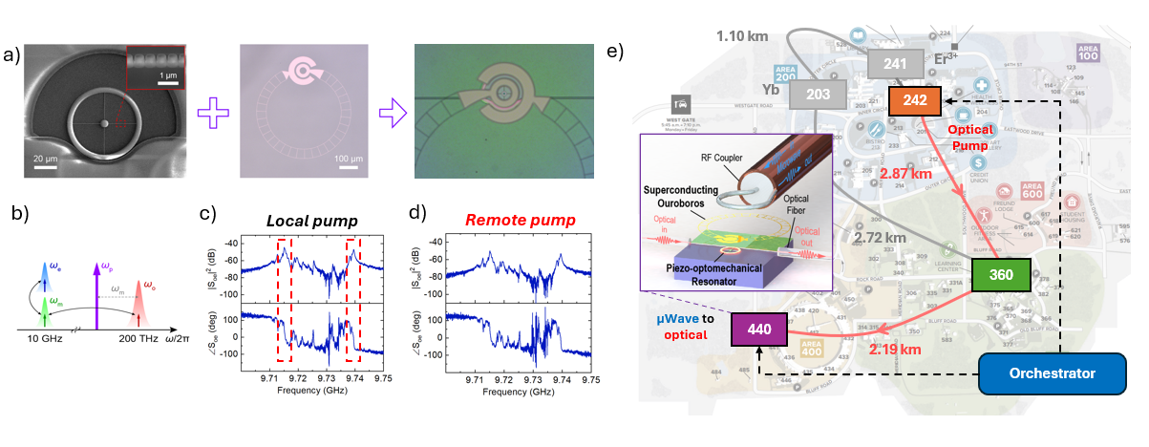
InterQnet-Achieve: Recent Milestone
First Microwave-to-Optical Conversion Across ArQNet
Demonstrated first M-O photon conversion (1st-gen piezo-optomechanical transducer, Bldg 440) Remote operation: optical pump in Bldg 242 controls transducer in Bldg 440 (2.87 km fiber)Two conversion bands observed: 9.715 GHz and 9.739 GHz (local and remote pump) Next step: pulsed-pump scheme, bidirectional conversion, efficiency/noise characterization
Notes:
The main message of this slide is that we have demonstrated classical microwave-to-optical conversion across ArQNet. This is not yet quantum-state transduction, but it is an important systems milestone.
The transducer is in Building 440. In one case the optical pump is local; in the other, the pump is generated in Building 242 and delivered over 2.87 kilometers of deployed fiber to drive the transducer remotely. We still observe conversion bands near 9.715 and 9.739 GHz, showing that the deployed-fiber pump delivery can support the conversion process.
That matters because superconducting qubits live in the microwave domain, while quantum networks use optical fiber. So this interface is essential. The remote pump result also suggests a future operating model where optical pump infrastructure could be centralized and distributed over the network, rather than duplicated next to every cryogenic node. The next challenge is moving from classical conversion to quantum-relevant operation: efficiency, noise, pulsed operation, and eventually bidirectional single-photon conversion.

Slide 12
Thrust II: Error Handling
Improving Yield & Robustness
Theme | Progress | Status / Next Step
Fault-Tolerant Entanglement Distillation (qLDPC) | Logical Bell pairs distilled at constant resource overhead (simulated) | Validating on hardware; scaling to realistic noise
Near-Term Error Mitigation (Pauli Check Sandwiching) | Lightweight fidelity improvement compatible with near-term hardware | Bell violation demo on ArQNet; improving gate fidelity
Encoded Repeaters (2nd-Gen Architecture) | QRE-CEC: 0.91 fidelity over 2,000 km; second-order error suppression | Scaling to larger code distances and heterogeneous platforms
Notes:
High-quality entanglement is what makes quantum networks useful, but it is also fragile. Photons are lost, memories decohere, and gates and measurements introduce errors. That is why error handling is a full thrust in InterQnet.
We are pursuing this at several levels. For near-term hardware, we use lightweight techniques such as Pauli Check Sandwiching. You can think of this as adding simple consistency checks around the operation we care about. It is not full fault tolerance, but it can help us reject bad outcomes and improve fidelity with modest overhead.
For larger-scale operation, we are studying quantum LDPC-based distillation. Distillation means using several noisy entangled pairs to produce fewer, cleaner pairs. LDPC codes are promising because their checks are sparse and scalable, so they offer a path toward higher-yield fault-tolerant entanglement without the overhead growing too quickly.
And for the longer term, we are exploring encoded repeaters, where the network distributes logical, error-protected entanglement rather than raw physical Bell pairs.
The key point is that error correction cannot be chosen in isolation. The right method depends on the hardware generation, the noise level, and the distance scale.

Slide 13
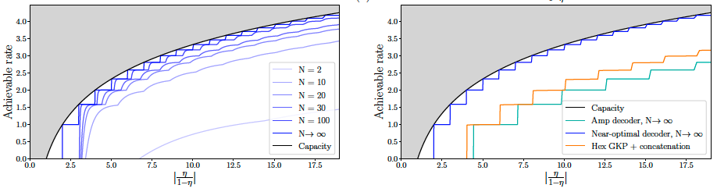
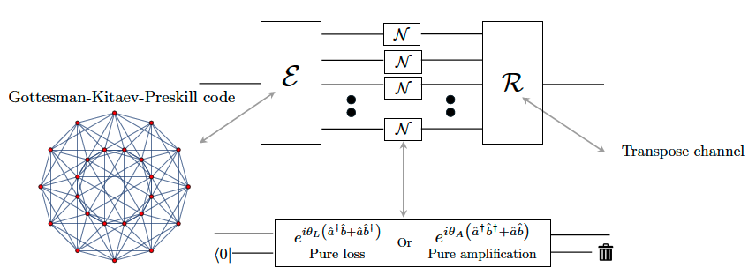
Bosonic Codes Approaching Quantum Channel Capacity
Increased coding rate for multi-mode GKP code
Capacity achieving performance with near optimal decoder
Goal: Design high-yield, high-fidelity entanglement purification near quantum capacity.
Approach: Use multi-mode GKP codes with optimized lattices over bosonic channels.
Encoding: Leverages dense lattice packings to boost quantum throughput.
Results: More modes improve fidelity and achievable communication rate.
Impact: Enables near-capacity entanglement distribution in hybrid quantum systems.
Zheng, He, Lee, Noh, Jiang, PRX Quantum 6, 030314 (2025)
Subramanian, Zheng, Jiang, PRX Quantum 6, 040342 (2025)
Notes:
This is a more theoretical result, but it asks a practical question: what is the best we could ever hope to achieve over lossy optical quantum links?
Quantum channel capacity is the quantum analog of Shannon capacity: the best rate and fidelity that physics allows for transmitting quantum information or distributing entanglement through a noisy optical channel.
Using multi-mode GKP codes and optimized lattice structures, the team showed a path toward getting close to that limit. The takeaway is that this helps define the long-term ceiling for high-yield, high-fidelity entanglement distribution, even though it is not a near-term implementation recipe.

Slide 14
Thrust III: Network Architecture & Protocols
Orchestration and Scalability
Theme | Progress | Key System Question
Network Orchestrator | Centralized control prototype; 12-hour continuous operation; remote synchronization | How does control scale with network size and load?
Entanglement Routing | Evaluated GHZ-based routing on complex topologies | How to balance global optimization and scalability?
Heterogeneous Simulation (SeQUeNCe) | Integrated device-aware models (Yb, SC, QFC, transducer) | How do hardware limits inform architecture design?
Notes:
I will now move to the architecture and protocol thrust.
There are three main pieces here: the network orchestrator, entanglement routing, and heterogeneous simulation in SeQUeNCe.
The common question is scalability. Can we automate a quantum network? Can we route entanglement efficiently as topology and demand become complex? And can realistic device models change the architecture decisions we would otherwise make?

Slide 15
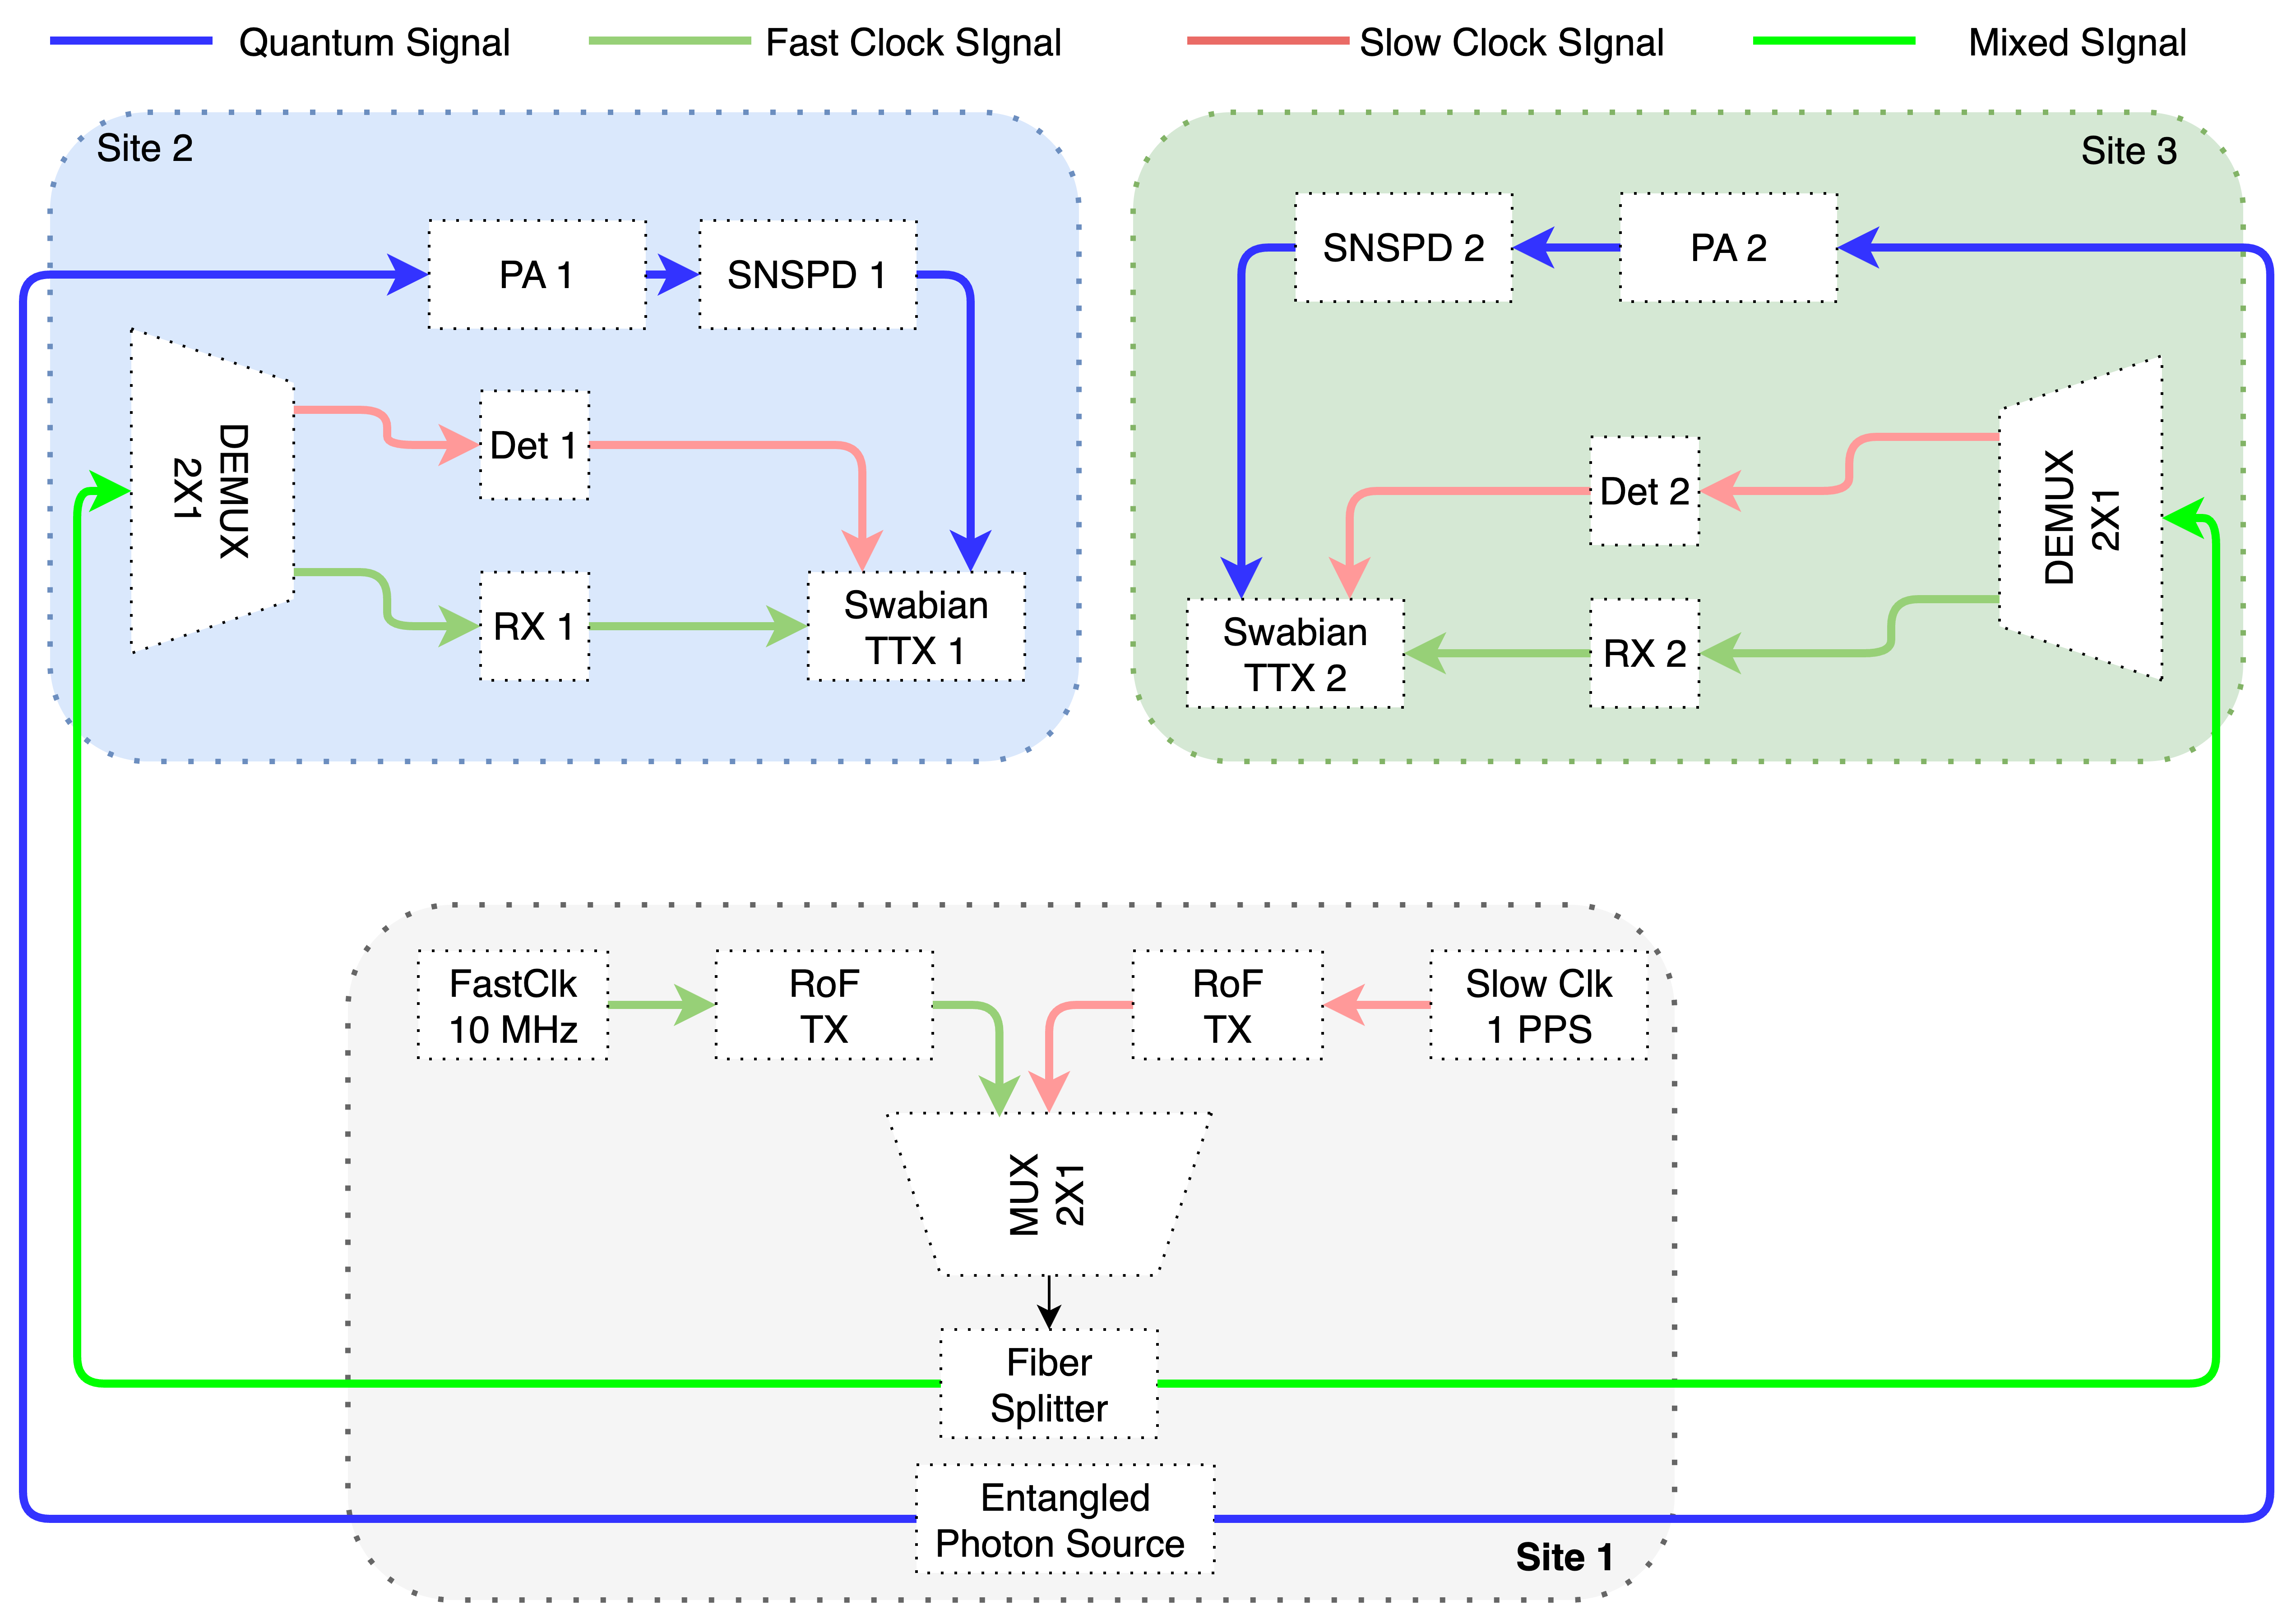
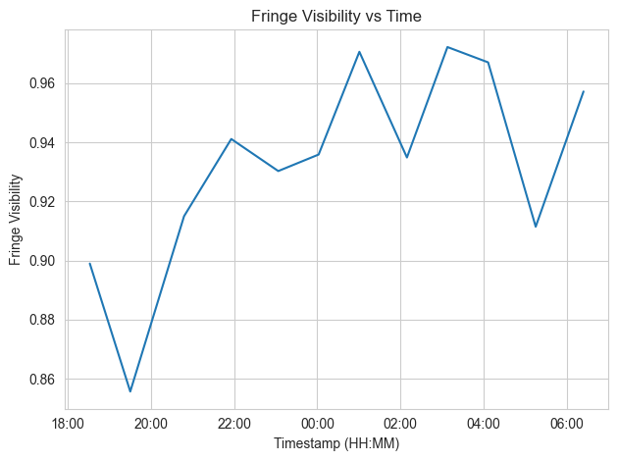
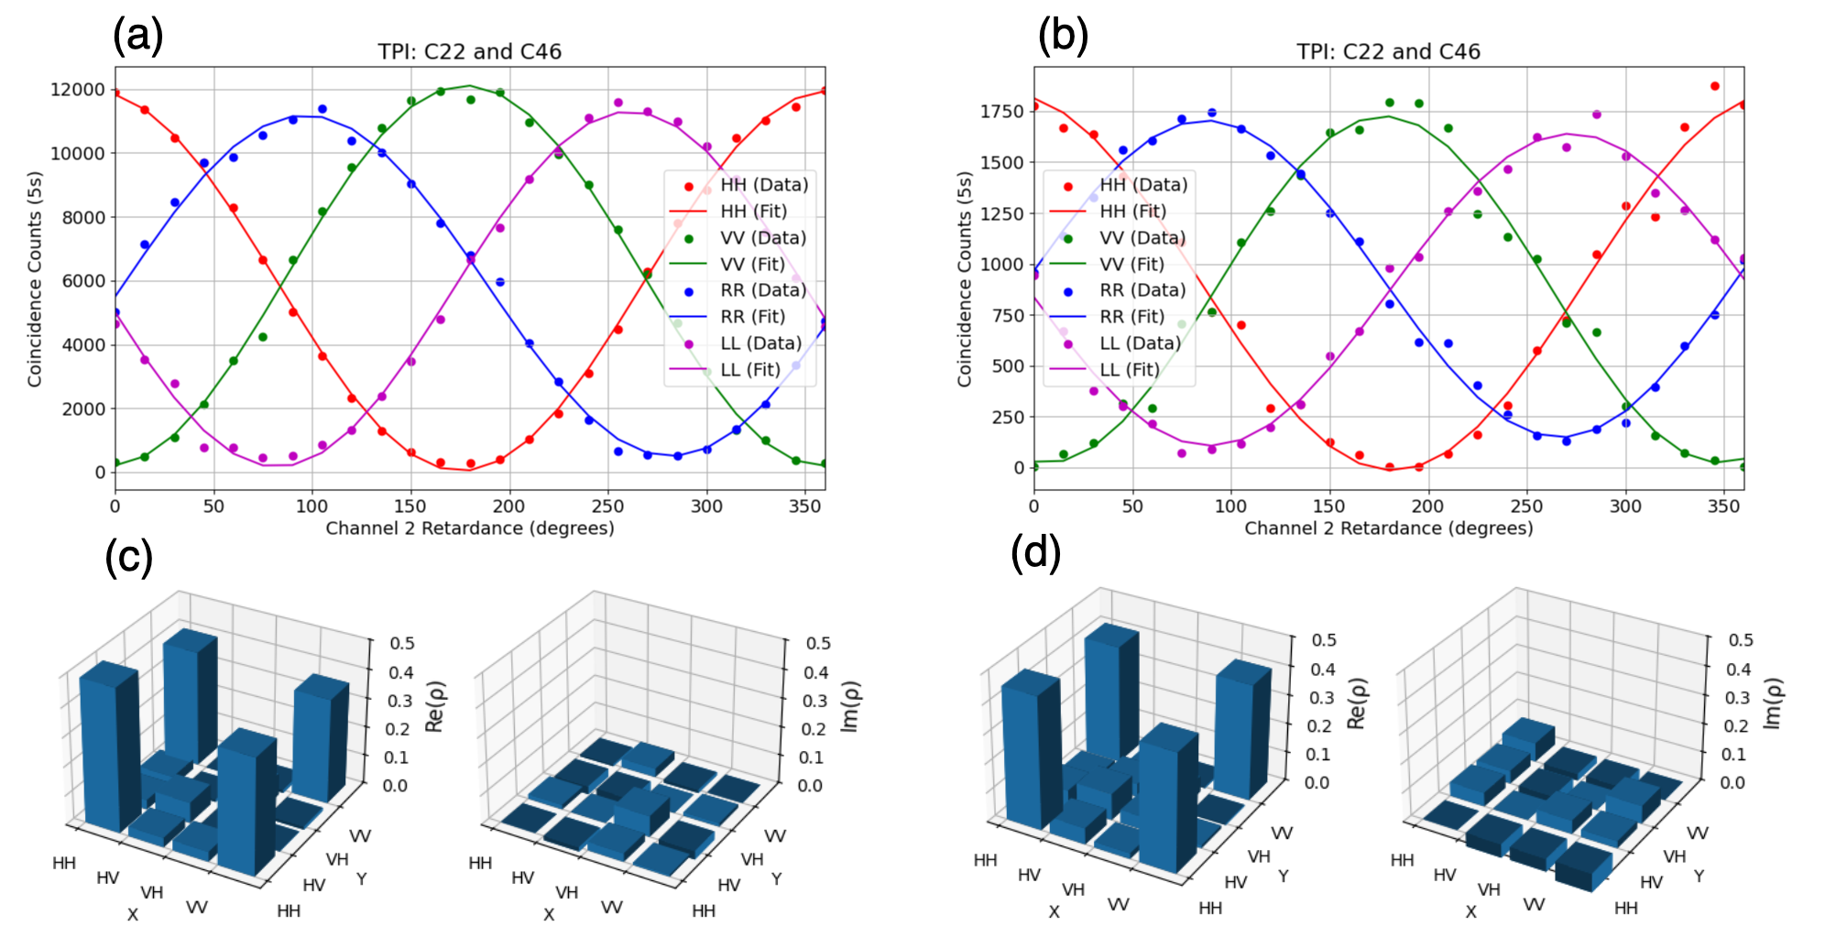
ARQNET Controller Prototype and Preliminary results
Implementation:
  Agents enable remote control of devices (e.g., EPS, SNSPD, all-optical switches, and time taggers)
  RF over Fiber custom clock synchronization system
  Communication over gRPC
  Centralized control, automated calibration, and continuous operation
Evaluation:
  Two-photon interference and Quantum state tomography
  Observed fringe visibility ~95%
  Continuous fringe visibility measurements over 12 hours with polarization drift compensation
arXiv:2511.01247v1
Notes:
The ArQNet controller is our first step toward an operational control plane for quantum networking.
Each device—photon sources, detectors, optical switches, time taggers, and related equipment—is wrapped by a software agent and controlled through gRPC. The orchestrator issues high-level commands, while device-specific details remain local. That is deliberately similar to SDN-style thinking.
Synchronization is handled with RF-over-fiber distribution of timing references. In our measurements, this adds only tens of picoseconds of jitter, which is appropriate for photon-coincidence experiments.
The main result is not just a visibility number. It is that we sustained automated operation and polarization-drift compensation over 12 hours. That is the shift from a manually tuned experiment toward an operated network.

Slide 16
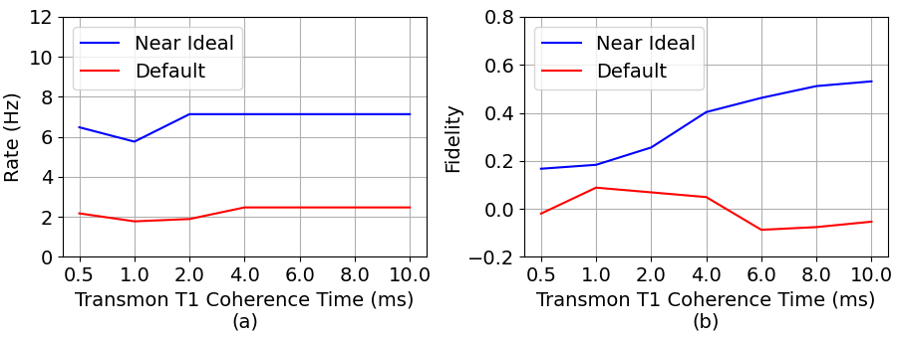

Simulation of a Heterogeneous Quantum Network
Goal: to develop a framework for faithful simulation of heterogeneous quantum networks.
Approach: introduce faithful device models for two representative platforms Ytterbium atoms and superconducting qubits, as well as QFC and quantum transducers in SeQUeNCe.
Evaluation: implemented entanglement generation and swapping and conducted extensive simulations in heterogeneous links.
Results: for entanglement generation between two superconducting nodes connected via a Yb-atom repeater, we observe that even with near-term optimistic device parameters, both entanglement rate and fidelities remain low.
Simulation results for entanglement generation between two superconducting nodes connected via an Yb-atom repeater. We vary the coherence time of the superconducting node and compare the entanglement rate (a) and fidelity (b) for both currently achievable and ideal device parameters in SeQUeNCe.
H. Miller, et al., “Simulation of a Heterogeneous Quantum Network,” accepted to the International Conference on Quantum Communications, Networking, and Computing (QCNC 2026).
Notes:
This simulation result shows why device-faithful modeling matters.
We asked what happens when two superconducting nodes are connected through a Yb-atom repeater, including realistic frequency conversion and transduction losses.
The result is sobering: with optimistic near-term parameters, the entanglement rate may be nonzero, but the fidelity remains very low when the superconducting coherence time is around 0.5 milliseconds. The qubit decoheres before the relevant heralding and swapping process can complete.
The design insight is clear: the superconducting qubit lifetime is the critical lever. When the lifetime increases toward 10 milliseconds, the fidelity improves substantially. This is exactly the kind of requirement that a full-stack simulation can feed back to hardware teams.

Slide 17
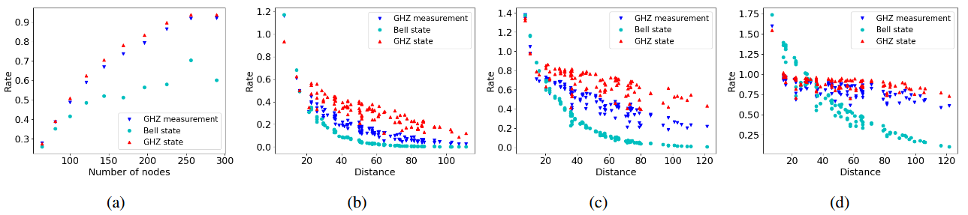
Routing Entanglement in Complex Quantum Networks Using GHZ States
Goal: to study the performance of an entanglement routing protocol based on generation of GHZ states between neighboring nodes.
Approach: analyze the performance of our protocol on large scale topologies like square grid, Waxman, and scale-free using Monte Carlo simulations.
Evaluation: implemented analytical models of our proposed protocol and state of the art entanglement routing protocols such as GHZ measurement and Bell state protocols.
Results: We find that our GHZ state protocol performs marginally better than the GHZ measurement protocol in square grid and scale-free networks, suggesting that a more sophisticated protocol that potentially utilizes global information or takes advantage of network segmentation is required.
Performance evaluation for square grid networks. (a) Average rate ⟨R⟩ for an N × N grid for N from 8 to 17. (b–d) Rate vs. distance (in km) for N = 15 and measurement success probability (q) equal 0.7, 0.8, 0.9, respectively.
X. Chen, et al., “Routing Entanglement in Complex Quantum Networks Using GHZ States,” accepted to the International Conference on Quantum Communications, Networking, and Computing (QCNC 2026).
Notes:
Routing entanglement is not the same as routing classical packets, because the resource being routed is fragile and probabilistic.
Here we studied GHZ-based routing. A GHZ state is a shared entangled state across three or more nodes, rather than just a two-node Bell pair. In principle, that can give a routing protocol more flexibility.
The result is useful but humbling. GHZ routing can help in structured settings such as square grids, but the advantage is limited in more realistic topologies. One reason is that larger GHZ operations are harder to perform reliably. Another is that protocols based mainly on local node-level decisions may not exploit multiple alternative paths as effectively as protocols that use a broader view of the network.
So the takeaway is not that GHZ routing is useless, or that it is the final answer. The takeaway is that realistic quantum networks will likely need more sophisticated control — perhaps global, hierarchical, or segmented routing.

Slide 18
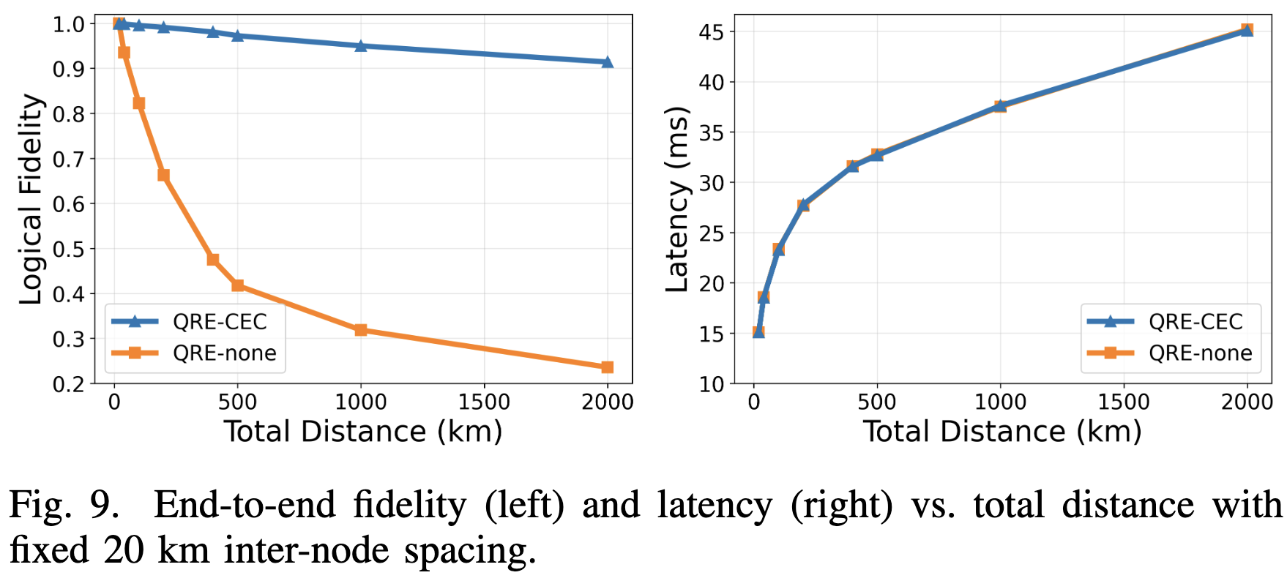
InterQnet-Scale: Encoded Quantum Repeaters at Network Scale
Second-Generation Repeaters: Logical Bell Pairs over Long Distances
2nd-gen repeaters: encode qubits into Steane [[7,1,3]] code
  Encoded swapping + classical error correction → 2nd-order error suppression
Simulation: SeQUeNCe + Stim (Patange et al., under review)
  0.91 logical fidelity at 2,000 km (100 hops) — QRE-none drops to 0.24
  Latency: 15–45 ms linear growth — identical for both protocols
Key tradeoff: more hops → lower loss, deeper circuit
Notes:
This slide looks further out, at what long-distance quantum networking may require.
If we distribute ordinary physical Bell pairs over many hops, errors accumulate quickly. So this protocol asks: what if we protect the entanglement before extending it across the network?
The idea is to encode each network qubit across seven physical qubits using the Steane code. Then, at the repeaters, entanglement swapping is performed on these encoded blocks rather than on single physical qubits. The measurement results are decoded classically, so some errors can be identified and corrected in software after the measurements.
The simulation result is encouraging. With this classical error-correction step, the protocol maintains about 0.91 logical fidelity over 2,000 kilometers and 100 hops. Without it, the final state becomes almost unusable. Latency still grows roughly linearly and remains in the tens of milliseconds.
The broader point is that long-distance quantum networking requires co-design: the repeater architecture, the code, and the classical control logic all have to work together.

Slide 19
Key Lessons Learned Toward Scalable Quantum Networks
Co-design (hardware + simulation + protocol) is essential
  SeQUeNCe reveals bottlenecks before hardware integration: default Yb+SC gives fidelity ≈0
  T1 coherence time is the critical lever: fidelity rises to >0.5 at T1 = 10 ms
Centralized SDN-style control works now; distribution is a longer-term goal
  Orchestrator: 12+ hrs continuous operation; multi-domain firewalls are real constraints
Error correction must match hardware, not just theory
  QRE-CEC: 0.91 fidelity over 2,000 km with second-order error suppression
  Near-term: PCS provides hardware-compatible fidelity gains on ArQNet
Quantum–classical coexistence is tractable; experiment must validate simulation
  Raman noise model + ML SOP tracking enable automated, adaptive network operation
  ArQNet data closes the SeQUeNCe model loop – co-design works in practice
Notes:
Let me summarize the lessons learned.
First, co-design is essential. Simulation turns general intuition into quantitative system requirements. The Yb-plus-superconducting study shows how qubit lifetime, conversion loss, transduction efficiency, and protocol timing together determine whether the architecture is viable.
Second, centralized SDN-style control is practical at today’s scale. The orchestrator result shows that automated, multi-building operation is possible, even with real security and operational boundaries. Distributed control will matter later, but centralized control is a useful starting point.
Third, error handling must be matched to hardware maturity. Near-term methods such as Pauli Check Sandwiching and longer-term encoded repeaters solve different problems.
Fourth, coexistence and operations are not side issues. Raman noise, polarization drift, synchronization, and monitoring are exactly where quantum networking begins to look like an NREN operations problem.

Slide 20
Collaboration Opportunities
Define shared benchmarks for quantum network scalability
  Neither US nor EU has consensus metrics for fidelity, rate, and latency at scale
  InterQnet SeQUeNCe models + NREN testbed measurements could anchor a joint suite
Joint simulation studies on NREN-relevant topologies
  Run InterQnet heterogeneous models on SURFnet, GÉANT, or other NREN topologies
  SeQUeNCe is open-source and actively extended — contributions welcome
Cross-testbed experiments: ArQNet ↔ European quantum testbeds
  Shared protocol development and interoperability testing: US DOE ↔ EuroQCI
  Automated orchestration, synchronization, and optical channel management
Notes:
I want to end with concrete collaboration opportunities.
First, we need shared benchmarks for quantum network scalability: not just fidelity, rate, and latency in isolation, but how those quantities behave across topology, load, distance, and operating conditions.
Second, we would like to run joint simulation studies on NREN-relevant topologies. SeQUeNCe is open source and actively extended, so there is a practical path for shared modeling.
Third, cross-testbed experiments and interoperability studies will become increasingly important as US and European efforts mature. This includes orchestration, synchronization, optical-channel management, and common APIs.

Slide 21
Q&A / Discussions
Notes:
Thank you. I will stop here and welcome questions and discussion.

