Slide 1

What do you depend on?
Rebooting the Old Reliables, TNC26
Ann Harding,
Anna Wilson
Notes:
AH: Hallo, I’m Ann,
AW: and I’m Anna
AH: and we are not actually the Old Reliables referred to in the title
AW: But we have collectively over 50 years of NREN experience between us and, well, we have…noticed some things.
AW: This is a personal reflection: I have two employers right now, and I'm speaking for neither of them.

Slide 2
What the hell is going on out there?
Notes:
Ann
We have been through multiple cycles of boom and bust.
We have nodded wisely when people talked about “VUCA” (volatility, uncertainty, complexity and ambiguity).
Honestly, we had no idea…

Slide 3
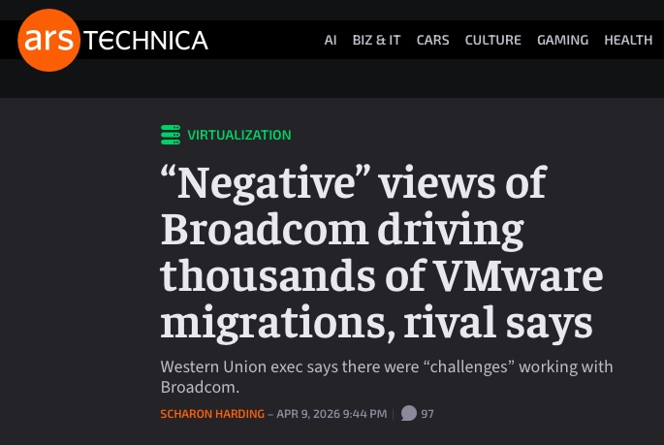
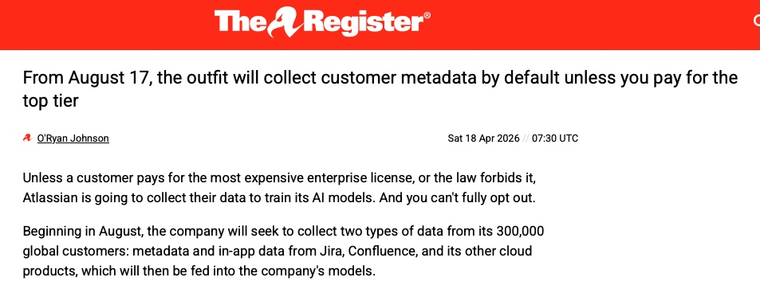

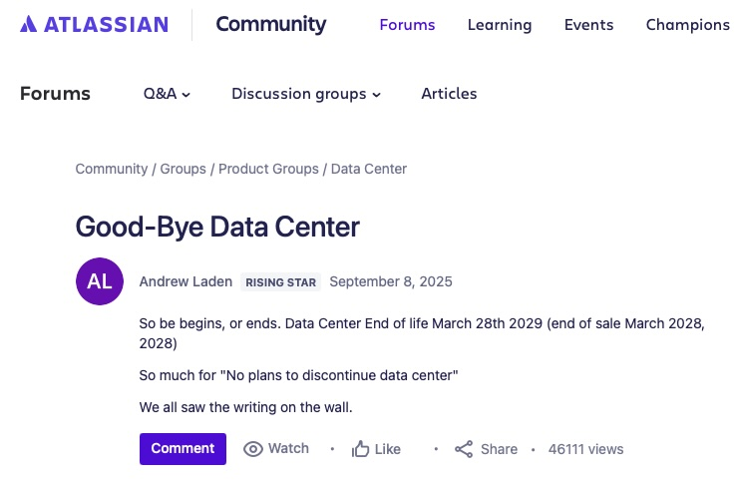
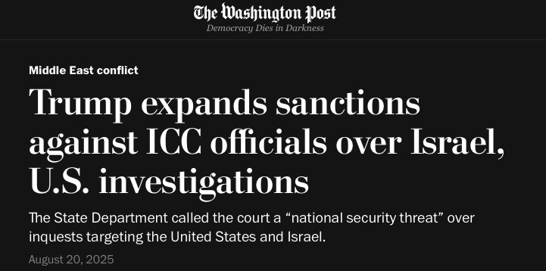
?
Notes:
AnnH
VMware buyout and license hikes
- Atlassian kills datacentre version
-Atlassian scrapes metadata for all bar the most expensive tier
- Sanctions on ICC officials. US individuals, corporations and groups are “not permitted to provide financial, material, or technological” services to the targeted persons
- Universities receive questionnaires from the US on research values - CH, IE, AUS, CA
And did you read about let’s encrypt this week?

Slide 4
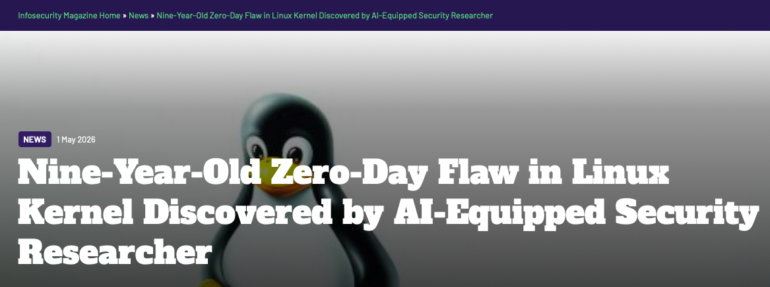
Past and future
Notes:
AnnaW:
AI is accelerating discovery of critical bugs while simultaneously overloading teams with triage of slop. Not advocating we should all run half our infra on FreeBSD instead, but what are we doing to support community initiatives we depend on?
The hardest thing about doing these slides is every day there is another chaos

Slide 5
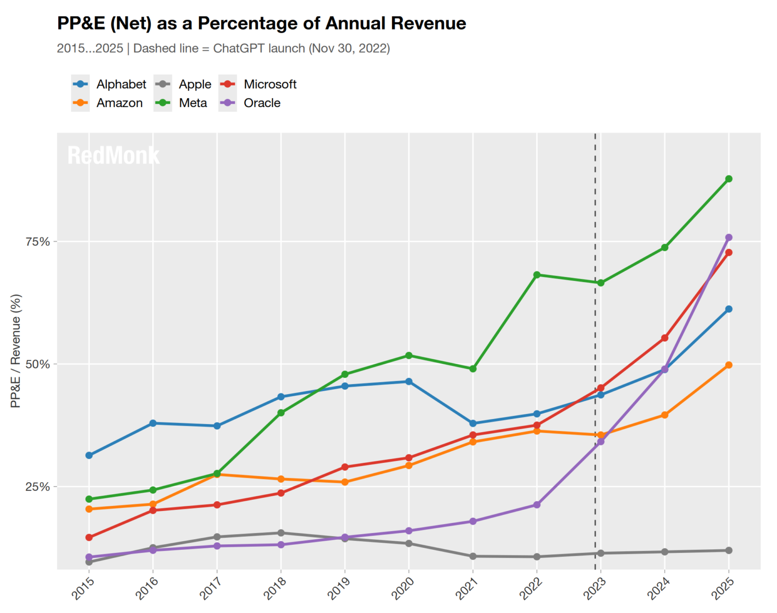
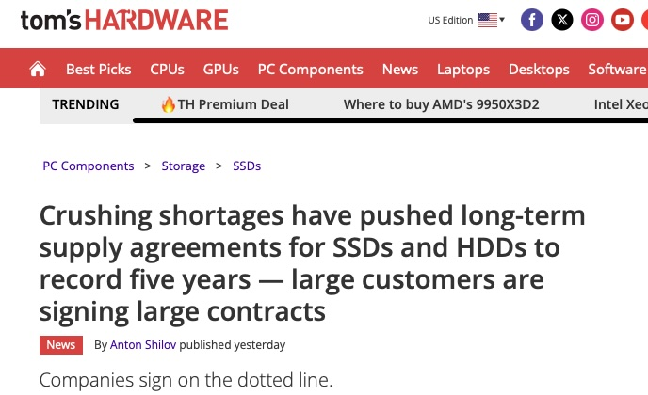
Hardware hoarding
Notes:
AnnH:
2025, OpenAI secures 40% of global memory production
HIgher-margin product lines are prioritised e.g NVIDIA Blackwell GPUs. Small and economical market is deprioritised.
Image - data centre investments - the rest of them
And what about the rest of us? Budgets set in summer 2025 that cover only 60% of planned hardware refreshes.
And if you can order, delivery is volatile and choices of other suppliers not sharing dependencies extremely limited

Slide 6

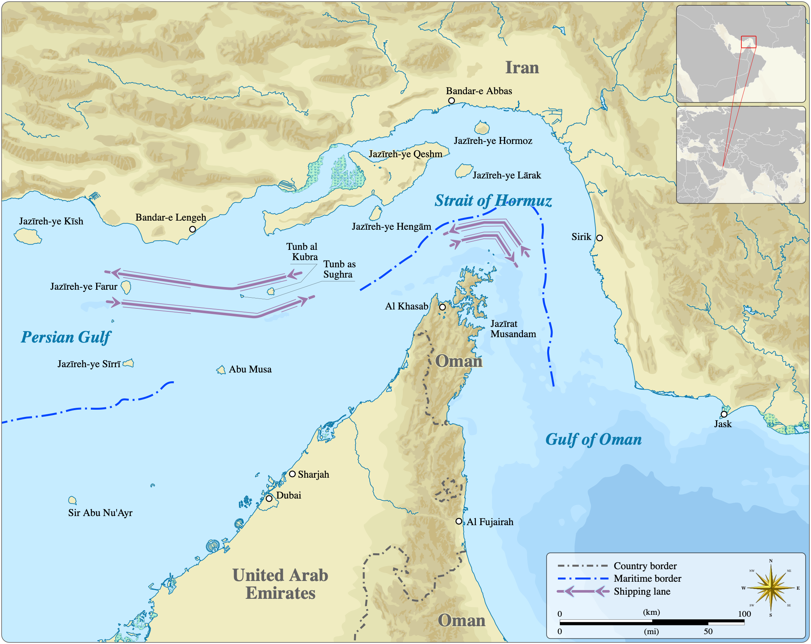
Nothing is normal
Goran_tek-en, CC BY-SA 4.0 <https://creativecommons.org/licenses/by-sa/4.0>, via Wikimedia Commons
Notes:
AnnH:
And if you can order, delivery is volatile and choices of other suppliers not sharing dependencies extremely limited
Hoarding like toilet paper except2 year old RAM doesn’t keep as well
In short, if your BCP depends on short notice ability to purchase capacity, you are in trouble.

Slide 7
What can we do?
Look to what we did before
Notes:
Annah
Timing c 7

Slide 8
The fundamentals
Keep doing them
Consistently
Notes:
AnnH: scope mindset, high level
This is Leonardo Genoni, Switzerland’s legendary goalie, age 38, playing since 2004, still top choice. Another old reliable;)
So, what are these fundamentals?

Slide 9
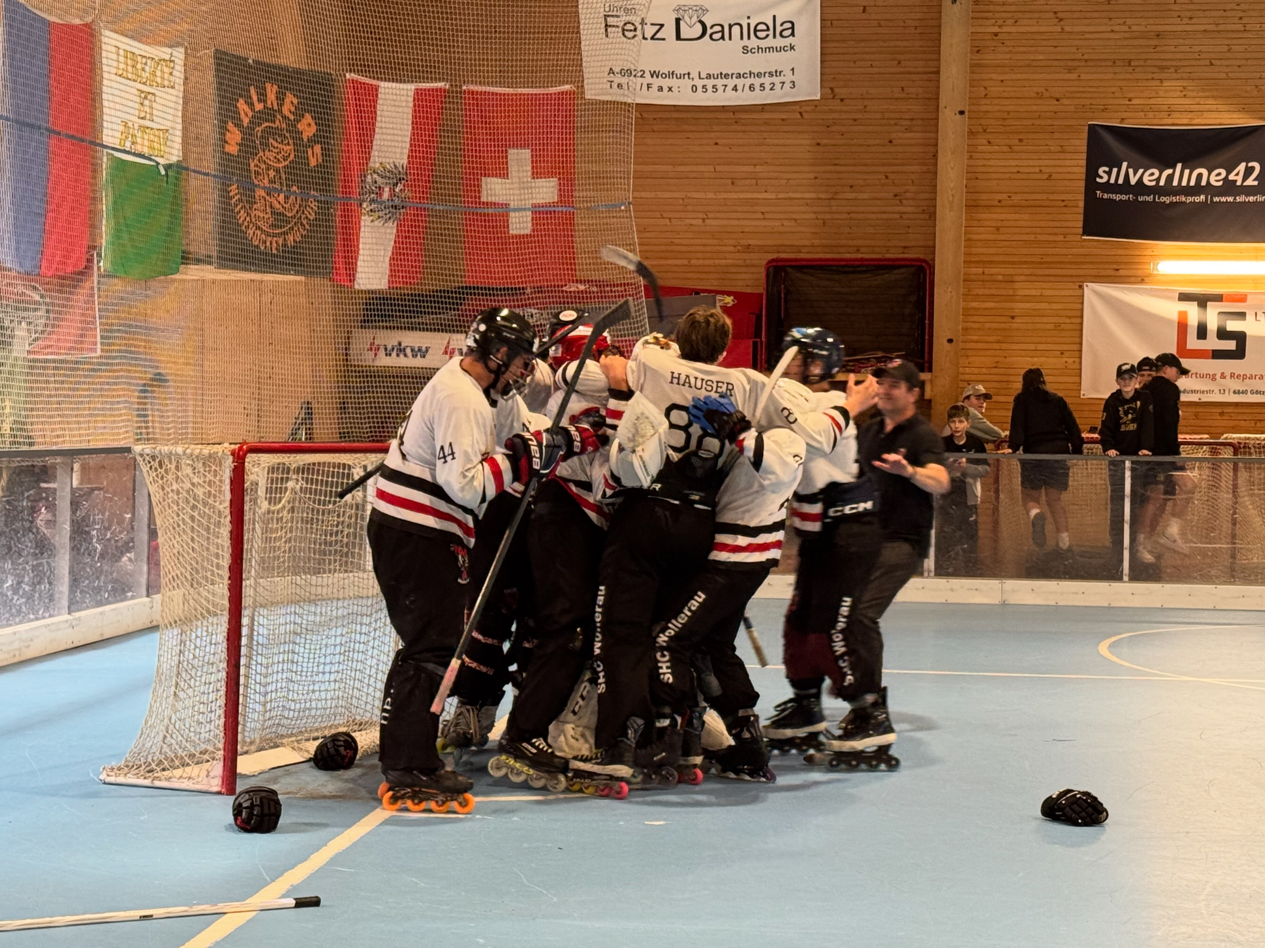
The weight of community
Notes:
AnnaW:
Made ourselves bigger for transit and connectivity - can we do this again?
Producing 20+ years IRU gave us enormous freedom. Can we reuse that pattern for other procurements?
Weight of community for hardware frameworks?
eduroam - human communication - draw engagement to shared norms -> became dominant global wireless consortium. biggest single wifi network in the world
Question AHa: if there's something in earlier TNC presentation can we build it in?

Slide 10
Remember when every router was a Cisco?
But we carefully avoided closed routing protocols
Notes:
AnnaW:
But we were careful to take advantage of this while not falling into traps
(and before you say we were small, this was an ENORMOUS portion of our budget)
open standards

Slide 11
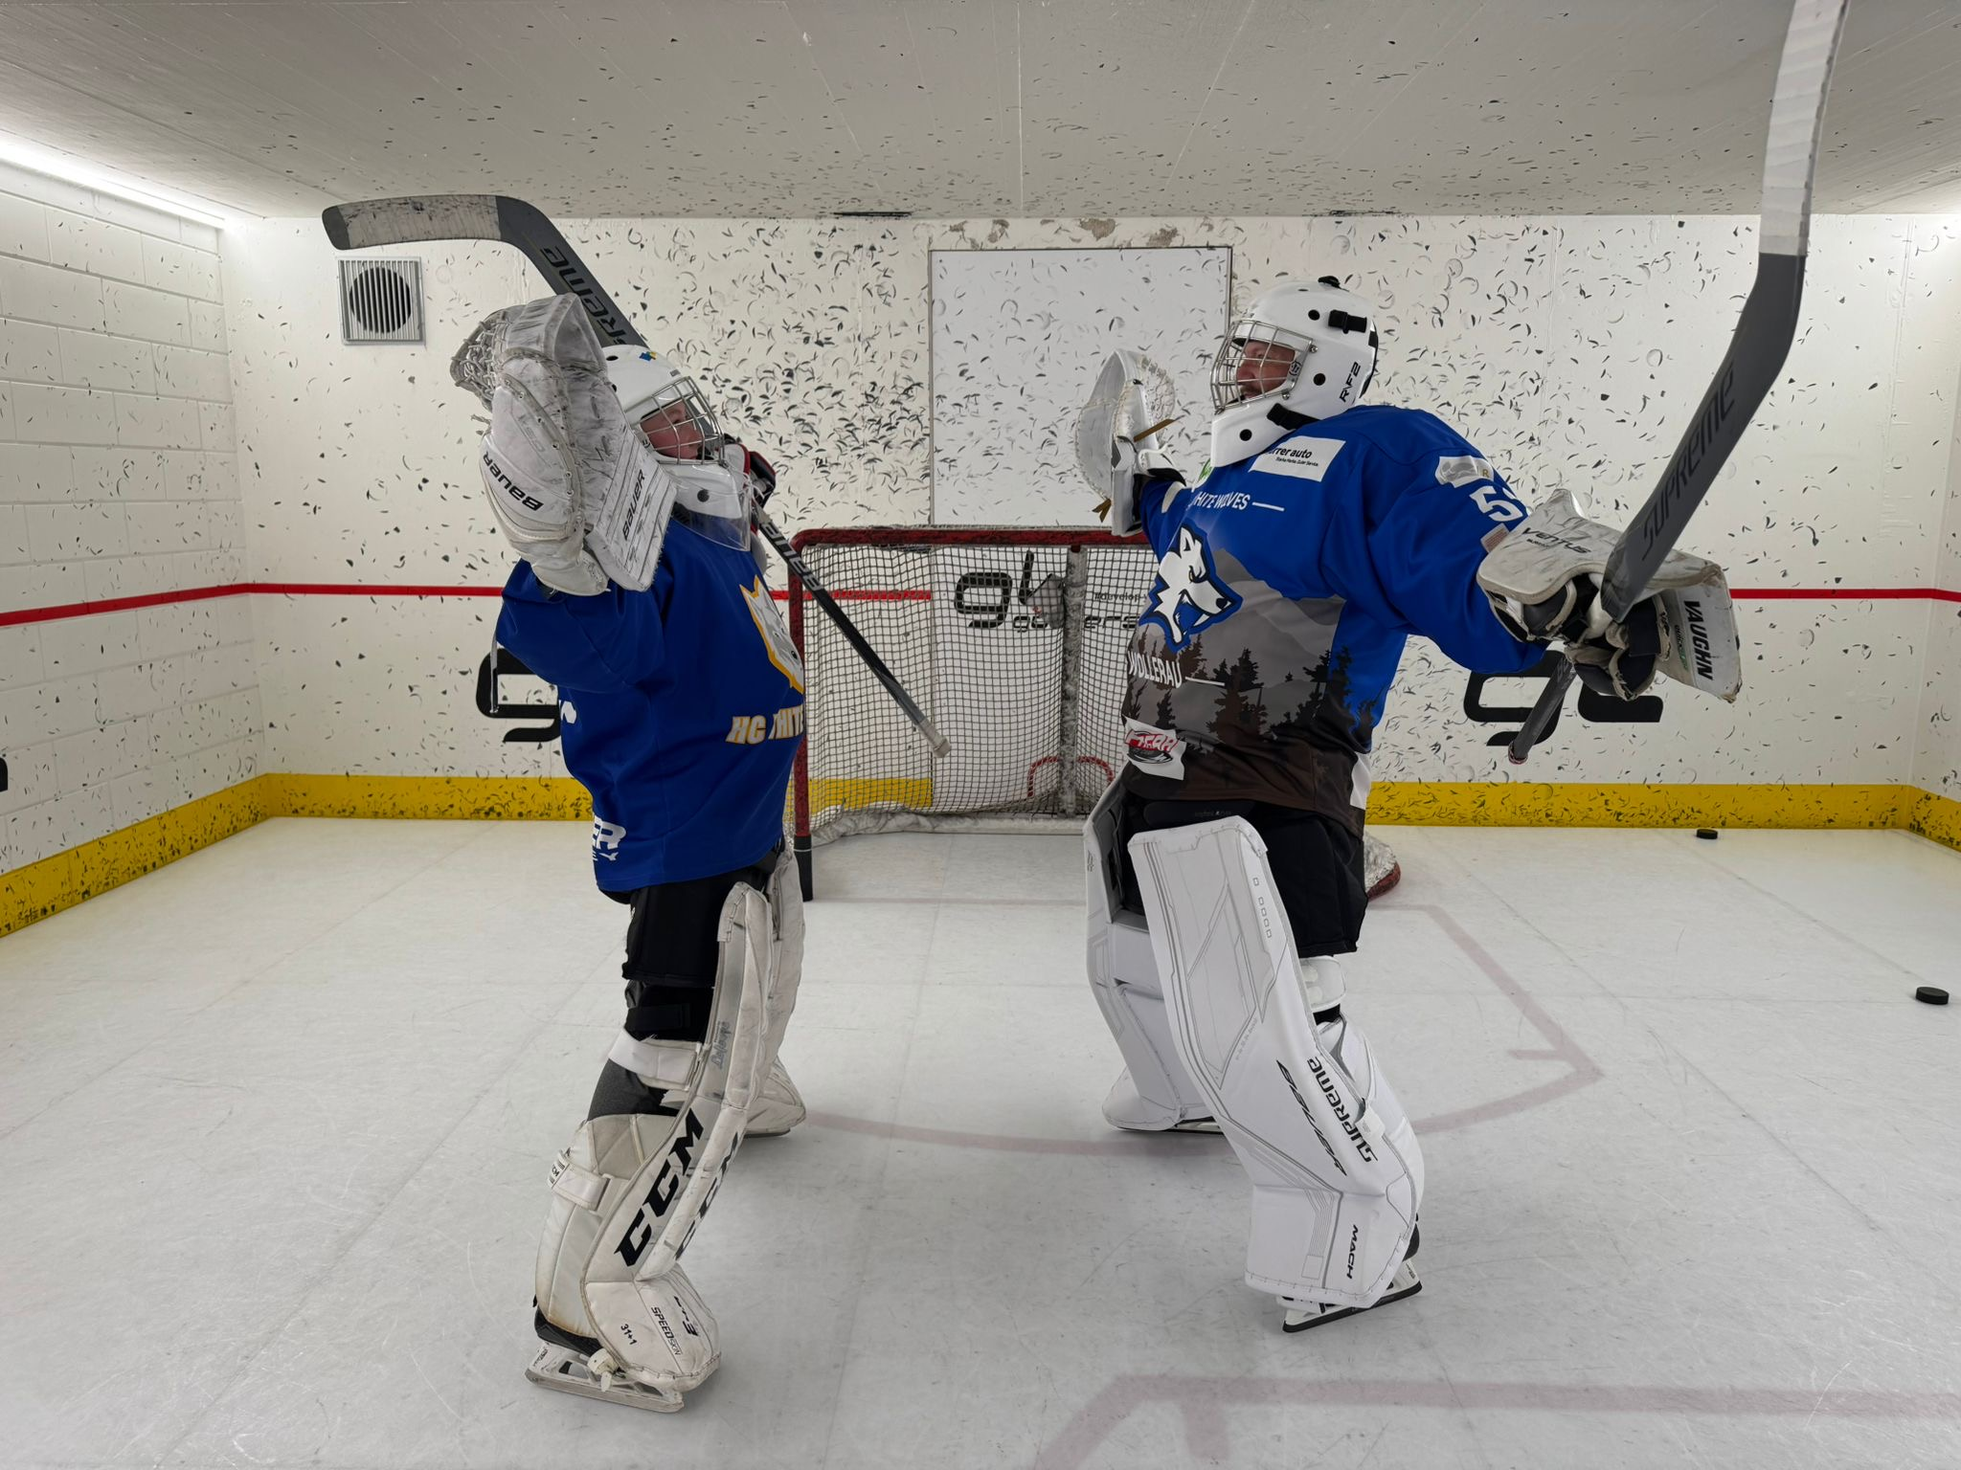
Resilience is our day-to-day job
We are really good at this
Notes:
AnnaW:
When leasing fibre, we pull out fibre maps and kmz files, and find all the potential crossover points. GÉANT in particular works super hard on this
When you live on an island that is mostly connected through another island, you really see this
And procurement is the key to this...
Know what you should own. Also with SaaS - your data is yours. Make sure you can get it
We take a lot of comfort from contracts - rightly so - but we have seen situations where contracts are overridden by force majeure of one sort or another - natural, political, economic. That's a disaster scenario - but we have disaster recovery procedures, so those need to be set up to handle that sort of breach of contract. What happens if you lose access to all your cloud data?
SaaS freezes access if you don't pay your bill. That puts your finance team in the operational loop.

Slide 12
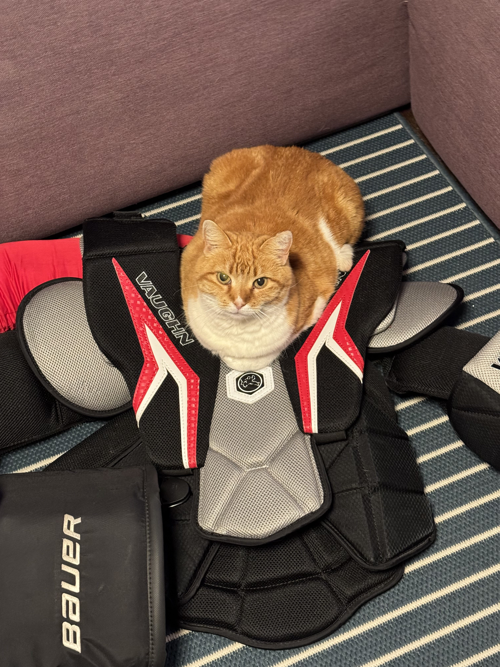
Our lever is procurement
Notes:
AnnaW:
We need the right kit…
Procurement’s emphasis on cost does not have to get in the way of a robust service - but it has to be planned and executed deliberately.
Emphasis on: we don’t need new tools to handle this, we don’t need to completely revamp our business or how we work. We have the skills and the tools.
So that's the lever we have, and we've used it to affect the market in our favour in this past. But this isn't the past. We're smaller fish in a bigger pond now. What can we do today?
And for the things we can't buy -> Ann

Slide 13
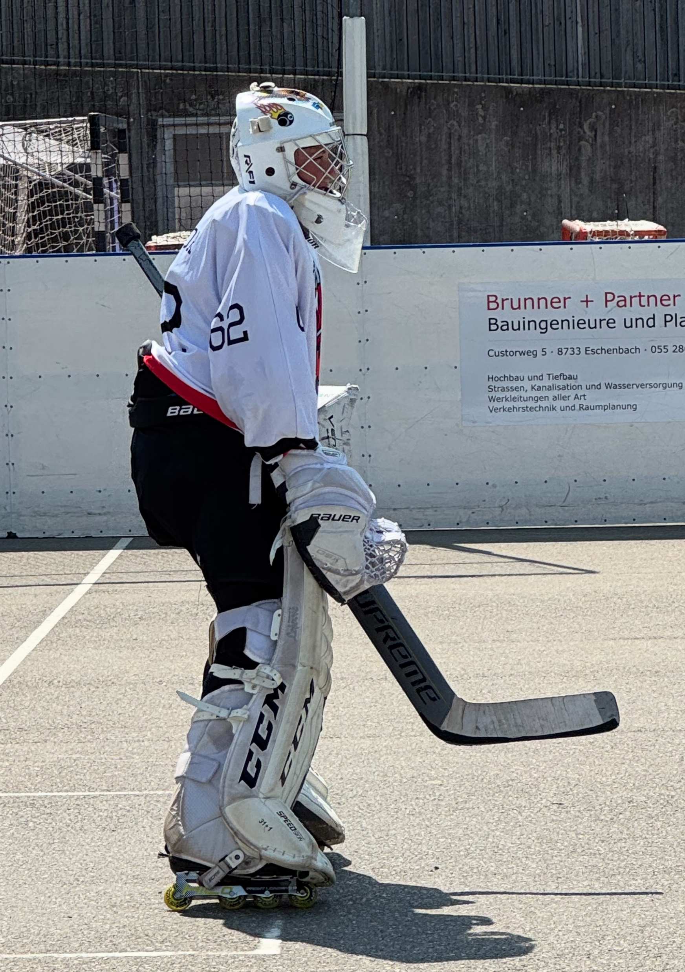
And when we can't control it?
Don't panic - we can see what comes out of this and adapt when we understand what's useful to our community
AI in everything means the question is not AI
We didn't jump into ecommerce in 1999 or NFTs in 2022 or enterprise wifi in 2005
Flow - keep patching, keep your lifecycle up to date so we are ready to jump in when it is time
Notes:
AnnH:
We still made eduroam
Certificate lifetimes shrinking - move faster
Standards and automation

Slide 14
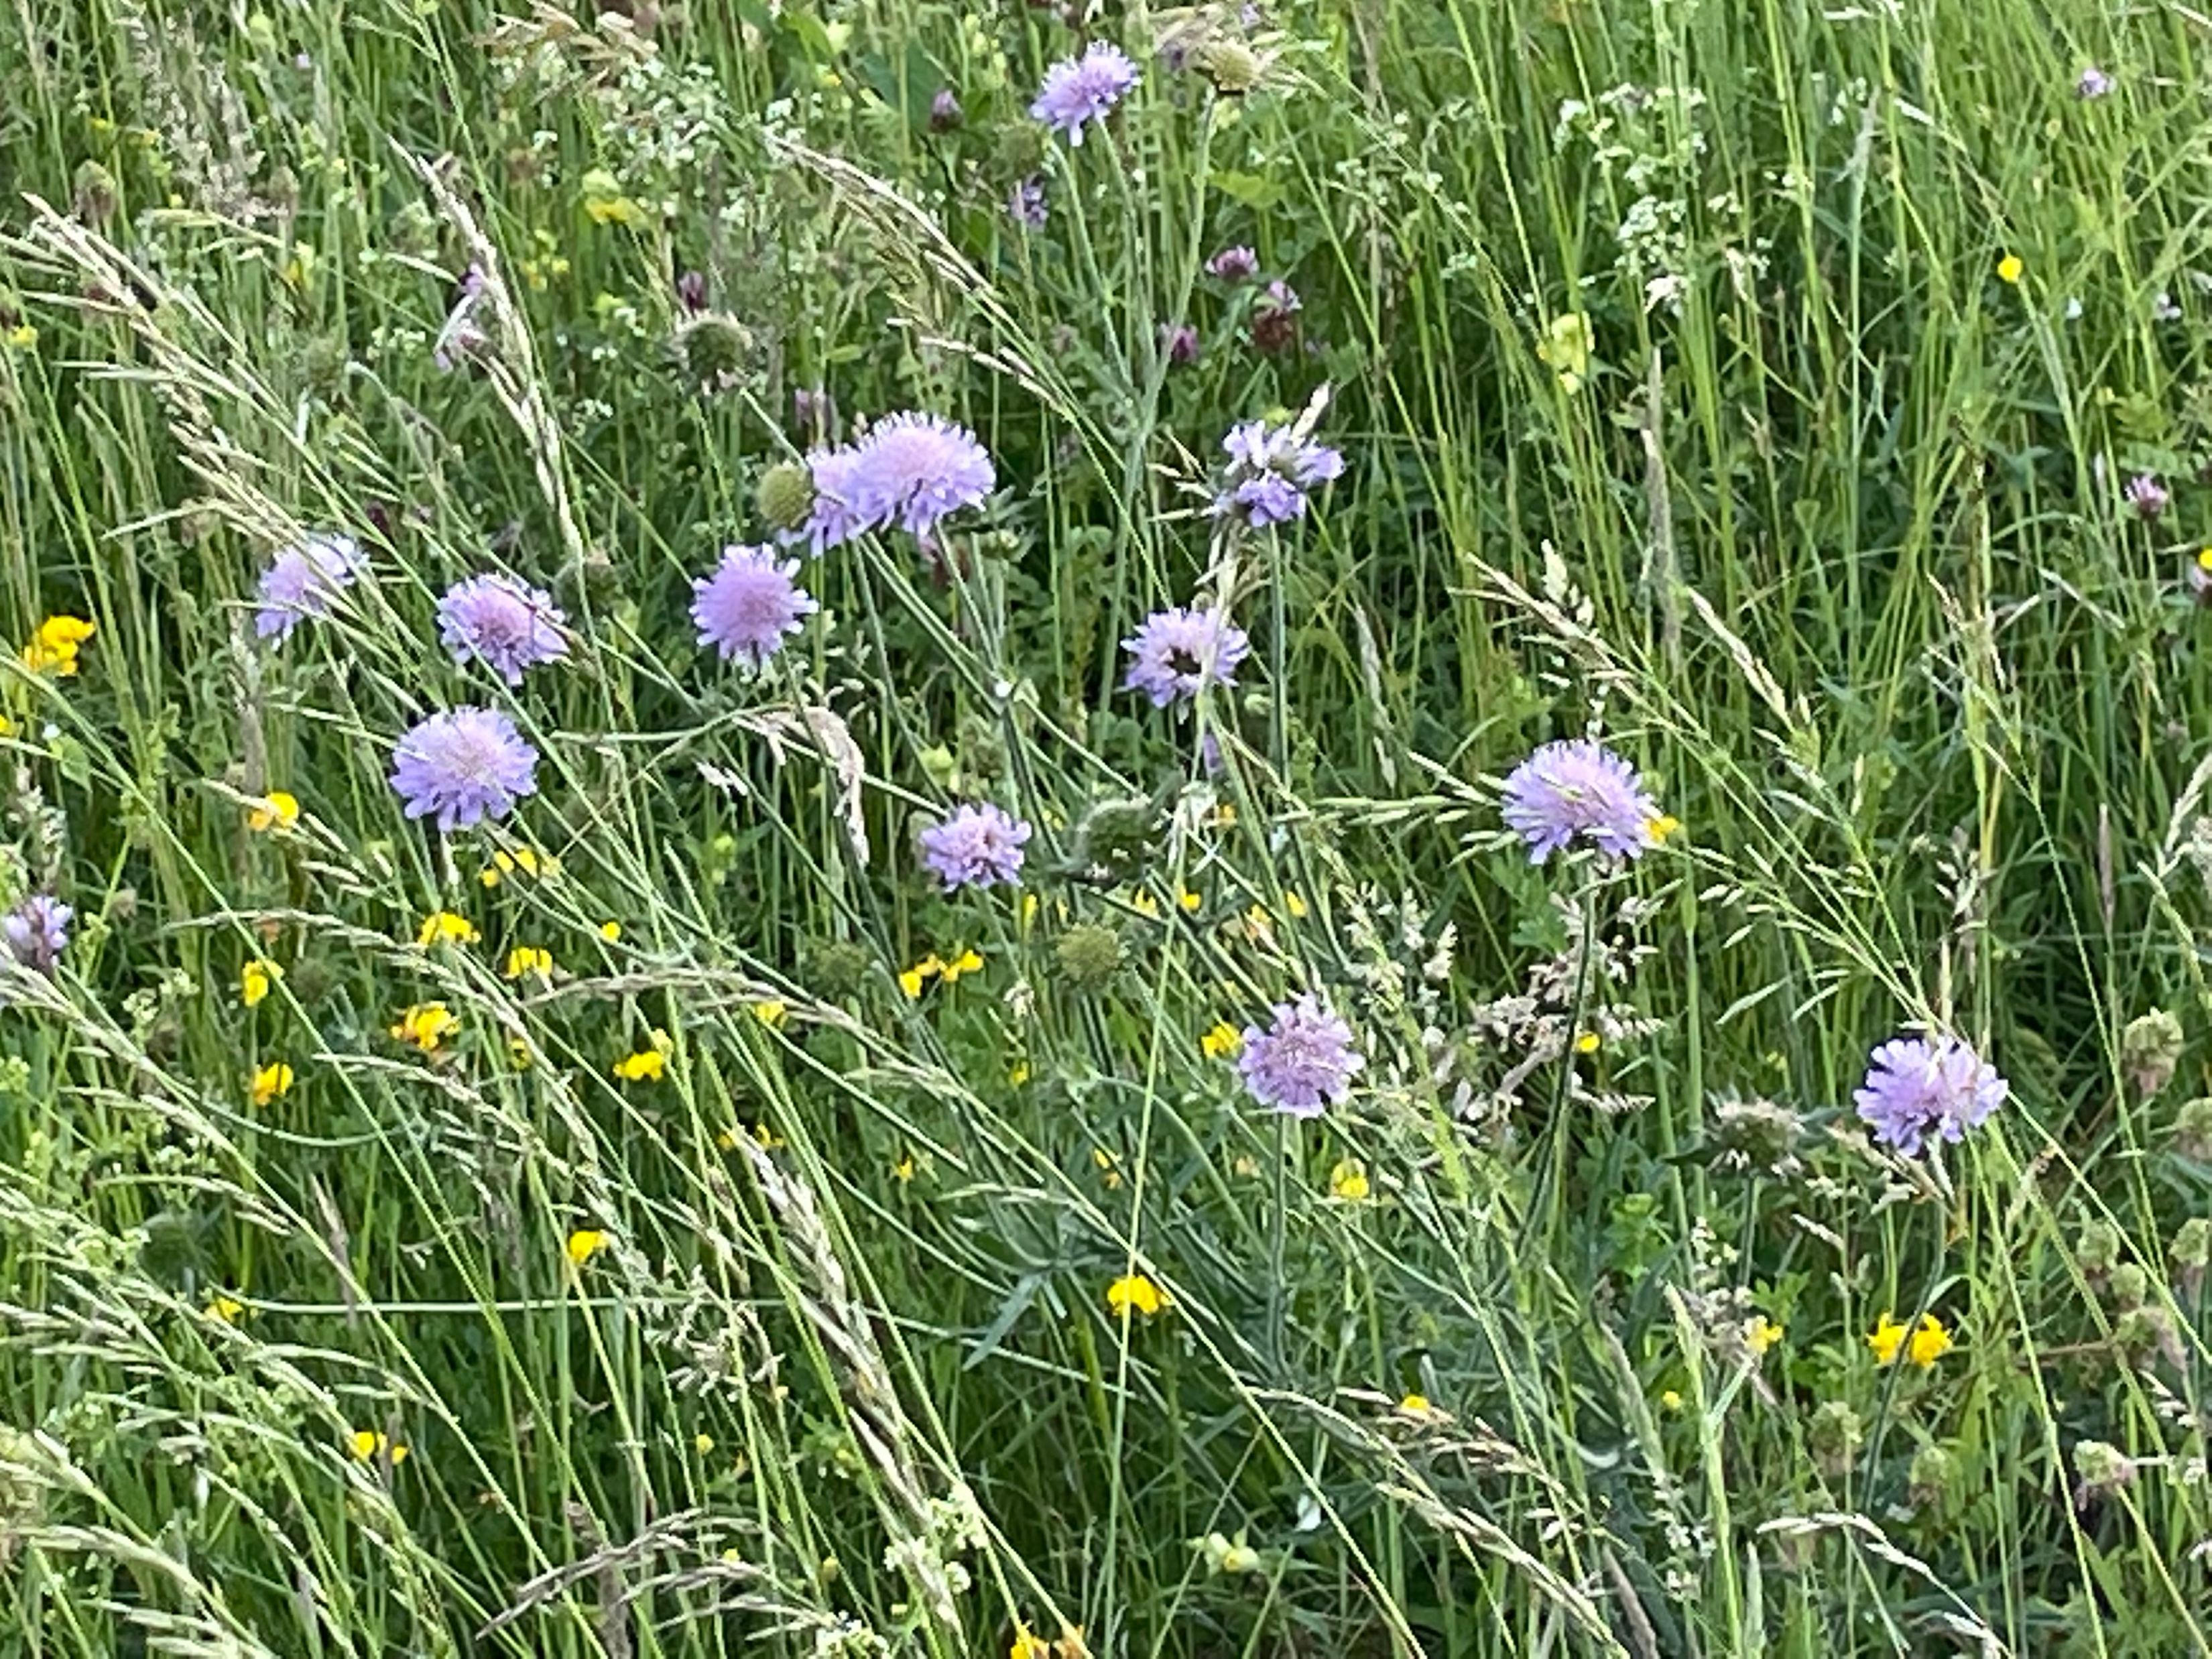
Rewilding
Common-pool resource management
Community networks
Global and open standards
Transparently funded
Notes:
AnnH: That was practical, let's go metaphorical again. This is basically what Maria Farrell said
What are the characteristics of a resilient ecosystem
AnnaW: What;'s the point of an NREN? What are we good at that differentiates us from commercial providers?
The network is the oldest of the old reliables. Why were we successful at building networks?
eduGAIN - raising a trust bar in edugain can be destructive - specs are hard to scale
Spec compliance

Slide 15
Thank You
This is an artisanal presentation.
All em-dashes are hand curated.

