Slide 1
When Infrastructure Meets Courage
Digital Sisu and the Rise of DevOps at RENU
Josh Elias Lubuulwa
Research and Education Network for Uganda (RENU)
tnc26 Helsinki
Notes:
Today, I would like to share a story that is less about technology and more about people.
It is the story of how a small team, operating under significant constraints, transformed the way we build and operate digital services.
It is also a story about Digital Sisu — the courage, resilience, and determination to keep moving forward when the odds are against you.

Slide 2
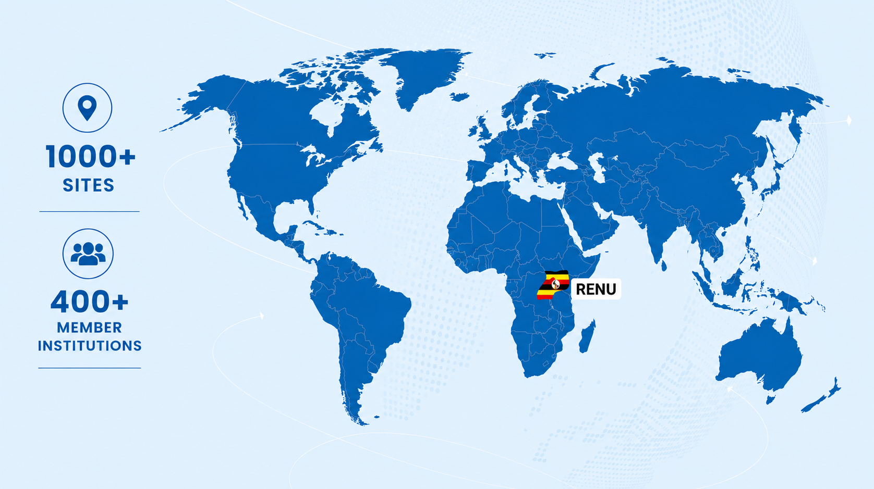
Who is RENU?
Notes:
For those who may not be familiar with RENU, we are Uganda's National Research and Education Network, located in East Africa.
Today, we connect more than 1,000 sites and serve over 450 member institutions across the country.
We provide critical digital services that support research, education, collaboration, and innovation.
Like many NRENs around the world, our impact continues to grow while our resources remain finite.
And that brings me to the challenge we faced.

Slide 3
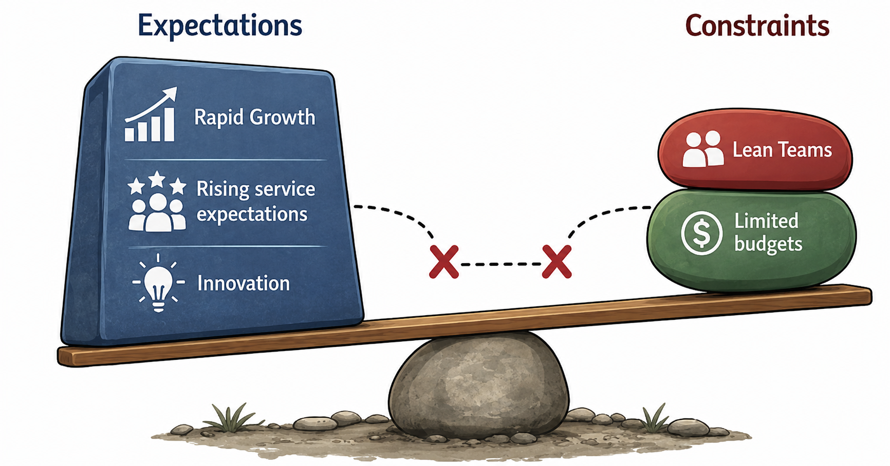
The Reality RENU Faces
How do you innovate when resources are constrained?
Notes:
This is a reality that many NRENs can relate to.
The number of users depending on our services continued to grow.
New digital services were being introduced.
User expectations kept rising.
Institutions expected services to be available 24 hours a day, seven days a week.
At the same time, small teams with limited budgets were expected to maintain existing systems, innovate, and deliver new services.
So we asked ourselves a simple question:
How do you continue innovating when resources are limited?

Slide 4
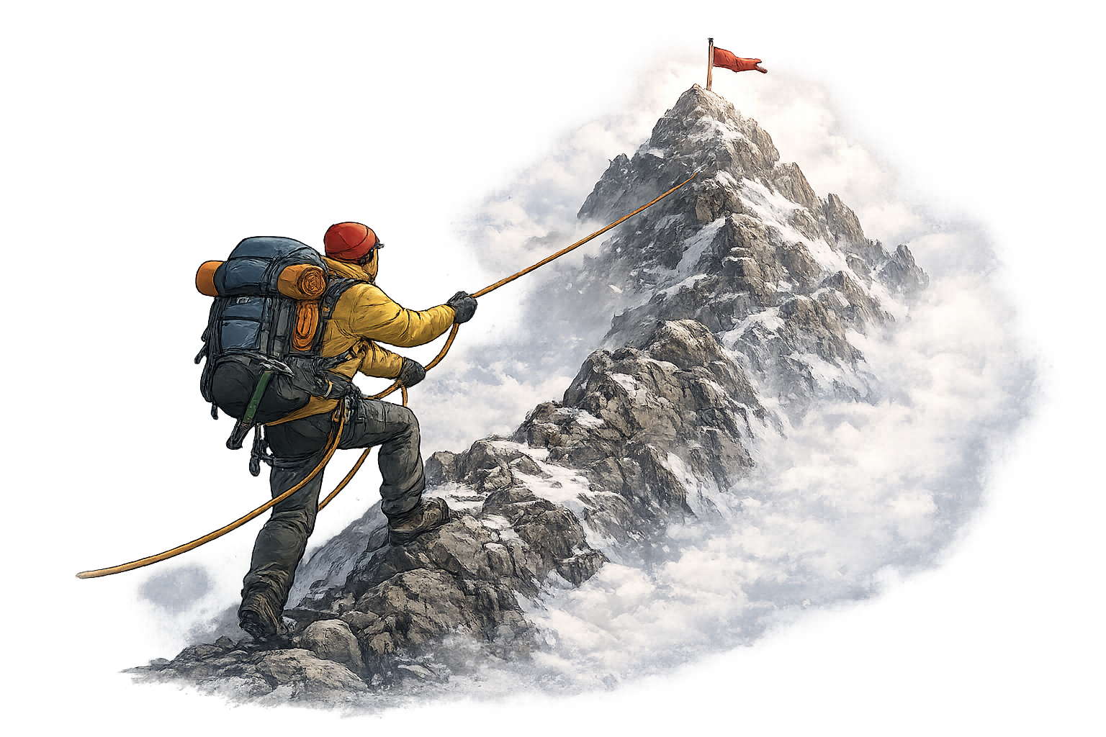
Sisu
From the Finnish concept of extraordinary courage and resilience amidst adversity.
At RENU, Sisu is something we were already living.
Notes:
The answer began with mindset.
Even before we transformed how we worked, we were already living what the Finns call Sisu.
Sisu is the courage and resilience to keep moving forward despite difficult circumstances.
Instead of focusing on what we lacked, we focused on how we could make the most of what we had.

Slide 5

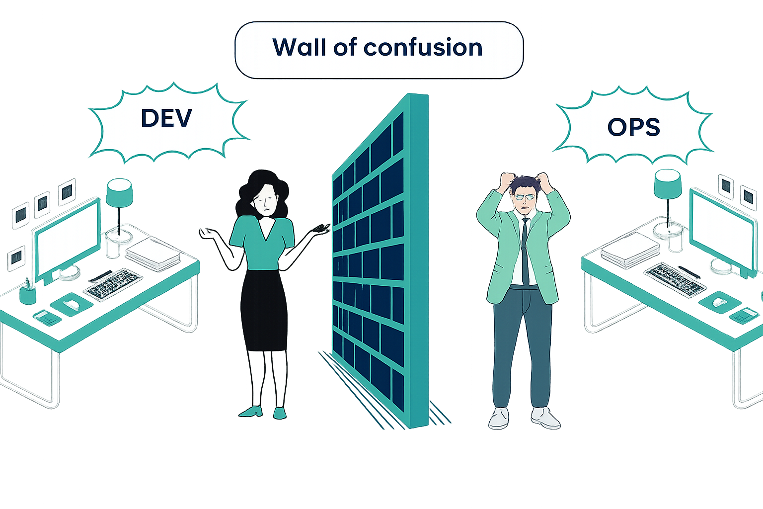



How we worked
Manual deployments prone to human error
Knowledge concentrated in a few individuals
Configuration drift between environments
“Siloed teams with poor communication”
Reactive incident response (always firefighting)
Notes:
Before talking about the transformation, it's important to understand where we started.
Development and operations worked largely in isolation.
Developers built applications and handed them over to operations teams to deploy and maintain.
This was the classic "throw it over the wall" approach.
Most deployments were manual.
Documentation was limited.
Knowledge was concentrated in a few individuals.
And we typically responded to incidents only after they had already happened.
We spent more time firefighting than improving.

Slide 6
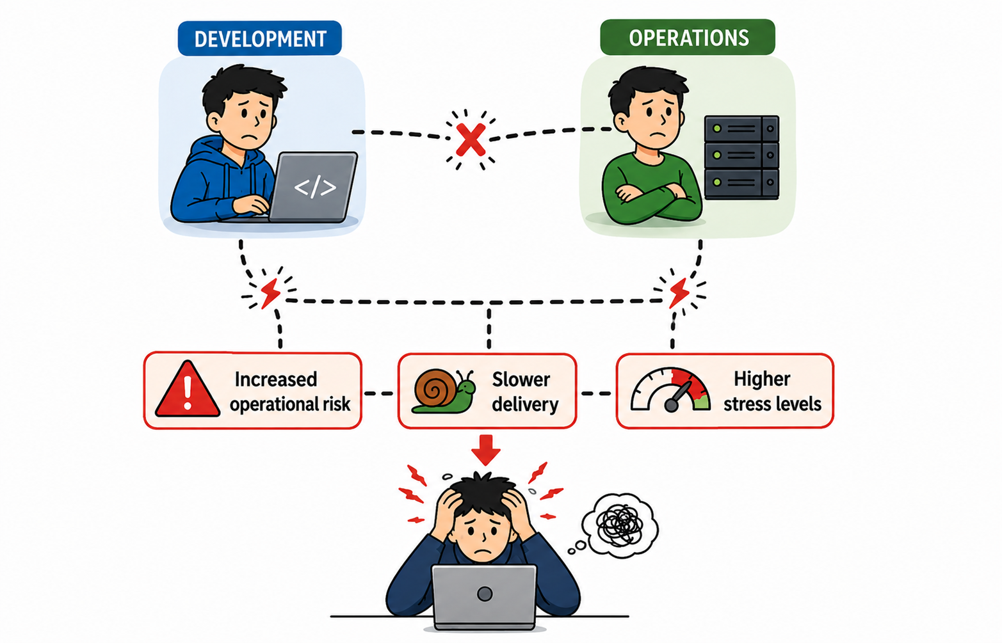
Results before the transformation
Working under those conditions this is what it actually looked like.
Notes:
These challenges affected both our users and our teams.
Outages lasted longer than they should have.
Feature delivery was slower.
Deployments felt risky.
People were hesitant to make changes because mistakes often led to blame.
Innovation suffered because fear replaced confidence.

Slide 7
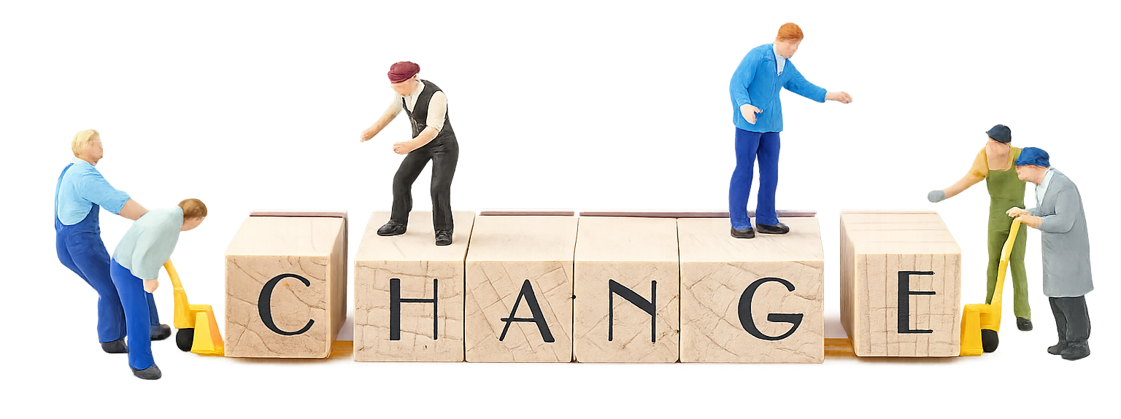
Continuing as we were was not sustainable
Notes:
Eventually, we realized that continuing this way was not sustainable.
The demands on our systems were increasing.
The complexity was increasing.
And the pressure on our teams was increasing.
Something had to change.
The question was not whether we should change.
The question was how.

Slide 8
A Shift in Thinking
Technology Was Not the First Problem
Our Focus
✕ Better hardware wasn't the answer
Shared ownership
✕ More tools alone wouldn't solve the problem
Collaboration
Transparency
✓ Culture needed to change first
Continuous improvement
"People change systems. Systems don't change people."
Notes:
One of the most important lessons we learned was that technology was not the first problem.
Buying more hardware would not solve these challenges.
Adding more tools would not solve them either.
The real change had to start with people.
So we shifted our focus toward shared ownership, collaboration, transparency, and continuous improvement.

Slide 9

Embracing DevOps as a Philosophy
DevOps is not just tools - it is a mindset shift.
From reactive to proactive. From blame to learning. From heroics to systems. Every team member had to decide to change
Notes:
As a response to these challenges, we embraced DevOps.
Not as a product.
Not as a tool.
But as a philosophy.
DevOps required a change in mindset.
It required everyone to think differently about how services were built, deployed, and operated.

Slide 10
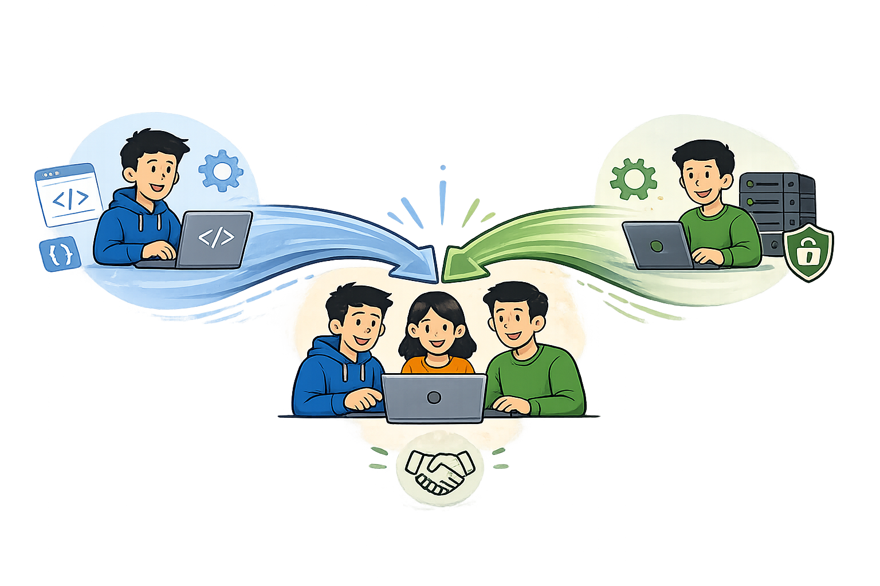
Embracing DevOps as a Philosophy
Breaking Silos
Teams work as one unit
Building Trust
Shared accountability across roles
Shared Responsibility
Everyone owns service quality
Faster Feedback Loops
Learn from every deployment
Continuous Learning
Improvement never stops
Notes:
In practice, DevOps meant breaking down silos.
It meant building trust.
It meant shared responsibility.
It meant faster feedback and continuous learning.
Most importantly, it meant recognizing that reliable services are everyone's responsibility.

Slide 11

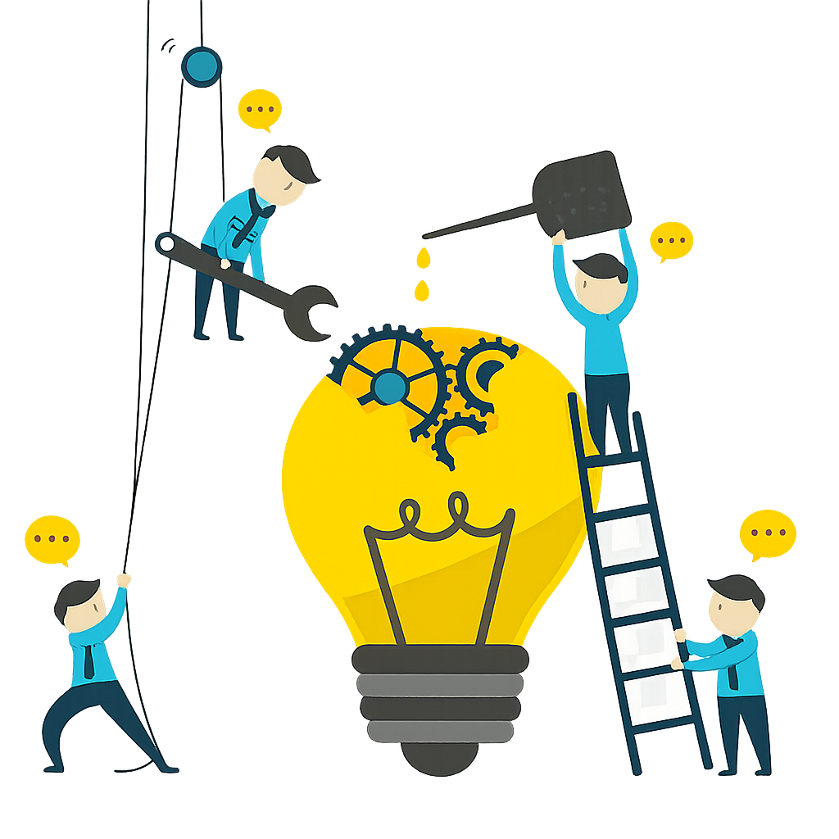


Failure Became a Learning Mechanism
Psychological safety made continuous improvement possible.
Blame, Fear, Finger Pointing
Learning opportunities, inputs for improvement. shared experiences
Improvement
This strengthened both systems and teams
Notes:
One of the biggest cultural shifts was how we treated failure.
Instead of asking, "Who caused this problem?"
We started asking, "What can we learn from it?"
Failures became opportunities to improve systems, processes, and communication.
Psychological safety made continuous improvement possible.

Slide 12


Automation as a Force Multiplier
Automation didn’t replace people, it freed them. Predictable work became predictable.
BEFORE
AUTOMATION
RESULT
Manual configuration drift
Infrastructure as Code
Predictable environments
Deployments diverged. ‘Works on my machine’ was normal.
Versioned, auditable, reproducible.
Fear of deployment
CI/CD pipelines
Safer, faster releases
Releases were rare, risky, late-night events.
Tested on every commit. Rollback is rehearsed.
Human error at the worst time
Repeatable runbooks
Disaster recovery becomes routine
Recovery was a high-stress improvisation.
What is automated, you can trust.
Notes:
Once the culture started changing, automation became much more effective.
The goal was never to replace people.
The goal was to free people from repetitive and error-prone work.
Automation allowed a small team to operate at a much larger scale.
It amplified expertise and increased confidence.

Slide 13




From Firefighting to Observability
From reactive firefighting to proactive reliability - we started seeing problems form.
BEFORE - REACTIVE OPERATIONS
AFTER - PROACTIVE OPERATIONS
Users report problems
Manual log-diving
Heroic fixes
Blame culture
We see issues forming
Centralised dashboards
Repeatable response
Learning culture
Metrics
Logging
Alerting
Dashboards
Real-time signal on what the system is doing right now - across every service.
Every event from every service in one searchable place.
Issues flagged before users notice anything.
Shared visibility for the whole team. Health is visible at a glance, not buried.
Reliability stopped being a heroic act. It became a property of how we built and watched things.
Notes:
Another major shift was observability.
Previously, we often learned about problems from users.
By the time we responded, the damage had already been done.
With better monitoring, logging, alerting, and dashboards, we started seeing issues before users experienced them.
We moved from reactive operations to proactive reliability.

Slide 14
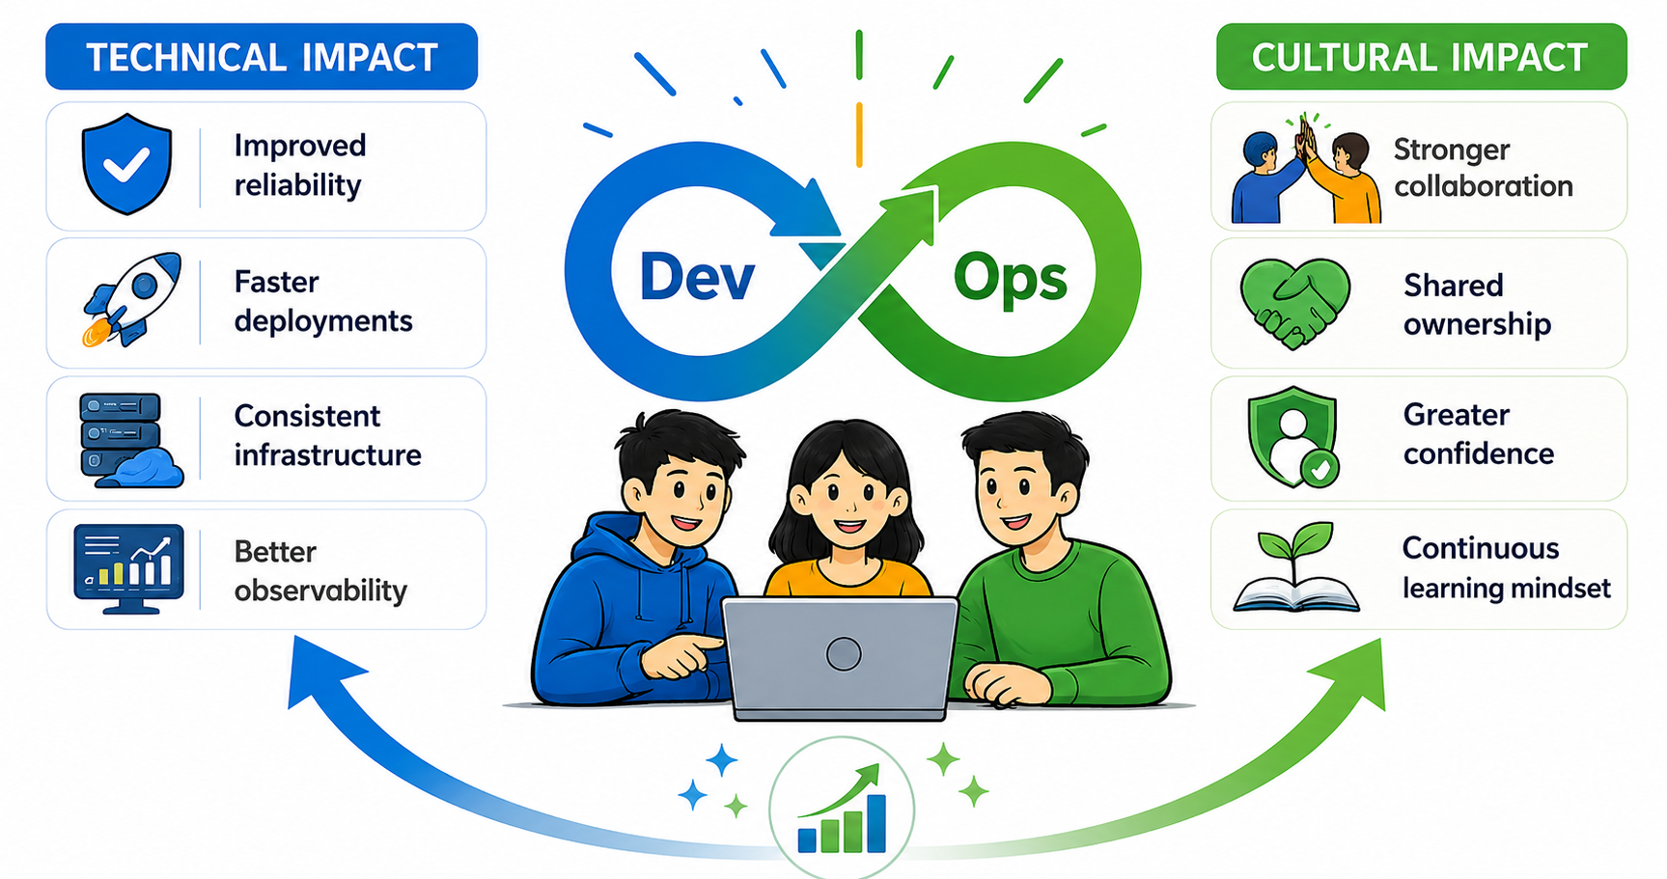
Outcomes and Impact
Notes:
The results were visible both technically and culturally.
Technically, we achieved greater reliability, faster deployments, more consistent infrastructure, and better observability.
Culturally, we developed stronger collaboration, shared ownership, greater confidence, and a continuous learning mindset.
The technology improved because the culture improved.

Slide 15






Key Lessons for NRENs
01
02
03
Culture scales better than hardware.
Automation multiplies small teams.
Automate the repeatable, relentlessly
People and practices outlast any single tool.
One engineer with IaC can do the work of many.
What you automate, you can trust. What you trust, you can extend.
04
05
06
Shared ownership builds resilience
Constraints can drive innovation
Make failure safe to learn from
When everyone owns the outcome, the service gets stronger.
Limited resources sharpen creative problem-solving.
Blame ends learning. Safety begins it. Choose deliberately.
Notes:
The lessons from our journey are especially relevant for NRENs operating under similar constraints.
Culture scales better than hardware.
Automation multiplies small teams.
Shared ownership builds resilience.
And constraints can become catalysts for innovation.

Slide 16
Innovation is still possible despite constraints; it comes from how teams respond. It is built through courage, resilience, and the determination to keep improving.
Notes:
If there is one thing I hope you take away from this presentation, it is this:
Technology amplified our progress, but culture enabled it.
Innovation doesn't come from unlimited resources; it comes from how teams respond to constraints.
It is built through courage, resilience, and the determination to keep improving.
At RENU, Digital Sisu helped us discover that when infrastructure meets courage, innovation becomes possible.
Thank you.

Slide 17
Thank You
Questions?
Notes:
Thank you very much for your time.
I would be happy to answer any questions or hear about similar experiences from your own organizations.
Thank you.

