Slide 1

INTEGRATED MONITORING
PORTAL FOR LATIN
AMERICAN NRENs
Tiago Monsores, Lead Network Engineer

Slide 2




Cooperación Latino
Americana de Redes Avanzadas
Introduction
RedCLARA is responsible for the implementation and management of the network infrastructure that interconnects the Latin American National Research and Education Networks (NRENs), and through them, a large number of universities and research centers.

Slide 3


Cooperación Latino
Americana de Redes Avanzadas
Members
Currently RedCLARA has 7 associated members
The coverage area is 12.9 million km²
For comparison, Europe area is 10.2 million km²
+105,435 km of network circuits
+2,000 connected universities

Slide 4
Cooperación Latino
Americana de Redes Avanzadas
Partners

Slide 5
Cooperación Latino
Americana de Redes Avanzadas
Initiatives

Slide 6
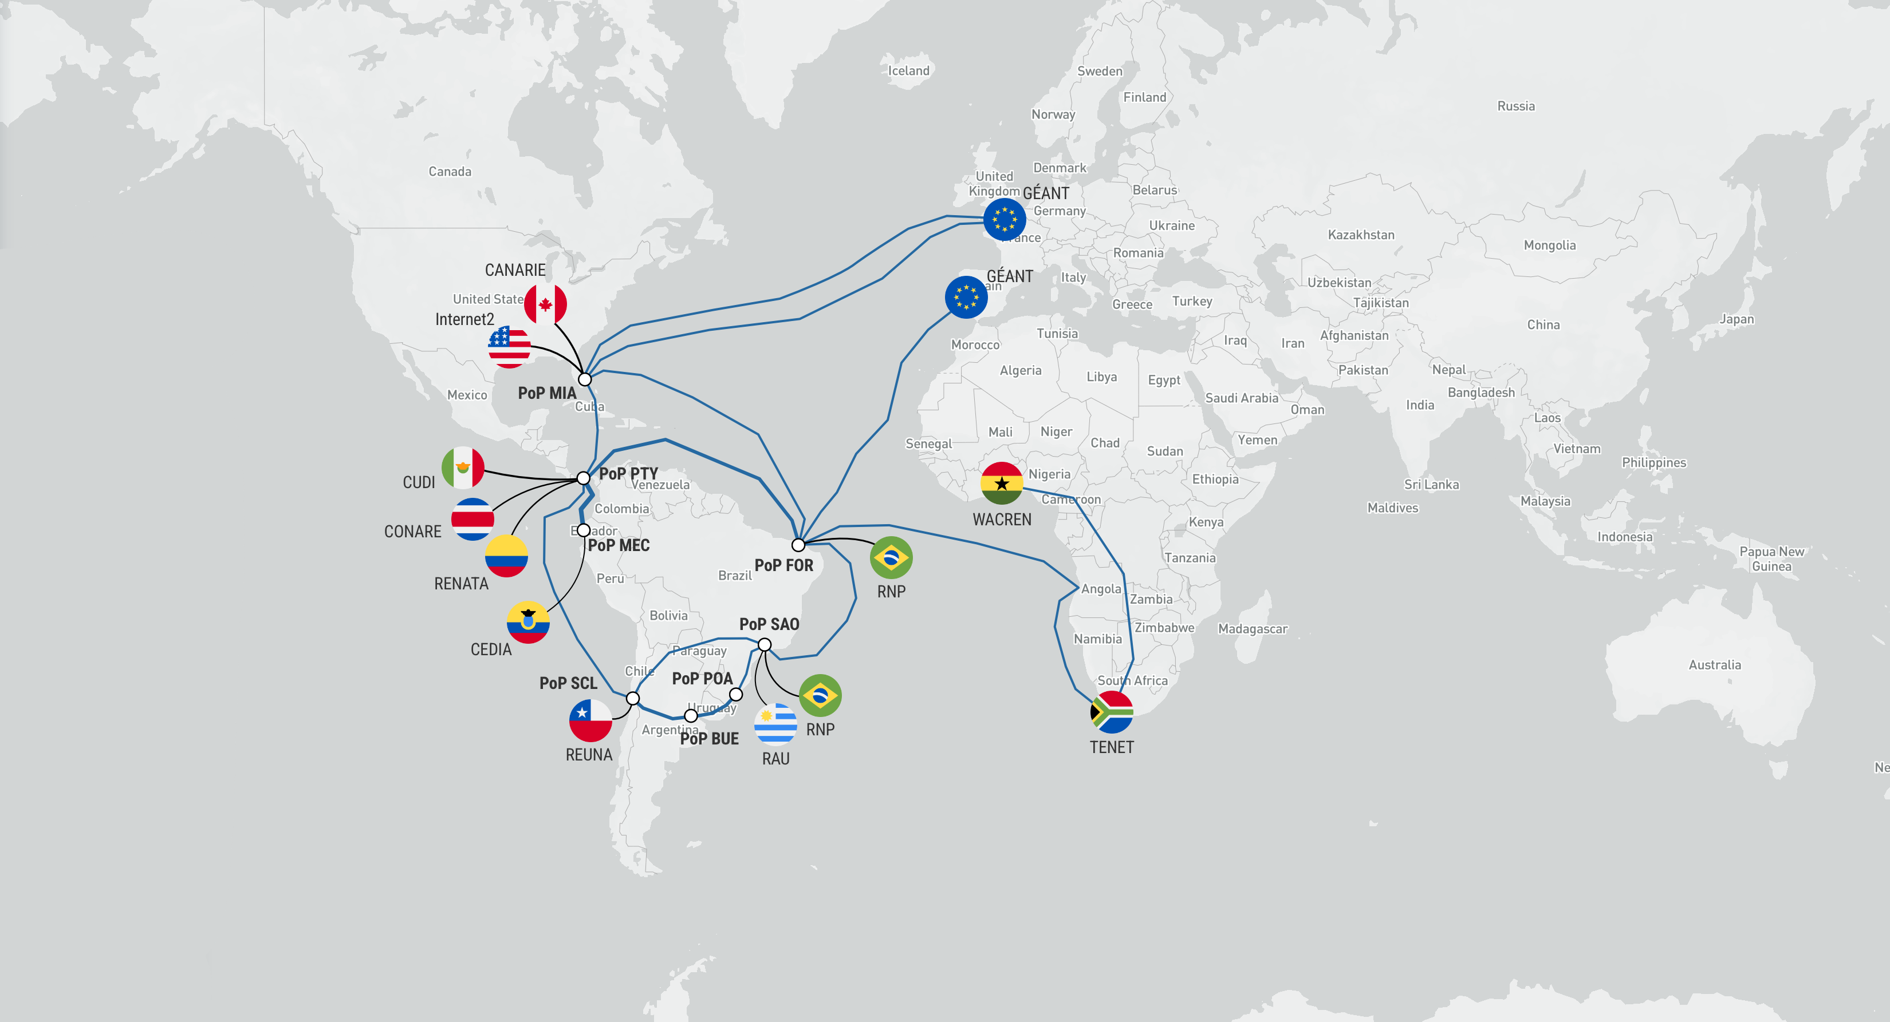
Cooperación Latino
Americana de Redes Avanzadas

Slide 7
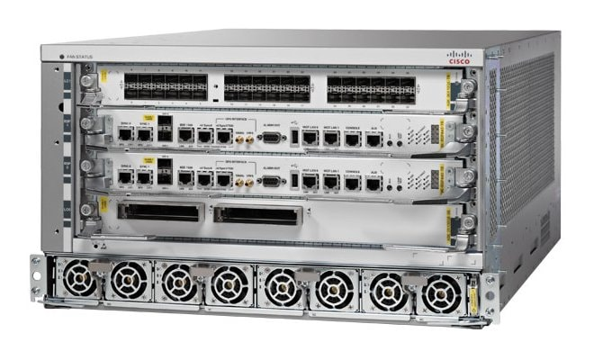
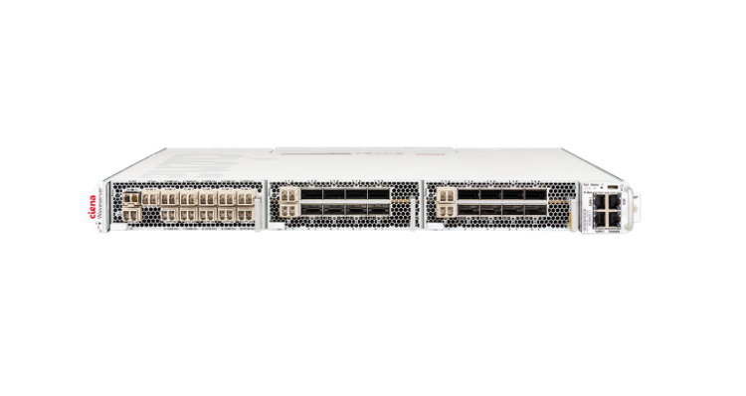
Cooperación Latino
Americana de Redes Avanzadas
Infrastructure
Cisco ASR 9904
6 RU
Up to 16 Tbps
2 line cards, 2 RSPs
Ciena WaveServer Ai
1 RU
Up to 2.4 Tbps line + 2.4 client
3 transponder slots

Slide 8
Cooperación Latino
Americana de Redes Avanzadas
Network features
High capacity: all backbone links are +100Gbps
Predictability: traffic flows through a coherent path
Security: MANRS participant with all 4 actions implemented + 100% score
Robust monitoring
Segment Routing
Model Driven Telemetry
Loop Free Alternate (LFA) Fast Reroute (FRR)

Slide 9
Cooperación Latino
Americana de Redes Avanzadas
Network Management Systems

Slide 10
Cooperación Latino
Americana de Redes Avanzadas
The Challenge
Operating a continental-scale network requires visibility across multiple domains
Backbone infrastructure
Routing and BGP
Network flows
Service monitoring
User-facing services

Slide 11
Cooperación Latino
Americana de Redes Avanzadas
The Challenge
The problem
Information was distributed across multiple independent systems which customers don’t have access
The solution

Slide 12
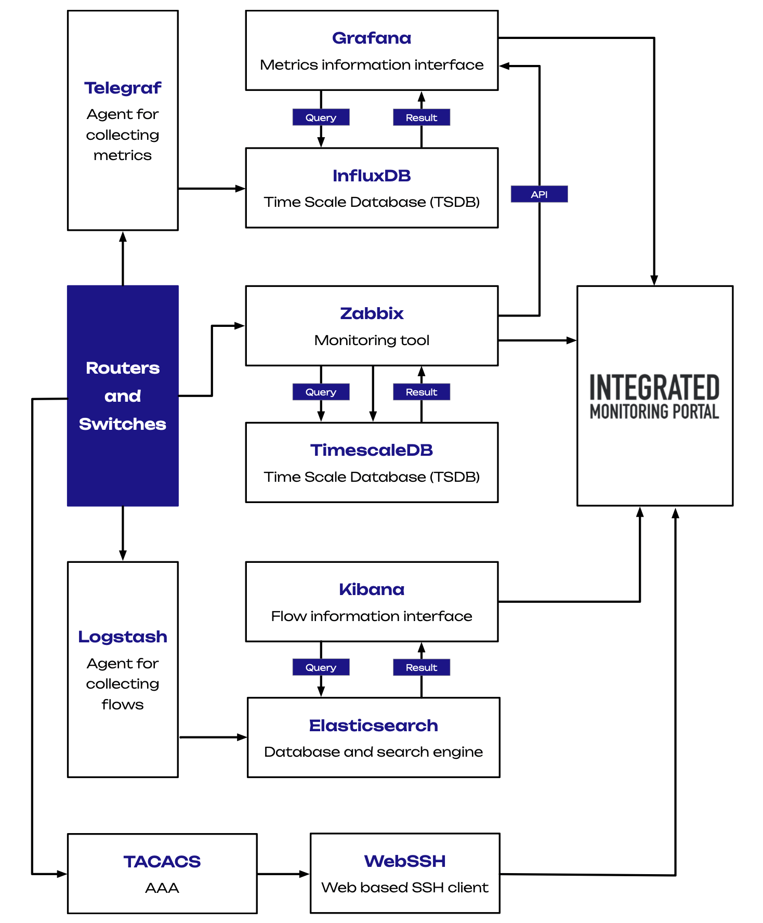
Cooperación Latino
Americana de Redes Avanzadas
Architecture

Slide 13


Cooperación Latino
Americana de Redes Avanzadas
Graphical
Interface and Authentication
Graphical interface built with Drupal
Drupal is an open-source Content Management System (CMS)
Authentication uses Shibboleth for federated login
It can be accessed using the following URL:
https://imp.redclara.net

Slide 14




Cooperación Latino
Americana de Redes Avanzadas
Traffic and BGP Monitoring
SNMP and Telemetry metrics collected with Telegraf using a polling time of 30 seconds
Latency measured with IP SLA
Data is stored in InfluxDB
Availability and Alerts provided by Zabbix
Dashboards built with Grafana

Slide 15
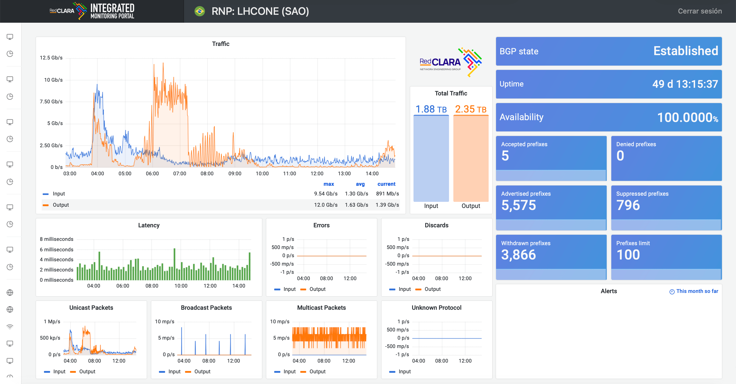

Slide 16
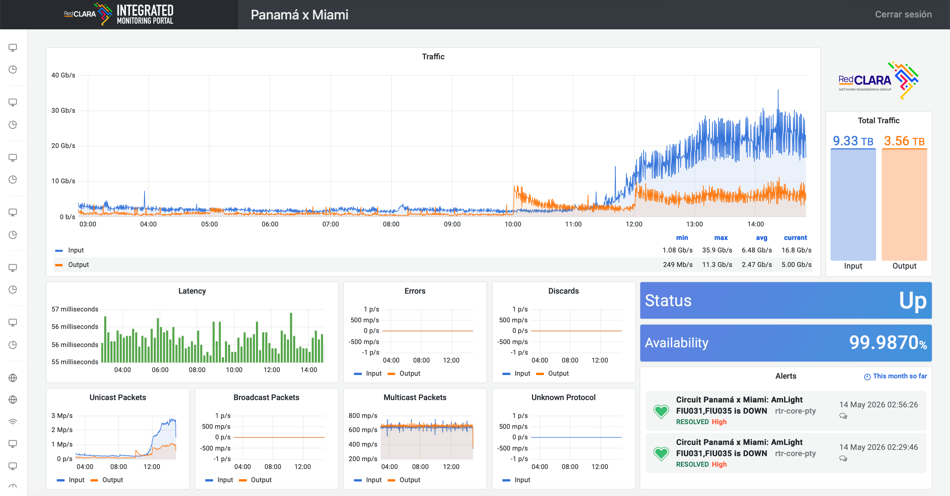

Slide 17


Cooperación Latino
Americana de Redes Avanzadas
Network Flows
Monitoring
Netflow v9 is configured on the routers
Only 0.01% of the packets are sampled
Flows are exported to Logstash
Data is enriched and sent to Elasticsearch
Dashboards are built with Kibana and are part of ElastiFlow

Slide 18
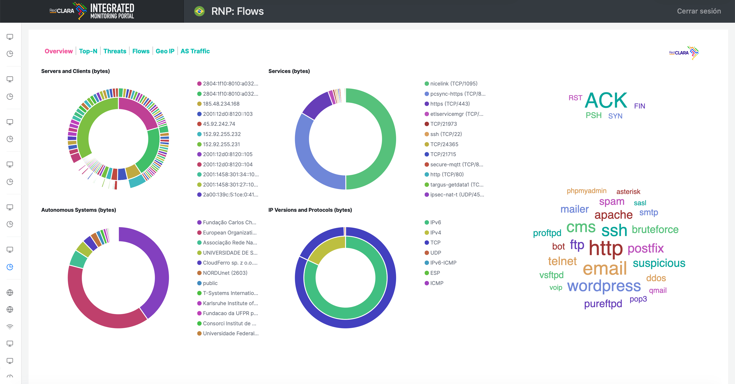

Slide 19
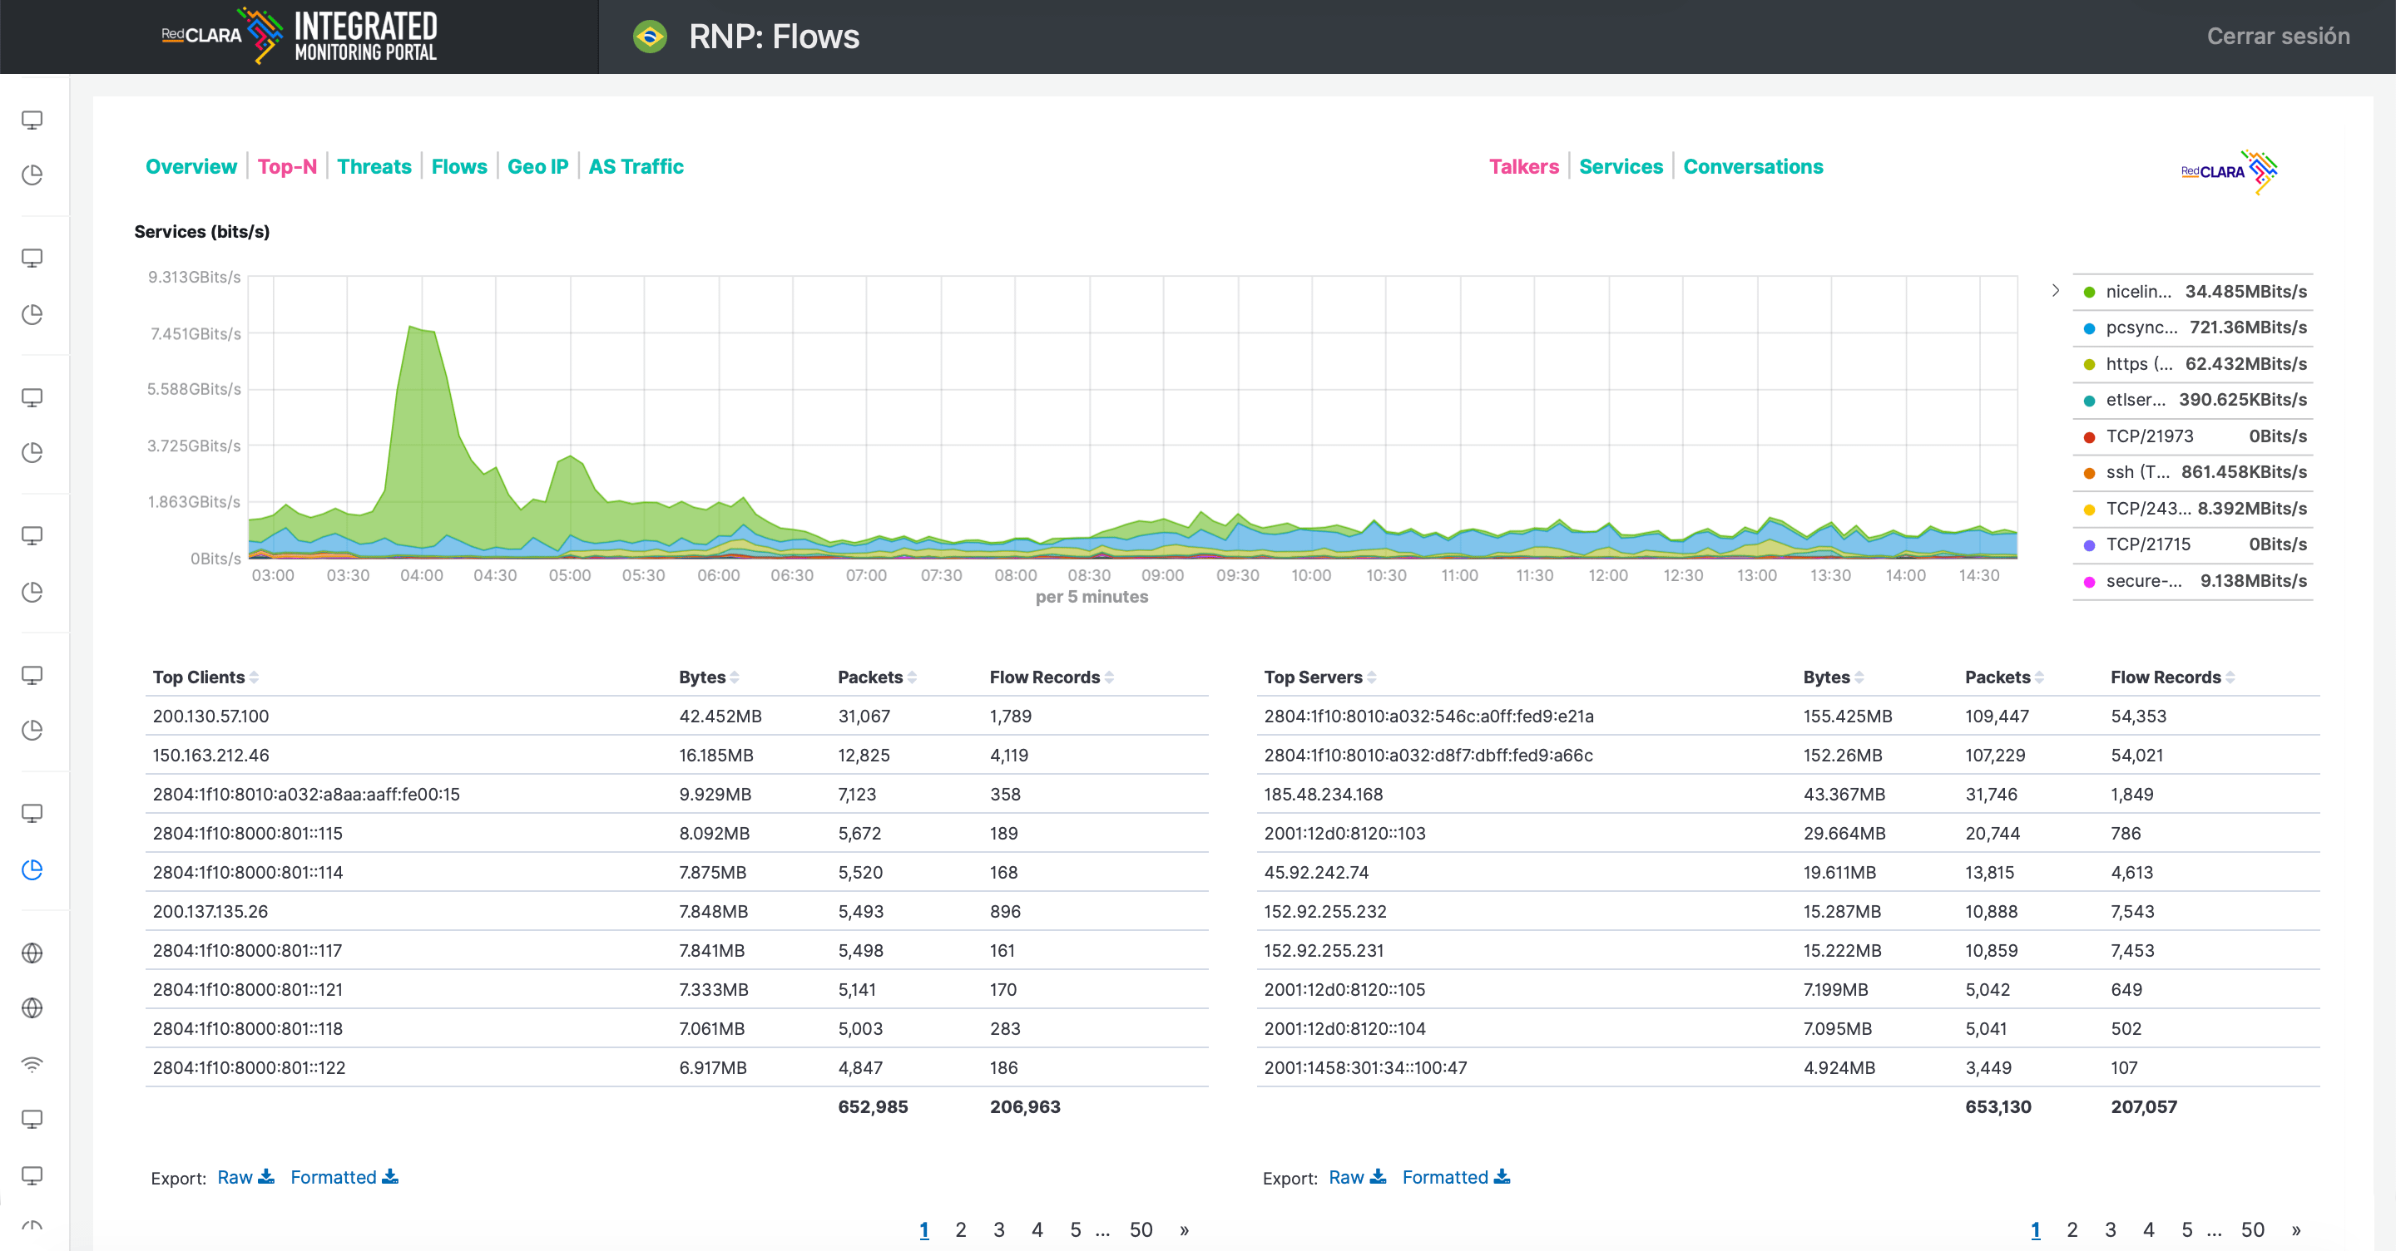

Slide 20
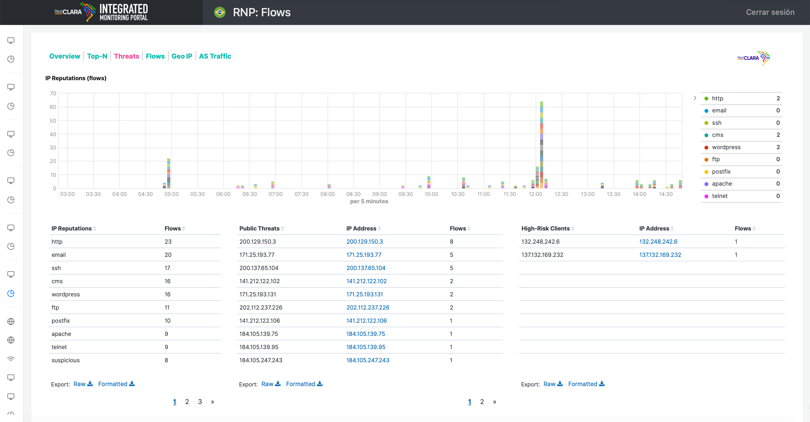

Slide 21
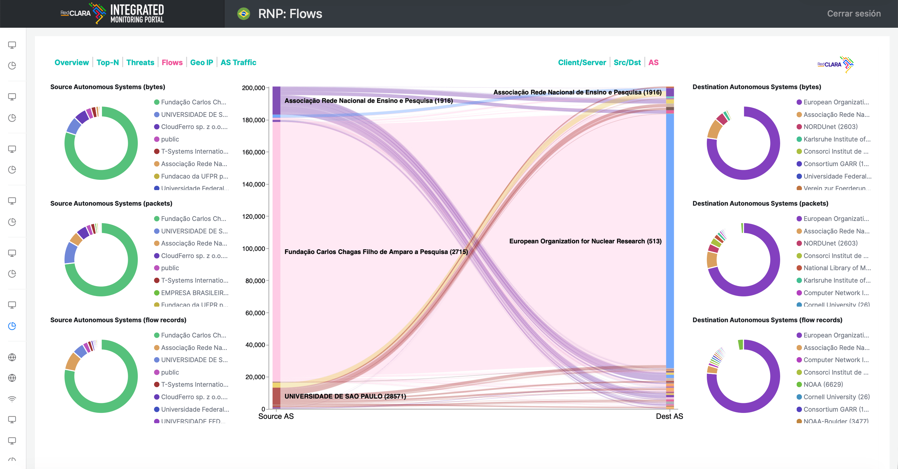

Slide 22
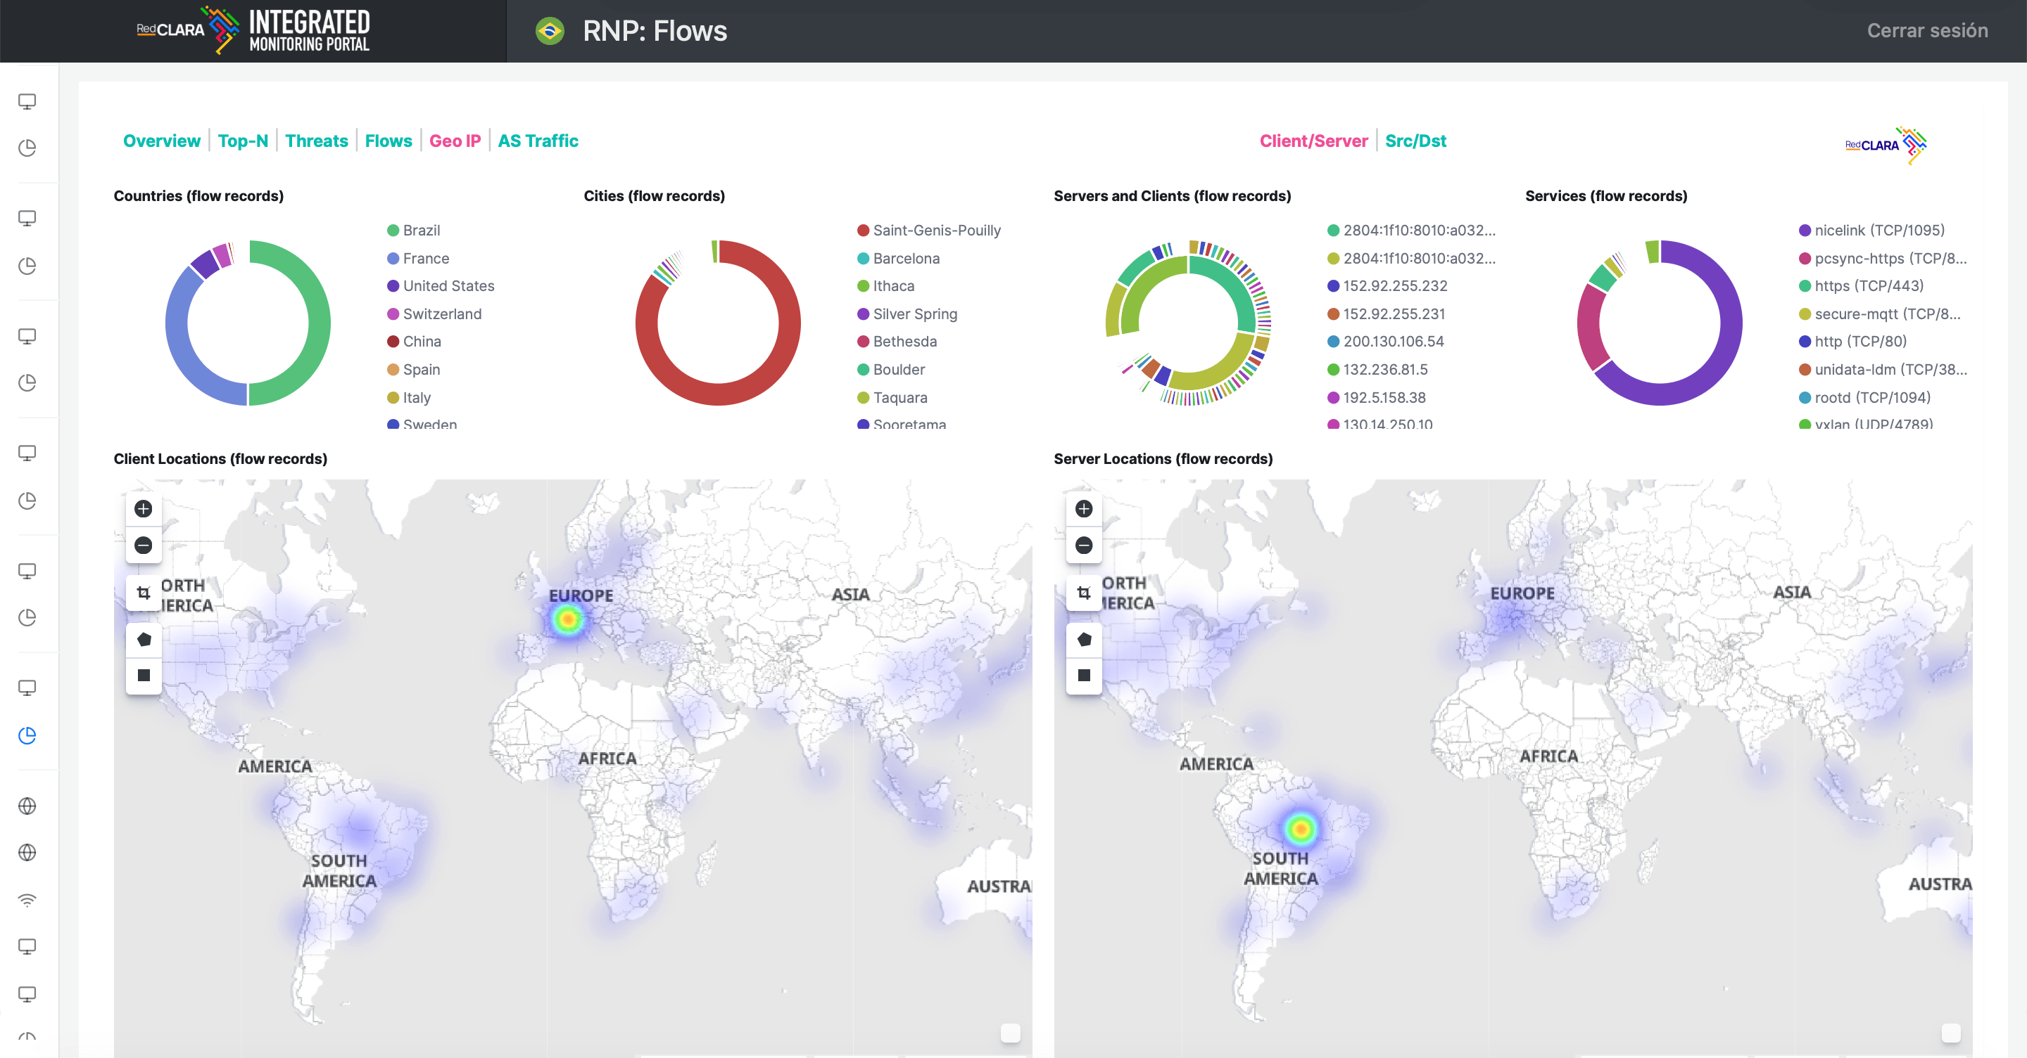

Slide 23
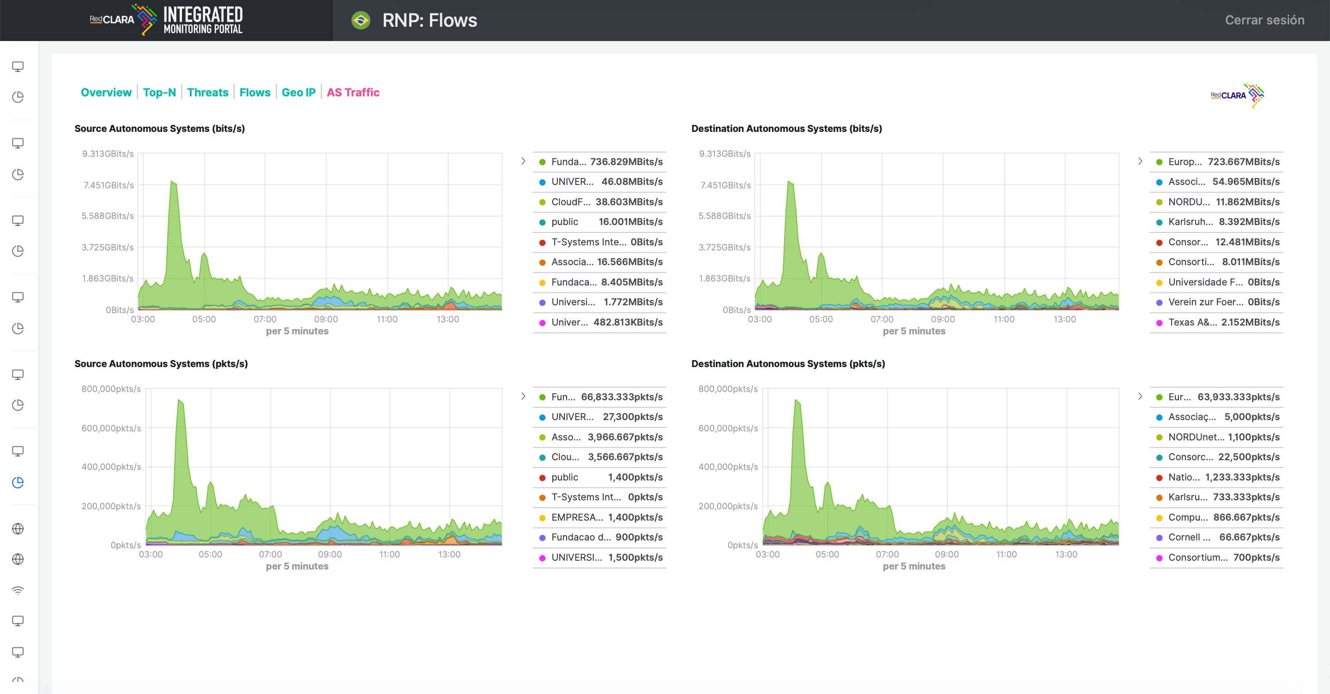

Slide 24
Cooperación Latino
Americana de Redes Avanzadas
WeatherMap
Two different WeatherMaps
Interactive WeatherMap built with GlobalNOC Network Map Panel plugin for Grafana (new)
Backbone WeatherMap built with Zabbix
General view for backbone circuit outages

Slide 25
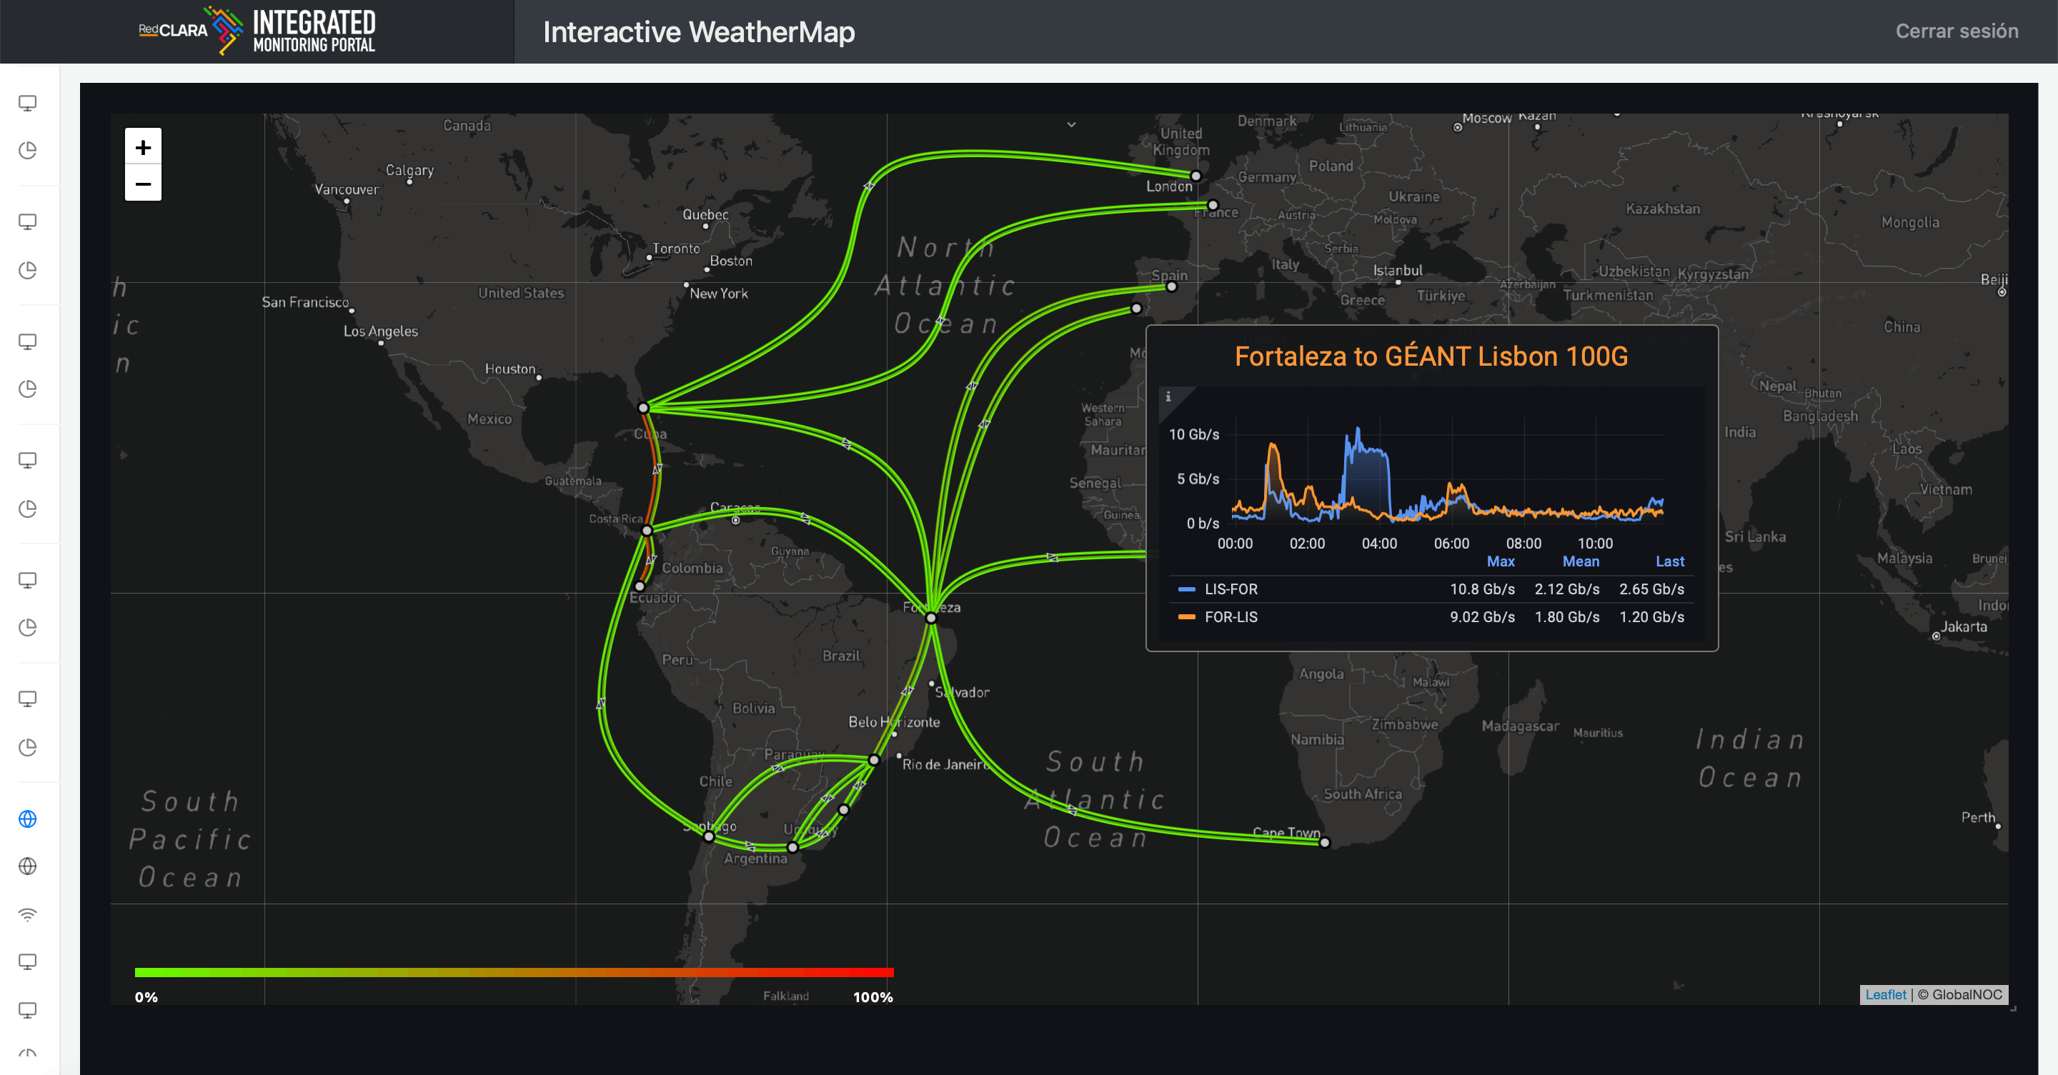

Slide 26
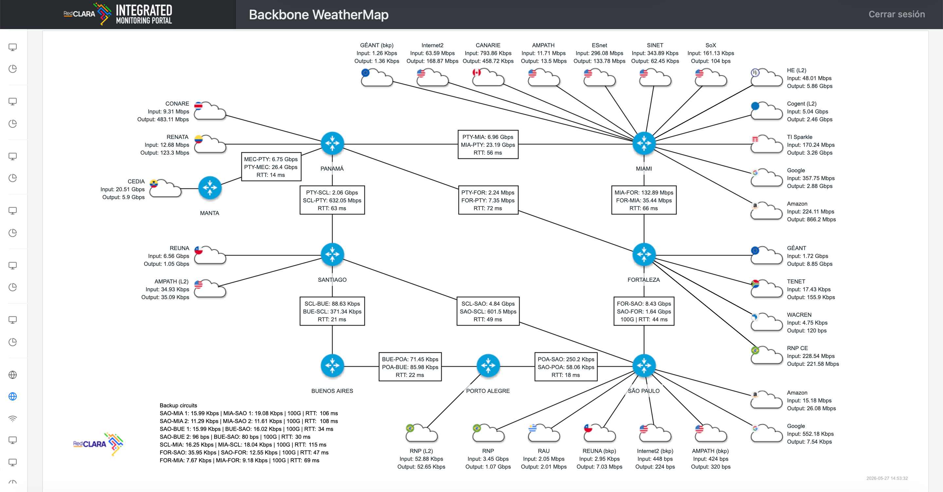

Slide 27


Cooperación Latino
Americana de Redes Avanzadas
WebSSH
Built with WebSSH (https://github.com/huashengdun/webssh)
User authentication, command authorization and accounting done by TACACSGUI
Only ping, traceroute and a set of show commands are allowed
WebSSH

Slide 28
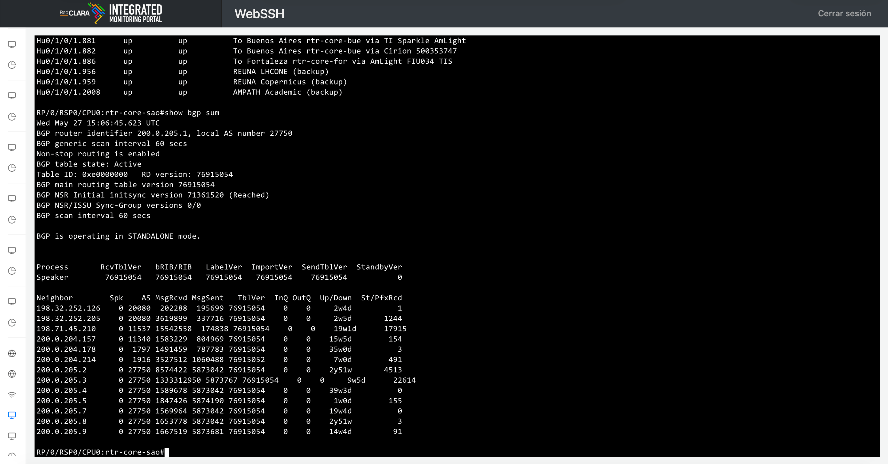

Slide 29
Cooperación Latino
Americana de Redes Avanzadas
eduroam
eduroam information is collected from logs
Logs are ingested to ELK Stak
Custom dashboards have been created to output the information

Slide 30
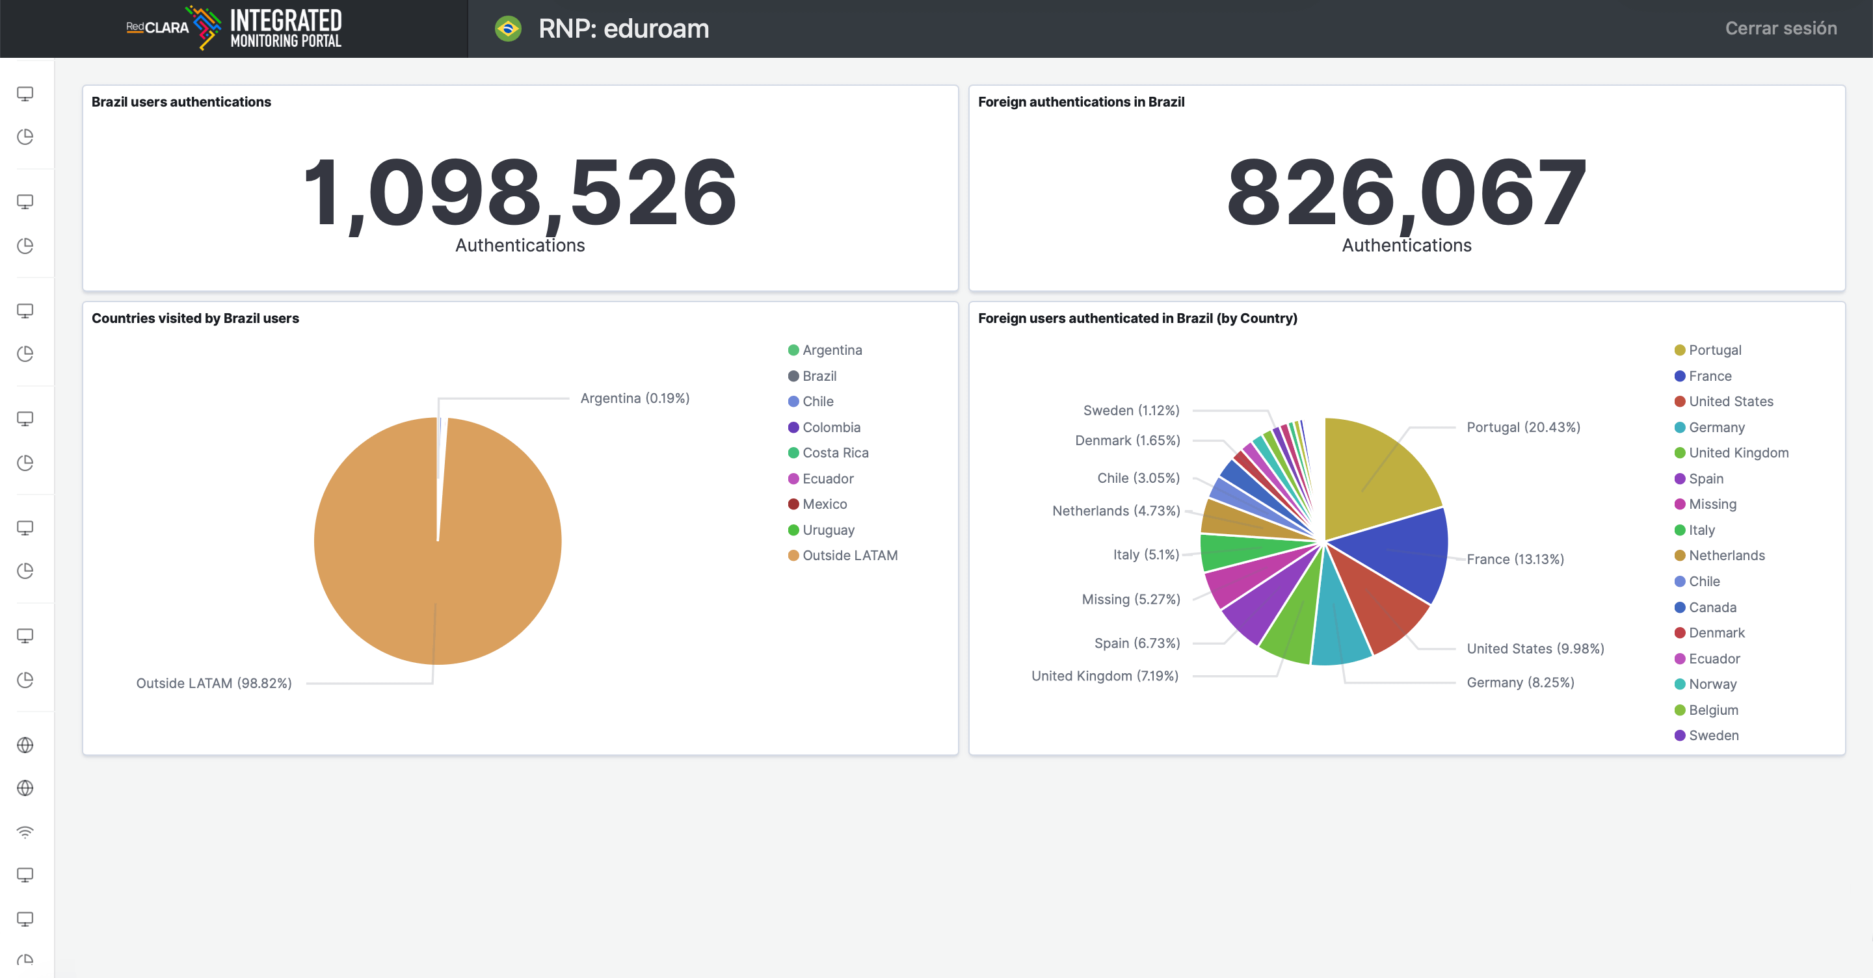

Slide 31
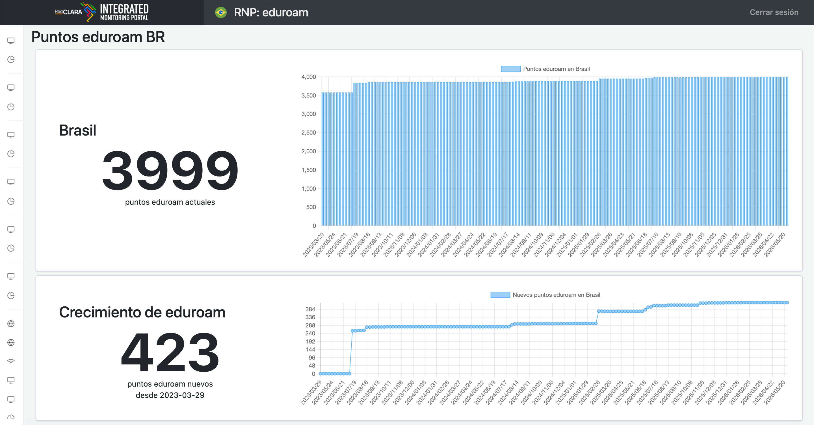

Slide 32

Cooperación Latino
Americana de Redes Avanzadas
SPIDER Project
Aims to maximize the use of BELLA Network and EllaLink
Custom dashboards for the project
Dashboards based on EllaLink traffic flows

Slide 33
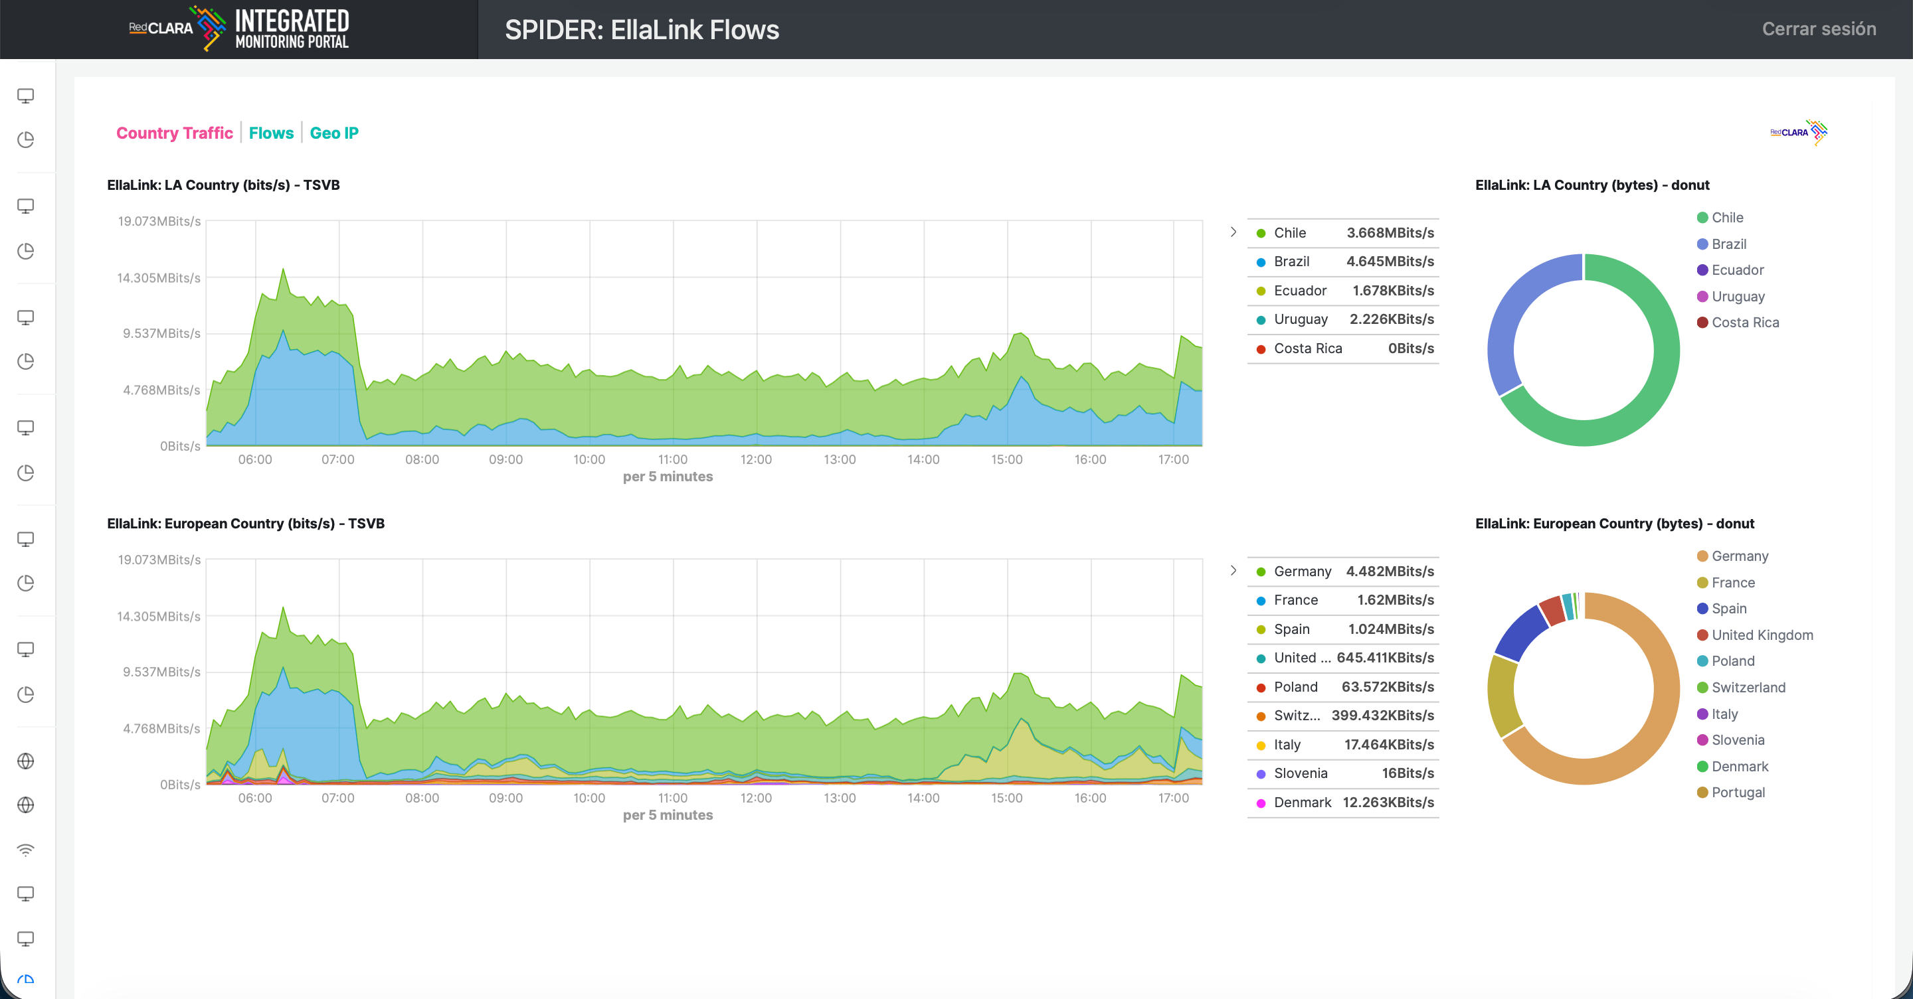

Slide 34
Cooperación Latino
Americana de Redes Avanzadas
IMP: From Data to Operational Intelligence
What we achieved
Unified access to monitoring, telemetry and operational tools
Improved visibility across RedCLARA backbone and services
Faster troubleshooting and incident analysis
Better operational efficiency for engineers and NRENs
A scalable platform built with open-source technologies

Slide 35
Cooperación Latino
Americana de Redes Avanzadas
IMP: From Data to Operational Intelligence
Looking ahead
More telemetry and automation
Advanced analytics and event correlation
New services and dashboards for NRENs
Continued evolution of network observability

Slide 36
Cooperación Latino
Americana de Redes Avanzadas
“Network visibility is not just about seeing data.
It is about turning data into actionable knowledge.”

Slide 37
Cooperación Latino
Americana de Redes Avanzadas
One Portal. One View. One Source of Truth.
Integrating monitoring, telemetry and operational tools for the Latin American research and education community

Slide 38







Cooperación Latino
Americana de Redes Avanzadas
QUESTIONS?

Slide 39





redclara.net
tiago.monsores@redclara.net
linkedin.com/in/tiagomonsores

