Slide 1
Sikt´s New R&E Network – procurement, strategies and learnings
11. June 2026
TNC26, Helsinki
Olaf.Schjelderup@sikt.no

Slide 2
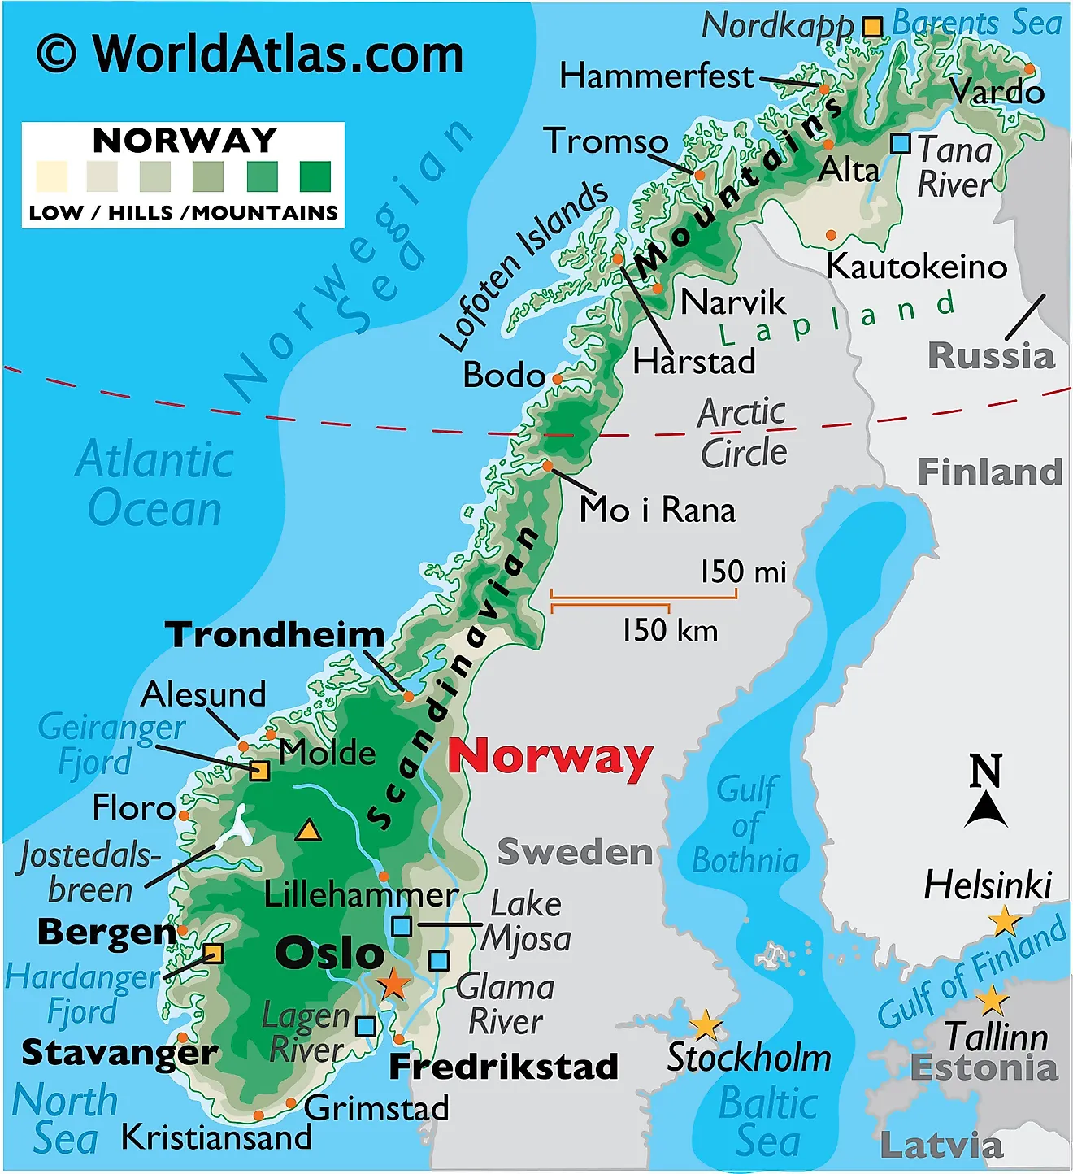
Facts about Norway
Population: 5,6 Million people
Lots of mountains, valleys, fjords, islands.
Coastline, including islands: 102.937 km
  2.5 x length of equator
Driving distance north-south within Norway is ca 3000 km (3-4 days, including ferry)
Area: 385 207 km^2
Scattered population and the geography gives generally high infrastructure costs
Norway´s NREN Uninett, operated by Sikt;
  Over 500.000 end user
  Over 20.000 km footprint in total
  21 state over universities and colleges, spread over ca. 50 towns/cities.
  Ca. 150 customers in total

Slide 3
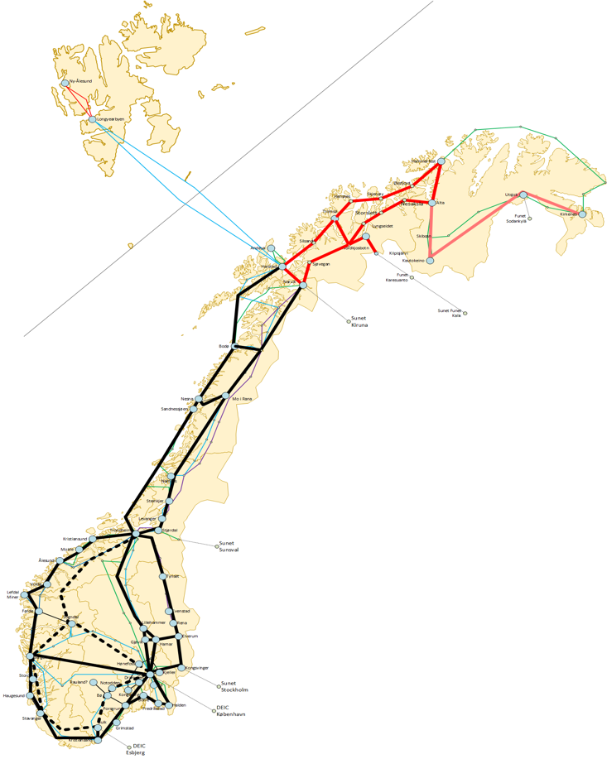
From Sets of Wavelengths to Terabit/s and more (2026 -> 20 yrs)
Example future topology from the RFQ

Slide 4

Needs and requirements
National coverage with many essential locations and destinations.
Terabit/s capacities
  Dark Dibre preferred, Optical Spectrum 2nd, Waves 3rd
Flexigrid and license free spectrum on DWDM-solutions
Even higher validated redundancy than today
  It was good already, but the tense geopolitical situation requires more
20 years IRU – the expected lifetime of the Open Line System (DWDM)
The possibility for Fibre Optic Sensing and bidirectional Time-and-Frequency transfer
Extra fiber pairs for research purposes (Quantum, sensing etc?)
Open for multi-subprovider solutions and topologies – “we were ready for hard and long negiotiations ;-)”.

Slide 5

Procurement process
Proposal delivered to the Ministry of Research and Education, november 22
In October 2023, a state loan from the Ministry of Education and Research was granted through the national budget for 2024. The loan is to be repaid with interest.
RFI spring 2023, RFQ launched end-of-2023
Award criteria: 60 % Quality, 40 % TCO
10 tenderers (very good, but also «phew»)
  3 with hybrid Dark Fibre and spectrum solutions
    Some with national coverage, others with ambitions
  7 with Dark Fibre only, more regional and/or metro oriented

Slide 6

The technical stuff
Asked for Dark fiber and Optical Spectrum
  Between major cities and regions
  Add/drop on locations of interest along the path
Offers for both Long-haul and Metro Dark Fibre
  Some offers with 2+ fiber pairs, at least one extra fiber pair dedicated research on advanced optical services
Offers for 1-1.2 THz optical spectrum solutions
  Some solutions may add/drop all spectrum arbitrary, while other´s solution were less dynamic and more alien wave oriented
Both unique and overlapping cable paths and telehousings offered.
  Ensuring redundancy/resilience requires detailed analysis, including where to place our own DWDM ROADMs.
Extreme complexity arised; Choosing one path will easily alter preference for a large set of other paths
  Solution to make this manageble; divide the country into 5 large regions, do evaluation on inter-regional legs with add/drops on essential locations in between.
Complex Excel-models developed for evaluation

Slide 7

Negotiations and contract awards
Negiotiated procedure (> 2 years)
  6 offer- and negiotiation phases
    Analysis and feedback for improvement, meetings and text
    Clarifications and alignments
    Each phase yielded improved offers
    Thousands of pages read each round
  Careful balance between further iterations and when to conclude
All decisions on contract awardings must be published at the same time - in line with procurement rules,
Best and final offers (BAFO) received May 2025
Contract award in January 2026 with 8 sub-providers
  Second round on two long legs due to change of strategy by one of the tenderers
Main contracts signed May 2026.
Roll-out-planning has started
A few supplementary procurement remains (regional redundancy, fiber accesss etc)

Slide 8
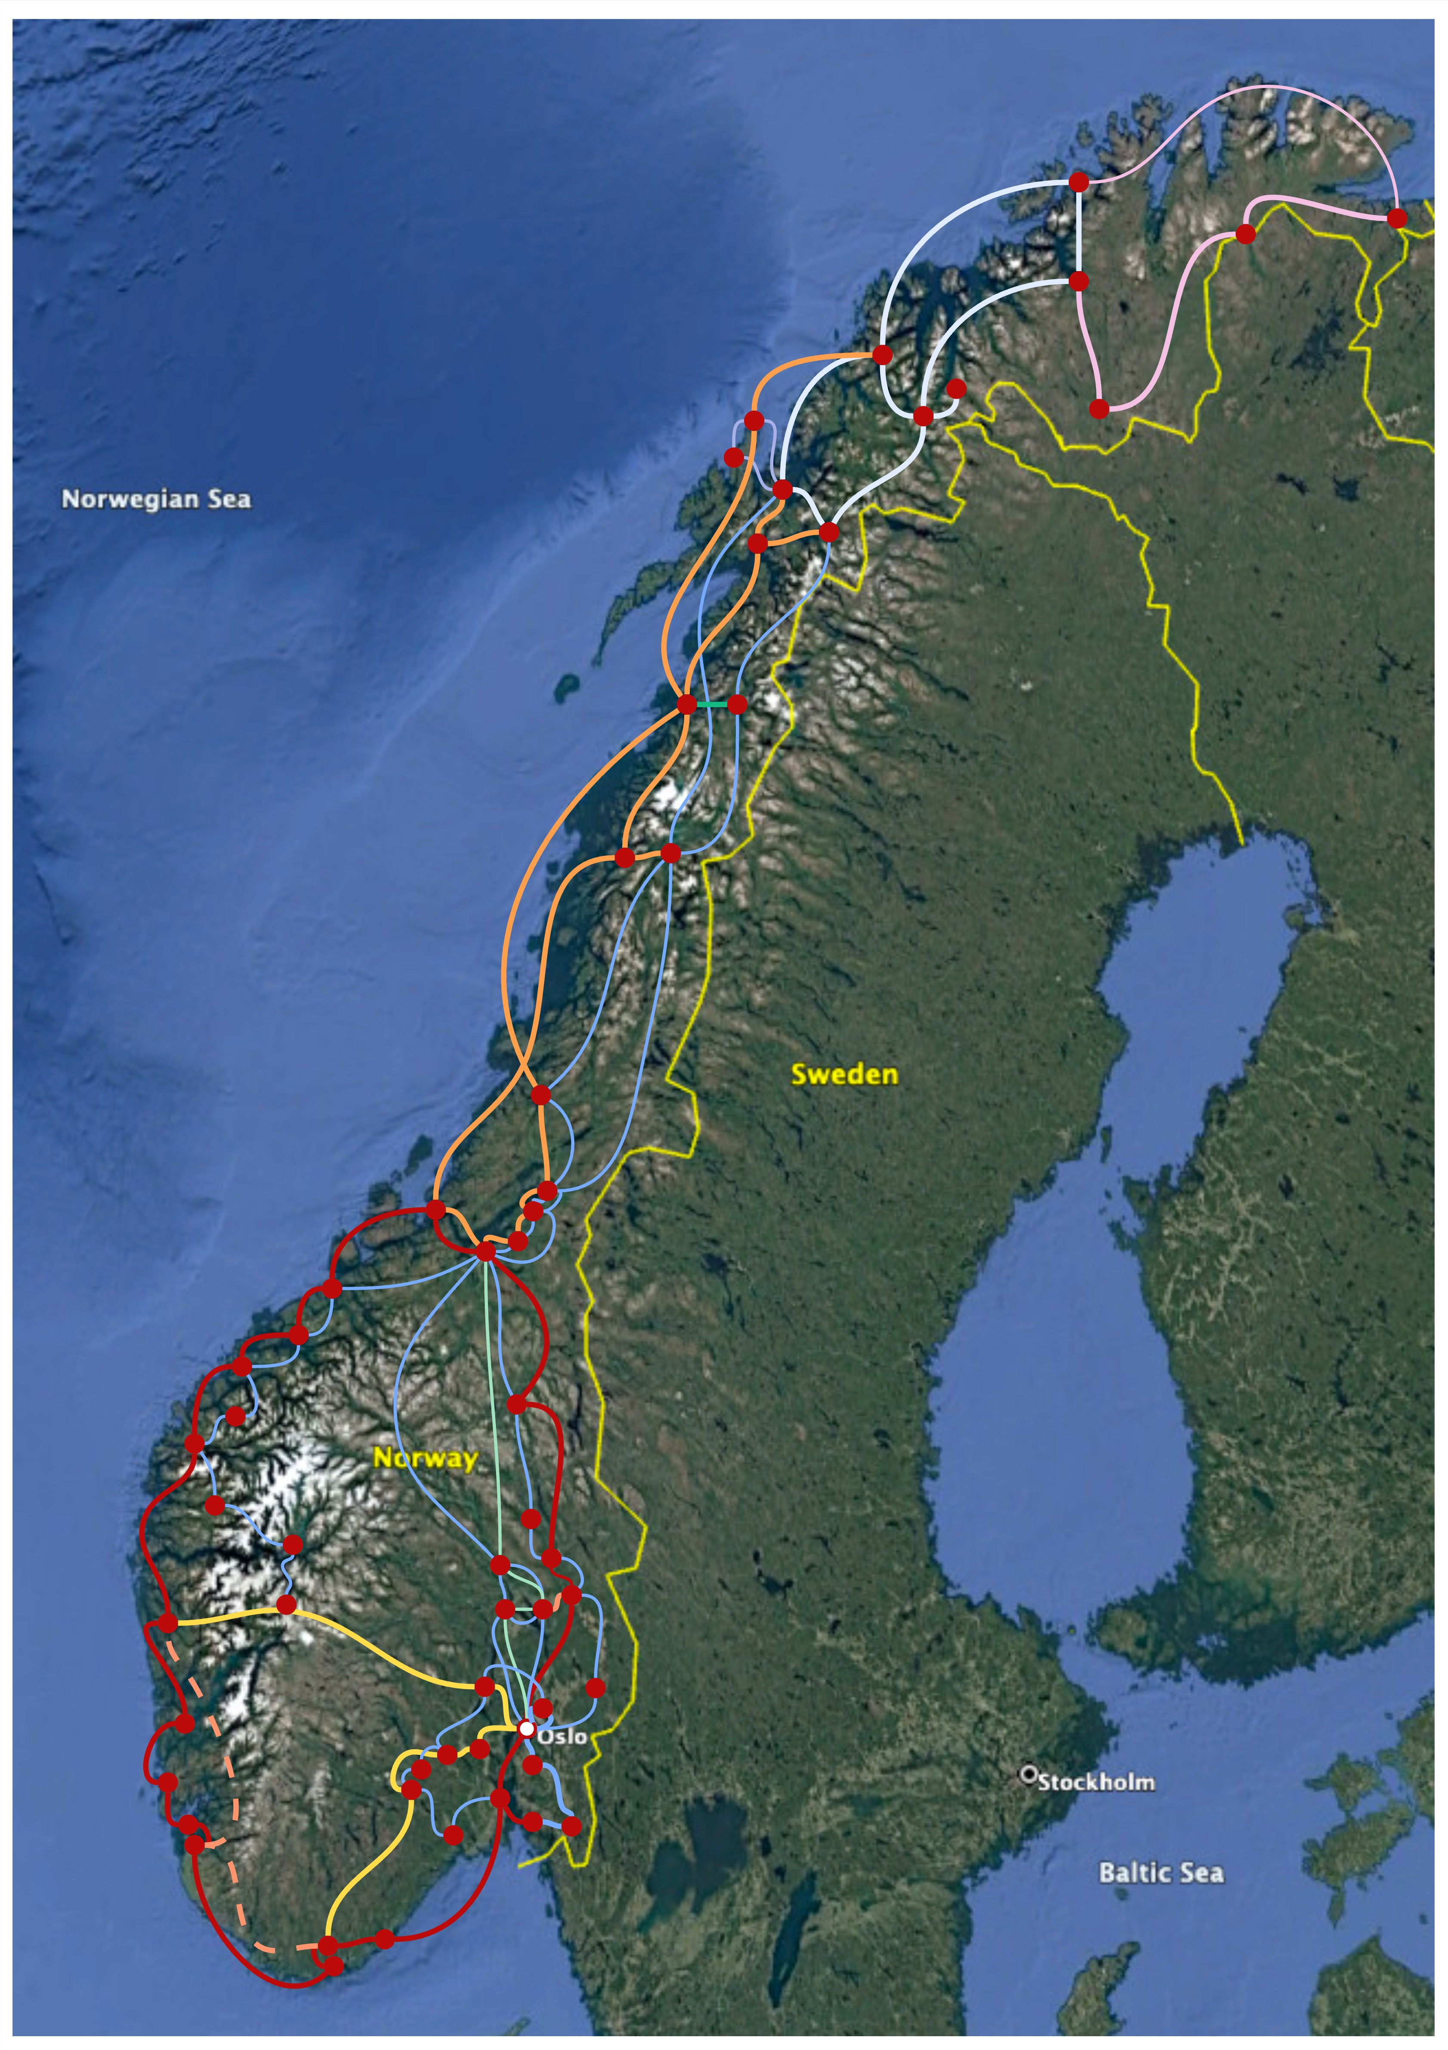
The Resulting Network
8 dark fibre and spectrum subproviders
2 previous ones up north (Troms and Finnmark)
Ca. 13.000 km optical long haul topology will be renewed (exl. Svalbard, route-crossing, metro fibers etc)
Huge cost savings, increased optical footprint and redundancy ☺.
Roll out 2026-28

Slide 9


Useful tips for fiber and spectrum procurement (1/2)
Dark Fibre monopolies are rising!
  Merges and acquisitions of regional players will happen
  Dark Fiber prices are rising in general, driven by needs from datacenter industry
  Karl Marx; «When two capitalists meet, they tend to build monopolies»:
Ask for both Dark Fiber and Optical Spectrum!
  Different market players increase the potential for real competition
  Dark Fiber providers meet their existing telecom customers as competitors.
Dark Fiber-only regional players may be interested in «free open spectrum» in return - as a part of the payment for the fibre.
  DWDM competence is a limited resource in the dark fibre business. Most NRENs are in the forefront.

Slide 10

Useful tips (2/2)
A multi-subprovider strategy requires a lot more work but can be a huge cost saver and may give improved solutions and more diversity/redundancy.
  In contrast; A one-run competition with one vendor. Easier but most likely a lot more costly.
  However, large topologies and many tenderers can create exponential rise in complexity for evaluation! One need to develop good evaluation algorithms in line with the evaluation criteria.
  Time is money + better solutions! Don´t rush, negotiations can be exhausting but also rewarding. Take control!
Ask for extra fiber pairs included - for research!
Regarding spectrum providers and L-band sensing (proven) and bidi-channels for T&F; spectrum providers with greenfield DWDM-plans may be willing to install these fundamental optical features for you.
A collaborative approach towards Dark Fiber players may get rewarded – your compentence and insight may help building strategic partnership/collaboration that helps on costing and bring opportunities!
Good luck, let´s keep in touch!

