Slide 1
Building Resilient Media Services Across Nordic NRENs
Nordic Media Group Collaboration
Harald Höckerstedt (CSC), Leif Kristiansen (Sikt)
11 June 2026
TNC26 • Helsinki, Finland

Slide 2

About this session
This session describes how the Nordic NRENs and NORDUnet work together to provide resilient, scalable, and cost‑efficient media services for research and education. The presentation highlights key insights, strategic choices, and practical examples of co‑operation.

Slide 3
Content includes:
Overview of the Nordic Media Group
Feature requirements and service‑testing methods
Media services today and plans for the future
Strategic considerations: cloud vs on‑prem, in‑house vs outsourced, cost control
Cases
Sikt’s procurement journey from Mediasite on‑premise to Panopto Cloud
Joint approaches to procuring Media Management Systems

Slide 4

CSC – IT Center for Science
We provide internationally high-quality ICT expert services to our customers
CSC has one of the world’s most eco-efficient data center environments located in Kajaani, Finland
Our primary customers are the Ministry of Education and Culture and the organizations in the domain, higher education institutions, research institutes and public administration
CSC is a non-profit state enterprise
We measure our success by the value we create to our owners
CSC is a company entrusted with special state assignments, owned by the state of Finland (70%) and Finnish higher education institutions (30%)
Over 50 years supporting Finland’s success – founded in 1971
Notes:
Finnish state owns 70% of CSC and Finnish higher education institutions own 30%. Companies entrusted with special state assignments are companies owned either partly or completely by the state, and in which the state has special interests regarding regulation or official duties; the company on its behalf has an assignment defined by the state. As part of national research system CSC develops, integrates and provides high-quality information technology services and ensures that Finland remains at the forefront of development.​
​
As a non-profit state enterprise with special tasks, the foundation for our existence is to create value for our customers. We catalyze our customers’ success by helping them to compute, preserve, transfer, analyze, and utilize information. Our owners determine the purpose of the enterprise and a majority of our services are aimed at meeting our owners' needs. ​
​
Our primary customers are the Ministry of Education and Culture and organizations in the field, higher education institutions (universities and universities of applied sciences), research institutes and public administration. Our owners are able to purchase our services without bidding and we provide services to our owners for no profit. As a non-profit enterprise we do not seek financial profit, and our success is measured in terms of how much value it generates for our owners and customers.​
​
We provide internationally high-quality ICT services for our customers, such as:​
Computing and data management services for researchers​
Digital learning and education services for education organizations​
Common platforms, identity management services and network for public administration and culture.​
​
CSC´s datacenter has operated in Kajaani since 2012. Our data center ecosystem includes Finland’s national computing resources Puhti and Mahti supercomputers and Allas, which is a data management system. In addition, EuroHPC’s, that is, EU’s supercomputing joint undertaking’s LUMI, which is one of the world’s fastest and ecofriendliest supercomputers, is also located in our Kajaani data center. The data center’s carbon footprint is minimized: for instance Kajaani’s geographical location provides excellent conditions for cooling down servers with outdoor air. LUMI’s excess heat is also reused in Kajaani district heating. ​

Slide 5

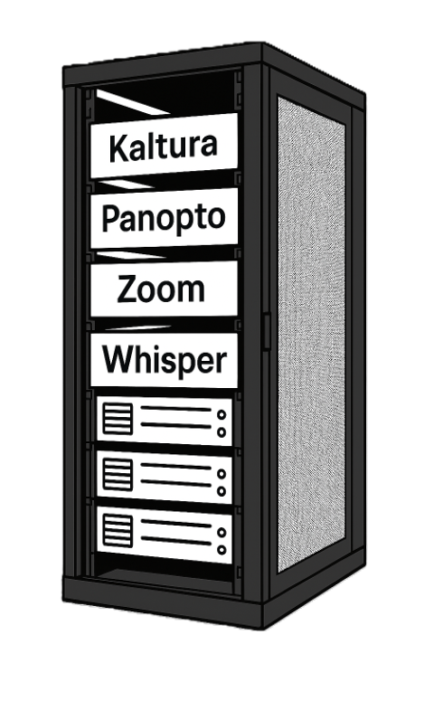

Funet Media services at CSC

Slide 6


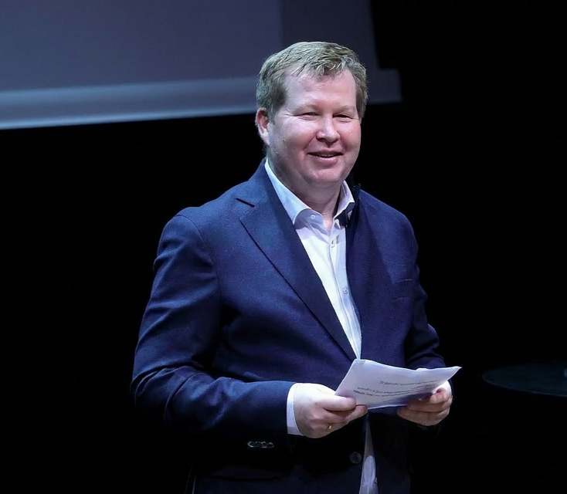
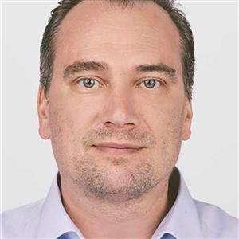
We are:
Leif Kristiansen
Harald Höckerstedt
Service Manager for the Panopto VMS Services in Sikt since 2021
Worked in Sikt, (and former UNINETT) since 2012
Responsible for Panopto services
Service Manager for Funet video services at CSC
Media Engineer (Bachelor of Engineering)
Worked with:
broadcasting
digital preservation
live streaming
video services for education

Slide 7

Sikt - Norwegian Agency for Shared Services in Education and Research
Government agency under the Norwegian Ministry of Education and Research
Established 1 January 2022 — merger of NSD, Uninett and Unit
Provider of shared digital services for the knowledge sector
Approx. 400 employees with offices in Trondheim, Bergen and Oslo
Promotes digitalisation, data sharing and open research

Slide 8
Sikt Video Services

Slide 9

Video Services — A view back in time
In apx 2017 Sikt, then UNINETT, had a program called eCampus.
As a part of this program UNINETT aquired Mediasite after a procurement process.
In 2021 Sikt had customers on Kaltura, Adobe Connect, Techsmith Relay, Zoom, Mediasite and Panopto (aquaired 2021)
Mediasite and Zoom was the largest systems until the end of 2021 when Mediasite was replaced by Panopto
Significant fragmentation of video platforms across the sector

Slide 10

Video Services — Today
Panopto: Cloud-based VMS — 34 institutions, own procurement since 2021
Zoom: On-premise and hybrid — agreement via Nordunet. +40 institutons
Two complementary platforms for video conferencing and lecture capture

Slide 11
Videoservices provided by the Nordic NRENs
NREN | Zoom | Kaltura | Panopto | Speech-to-Text
Funet | ✅ | ✅ | ✅ | ✅ (via Kaltura)
SIKT | ✅ | — | ✅ * | ✅ (Whisper, UiO)
Sunet | ✅ | ✅ | — | ✅ (Sunet Scribe)
DeiC | ✅ | ✅ | ✅ | ✅
RHnet** | ✅ | — | ✅ | —
*Sikt has their own contract with Panopto
**Not actively participating

Slide 12

Procurement Journey: Mediasite → Panopto Cloud
Mediasite on-premise became extremely costly as video usage exploded in 2020
In short: Need for additional hardware made the situation unsustainable
Major challenges with stable operations — change was necessary
Common services has a long tradition in Sikt. It is a common understanding that smaller institutions benefits of joining forces

Slide 13

On-Premise vs. Cloud — The Norwegian View
Cloud ✅ Stability, scalability, part of a larger operating environment, cost-effective
Cloud ⚠️ GDPR challenges, data centres located outside national borders
On-premise ✅ Control over own data, perceived as secure
On-premise ⚠️ Expensive, vulnerable with small operating environments

Slide 14

Why Did Sikt Choose a Cloud Solution?
High participation — joint procurement gives leverage and better terms
Ease of use — lower barrier for users and administrators
Strong LMS integrations — seamless connection to learning platforms
Hardware independence — no local hardware to operate or replace
Support for varied recording scenarios — classroom, screen capture, mobile and more
Cost efficient
SIKT’s cloud first strategy

Slide 15

Anti Lock-In Strategy: Cradle to Grave
Strategy must cover the full service lifecycle — from procurement to exit
Long contract period — short exit time: plan your way out from day one
Embed in the tender: requirements for open APIs, standard content formats, and contractual exit support with data extraction assistance
Contractual exit support: define upfront what the vendor must deliver when you leave

Slide 16

Governance and Cultural Lock-In
In governance: avoid building yourself in — don’t let operations depend on a single vendor’s proprietary features
Plug-ins in governance should use universal integrations — not vendor-specific connectors
Microsoft usage has challenged this — deep integration makes switching costly
Cultural lock-in is challenging regardless of platform — users adapt to tools, not just data

Slide 17
Working together
The Nordic VMS community is a fragile structure
Personal relationships are important
It is not mandatory to take part in the community
Nrens can do their own procurement process (as Sikt did with Panopto)
Challenging to establish a common understanding of the benefits of a national unit within the user base (universities)
Even more challenging is establishing a common understanding of a Nordic corporation
Challenging to establish a scalable one-size-fits-all system when the universities vary from 100 to 50 000 students
Freedom of choice forces us to deliver good services. Dissatisfied customers will find something else to do — we have seen examples of that (not within the video service).

Slide 18
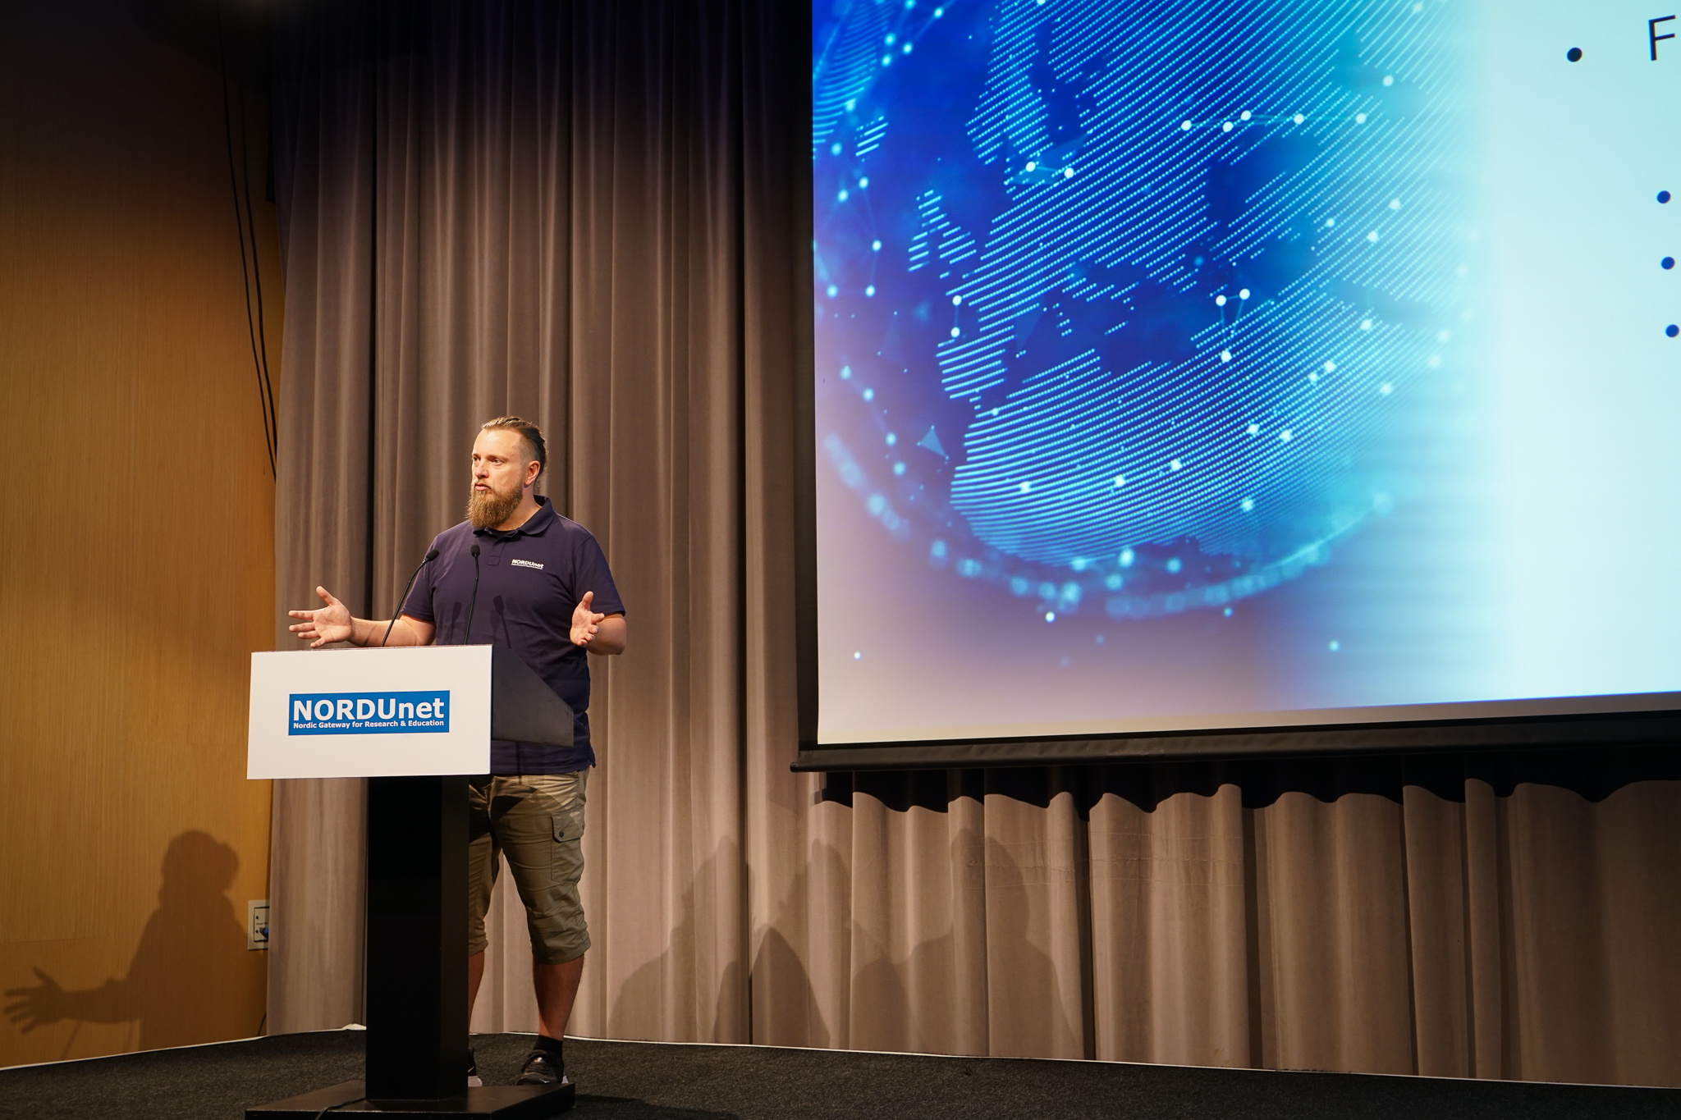

Co-owned by the Nordic NRENs
Runs our services
Share costs
Increase quality
Cooperation
More we

Slide 19
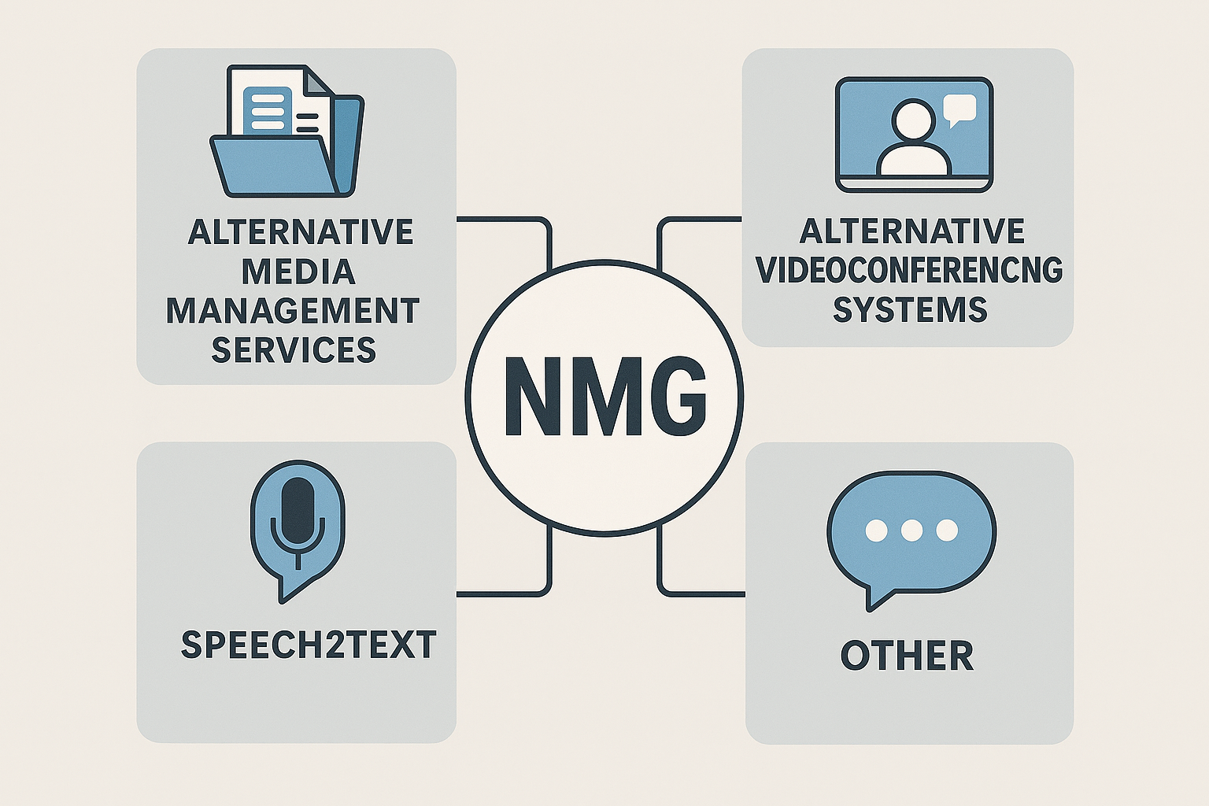
Nordic Media Group NMG
NORDUnet media services
Bi-weekly meetings
10-15 attendees, including NORDUnet technical staff
Arranged and hosted by Thorkild Jensen, DeiC
Focusing on daily challenges
Separate sub-groups when needed

Slide 20

Going on
Nordic Media Group – Strategic Forum
NMG sister group
Long-term planning
Needs, priorities, and strategy across NRENs
Future direction
Established late 2025
Consists of media specialist
One mandate per NREN
Quarterly meetings
Reports to stakeholders

Slide 21

NMG–S outcomes
Common theme: Digital sovereignty & continuity for e-meetings
Identified key strategic questions
  What happens if current solutions (Zoom) fail?
  What level of readiness and backup is needed?
  How much should be Nordic vs national?
Discussed fallback platforms based on testing results
Different views

Slide 22
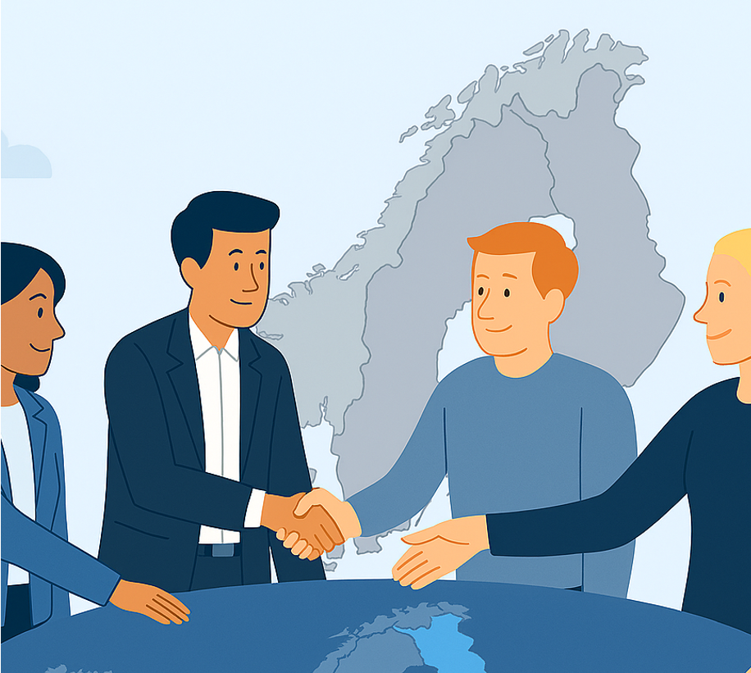
NMG-S – Goals for 2026
Create a Nordic Continuity & Resilience Roadmap for e-meeting services
Roadmap document
Recommendations to NORDUnet Customer Advisory Group
Presentation at the NORDUnet Conference (Autumn 2026)

Slide 23
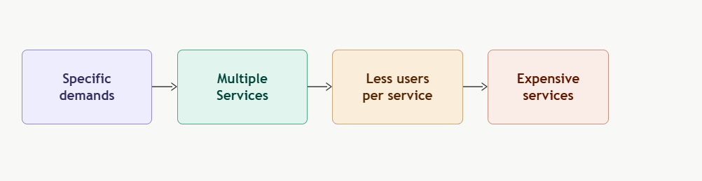
Challenges
Different views on services
Specific demands = multiple services = less users per service = expensive services
Politics
Voluntary to use NREN video services
One sixe does not fits all

Slide 24

Success Stories
What went right.
Notes:
AI-genererat innehåll kan vara felaktigt.
---

Slide 25

CSC procurement 2025
Media Management Systems
Worked together on criteria within an NMG sub-group
Led to CSC / Panopto Cloud framework
Collaboration between the Nordic NRENs and NORDUnet
Sikt shared valuable experience
DeiC started a similar procurement
Cooperation at its best!

Slide 26
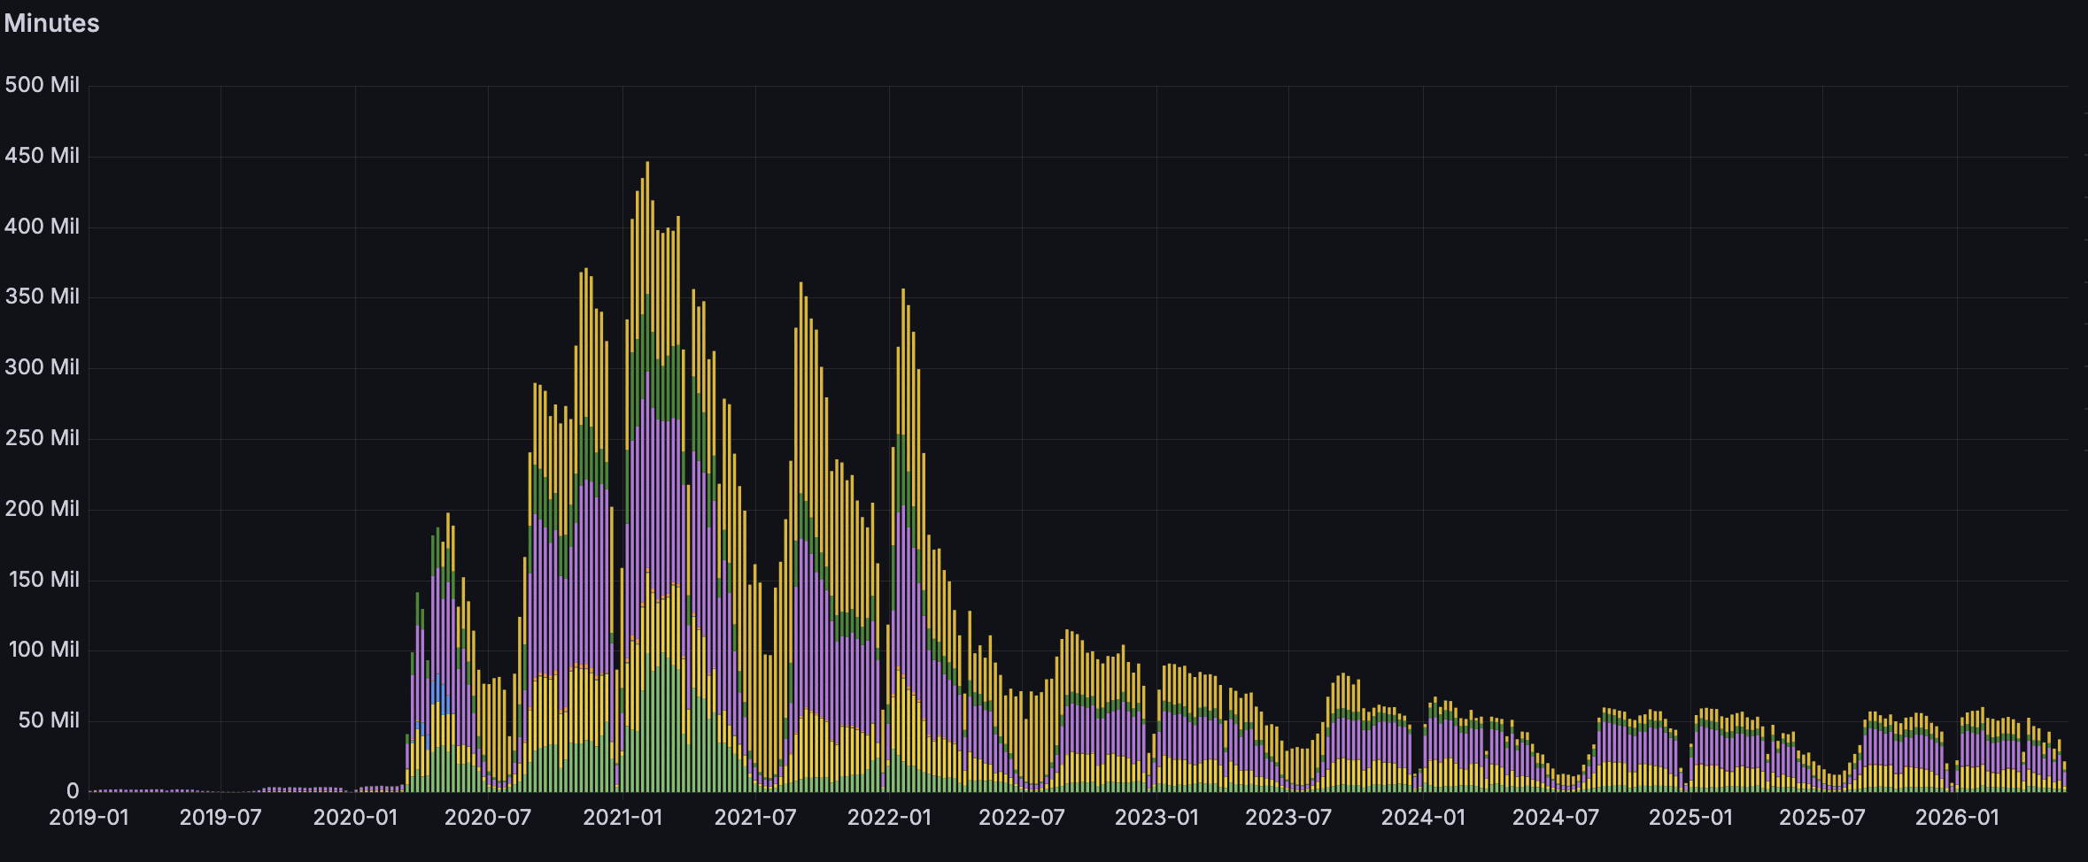
Zoom
On-premise
Over 1 million Nordic users
Cost-efficient
Made AWS cluster for possible during covid19
Not possible separately

Slide 27
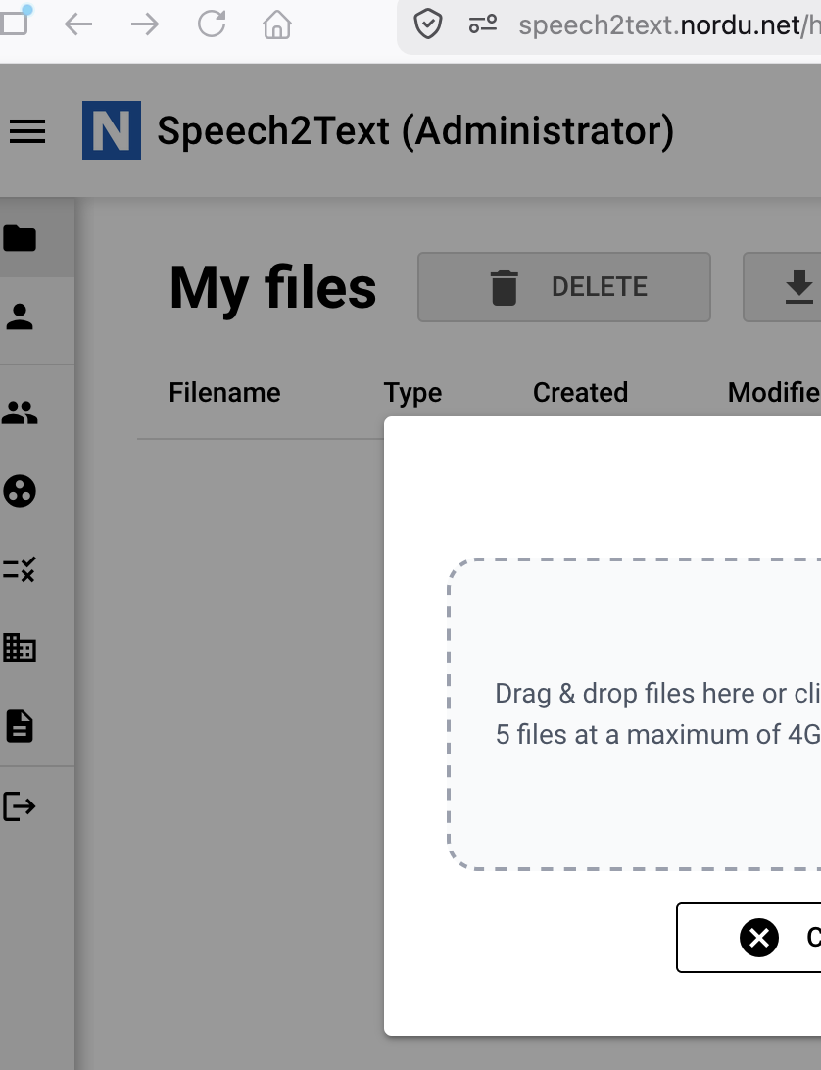
Speech2text
Sunet Scribe
Others joined the development
NORDUnet copied
Now offered for the Nordics

Slide 28
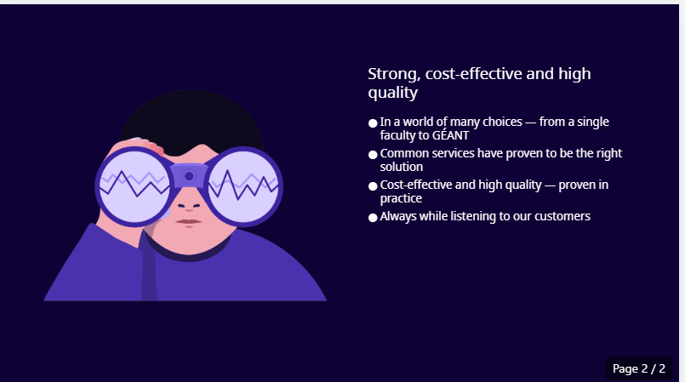
Why less me, more we
Strong, cost-effective and high quality
In a world of many choices — from a single faculty to GÉANT
Common services have proven to be the right solution
Cost-effective and high quality — proven in practice
Always while listening to our customers

Slide 29

Questions?
Notes:
AI-genererat innehåll kan vara felaktigt.
---

Slide 30

Contact information
Leif Kristiansen
Leif.kristiansen@sikt.no
+4797506035
Harald Höckerstedt
harald.hockerstedt@csc.fi
+358405745604

