Slide 1
Democratizing AI-Enabled Research Infrastructure:
A Replicable Framework for Underserved Institutions
Mike Erickson // Internet2
Rich Knepper // Coalition for Academic
Scientific Computation (CASC)

Slide 2
Background
CASC - a robust, sustainable ecosystem supporting academic research computing and
data services, enabled by a vibrant, diverse community of professionals
Be a trusted advisor to government; advocate for investment in RCD; foster community;
host forums for strategy development
110 member institutions, partnerships with UK-HPC-SIG, US-RSE, Digital Research Alliance
Regular meetings with gov’t agencies, leadership development, engagement with policymakers
Internet2 - Supporting the mission of the research & education community by providing an
advanced technology platform to enable discovery, innovation, and education
Deliver cutting-edge network infrastructure, identity and security services, and transformative cloud technologies
Convene and foster collaboration among its members while forging partnerships across sectors and around the globe
530 member institutions, with an active community of 1000s of institutions and organizations

Slide 3
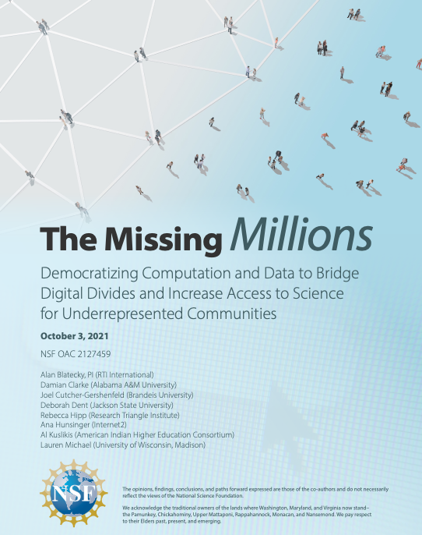
Premise: Our work is better when it is as inclusive as possible
“Inclusive”
  Representative of all voices in the community
  Practically: beyond the well-resourced, well-developed, mature “R1” programs
Include and amplify the voices that are often overlooked or at the periphery
NSF Sponsored Report: “The Missing Millions”; Blatecky, et al
Change is happening - we need a bigger solution set

Slide 4
Taking Action
CASC and Internet2 are both operating under this premise
  Expanding membership to new communities
  Building affiliate networks (including I2-CASC)
  Partnering with funding agencies
  Building leadership capacity
  Advancing human and technical capabilities of under-resourced communities
Have always been driven by “We” - now focused on “More We”

Slide 5



One Effort: MS-CC / Internet2
The Minority Serving Cyberinfrastructure Consortium (MS-CC)
“We will engage as full contributors to the Global R&E Community”
Goal: Lower the barriers of access by providing institutions with resources necessary to
  advance campus CI capabilities and become more engaged R&E community participants.
Methods:
  Cyberinfrastructure capability development
  Workforce Development
  Fostering Sustainable Community
Evaluation of the effectiveness of different approaches
  Direct institutional investment
  Research / project support

Slide 6
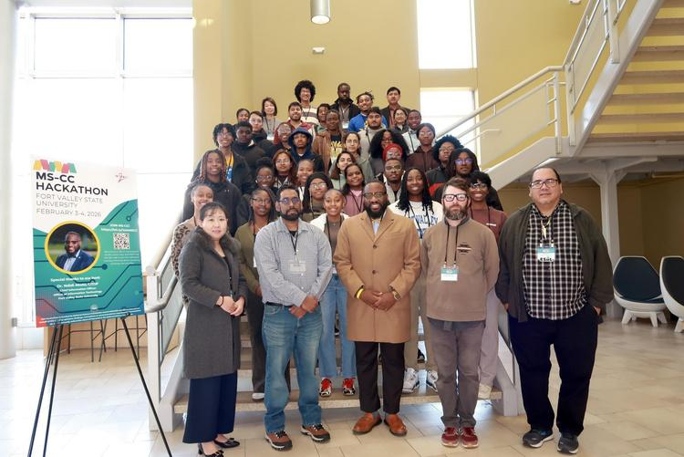















Impact Through Engagement
Internship Program
Hackathons
Workshops
AI & Technical
Webinars
Communities of Practice
Resource Center
Multi-Campus CI Collaboration
Research Catalyst Program
Proof-of-Concept
Grant

Slide 7




CASC’s Work: The Ecosystem
Position Committee
  Developing and sharing positions, RFIs, joining community statements
Partnership with US National Science Foundation - Community Workshop - a first!
Partnering with other organizations
  US - CARCC, CRA, CNSF
  Internationally - UK HPC-SIG, Digital Research Alliance
Creating more space in our model
  More membership options
  Affiliate model for orgs and firms

Slide 8
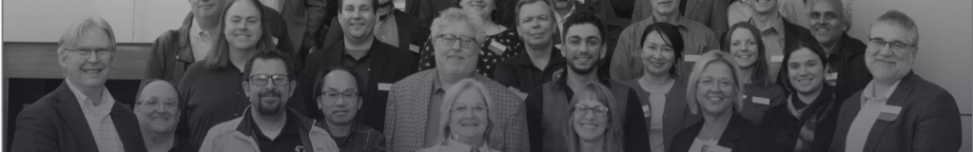
CASC’s Work: The Professionals
Cyberinfrastructure Leadership Academy - building leaders (October 19, 2026)
Open Member Meeting Series
  informing, discussing, assessing
Mentorship Program strengthening our human network
  connecting experienced leaders with a new generation

Slide 9

Adapting to the circumstances
Over the past year…
We planned for
Broadening the community
Building coalitions
Strengthening leadership
We pivoted towards
Mutual Aid: information-sharing, joint statements
Mentoring
New messaging emphasis

Slide 10

Our Common Outlook / Vision
Work with new communities with awareness of their context
Receive new ideas with open-mindedness - you may not get what you expect
Change is happening on all fronts: technology, research, funding, “rules”
Flexibility and creativity are needed to face these challenges
The upside of chaos?
Experimentation is more acceptable
If the idea is in the room - we get more ideas with a bigger room

Slide 11
Questions?
Thank You!
Mike: merickson@internet2.edu
Rich: cascchair@casc.org

