Slide 1


Award-Winning
Well-Being as a
Strategic Lever for
Service Excellence
The CEDIA Experience
Fernando Avilés Molina
Head of Human Talent – CEDIA · TNC26, Helsinki
Notes:
1

Slide 2

THE THESIS
Well-Being is Not a Perk — It is Strategy.
People
Culture
Engagement
Service
Excellence
Organizational
Results
→
→
→
→
"At CEDIA, we stopped treating well-being as an isolated HR initiative. We began to see it as a strategic driver capable of transforming culture and improving service excellence."
Notes:
2

Slide 3




CONTEXT
Who We Are
Ecuador's National Research and Education Network, connecting universities and research institutions across the country.
Highly Technical
Academic Ecosystem
Specialized R&E infrastructure
Universities & research centers
In knowledge-intensive organizations,
the real competitive advantage is people.
Innovation Focus
Talent-Intensive
"In organizations like ours, the true competitive advantage is not only technology — it is people."
Every single person counts
Cloud · Cyber · Digital Transform.
Notes:
3

Slide 4





THE CHALLENGE
Before the Transformation
"We had talented people. But talent alone is not enough if people do not feel connected, recognized, and valued."
Rapid Growth
High Expectations
Technical Pressure
Engagement Gap
Culture & Belonging
Fast-scaling organization
Mission-critical service demands
Constant operational complexity
Need to strengthen connection
Build a shared identity
Notes:
4

Slide 5




DIAGNOSIS
Understanding the Human Experience
"Before proposing solutions, I needed to understand what people were experiencing."
Workshops
Active Listening
1:1 Conversations
Group sessions to surface lived experience
Deep 1:1 presence — no agenda
100+ individual conversations conducted
Cultural Diagnosis
People Analytics
Feedback Processes
Mapping values, norms and behaviors
eNPS, engagement & climate data
Structured listening at every level
"People were looking for trust, belonging, recognition, and genuine human connection."
Notes:
5

Slide 6






INSIGHTS
Culture is Felt Before it is Explained
Closer Leadership
Psychological Safety
Recognition
Development
Better Communication
Belonging
Family Integration
"You can feel culture before it is explained."
Notes:
6

Slide 7
TRANSFORMATION
Building a Human-Centered Strategy
Leadership Proximity
Family-Centered Experiences
Regular 1:1 check-ins. Leaders present, not distant.
Inviting families in — because people bring their whole lives to work.
Continuous Feedback
Data-Driven HR Decisions
Structured listening at all levels — not once a year, but always.
People Analytics to move from gut-feel to informed leadership.
Well-Being Initiatives
Internal Communication
Sport Day, Hiking Club, Zumba. Real life, not just perks.
Transparency, clarity and voice at every level of the organization.
Recognition Practices
Purpose-Driven Culture
Visible, consistent recognition tied to values and impact.
Connecting every role to meaningful impact for Ecuador's research world.
Notes:
7

Slide 8







WELL-BEING MODEL
A Holistic Approach
"Well-being is not yoga classes or isolated activities. It is the emotional experience employees have inside the organization."
Emotional
Well-Being
Trust
Belonging
Growth
Recognition
Human
Connection
Purpose
Notes:
8

Slide 9


OUR PEOPLE
When Family Becomes Part of the Culture
One of our most powerful initiatives was the Excelencia Académica event. Every year, we invited the children of our team members to celebrate their academic achievements — on stage, in front of their parents and the entire CEDIA family.
Emotional Bond
When families feel included, employees feel fully seen.
One child looked at her father and said:
Pride & Recognition
"The place where you work sees me.
The place where you work is proud of our family."
Celebrating people's lives — not just their deliverables.
Belonging Amplified
Culture that extends beyond the office walls.
Notes:
8

Slide 10
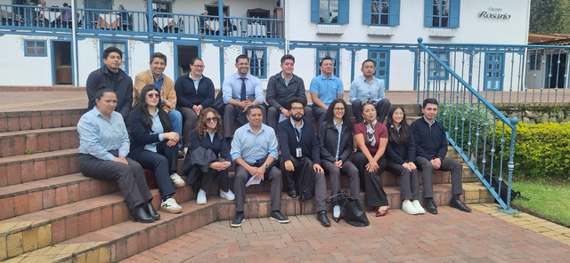
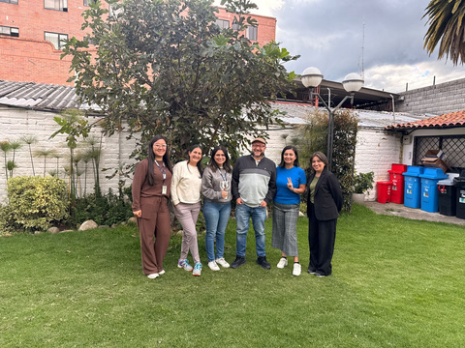
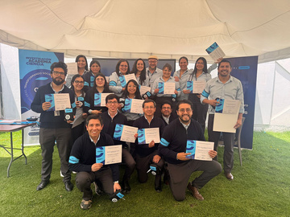
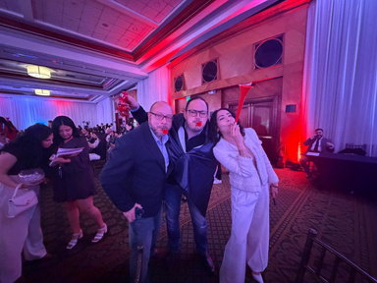
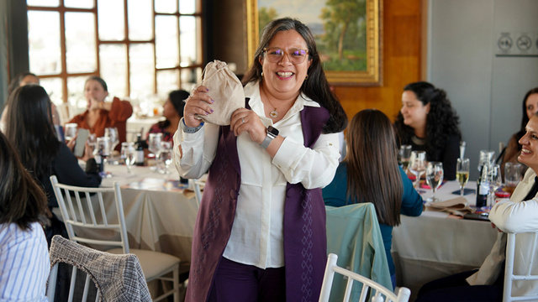

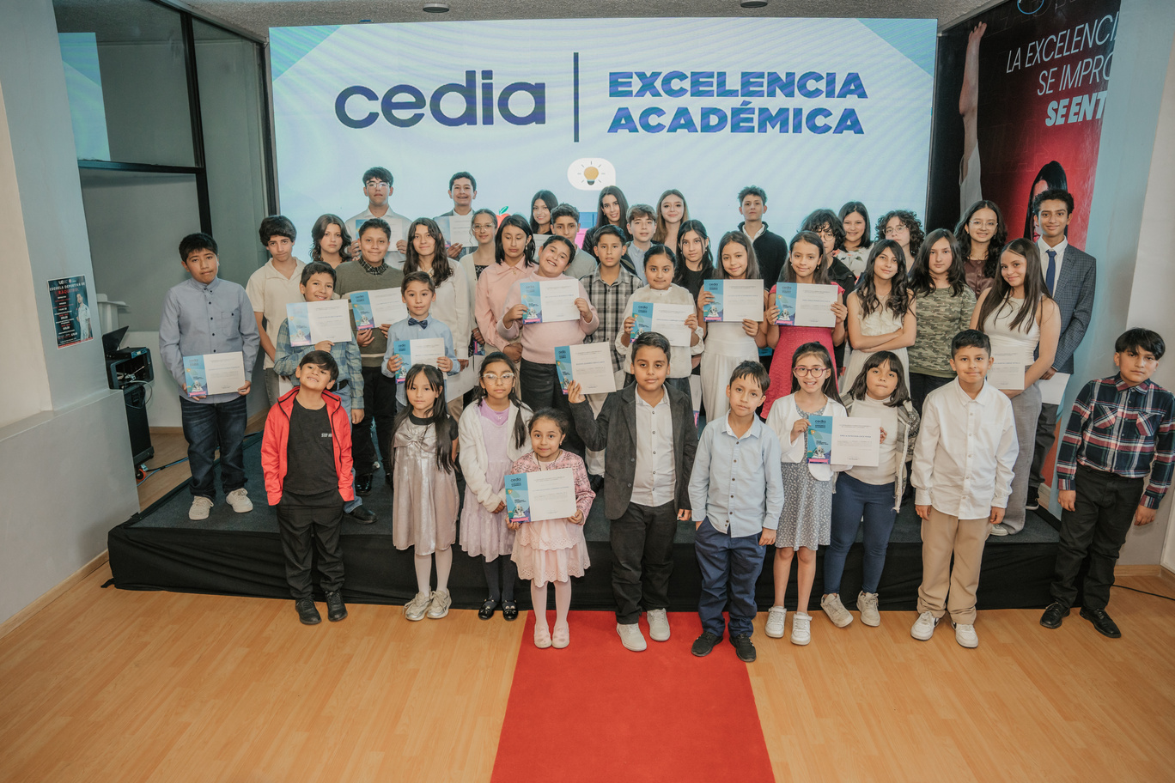
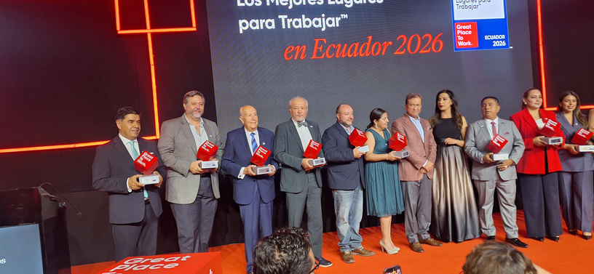
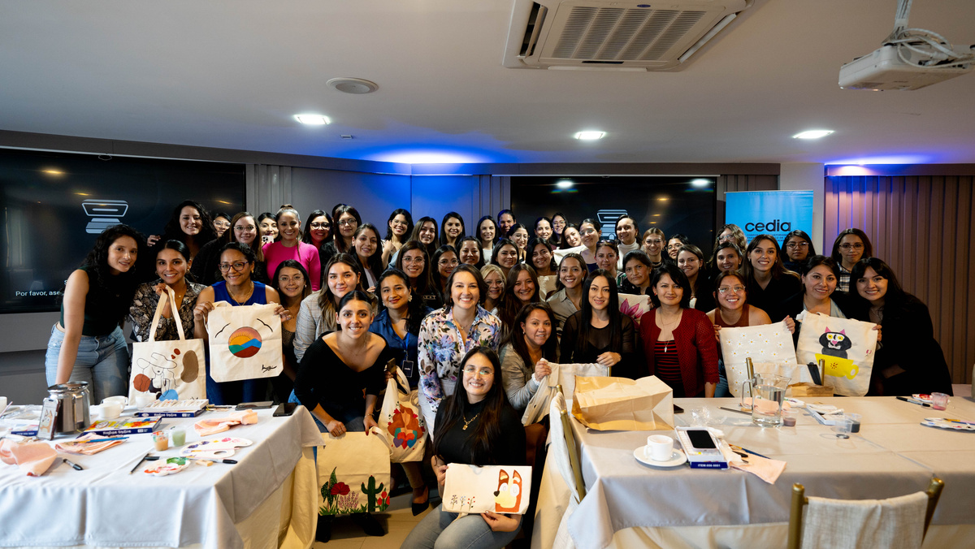
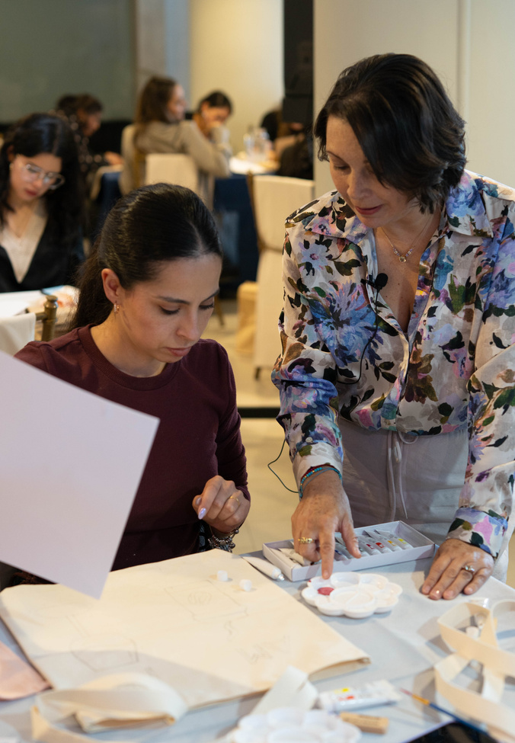
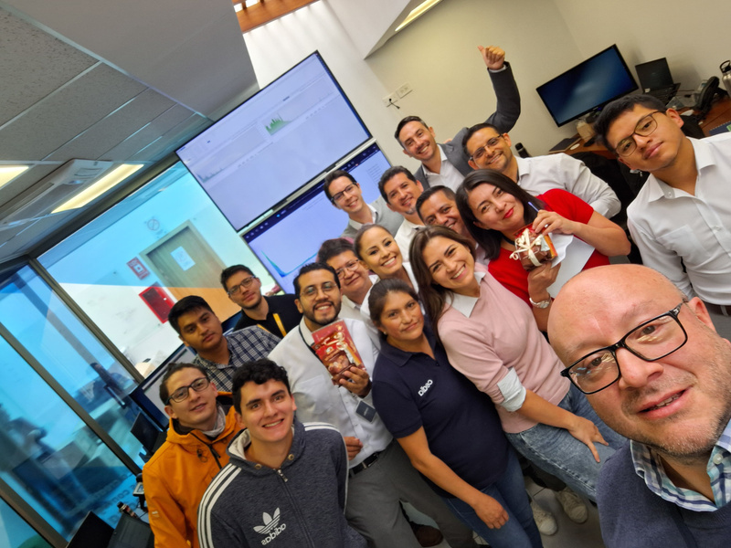
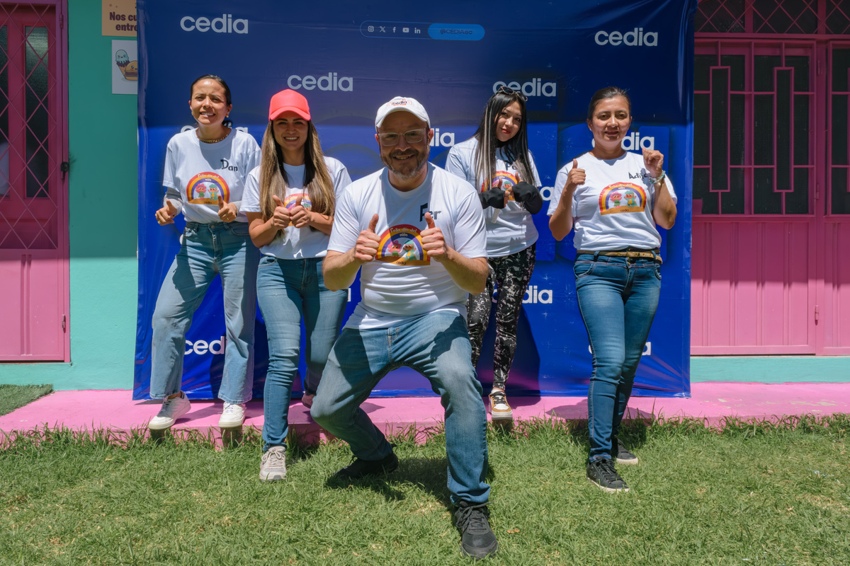
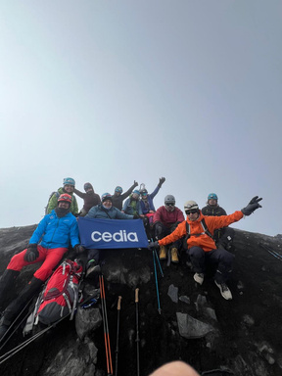
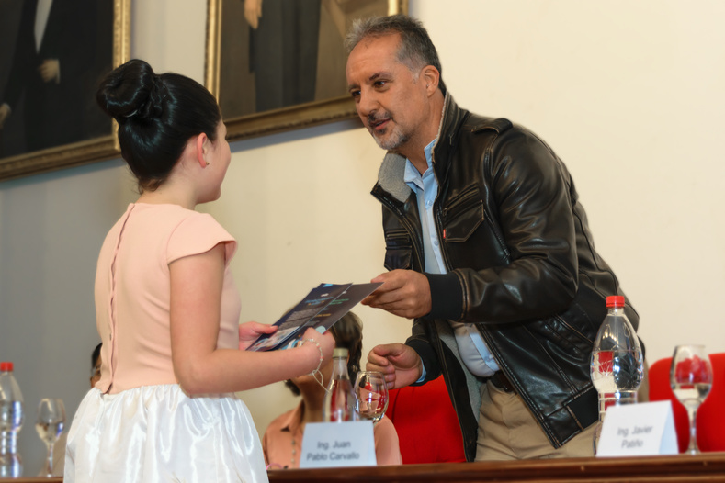
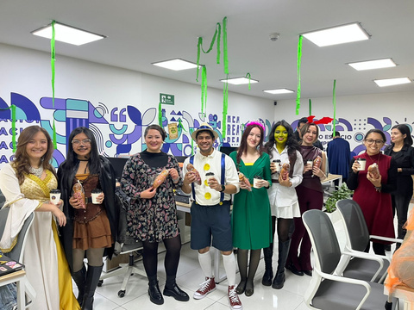
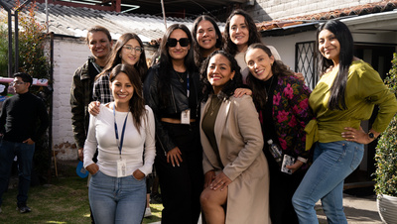
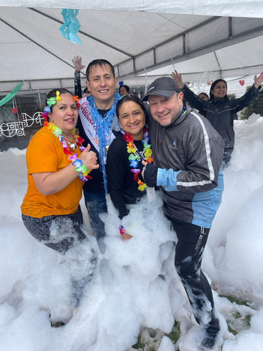
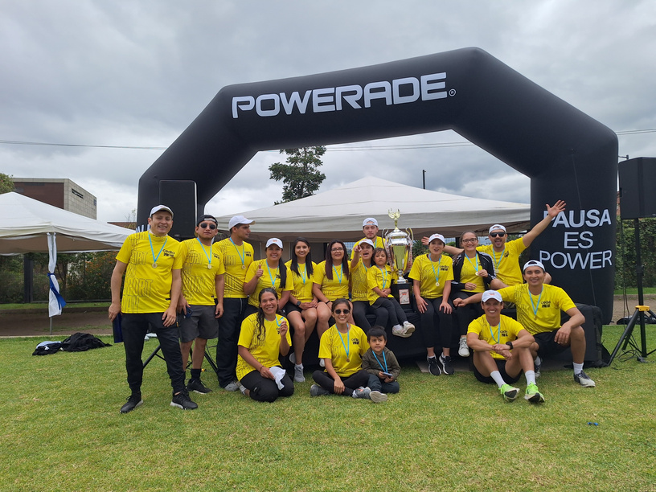
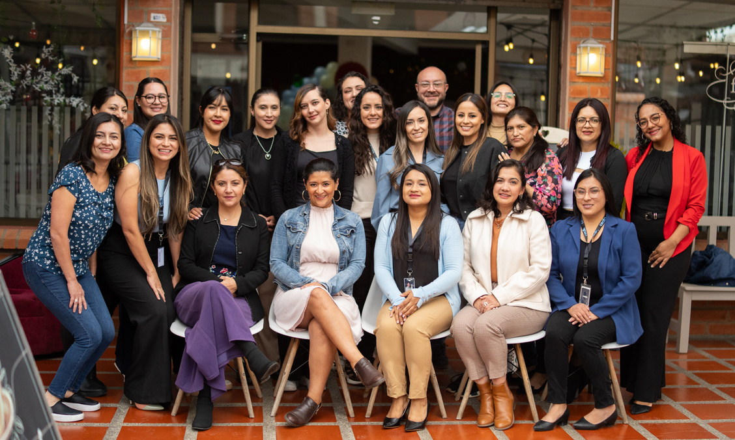
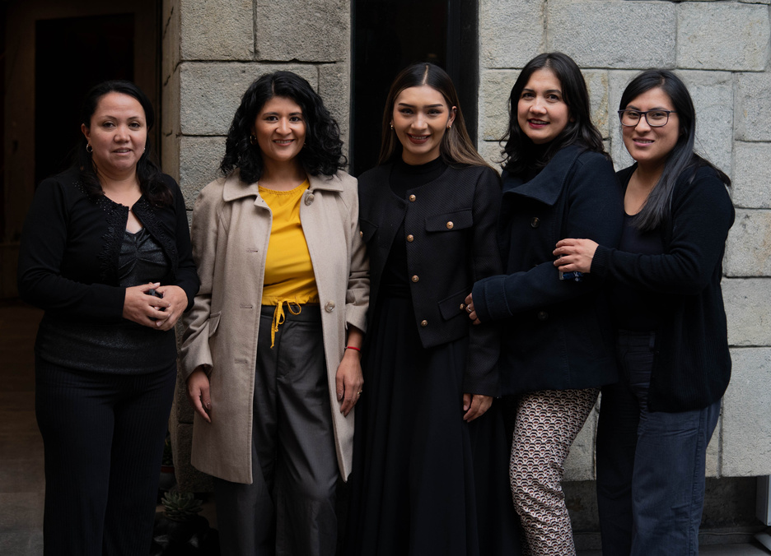
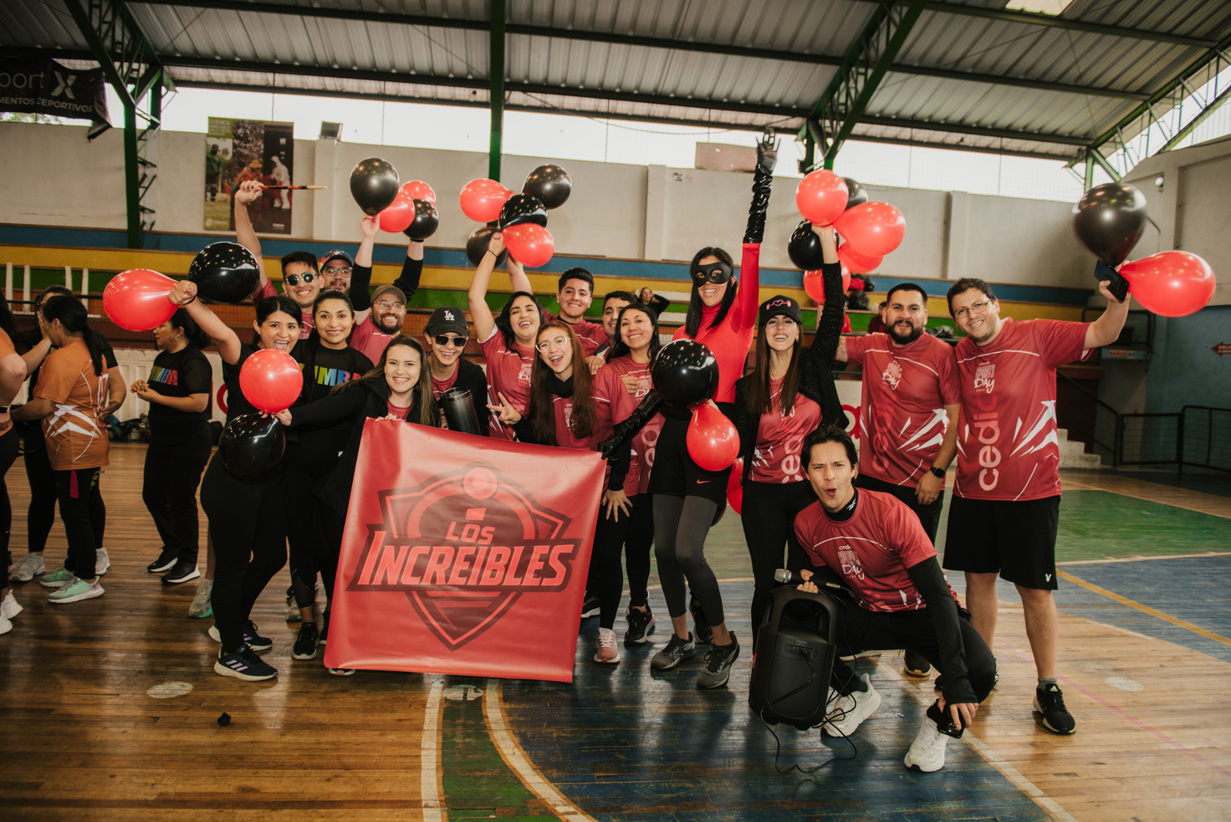
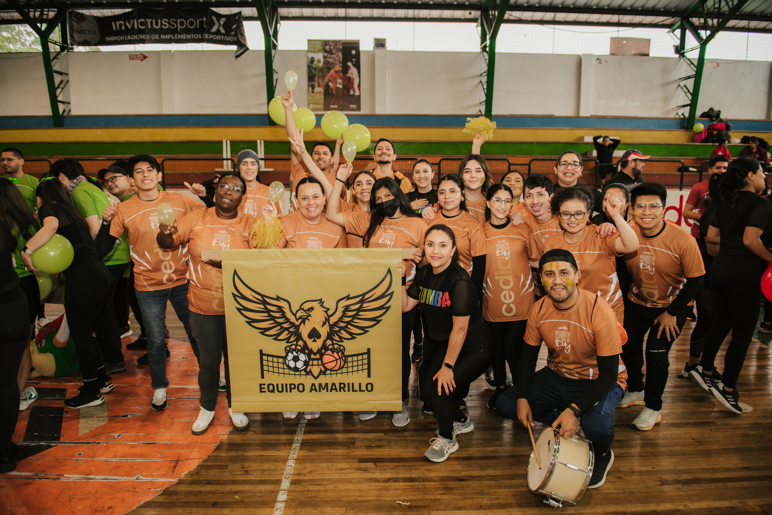
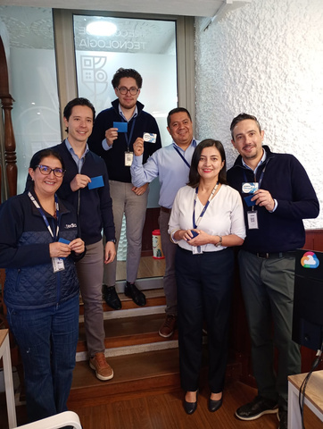
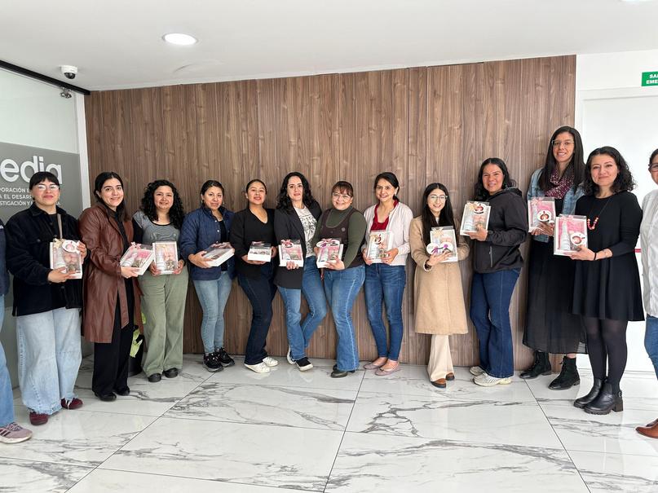
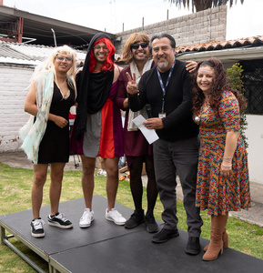
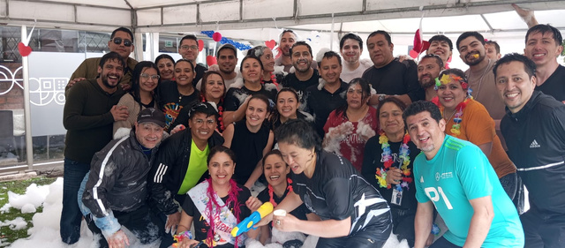
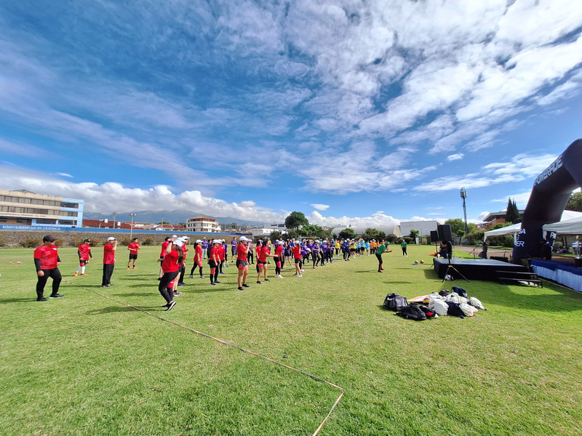
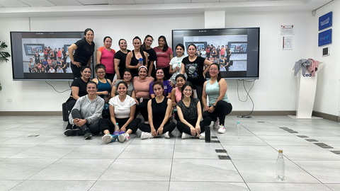
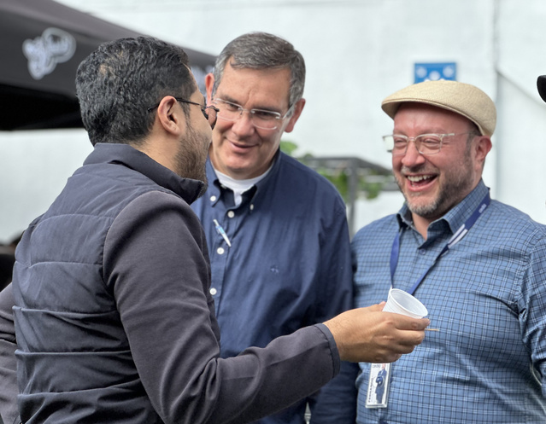
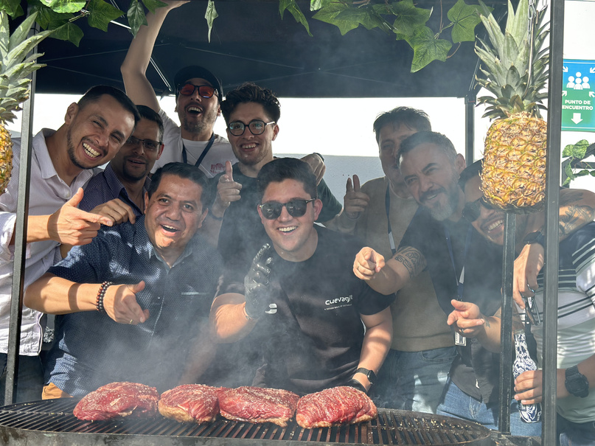
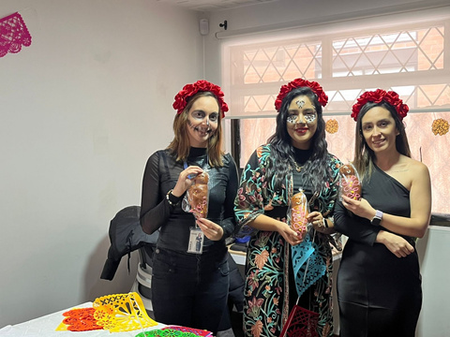
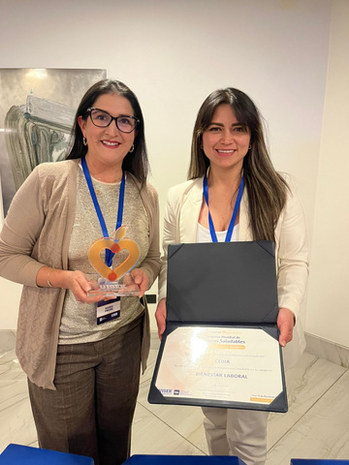
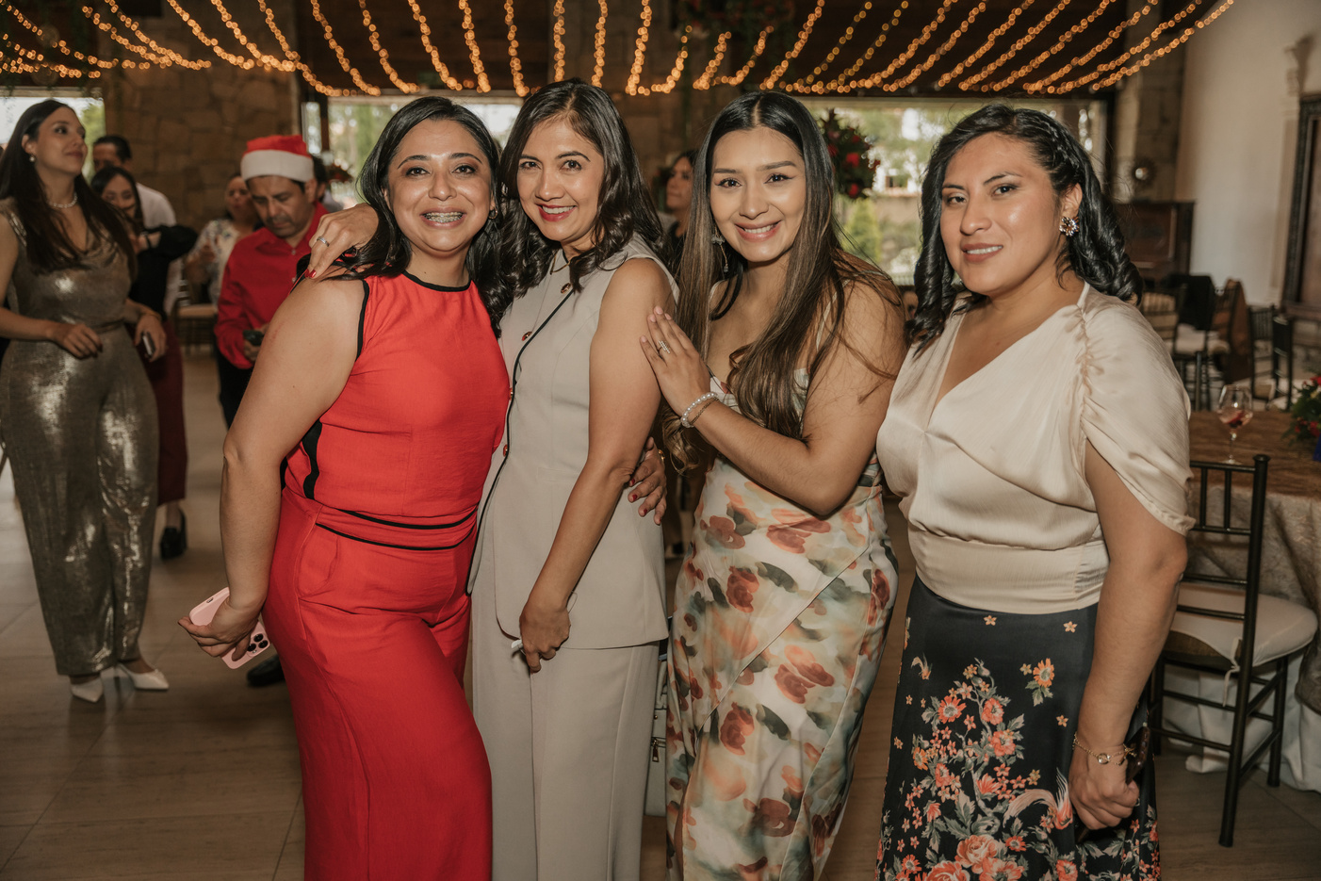

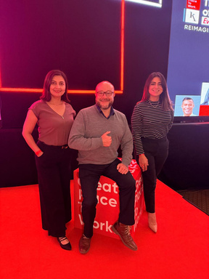
OUR PEOPLE
This is What Culture Looks Like
"We had talented people. But talent alone is not enough
if people do not feel connected, recognized, and valued."
Notes:
4

Slide 11
DATA & ANALYTICS
Measuring Culture
"Culture should be emotional —
but also measurable."
eNPS
Employee Net Promoter Score
Feedback Trends
Continuous sentiment analysis
We incorporated People Analytics to move from gut-feel decisions to data-informed leadership — without losing the human touch.
Engagement Indicators
Team & individual level
Climate Data
Organizational pulse
Leadership Insights
Manager effectiveness data
Notes:
9

Slide 12
RESULTS
What Happened?
2×
#12
🏆
GPTW Certifications
National Ranking
Well-Being Award
Consecutive years
Best companies in Ecuador
Previsionar Congress
↑ Engagement
↑ Retention
↑ Pride
↑ Culture Strength
"Well-being was not the outcome. It was the engine."
Notes:
10

Slide 13
VOICE OF CEDIA
We Asked: "Define CEDIA in One Word."
In our open eNPS survey, one question had no options — just an open field:
#2
Family
"In one word, what is CEDIA to you?"
#1 Innovation
The word most people chose — reflecting who we are.
That is not a program.
That is culture.
But the second word stopped us.
When your people call their workplace a family — you know the work was real.
Notes:
10

Slide 14
FOR YOUR NREN
Lessons for Technical Organizations
01
Well-Being Is Strategy
Not a benefit. Not an HR program. A strategic decision that directly affects your capacity to deliver excellent service.
02
Culture Must Be Intentionally Designed
It will not emerge on its own. If you don't shape your culture, something else will — and you may not like what grows.
03
Service Excellence Starts Inside
The quality of what you deliver externally is a direct reflection of how people feel internally. Always.
"In technical ecosystems, organizational culture is also infrastructure."
Notes:
11

Slide 15
Networks connect institutions.
Technology connects systems.
But care connects people.
Connected people build extraordinary organizations.
That is the real infrastructure of excellence.
Notes:
11

Slide 16

Thank you
Any questions?
Fernando Avilés Molina
Head of Human Talent – CEDIA · Ecuador
linkedin.com/in/fernando-aviles-molina
Notes:
13

