Slide 1
Resilient by Design: Applying Digital Sisu through DevOps Automation
Josh Elias Lubuulwa
Research and Education Network for Uganda (RENU)
elubuulwa@renu.ac.ug
tnc26 Helsinki
Notes:
Today I would like to share our journey of building resilient digital infrastructure through DevOps automation and how this aligns with the Finnish concept of "Sisu"—the determination to continue despite challenges.
This presentation is not just about technology. It is about how people, processes, and automation come together to keep critical digital services available when failures inevitably occur.
At RENU, resilience is not theoretical. It is something we practice every day while supporting hundreds of institutions and thousands of researchers, students, and educators.

Slide 2
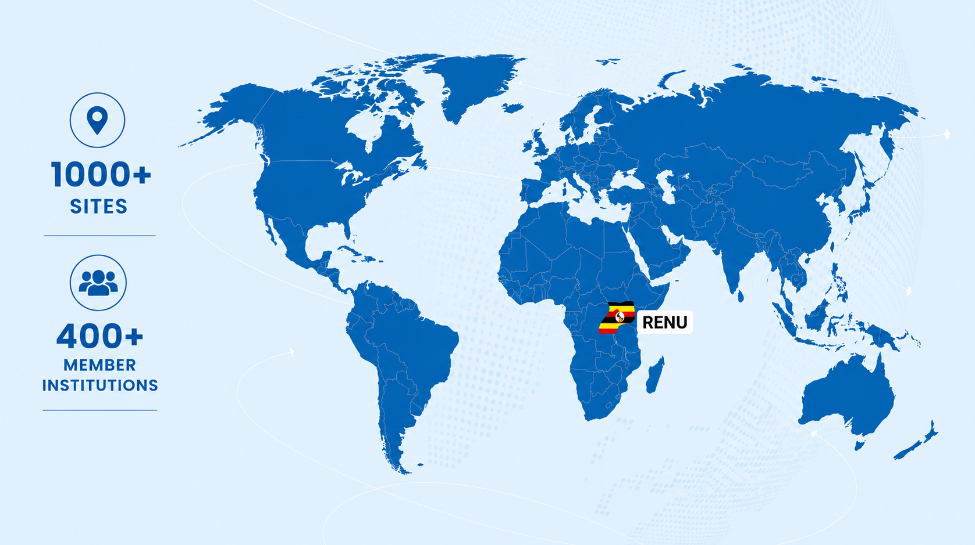
Who is RENU?
Notes:
RENU is Uganda's National Research and Education Network located in East Africa.
Today we connect more than one thousand sites and support over four hundred member institutions across the country.
Beyond connectivity, we provide a growing portfolio of digital services including identity management, cloud services, collaboration platforms, eduroam, security services, and institutional applications.
Because so many institutions depend on us, reliability is not optional. Every outage has a direct impact on learning, research, and administration.
This reality has shaped how we think about resilience.

Slide 3
Failure Is Not an Exception
"What happens when a critical service fails at 2 AM?"
These aren't hypotheticals. At RENU, each of these has happened.
Failed Deployment
Service Outage
Network Failure
A Friday release silently breaks the SIMS. Students can't submit assignments.
A routing change affects a Research pipeline. Every minute costs.
The identity service goes down. No one can log in.
Failures are inevitable. Resilience is how we respond.
Notes:
Let me start with a simple question:
What happens when a critical service fails at 2 a.m.?
For many organizations, failure is viewed as an exception.
In reality, failures are guaranteed - Services go down, Deployments fail, Networks experience outages, Human beings make mistakes.
At RENU, we have experienced all of these situations - Identity services have gone offline, Routing changes have interrupted connectivity, Software releases have introduced unexpected problems.
The key lesson is that resilience is not about preventing every failure.
Resilience is about how quickly and effectively we respond when failures occur.

Slide 4
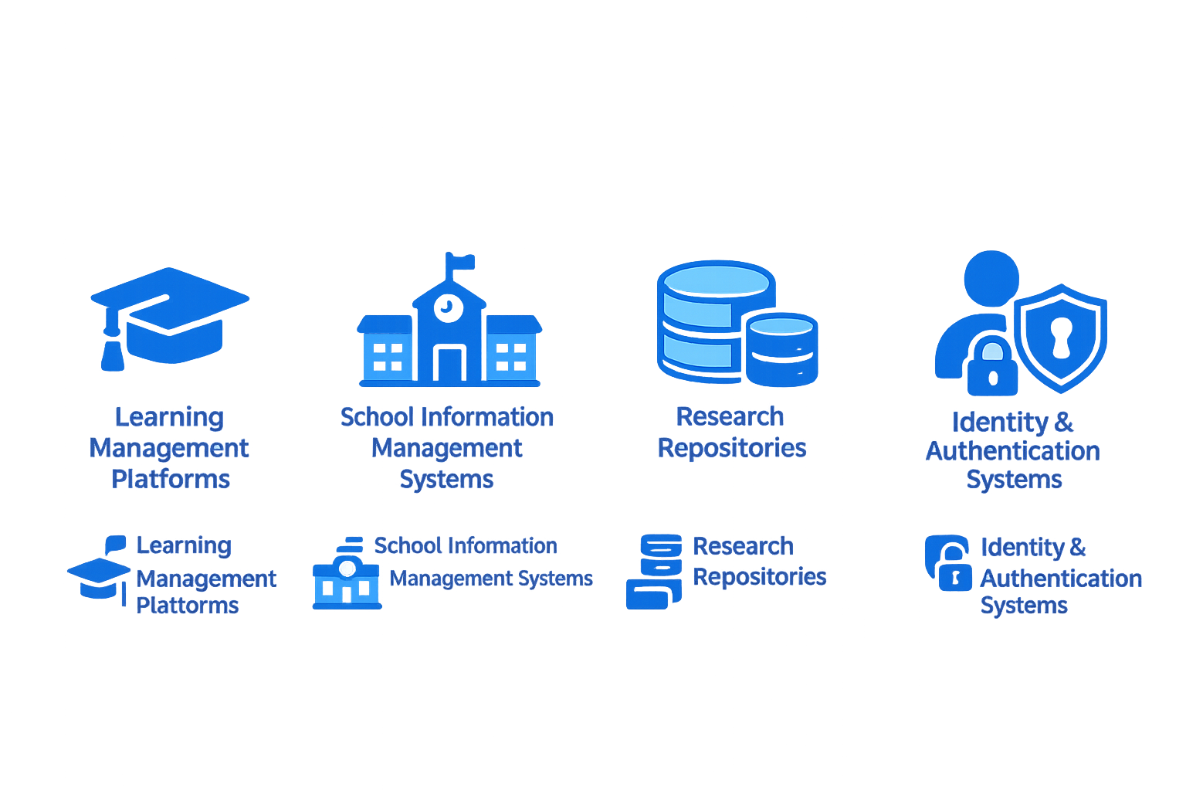
What RENU Is Responsible For
Reliability isn't theory - it's operational necessity for 400+ institutions.
👥 Lean Teams
⏱ Higher Expectations
📈 Increasing Complexity
"We cannot scale reliability with manual efforts alone."
Notes:
As an NREN, we operate in an environment where expectations continue to increase.
We have relatively lean teams managing infrastructure that supports large communities of students, researchers, and educators, At the same time, services are becoming increasingly interconnected and complex.
Users expect the same reliability they receive from public utilities.
When services become essential, downtime becomes unacceptable.
This created an important realization for us:
We cannot scale reliability through manual effort alone.
Something had to change.

Slide 5
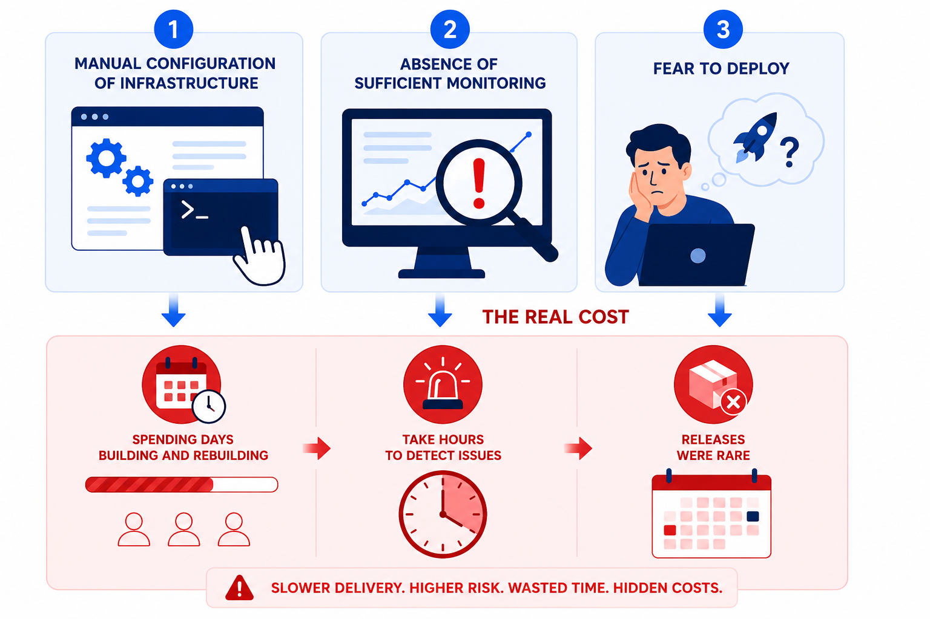
The Cost of Manual Operations
Notes:
Like many organizations, we once relied heavily on manual processes.
Manual configuration - No version control. Knowledge walks out the door with each engineer → One failed server meant days of manual work, rebuilding from memory
No monitoring - We found out about outages when users called → Users were our monitoring system. always reactive, never proactive
Deployments feared - Deployments were stressful events because every release introduced uncertainty. A bad deploy meant hours of manual rollback with no safety net. → Fear of change meant slow iteration
As a result, teams became cautious about change, Innovation slowed because reliability depended too heavily on individuals.
The challenge was not simply technical debt, The challenge was operational risk.
We needed a more sustainable approach.

Slide 6
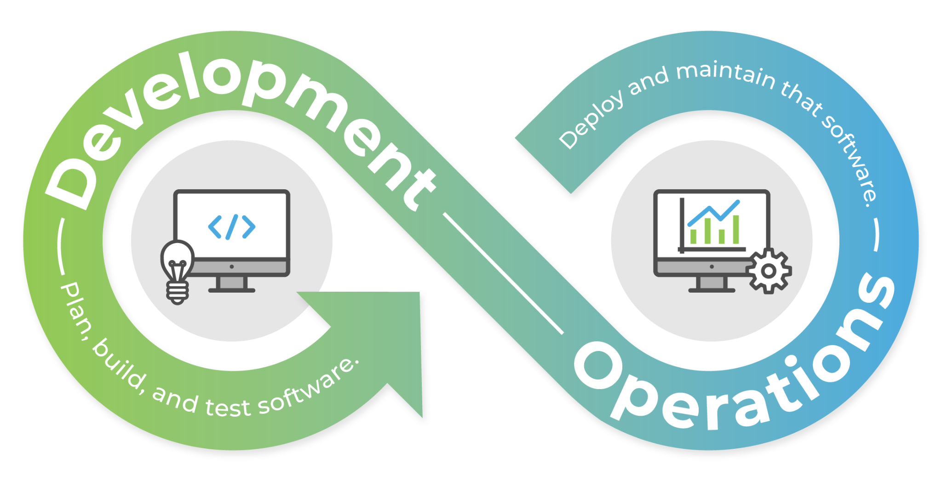
Here is how RENU responded
Notes:
So how did RENU respond?
The answer was not a single tool.
It was a shift toward DevOps principles and automation.
We began treating resilience as something that could be designed into our systems rather than achieved through heroics.
The next few slides will highlight the major changes that enabled this transformation.

Slide 7
What DevOps Changed
Manual Operations
Automation
Resilience
Snowflake servers
Hero culture
Reactive firefighting
Tribal knowledge
Fear of change
IaC & CI/CD
Observability
Repeatable processes
Self-healing systems
Systems recover fast
Teams learn from failure
Change is safe & fast
Reliability is shared
Confidence to innovate
Notes:
DevOps changed how we think about operations.
Previously, we had unique servers, reactive firefighting, tribal knowledge, and fear of change.
Through automation, Infrastructure as Code, observability, CI/CD, and self-healing systems, we created repeatable and predictable processes.
The outcome was resilience.
Systems recovered faster, Teams learned from failures, Changes became safer, Reliability became a shared responsibility.
Most importantly, people gained confidence to innovate.
DevOps is not just about tools.
It is a cultural shift in how teams build and operate systems.

Slide 8
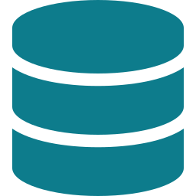
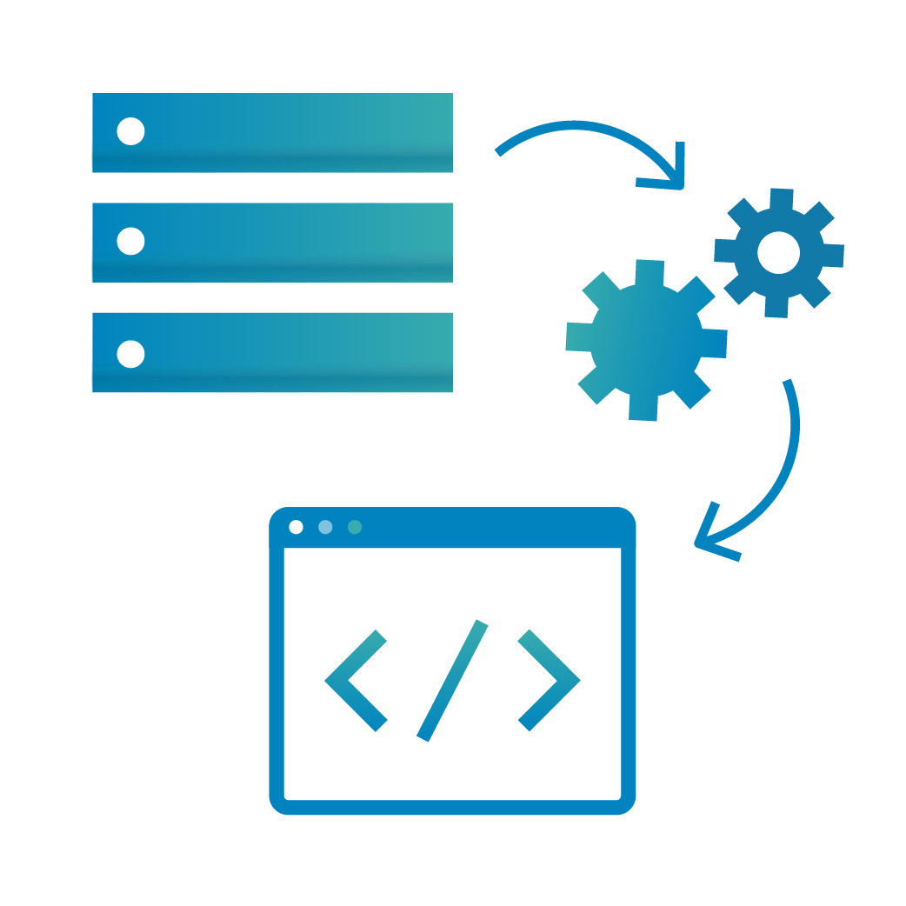



Infrastructure as Code
Infrastructure can now be recreated from code
Version Controlled → Changes tracked → Instant Rollback
Consistent Deployments → Dev, Staging & Production
Automated Provisioning → Capacity Provisioned instantly
Disaster Recovery Ready → Environment Rebuilt from code easily
Notes:
One of the most impactful changes was Infrastructure as Code.
Previously, rebuilding infrastructure often required manually repeating steps from memory.
Today, infrastructure definitions exist as code.
Changes are version controlled, Every modification is reviewed and tracked, Environments can be provisioned automatically and consistently, Development, staging, and production behave the same way.
When failures occur, recovery becomes faster because environments can be recreated from code.
Instead of spending days rebuilding infrastructure, we can restore services in minutes.
Infrastructure became reproducible, predictable, and resilient.

Slide 9
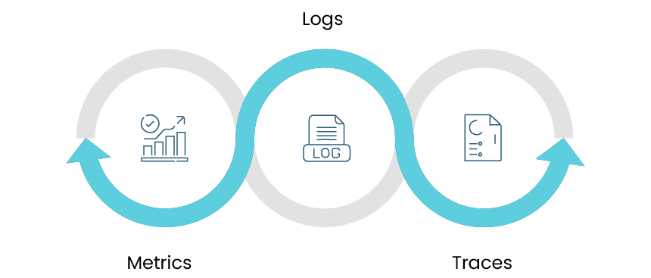
Observability
We now get alerts us before users notice.
METRICS: Latency, error rates, CPU. Are things normal right now?
LOGS: What happened, when, in which service? The audit trail.
TRACES: Where did that slow request actually spend its time?
Notes:
Another major improvement came through observability.
Traditionally, users were our monitoring system.
We learned about outages only after receiving complaints.
Today we rely on metrics, logs, traces, and alerts.
Metrics tell us whether systems are healthy, Logs explain what happened, Traces show how requests move through distributed services, Alerts notify engineers before users notice problems.
This shift from reactive operations to proactive operations fundamentally changed how we manage reliability.
Observability gives us visibility, and visibility enables faster decision-making during incidents.

Slide 10
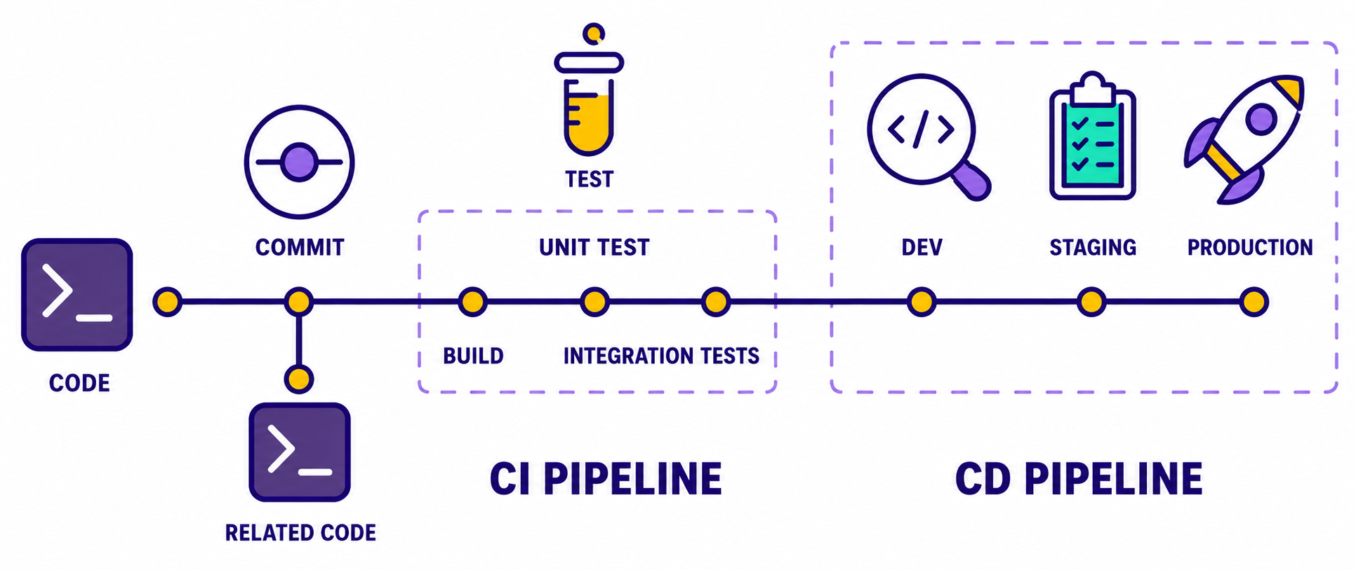
Automated Testing & CI/CD
Catch failures before they are moved into production. Pipelines are safety nets.
Notes:
Automation extends beyond infrastructure.
It also applies to software delivery.
Previously, defects sometimes reached production because testing relied heavily on manual processes.
Today, automated pipelines validate code before deployment.
Every commit passes through testing, security checks, and deployment workflows.
If something fails, deployment stops automatically, This reduces human error and increases confidence.
Teams can release changes more frequently because the pipeline acts as a safety net.
Instead of fearing deployments, we now view them as routine operations.
That confidence is a critical component of resilience.

Slide 11
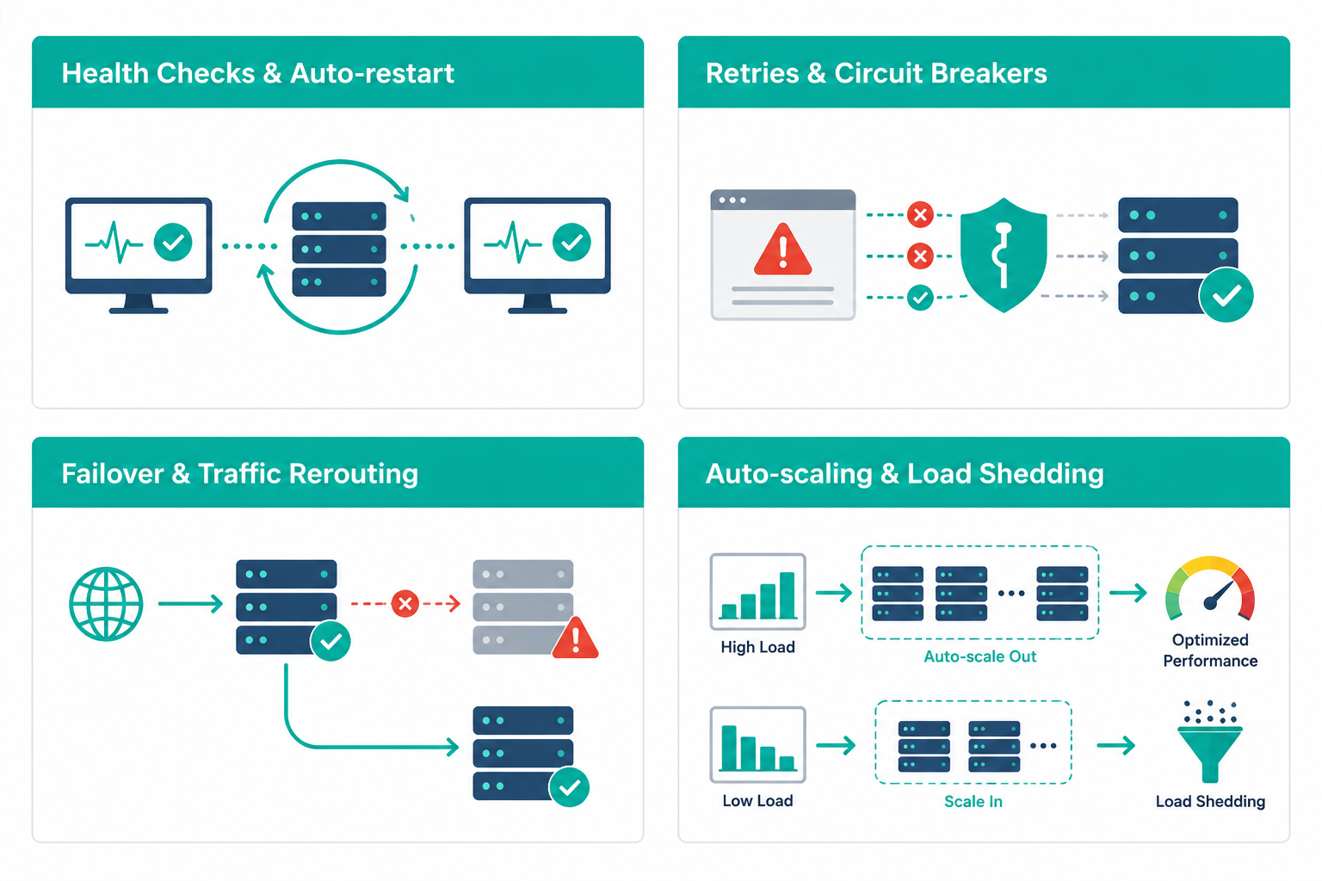
Self-Healing & Recovery
The best incident response is the one that already happens automatically
Notes:
Perhaps the most visible expression of resilience is self-healing infrastructure.
Consider a service that crashes because of a memory leak.
Previously, someone would receive a call, log in, investigate, and restart the service manually, Today, platforms such as Kubernetes can detect the failure and automatically restart workloads.
Traffic can be redirected to healthy instances.
Retries and circuit breakers prevent cascading failures.
Auto-scaling helps systems adapt to increased demand.
The objective is simple: - Allow systems to recover themselves whenever possible.
The best incident response is the one that happens automatically.

Slide 12
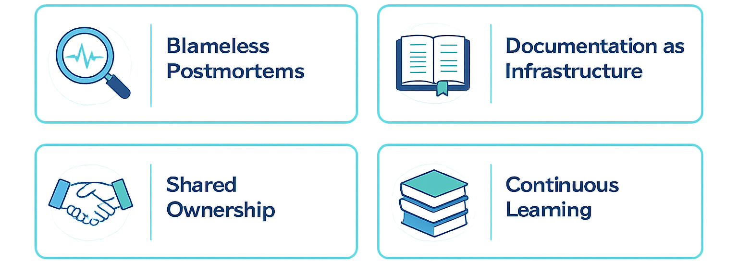
The Human Side of Resilience
Technology recovers systems. Culture sustains resilience
Notes:
Technology alone does not create resilience.
People and culture matter equally.
One important practice is conducting blameless postmortems.Instead of asking who caused the problem, we ask what conditions allowed the problem to occur.
This encourages learning and transparency.
Documentation is another critical factor.
Knowledge should belong to the organization, not to a single individual.
Shared ownership ensures that reliability becomes everyone's responsibility.
Finally, every incident becomes an opportunity to improve.
Resilience grows when organizations consistently learn from experience.

Slide 13
Three Lessons. Hard-Earned
01
Automate repetitive work
02
Expect Failures, Design for Them
03
Measure, Learn, and Improve
Notes:
Looking back, there are three key lessons we have learned.
First, automate repetitive work.
Anything repeated regularly is a candidate for automation.
Second, expect failures and design for recovery.
Failures are inevitable, so resilience must be intentional.
Third, measure, learn, and improve continuously.
Resilience is not a destination.
It is an ongoing process of refinement.
These lessons have helped us build systems that are more reliable and teams that are more confident.

Slide 14
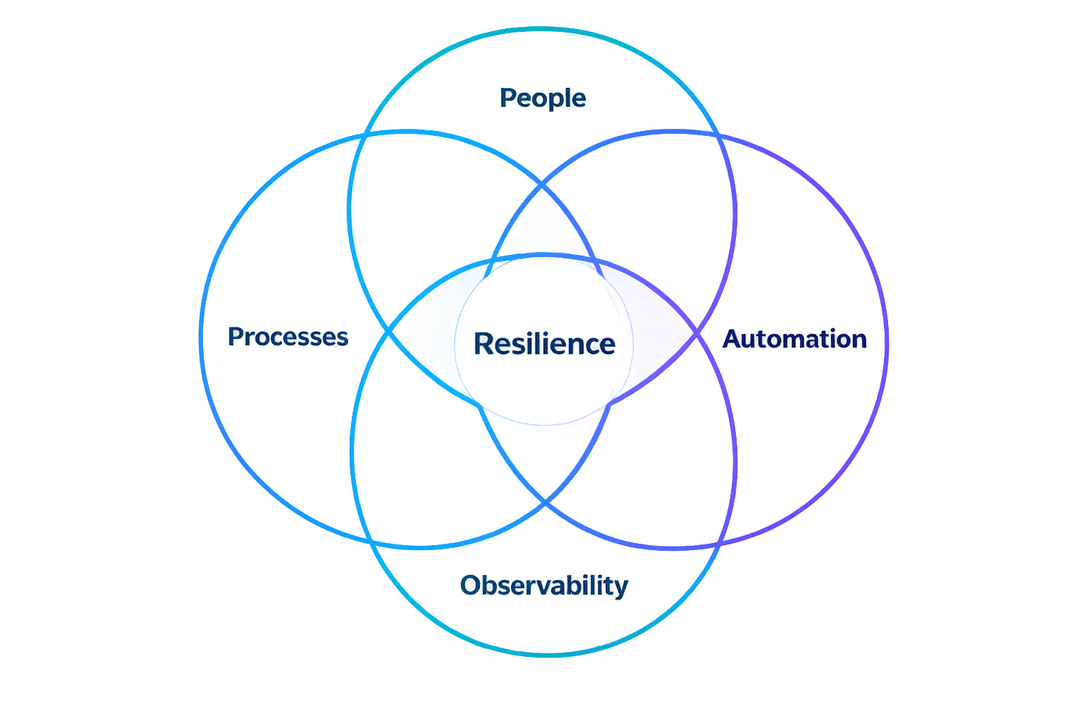
Resilience is not a single tool or practice. It is the compound effect of all four
Notes:
At this point, it becomes clear that resilience does not come from a single technology.
It emerges from the combined effect of Infrastructure as Code, observability, CI/CD, self-healing systems, and strong organizational culture.
Each practice reinforces the others.
Together they create systems that can withstand disruption and recover quickly.
Resilience is not about avoiding every failure.
It is about building systems and teams that recover, adapt, and continue delivering value.
That is the essence of Digital Sisu.

Slide 15
Thank You
How is your NREN building digital resilience?
Josh Elias Lubuulwa
elubuulwa@renu.ac.ug

