Slide 1
Saz: Agentic Workflow Engine
Engineering safe agentic WFs for real word operations
Fariman Torkashvand
Senior Software Engineer at GÉANT
Helsinki
11 Jun 2026

Slide 2

Operations are where AI gets risky
Incidents, changes, and support tickets end in actions.
In production, the failure mode is “wrong action,” not just “wrong text.”
That means the workflow boundary matters more than the chatbot surface.
Operational Systems
Alert / Ticket
AI-assisted analysis
Action boundary
Ticket API
Paging
Automation
endpoint
Working action risk

Slide 3



Banning AI does not keep you in control
Real teams want help with triage, summaries, routing, and draft generation.
If that demand exists, governance must live in the internal toolchain.
The design question becomes: where do policy, approval, and audit live?
Shadow / ad hoc use
Ban it
Browser tab
External prompt
Copy / paste
Need internal
AI capability
Let it loose
Unbounded automation risk
Govern it inside
Workflows
YAML Workflow
Policy checks
Approval gates
Audit events
Controlled
Internal capability

Slide 4
What Saz actually is
YAML is compiled into an executable workflow spec.
A run becomes an execution plan and step-by-step runtime context.
The executor is responsible for grounding, checks, execution, and persistence.
Events are persisted and can be streamed live per run.
Human-authored
YAML
Compiler
Planner
Verifier / Critic
Executor
Compiled workflow
Execution Plan
Tool registry
Policy engine
Audit events + step records
UI
Live stream

Slide 5
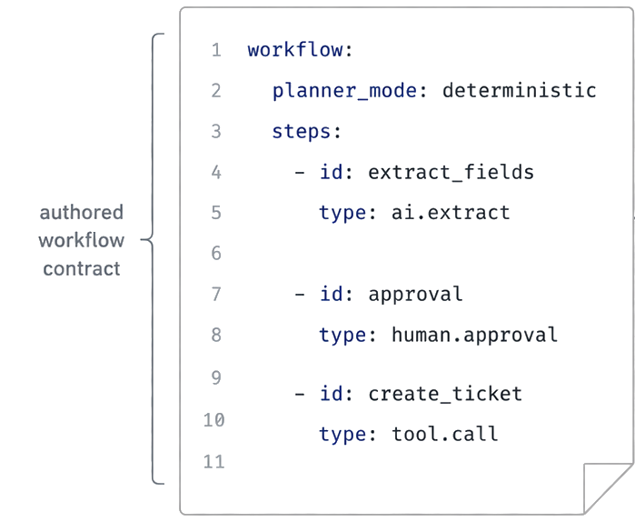
Workflow first, not agent first
YAML defines flow metadata, policies, forms, and workflow steps.
AI steps require explicit instruction and expect schemas.
Tool calls and approval steps require human-authored descriptions.
Templates constrain data flow with $form, $step, $env, and $secret.
Workflow owns
sequence
Extract fields
Human approval
Create ticket
Expect schema
Bounded tool
Policy
Audit

Slide 6
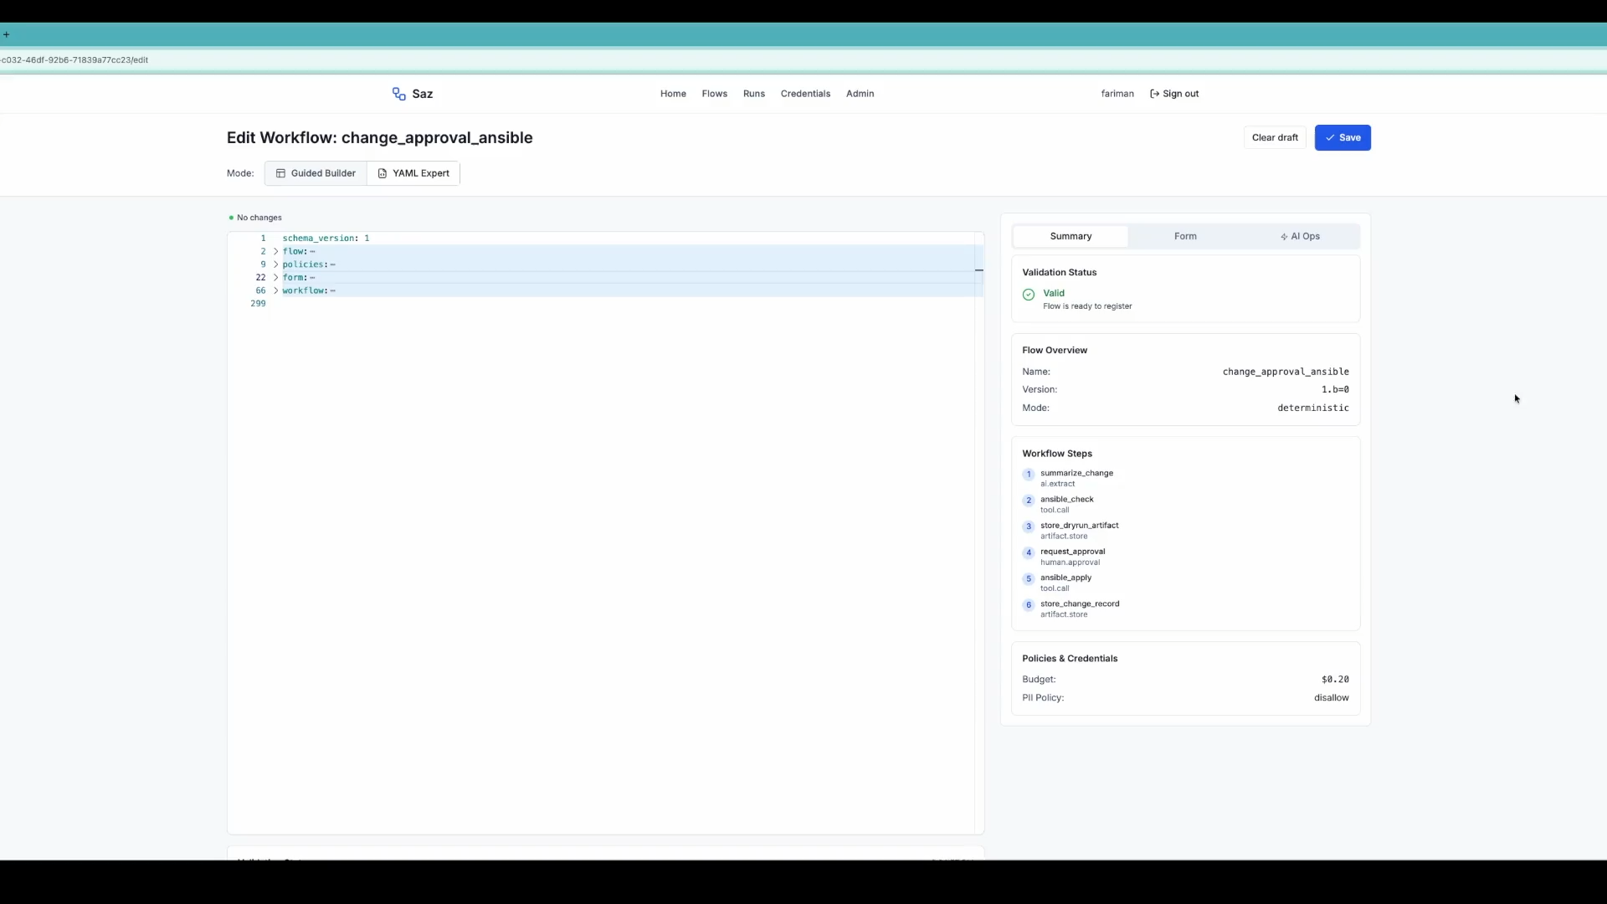
Enter Saz: An Agentic Workflow Engine

Slide 7
Two execution modes, one safety envelope
Deterministic mode maps YAML steps directly to the execution plan.
Agentic mode asks a planner to generate a structured plan from DSL, tools, and budget.
In deterministic mode, AI is limited to declared ai.* steps.
In both modes, execution still goes through policy, verification, and audit.
Deterministic mode
Step A
Step B
Step C
Shared safety envelope
ExecutionPlan
Step 1
Step 2
Step 3
Agentic Mode
Policy checks
Verification
Executor
Tool
Execution
Audit trail
Bounded replan

Slide 8

Plan, verify, then act
The planner proposes a structured plan.
Each step is grounded into a concrete tool call.
The verifier can pass, fail, request replan, or escalate.
Post-execution critique checks schema conformance and result safety.
Replanning is bounded by a policy limit.
Bounded replan
Plan
Ground tool call
Policy check
Verify
Execute
Critique
Execution / PlanStep
Resolve arguments
Budget | PII | rate limits
Post-execution
Execute only
If approved

Slide 9
Policy is part of execution
Runtime
controls
Budgets track tokens, cost, steps, and elapsed time.
PII can be tokenized before model calls and selectively restored only for approved outbound paths.
Tool calls are budget-checked and rate-limited.
Replanning is bounded, not open-ended.
Secrets are resolved separately from workflow logic.
Budget
Privacy / PII
Rate time
Executor
Secrets
Replan limit
Approval gates

Slide 10
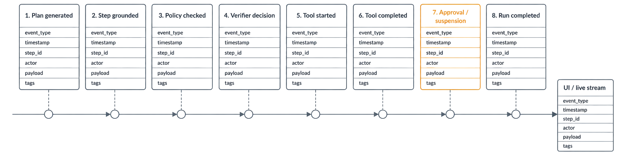
Auditability is a first-class output
Grounded step input is stored before execution and output is stored after completion.
Events cover plan generation, verifier decisions, tool lifecycle, replans, approvals, suspensions, and final outcomes.
Every event carries run context such as run_id, step_id, planner_mode, actor, and payload.
The same event model supports live streaming and post-run review.

Slide 11


Example patterns: change approval and PII-safe support
Change approval
PII-safe support
Change approval: assess risk, generate summary, pause for human approval, trigger automation, wait for callback, store an artifact.
PII-safe support: inspect message, summarize from sanitized content, forward safely, store a redacted record.
Both examples keep AI inside a human-designed workflow rather than above it.
The approval path is tested for suspend, resume, and context restoration
Assess risk
Incoming message
Generate summary
Detect / tokenize PII
Human approval
Sanitized only
Trigger automation
Summarize sanitized content
Wait for callback
Forward approved content
Call Back
External system
Store artifact
Store redacted record

Slide 12

Patterns NRENs can reuse
Make the workflow definition the control plane.
Separate planning from verification.
Enforce budgets, privacy, approval, and audit in the runtime.
Start deterministic, then add agentic planning where ambiguity justifies it.
Build safe internal options before ad hoc usage becomes the default.
Wrokflow is the
Control plane
Separate planning
From execution
Planning
Execution
Verify before
Acting
Make policy
Executable
PII
Budget
Secret
Action
Execution
Verify
Replan Limit
Rate limit
Approval gate
Keep human
Gate explicit
Treat audit as a
Product output
event_type
Timestamp
step_id
Actor
Payload
Tags
Approval

Slide 13
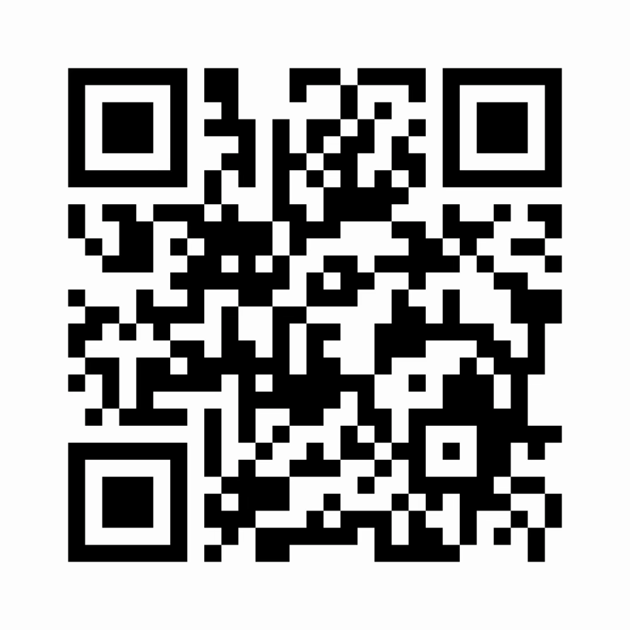
Next Step and Call to Action
Improve UI, governance, and integration maturity
Explore safe internal AI use cases with NRENs
Start small: one workflow, one policy boundary, one audit trail

Slide 14
Thank You
Any questions?
Fariman.Torkashvand@geant.org

