Slide 1

Building lightweight digital-sovereign AI Chatbots for Higher Education
Connecting the dots of openness.
“Lightweight Digital Sovereign AI Chatbots” is licensed under a CC BY 4.0 International License.

Slide 2
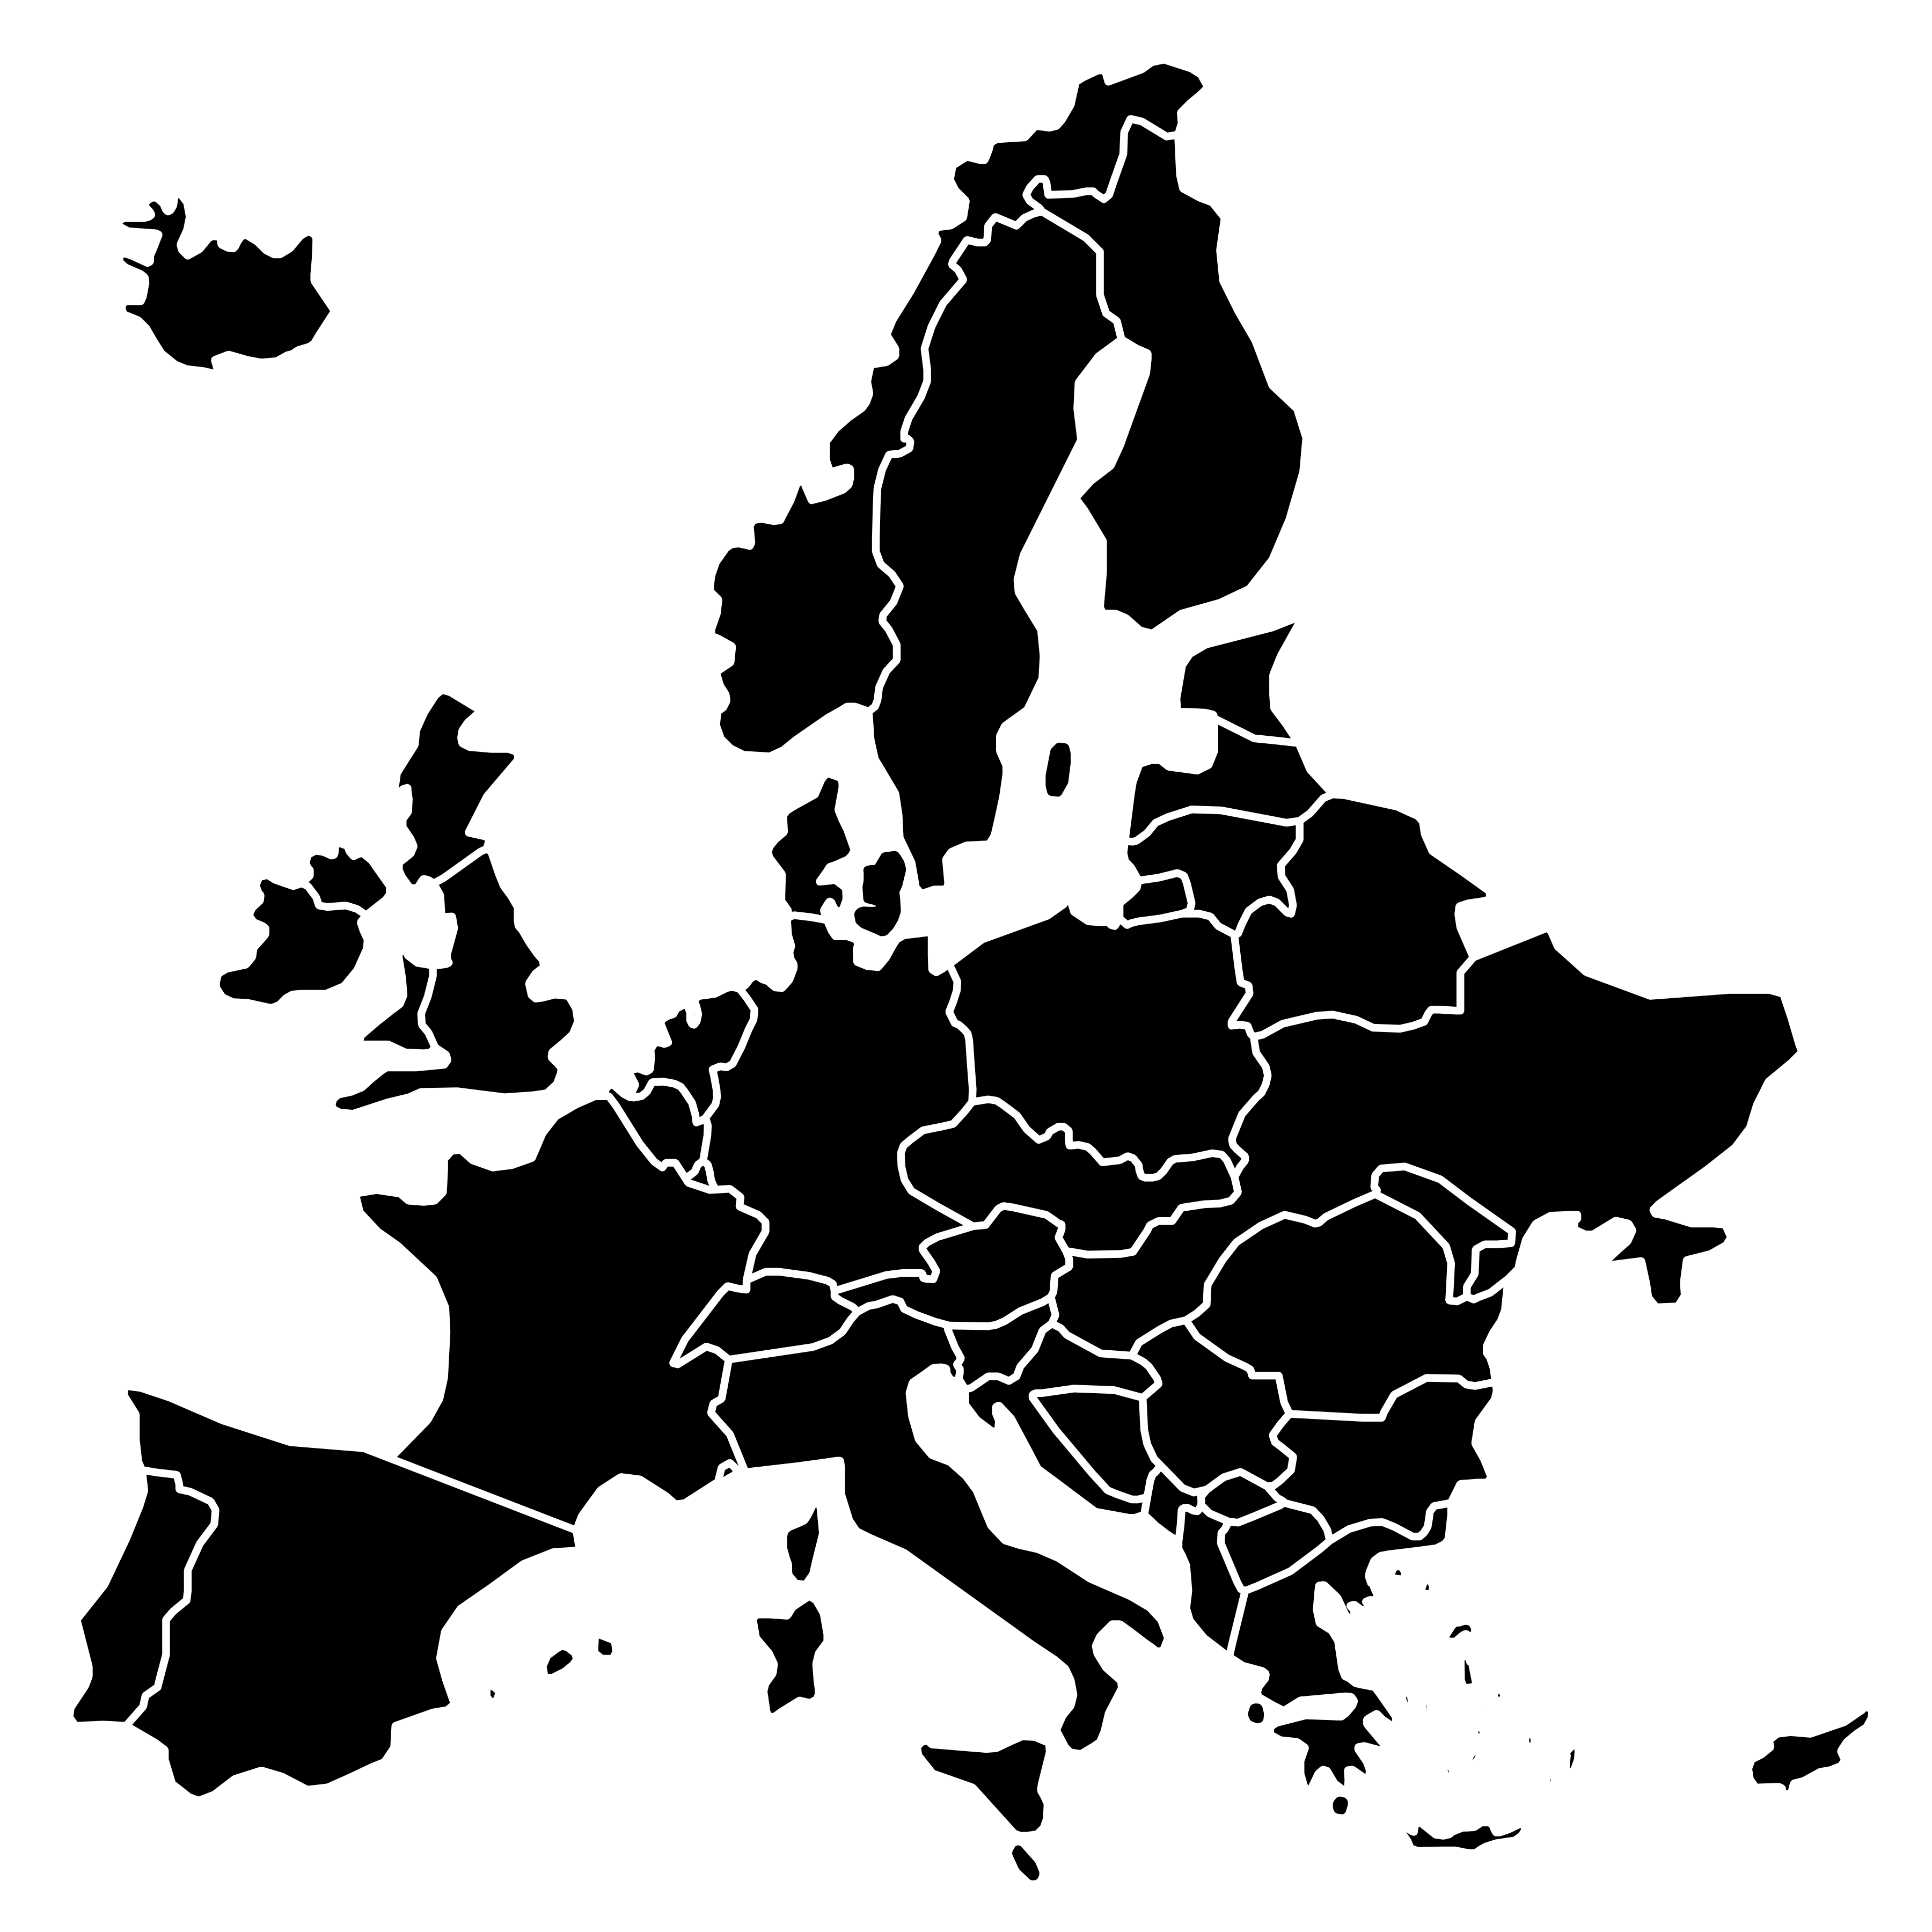

Karlstad
University
22.000 Students
11.000 Online
1.400 Staff

Slide 3
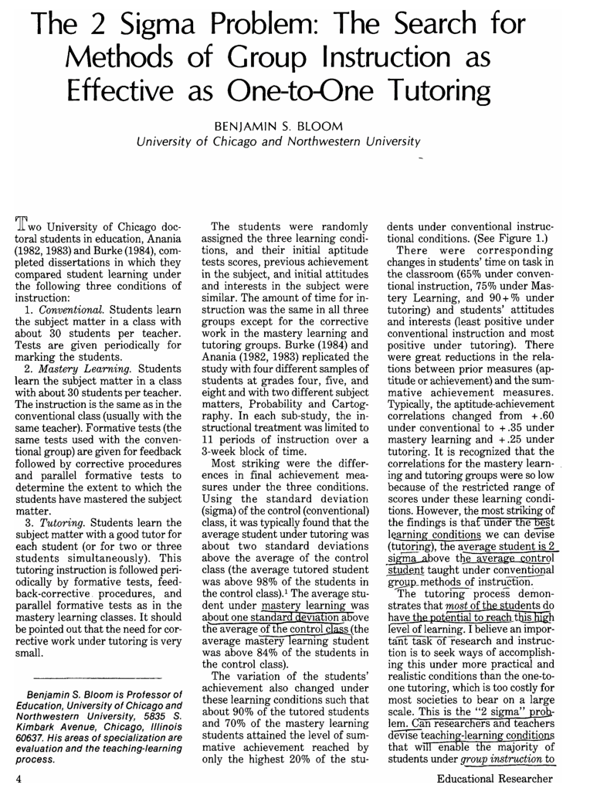
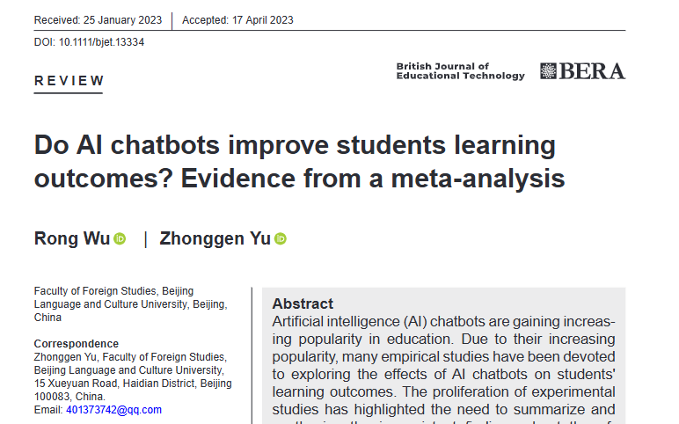
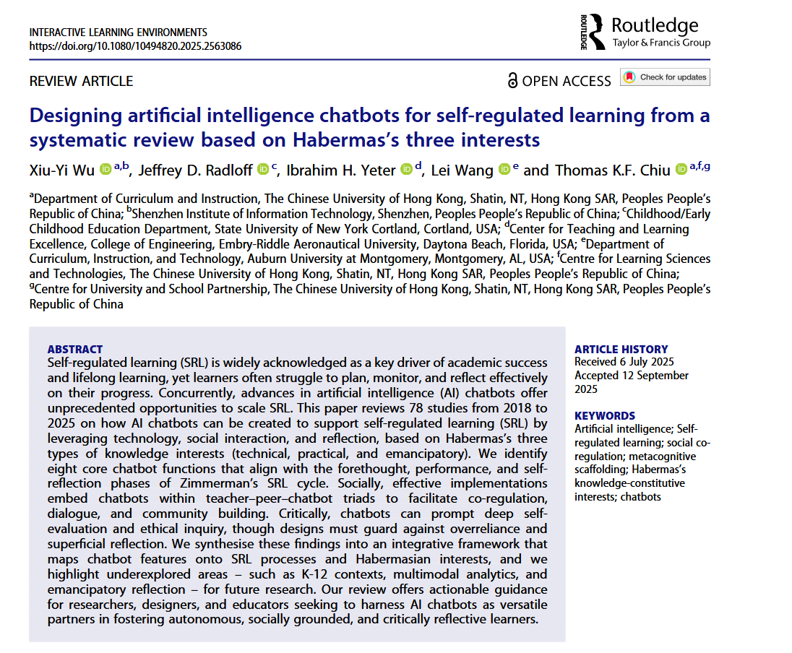

Slide 4
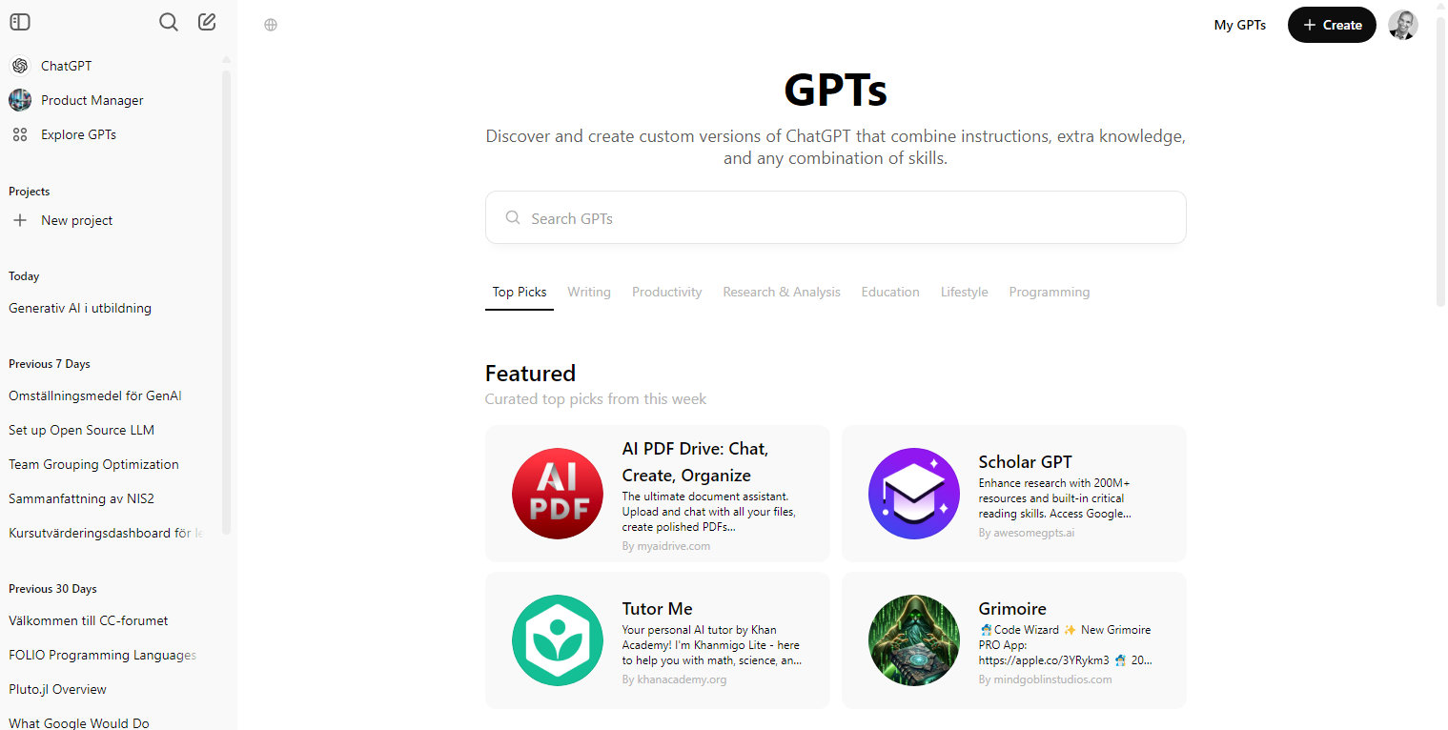

Slide 5
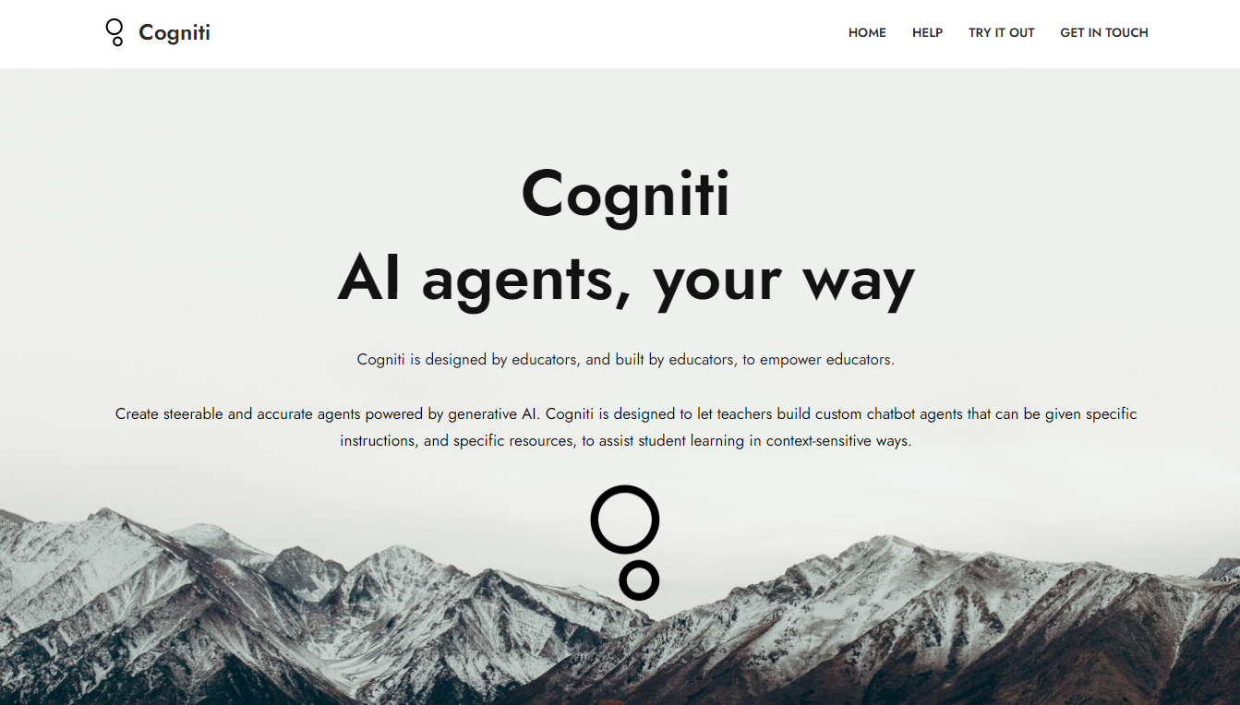

Slide 6
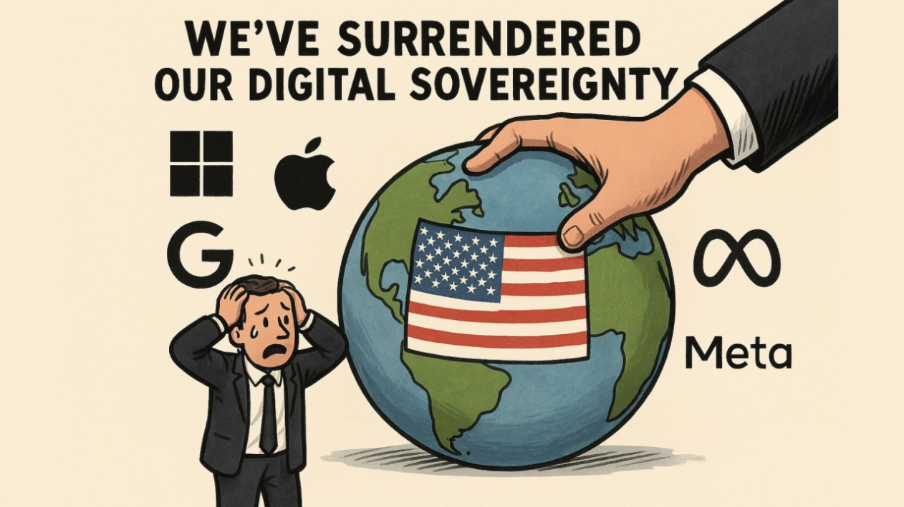
©Thomas Secher: https://www.linkedin.com/pulse/hidden-empire-how-we-surrendered-our-digital-win-back-thomas-af3qf

Slide 7


Customized sovereign chatbots
Learning Management System
LTI 1.3 Advantage
WordPress Multisite
LLM Inference
By Jonathasmello - Own work, CC BY 3.0, https://commons.wikimedia.org/w/index.php?curid=18460156

Slide 8
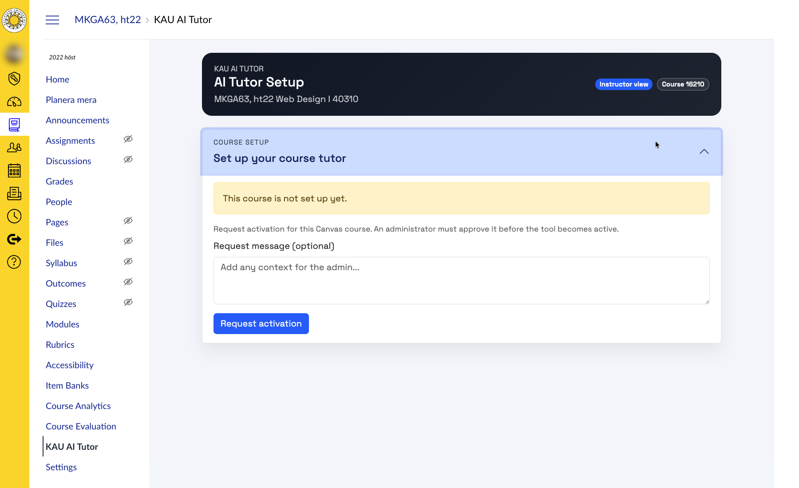

Slide 9
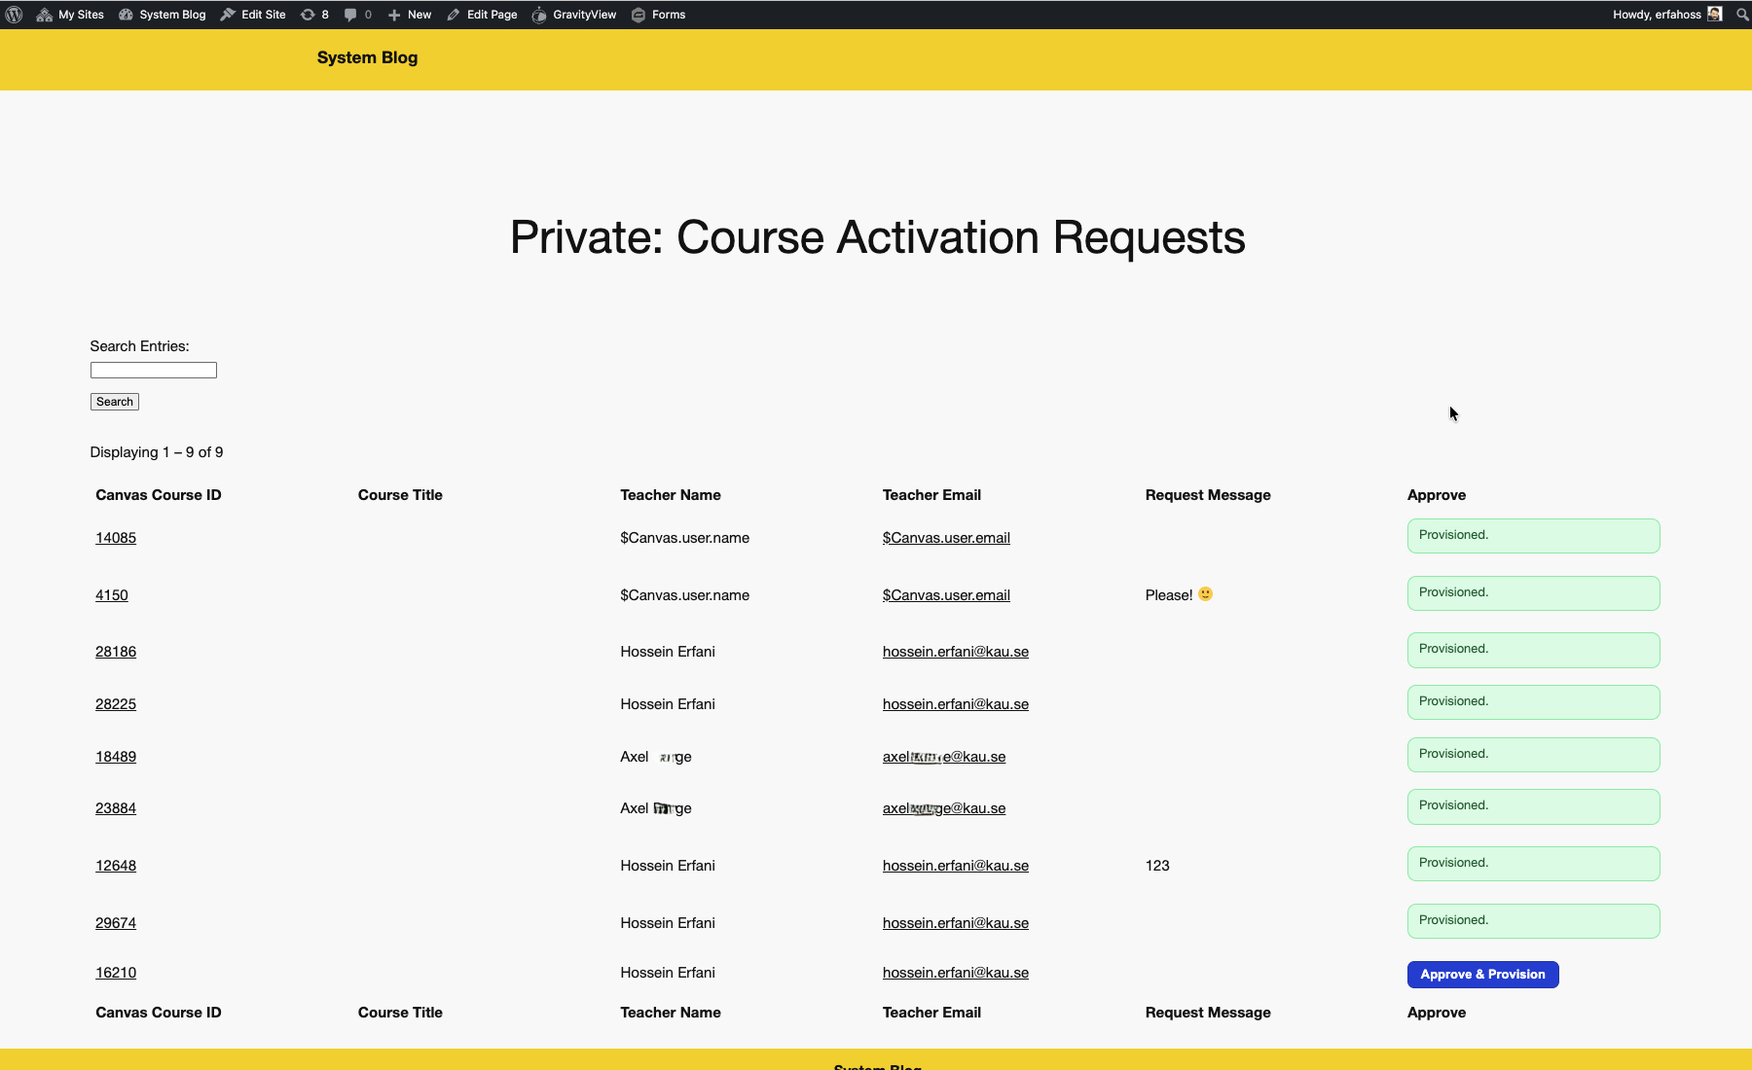

Slide 10
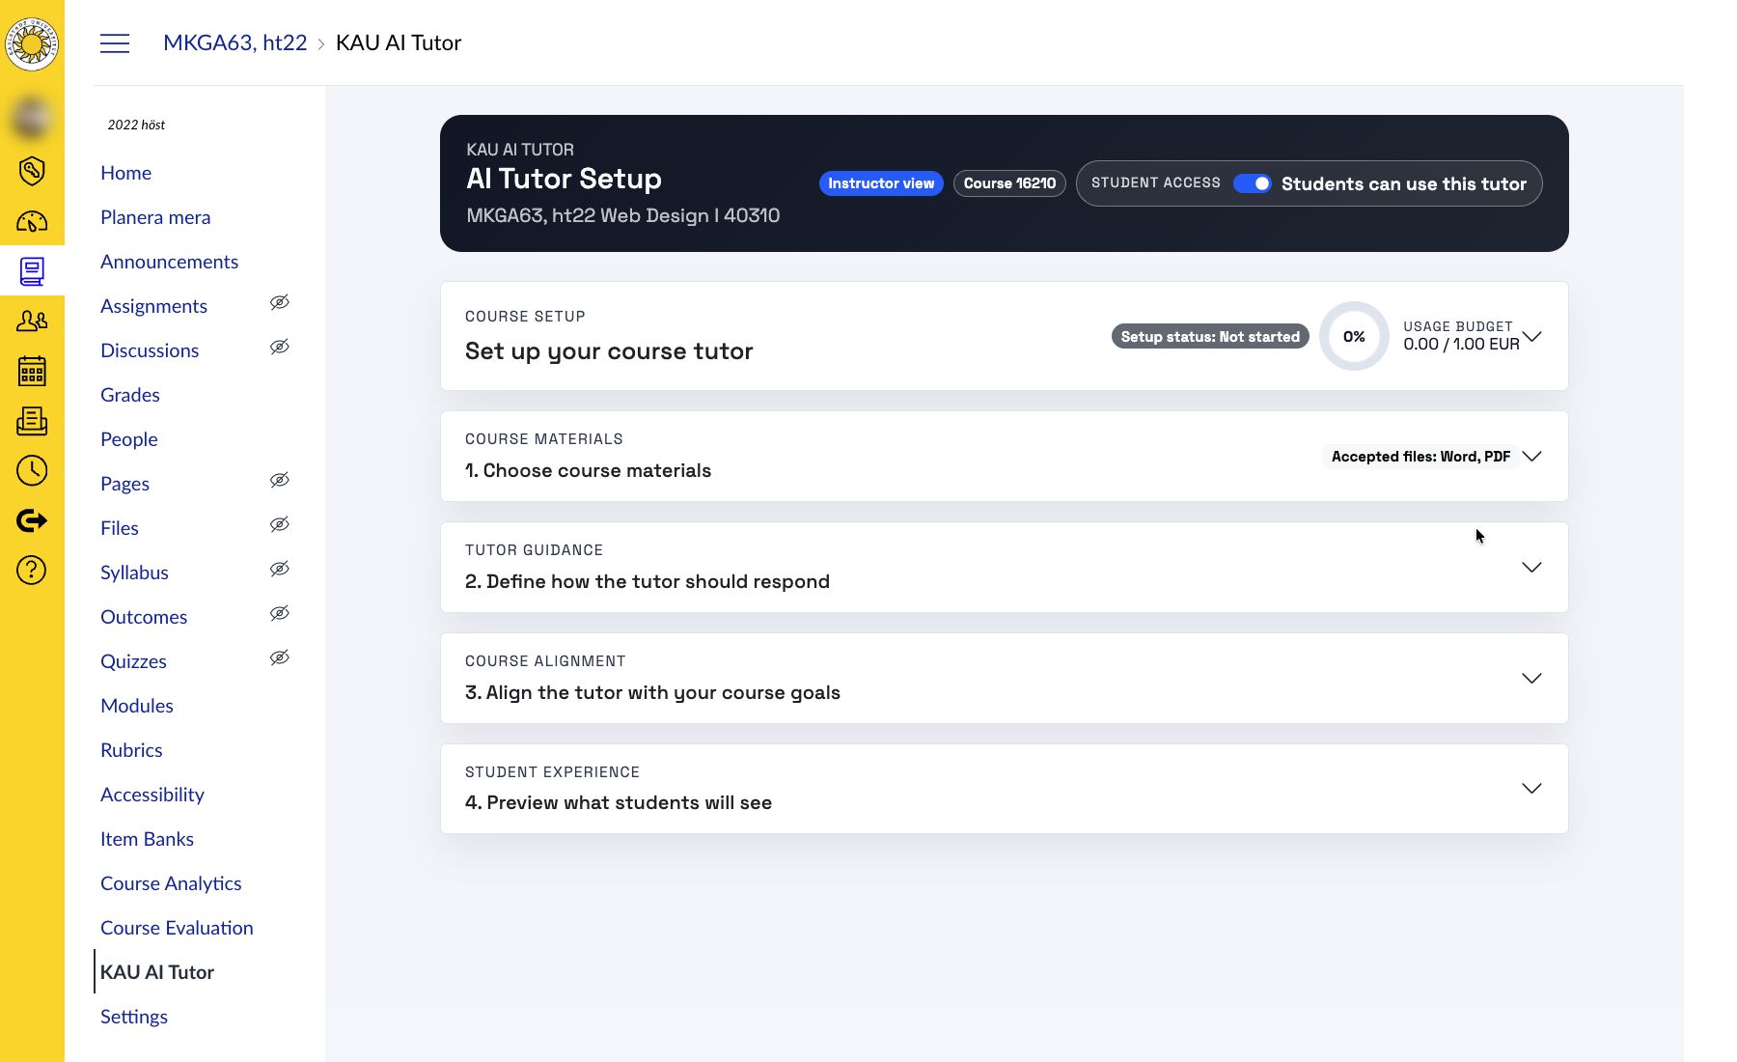

Slide 11
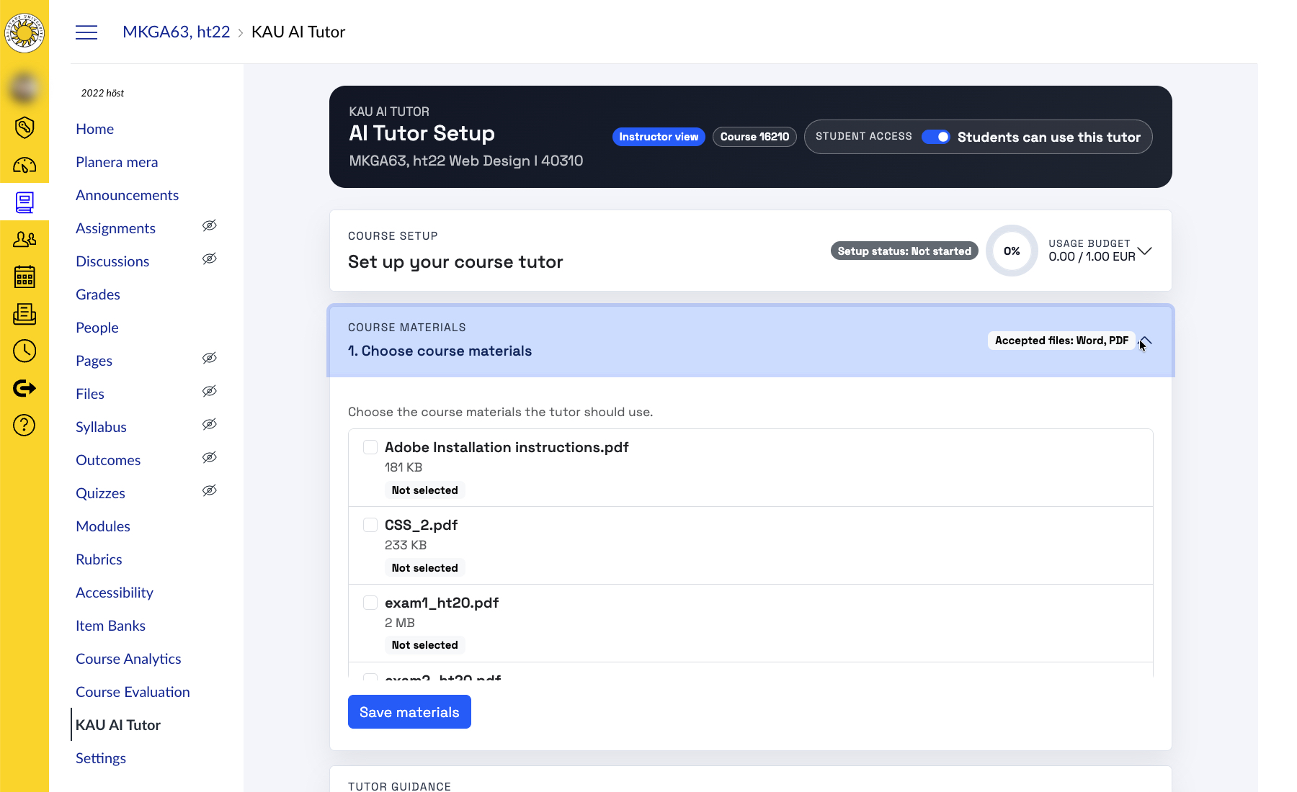

Slide 12
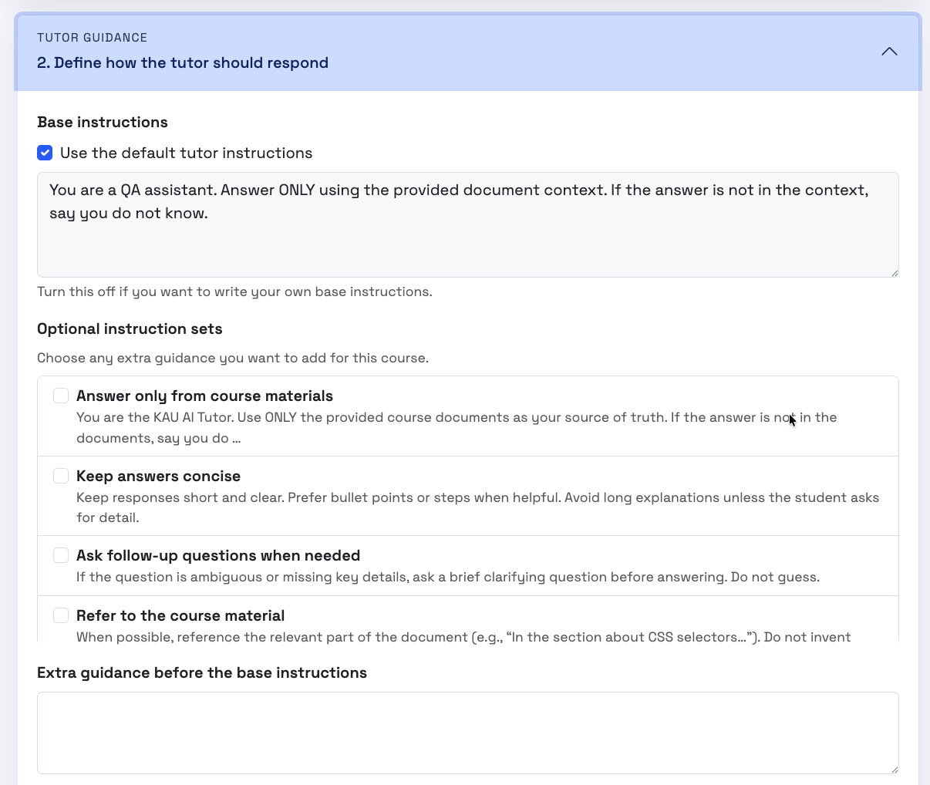

Slide 13
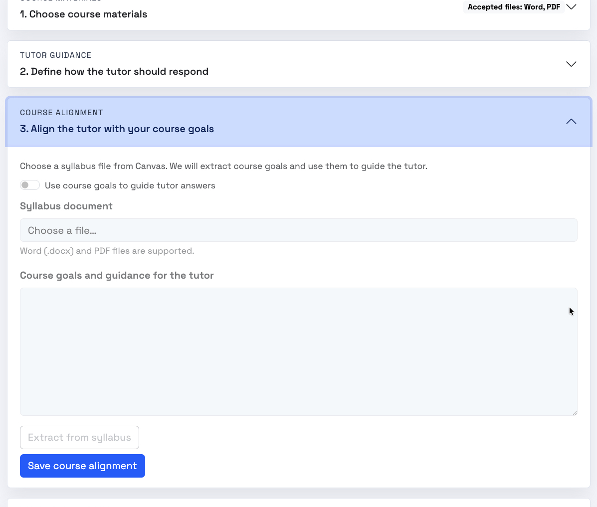

Slide 14
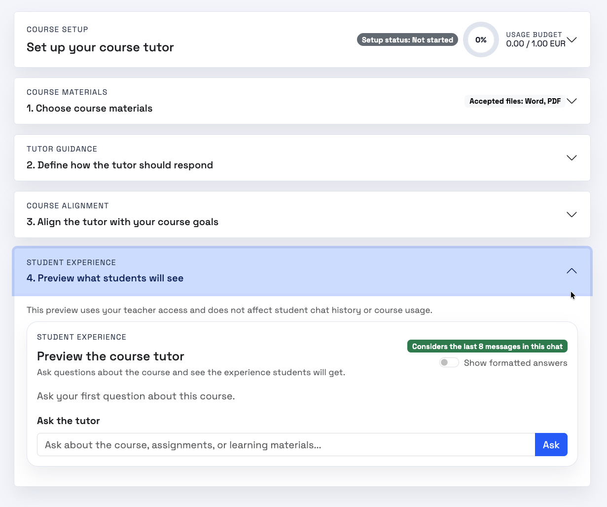

Slide 15
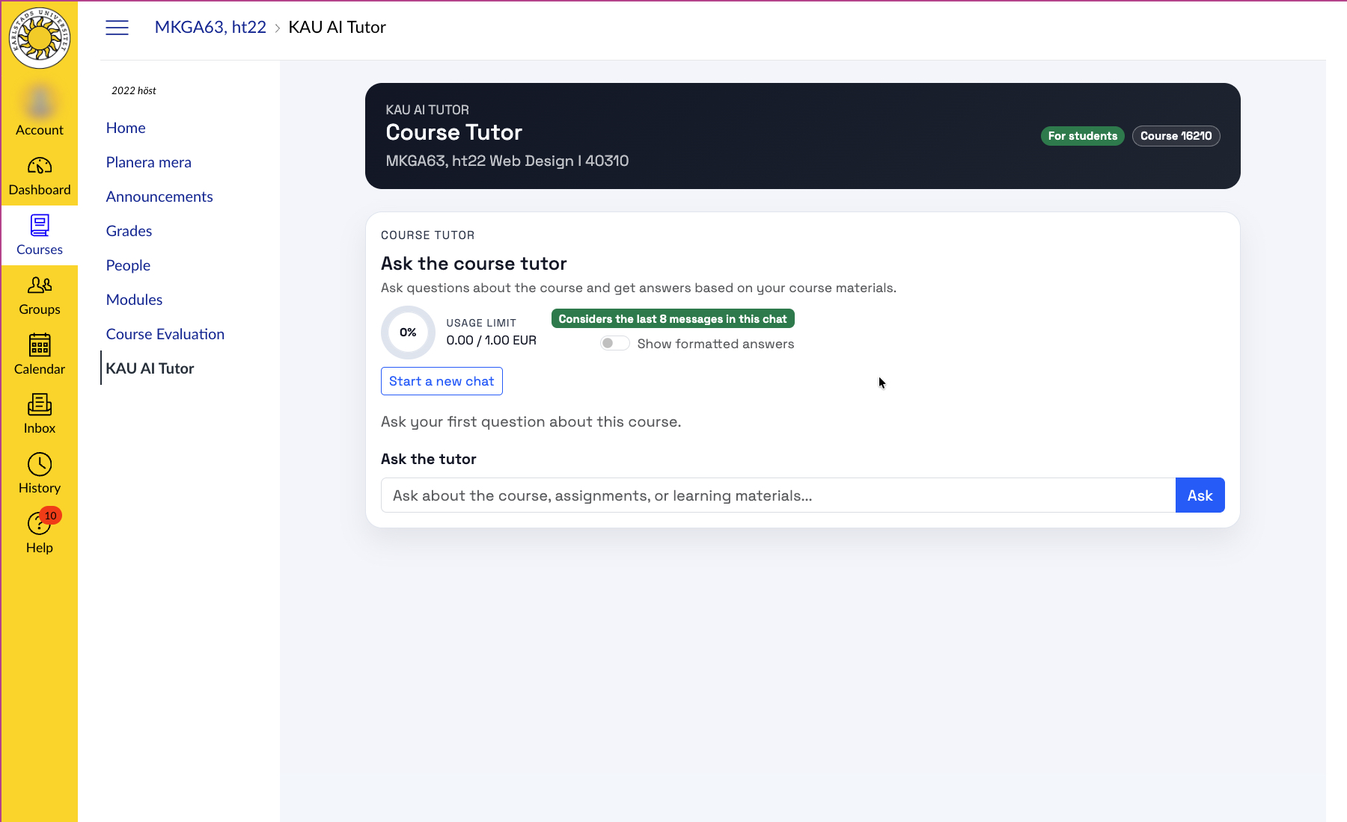

Slide 16
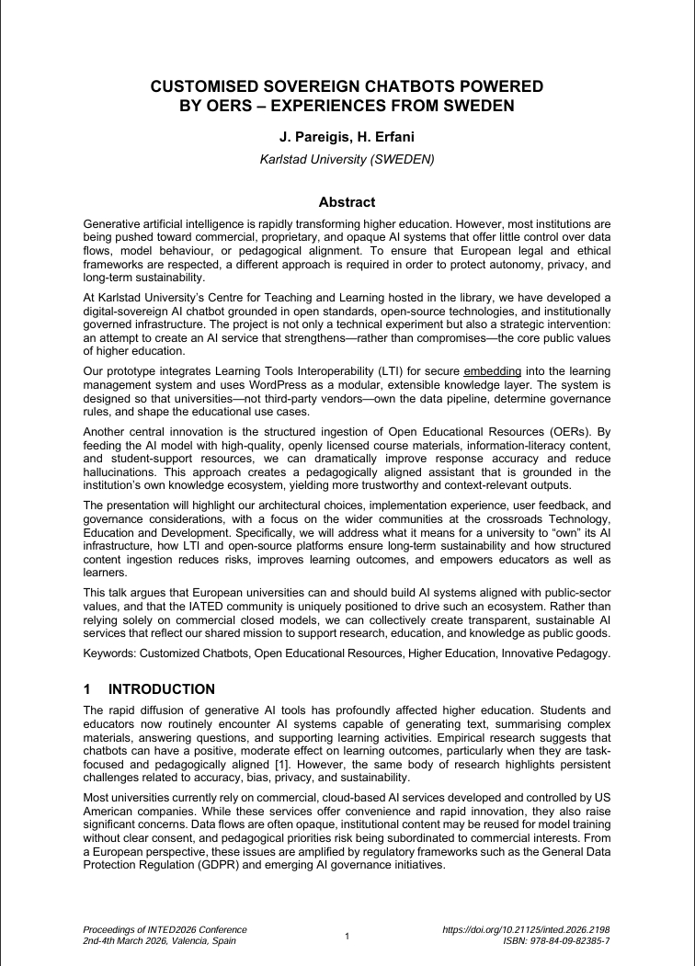
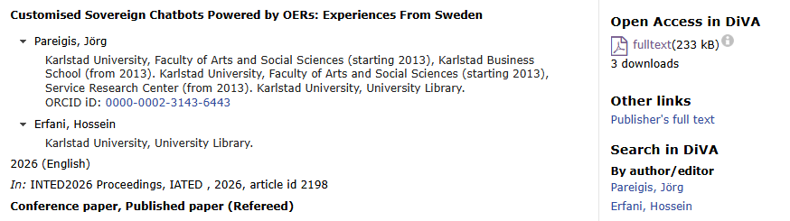
https://www.diva-portal.org/smash/get/diva2:2049990/FULLTEXT01.pdf

Slide 17
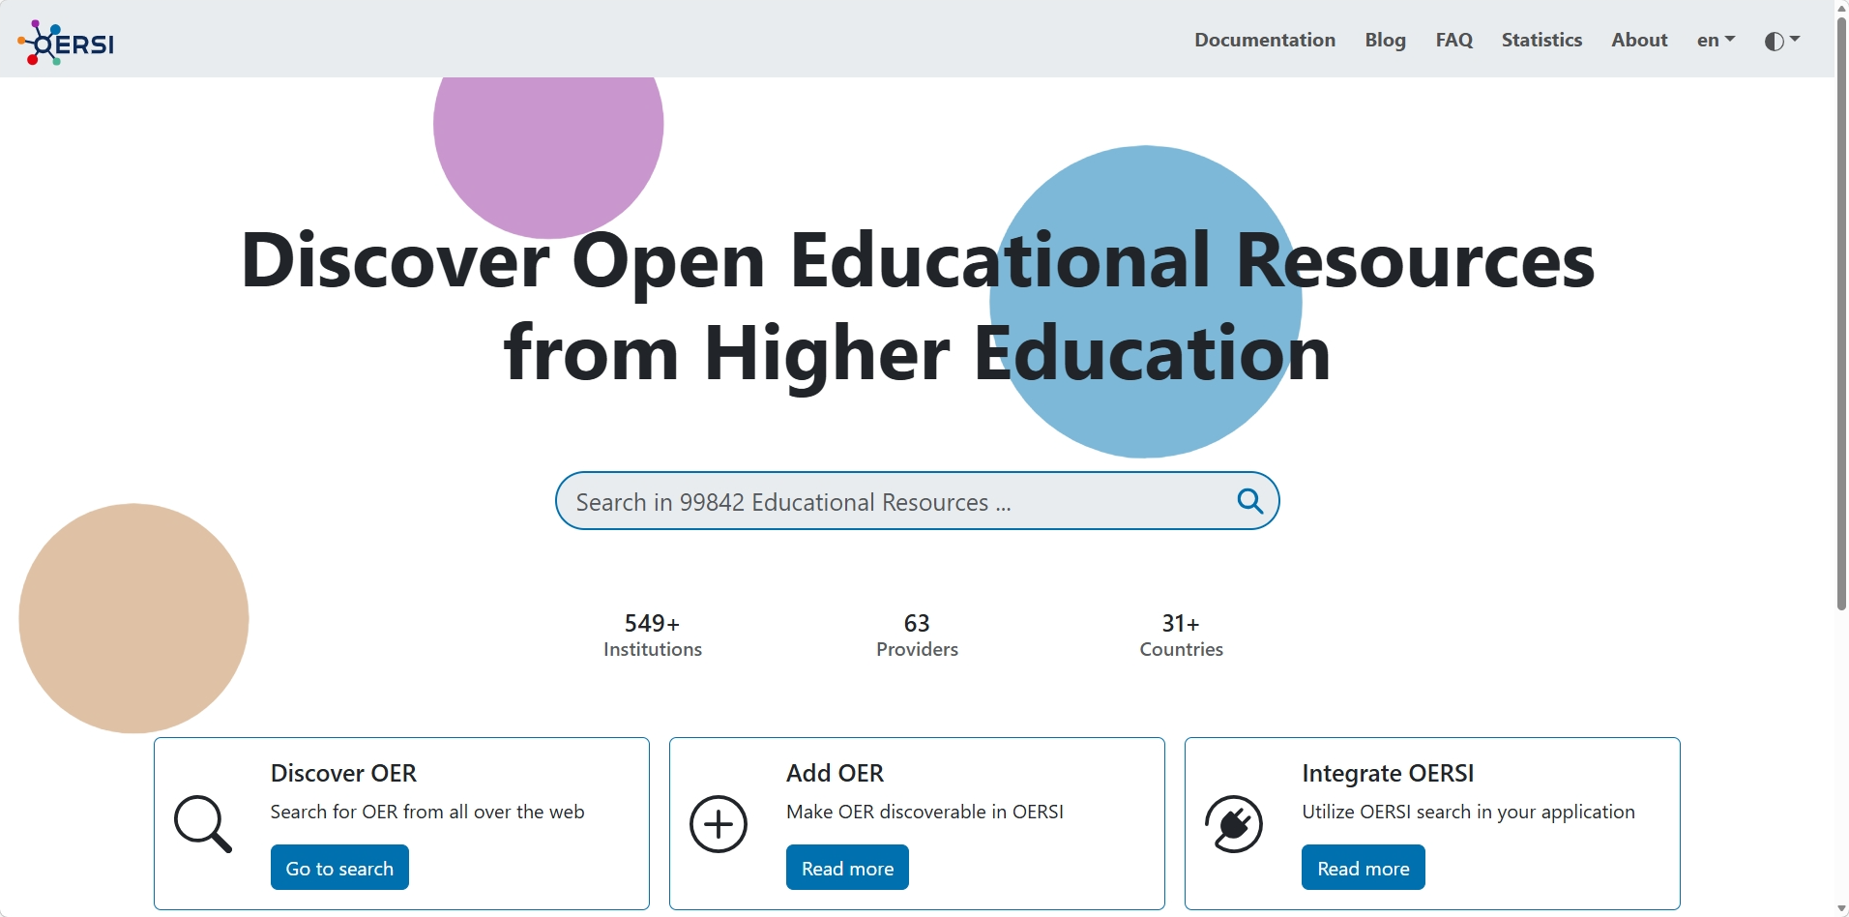

Slide 18
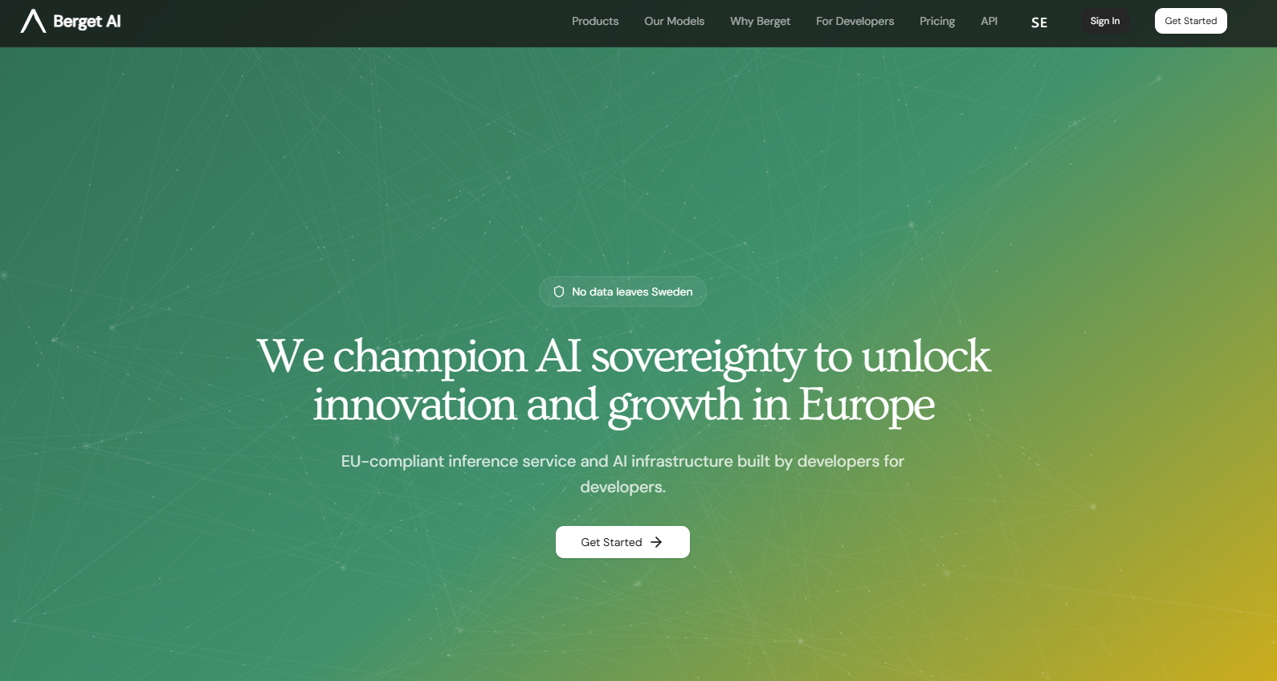
Berget AI - We champion AI sovereignty to unlock innovation and growth in Europe

Slide 19
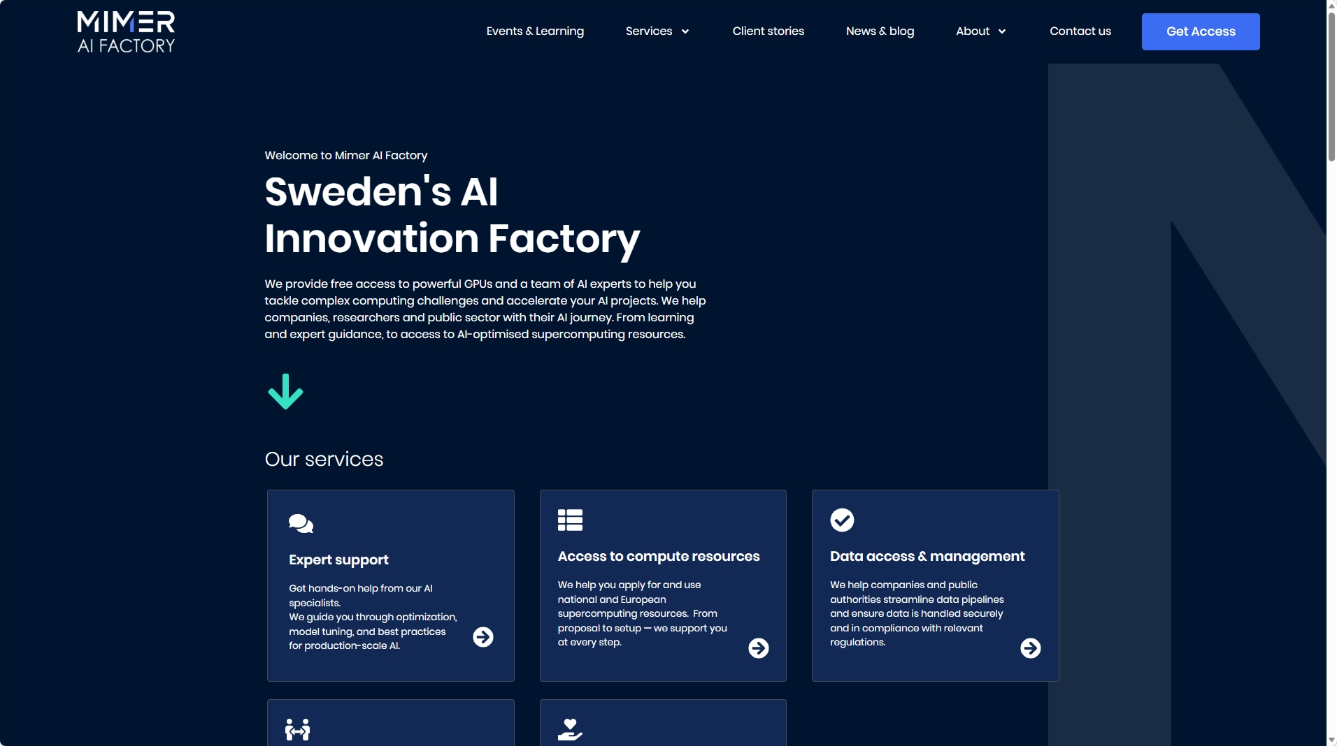
MIMER AI Factory

Slide 20
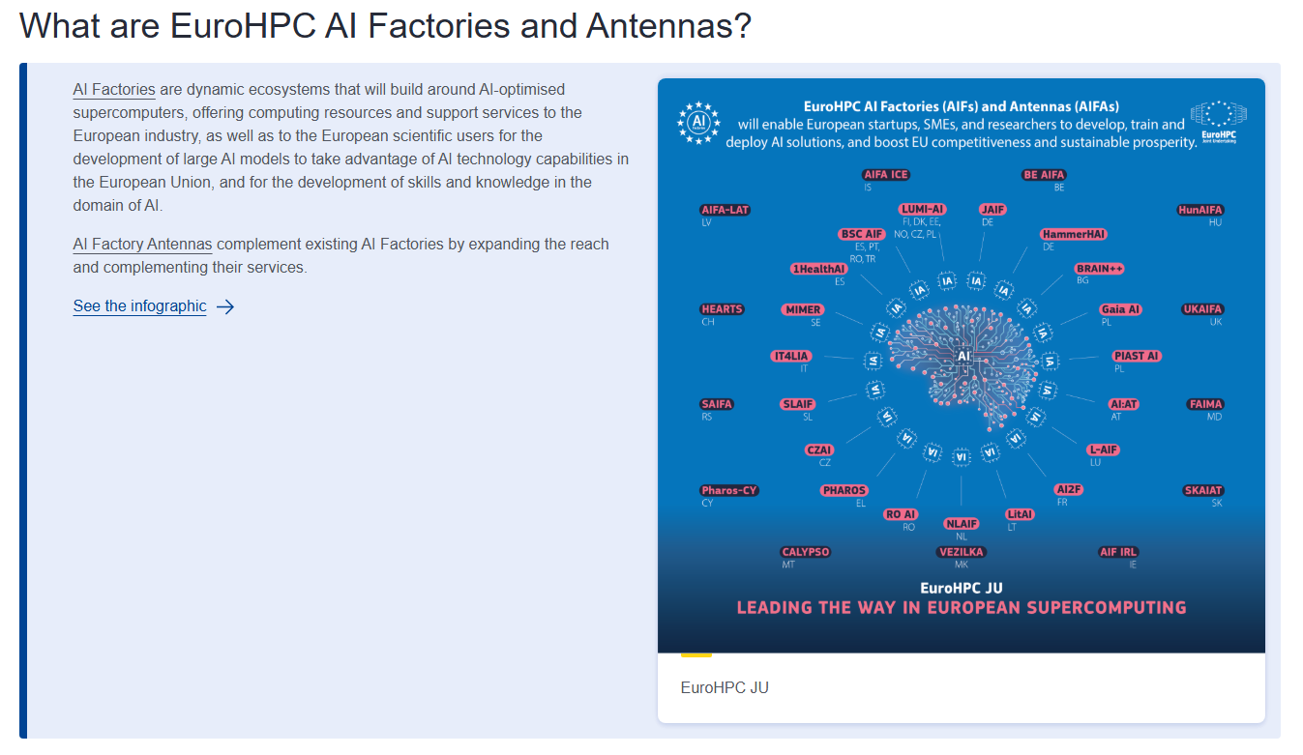

Slide 21
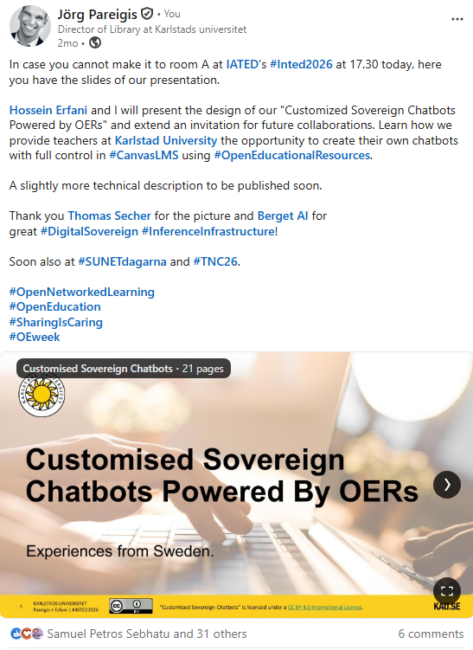

Next steps and events
Summer/autumn ’26:
– Pilottesting with selected teacher and courses
– Evaluation of pilots and continuous agil development
– Release on GitHub for community collaboration and reuse?
– Commercialization?

Slide 22
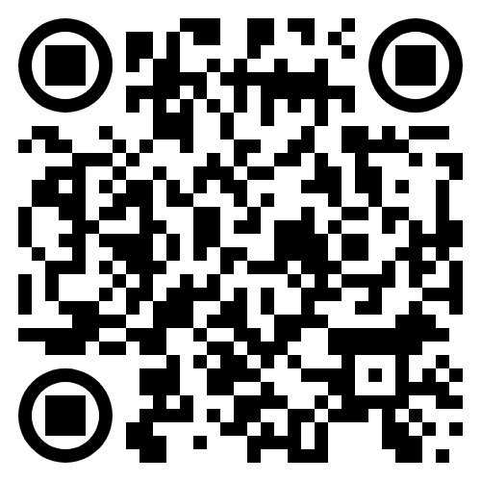
Let’s work together!
jorg.pareigis@kau.se @joergelp
hossein.erfani@kau.se
sola.kau.se/upekau/tnc26/

