Slide 1
AI Meets Software Governance in GÉANT
Marcin Wolski (PCSS), Toby Rodwell (GÉANT)
Helsinki
11 June 2026
Notes:
Good afternoon all, and thank you so much for coming to this session. It’s just before the closing plenary , some, perhaps many of you will be leaving shortly, and we really appreciate you’ve decided to join us rather than making a last tour of the exhibition stands, or having that last catch up with an international colleague or peer. And I would be the first to admit that the subject of this presentation is not the most thrilling – Software Governance is many things, but exciting and intriguing are not two of them. In fact, to be entirely honest, I rather suspect if we did not have AI in the title then we might not have made it on to the programme. I was at the Submarine Networks conference in London 2 weeks ago and in every presentation that touched on AI, and there were a lot, the speaker would say something along the lines of “It wouldn’t be a 2026 conference if we didn’t mention AI”.

Slide 2
TNC 2026 __
Notes:
Well, here we are at *the* networking conference, it *is* 2026, so the obvious next word here is …

Slide 3
TNC 2026 AI
Notes:
… “AI”.
Now, I don’t want you to think we put AI in the title just to get our proposal accepted, but I did recently come across the term “AI Washing” in a news article. In that article PR executives explained how companies were desperately trying link their products to AI, such as re-branding any form automation as ‘AI’, regardless of how meaningful or relevant such a claim might be.

Slide 4

The Rise of AI
Notes:
The current interest, or indeed fascination, with AI makes these companies attitude understandable. Whilst there are, rightly, many concerns surrounding AI, some of which we’ll look at shortly, AI is particularly well suited to software development, where for the most part it is seen as a tool, rather than as a replacement for humans. Adoption is uneven, with some organizations embedding AI assistance into all aspects of their software development life cycle, whilst elsewhere developers are using browser-based tools and personal accounts. But despite this variety it is clear AI coding assistants have moved from being pilots or gimmicks to standard tools in mainstream development. GitHub Copilot has more than 20 million users and is deployed in 90% of Fortune 100 companies, whilst Anthropic’s Claude LLM has already established itself as the go-to tool for software developers.
The latest version of Claude, Mythos, recently hit the news headlines as Anthropic had announced that it was so good at finding code vulnerabilities that they were limiting its initial release to a select group of industry partners. Now, some think this was just a marketing trick, to build up interest and hype in the new model, but Mozilla, one of those with access, blogged that Mythos helped it identify nearly 300 vulnerabilities in its weekly release of FireFox, compared to 22 such bugs found the month before by another Anthropic model, Opus 4.6.

Slide 5

The Riseks of AI
Notes:
Whilst AIs such as Mythos may be good at finding security vulnerabilities, conversely it seems that AI generated code is more likely to contain bugs than human written code. Since LLMs are trained on, amongst other material, whatever they can find on the Internet, there is also a risk that the code they offer up is in fact something they have found, and they are unwittingly, and uncaringly, breaching that software’s associated license.
Ensuring software is properly licensed, and that it respects the licensing of any existing software module it itself depends upon, is one important aspect of software governance, which within the GN5-2 project is the responsibility of the ‘Software Governance and Support’ Task.

Slide 6





GN5-2: Software Governance and Support
Software Development Support
Software Testing
Software and License Management
Software Development Training
Software Governance eAcademy
Notes:
The task is lead by Marcin, my co-presenter, and five NRENs, whose logos are shown here, contribute to the work: AMRES, DFN, MARNET, PCSS and RASH. There are 5 sub-tasks, also listed here, which I will quickly run through them but not in any detail so feel free to ask questions later if interested:
Software development support provide tools such as code repositories, and virtual machines.
Software testing provide software composition analysis tools for automated testing, and if requested can perform more manual tests.
The Software and License Management team provide advice and guidance on best practice for software development, and for using and applying software licenses.
The Software Development Training team deliver themed training events, one or two per year.
The Software Governance eAcademy provide training material for online, self-paced learning
As I’m sure you will have noticed, there have been quite a few presentations at TNC that have been about AI. In fact, I will come clean to you and admit that I pointed both ChatGPT and Claude to the public TNC website and asked them how many presentations there were about AI. Interestingly, neither of them came up with convincing answers, but I strongly suspect it was not because these massively powerful foundation models could not do the task, but rather because of my poor and lazy prompting. In the book ‘The Hitchikers Guide to the Galaxy’ by the British author Douglas Adams, a race of hyper intelligent pan-dimensional super beings create a powerful computer called Deep Thought to come up with the answer to life, the universe, and everything. Deep Thought takes 7 and a half million years to produce the answer, which is forty-two. The super beings are understandably confused by this and ask Deep Thought if it is sure of the answer. Deep Thought says that the answer is definitely right, but it was the question that was wrong.
So having established the importance of asking the right question, I’ll now hand over to Marcin who will continue our presentation by telling you about the survey he recently ran.

Slide 7
Survey on AI usage
in GN Software Development

Slide 8
GN Software Development – A survey on AI usage
Why this survey?
  To understand how AI is actually used in GN teams
What we assessed?
  Usage
  Impact
  Risks
  Gaps and Needs
Target: GN5.2 community involved in SW development
Time frame: March – May 2026
Notes:
Refer to Toby’s intro about risk inception, we want to get some evidence subject
Toby mentioned rapid adoption of AI across software development roles. It is clear about AI impact on productivity and delivery, however with the great power comes great responsibility, and emerging issues such as quality, trust, security has to be treated seriosuly.
We lanuched the survey to Understand how AI is actually used in GN5-2 teams. In particular we want to assess
Real usage patterns (coding, testing, documentation)
Impact on productivity, quality, and trust
Key risks, barriers, and governance gaps
The survey target GN5.2 project community, Time frame: March – May2026

Slide 9


Survey on AI usage - Respondents
20 responses
Majority already uses AI regularly (weekly or more)
Experienced, technical AI users
Tech roles are in the majority
Regular AI usage (weekly → daily)
15 technical roles
5 leaders/manager
16 have more than 6 years of experience
Responses come from active AI practitioners representing key GN5.2 WPs
Notes:
Respondents
20 responses (anonymous, but with roles and Work packages or product they represent)
~15 technical roles 5 managers/leaders
~80% with 6+ years experience
Strong representation from key teams (WP9, WP6 ~70%)
Sample profile
Experienced, technical AI users
Regular AI usage (weekly → daily)
Early but relevant GN5-2 sample

Slide 10
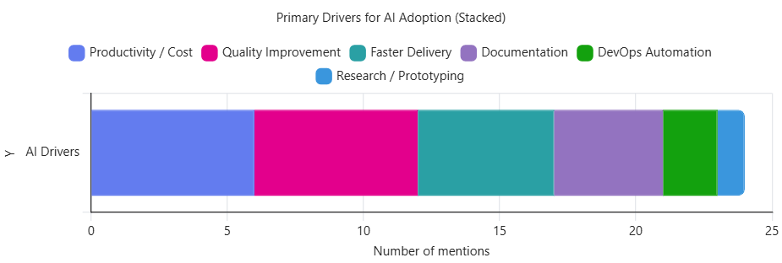

Survey on AI usage - Motivation
Adoption pattern is predominantly bottom-up (developer-driven) .
Notes:
Productivity and speed are the strongest drivers, followed by expected improvements in code quality and documentation support.
Primary drivers
Faster delivery & productivity gains (%)
Improved code quality (expected, partially observed??)
Documentation & knowledge suport
Learning and problem solving
Adoption pattern
Predominantly bottom-up (developer-driven) (%)

Slide 11
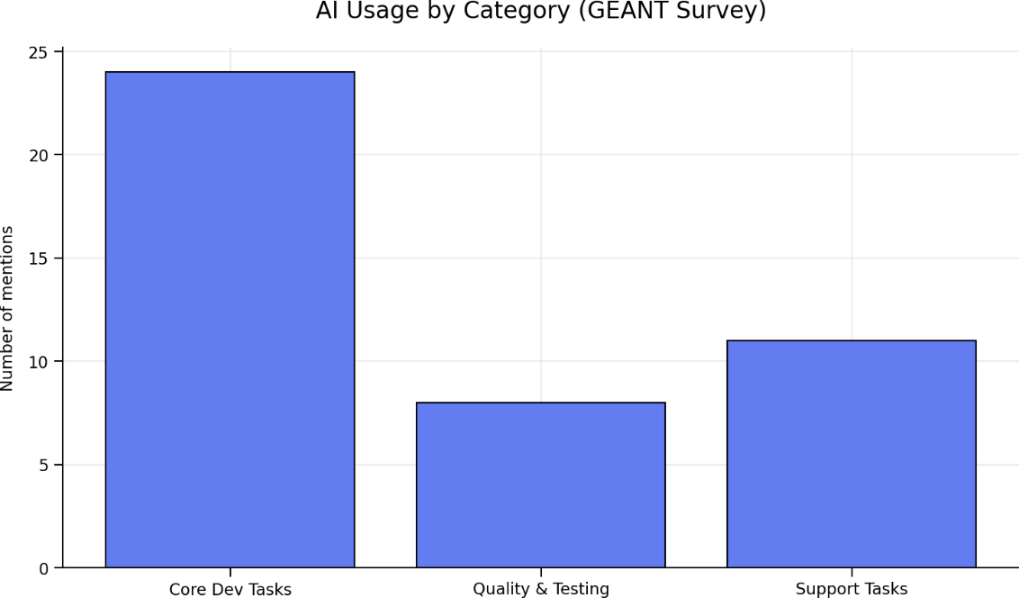
Survey on AI usage: Current Usage Patterns
1. Core Dev Tasks
-> coding, fixing, refactoring
2. Quality & Testing
3. Support Tasks
-> docs, security, others
~50%
~20%
~30%
AI is used across the entire SDLC, not just coding
Notes:
Grafika: SDLC diagram z AI w każdym etapie
~80% usage = execution layer (coding + support)
1. Core Dev Tasks (~50%)
-> coding, fixing, refactoring
2. Quality & Testing (~20%)
3. Support Tasks (~30%)
-> docs, security, others

Slide 12
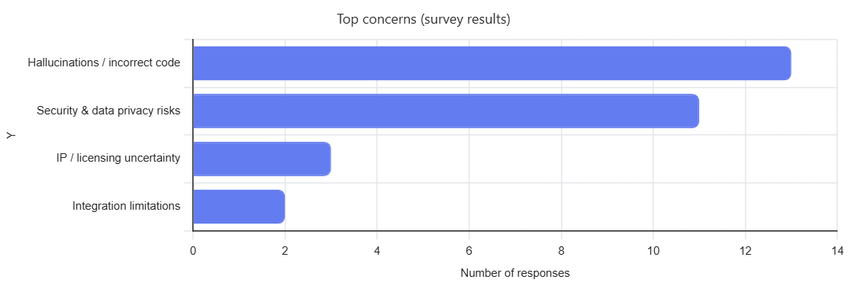
Survey on AI usage – Risks & Awareness
AI-generated code may introduce more defects (observed in studies)
Notes:
Top concerns
Hallucinations / incorrect code
Security & data privacy risks
IP / licensing uncertainty
Integration limitations
Key insight: AI is widely used but cautiously trusted
Hallucynacje to zdecydowanie #1 problem (dominujący sygnał) Security/privacy – silny drugi obszar ryzykaIP i integracje są dużo mniej powszechne, ale nadal istotne niszowo
„The underlying assumption is that you are using "AI", you can only indicate the degree to which you use it. The omission of even mentioning possible ethical concerns with this "technology" is also unfortunate.
"AI" is a net *negative* for me (and the world), by a big margin. The relentless propaganda for it is draining. It makes it challenging to remain sane in a world/field/organization where many people seem to have lost the plot and vibe code/write/generate their way to a fascist dystopia.

Slide 13
Survey on AI usage – Trust & Verification practices
Verification practices
Manual code reviews (100%)
Trust level
Majority: Moderate trust
Rarely: Low trust
Unit testing, Runtime testing (45%)
Security scanning (25%)
Static analysis (e.g., SonarQube) (60%)
AI checks AI (20%)
Only a minority of developers report high trust in AI output
„Productivity-quality” paradox
The more AI is used, the more validation is applied
Notes:
Almost all respondents indicate:
Manual code review
Unit testing
Static analysis (e.g., SonarQube)
Security scanning
Runtime testing
-> pełny, klasyczny stack kontroli jakości
-> To dokładnie wpisuje się w klasyczny model engineering:
verification = „czy budujemy poprawnie”
validation = „czy działa poprawnie”
Trust level (z ankiety)
Dominujące: Moderate trust
Występuje też: Low trust
Brak: wysokiego, bezwarunkowego zaufania
-> Innymi słowy: zaufanie do AI jest ograniczone i ostrożne
Message: Low-to-moderate trust in AI is compensated by very strong verification practices
AI zwiększa produktywność
ALE jednocześnie:
zwiększa ryzyko błędów / hallucination
powoduje nadmiarową walidację
Dlatego obserwujemy:
więcej AI → więcej verification, nie mniej

Slide 14
From insights to actions

Slide 15

From Insights to Action
Key observations:
  High adoption
  Productivity gains
  Trust and governance gaps
The current Task 2 offer:
  Guidelines
  Trainings
  AI code reviews
  Community building
Notes:
Gap: AI adoption is ahead of governance
4. Transition slide - From Insights to Action

Slide 16
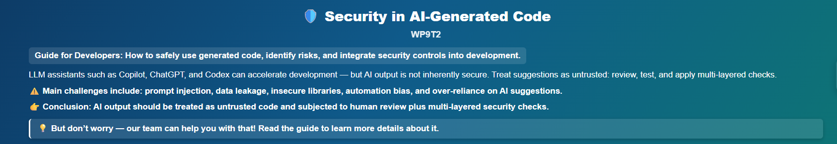
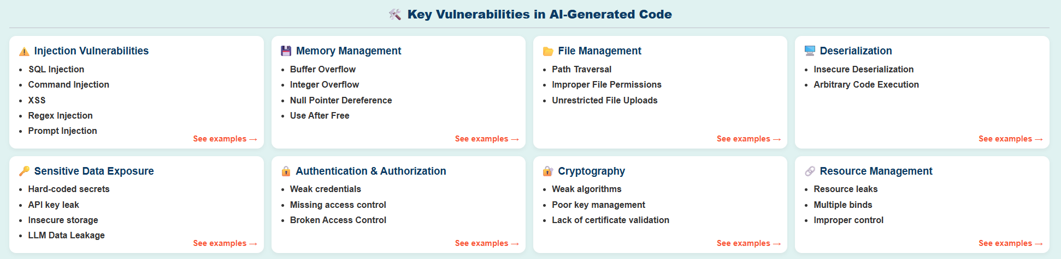
Guidelines - Secure Use of AI in Development
insecure patters in generated code
Risk of data leakage via prompts
Notes:
Developer guidelines
Published guidance on AI-generated code security: Security in AI-Generated Code Guideline - GEANT Software Development Support - GÉANT federated confluence
Key recommendations:
Treat AI-generated code as untrusted input
Enforce security controls and validation
Integrate into standard SDLC

Slide 17
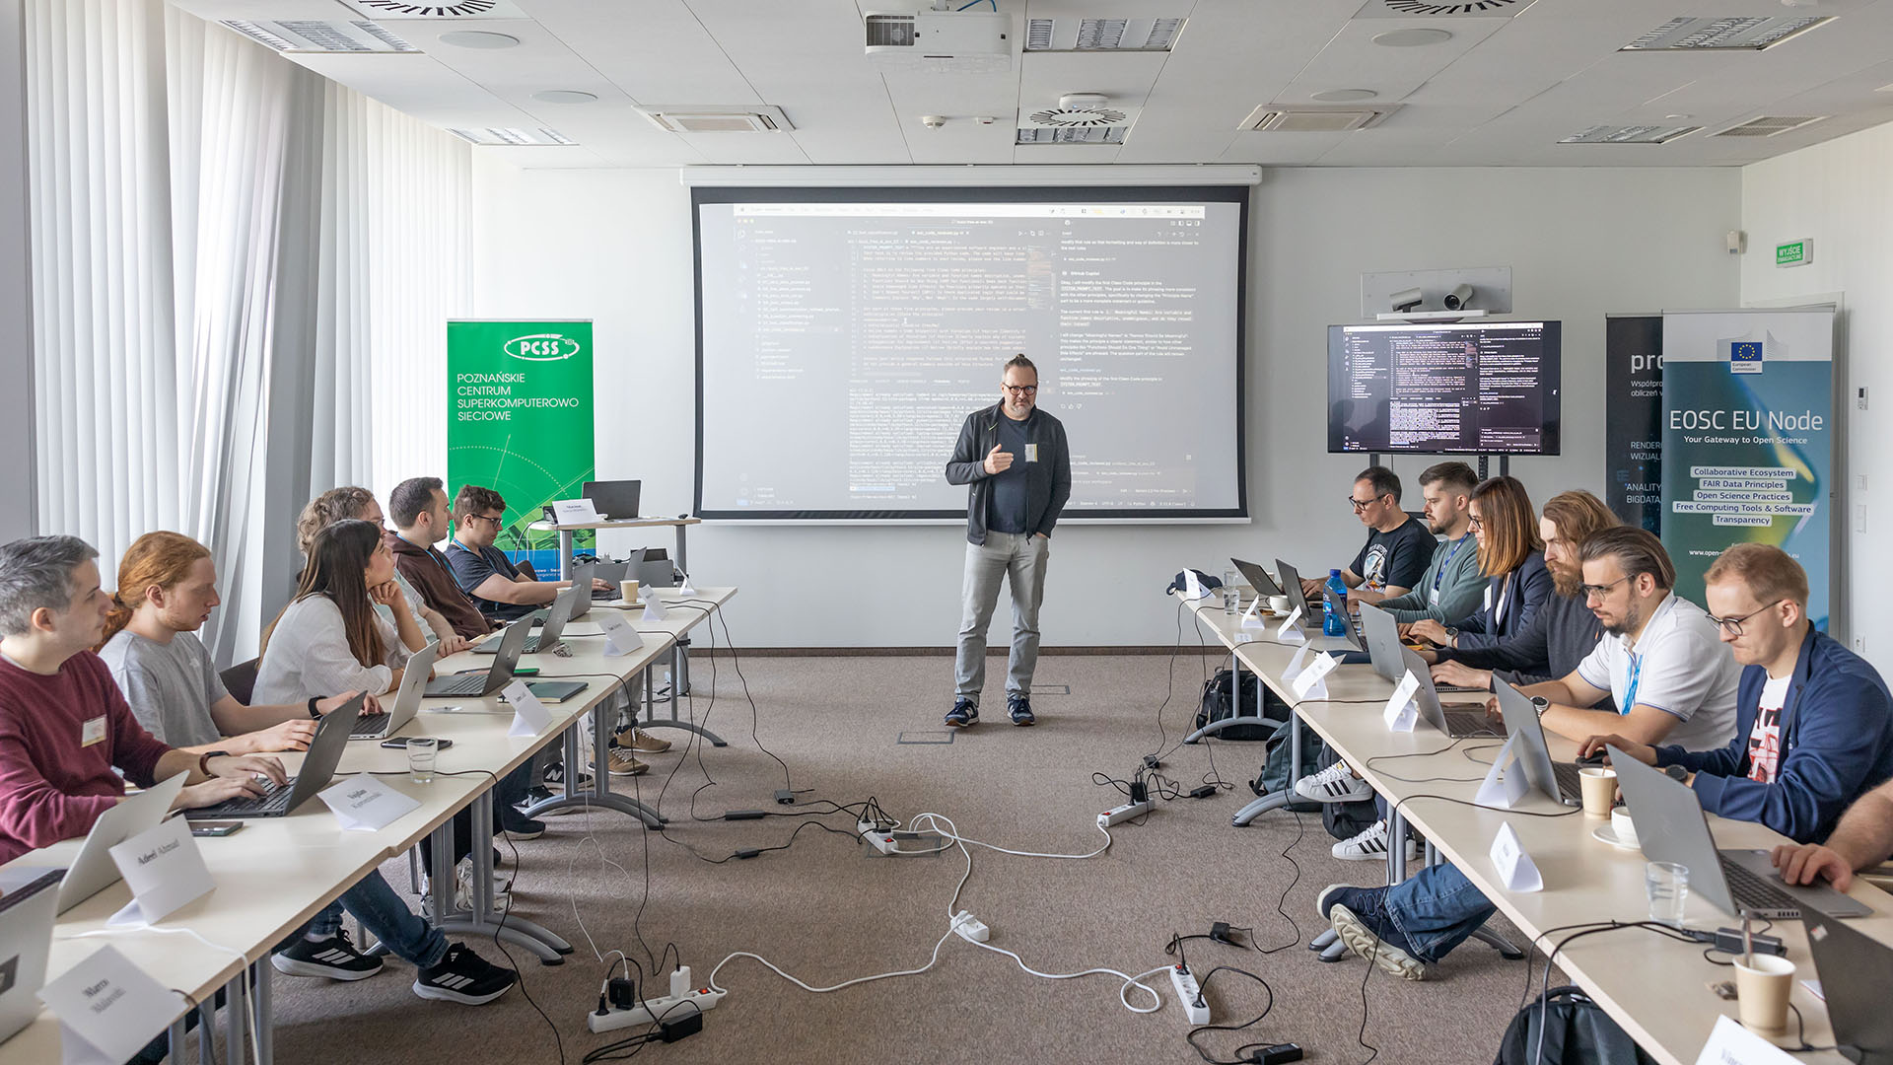
Training and Capability Building
School of Software Engineering`25: „Generative AI buzz-free programming with LLMs”
Secure Code Training `25: „Security of AI and LLM systems”
Notes:
Goal: Build AI skills + security awareness across developers.
School of Software Engineering - GEANT Software Development Support - GÉANT federated confluence
SCT 25: security of AI and large language model (LLM) systems
An introduction to AI and LLM mysteries
Threats classification, based on relevant OWASP standards and Top 10s
HackLLMe contest - a new version of the SCT practical hacking workshop!
Approaches to protect AI and LLM systems against classical hacking and domain threats

Slide 18
AI-Enabled Code Review
Assumption: AI review helps scale verification effort without scaling team size
Objective: Evaluate effectiveness of AI in code review compared to traditional methods:
Approach
  Standard human review
  AI-assisted review
Compare results:
  Accuracy
  Coverage
  Efficiency
Notes:
Spend a couple of minutes about it

Slide 19

AI-Enabled Code Review - methodology
Prompt-driven structured review (LLM)
Input from code inspection tools
  Validation flaws
  Authentication/authorization issues
  Injection vulnerabilities
  Secrets handling problems
A report in a human-readable format:
  Severity, confidence, CWE classification
  Concrete remediation steps
Bring AI closer to professional review standards
Notes:
Agents and tooling (future)
Open source coding agents (e.g., OpenCode)
IDE-based agents (JetBrains – planned)
Prompt-driven structured review:
Focus strictly on security issues
Identify:
Input validation flaws
Authentication/authorization issues
Injection vulnerabilities
Secrets handling problems
Require:
Severity, confidence, CWE classification
Attack scenarios
Concrete remediation steps

Slide 20

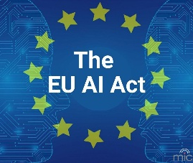

AI-Enabled Code Review – infrastructure and tools
Use LLMs hosted locally
PCSS Cloud (https://pcss.plcloud.pl/)
  Access to open-source models
  Control over data
  ISO 27001/9001
PCSS Local LLMs
  Qwen3-Coder-Next
  Devstral-2-123B
  DeepSeek-V3.1

Slide 21

Towards GÉANT/NRENs User Group
Motivation
  Federated ecosystem with different teams
Goals of the User Group
  Aligh approaches in AI usage
  Share Best Practices
  Create reusable patters
Composition
  GN5.2 Project owners
  Top software contributors
  Active representatives from NRENs
Notes:
AI its a tool, we want to build active SW devel community
Motivation
Active SW projects: 44
Projects marked as GN5-2: 37
-GN5.2 SW contributors: 107
-SW developers: 77
Goals of the User Group
Learn about pains vs gains with regards to the current Task 2 offer
Get better insight into the AI adoption (AI survey follow-up)
Build community around AI in SW development
Share best practices
Composition
Top contributors
Active project owners
Representatives from NRENs
We want to have also representatives from NRENs who take part in the joint development of the

Slide 22
Conclusion

Slide 23
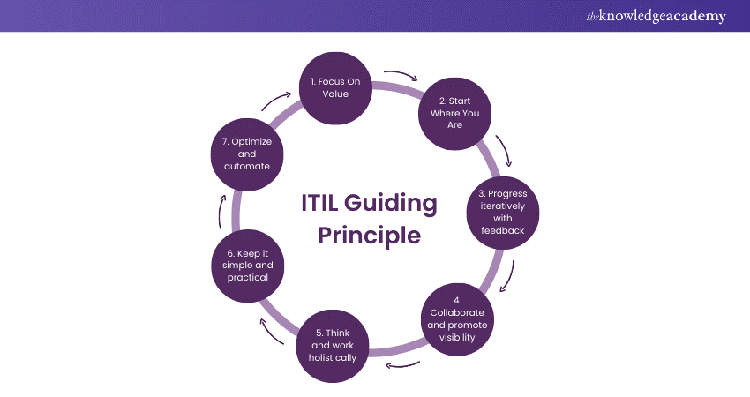
Summary
Notes:
1 – survey
2- current WP9 Task offer
3- work in progres (such as AI-enabled code review)
4 – user group
5-

Slide 24
Summary
AI already transforming GÉANT software development
Governance evolution required:
  Security
  Trust
  Compliance
Hybrid approach:
  AI + tools + human expertise
Notes:
Main messages
AI is transforming software development across GÉANT
Governance must evolve to address:
Security
Trust
Compliance
Hybrid approach is essential:
AI + tools + human expertise
Final statement: The goal is not just faster development — but trusted, secure, and accountable AI-assisted software.

Slide 25
Join the discussion
Contribute to new guidelines and practices
Participate in the upcoming SW development user group

Slide 26
Thank you
Any questions?
marcin.wolski@pcss.pl
toby.rodwell@geant.org

