Slide 1
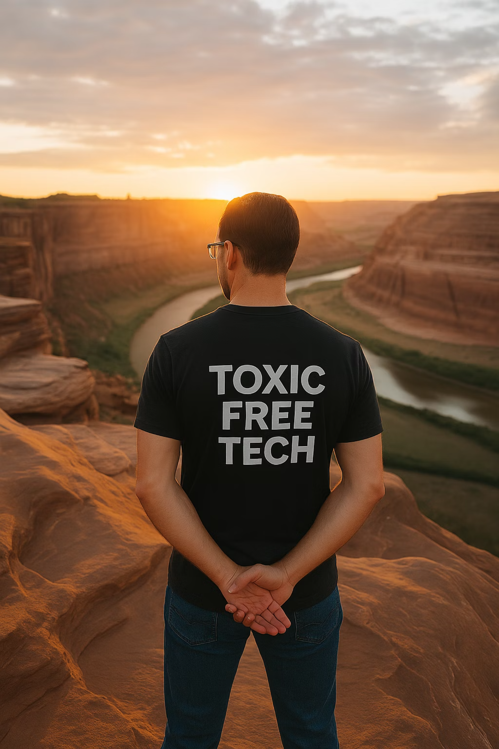
Toxic_Free_Tech
Mental Health and Workplace Culture in Tech: A Personal Perspective
Every day in workplaces across the tech industry, thousands of bright minds struggle silently with mental health challenges. This presentation offers both a deeply personal journey and a roadmap for creating workplace cultures where people can truly thrive. Because sometimes the most important innovation isn't technological—it's human.
Notes:
ToxicFreeTech / Mental Health and Workplace Culture in Tech
“Today is not about numbers or fancy slides. It’s about us – the people in tech. Because the most important innovation isn’t always technology. Sometimes, it’s humanity.”

Slide 2
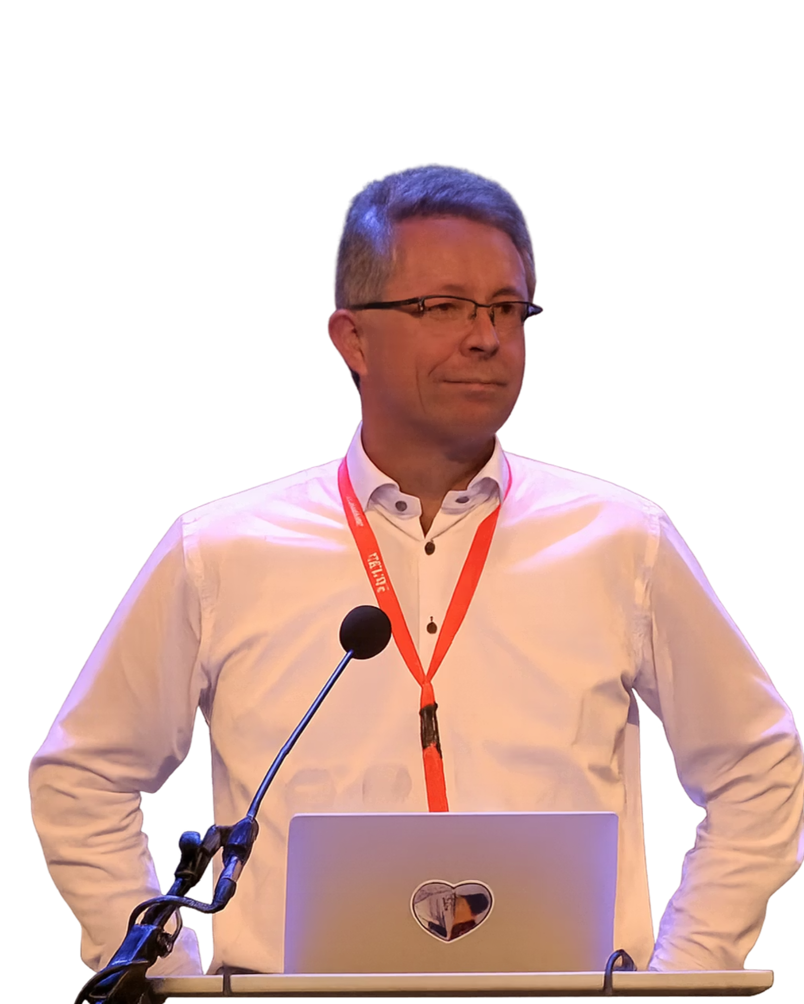
A Friend, A Legacy
There’s someone who was supposed to be here with me today. In 2019, my dear friend Erik Bais stood on the NLNOG stage and said what many were too afraid to say out loud:
“This industry is burning people out. We need to change the way we work – now.”
Erik was more than a friend. He was my ally, my brother in arms. In March 2024, just a few weeks before his sudden passing, we sat down at CloudFest in Rust and agreed to do this work together — to speak up, to build solutions, to protect people like us and the ones we’ve lost.
This isn’t just my story.
It’s ours.
And it continues — with all of you.
Notes:
A Friend, A Legacy
“I wasn’t supposed to be on this stage alone. My friend Erik Bais stood up in Amsterdam back in 2019 and said what many were afraid to: ‘This industry is burning people out. We need to change – now.’ We had planned to do this together. Today, I carry his voice with mine.”

Slide 3
Before the Breakdown
1996-2003
2009- 2014
Early 2011
Training as a chef and second apprenticeship as an office clerk specializing in accounting and IT.
Changed companies, same focus. But now working as Sales Director here.
Complete breakdown and a suicide attempt
1
2
3
4
5
2003-2008
2010
Sales Manager for an international company focusing on IT and infrastructure.
From 2010 onwards, I began trying to compensate for the mounting pressure more intensively with alcohol and stimulant drugs.
For years, I maintained a carefully constructed facade of success. I was the reliable one, the problem-solver, the person who could handle anything. Meanwhile, I was slowly disintegrating behind a screen of achievement and artificial chemical balance.
Then came the collapse. Total. Complete. Public.
Notes:
Before the Breakdown
“From the outside, my life looked great: career, success, status. On the inside? Collapse. Alcohol, drugs, constant pressure. I wore the mask of the reliable achiever – until it all fell apart in 2011. Publicly, and completely.”

Slide 4
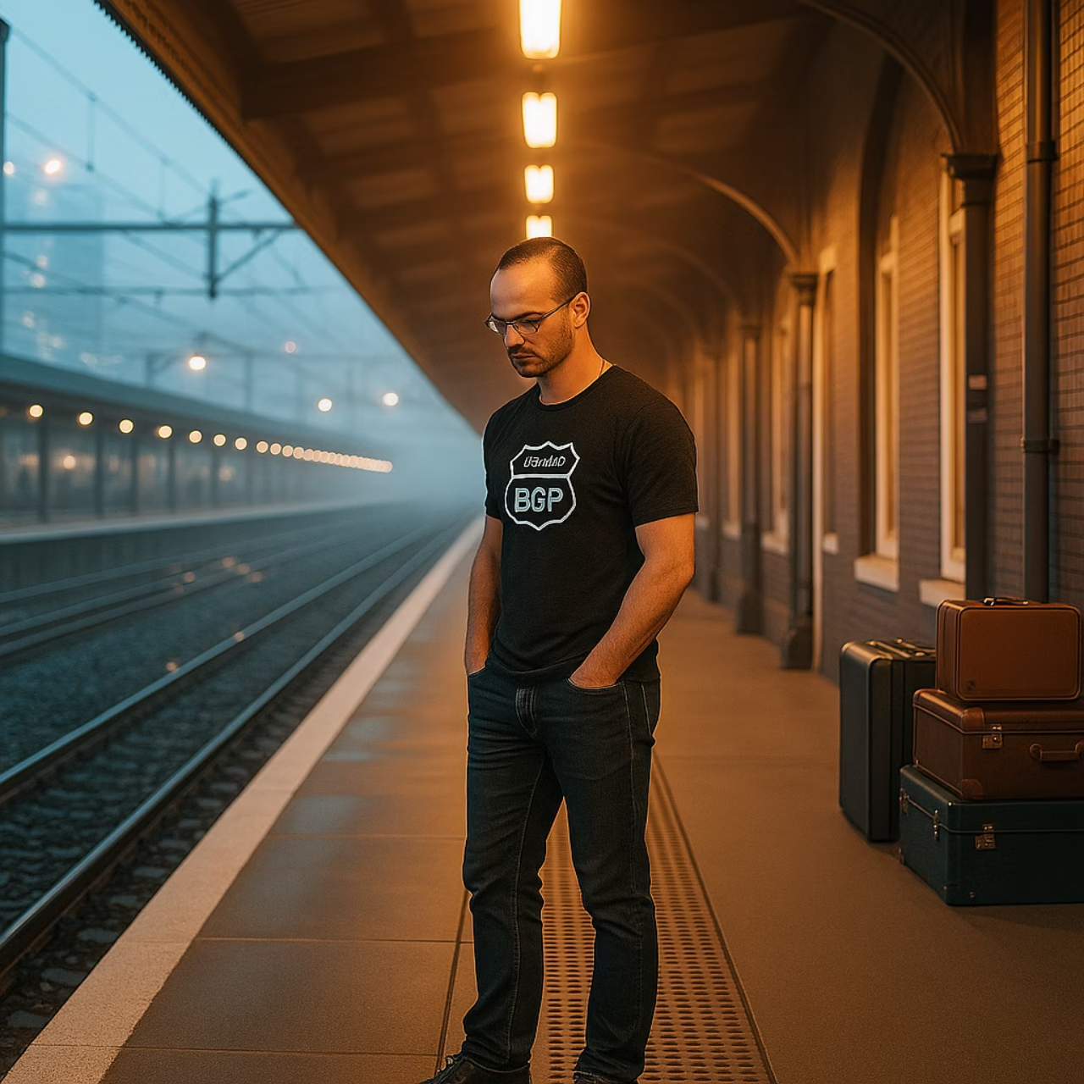
Who am I?
My name is Rene Fichtmueller.
In 2011, I stood at a train station platform in Panketal, Germany. It was 2:17 AM on a Tuesday. I had been awake for 72 hours straight. My heart was racing at 130 beats per minute. My hands wouldn't stop shaking.
I was completely alone, too much work, cheating on my wife, lots of alcohol and stimulants.
I was ready to end my life.
That moment, the moment I nearly became another statistic, is why I'm speaking to you today. Because I survived when too many of our colleagues don't.In short: a little experienced in life, work-life blending friend, diagnosed with ADHD/ ADD (Attention Deficit Disorder) and ICD (Impulse Control Disorder)
Notes:
Who am I?
“My name is René. In 2011, I stood on a train platform in Panketal at 2:17 in the morning. I hadn’t slept in 72 hours, my heart was racing, my hands shaking. I was ready to end my life. I share this not for pity – but because I survived when too many of our colleagues did not.”

Slide 5
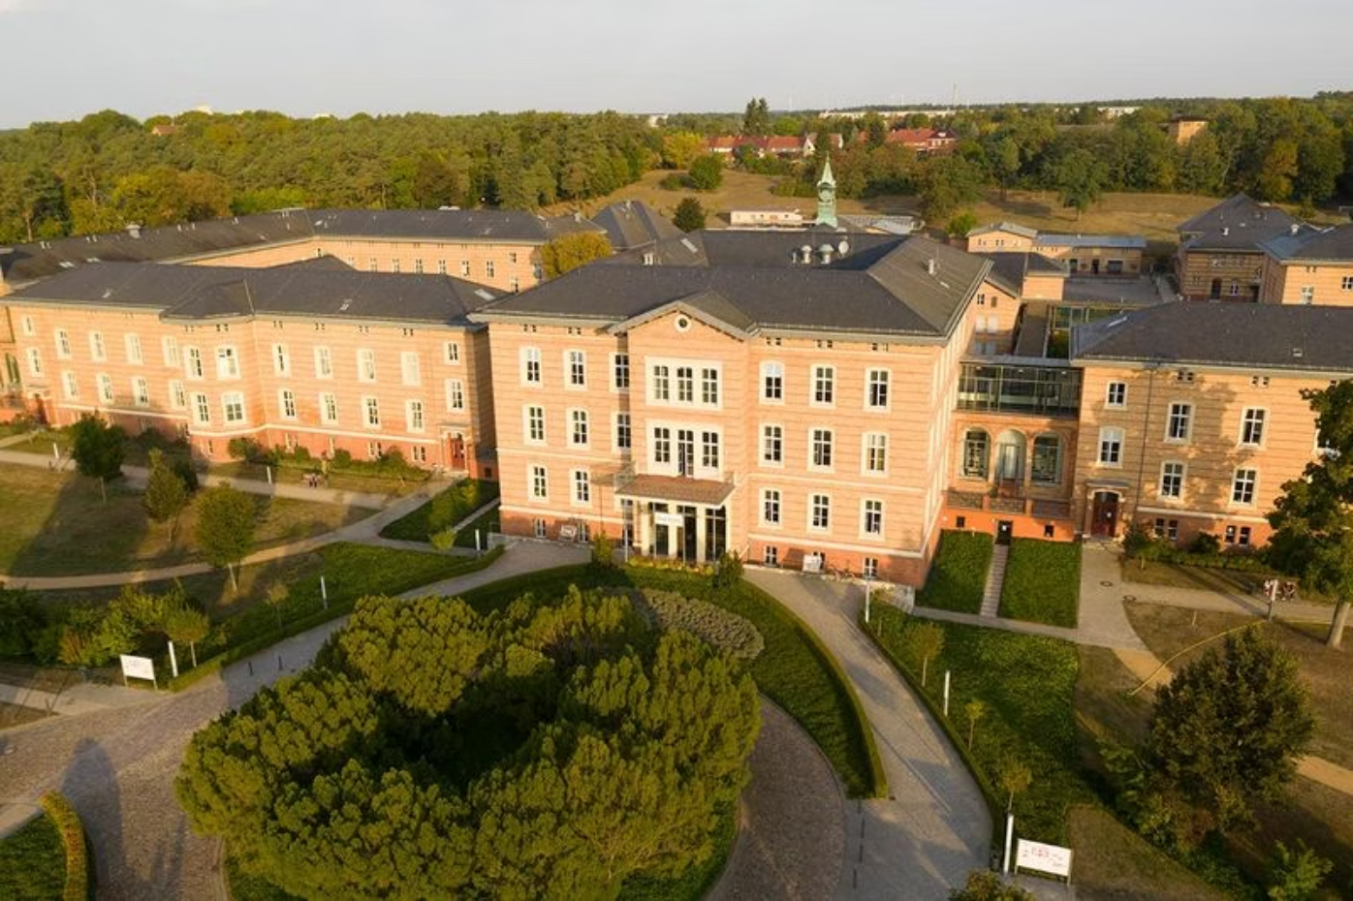
The Turning Point
What followed was the hardest and most important journey of my life:
Three months in psychiatric care. Initially under 24-hour supervision. Learning to breathe again. Learning to sleep without pharmaceutical assistance.
Six months in rehabilitation. Group therapy. Cognitive behavioral therapy. Medication management. Learning that vulnerability isn't weakness—it's human.
One year away from job. No laptop. No smartphone. No constant connectivity. Just the painful, necessary work of reconnecting with myself.
"The moment I admitted I wasn't okay was the moment I began to heal."
I survived because I finally received proper care. I survived because someone noticed. I survived because, despite everything my depression told me, I wasn't actually alone.
And my wife stood by me! ALWAYS!
Notes:
The Turning Poin
“Three months in psychiatric care. Six months of rehab. A year away from work – no laptop, no smartphone. Just the hard work of learning to breathe, to sleep, to live again. It saved me. And my wife stood by me through it all. The moment I admitted ‘I’m not okay’ was the moment I began to heal.”

Slide 6
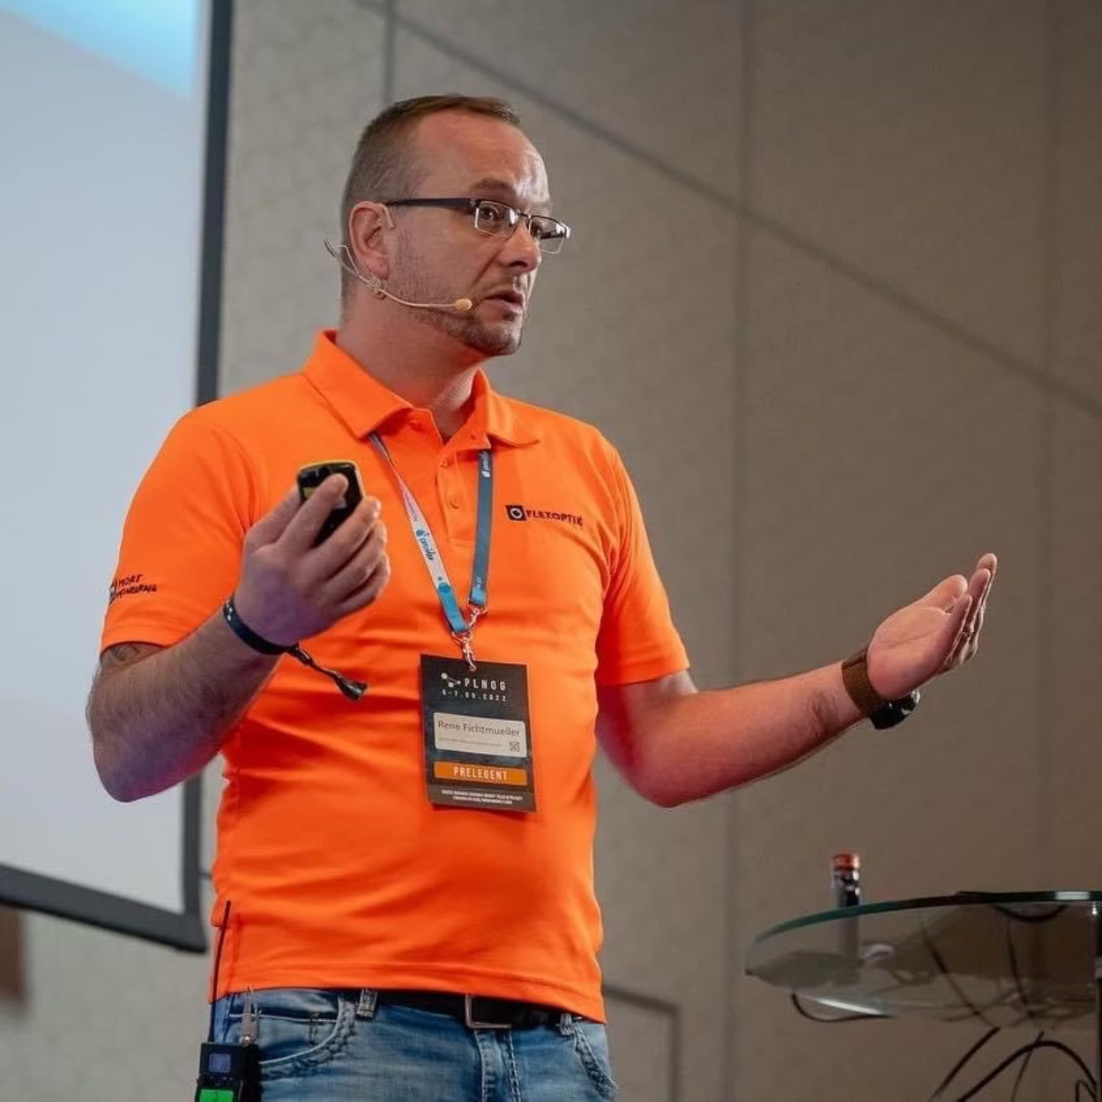
Why I Speak
I speak today because silence kills.
I speak because in the 13 years since my breakdown:
I've attended the funerals of three former colleagues who died by suicide
I've watched dozens more brilliant minds leave the industry due to burnout and mental health crises
I've witnessed companies implement "wellness programs" that amount to little more than PR exercises
But most importantly, I speak because vulnerability heals.
Every time I share my story, someone approaches me afterward—sometimes in person, sometimes via a late-night email—and says, "I thought I was the only one."
You are not the only one. And your struggle deserves to be acknowledged.
Notes:
Why I Speak
“I speak because silence kills. In the 13 years since my breakdown, I’ve been to funerals of colleagues who died by suicide. I’ve watched others burn out and leave the industry. And I’ve seen companies parade ‘wellness programs’ that were nothing but PR. But every time I share my story, someone says: ‘Thank you – I thought I was the only one.’ That’s why I speak.”

Slide 7
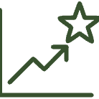
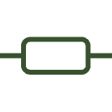

The Reality in Tech
Relentless Pace
Digital Isolation
The Perfection Facade
The tech industry glorifies speed. Sprint after sprint. Release after release. "Move fast and break things" – but what happens when the thing that breaks is you?
We build tools that connect the world while sitting alone at our desks. Remote work offers freedom but can amplify isolation. Slack messages replace human connection.
We maintain carefully curated professional personas. Share the wins, hide the struggles. Imposter syndrome festers in environments where vulnerability is seen as weakness.
76% of tech workers report feeling consistently rushed to meet deadlines, with 68% saying they regularly work outside normal hours to keep pace.
62% of tech employees report feeling disconnected from their colleagues, even when collaborating on the same projects.
83% of developers report experiencing imposter syndrome, yet only 17% have ever discussed it with colleagues.
But behind our smiles and our "I'm fine" responses in stand-ups lies a much more complex reality – one we rarely discuss openly in professional settings.
Notes:
The Reality in Tech
“Let’s be real: this industry runs on relentless speed. Sprint after sprint, release after release. 76% feel constantly rushed, 62% feel isolated, 83% battle impostor syndrome. Behind the wins and the polished updates, there’s often hidden pain.”

Slide 8
The invisible weight and the truth I
No Room for Misstakes
Lack of Trust
Excessive Stress
In a culture that demands perfection, every misstep feels magnified. This pressure stifles innovation and leads to decision paralysis, as the fear of failure outweighs the drive to experiment.
Toxic workplaces often stem from a fundamental lack of trust within the team. When colleagues don't trust each other, collaboration suffers, and a climate of suspicion replaces psychological safety.
Employee stress is rampant, fueled by burnout, poor communication, leadership conflicts, and unclear expectations. This constant pressure leads to declining mental health and reduced productivity.
Notes:
The Invisible Weight I–III
“Perfectionism, lack of trust, constant stress. Office Gossip, high turnover, blurred boundaries between work and life. No career support, low morale, guilt for being sick. These issues quietly eat away at people – and at teams – until they break.”

Slide 9
The invisible weight and the truth II
Office Gossip & Distrust
High Turnover Rates
Unhealthy Work Boundaries
What might seem like harmless chatter actually poisons the well, fueling drama, distrust, and emotional tension. It pits colleagues against each other, eroding team cohesion and creating a truly toxic atmosphere.
Constantly seeing new faces? High employee turnover isn't just an HR problem; it's a glaring symptom of deeper, unresolved issues within the culture. It signals a lack of psychological safety and a failure to retain valuable talent.
In toxic cultures, the line between work and life blurs, then vanishes. Constant demands, unspoken expectations for "always-on" availability, and a lack of respect for personal time systematically destroy work-life balance, leading to chronic stress and burnout.
These insidious elements often remain unaddressed, contributing significantly to the mental and emotional toll on individuals within the tech industry.
Notes:
Intro:
👉 “These are three toxic realities we rarely address – but they quietly destroy teams and people.”
Office Gossip & Distrust
👉 “Gossip may feel harmless, but it poisons trust, fuels drama, and kills collaboration.”
High Turnover Rates
👉 “Constant churn isn’t just HR’s problem – it’s a clear signal the culture is broken.”
Unhealthy Work Boundaries
👉 “When work and life blur, stress becomes permanent. ‘Always-on’ is the fast track to burnout.”
Closing:
👉 “These hidden issues eat away at wellbeing and innovation if we don’t face them head-on.”

Slide 10
The invisible weight and the truth III
Lack of Career Support
Low Morale & Negativity
Sick Guilt
When companies fail to invest in employee development, it leads to stagnation. Without clear pathways for growth, motivation plummets, and talented individuals often seek opportunities elsewhere, feeling undervalued and unsupported.
A pervasive sense of negativity can quickly infect an entire team. When morale is low, productivity dips, collaboration falters, and a toxic atmosphere takes root, making every workday feel heavier than it should.
The pressure to be "always on" fosters a debilitating sense of guilt when employees need to step away due to illness. This "sick guilt" often leads to working while unwell, prolonging recovery and contributing to chronic stress and burnout.
These systemic issues create a heavy, unseen burden on individuals, silently eroding well-being and productivity within the tech industry.
Notes:
Intro:
👉 “Here are three more hidden cultural problems that quietly drain people and teams.”
Lack of Career Support
👉 “When companies don’t invest in growth, motivation dies. People feel stuck, undervalued, and eventually leave.”
Low Morale & Negativity
👉 “Negativity spreads fast. When morale drops, productivity and collaboration collapse, and every day feels heavier than it should.”
Sick Guilt
👉 “The pressure to be ‘always on’ makes people feel guilty for being ill. They work while unwell, delay recovery, and end up burning out.”
Closing:
👉 “These systemic issues create a silent but crushing weight – eroding wellbeing and performance across the industry.”

Slide 11
The Invisible Weight
52%
48%
73%
of tech workers
of engineers
of tech professionals
Report experiencing anxiety symptoms that interfere with their work performance
Have had a panic attack related to work pressures in the past year
Say they've hidden mental health challenges from colleagues out of fear of career repercussions
These statistics represent the daily reality for many in our industry: maintaining professional composure while battling internal storms. The developer who excuses themselves from meetings to manage panic attacks in the bathroom stall. The product manager who smiles through demos while fighting suicidal ideation. The UX designer who can't sleep for days before presentations due to crippling anxiety.
We've become experts at hiding our struggles – and that silence is killing us.
Notes:
Hard Numbers
“52% experience anxiety symptoms. 48% had panic attacks in the past year. 73% hide mental health struggles out of fear. We’ve become experts at masking – and that silence is what kills.”

Slide 12



Guilt Culture
Tech has developed a particularly toxic relationship with mental health:
"Always On" Expectation
The "Passion" Trap
Survivorship Bias
The line between work and life has been completely erased. Weekend Slack messages. Midnight emails. Taking vacation but keeping one eye on notifications. Being physically present with loved ones while mentally at work.
"If you love what you do, you'll never work a day in your life." This toxic mantra justifies unhealthy work practices. If you're not willing to sacrifice your wellbeing, maybe you're just not passionate enough.
We celebrate the exceptional cases who thrived under pressure while ignoring the countless people who burned out trying to emulate them. For every success story, dozens have quietly disappeared.
Notes:
Guilt Culture
“Always-on culture. The toxic myth that ‘if you love your job, it’s not really work.’ Survivorship bias that celebrates the few who thrive while ignoring the many who burn out. These aren’t motivators – they’re fuel for burnout.”

Slide 13








The Cost
Business Cost
Human Cost
Reduced productivity. Increased errors. High turnover. Lost institutional knowledge. The World Economic Forum estimates mental health costs businesses $1 trillion annually in lost productivity.
Depression, anxiety, substance abuse, and suicide. Lost relationships. Shattered families. Lives permanently altered by preventable mental health crises.
Industry Cost
Innovation Cost
Talented people leave tech entirely. Diverse perspectives are lost. Our industry becomes increasingly homogeneous, represented only by those who can endure toxic conditions.
Psychological safety is essential for creative thinking. Environments where people fear vulnerability crush innovation. The products we build reflect our mental state.
When we fail to address mental health in tech workplaces, everyone loses. The individuals suffering in silence. The companies losing talent and innovation. The industry becoming less vibrant and diverse. And ultimately, society itself, as we build technology in our own distorted image.
Notes:
The Cost
“The costs are enormous. Human cost: depression, broken families, lost lives. Business cost: over one trillion dollars a year in lost productivity. Innovation cost: crushed creativity in unsafe environments. Industry cost: diverse talent leaves, making tech less inclusive and less resilient.”

Slide 14
How Companies Can Help
1
2
3
Create Genuinely Safe Spaces
Listen- "Really" Listen
Take Meaningful Action
Not just lip service about "bringing your whole self to work," but concrete policies that prove vulnerability won't be punished:
Go beyond annual surveys and create ongoing feedback mechanisms:
Move beyond symbolic gestures to structural changes:
Regular, anonymous pulse checks on team mental health
Adjust timelines when teams show signs of burnout
Mental health days that don't count against sick leave
Trained mental health first responders in every department
Build recovery periods into project plans
Leaders who model appropriate self-disclosure
Train managers to recognize distress signals
Facilitated discussions about work pressure and burnout
Create clear pathways to support that preserve privacy
Performance reviews that consider sustainable work patterns
Exit interviews that specifically address wellbeing factors
Measure success not just by output but by sustainability
Normalized breaks and boundaries
The most effective interventions are those that address root causes in company culture, not just symptoms. Creating a mentally healthy workplace isn't about hiring a Chief Wellness Officer—it's about fundamentally rethinking how we work.
Notes:
How Companies Can Help
“Companies can act now:
Create safe spaces – with real policies like mental health days.
Really listen – with ongoing check-ins, not just yearly surveys.
Take action – adapt deadlines, train managers, and measure success by sustainability, not just output.
It’s not about quick fixes – it’s about changing culture.”

Slide 15
A Final Ask
When this presentation ends, you'll return to your daily work. To your deadlines and meetings and Slack notifications.
But I ask you to carry one thing with you:
Don't go home silent.
Go home open.
Open to noticing your own mental state.
Open to recognizing the signs of struggle in your colleagues.
#Open to creating spaces where people can speak honestly about the challenges they face.
Because that openness—that willingness to listen and be heard—is what saves lives. It might have saved mine, years ago on that train platform. And it might save someone in your workplace tomorrow.
Notes:
A Final Ask
“My ask is simple: Don’t go home silent. Go home open. Open to noticing your own state. Open to recognizing signs in your colleagues. Open to creating spaces where people can speak honestly. That openness saves lives. It saved mine.”

Slide 16

Scan to Connect
Let's continue this conversation beyond today. Scan this QR code to:
Join our community of tech professionals committed to mental health advocacy
Access industry-specific resources for managing workplace stress
Connect with trained peer supporters who understand the unique challenges of tech work
Request a workplace culture assessment for your company
Book a speaker for your next company event or team meeting
You are not alone in this work. Together, we can create tech workplaces where both innovation and human wellbeing thrive—where no one has to choose between their career and their mental health.
Let's change this together, one conversation at a time.
Notes:
Scan to Connect
“Want to continue? Scan the code. Join the community, get resources, connect with peers, book workshops. Because change doesn’t happen alone – it happens together.”

Slide 17

Thank You
For listening
For feeling
For not looking away
Rene Fichtmueller
rf@flexoptix.net
Notes:
Thank You
“Thank you for listening. Thank you for not looking away. And thank you for choosing to be part of a healthier tech culture.”

