Slide 1
We Don’t Want Another Hero
Brian Nisbet, Asiera
Helsiniki, Finland
11th June 2026

Slide 2
Photo by Godz1 on Unsplash
Notes:
Fado, Fado in Eoraip, or Once Upon a Time in Europe, the battered and burnt-out hero returned from slaying the great beast (probably some LLM related nonsense, or the DNS, maybe BGP?) and lo the people of the NREN said onto them, “Thank you, but... we could have helped, and we have rotas and processes and management support.” And then they looked around at all of the banners glorifying heroism and at all the work that was left to do and lo, they were confused.

Slide 3
Photo by Tom Barrett on Unsplash
Notes:
Because here’s the thing about heroes, so much of what we think about them is made-up. So many examples of them in media are exceptional humans, or super heroes, or failures who just happen to manage to do the right thing and succeed. They’re scripted narratives (that I often hugely enjoy), but even when we know that’s what they are, it seeps into our brains. And even those stories tend to be short and often have a happy ending, not go on for years, or entire careers. Of course there are stories where it’s plainly shown how ongoing heroism breaks people, but that’s a whole other talk for a different type of conference.
Speaking of whole other talks, I chose this image being fully aware that NRENs are not medical professionals and there is no attempt to claim the amazing work they do for us, but glorifying them as heroes (especially during the heights of the COVID pandemic) did a lot of harm. So not the right place, and anyway, I’m not qualified to give that talk.
But I am qualified to talk about NRENs, so let’s do that! One of the USPs of NRENs is that we know our clients better than a corporate entity could. In a lot of cases, including Asiera’s, we’re a membership based company and we work hard to be a partner to our clients, not a vendor. When they email us or pick up the phone we know who they are, what services they have, what issues they’ve been experiencing. We care and we want to make sure that care is translated into great services with awesome uptimes.
We also care about our staff, don’t we? Primarily because they’re people and we should care about people without justification or reservation, but also because they do an awesome job, and because we’ve invested in them and need them to provide that service to our clients.
Unfortunately it’s very easy for the former to eclipse the latter, both on an individual and company basis. It’s easy for people to feel that if they don’t do the heroic thing then the client will be unhappy, or worse, they’ll be blamed. These could be individual engineers, or managers, with the latter not delegating enough, or pushing their own staff to go beyond. While people could talk for hours about bad management techniques, today is about the failure mode of heroics, whether permitted from the top, or individually generated. This talk is about how heroes may appear to be awesome, but that we don’t want them, and that nobody should want them.
And when I say “awesome” I mean that in a variety of ways. One of the biggest organisational failures for heroism is that they often are single points of awesome and when they’re not around (see “fleshy humans”) things break, often badly.
This is something we’ve talked about in Asiera for a while, but I’m not trying to claim we’re perfect. We’re all fleshy humans just like you, but it’s all a process, day-by-day.

Slide 4

Photo by Marek Piwnicki on Unsplash
Notes:
But, Brian, you’ll say, I have to do that because:
My NREN is tiny;
My NREN is underfunded;
If I don’t do it, nobody will;
It shows I care;
It shows we, as an NREN, care;
Short term things happen, especially in the beginning, but people can convince themselves that short term is forever, or even that a break of a week resets everything
URAN complete exception, that is not normal times, no matter how long it goes on for, but there are whole other talks about long term crises and we have lots to learn
Who are people trying to convince? If there’s no push back, then those with the purse-strings etc. will just agree and move on

Slide 5
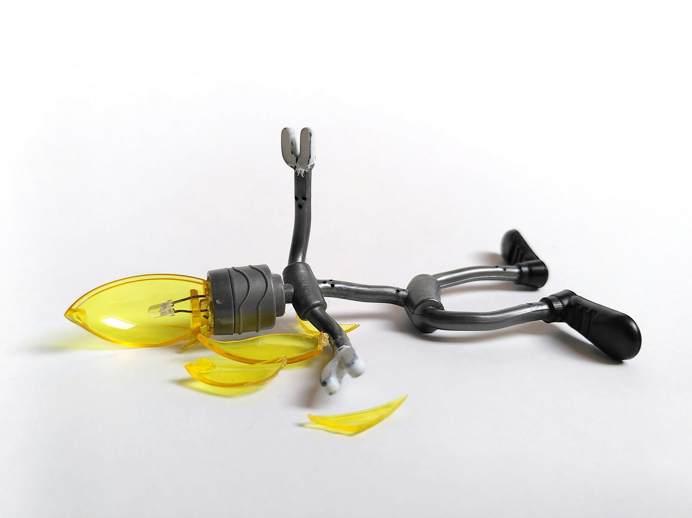
Photo by Rudi Endresen on Unsplash
Notes:
Burn-out and worse;
Doing more with less;
Unreasonable expectations to clients build;
Unreasonable expectations to funders build;
The kind of heroics I’m talking about fixes immediate problems, not the underlying issue;
In fact masks underlying issue;
Sets up a bad workplace culture;
Makes hiring more difficult;
Single Point of Awesome;
It’s bad for the people you care about.

Slide 6
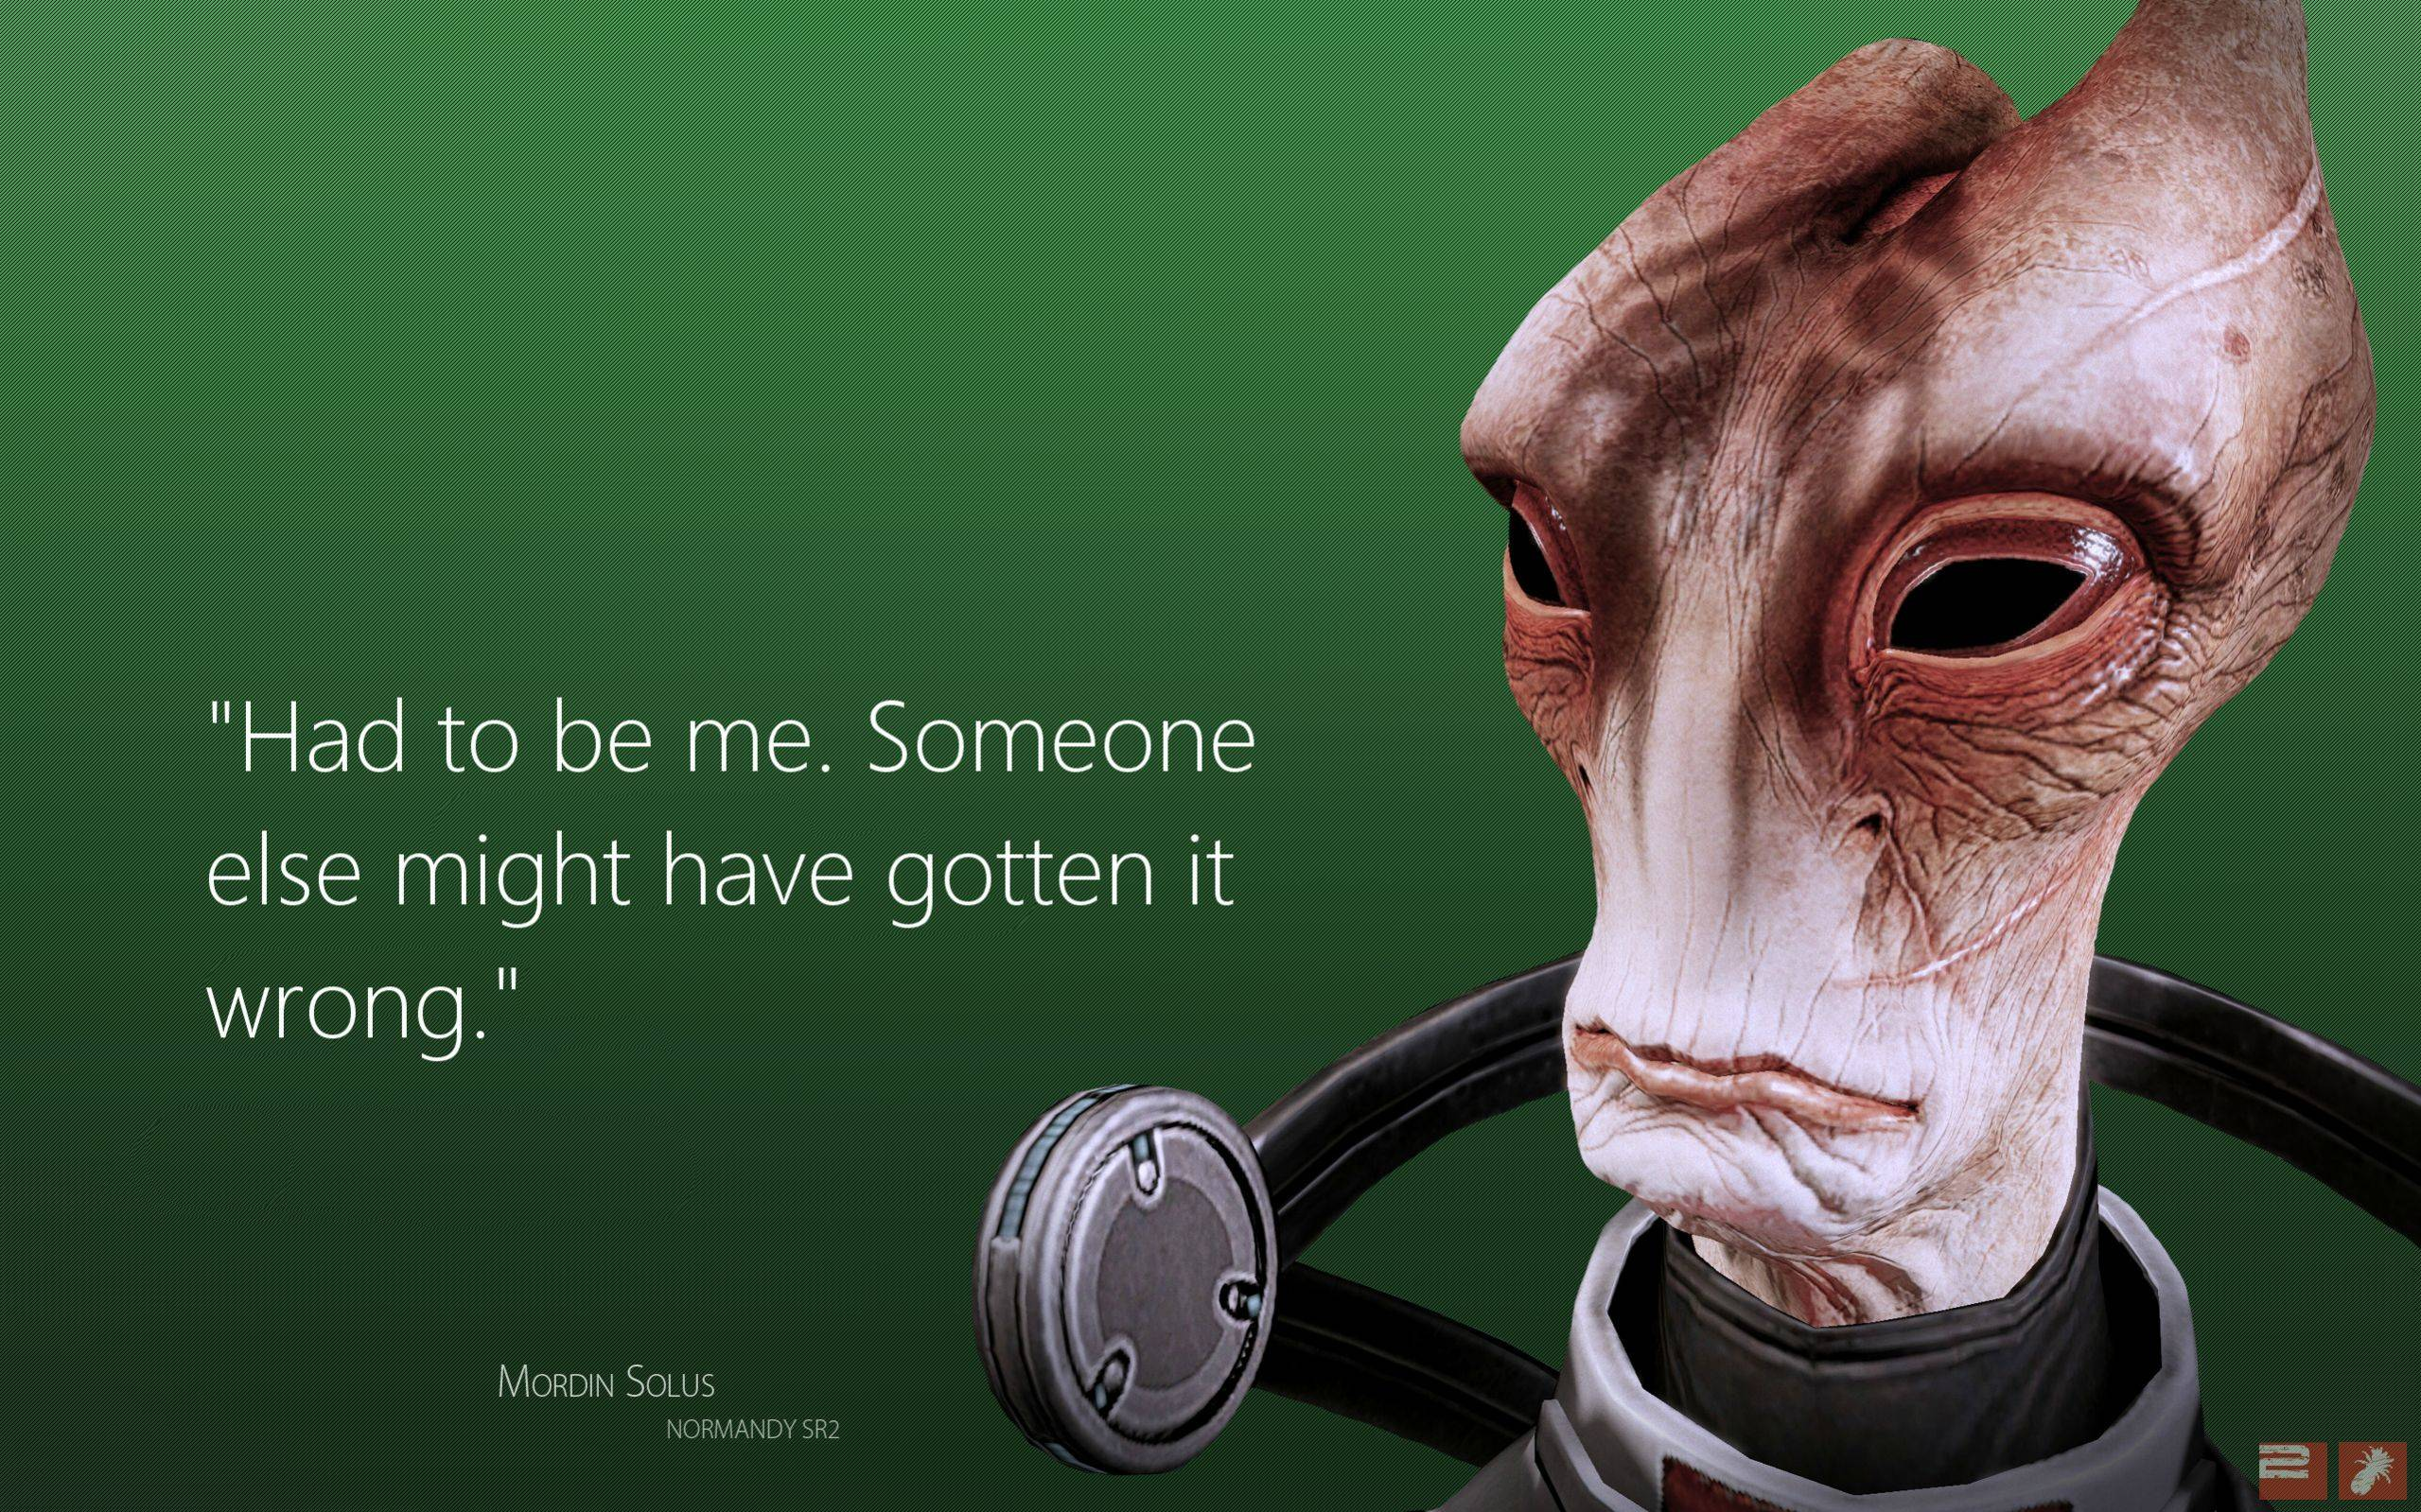
Notes:
These may have been conversations, they may have been followed-thru on:
We need to send an engineer to every site in case the 3rd party messes up, so I’ll do it;
From Masto: “A staff engineer at my old company got laid off during “cost cutting”; his entirely farewell meeting was 12 minutes long. Week later: payment service started randomly failing. Turns out he was manually fixing edge-ca data corruption ever night for 3 years. Nobody even knew. The most dangerous systems are the ones surviving because of one invisible engineer.”
Recent large project, staff member noticed and fixed, off their own bat, a bunch of stuff the project team wasn’t aware of/didn’t account for, but it was too late to shout stop on the project;
We can’t do this without me, it would put too much burden on others;
I can’t hand this over, it would put too much burden on others;
Had to be me. Someone else might have gotten it wrong;

Slide 7
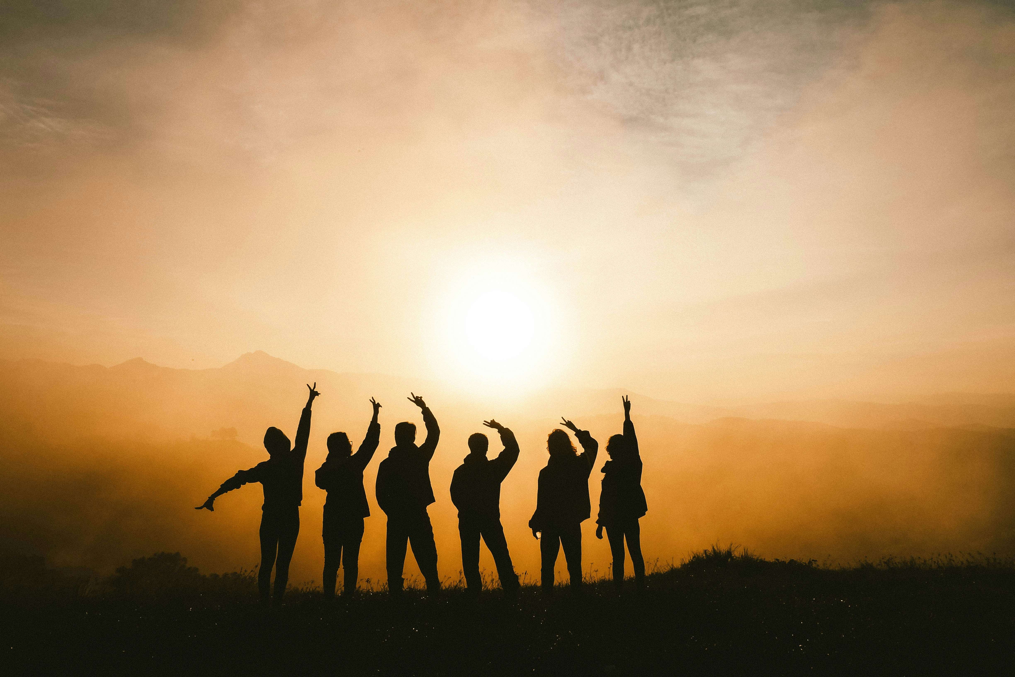
Photo by Chang Duong on Unsplash
Notes:
What Can We Do?
Reevaluating the case we make for documentation and SOPs and why they’re vital;
Hiring staff who can write and run such processes properly and/or training current staff to do so;
Normalising handover and taking breaks, especially during a crisis;
Practising crisis situations without key personnel;
Being honest about resiliency and funding, both internally and with clients;
Ensuring that staff have the management support they need;
Praising consistent, day-to-day work above acts of heroism.

Slide 8
Thank you
Any questions?
brian.nisbet@asiera.ie
@natural20.bsky.social
@natural20@mastodon.ie

