Slide 1
Situational Leadership
Adapting your leadership style to the person, the task, and the moment
Radu Velcea
TNC26
June 10, 2026
Notes:
Today we’ll explore a leadership model that is very useful because it reminds us of something simple but often forgotten: people do not need the same leadership all the time. The same person may need clear direction in one task, encouragement in another, and full delegation in a third

Slide 2
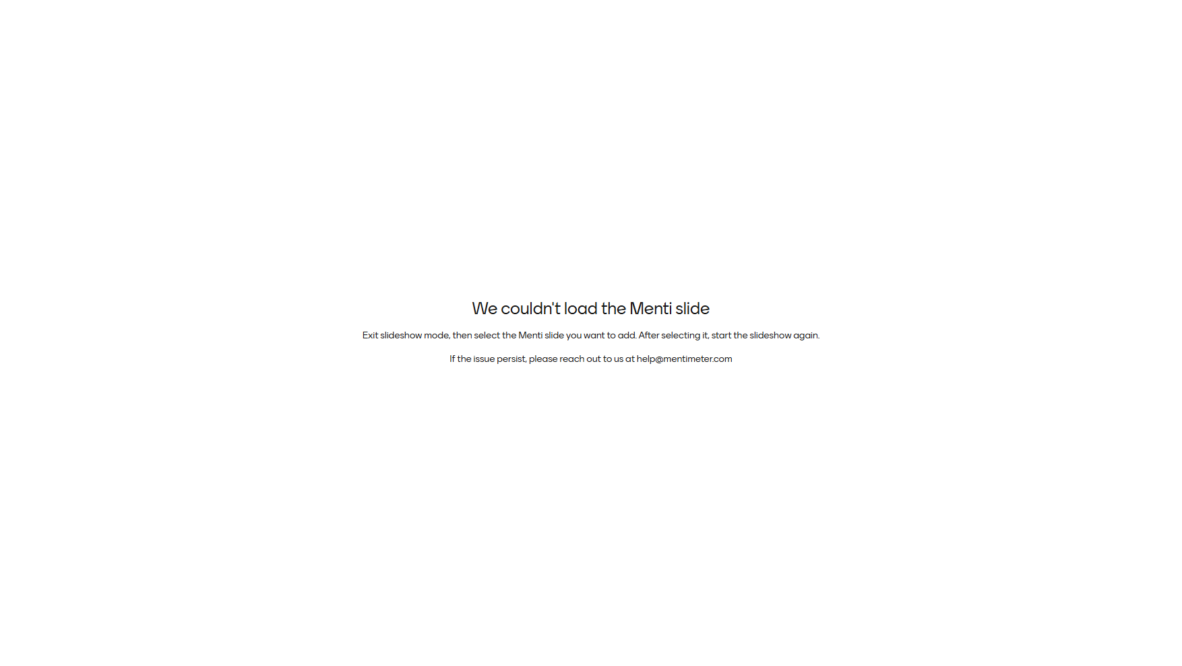
Notes:
Facilitator notes:
After results appear, say:
“There is no single perfect answer here. The real question is: what does the person need in that specific situation?”
Transition:
“That is exactly what Situational Leadership helps us think through.”

Slide 3
One central question
What does this person need from me right now?
Not in general.
Not as a fixed personality label.
But for this specific:
Task
Goal
Responsibility
Moment
Notes:
Facilitator notes:
This is your anchor slide.
Suggested script:
“The model is not about deciding that someone is a beginner or an expert as a person. Someone may be very experienced in one area and completely new in another. The key is to look at the person in relation to a specific task.”

Slide 4
Quick reflection: same person, different task
Think of one person you work with
For one task, they may need a lot of guidance.
For another task, they may be completely independent.
Pair discussion: 2 minutes
Discuss with the person next to you:
“What is one example where the same person might need different leadership depending on the task?”
Notes:
Theatre format works well with “turn to your neighbour”.
Keep this short.
Debrief with 2–3 voices:
“What did you notice?”
Expected insight:
The same person can be at different levels depending on the task.

Slide 5
Situational Leadership
Leadership styles
How the leader behaves
Development levels
What the individual needs for a specific task
Notes:
“The model has two parts: leadership styles and development levels.”
“Leadership styles are about what the leader does.”
“Development levels are about what the individual needs for a specific task.”
“This is not about labelling people. It is about diagnosing the situation.”
“The same person can need different leadership depending on the task.”
“The key question is: What does this person need from me for this task, right now?”
“We’ll first look at the leadership styles, then connect them to development levels.”

Slide 6
Situational Leadership
Directive behaviour
The leader gives clarity about:
What to do
How to do it
When to do it
What good looks like
How progress will be checked
Supportive behaviour
The leader helps through:
Listening
Encouraging
Asking questions
Involving the person
Building confidence
Facilitating decisions
Notes:
Directive does not mean controlling. Supportive does not mean simply being nice. Both can be very helpful when they match the person’s need.

Slide 7

Notes:
“Why is B directive?”
Expected answer:
Because the leader provides clear structure and tells the person how to proceed.
Follow-up:
“Could directive behaviour still be respectful and empowering?”
Answer:
Yes, if the person needs clarity.

Slide 8
Pair challenge: classify the behaviour
Statements
“Use this template, complete sections 1–3 and send me a draft by Thursday.”
“What part of this task feels unclear or difficult right now?”
“Let’s review your draft together tomorrow, and I’ll help you identify the next improvements.”
“I’m sure you’ll manage somehow.”
“Here is the process to follow, and if you get stuck, come to me and we’ll work through it.”
“You decide the approach and update me when the final version is ready.”
Notes:
“Use this template, complete sections 1–3, and send me a draft by Thursday.”Directive
2. “What part of this task feels unclear or difficult right now?”Supportive
3. “Let’s review your draft together tomorrow, and I’ll help you identify the next improvements.”Both
4. “I’m sure you’ll manage somehow.”None / unclear
5. “Here is the process to follow, and if you get stuck, come to me and we’ll work through it.”Both
6. “You decide the approach and update me when the final version is ready.”Low directive / low supportive — Delegating

Slide 9
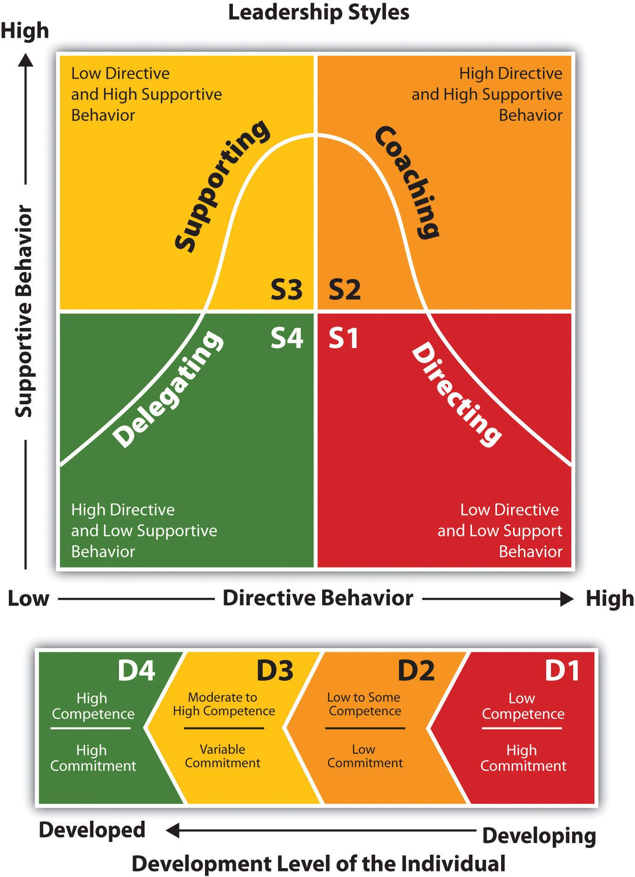
The leadership style matrix
Style | Directive behaviour | Supportive behaviour
S1 Directing | High | Low
S2 Coaching | High | High
S3 Supporting | Low | High
S4 Delegating | Low | Low
Notes:
The horizontal axis is directive behaviour. The vertical axis is supportive behaviour. By combining high and low levels of each, we get four leadership styles.

Slide 10
S1 Directing
High directive, low supportive
Useful when someone needs:
Clear instructions
Structure
Demonstration
Close follow-up
Frequent feedback
Notes:
Leader language:
“Here is the goal, here are the steps, and let’s check progress tomorrow.”
Clarify that “low supportive” does not mean cold or unfriendly.
Say:
“It means the main need is not emotional support or involvement yet. The main need is clarity.”

Slide 11
S2 Coaching
High directive, high supportive
Useful when someone needs:
Guidance
Explanation
Encouragement
Reassurance
Practice
Feedback
Notes:
Leader language:
“Let me explain why this matters. We’ll work through it together, and I’ll support you as you build confidence.”
This is often the most effortful style for the leader.
Say:
“Coaching in this model is not only asking questions. It includes both direction and support.”

Slide 12
S3 Supporting
Low directive, high supportive
Useful when someone:
Has the skills
Can contribute
Needs confidence
Wants involvement
May be hesitant or self-critical
Notes:
Leader language:
“You have the skills. What approach do you think would work best?”
Facilitator notes:
Stress that the leader avoids over-directing here.
Say:
“With S3, the leader does not need to explain every step. The person can do the task, but may need confidence, encouragement, or a thinking partner.”

Slide 13
S4 Delegating
Low directive, low supportive
Useful when someone:
Is competent
Is confident
Is motivated
Can work independently
Is ready to own the outcome
Notes:
Leader language:
“You own this. Keep me updated on key milestones, and let me know if you need anything.”
Facilitator notes:
Clarify that delegating is not disappearing.
Say:
“Delegating still includes clarity on outcomes and availability. It does not mean abandoning the person.”

Slide 14
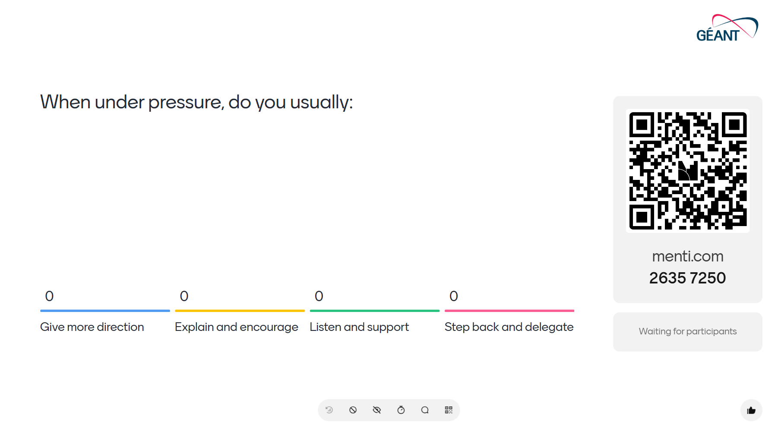

Slide 15
Development levels
Level | Name | Competence | Commitment
D1 | Enthusiastic beginner | Low | High
D2 | Disillusioned learner | Low to some | Low
D3 | Capable but cautious contributor | Moderate to High | Variable
D4 | Self-reliant achiever | High | High
Notes:
“From right to left, the person moves from developing to developed. But this is not always linear. A new task can move someone back to D1, D2, or D3.”
D1: Enthusiastic beginner
Low competence, high commitment
Typical signs:
New to the task
Excited to start
Eager to learn
May underestimate the difficulty
Does not yet know what they do not know
Leadership need:
Clear direction
Best match:
S1 Directing
Facilitator notes:
Example:
“A new colleague is excited to prepare their first project update but has never used the internal template or process before.”
D2: Disillusioned learner
Low to some competence, low commitment
Typical signs:
Has started learning
Realises the task is harder than expected
Makes mistakes
Feels frustrated or overwhelmed
Confidence drops
May want to give up
Leadership need:
Direction and support
Best match:
S2 Coaching
Facilitator notes:
Say:
“This is where leaders often need patience. The person is not failing; they are in the messy middle of learning.”
D3: Capable but cautious contributor
Moderate to high competence, variable commitment
Typical signs:
Can do the task
Has relevant experience
Makes useful contributions
May still seek reassurance
May be self-critical
May be confident one day and hesitant the next
Leadership need:
Support and confidence-building
Best match:
S3 Supporting
Facilitator notes:
Say:
“Too much direction here can reduce confidence. The person needs support, not step-by-step instruction.”
D4: Self-reliant achiever
High competence, high commitment
Typical signs:
Consistently competent
Autonomous
Confident
Motivated
Recognised as an expert
May inspire others
Leadership need:
Autonomy and trust
Best match:
S4 Delegating
Facilitator notes:
Say:
“This is where the leader creates space. Too much involvement may feel like micromanagement.”

Slide 16


Slide 17


Slide 19


Slide 20
The four ideal matches
Development level | Person’s need | Leadership style
D1 | Direction | S1 Directing
D2 | Direction and support | S2 Coaching
D3 | Support | S3 Supporting
D4 | Autonomy | S4 Delegating

Slide 21
Diagnose first. Then adapt.
Ask:
What is the specific task?
What is the person’s competence?
What is the person’s commitment?
What do they need more of: direction, support, or autonomy?
Which style fits best?
Notes:
“Now the full model should be easier to read. The top shows the leadership styles. The bottom shows the development levels. The practical move is matching the bottom to the top.”

Slide 22

Notes:
Facilitator notes:
Ask:
“Why not S1?”
Expected:
They need direction, but also encouragement and support.
Ask:
“Why not S4?”
Expected:
They are not ready for autonomy yet.

Slide 23
Pair practice: what should the leader say?
Same scenario
A team member is discouraged after two difficult stakeholder meetings.
Pair discussion: 2 minutes
What should the leader say or do next?
Try to include both:
Direction
Support
Notes:
Ask for 2–3 examples.
Possible strong answer:
“You’ve made a good start, and stakeholder meetings can be difficult at first. Let’s review what happened, identify two things to improve, and prepare the next meeting together.”
Debrief:
Highlight where the answer includes direction and where it includes support.

Slide 24
Mismatches
When the style does not fit the need
There are two common mismatches:
Over-supervision
Too much direction or support.
Under-supervision
Too little direction or support.
Notes:
Leadership can miss the mark in two opposite ways. We can give too much and make people feel micromanaged. Or we can give too little and make people feel abandoned.”
Too much leadership for the situation
Example:
Using S1 Directing with a D4 expert
Possible impact:
Feels like micromanagement
Expertise feels ignored
Motivation drops
Trust is damaged
Facilitator notes:
Ask:
“Have you ever seen someone lose energy because they were over-managed?”
No need for long stories. Just a few nods or brief comments.
Slide 31 — Under-supervision
Too little leadership for the situation
Example:
Using S4 Delegating with a D1 beginner
Possible impact:
Feels like abandonment
Confusion increases
Mistakes increase
Confidence drops
Facilitator notes:
Say:
“Delegating too early can look like empowerment from the leader’s perspective, but feel like abandonment from the employee’s perspective.”

Slide 25


Slide 26
Personal application
Think of one real situation
Choose one person and one task.
Reflect:
What is the task?
What is their competence for this task?
What is their commitment or confidence?
What development level might they be at?
What leadership style would best match their need?
Notes:
Facilitator notes:
Give people two silent minutes.
Then ask them to turn to a neighbour:
“Share only the task and the leadership style. No names.”
This keeps it safe.

Slide 27
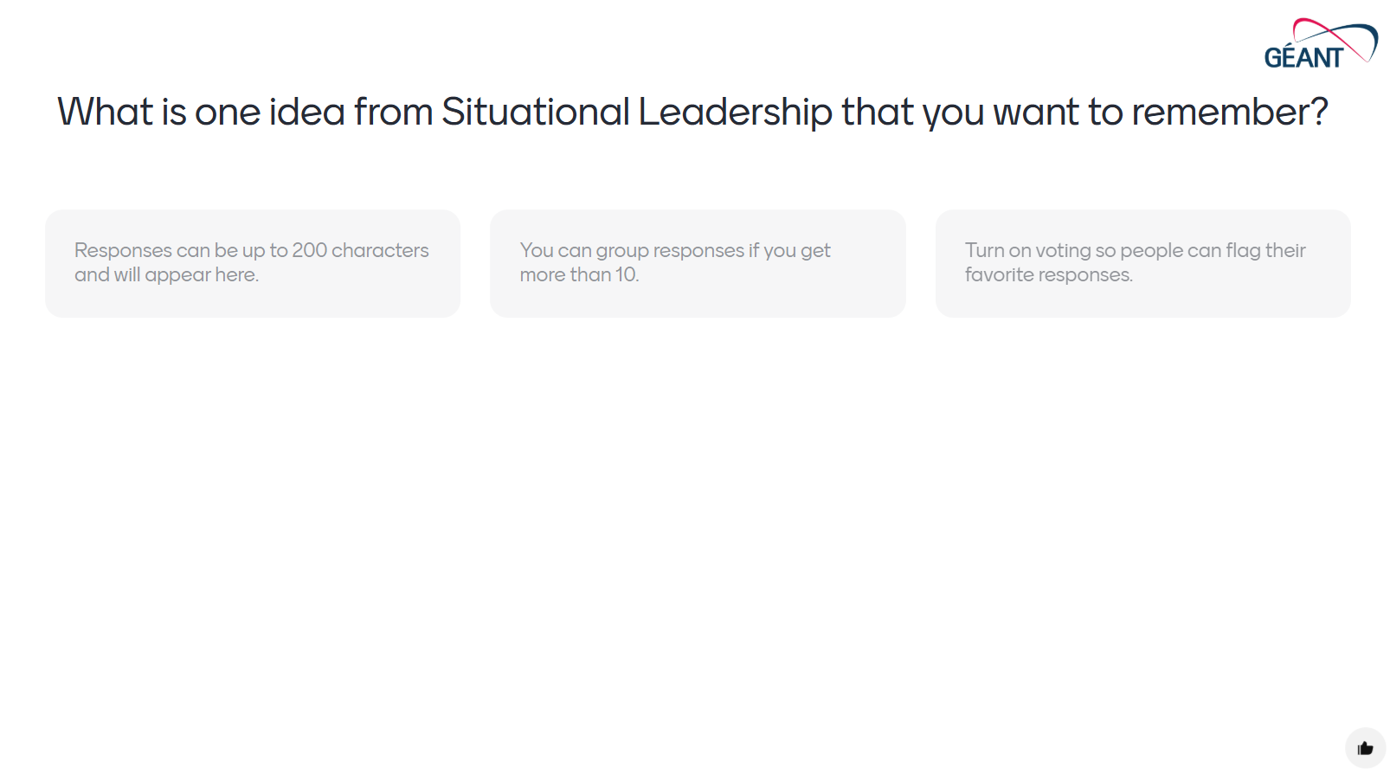
Notes:
Possible participant answers:
Diagnose the task, not the person.
Do not delegate too early.
Experts do not need micromanagement.
Coaching includes both direction and support.
Adapt your style to the situation.
Facilitator notes:
Read out a few responses.
Connect the responses to the core message.

Slide 28
Thank you
radu.velcea@geant.org

