Slide 1
Designing the Individual Contributor to Manager Program
Radu Velcea
TNC26
June 10, 2026
Notes:
Today we’ll explore a leadership model that is very useful because it reminds us of something simple but often forgotten: people do not need the same leadership all the time. The same person may need clear direction in one task, encouragement in another, and full delegation in a third

Slide 2
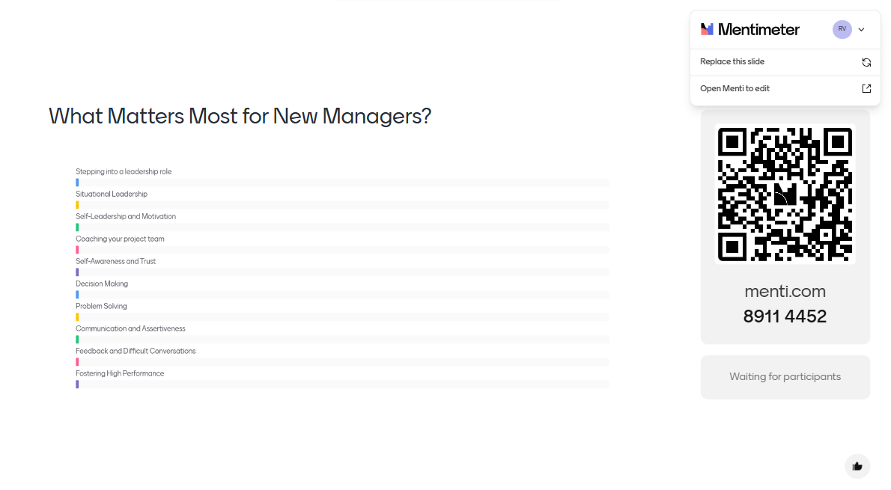

Slide 3
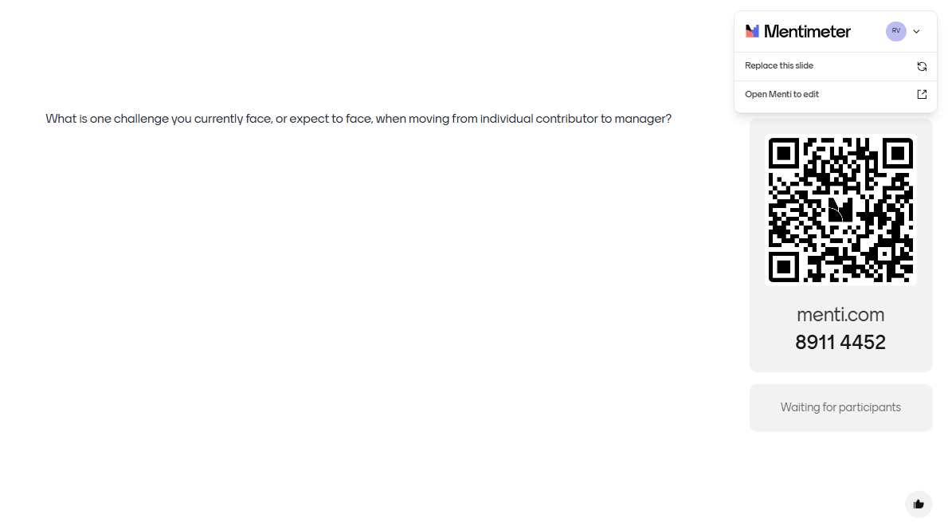

Slide 4
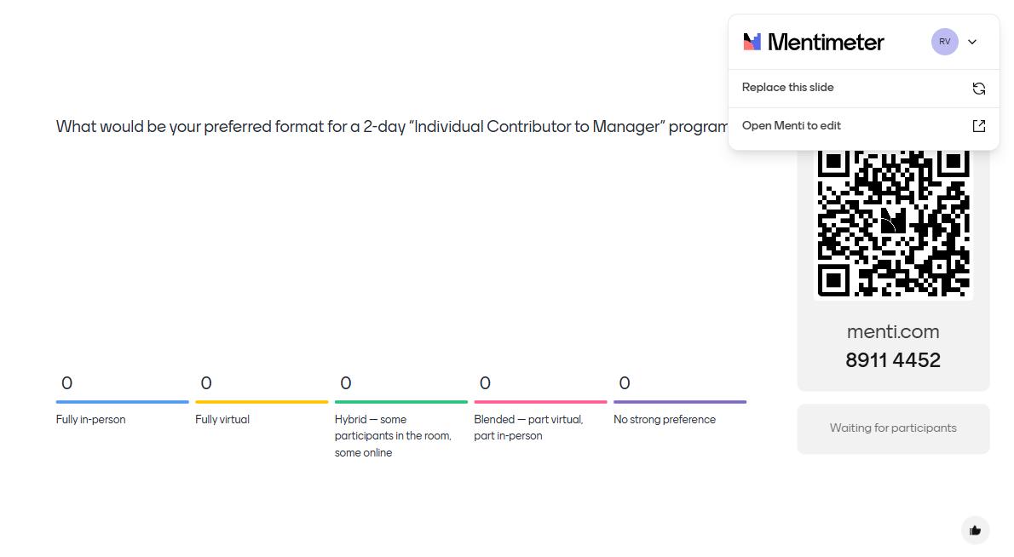

Slide 5

Scan the QR code to express your interest in attending the Individual Contributor to Manager program in 2027.

Slide 6
Thank you

