Slide 1
Latvian Quantum Shields: Securing Networks and Clouds
Sergejs Kozlovičs
Helsinki Music Hall
June 10, 2026
Notes:
The National Institute of Standards and Technology (NIST) and the European Union recommend transitioning to quantum-secure cryptography between 2030 and 2035. While Post-Quantum Cryptography (PQC) does not require specialized quantum hardware, it has to withstand the test of time, and it provides only security against quantum computational attacks. Quantum Key Distribution (QKD) offers an alternative approach. Although it requires new network infrastructure, QKD can provide perfect forward secrecy and even information-theoretic security (ITS) when used with a one-time pad. While the broader vision of a quantum internet—including technologies such as quantum teleportation—will require further advances, practical QKD systems are already commercially available.

Slide 2
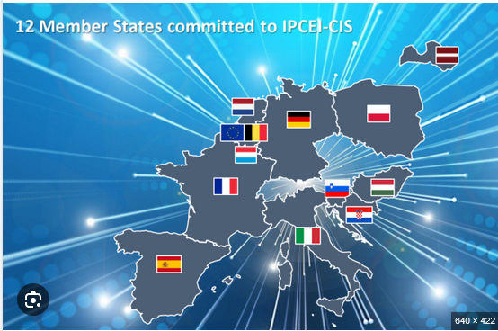
IPCEI-CIS
IPCEI-CIS (Important Project of Common European Interest on Next Generation Cloud Infrastructure and Services)
Project Nr. 5.1.1.2.i.0/4/25/A/CFLA/005.
01.09.2025.-31.12.2027
We are in the Security workgroup!
Quantum-safe access to the cloud
Quantum-safe data backup
Oktawave S.A.
Warsaw, Poland
https://oktawave.com/en
OpenNebula Systems, SL
Madrid, Spain
https://opennebula.io/
Tiscali Italia S.P.A.
https://www.tiscali.it/
Notes:
Description: The intervention will present current quantum-related activities at the Latvian NREN (IMCS, University of Latvia), including quantum-safe access to cloud services, quantum-safe backup solutions, the cross-border Lat-LitQN project (partnering with GÉANT), and our new ITS-secure key relay algorithm for semi-trusted QKD networks.
Bio: Sergejs Kozlovičs is a leading researcher (a mathematician and computer scientist) at the Institute of Mathematics and Computer Science of the University of Latvia (Latvian NREN). He is also an associate professor at the University of Latvia. Currently, Sergejs is focusing on quantum communications and quantum-secure cryptography.

Slide 3
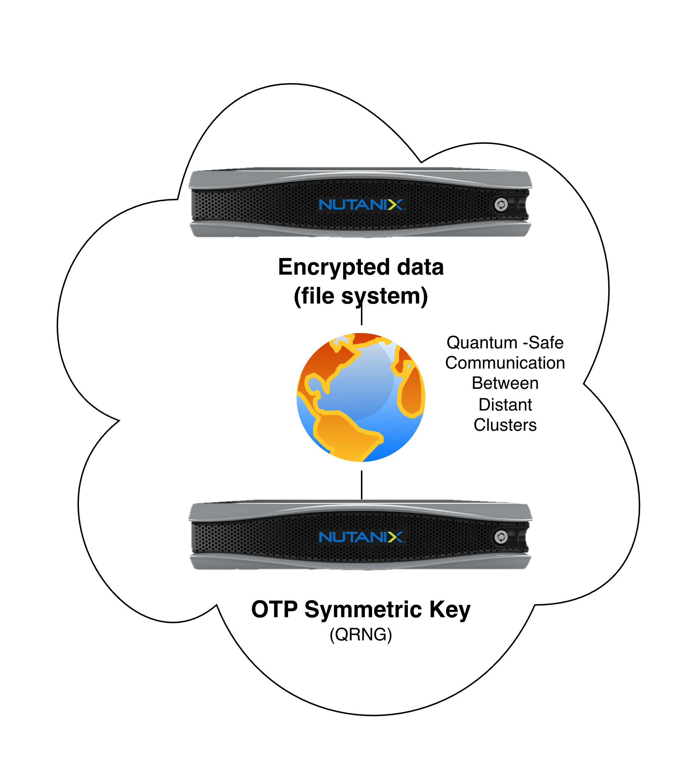
Quantum-Safe Data Backups (ITS)
OTP keys (aka Vernam’s cipher) to encrypt files
Two pillars:
1. Encrypted data and OTP keys are stored at two distant locations.
2. OTP Keys are generated using quantum mechanics
QRNG – fast but need to transfer the keys to encrypt
QKD – slower but no key
re-transmission needed

Slide 4
Quantum-Safe Data Backups (ITS)
Can be virtually any cloud.
We are experimenting also with OpenNebula.
OTP keys (aka Vernam’s cipher) to encrypt files
Two pillars:
1. Encrypted data and OTP keys are stored at two distant locations.
2. OTP Keys are generated using quantum mechanics
QRNG – fast but need to transfer the keys to encrypt
QKD – slower but no key
re-transmission needed

Slide 5
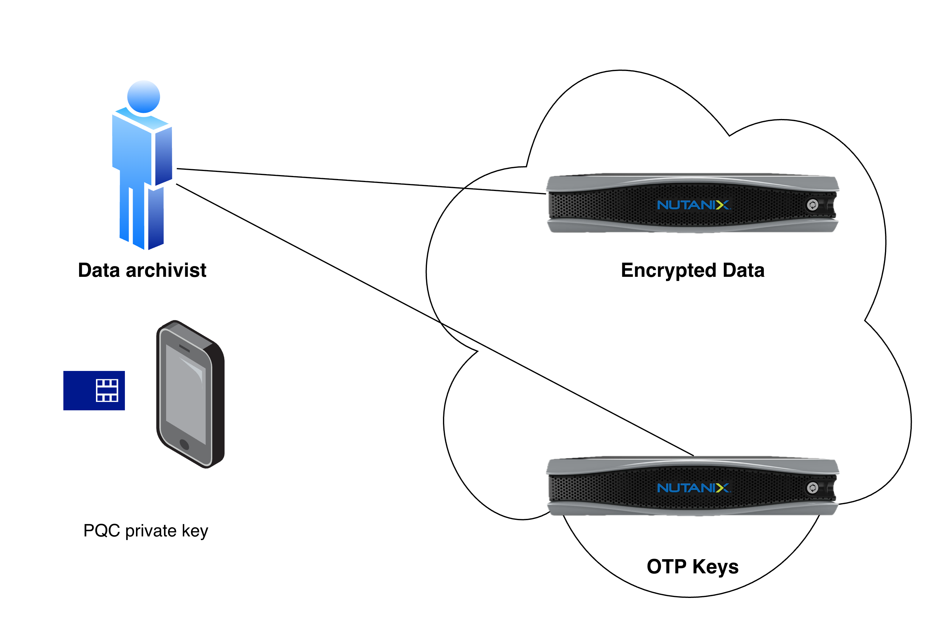
Quantum-Safe Data Backups (ITS)
Quantum-safe way to connect to both clusters
PQC for authentication
Promise: PQC will not be broken for the duration of one backup session
QKD-encrypted connections to the cloud

Slide 6
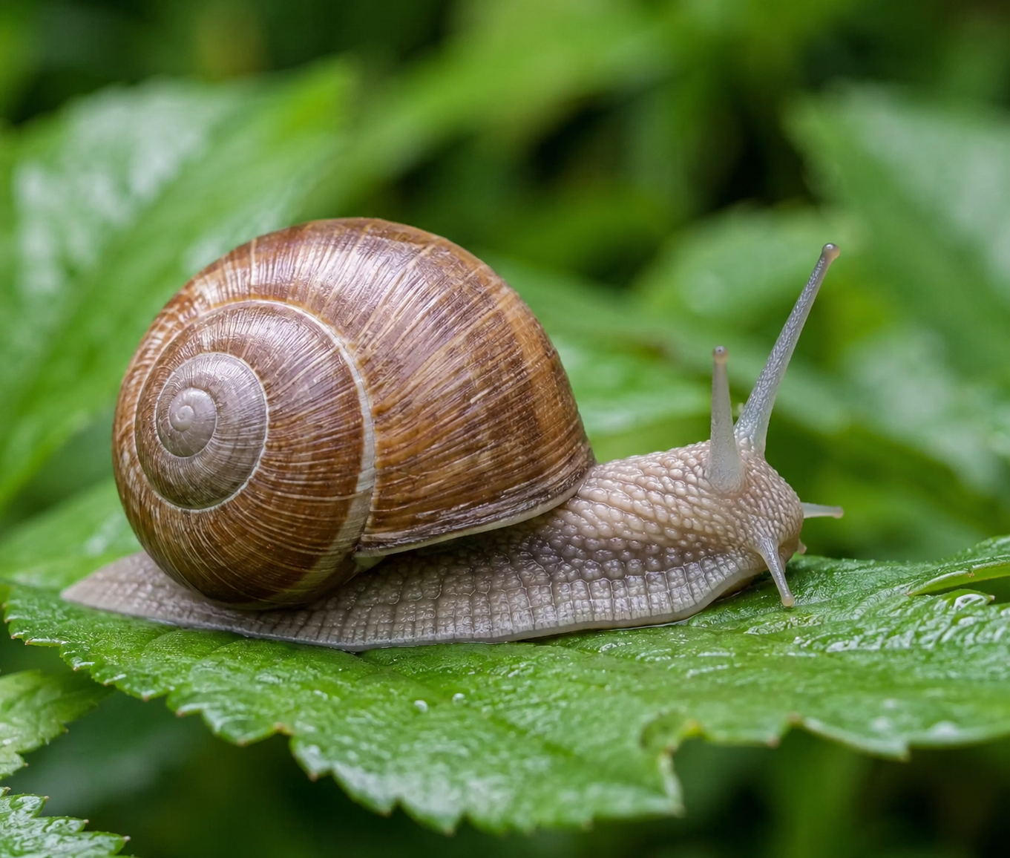
Quantum-Safe Data Backups (ITS)
The problem: it is SLOW!

Slide 7
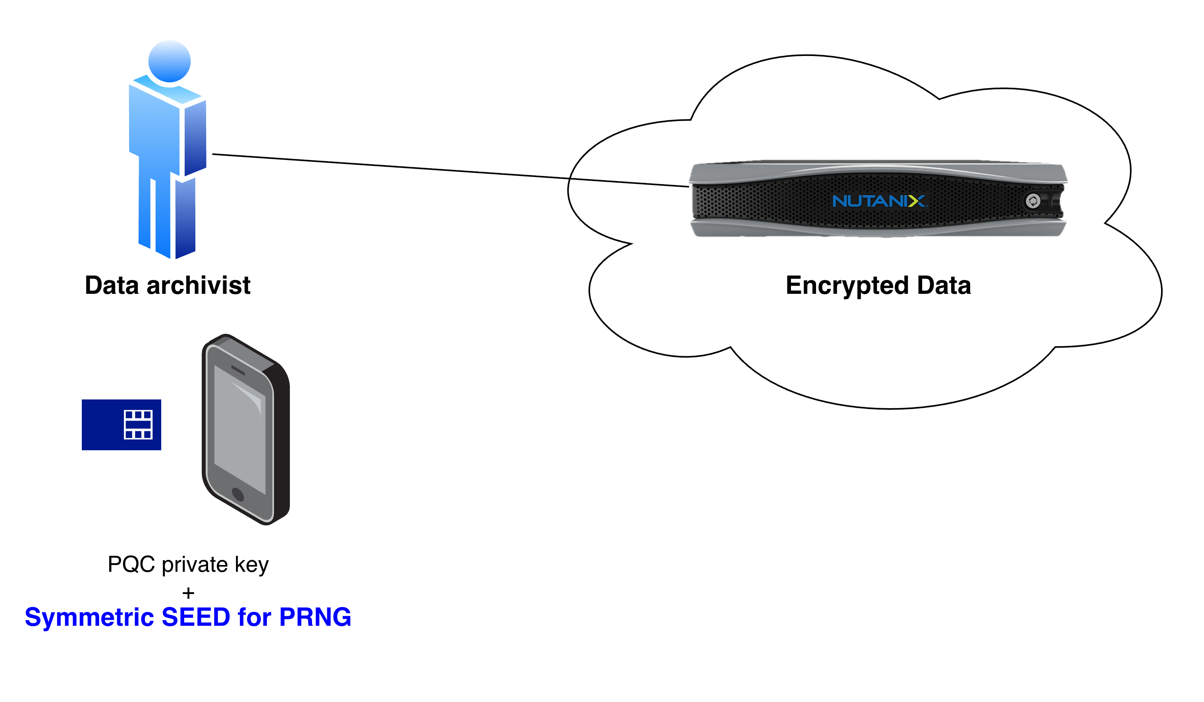
Quantum-Safe Data Backups (non-ITS)
256-bit SEED as AES-256 key?
We need random access!
AES-CTR (for file encryption)
AES-XTS (for full disk encryption)
But for authenticated encryption: AES-GCM.
But it is without random access!

Slide 8
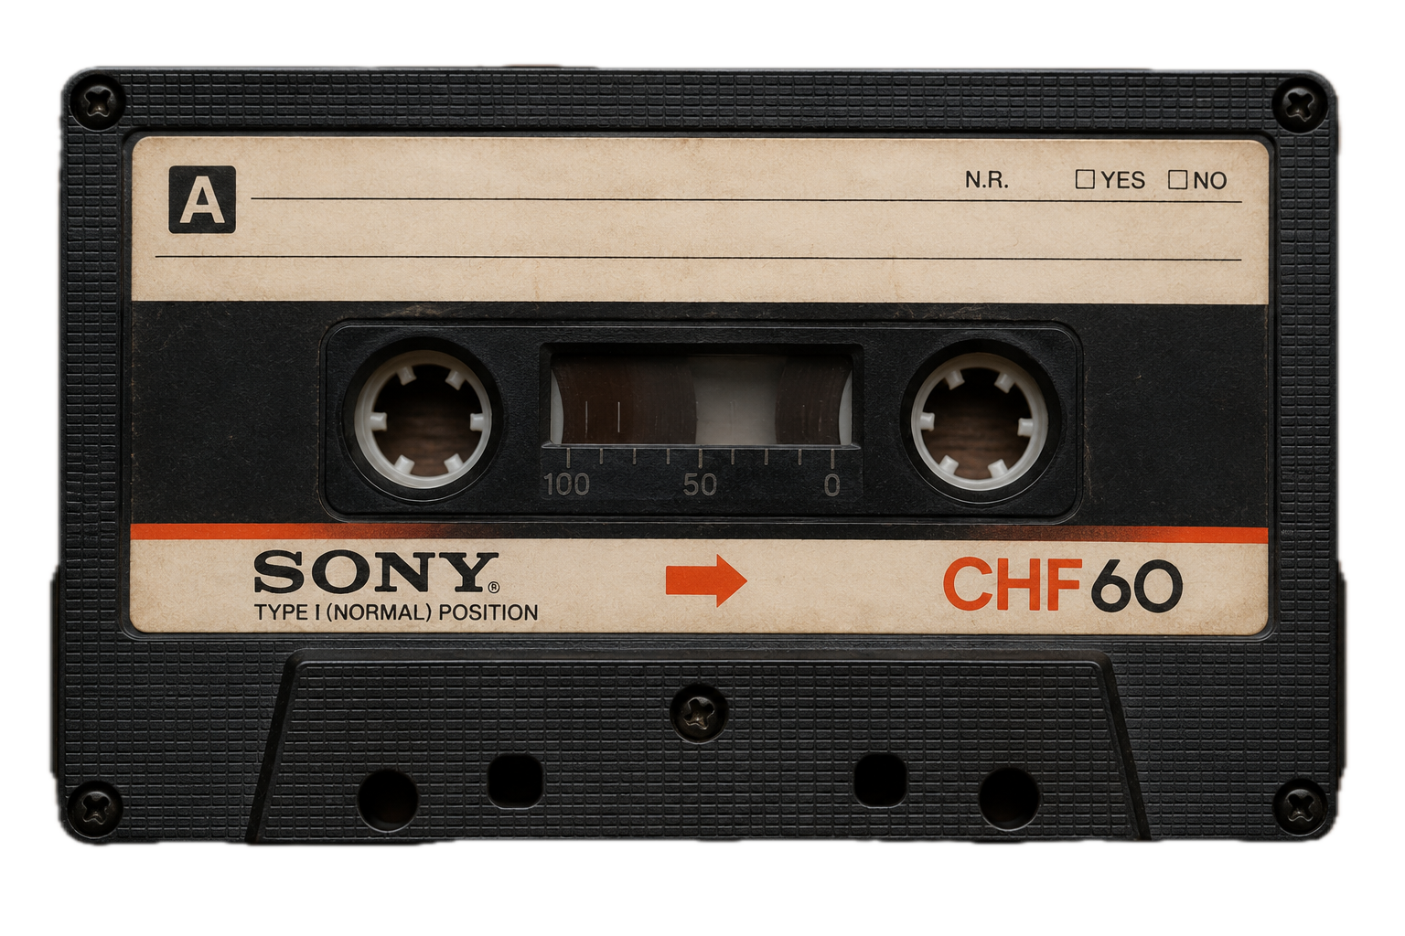
Quantum-Safe Data Backups (non-ITS)
256-bit SEED as AES-256 key?
We need random access!
AES-CTR (for file encryption)
AES-XTS (for full disk encryption)
But for authenticated encryption: AES-GCM.
But it is without random access!

Slide 9
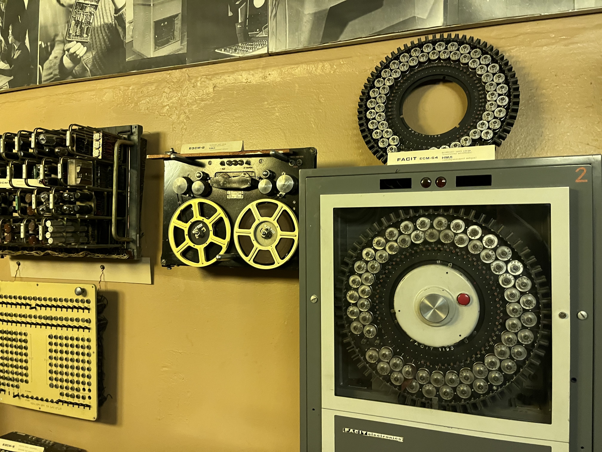
Quantum-Safe Data
Backups (non-ITS)
Chunked AES-GCM!
Split files into chunks
Encrypt each chunk with AES-GCM
Chunk keys (2 options):
Hash-based PRNG for deriving chunk keys.
A new QRNG key for each chunk stored at the key cluster.
IMCS museum in Riga

Slide 10
A lot to work to do…
Cloud Access Architecture
Data Formats
New universal APIs (cloud-provider-independent)
Open-source implementation
…

Slide 11

Notes:
Description: The intervention will present current quantum-related activities at the Latvian NREN (IMCS, University of Latvia), including quantum-safe access to cloud services, quantum-safe backup solutions, the cross-border Lat-LitQN project (partnering with GÉANT), and our new ITS-secure key relay algorithm for semi-trusted QKD networks.
Bio: Sergejs Kozlovičs is a leading researcher (a mathematician and computer scientist) at the Institute of Mathematics and Computer Science of the University of Latvia (Latvian NREN). He is also an associate professor at the University of Latvia. Currently, Sergejs is focusing on quantum communications and quantum-secure cryptography.

Slide 12
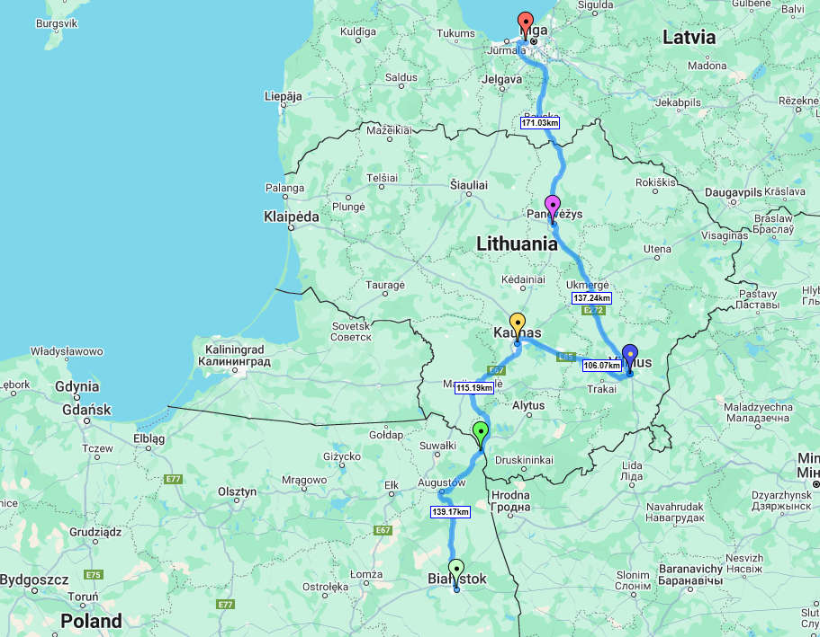
Lat-LitQN Cross-Border Concept
Lat-LitQN
Rīga:
Track: Rīga -> Panevėžys
  Road distance: 154 km
  Fiber distance (approx.): 170 km
Panevėžys:
Track: Panevėžys -> Vilnius
  Road distance: 137 km
  Fiber distance (approx.): 150 km
Vilnius:
Track Vilnius -> Kaunas
  Road distance: 104 km
  Fiber distance (approx.): 115 km
Kaunas:
Ogrodniki / Białystok:
LV-LT
LT-PL
KMS (ETSI020)

Slide 13
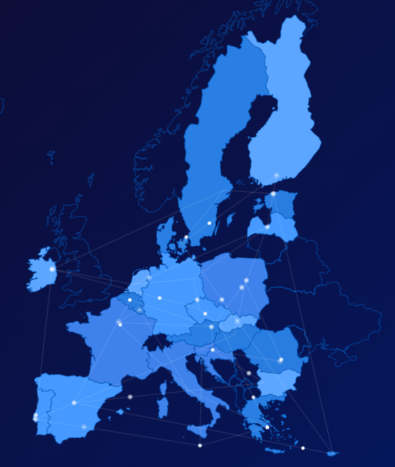
Lat-LitQN
Part of EuroQCI: European Quantum Communication Infrastructure
National quantum communication infrastructure
> cross-border network
> pan-EU quantum safe networks

Slide 14





Lat-LitQN Partners
Tet (LV)
Coordinator/ industry partner
Responsible for:
Cross-border QKD link development
Passive infra in LV & LT
KTU (LT)
Academic partner
Responsible for:
KMS for cross-border link, data processing and systems integration
IMCS UL (LV)
Academic partner
Responsible for:
Technical interoperability requirements
Fesibility study on OGS
VU (LT)
Academic partner
Responsible for:
Recommendations for Lat-LitQN QKD connection to panEU networks
GEANT (NL)
Associated partner
Responsible for:
Development of roadmap for QKD use in EU academic network
14

Slide 15
Planned Results
Cross-border
QCI backbone
~300 km
Riga – Panevezys – Vilnius
1-2 trusted nodes
1 trusted node in Panevezys (LT), if needed 1-2 additional nodes in Bauska (LV) and Ukmerge (LT)
2 pairs of QKD
Long-distance QKD deployment models, integrated with fiber-optics
Q-KMS
Integrated Quantum Key Management System, developed according to ETSI GS QKD 020 standarts
Fesibility study on
satellite-to-ground
Study on potential of integration of terrestrial WKD with satellite links (e.g. Eagle-1)
Passive
infrastructure
~85% existing fiber-optics assets, ~15% (43 km) in LT will be constructed in 2026 (outside proj.)

Slide 16
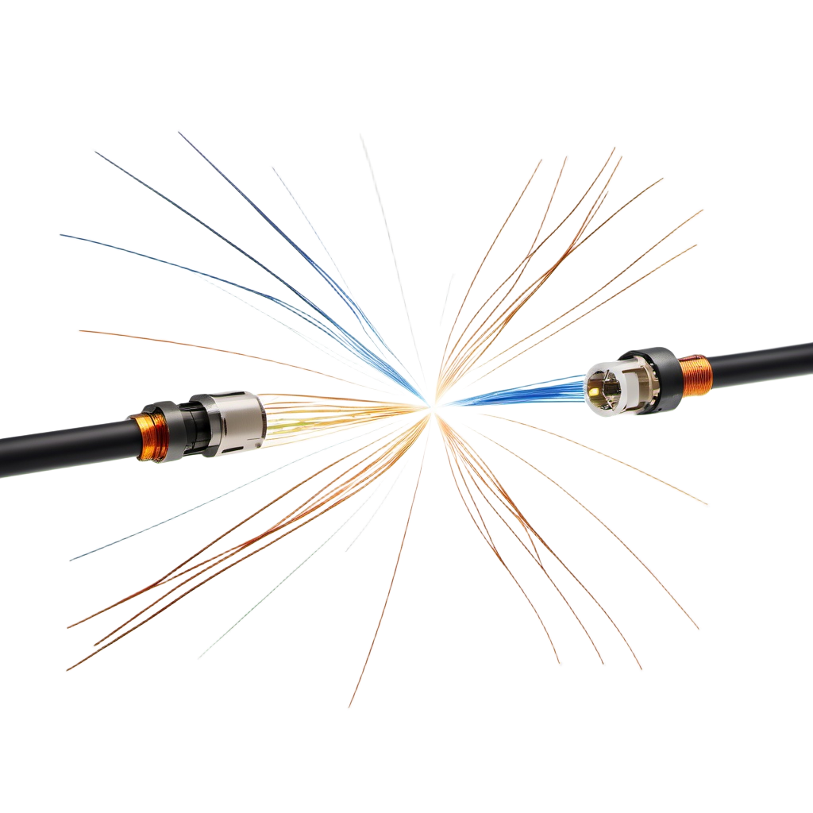
Secure Key Relay
GEANT topology for classical nodes
(we may expect similar for QKD)
We have: secure point-to-point QKD keys
We need: secure end-to-end keys
The problem: trusted nodes may be “not trusted”.
dishonest administrator
node controlled by an untrusted third-party

Slide 17

Secure Key Relay
Problems:
Some trusted nodes may be malicious.
Topology is unknown!
Topology may change!
We need secure key relay method!
ITS-secure, if the network topology supports it (e.g., 2-connected).
Computational secure for networks with articulation points.

Slide 18
Random Walks
Initially: reactive
Then: proactive
Different Random Walk variants
New heuristics to avoid overloaded nodes
Scouting phase (path investigation without consuming point-to-point QKD keys)
Loop elimination
Signed paths (PQC*)
Sending multiple random chunks via different paths by
OTP-encrypting them using
point-to-point QKD keys

Slide 19
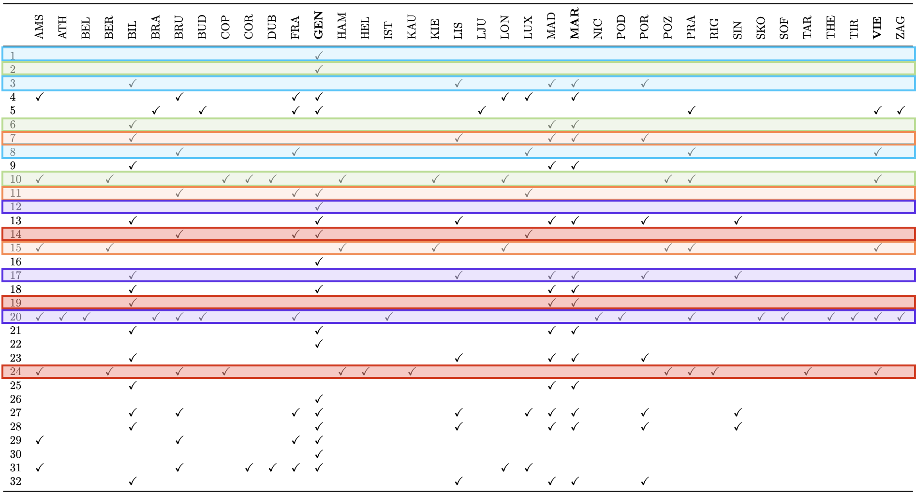
Constructing ITS-secure end-to-end keys => can determine max cartel size m
We use: Max-Flow Min-Cut theorem + Leftover Hash Lemma + XOR extractor

Slide 20
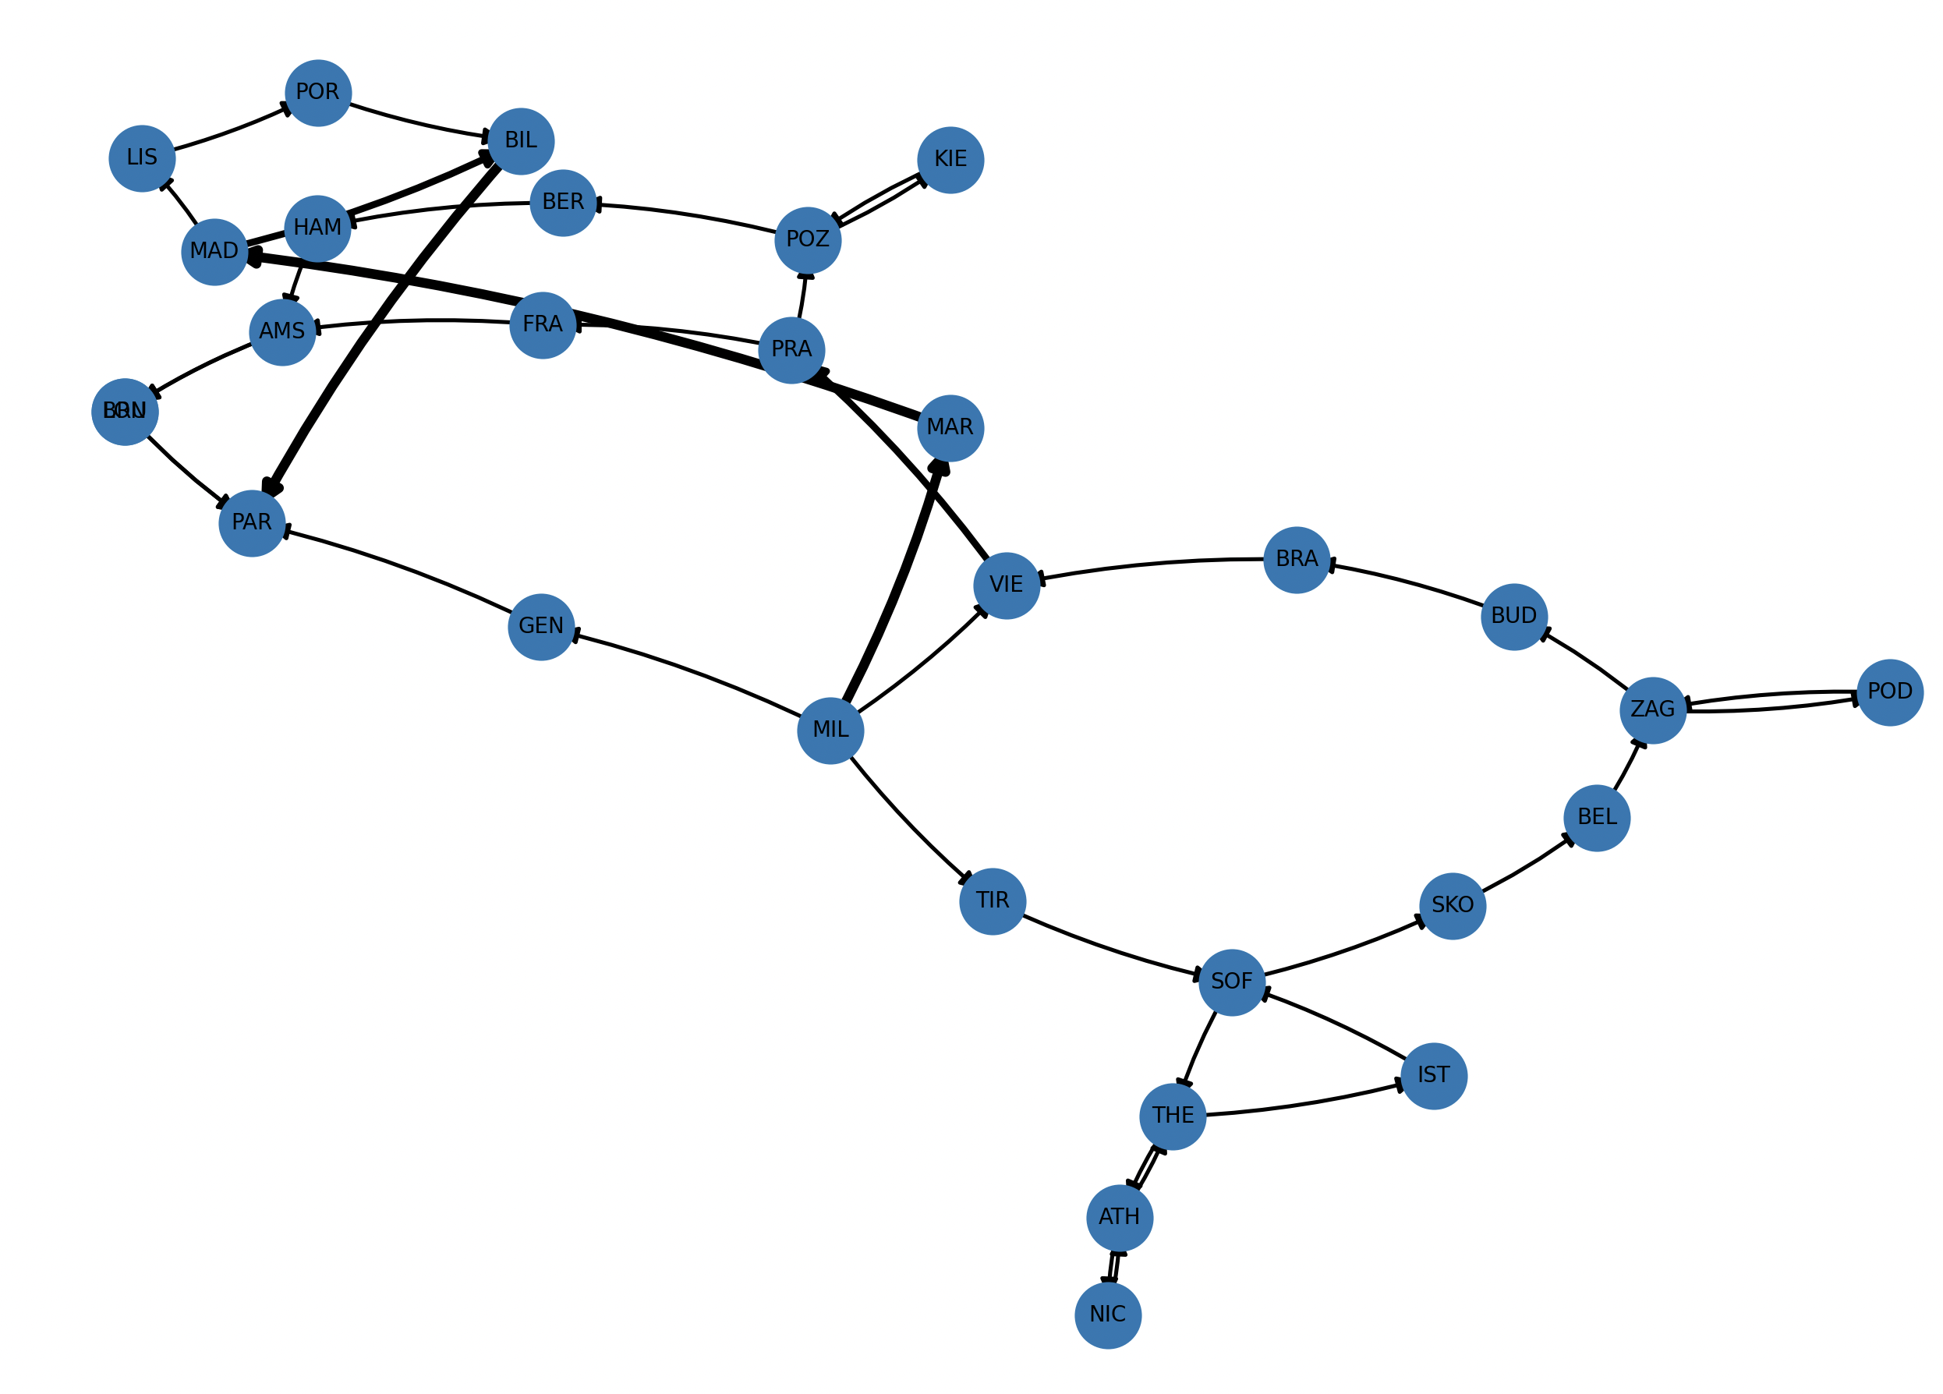
Example
No articulation points
Min cut between MIL and PAR is 3
There are also 3 node-independent paths
Reconstructed subgraph from 32 chunk paths

Slide 21
Computationally-Secure Layer
Useful for non-2-connected graphs (with articulation points)
Two chunks have 64≥58 bytes.
We can permute them.
Theorem. A random permutation of 64 independent uniform bytes provides the expected security of 288.18 bits.
We send the permutation in a PQC-encrypted message.
// BTW, we also need to send a random string in that message (needed for LHL),
but that string can be public, because LHL is a strong randomness extractor.

Slide 22
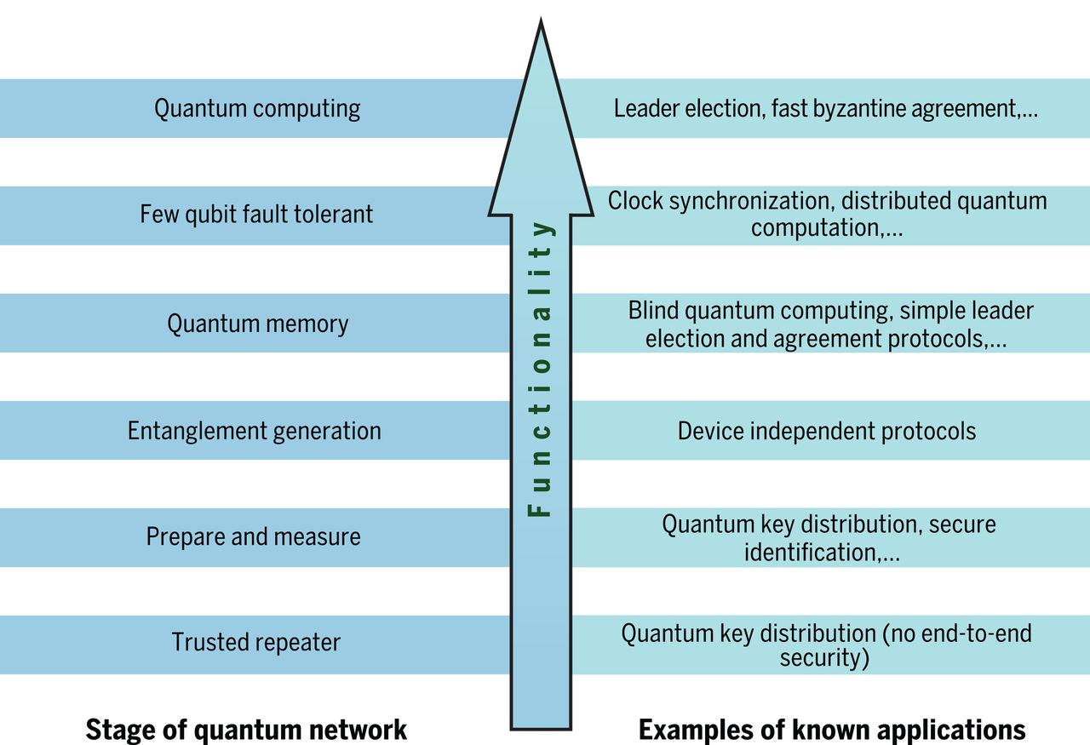
Towards the Quantum Internet
Stephanie Wehner et al. Quantum internet: A vision for the road ahead.
Science 362, eaam9288 (2018)
With end-to-end security!

Slide 23
Thank you!
Kiitos!
sergejs.kozlovics@lumii.lv

