Slide 1
Quantum in GÉANT
Overview and updates from SIG‑Quantum
Domenico Vicinanza
BoF on Quantum Technologies

Slide 2

Strategic context
Quantum technologies are moving from research into strategic infrastructure
More than 15 NRENs are now engaged
EU landscape:
  European Quantum Act expected in 2026
  European Quantum Skills Academy (virtual centre, expected 2026)
  Quantum Sensing Roadmap & Space and Defence Technology Roadmap (2026)
  Quantum Sandbox
Increasing quantum presence and evolving role of EuroHPC
Two quantum computers:
  PIAST-Q (Poznań, Poland) and VLQ/Lumi-Q (Ostrava, Czechia) already operational
Four additional systems are currently in the deployment phase
  Germany, Spain, Italy, and France
  Platforms in the Netherlands and Luxembourg also planned
Notes:
Inaugurated Systems: Two quantum computers—PIAST-Q (Poznań, Poland) and VLQ (Ostrava, Czechia)—are already operational, marking the first phase of the European leap into the quantum era.
Ongoing Deployments: Four additional systems are currently in the deployment phase across Germany, Spain, Italy, and France, with platforms in the Netherlands and Luxembourg also planned.
Euro-Q-Exa (Germany): A key superconducting system hosted at the Leibniz Supercomputing Centre. It is expected to offer a 150-qubit system by the end of 2026.
Hybridization Goal: EuroHPC successfully reached its 2025 target of having the first quantum-accelerated computers—hybrid systems where quantum processors act as accelerators for classical supercomputers.
Parallel 2026 Initiatives
European Quantum Skills Academy: A virtual center planned for launch in 2026 to provide centralized training and talent development.
Quantum Sensing Roadmap: The Commission is developing a dedicated Space and Defence Technology Roadmap by 2026 for next-generation sensors like gravimeters and advanced threat detection.
Quantum Sandbox: President von der Leyen has proposed a "Quantum Sandbox" to allow for controlled research and dialogue between regulators and innovators.

Slide 3

GÉANT strategic role
Act as the European coordination and enablement layer for quantum networking
  sitting between national NREN initiatives and EU-level programmes.
Focus on cross-border coherence, interoperability, operational readiness and skills
Serve as a trusted technical and single point of contact for the European Commission and related bodies.
Notes:
Act as the European coordination and enablement layer for quantum networking, sitting between national NREN initiatives and EU-level programmes.
Focus on cross-border coherence, interoperability, operational readiness and skills, rather than building national quantum infrastructure.
Serve as a trusted technical and single point of contact for the European Commission and related bodies.

Slide 4

Focus
Prioritise quantum communications and cryptography, with emphasis on EuroQCI coordination and federated KMS.
Support quantum computing
  High-performance connectivity
  Hybrid quantum-classical networking
  EuroHPC
Support/enable quantum sensing and longer-term quantum internet developments.

Slide 5
Quantum roadmap: 12 months to 5 years
12–24 months: foundations | 3–5 years: integration
EuroQCI coordination and federated KMS | Quantum activity and funding proposal for GN5-3
NREN alignment through the Quantum Strategy Coordination Group | GÉANT as integration platform for hybrid quantum-classical networking
Training, skills and practical know-how | Industry engagement on interoperability, standards and trials
Evidence-based view of NREN activity | Readiness for early quantum internet pilots

Slide 6
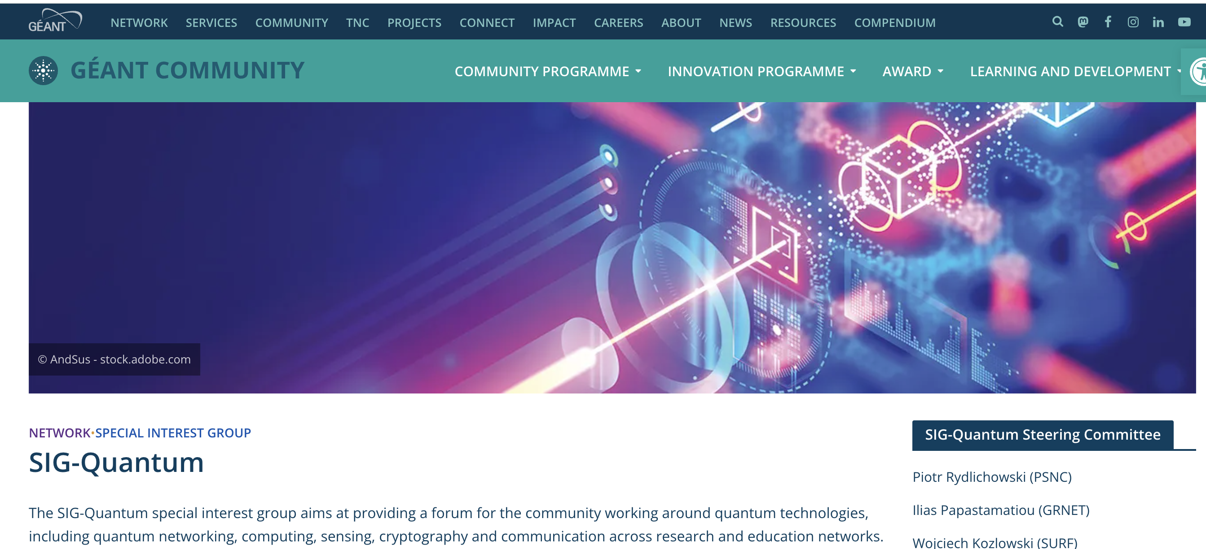
SIG-Quantum: https://community.geant.org/sig-quantum/

Slide 7
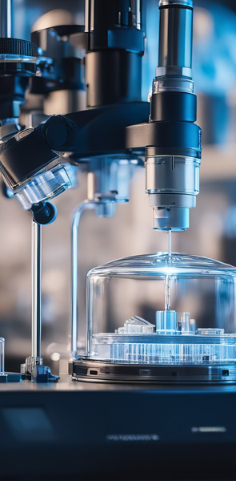
SIG-Quantum
Open forum for the diverse community engaged in quantum technologies, across Research and Education Networks (RENs).
A hub for the exchange of:
  Experiences
  Ideas
  Knowledge on the
    Development
    Deployment
    Testing
    Standardisation of quantum solutions.
Notes:
SIG-Quantum was launched in June 2025 at TNC25 in Brighton, as a collaborative forum to advance quantum technologies and shape the future of Research and Education Networks.

Slide 8
Focus Areas
Quantum networking
Quantum computing
Quantum sensing
Cryptography and communication across Research and Education Networks (RENs)
Grouping:
  National Research and Education Networks (NRENs)
  Research institutes (worldwide)
  Vendors and commercial partners
  Members of the community with an interested in quantum technologies

Slide 9
Role of SIG-Quantum
Act as a hub for exchanging ideas, experiences, and knowledge.
Facilitate development, deployment, testing, and standardisation of quantum solutions.
Collaborate on designing a coherent quantum strategy for GÉANT.
Liaise with similar initiatives in GÉANT sister networks worldwide.
Lead evaluation and testing of quantum technologies in R&E networks.
Exchange, Facilitate, Collaborate, Liaise and Lead

Slide 10
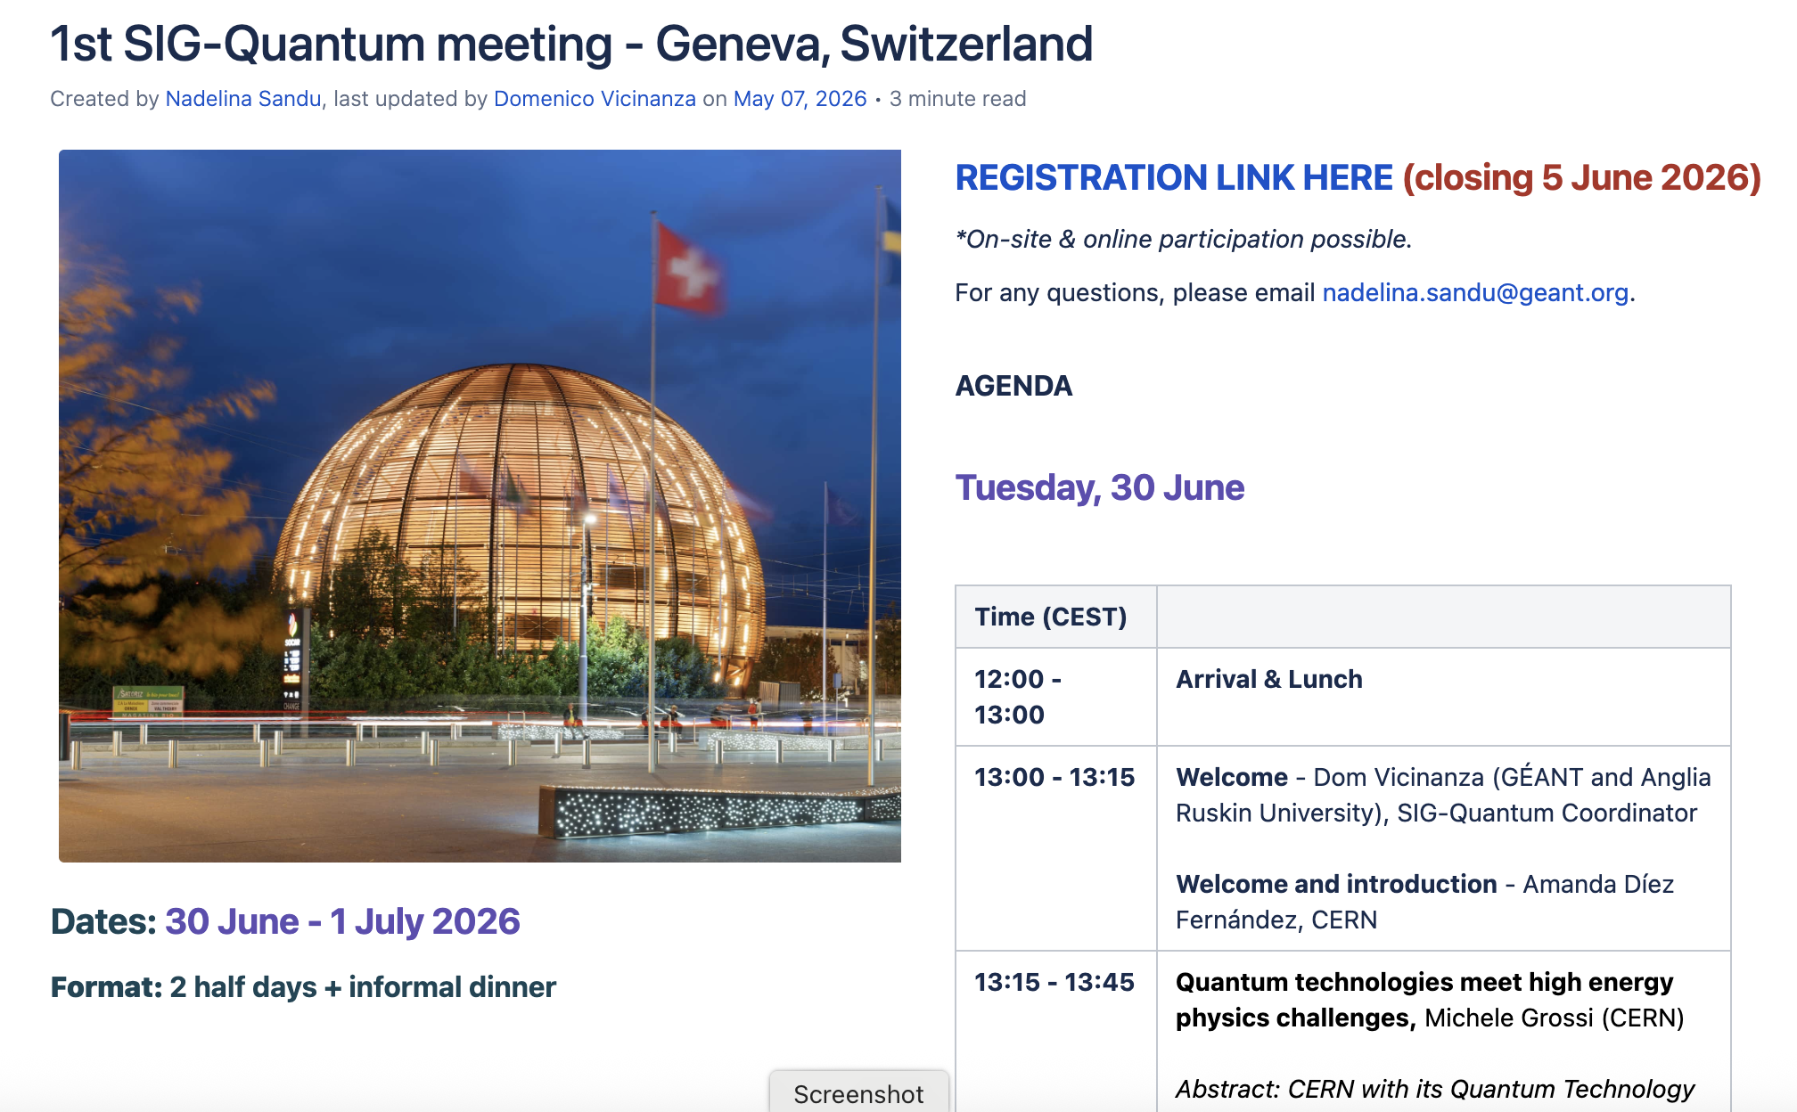
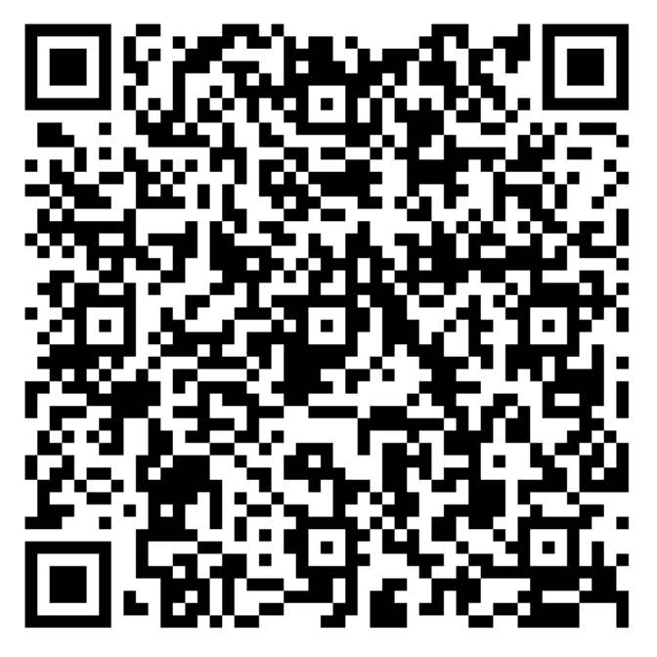
First In-Person SIG-Quantum (CERN, Geneva, 30/06-01/07)

Slide 11
Thank you
Any questions?
domenico.vicinanza@geant.org

