Slide 1
What if your NREN didn’t exist?
Rebuilding a case for NRENs imagining a world without them
Rosanna Cramarossa Norman, GÉANT
TNC26, Helsinki
9 June 2026
Notes:
Thank you for joining us for what we hope will be a slightly different kind of conversation.
As communications professionals, advocates, and members of the NREN community, we often spend a great deal of time explaining what NRENs are, what services they provide, and why they matter. Yet many of us have experienced the same challenge: despite the enormous value NRENs create, that value can sometimes be difficult to communicate to those outside our community.
Today, we are going to approach that challenge from a different angle.
Rather than asking what NRENs do, we will ask a more provocative question:
What if NRENs didn't exist?
Imagine that tomorrow your NREN simply disappeared. No warning. No transition plan. Gone.
What would stop working first? Who would be affected? Which research projects would stall? Which collaborations would become more difficult—or impossible? What would this mean for students, researchers, institutions, and society?
By exploring the absence of NRENs, we hope to uncover their true value through your own experiences and stories. Not through service descriptions or technical specifications, but through real-world consequences, human impact, and collective reflection.
This is a co-creation session. There are no right or wrong answers. The expertise in this room is our most valuable resource, and the goal is to build on that expertise together.

Slide 2
Exercise 1 (15 minutes)
Imagine that your NREN disappears. Gone. What breaks first?
Immediate reactions
Moderated group activity
Develop one concrete story or persona (e.g. PhD student, researcher, cross boarder research scientist, professor)
What happens to them without an NREN?
Notes:
Appoint note taker
Appoint moderators
Share immediate reactions - the note taker jots them down discussion - on real-world impacts.
Explore what breaks when NRENs disappear;
Develop realistic stories and personas that illustrate the consequences.
Reflect on how to overcome the challenges of communicating NREN value.
And collectively create language that can help all of us better explain the strategic importance of NRENs to funders, policymakers, institutional leaders, and wider stakeholders.
By the end of the session, we aim to leave with practical outputs: stories, messages, and insights that we can take back to our own organisations and use in future communications and advocacy efforts.
Most importantly, the results of today's discussion will also feed into future SIG-Marcomms work and will be presented back to the community at our next meeting.
So, let's begin with a simple but powerful question:
If your NREN disappeared tomorrow morning, what breaks first?
Develop one concrete story or persona illustrating what happens without an NREN (e.g. a PhD student, a cross-border research scientist, a professor, a researcher etc.).

Slide 3
Exercise 2 (15 minutes)
The hard question
How can we overcome the challenge to explain NRENs to funders, ministries, and leadership?
Moderated group activity
Notes:
Add pointers, invite to thinking for instance about dependencies that are not always visible and we see the value only when they start breaking.
Let’s explore challenges such as visibility, competition, technical framing, or misalignment with policy priorities.
Which parts of research, education, or society depend on NRENs?
What breaks first when trusted research infrastructure is missing?
How can invisible value be communicated without waiting for crisis?
Are NRENs being framed as technical services rather than strategic capability?
What language connects better with policy priorities: innovation, resilience, sovereignty, competitiveness, trust?

Slide 4
Exercise 3 (15 minutes)
“An NREN is essential because _____.”
Notes:
Responses will be collected in a Mentimeter word cloud which will form a tangible output of the session.

Slide 5
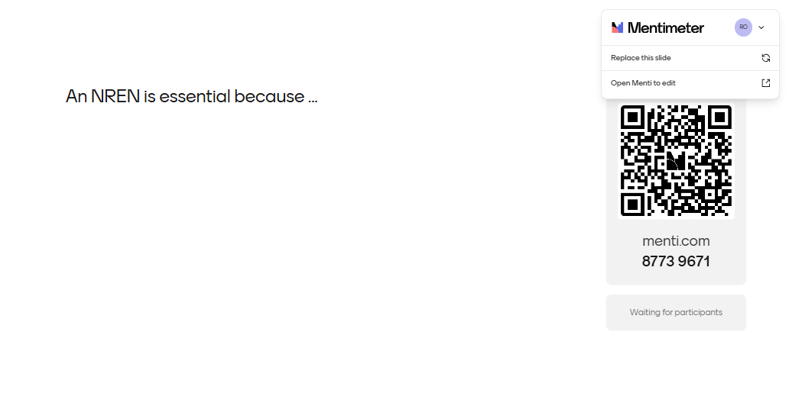

Slide 6
Thank you
Any questions?
Presenter email

