Slide 1




GÉANT Twinning Programme
Collaborative Capacity Building
between NREN Nepal & CSC/FUNET
Activities and Progress · TNC26, Helsinki, Finland
Rajan Parajuli and Harri Kussisto · Tuesday, 09 June 2026 · Helsinki, Finland

Slide 2

About the Twinning NRENs
🇳🇵 NREN Nepal
🇫🇮 CSC/FUNET Finland
40+ member institutions
Universities, medical schools & research centers
Connected to Asi@Connect & global R&E networks
About 80 member institutions
Universities and Research Insitutions
Connected with GÉANT and NORDUnet
Key Services
Key Services
R&E network Connection
eduroam
FileSender
Zoom Meeting
Moodle based LMS Implementation Support
Technical Training
Campus Network Design Advisory
R&E network Connection
Supercomputing access
HAKA identity federation
Research support services
eduroam
FileSender
Cloud services
Security services, and etc.
GÉANT Twinning · TNC26 · Helsinki · 09 June 2026

Slide 3
Twinning Programme Overview
Overall Objective
Forge collaboration by leveraging the respective strengths and experiences of both NRENs in NREN operation, R&E application and services handling, and supporting research communities.
01
02
03
eduroam Service Enhancement
Supporting REN awareness
Weekly Meetings & Exchange Visits
Mutual learning and sharing through weekly online meeting and reciprocal in-person exchange visits
Sharing existing awareness materials of both NREN
Revisit existing sensitization materials and also develop new materials
Organize a few meeting with relevant government bodies and share FUNET supports to R&E communities in Finland
eduroam policies development for providers
eduroam CAT deployment and uses of geteduroam application
eduroam user dashboard deployment
eduroam Visitor Access (eVA) deployment
eduroam troubleshooting guide
GÉANT Twinning · TNC26 · Helsinki · 09 June 2026

Slide 4
Timeline of the Activities Accomplished
19 Feb 2026
Mar 2026
Apr 2026
May 2026
3–5 Jun 2026
9 Jun 2026
Project
Kick-off
eduroam CAT deployment and get eduroam awareness
Eduroam policy development for eduroam providers
Eduroam dashboard development
Mid-Term Review
NREN Visit
Helsinki
TNC26
Presentation
7
1
3
26 September
Weekly Knowledge exchange meetings
Completed, expecting a total of 15 meetings
Mid-term review
held
Focus areas
in progress
Programme
end date
GÉANT Twinning · TNC26 · Helsinki · 09 June 2026

Slide 5
Key Progress Achieved
✓
All member institutions enabled for eduroam CAT
✅ Done
✓
geteduroam application support available to all institutions
✅ Done
✓
eduroam dashboards developed for member institutions
✅ Done
✓
eduroam policy developed for eduroam providers
✅ Done
→
Local eVA deployment initiated with support from FUNET and SURF
🔄 In Progress
→
eduroam troubleshooting guide for identification of eduroam connection issues
🔄 In Progress
→
Revisit existing sensitization materials and also develop new materials
🔄 In Progress
GÉANT Twinning · TNC26 · Helsinki · 09 June 2026

Slide 6
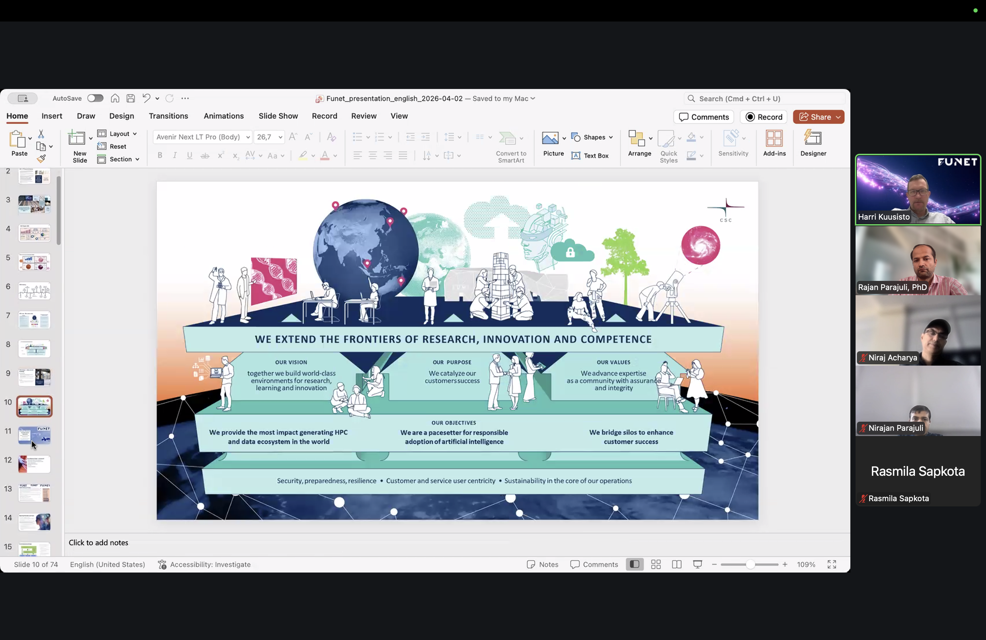






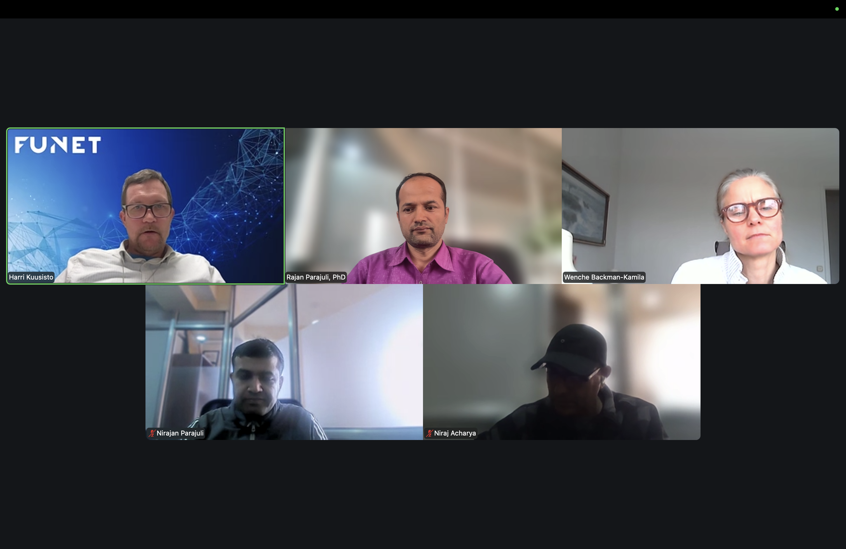


Knowledge Exchange through Weekly Online Meetings
Every Thursday
Topics covered in weekly meetings and during the visit at CSC/FUNET
Policy Framework
eduroam Dashboard
Participation policies & agreements
Analytics & outage detection
eVA Deployment
eduroam in Finland
Visitor access with SURF & FUNET
How CSC/FUNET operates nationally
eduroam CAT & geteduroam
REN Awareness Practices
Configuration & awareness
Services portfolio & materials
Troubleshooting Guide
R&E Services & Applications
eduroam issue resolution
Research & education network services
GÉANT Twinning · TNC26 · Helsinki · 09 June 2026

Slide 7
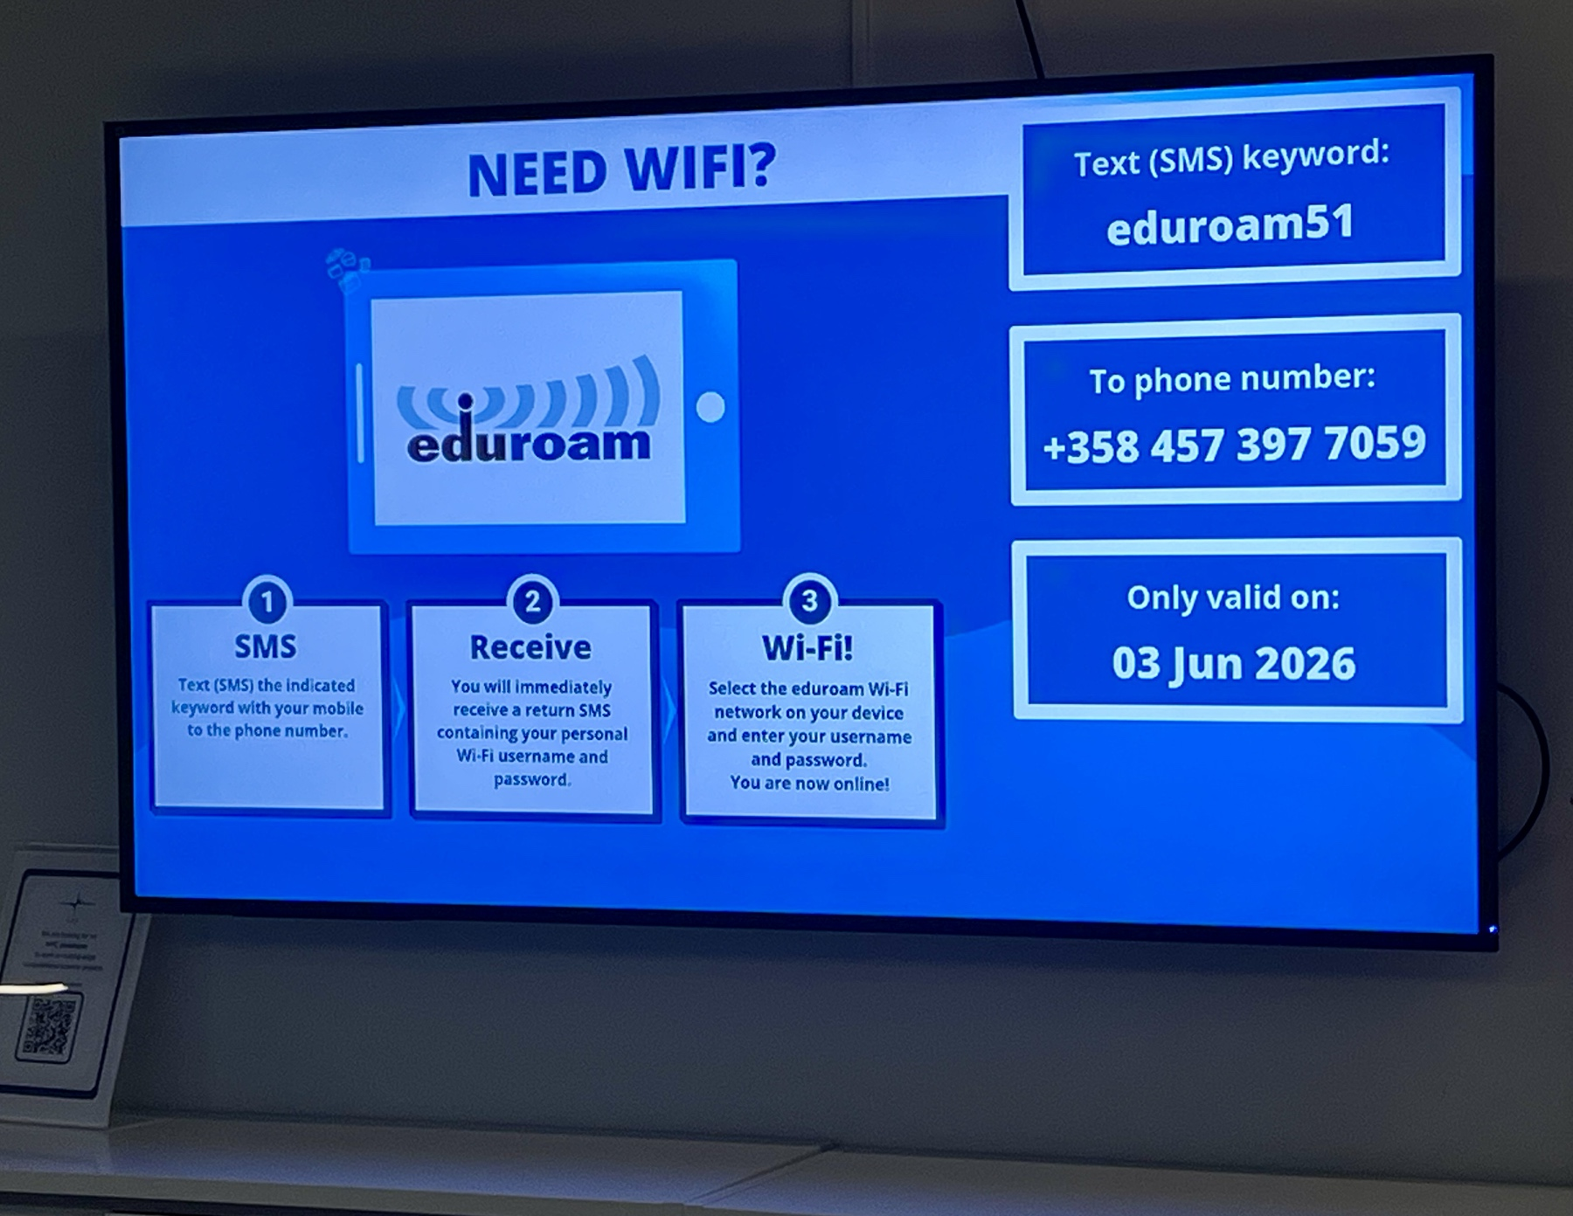
NREN Visit to CSC/FUNET — Helsinki
Knowledge Exchange Visit · 3–5 June 2026
Topics Discussed
NREN operations & governance
eduroam services enhancement, hands on demonstration of eVA, CAT deployment, etc.
REN Awareness materials
Research support services
Future collaboration opportunities
Visit Highlights
eduroam technical deep-dive discussions and demonstration
CSC facility tours & service demos
Liaising for possible collaboration among member institutions of both NRENs
GÉANT Twinning · TNC26 · Helsinki · 09 June 2026

Slide 8
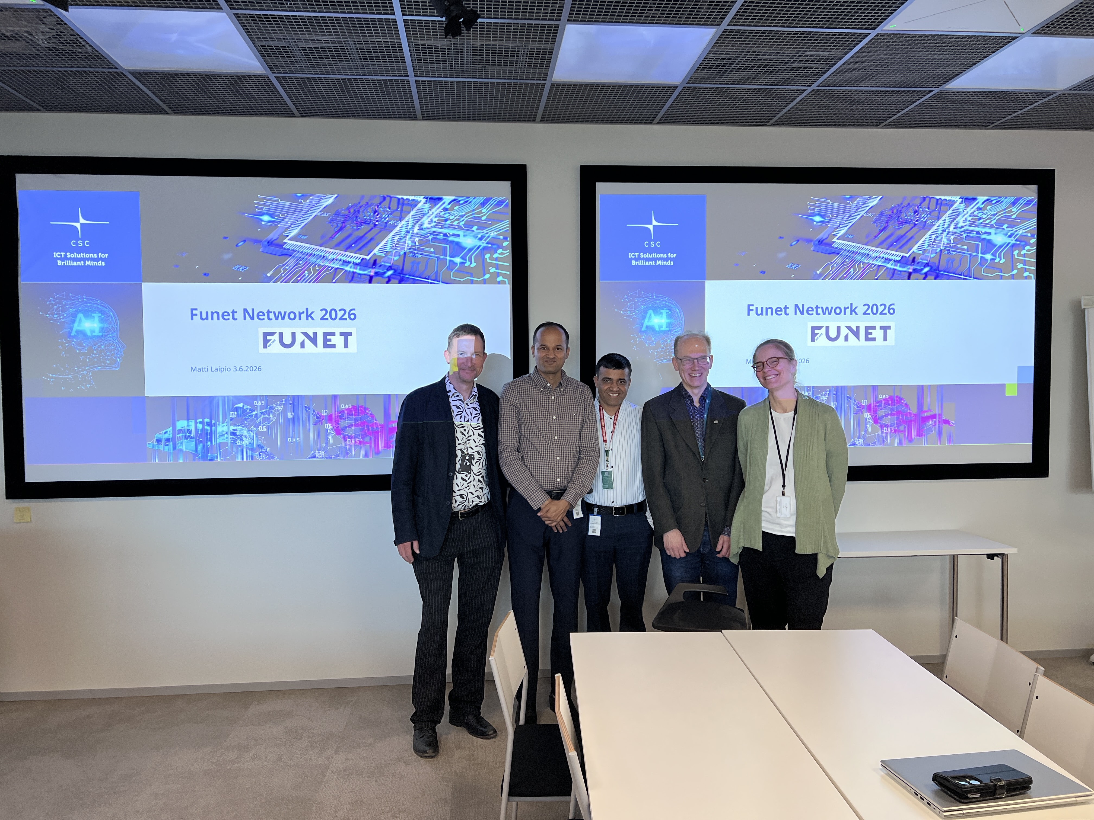
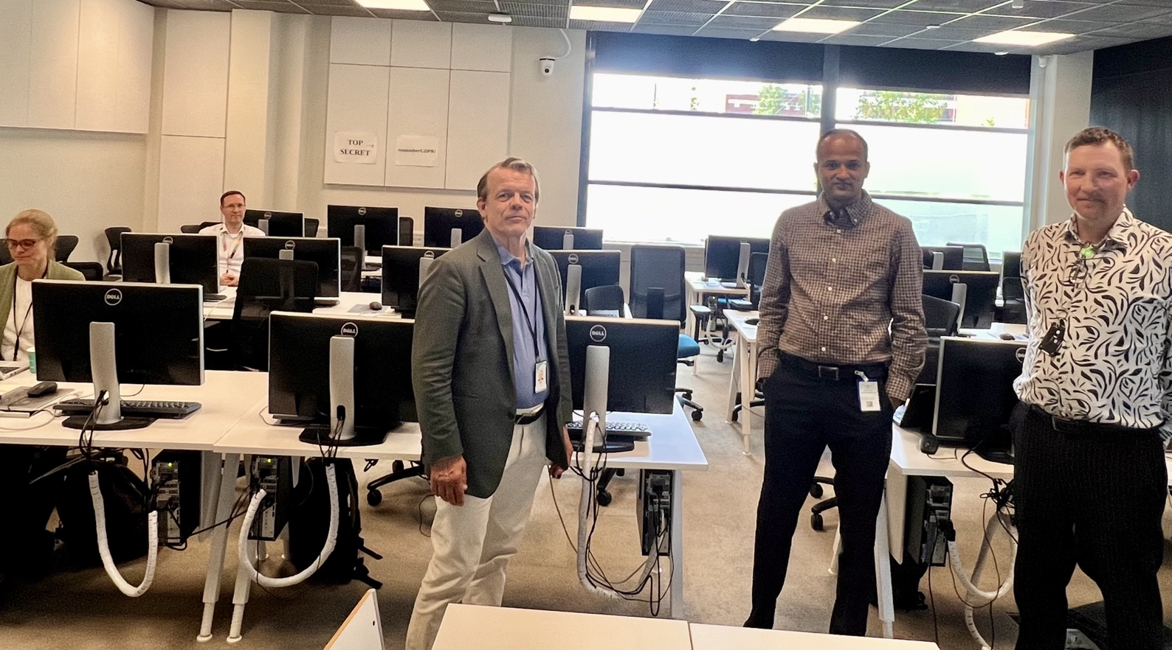
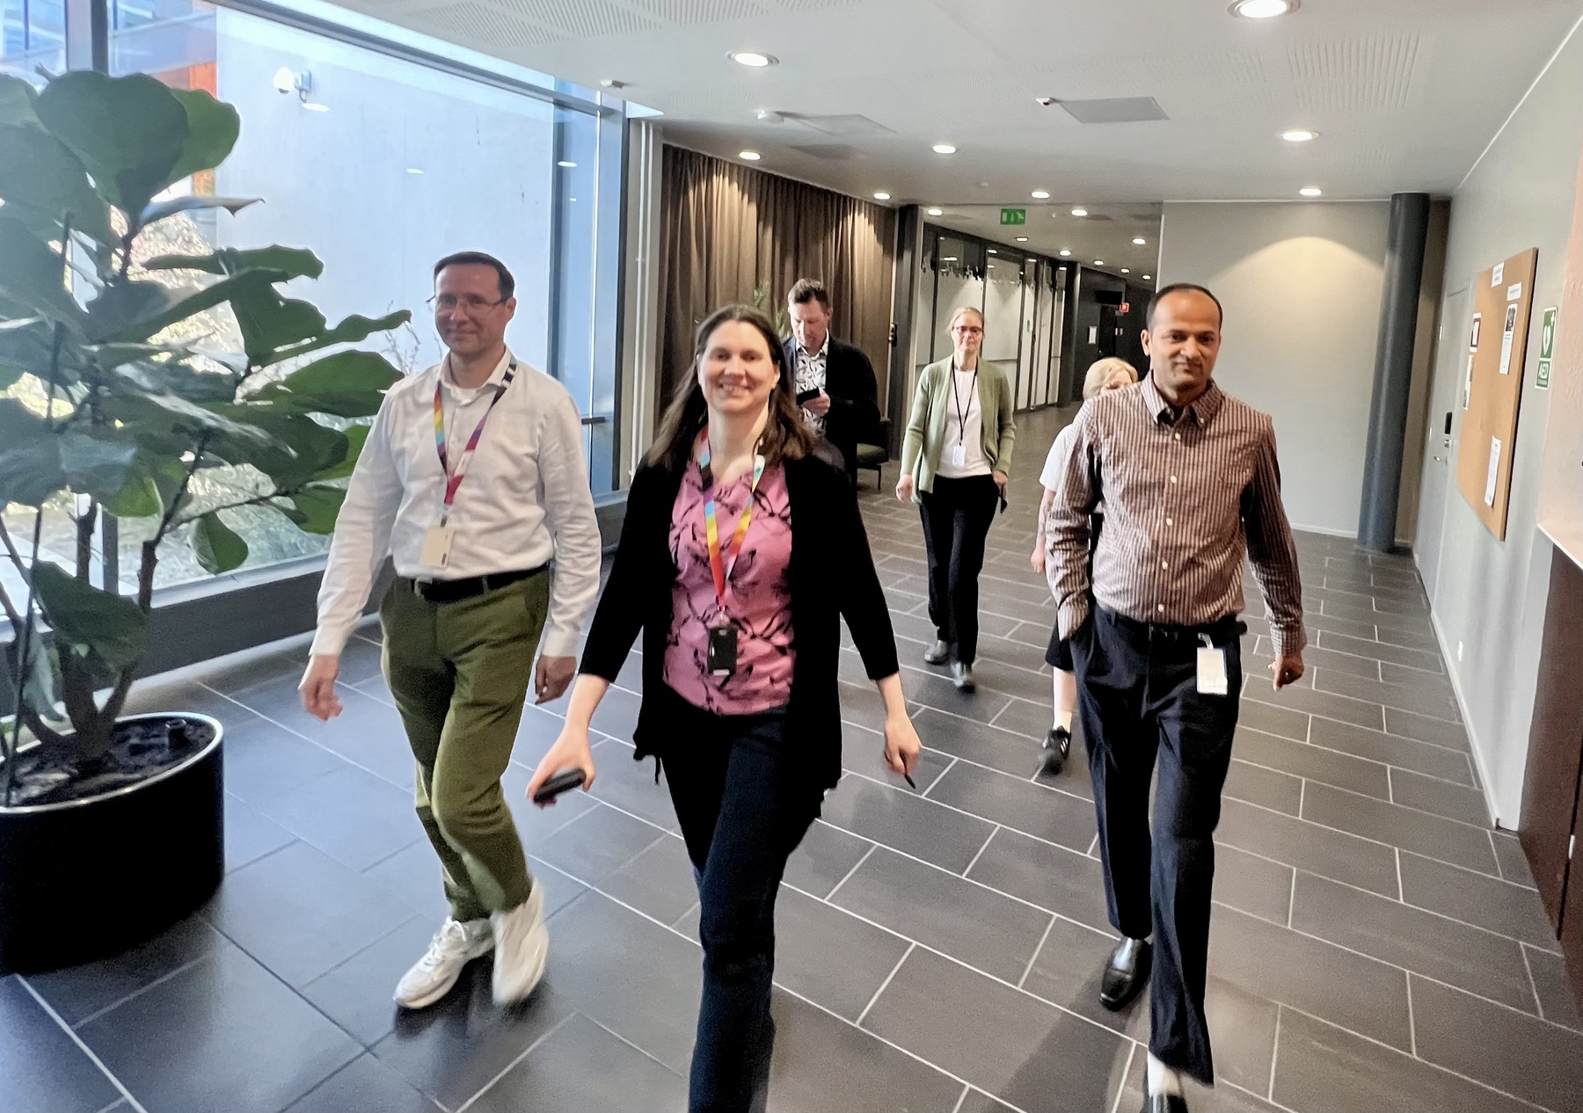

Slide 9
Next Steps & Looking Ahead
Remaining programme milestones through September 2026
Jun–Jul 2026
Jun–Jul 2026
🔗 Complete eVA Deployment
📡 eduroam Monitoring
Finalize eduroam Visitor Access with SURF support
Finalize remote outage detection & monitoring dashboard
Jul 2026
Jul 2026
👩‍💻 Administrator Training
📁 Large File Transfer Tests
Online training for ~20 eduroam administrators across NREN institutions
Demonstrate REN advantages over commercial networks
Aug / Sept 2026
Aug 2026
✈️ FUNET Visit to Nepal
📝 Awareness Materials
Exchange visit including government & stakeholder meetings
Finalize joint presentation & NREN introductory video
Ongoing
September 2026
🔄 Weekly Collaboration
📋 Final Report
Continue Thursday meetings; share results via GÉANT & APAN62
Draft, review & submit final project report to GÉANT
GÉANT Twinning · TNC26 · Helsinki · 09 June 2026

Slide 10
Key Insights
CSC/FUNET ↔ NREN Nepal
LEARNINGS
THE NREN VALUE PYRAMID
Research Ecosystem
Cross-border collaboration & innovation culture
Both NRENs are facing similar challenges — but the severity is different.
R&E Applications & Services
Connectivity is the foundation — the ultimate goal is providing R&E services to foster research collaboration and a thriving innovation ecosystem.
Connectivity
Awareness, training, and community engagement matter as much as infrastructure.
GÉANT Twinning · TNC26 · Helsinki · 09 June 2026

Slide 11
Team Members of the Twinning Activities
🇳🇵 NREN Nepal — Team
🇫🇮 CSC/FUNET — Team
R
Rajan Parajuli, PhD
H
Harri Kuusisto
Project Lead
Project Lead
I
Indiver Badal
J
Janne Oksanen
Technical
Technical
N
Nirajan Parajuli
W
Wenche Backman-Kamila
Technical
Technical
N
Niraj Acharya
Technical
A
Aryan Joshi
Technical
Thank you for joining us at TNC26 · Questions welcome
GÉANT Twinning · TNC26 · Helsinki · 09 June 2026

