Slide 1
Twinning for Impact: Building Partnerships Across the Global NREN Community
Leonie Schäfer (DFN) - GÉANT Twinning Programme Chair
Community Hub
9 June 2026

Slide 2
What is Twinning?
Collaboration between peers, not a teacher–student relationship
Joint projects
Exchange visits
Tangible Outcomes
Long-term partnerships

Slide 3
Twinning in Action
Nepal (NREN) + Finland (CSC / FUNET)
Current Twinning Project
Lessons learned and outcomes

Slide 4
Global Perspectives
EUMEDplus
Asi@Connect
Bangladesh (BdREN)

Slide 5
Question for Discussion
What should the next generation of NREN Twinning look like?
Notes:
What makes a Twinning partnership truly successful, and how do we sustain its impact beyond the formal project period?
How can we strengthen cooperation and knowledge exchange across regions to accelerate NREN development worldwide?
Which capabilities are most important for NRENs to develop today, and how can Twinning help accelerate that journey?

Slide 6

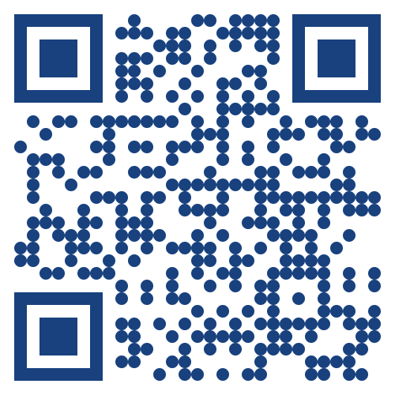
Get involved !
2026 Opportunities: One opening still available!
We are operating a rolling submission scheme for the remainder of the year.
2027 Planning: * Submission Deadline: End of October 2026.
  Project Start: January 2027.
Visit our Wiki: https://wiki.geant.org/x/igA2Lg
Follow us on CONNECT:
https://connect.geant.org/tag/twinning-programme
Scan to go to the GÉANT Twinning Wiki

Slide 7
Thank you
Any questions?
schaefer@dfn.de

