Slide 1


Global NREN partnership
www.rash.al
From Twinning to Impact
Dr. Arjan Xhelaj
TNC26
Helsinki, 9 June

Slide 2
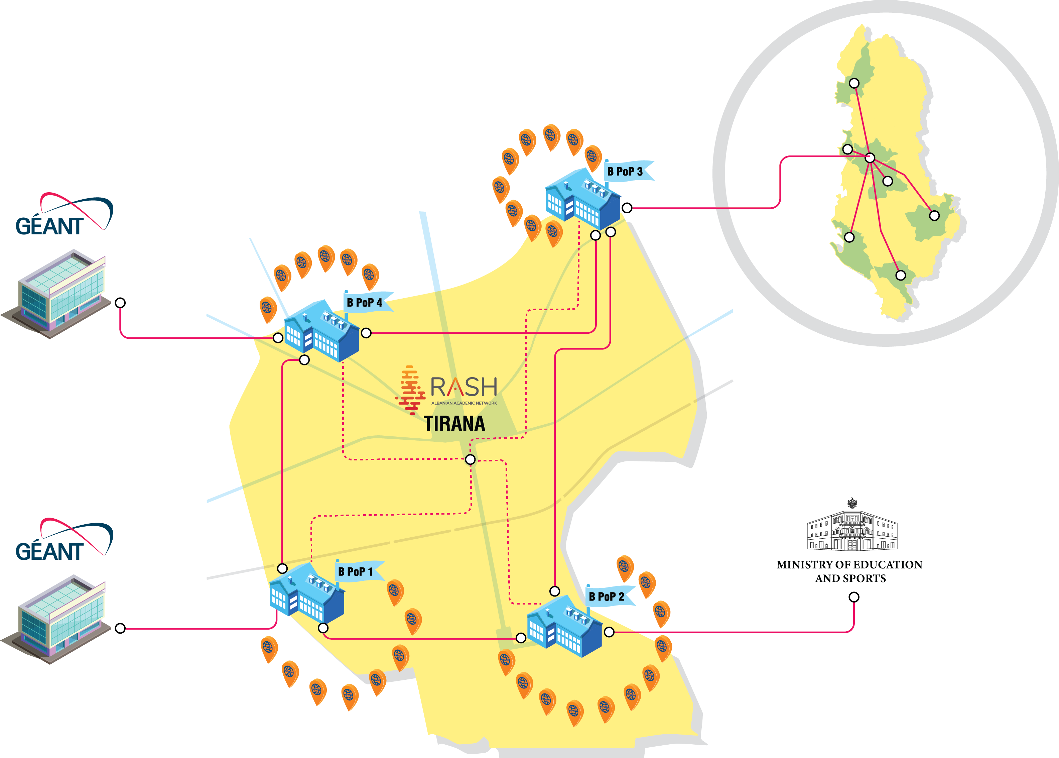
RASH
Services
SW & e-infrastructure services built by RASH fall into two main branches:
www.rash.al

Slide 3
our challenges
Idea: Building a CIRT4EDU in Albania @ RASH
NREN with:
Experience in creating a CIRT at an institutional and national level for Education and certification by international organizations such as FIRST, etc.
Experience in implementing AI models in the service of universities and scientific researchers
Experience in providing IT services that simplify and facilitate student mobility or their application for international studies
Cybersecurity
Artificial intelligence in education
Internationalization and student mobility

