Slide 1
Bridging Action and Maturity:
A New Digital Blueprint for
"The Case for NRENs"
Leonie Schäfer (DFN), Andrea Meloni (GÉANT), Paul Hasleham (GÉANT)
Community Hub
9 June 2026

Slide 2
The Case for NRENs: From a Static Library to a Strategic Roadmap
Objective: Our goal is simple: to help NREN leaders move from knowing what to do, to knowing what to do next.
Growing demand for NREN development support worldwide, combined with increasing expectations from governments and funding bodies, requires more than a document repository—it requires a practical roadmap.
A New Blueprint: Moving beyond passive document storage to an interactive, practical tool for NREN leadership
Tailored Support: Designed specifically for NREN Directors establishing new networks or expanding existing infrastructure.
Phased Evolution: Setting the conceptual foundation today to secure the implementation roadmap for the upcoming GN5-3 project phase.
Notes:
Welcome the audience and introduce yourself as the Strategic Concept Lead for the project.
"The traditional 'Case for NRENs' has been a fantastic repository of knowledge, but as NREN leaders, we don't just need a digital library of PDFs—we need an actionable roadmap."
"We are spearheading a complete transformation of the platform to turn it into a dynamic, strategic tool that guides directors through the real-world lifecycle of building and scaling a network."
"Whether you are currently setting up a brand-new NREN or fighting to expand your existing infrastructure, this platform is being redesigned for you."
"Right now, we are finalising the initial 'lightweight' phase, and we are using this session as a strategic consultation to show the value of this concept and ensure we reserve the necessary budget and focus for its full rollout“
Particularly valuable for emerging and developing NRENs, while also supporting established NRENs planning their next stage of growth.

Slide 3
Action Drives Maturity: The "Checklist-Feeds-Matrix" Logic
The Operational Checklist: A practical, step-by-step roadmap covering governance, financial sustainability, and technical infrastructure.
The Maturity Matrix: A strategic self-assessment framework to evaluate your current phase and set future milestones.
Dynamic Integration: Operational actions instantly map to strategic maturity, transforming daily progress into a clear visual dashboard.
Example: "Establish a formal governance structure" → contributes to Governance Maturity Level 2
Example: "Secure multi-year government funding" → advances Financial Sustainability maturity.
Notes:
"To make this tool practical, we anchored it around a very simple, system-oriented concept: the Checkbox Approach."
"At the foundational level, we have a clear, operational Checklist. This isn't just a generic to-do list; it’s a curated, step-by-step roadmap designed to guide NREN Directors through the critical milestones of governance, securing long-term funding, and building technical infrastructure."
"But we wanted to take it a step further. We wanted to connect these daily actions to your overarching strategy. That is where the Maturity Matrix comes in."
"The logic is completely integrated: as you progress and tick off items on your operational checklist, those actions automatically feed into the Matrix. It instantly updates your strategic self-assessment, showing you exactly what development phase your NREN is in and, crucially, what steps you need to take next to expand."
"It translates complex, long-term organizational growth into a tangible, rewarding dashboard that you can share with your team and your stakeholders."

Slide 4
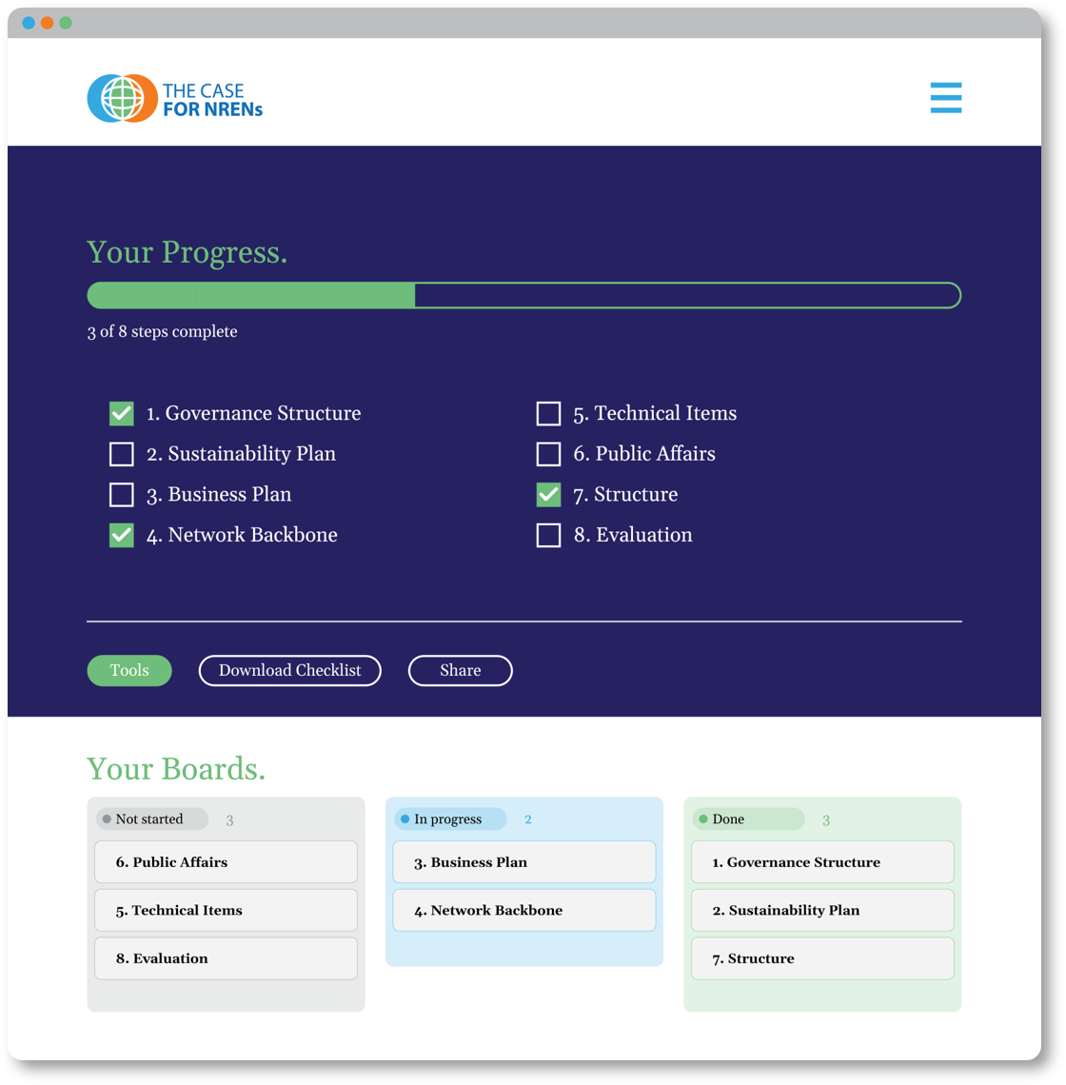
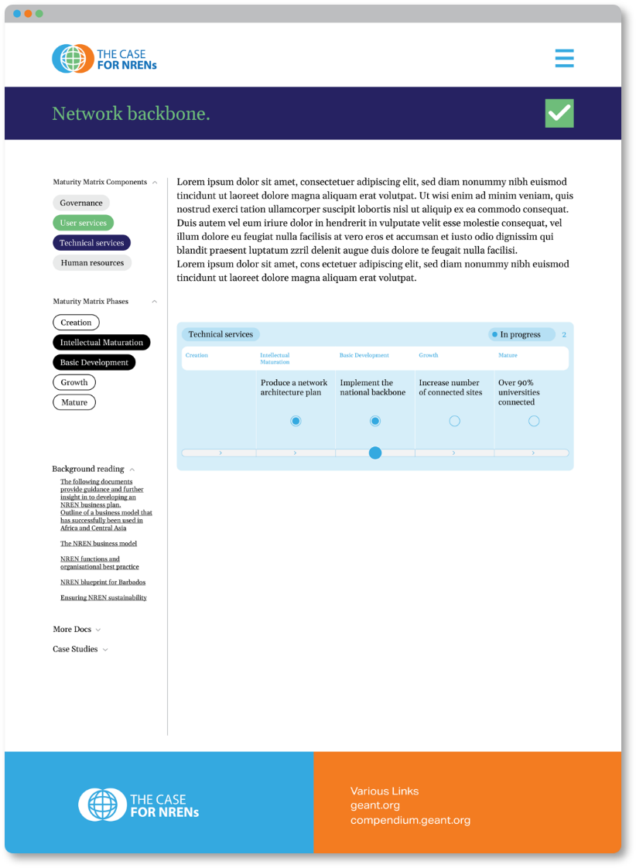
A Glimpse of the New User Experience
Grounded in Reality: Translating the structural concept into a clean, intuitive, and professional dashboard.
From Concept to Interface: Showcasing how a single user action seamlessly updates an NREN’s strategic maturity profile.
Built for Substance: The visual framework and technical architecture are locked in—now we are ready to populate the platform.
Notes:
"We want to move from theory to reality. Here you can see a sneak peek of the new user interface we have been developing."
"Our design team has built a clean, professional, and streamlined dashboard that brings this 'Checkbox Approach' to life. It is designed to be highly intuitive, showing a clear, interactive timeline where a user can log a completed milestone and immediately see their structural profile change on the screen."
“The visual framework and technical architecture are already in place.”
"But a beautiful interface is only as good as the value it delivers. This clean structure is designed to serve a greater purpose: it is the launchpad for the high-quality, practical resources that NREN Directors need every day."
"Now that the visual blueprint is ready, our primary focus is ensuring that the substance inside the platform is exactly what you need to succeed."

Slide 5
Shaping the Substance: Practical Evidence Over Theory
The Focus: A strategic content consultation—we are seeking your expertise on the platform's substance, not its design.
Navigating Government Engagement: Identifying the specific tools, arguments, and templates that successfully convince ministries and funding bodies.
Real-World Success Stories: Sharing regional experiences to help us map the most effective advocacy materials for the global community.
Notes:
"As I mentioned, the design and technical frameworks are in place. Today, we are hosting a strategic consultation focused purely on the content."
"We don't need feedback on where the buttons are; we need your real-world insights into the substance of this platform."
"Every NREN Director in this room knows that the biggest hurdle isn't just the technology—it's political and financial sustainability. We want to know: what actually works when you are engaging with your government, your ministries, or your regional stakeholders?"
"When you are in a high-stakes meeting trying to secure funding or expand your mandate, what specific documents, business cases, or templates do you wish you had in your pocket?"
"We want to gather these real-world experiences and successful approaches from across the global community—especially from emerging regions—so we can turn them into practical, downloadable resources on the platform."
"Your input here will directly shape our content priority list, ensuring the platform contains the exact tools needed to help you back your case to your government.“

Slide 6
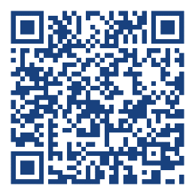
Shape the Future of NREN Advocacy
What was the single most convincing argument or document that helped secure government support for your NREN?
Show your interest: Help us demonstrate community demand to secure implementation budget.
Join the Mailing List: Stay directly updated as the platform transitions from this initial lightweight phase into a fully dynamic tool.
Contribute Your Material: Share the templates, policy papers,
and documentation you deem vital for convincing stakeholders.
Connect Now: Case for NRENs Blueprint
Notes:
"To make this vision a reality, we need your active participation starting today."
"First, we need you to show your interest. By scanning the QR code and engaging with us, you help us demonstrate a strong community demand. This is vital for us to secure and reserve the necessary budget and resources for the full rollout in the next project phase."
"Second, please join our mailing list. This will ensure you stay directly informed as we transition from this initial lightweight phase into a fully dynamic platform."
"And most importantly, contribute your material. If you have a policy paper, a business case template, or a specific presentation that successfully convinced your government to support your network, please share it with us. Let’s build this global roadmap together to support the next generation of NREN leaders.“
"Without capturing and structuring this knowledge now, valuable experience from successful NREN development efforts remains scattered across regions and generations of leadership.”
"Thank you very much, and I look forward to your questions and your contributions.“

Slide 7
Thank you
Any questions?
schaefer@dfn.de

