Slide 1
Digital Safety Fresco
A mental model for better security
Security Awareness Task Force
Community Hub Unplugged
10th June 2026
Notes:
Explore the Digital Safety Fresco, a collaborative workshop helping non-technical users understand digital systems and safe behaviour.

Slide 2
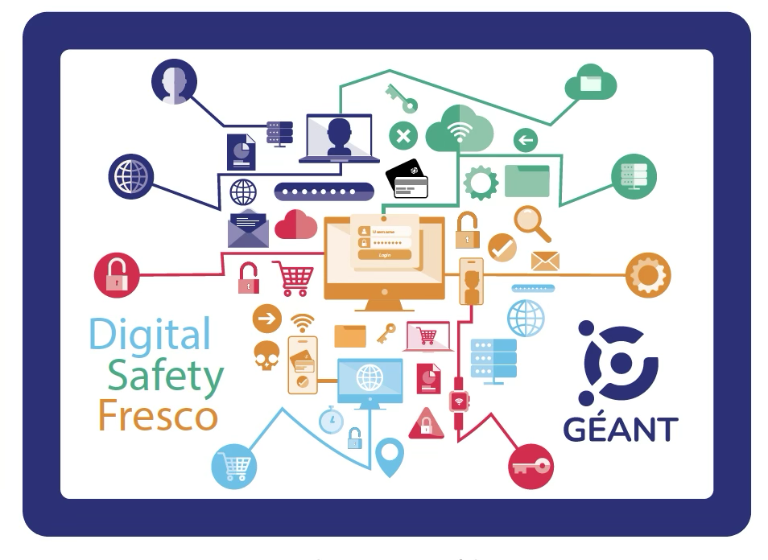
Notes:
Explore the Digital Safety Fresco, a collaborative workshop helping non-technical users understand digital systems and safe behaviour.
The Digital Safety Fresco is an interactive and collaborative workshop designed to raise awareness about digital safety.
The goal of this workshop is not to create fear. It is to help you understand how the digital world works and how your everyday behaviour in uences
your online safety and your organisation's security. Being safe online also has a political dimension: information is power and understanding who has access to your data matters.

Slide 3

Notes:
A mental model is the internal map we use to understand how something works. It allows us to predict outcomes, see connections, and make better decisions, especially in complex environments. Without a mental model, we rely on isolated rules ("use a strong password," "don't click links); with one, we can reason, adapt, and develop a stronger sense of self-efficacy. How did you learn?

Slide 4

A mental model to understand the world: the fundamentals
Data
Devices
Networks
Software
Notes:
As practitioners we’ve realised, that many people never got a globe like that for the digital world we live in.
They don’t have a coherent mental model, which has considerable consequences not just for their safety, their organisations security but also to digital citizenship and our collective future.
That led us to a collaborative, card-based workshop format built around four pillars >security risks and user behaviours.
By making the system visible, including its hidden layers, and how they are connected, the workshop enables participants to better understand why security practices matter and how they can be safer online.

Slide 5
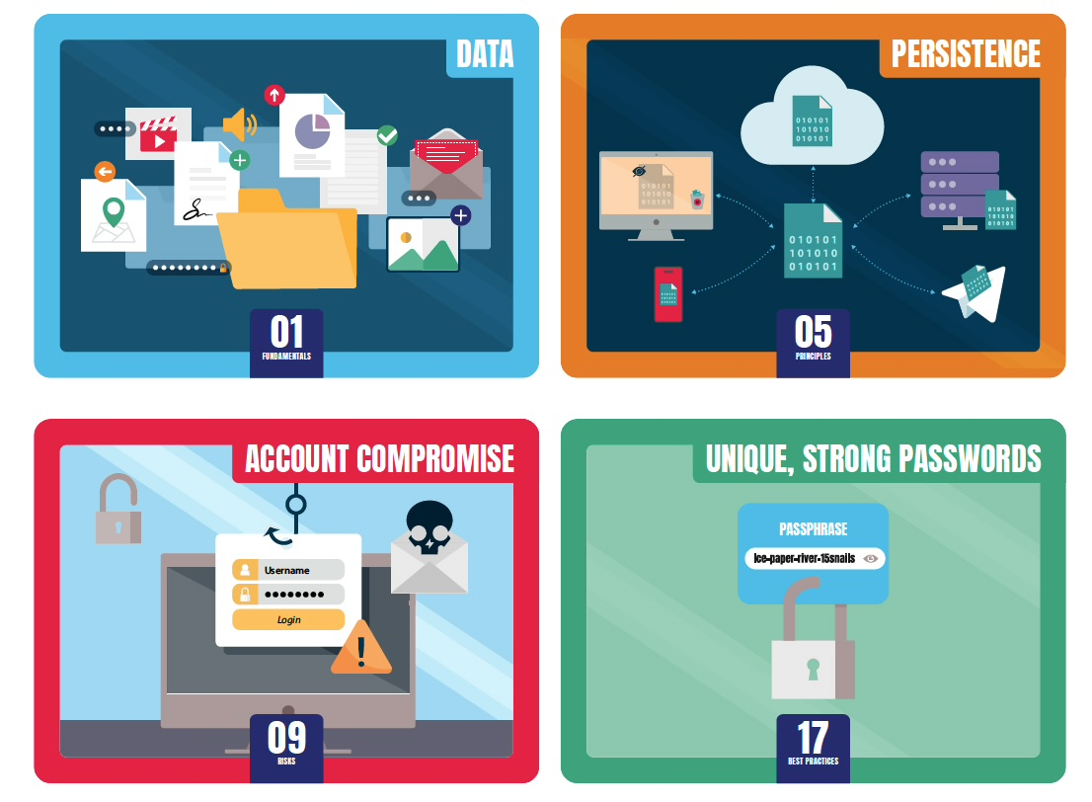
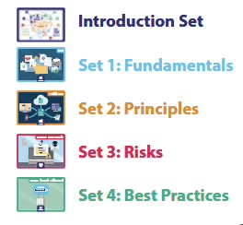
4 sets of cards + 1 intro set for facilitators

Slide 6
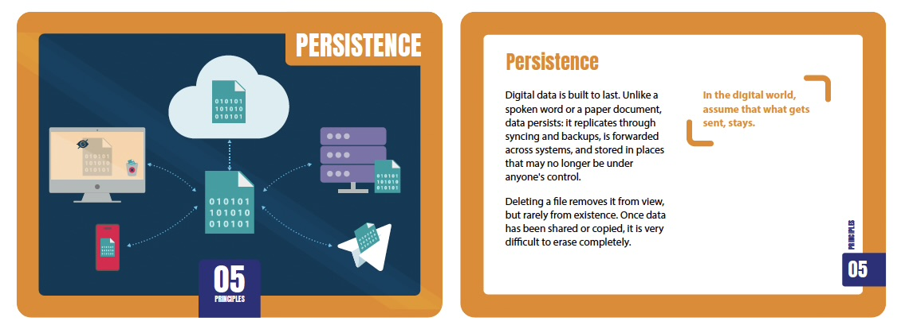
Example: Principles - Set 2, Card 5, Persistence

Slide 7
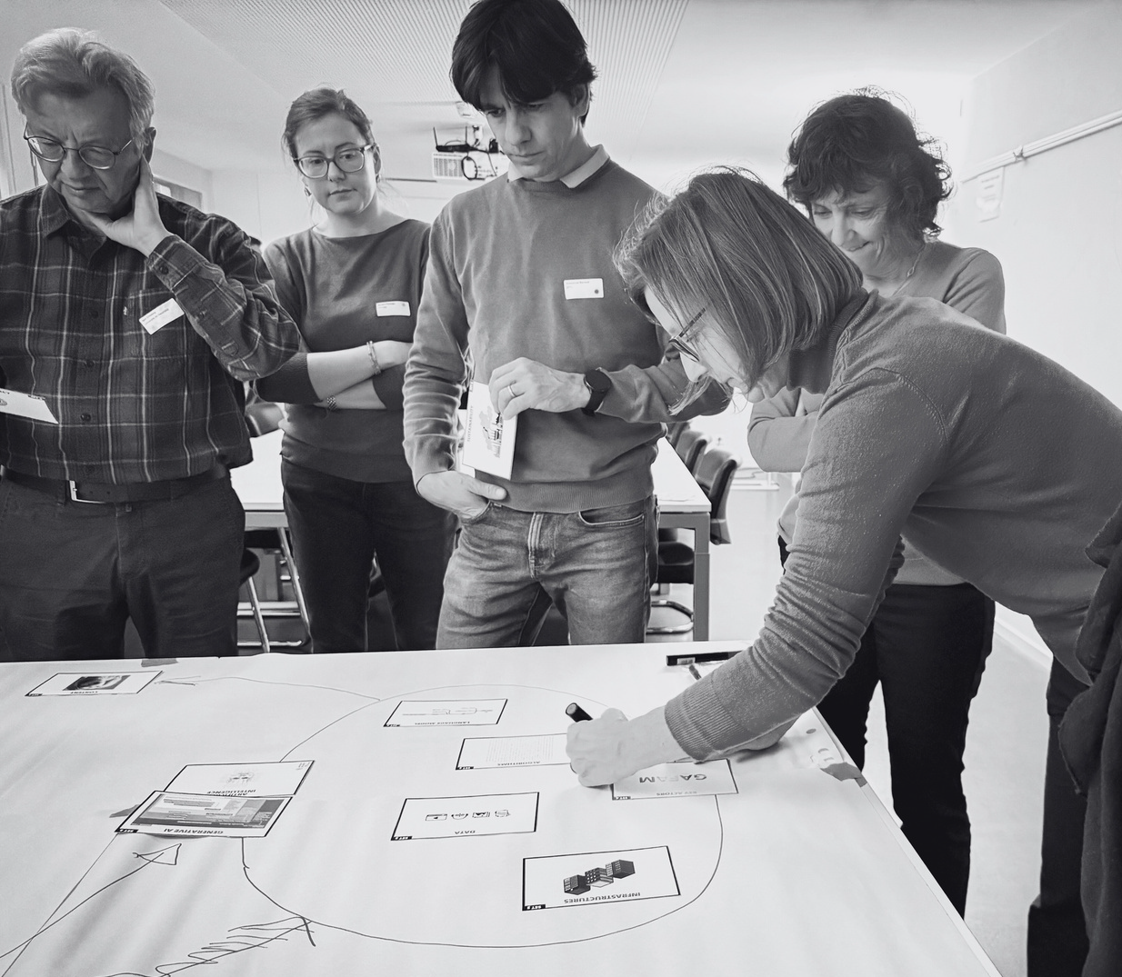
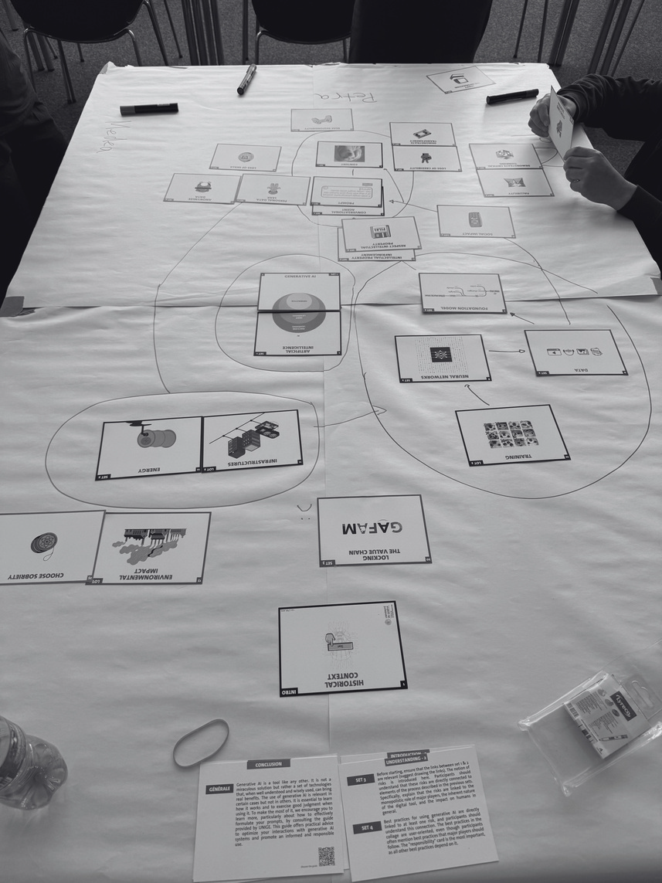
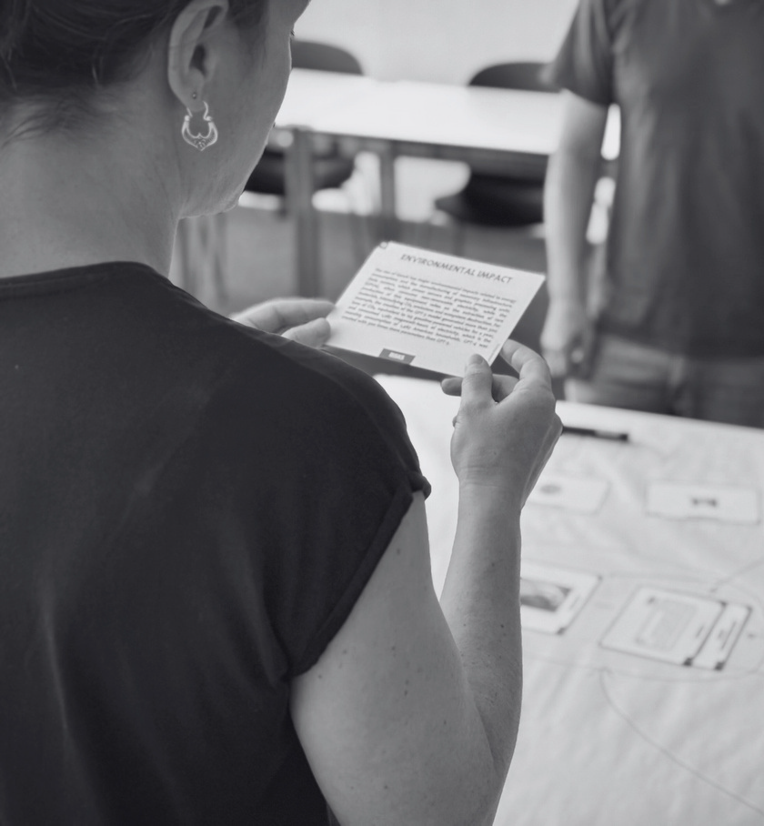
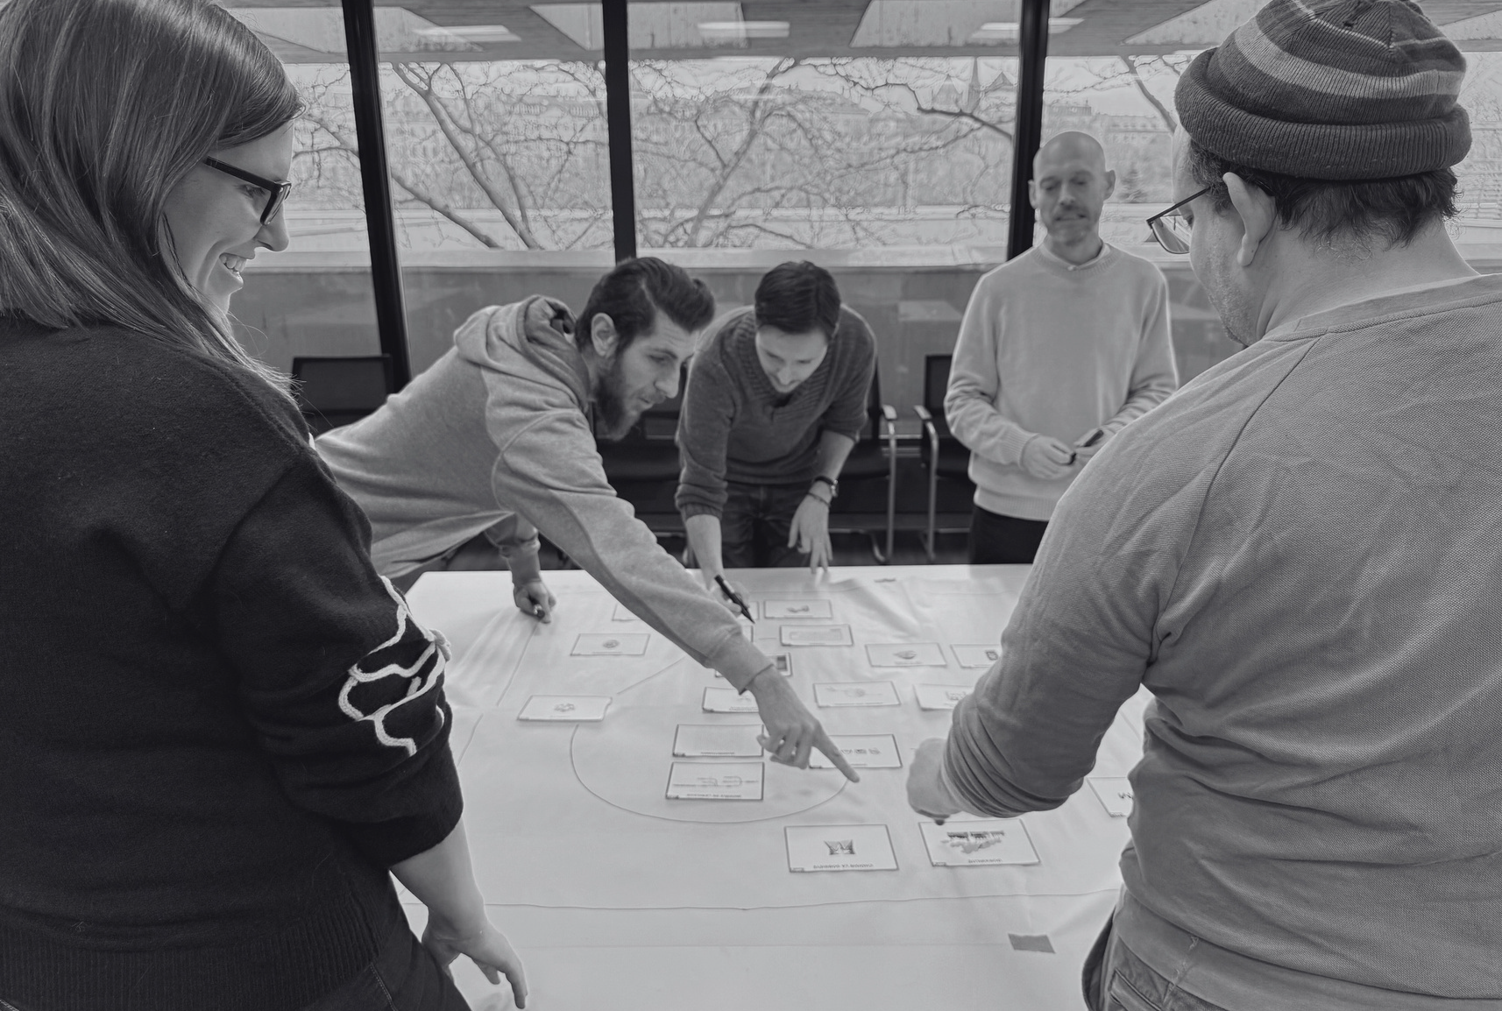
Notes:
Participants get cards explaining concepts in simple terms, that they then connect to other cards based on the discussion they have. They sort info and construct a map, they visualise the concept themselves by talking about it and relating it to their own lived experience which makes it much stickier than a passive talk (like what I'm doing with you now)
Ideal group size 3-5 ppl, you don't need a facilitator but it helps if you have one and get a larger group together which you can subdivide. Not tested yet, but we aim at under 2h (90-100 min)

Slide 8
How to use the GÉANT Digital Safety Workshop
Finished workshop (set of cards) will be available Q3 2026
GÉANT branding with white labeled space for individual branding
cc-licence
customise to your needs (e.g. link to your intranet, translations)
Sign up for the Security Awareness Community and access the Resources Hub: https://security.geant.org/awareness/
Get in touch: awareness@geant.org
Notes:
The materials are creative commons. Anyone working with a community — whether that's students, staff, researchers, or citizens — can run this workshop. You don't need to be a security expert to facilitate it.

Slide 9
Thank you
Any questions?
Presenter email

