Slide 1
Where AI Meets Networks: the Role of AI Factories
Sara Garavelli, CSC-IT Center for Science & LUMI AIF
sara.garavelli@csc.fi

Slide 2
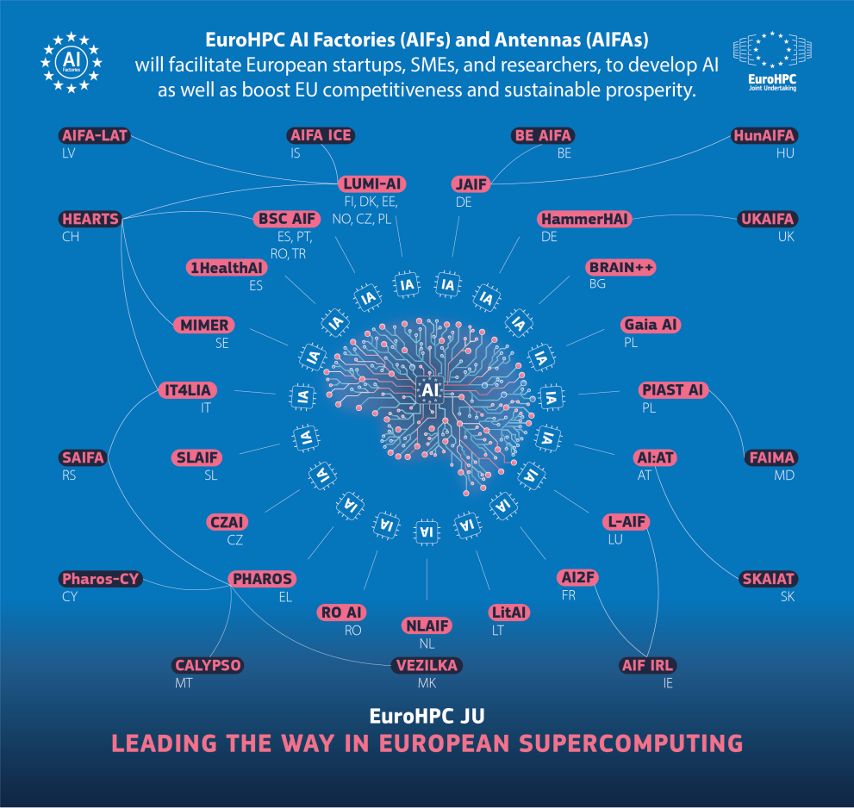
EU mobilises €200 billion for AI
EU is lagging the global AI race
  Sovereign compute capacity
  Competitive European AI companies
  Industrial adoption at scale
19 AI Factories across EU + 13 AIF Antennas
  AI Factories:
    Large-scale supercomputing infra for commercial R&D&I
    Different industrial/application focus areas, hardware variety
  AI Factory Antennas complement existing AI Factories by expanding the reach and complementing their services

Slide 3

AI Factories and Antennas
  AI Factories boost European competitiveness in AI
  Ecosystems formed around supercomputers to foster innovation
  Compute + Data + Talent in enormous scale
  Economic impact & Workforce development
  SMEs and startups, academia and public sector
  – paid tiers for large industry
  Subsidised resources (HW, SW, services)

Slide 4
LUMI AI Factory in a nutshell
The largest AI Factory, pooling resources from 10 European countries, to empower the European AI ecosystem
Consortium include six member states Czechia, Denmark, Finland, Estonia, Norway, and Poland.
AI Factory Antennas associated with LUMI AI Factory include Belgium, Iceland, Latvia, and Switzerland.
Key industrial sectors: Manufacturing industries, Health and life sciences, Communication technologies and networks.

Slide 5
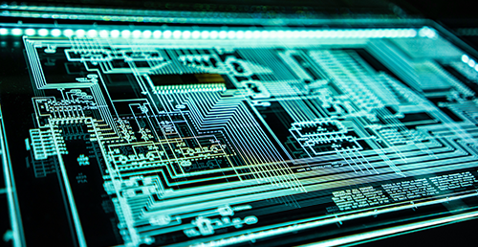


Our unique service offering
Largest AI supercomputers
in Europe
Different sized packages for AI computing
Supercomputing environment & Kubernetes
Scalable AI training up to foundation model range
Access to high value data
(Dataset-as-a-Service)
Integration of data streams
Confidential and secure data environment
LUMI hosting is ISO 27001 certified
AI expertise from a consortium
of 200+ specialists
Consultation for all phases of AI development
Special skills in large scale AI and code optimization
Tailored training in AI and high-performance computing
LEADERSHIP COMPUTING
DATA LAB
AI EXPERTISE
Explore our services at https://lumi-ai-factory.eu/service-catalogue/
Images: Adi Goldstein, Jaffer Nizami, and John all on Unsplash

