Slide 1
Working as one
Delivering European Hyper-Connectivity
GÉANT & 27 EU NRENs
TNC26, Helsinki
Wednesday 10 June, 2026

Slide 2


Europe has something unique
A Network Infrastructure Built for Research and Education -
by Research and Education
And working together has made it possible

Slide 3
Getting us to Next Level
A federated European HPC ecosystem
Hyperconnected

Slide 4
EuroHPC HyperConnectivity: What does it do?
Access to world-class HPC resources
Provide service assurance with well-defined processes, shared monitoring & reporting
Research sovereignty
  Europe-owned infrastructure and data pathways ​
Democratisation of resources
  Reach to users across all member states, education sectors, and disciplines ​

Slide 5
EuroHPC HyperConnectivity: How does it do it?
A Hyper-Connectivity Service Area (HCSA)
  Effectively a “Network As A Service” area offering high-capacity connectivity to and in between “Points of Interests” – end sites
Connectivity between PoIs and the HCSA
  Ensuring that PoIs joining the HCSA are connected or able to according to the parameters set by the EuroHPC JU – capacity, resiliency level, security, monitoring requirements and so on
P3
P4
P2
NREN as“Access”
IP
P3
P3
P2
NREN as“Access”
NREN as“Access”
IP
P1
HCSA
IP
P1
P1
Regional Network
P1 - Cloud
P5
P1 - IX
IP
P1 - IX
Global R&E​
IP
P1 - Cloud

Slide 6
EuroHPC HyperConnectivity: When does it do it?
Mar 2026 – Sep 2026
Implementation & delivery of the HCSA
Incl. pilot sites
Oct 2026 – Sep 2027
Progressive onboarding of PoIs
Oct 2027 – Sep 2029
Fully hyperconnected ecosystem in operation

Slide 7
Introducing the HCSA pilot NRENs
4 pilot NRENs:
  CSC – IT Center for Science / FUNET: EuroHPC LUMI (P2)
  RESTENA: EuroHPC MeluXina (P2)
  ACONET: Vienna Scientific Cluster & University of Graz-ZIM (Clarin RI) (P3)
  FCCN: INESC-ID & FCT Nova (P4)
Today, CSC/Funet & RESTENA will share their story

Slide 8
HCSA Pilot Site:
LUMI, Kajaani
CSC/Funet preparations and site onboarding
Matti Laipio
TNC26, Helsinki
Working as one:
Delivering European Hyper-Connectivity
Wednesday 10 June, 2026

Slide 9


The journey so far
Network upgrades to 400 Gbit/s
  Funet IP-core was upgraded in 2024-2025
  Funet-Nordunet connectivity was upgraded in 2026
  Various links in Nordunet and hand-over to GÉANT upgraded in 2026
Monitoring and telemetry setups
  Monitoring access to Kajaani for GÉANT
PMP server to Kajaani
  PMP server was specified by GÉANT and ordered accordingly
  Expected delivery and installation is during July-August
Onboarding
  LUMI fully onboarded and ready

Slide 10
Next steps
Installation and provisioning of the PMP server in Kajaani
Contacting the P3-P5 sites in Finland and investigate if they are able to connect
High performance redundancy to international connectivity for Funet with NORDUnet
e.g. upgrading the Helsinki-Hamburg link to 400 Gbit/s

Slide 11
Reflections & highlights
So far so good!
Network upgrades with NORDUnet has went very well – the core network is ready
GÉANT has coordinated work well and provided information and help
Upgrading the network takes time – right now even more!
Component shortages affect to network equipment and servers’ delivery times
due to AI boom

Slide 12
Thank you
Any questions?
Matti.Laipio@csc.fi

Slide 13
HCSA Pilot Site:
Meluxina
RESTENA preparations and site onboarding
Claude TOMPERS
TNC26, Helsinki
Working as one:
Delivering European Hyper-Connectivity
Wednesday 10 June, 2026

Slide 14

The journey so far
Initially deployment seemed rather daunting Tbit at a time where 400G connectivity was new & expensive
Requirements reviewed: 200G
400G became mainstream
  Including 400G ZR+ coherent optics
Notes:
Going all the way back as 2018.
Back then Meluxina did not exist (June 2021)
400G hardly existed (first short-haul pluggables appeared end 2018)
100G long-haul did not exist as pluggables either
What ? Why ? Really ?
Fast-fwd to 2024 → Tender started
200G much more realistic

Slide 15
The journey so far
Timeline overlaps our own backbone renewal
  Partial Upgrade from 100G to 400G
  New vendor for IP network
  New GÉANT POP LUX
Additional equipment for 400G on the transport layer
Notes:
Timeline overlap helped us keeping cost down. Only delta invoiced to project.
Transport layer pretty straight forward due to 400G coherent pluggables.
New vendor obviously increased the workload significantly (new cli, automation, ...)

Slide 16
The journey so far
PoI Monitoring
  Dedicated Prometheus instance the GÉANT can pull metrics from
Notes:
Fairly easy, all the bits existed or were planned anyways.
Steep learning curve on GNMI(c).
Took some fiddling with GNMIc, but overall clean setup.
Main GNMI server polls net devices
→ Saves into our own Prometheus
→ Exposes itself as GNMI server
GEANT instance server polls specific metrics from main GNMI server
→ Saves into local Prometheus for GEANT to poll

Slide 17
The journey so far
PMP server
  RESTENA is buying hardware according to GÉANT specs
  GÉANT will manage the instance
  Prices are painful, availability puts timeline at risk
Notes:
Not much to say about the PMP server.
Ordered but no on-hand experience with it yet.

Slide 18
Next steps
New backbone routers are still being deployed
Transport layer equipment ordered, waiting for delivery
PMP server ordered, waiting for delivery
Notes:
Still preparing new backbone routers
→automation system to be adapted
Good progress
PMP server ordered

Slide 19
Reflections & highlights
So far the tender phase was the most “exciting” part
Deployment so far business as usual
  including mandatory curveballs
Notes:
Anyone who was part of the tender process can witness that. :)
Curveballs not necessarily specific to the project, more of a coffeebreak discussion.

Slide 20
Thank you
Any questions?
claude.tompers@restena.lu

Slide 21
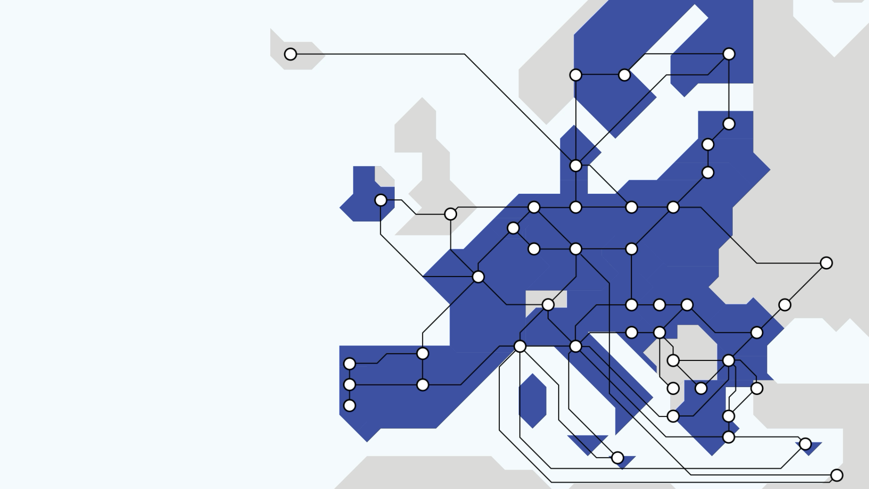

Slide 22
Thank you
Any questions?
hyperconnectivity@geant.org
find out more

