Slide 1
The Identity Wallet Landscape is Evolving
Use cases for the R&E Community
Wallets activity – GN5-2
Community Hub – T&I in Action
11 June 2026

Slide 2
Agenda
Introduction to the wallet activity in GN5-2
Round table discussions
  R&E use cases
  Interoperability & Development

Slide 3
Introduction: wallets activity in GN5-2 (1/2)
Current state of Digital Identity Wallets
General topics of the EUDI Wallet
Digital Identity Wallet Terminology
National adoption
NREN involvement
Standards Landscape for R&E Digital Identity Wallets
Verifiable Credentials 2.0
eIDAS 2.0
Architecure and Reference Framework (ARF)
OpenID4VCI + OpenID4VP
OpenID Federation Wallet Architectures 1.0
Overview of OpenID Federation and guides to help people understand what OpenID Federation is, how it works and how to use it
Interoperability for Identity Wallets and Credentials
Role of Identity Federations in the Wallet Ecosystem
Collect information to support the interoperability lab
Risk management

Slide 4
Introduction: wallets activity in GN5-2 (2/2)
Credentials and wallets community effort
Create a space for the R&E sector to connect to discuss important topics
Ontological view of wallets and credentials in R&E
Overview of what the wallet eco-system looks like, with focus on components and stakeholders.
R&E use cases for wallets and credentials
Overview of the possible use cases for wallets in R&E
Global R&E interoperability lab
Facilitate understanding for the wallet ecosystem and create alignment
Synthesise the work in the other topics to try to explain how everything fits together.
Setup infrastructure to showcase use cases for R&E
Test interoperability of their own components against other setups
Guiding principles: comprehensibility, benefits, innovation, legitimation, product/governance vision

Slide 5
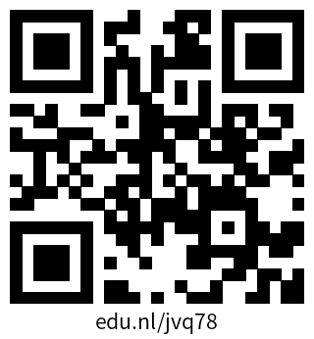
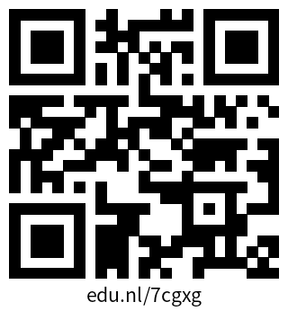
Discussion
Group 1: R&E use cases
  eduID
  General use cases
Group 2: Interoperability & Development
  What are you planning?
  What are you building?
Wallet wiki
Wallet mailing list

Slide 6
Thank you
Any questions?
Please don’t forget to subscribe to the mailing list!

