Slide 1

Exploring nmaas Platform Use Cases
Beyond network and service monitoring
Łukasz Łopatowski (PCSS)
Vojdan Kjorveziroski (UKIM)
TNC 2026, Helsinki, Finland
Community Hub, 11 June 2025
Public (PU)

Slide 2


Agenda
nmaas Use-Cases Overview
(demo) Active Monitoring in EdgePL project
(demo) nmaas service Dashboards with Metrics
(demo) Educational exercises at scale with vLAB
(demo) Web Service Health Monitoring and Backups in PCSS
(demo) AI-assisted operations via MCP Server
Contribute to the application catalogue
Feature requests and what’s next

Slide 3
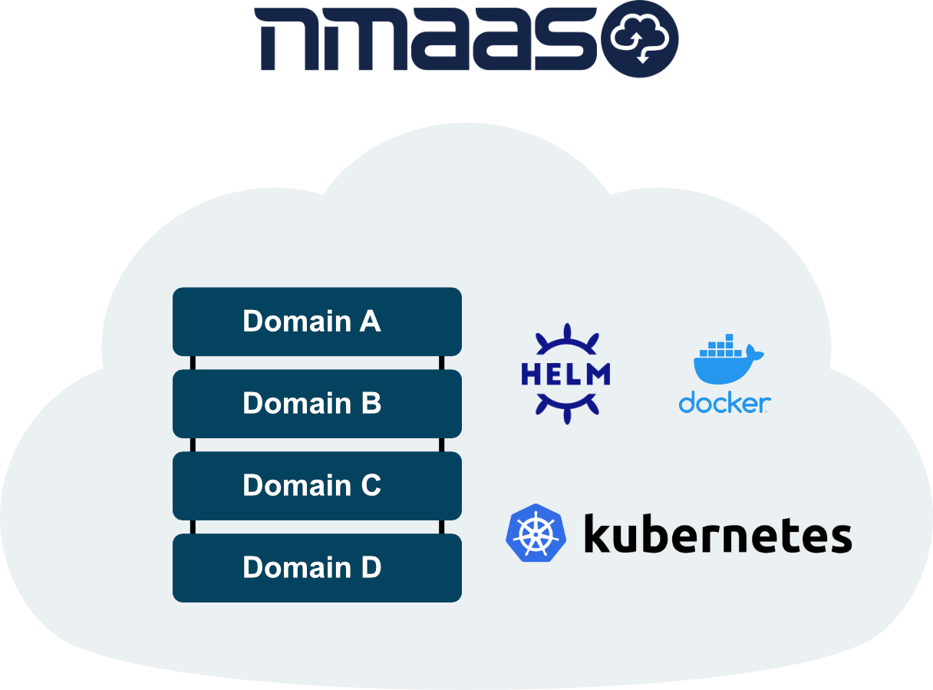
nmaas Platform
nmaas is an open-source platform for orchestrated deployment of applications in a cloud environment
Kubernetes-based infrastructure
Multi-tenant architecture
Simple application deployment and upgrade
Wide and easily extendable portfolio of applications
GitOps for application instance configuration
Easy troubleshooting via integrated log viewing and interactive command execution
Source code available at https://gitlab.software.geant.org/nmaas

Slide 4
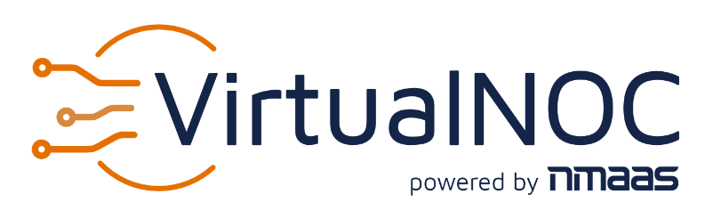
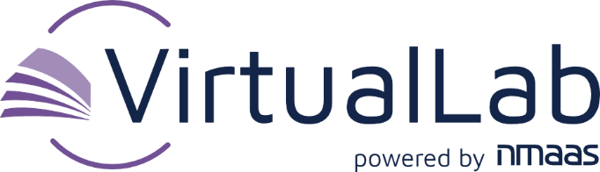
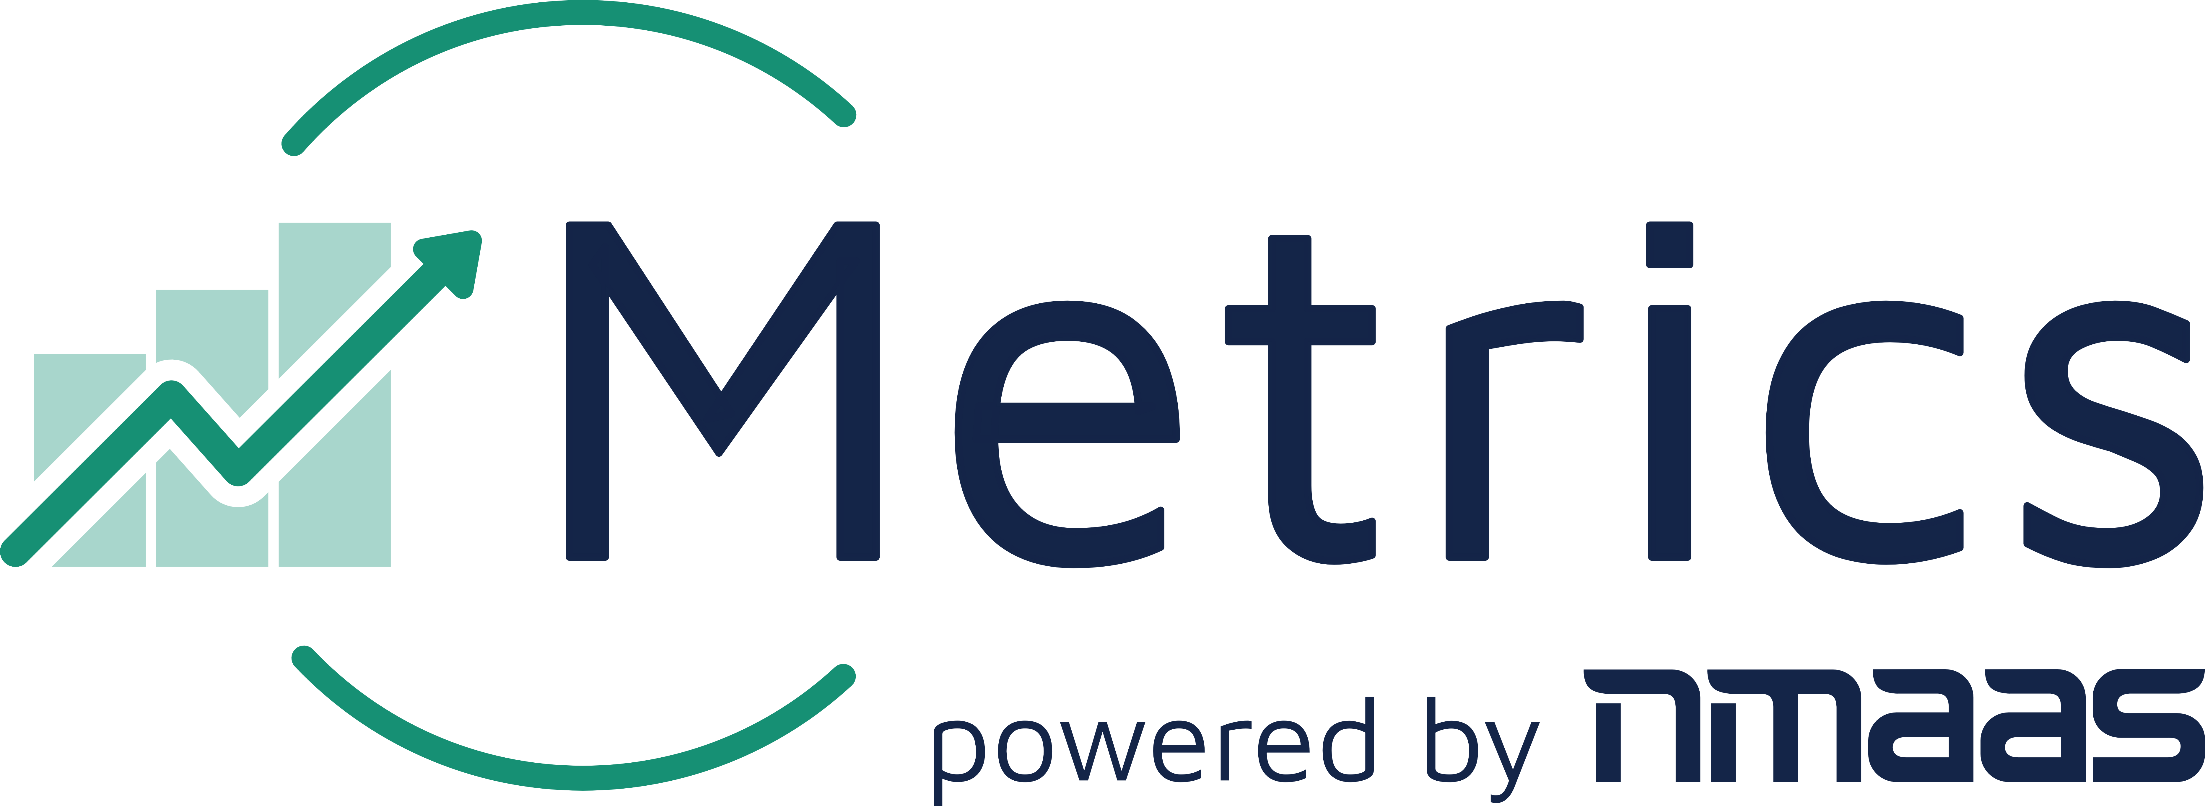
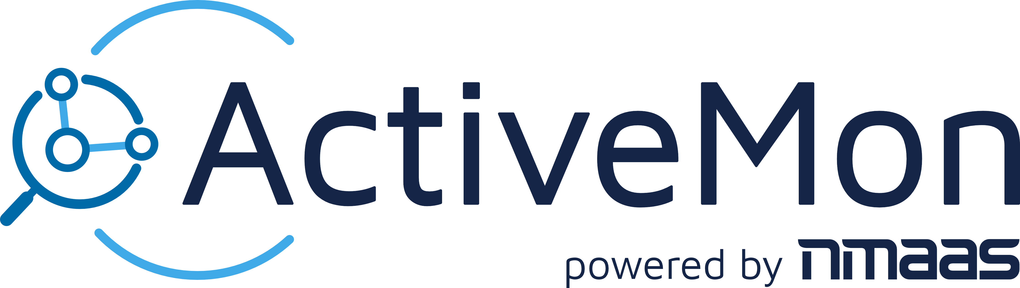
nmaas Use-Cases
nmaas as versatile orchestration platform
Support for multiple use-cases by providing software features and applications
Currently supported use-cases on top a common code base:
  nmaas for Virtual NOC (originally referred to as NMaaS - Network Management as a Service)
  nmaas for Virtual Lab (online hands-on exercises in an education context)
  nmaas Metrics (data crawling, analysis, and visualization toolkit)
  nmaas ActiveMon (perfSONAR-based active network measurements)

Slide 5
Active Monitoring in the EdgePL Project
Demonstration

Slide 6
Service Dashboards and Metrics
Demonstration

Slide 7
Educational Exercises at Scale with vLAB
Demonstration

Slide 8
Web Service Health Monitoring and Backups in PCSS
Demonstration

Slide 9
AI Assisted Operations with nmaas MCP
Demonstration

Slide 10
What would you like to see on nmaas? (Application edition)

Slide 11
What would you like to see on nmaas? (new features)

Slide 12

Conclusion and Future Plans
nmaas as an open-source multi-cluster application orchestration platform
Versatile and adaptable to different use-cases
Remote cluster support enabling new use cases
  Distributed Active Monitoring
  Sharing GPU resources on Edge nodes
Continuous evolvement of the application portfolio
Extending nmaas with generative AI
  nmaas MCP, new application addition

Slide 13
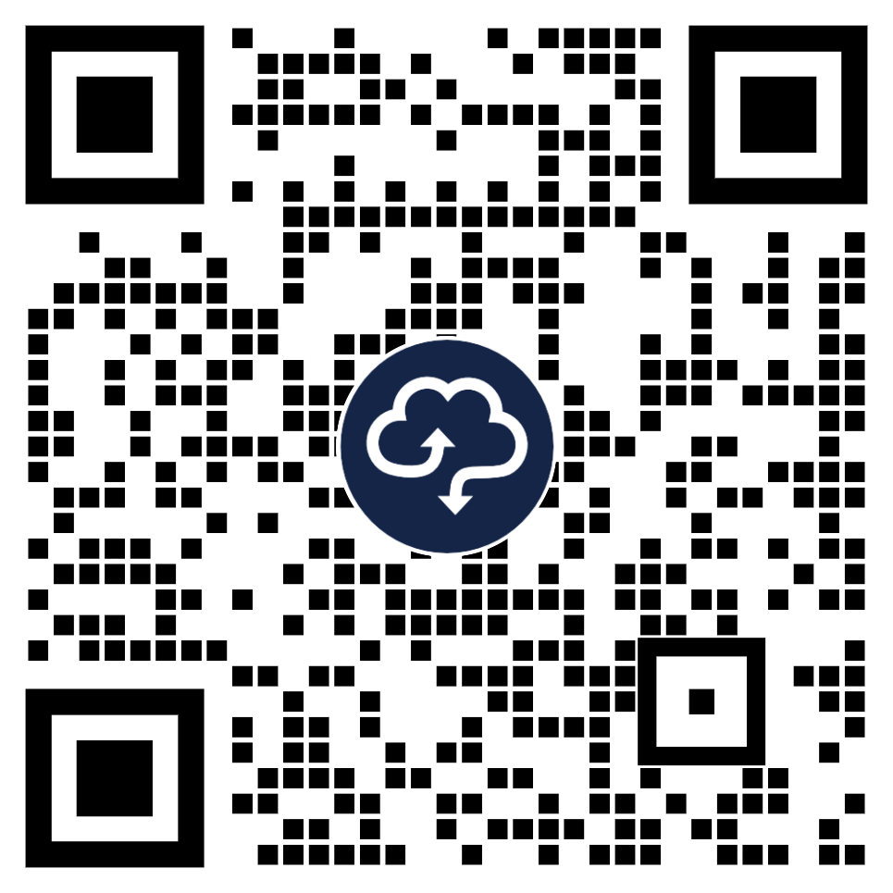
Thank You
Documentation
Contact the nmaas team
https://docs.nmaas.eu/
nmaas@lists.geant.org

