Slide 1
In the era of AI, how are NRENs collecting, using, and sharing data for collective impact?
Community Hub Session
Organised by the GÉANT FAIR Data Portal Team
11 June 2026

Slide 2
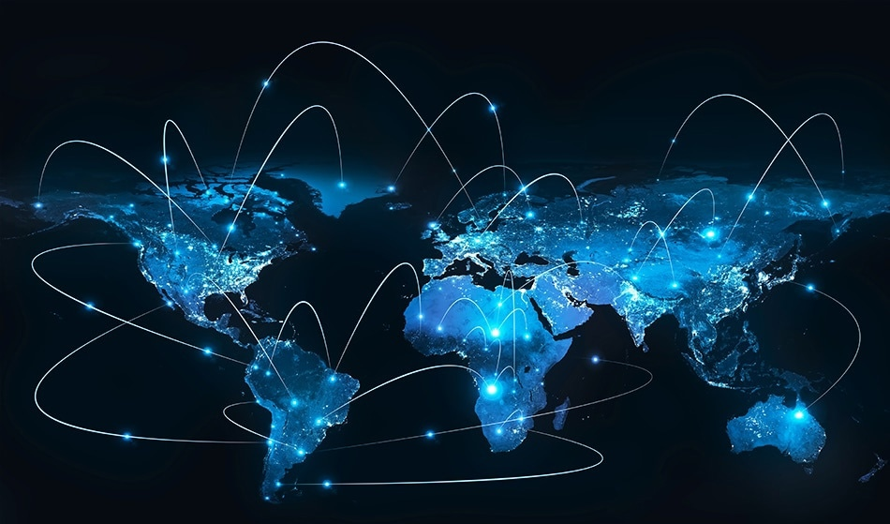
The NRENs as a Data-Sharing Community?
43​
NRENs
+ 62​
countries outside GÉANT membership
...we are a BIG community.
3.3 EB
transit data per year
3.3 EB
transit data per year
6K​
NRENs Staff
9.1 PB
transit data per day
62K
institutions
connected
9.1 PB
transit data per day
How are we dealing with our data?
Are we collecting data?
What kind of data do we have?
And are we sharing it?​
Notes:
And about us?
NREN community?

Slide 3
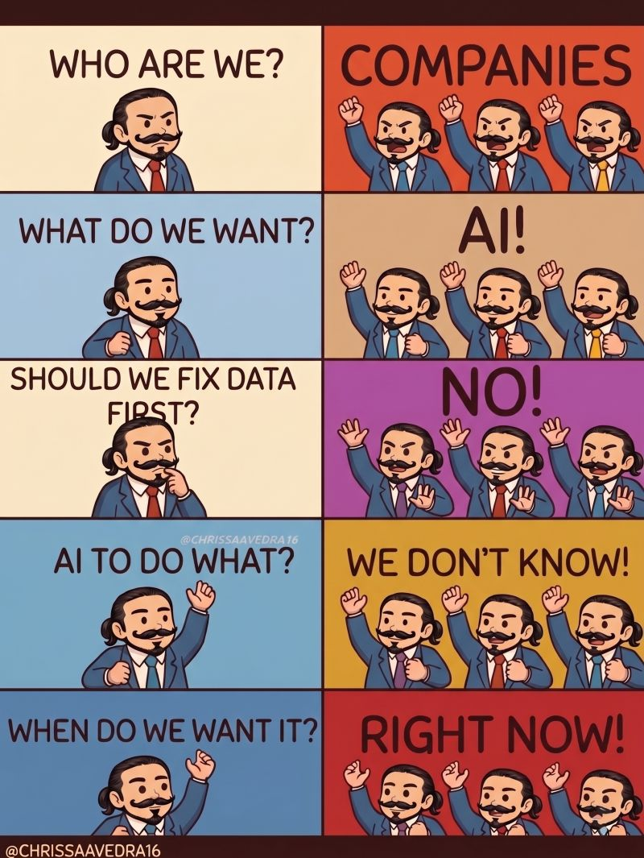
Session Flow
Introduction into the Session
Rapid-Fire Introduction for each panellist
  CESNET’s Network Datasets
  ROBIN service
  MetrANOVA
  Fibre-Sensing Data
  GÉANT Fair Data Portal
Questions to the panellists
Audience Discussion

Slide 4

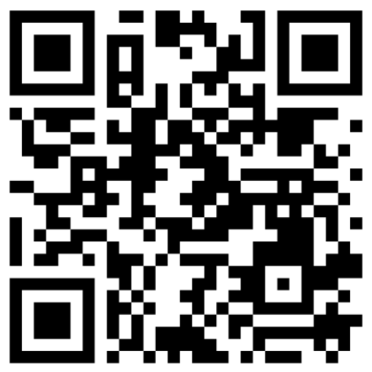
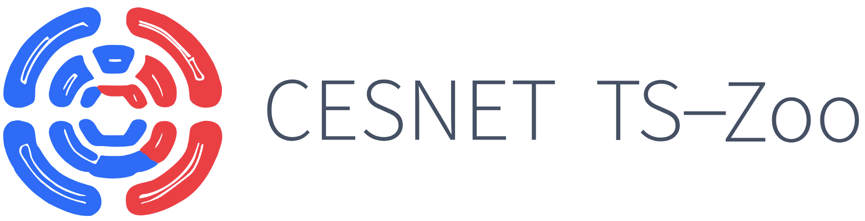


CESNET's Network Datasets
What is future of the initiative?
Focus more on threat and anomaly detection datasets.
Comprehensive ISP-scale datasets from the CESNET3 academic backbone network.
How?
  Ipfixprobe flow exporter
  Ipfixcol2 flow collector
  Custom data processing pipelines
  Custom Python libraries for data provision and processing
Open datasets for:
  TLS/QUIC classification
  Traffic forecasting
  Threat detection
  Anomaly Detection
Collaboration with Czech
Technical University in Prague
Collaboration with NRENs?
Expanding data collection across multiple NRENs to evaluate the cross-network transferability of ML models.
Contact: @cesnet.cz
koumar
pesek
luxemburk
For more information

Slide 5
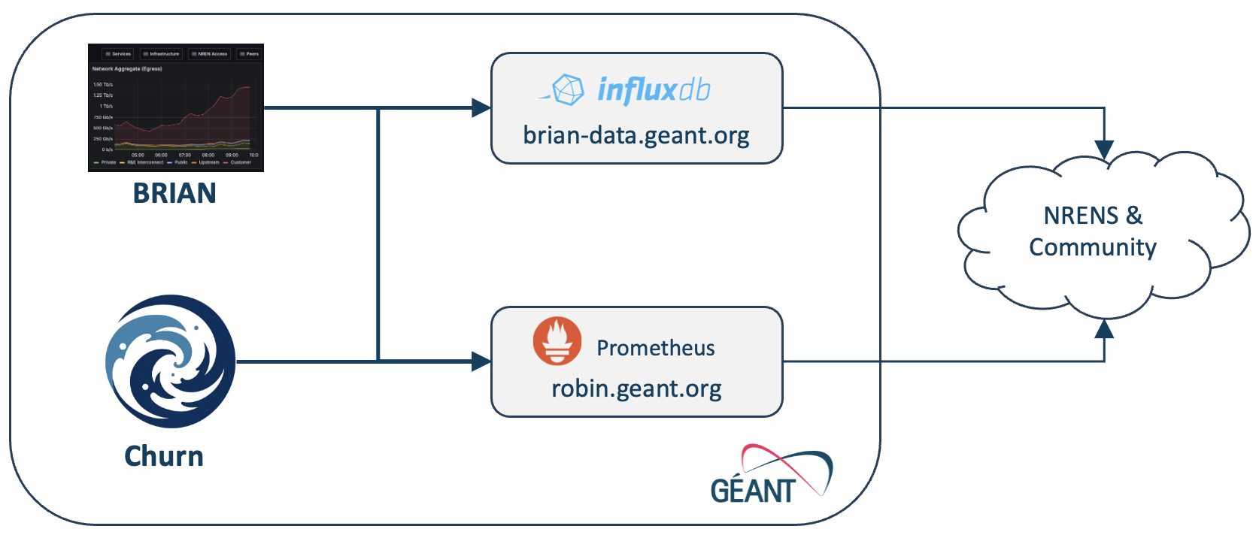
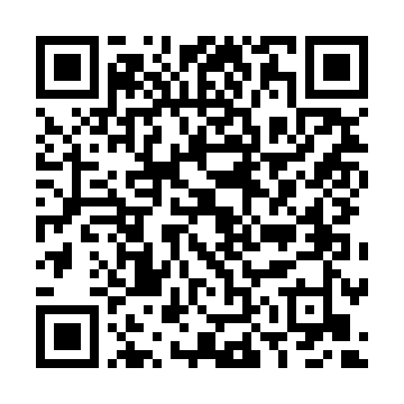

ROBIN
What is future of the initiative?
Ongoing iterations and improvements
Still some issues to be solved
(finer access permissions, etc.)
A portal for sharing GÉANT network monitoring and telemetry data within the community.
Collaboration with NRENs?
Specific to GEANT network, sharing is controlled
Additional data added case-by-case
Contact: GÉANT
swd@geant.org
For more information

Slide 6

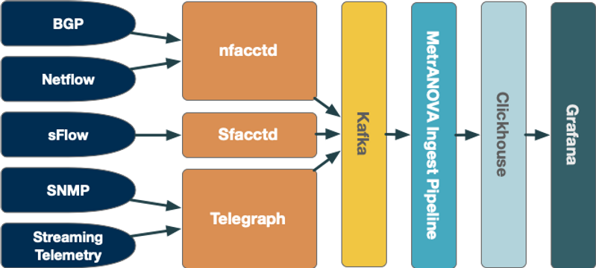
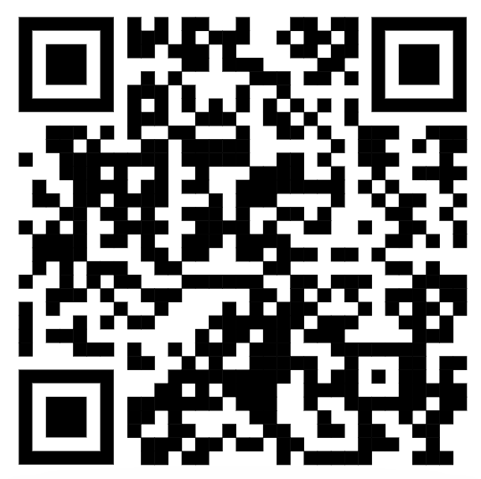
MetrANOVA
Network Measurement for Advancing Network Observation, Visualization, and Analysis.
Controlled data sharing while preserving digital sovereignty.
What is future of the initiative?
Further improvements of existing features:
  Monitoring Network Flow with BGP metadata,
  Device Metrics with SNMP and Streaming Telemetry,
  Policy-based / authenticated data sharing
Wider deployment
Collaboration with NRENs?
Developed in a global R&E consortium, free for use!
Contact:
https://www.metranova.org/
ebalas@es.net
For more information

Slide 7


GÉANT Fibre Sensing Service
What is future of the initiative?
PLM development gate
Incorporation into new projects (SEA-FOCUS is being submitted)
Expansion of sites with similar model
GÉANT deploys DAS on AMS-LON backbone link.
4.7 TB of data per day covering 30,000 sensor points along the one cable.
GÉANT just bought 3 more DAS units (currently in Sines, Portugal, Crotone, Italy, and Rhodes, Greece).
Data is bought by SURF and offered to Dutch research communities.
Data is used by research communities to investigate earthquakes, exploding ordinance, wind farms, sea surface state, marine life, marine ecosystem habitat observation, vessel monitoring. Can also be used to monitor aircraft and for cable protection.
AI tools are essential for efficiently going through all this data (but won't be developed by GÉANT).
Data is offered under the licence CC BY-NC-SA 4.0
Based on the SUBMERSE technical architecture.
Collaboration with NRENs?
SURF for now
Contact:
Chris Atherton

Slide 8
GÉANT FAIR Data Portal
Aim: Establish a FAIR Data Portal for GÉANT and create the foundation for data-sharing culture
Testing scenario built with InvenioRDM
How?
  Facilitate internal data-sharing through a Data Champions Group
  Map Data inventory and knowledge about internal datasets
  Provide training for staff on the importance of FAIR data and good data-sharing habits
Cross-team initiative, supported by the internal innovation fund
What is future of the initiative?
Project end in October, move into Proof-of-concept phase, expand into NRENs in 2027?
Collaboration with NRENs?
Working on touch points with GN5-2 WP6
Contact: GÉANT
Daniela Brauner,
Emma Apted,
Tanja Maier

Slide 9
Our Panelists
Josef Koumar
CESNET's Net-work Datasets
Erik Reid
ROBIN Service
Edward Balas
MetrANOVA
Chris Atherton
Fibre-sensing
Daniela Brauner
GÉANT FAIR Data Portal

Slide 10
Thank you

