Slide 1



eduroam Login Made Simple
HOW PASSKEYS CAN HELP
tnc26 | 10.06.2026
Jan-Frederik “Janfred” Rieckers

Slide 2

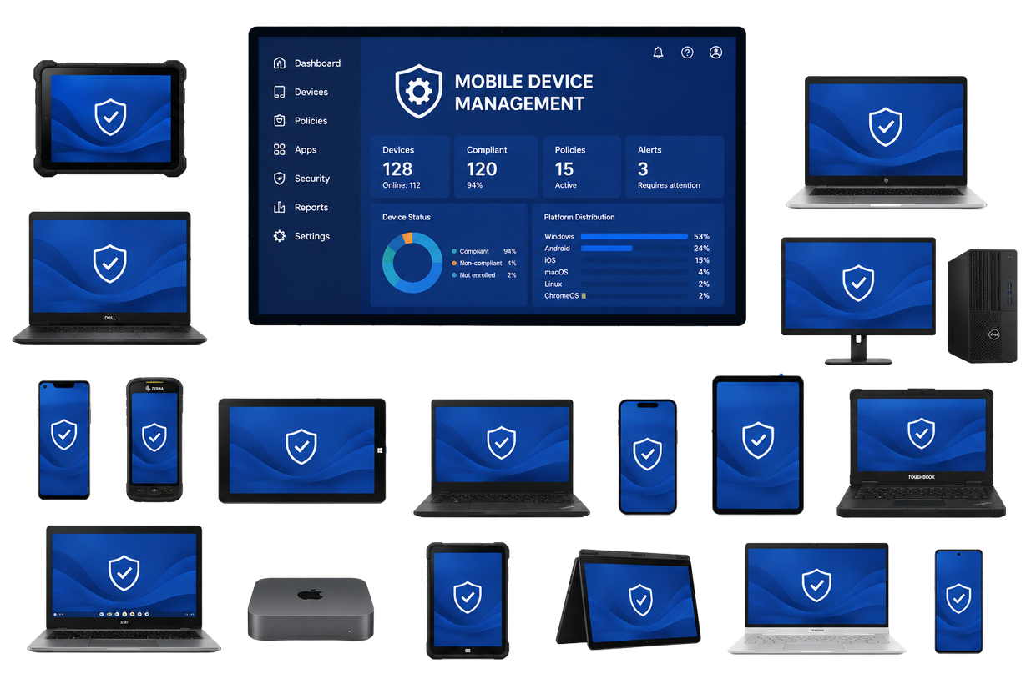

Let’s talk about eduroam-Login
Secure
Secure
Usable
Usable
BYOD-capable
CHOOSE TWO!

Slide 3


Let’s talk about eduroam-Login
Secure
Usable
BYOD-capable
BYOD-capable
CHOOSE TWO!

Slide 4
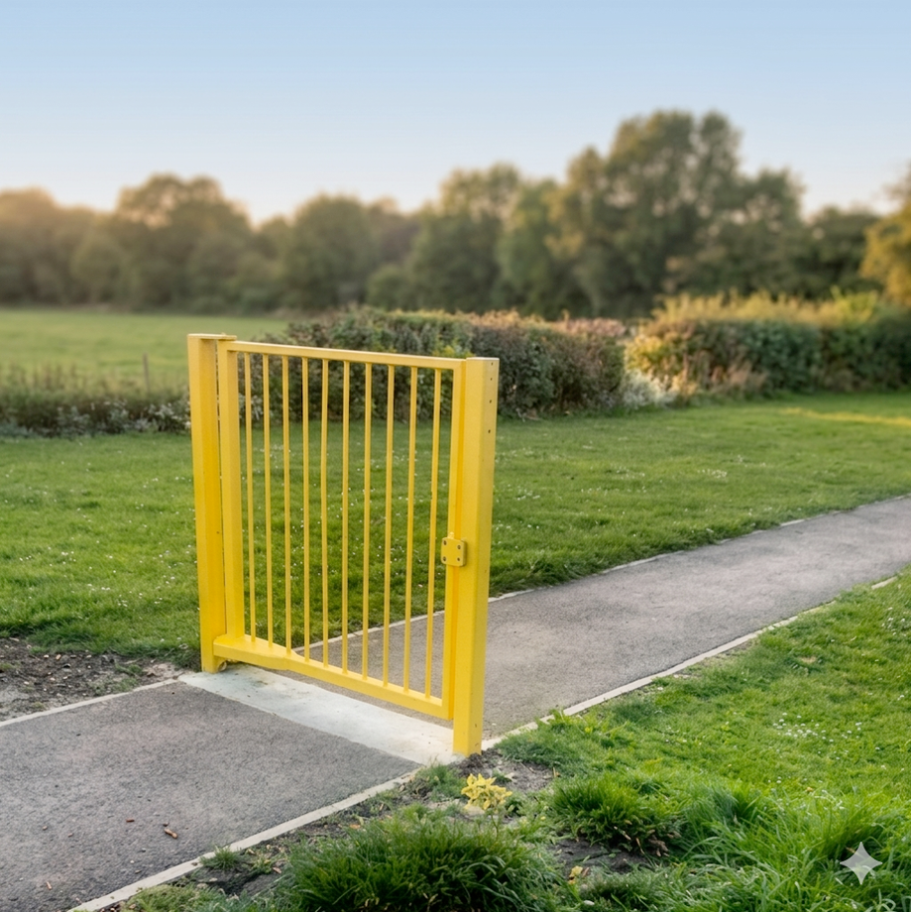
Let’s talk about eduroam-Login
Secure
Usable
Usable
BYOD-capable
CHOOSE TWO!

Slide 5
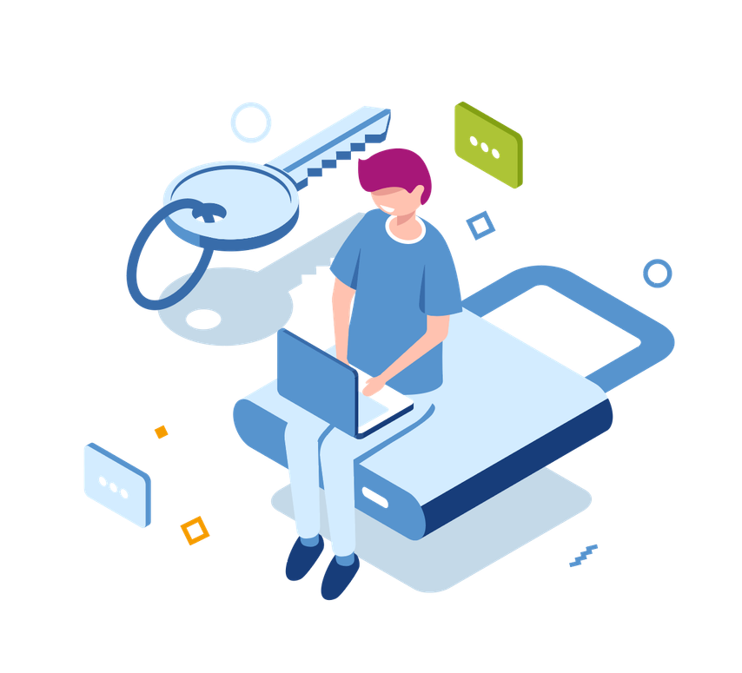
... LET’S LOOK AT THE WEB
Passwords are out. WebAuthn with Passkeys are the new hype.
PASSKEYS ARE:
  PHISING RESISTANT
  EASY TO USE
  DON’T NEED A USERNAME*
*IF WE USE DISCOVERABLE CREDENTIALS

Slide 6

Why not use Passkeys for eduroam?
Register a device-bound Passkey on the university website
Click on the SSID and enter your university’s domain
We have a working proof of concept.
You can log in to eduroam here using
EAP-NetAuthn.

Slide 7

EAP-NETAUTHN – THE OBSTACLES
Passkeys were developed only for Web
IETF owns EAP
W3C owns WebAuthn
FIDO Alliance owns FIDO

Slide 8




So Let’s talk about EAP-NetAuthn
Secure
Usable
Usable
BYOD-capable
BYOD-capable

Slide 9



CONTAKT
Jan-Frederik Rieckers
Mail: rieckers@dfn.de
Fon: 0049 30 884299-339
Address:
DFN-Verein
Alexanderplatz1
D-10178 Berlin
eduroam Support
Mail: eduroam@dfn.de
Fon: 0049 30 884299-9120

