Slide 1




Designing Modular Pipelines
for Intrusion Detection
Evgenija Krajchevska
Researcher & Teaching Assistant · Faculty of Computer Science and Engineering, UKIM, Skopje
In collaboration with MARnet – Macedonian Academic and Research Network

Slide 2

Attacks are getting smarter
Are our defenses?

Slide 3
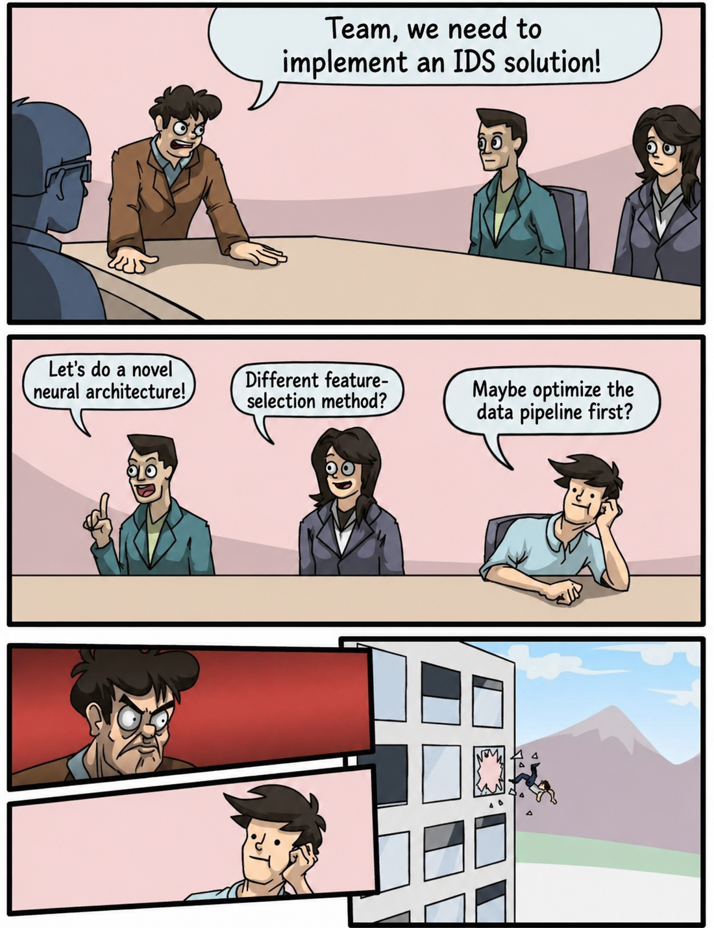

Slide 4

Intrusion Detection System is like airport security

Slide 5

The shift: beyond better scanners
Can we improve the
detection workflow
around the model?

Slide 6

Stage 1: Telemetry ingestion
events
Data Source
Telemetry
Ingest

Slide 7


Stage 2: Entity keying
events
Data Source
Telemetry
Ingest
Entity
Keying

Slide 8


Stage 3: Window aggregation
event 1..N
events
Data Source
Telemetry
Ingest
Entity
Keying
Window
Aggregation

Slide 9


Stage 4: Parallel preprocessing
batch 1..N
event 1..N
Preprocessing 1
events
Data Source
Telemetry
Ingest
Entity
Keying
Window
Aggregation
Preprocessing 2
batch 1..N
Preprocessing N

Slide 10


Stage 5: IDS model predictions
batch 1..N
event 1..N
Preprocessing 1
IDS Model 1
events
Data Source
Telemetry
Ingest
Entity
Keying
Window
Aggregation
Preprocessing 2
IDS Model 2
batch 1..N
Preprocessing N
IDS Model N

Slide 11

Stage 6: Arbiter and outputs
batch 1..N
Alerts
event 1..N
Preprocessing 1
IDS Model 1
events
Data Source
Telemetry
Ingest
Entity
Keying
Window
Aggregation
Preprocessing 2
IDS Model 2
Arbiter
Metrics
batch 1..N
Preprocessing N
IDS Model N

Slide 12
Better models still matter
But they need a workflow that can evolve
Thank you

