Slide 1

Instant Data Structures via Shared Memory
Roman Janota
Notes:
Hi everyone, my name is Roman Janota and I'm excited to share with you what I at CESNET have been working on.

Slide 2

Notes:
Imagine managing a massive network.

Slide 3
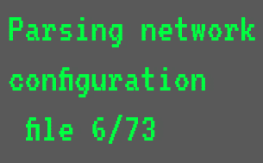

⏳
Network Monitoring Program
Notes:
So you start up your favorite network monitoring program, and then... you wait.
You practically have time to make coffee while it loads.
Before this tool can actually do anything, it first has to map out the network by parsing configuration files.
Reading tens or hundreds of these files is incredibly slow.

Slide 4
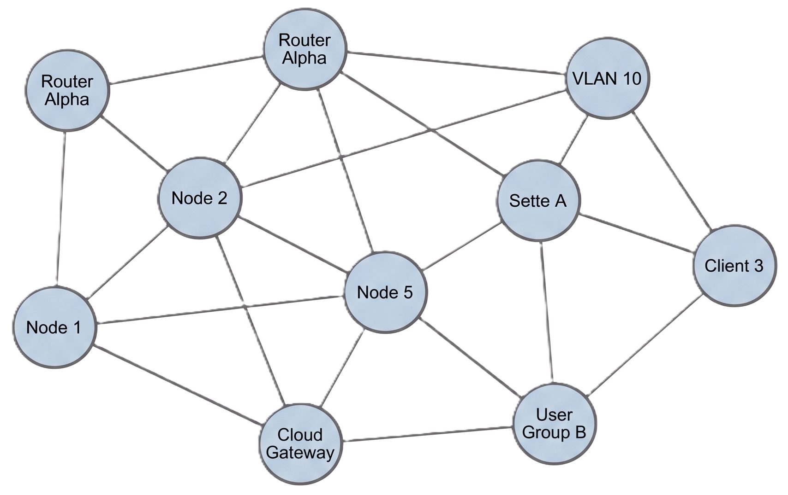
User queries
Network Monitoring Program
Internal Representation
(Data Structure)
Notes:
Eventually, it translates all that file data into a usable internal representation, a data structure, that you can actually work with.

Slide 5
⏳
⏳
⏳
Network Monitoring Program 1
Network Monitoring Program 2
Network Monitoring Program 3
Notes:
But what if you need to run multiple user queries at the same time?
The whole process starts over, and you're stuck waiting again.
As the networks grow bigger and bigger, this problem gets more and more noticeable.
So we asked ourselves: If all these programs are looking at the exact same network, why not just parse those files once and share the result? So, that's precisely what we did.

Slide 6



Program Memory Layout
Program 1
Stack
Private Network Map,
no one can access
Network Map
Heap
Program Code
Notes:
Well, normally, once a program parses the Data Structure, it stores it privately somewhere in its memory. No other program can access it here.
So we somehow needed to make it public.

Slide 7
Shared Memory Layout
Private Memory
Shared Memory
Shared Network Map,
everyone can access
Program 1
Stack
Network Map
Network Map
Heap
Program Code
Notes:
To put it simply, our solution moves this map from the program's private memory into a Shared Memory region, where everyone has access to it.
To explain what Shared Memory actually is, let's think of the following analogy.

Slide 8
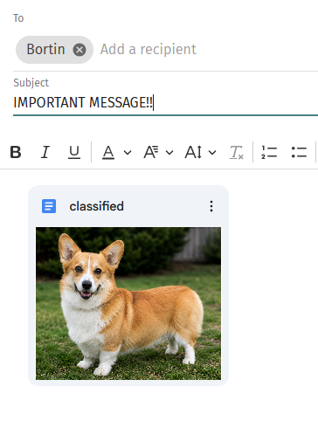
Shared Memory Analogy
Think of Shared Memory like a Google Doc
Notes:
Imagine you have an important Google Doc with some very important data.
Now imagine you wish to share this Doc with your colleague over e-mail.
Well, you can just simply attach the Doc to the e-mail and send it.
The colleague then just downloads the Document and opens it in like Microsoft Word.

Slide 9
Everyone has to
Download it and
Open it.
Notes:
But what if you need to send the Doc to multiple people?
Not using Shared Memory would be like having to attach this Doc to every single email, everyone would have to download it and open it, which is very ineffective.

Slide 10
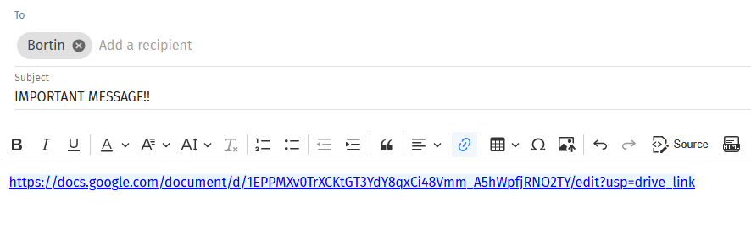
Just Send Everyone a Link instead.
Only One Click Needed.
Notes:
On the other hand Shared Memory would be like just sending a link to the Doc to everyone and now everyone has access to it with one single click, no downloading, no extra work needed.

Slide 11

Using Shared Memory
Shared Memory
The first program creates the document.
Then it creates a link to it and stores it in Shared Memory.
Program 1
Stack
https://docs.google.com/classified
Empty Space
Network Map
Heap
Empty Space
Program Code
Notes:
So in our case, the first program does the hard work and writes this document.
Once it's finished, it creates a link to it and stores it in the Shared Memory.

Slide 12
Is There a Link?
Program 2
Shared Memory
Stack
https://docs.google.com/classified
Heap
Program Code
Notes:
Now, when a different program starts up,
it first checks the Shared Memory to see if there is a link to the Doc already created by someone else.

Slide 13
Is There a Link?
Yes, there is!
Program 2
Shared Memory
Stack
Empty Space
https://docs.google.com/classified
Heap
Empty Space
Program Code
Notes:
If there is, it can just grab it without any issues.
If there isn't, that means that this program is actually the first one and it needs to create the Document itself.

Slide 14
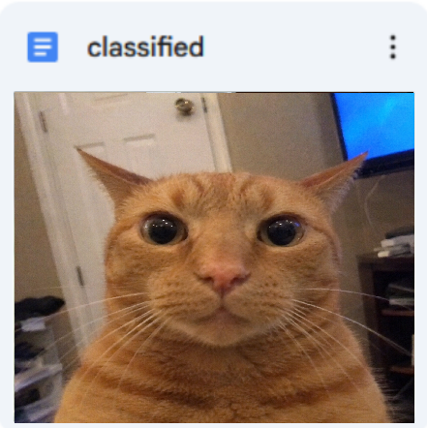
There Is a Problem…
What if the program decides to change the document?
It can do so, but needs to generate and share the new link.
Program 1
Program 1
Stack
Stack
Empty Space
Empty Space
Network Map
Network Map
Heap
Heap
Empty Space
Empty Space
Program Code
Program Code
Notes:
There were some technical issues we needed to overcome though.
Namely what if any program decides it needs to make certain changes to the Doc?
In our case, it could mean adding a new node to the network.
Well, it can do so without any problems, but it needs to let every other program know that there has been a change.

Slide 15
Shared Memory
A Different Link!
Program 1
Stack
https://docs.google.com/classified2
Empty Space
Network Map
Heap
Empty Space
Program Code
Notes:
How we do this is that we simply generate a new link to the new, changed document
and replace the existing one in the Shared Memory.

Slide 16
Is There a Newer Link?
Program 2
Shared Memory
Stack
Empty Space
https://docs.google.com/classified2
Heap
Empty Space
Program Code
Notes:
So whenever any program wishes to access the Doc, it needs to check the Shared Memory every time, to see if there is a newer, different link.

Slide 17
Is There a Newer Link?
Yes, there is!
Program 2
Shared Memory
Stack
Empty Space
https://docs.google.com/classified2
Heap
Empty Space
Program Code
Notes:
If it then sees that there is a newer one, the program just grabs the new link and can instantly go to answer the user queries.

Slide 18
Up To 400x+ Faster ⚡⚡⚡
Notes:
Ultimately, this represents a completely different approach to starting up your programs,
and I mean pretty much any programs with similar properties or bottlenecks.

Slide 19
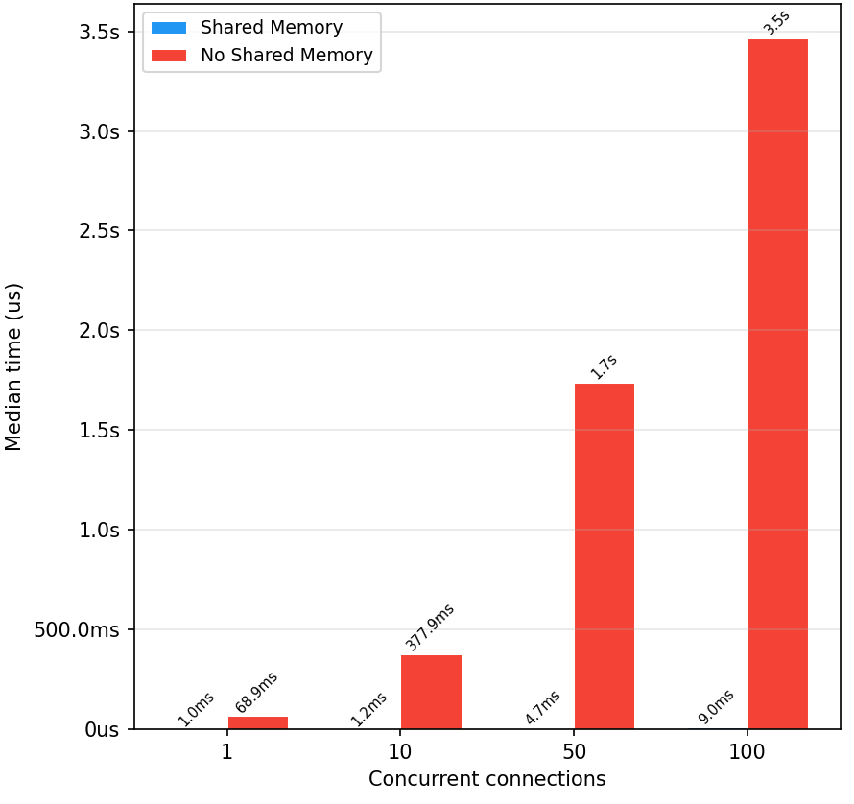
Up To 400x+ Faster ⚡⚡⚡
Notes:
Looking at the benchmark results, our boot-up times completely shatter the classical approach.
The red bars show the boot-up times of the old method, while the blue bars show the newer approach.

Slide 20

Up To 400x+ Faster ⚡⚡⚡
Notes:
The blue bars aren't missing from the graph, the difference is just that massive.

Slide 21
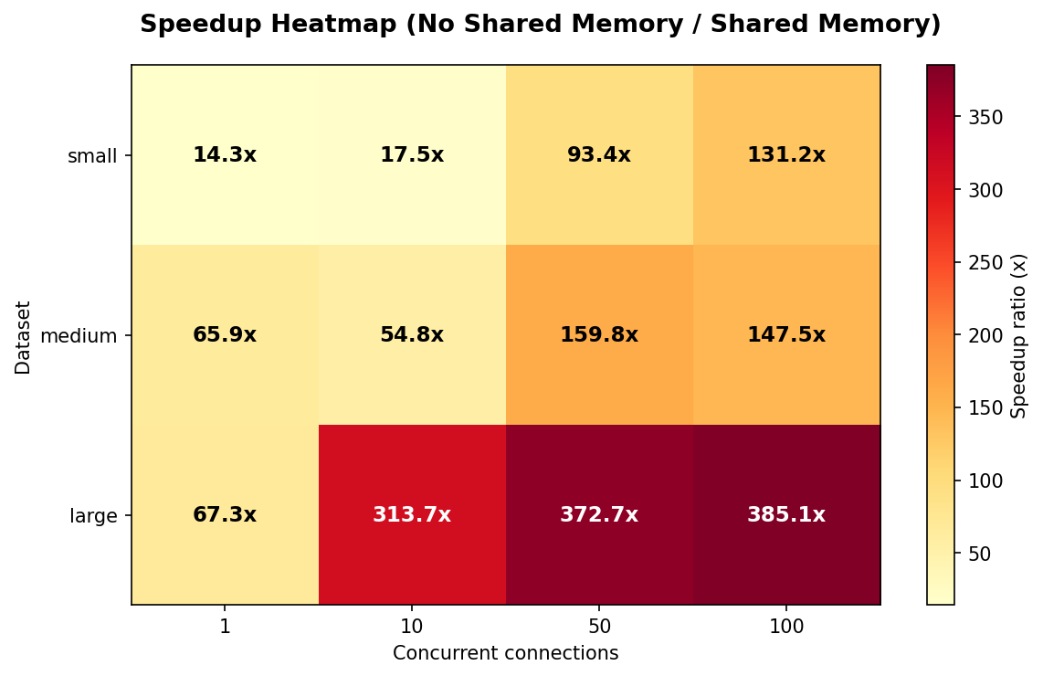
Up To 400x+ Faster ⚡⚡⚡
Notes:
Furthermore, in a larger dataset, we achieved a huge speedup ratio of around 400 times.
This isn't just a minor optimization; it's a fundamental shift in how we handle massive data structures at scale.

Slide 22

Thank you
Any questions?
janotaroman02@gmail.com
Notes:
Thank you for listening and feel free to contact me.

